Slide 1
Neural machine translation: Encoder-decoder approaches
Student: Nguyễn Duy Hàn Lâm (Id: 196005004)
Instructor: Nguyễn Chí Thiện

Slide 2
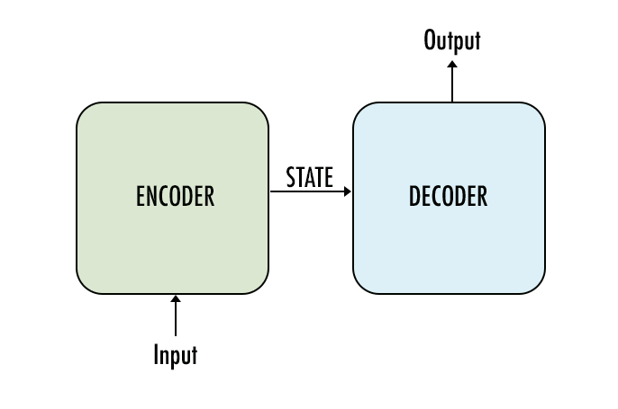
The concept

Slide 3
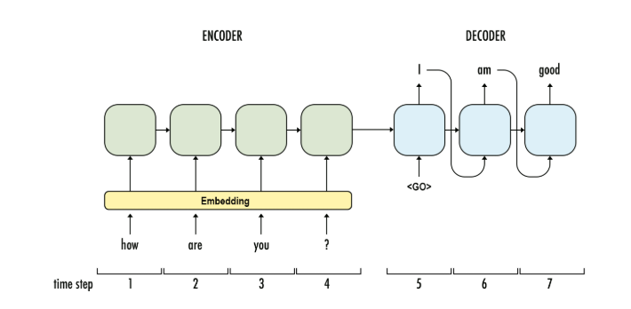
1.1a Recurrent Neural Network (RNN) Encoder-Decoder Architecture
Bạn
khỏe
không
GRU
GRU
GRU
GRU
GRU
GRU
GRU
...

Slide 4
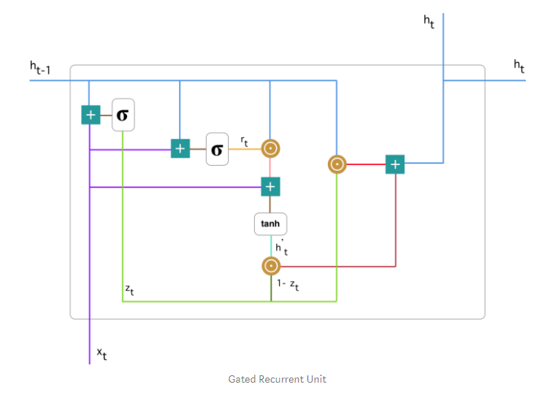

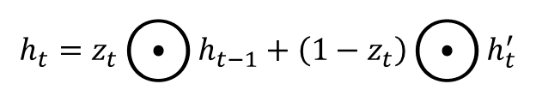


1.1b Gated Recurrent Unit (GRU)
$$z_{t}=σ\left(W_{z}^{t}x_{t}+U_{z}^{t}h_{t−1}\right)$$
$$r_{t}=σ\left(W_{r}^{t}x_{t}+U_{r}^{t}h_{t−1}\right)$$
$$h_{t}^{′}=\tanh\left(Wx_{t}+r_{t}⊙Uh_{t−1}\right)$$
$$h_{t}=z_{t}⨀{h_{t−1}}+\left(1−z_{t}\right)⨀{h_{t}^{′}}$$

Slide 5
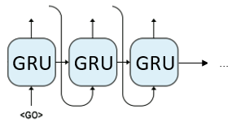
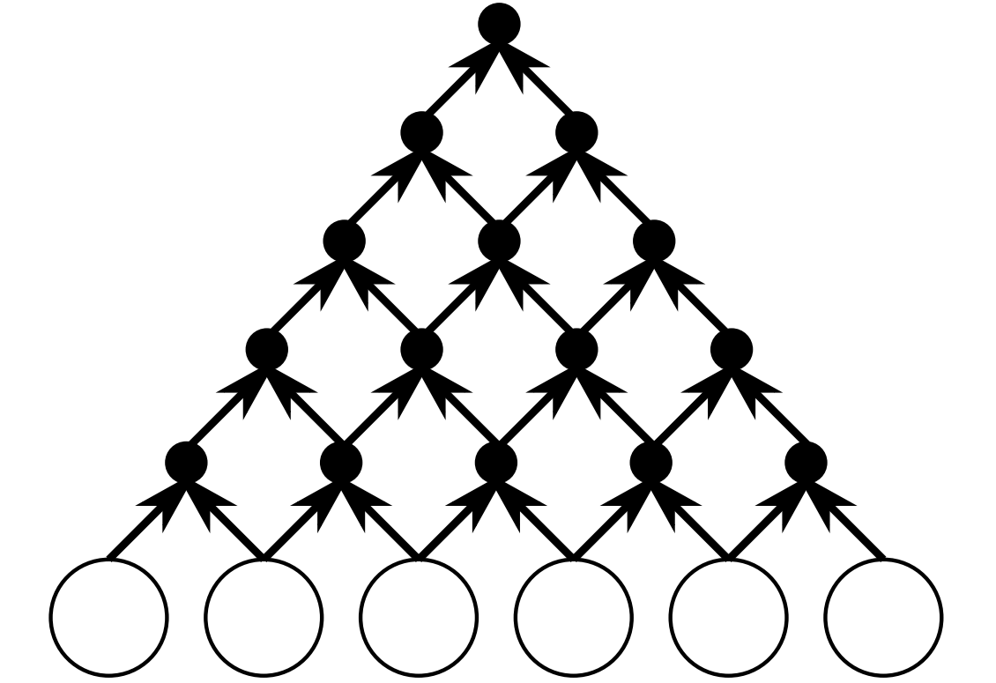



1.2a Convolutional Neural Network (CNN) Encoder- RNN Decoder Architecture
Decoder
$$y_{1}$$
$$y_{2}$$
$$y_{3}$$
Encoder

Slide 6
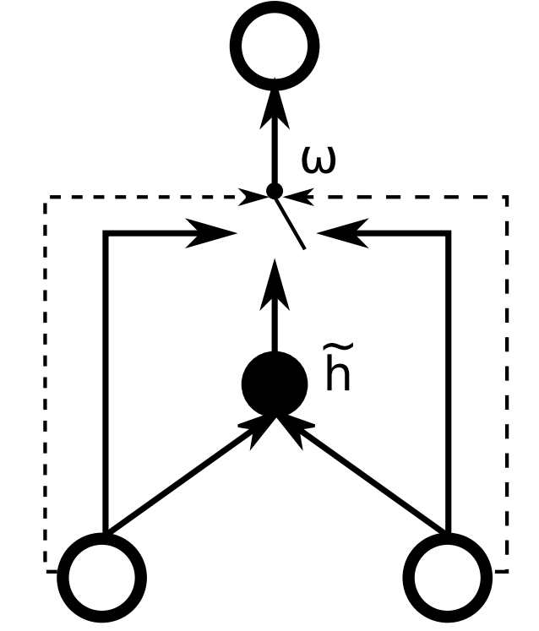



1.2b Gated Recursive Convolutional Neural Network
$$h_{t,j}$$
$$h_{j−1}^{t−1}$$
$$h_{j−1}^{t−1}$$

Slide 7
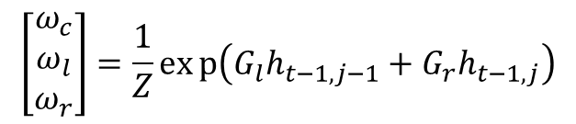



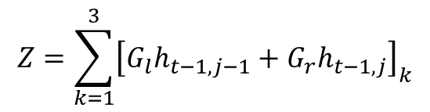
1.2b Gated Recursive Convolutional Neural Network
$$h_{t,j}$$
$${\tilde{h}}_{t,j}=f\left({W_{l}h}_{t−1,j−1}+W_{r}h_{t−1,j}\right)$$
$$h_{t,j}=ω_{c}{\tilde{h}}_{t,j}+ω_{l}h_{t−1,j−1}+ω_{r}h_{t−1,j}$$
$$\left[\begin{matrix}ω_{c} \\ ω_{l} \\ ω_{r}\end{matrix}\right]=\frac{1}{Z}exp\left(G_{l}h_{t−1,j−1}+G_{r}h_{t−1,j}\right)$$
$$Z=\sum_{k=1}^{3}{{\left[G_{l}h_{t−1,j−1}+G_{r}h_{t−1,j}\right]}_{k}}$$
$$h_{j−1}^{t−1}$$
$$h_{j}^{t−1}$$

