Slide 1
Neural machine translation Encoder-decoder approaches
Student: Nguyễn Duy Hàn Lâm (Id: 196005004)
Instructor: Nguyễn Chí Thiện

Slide 2
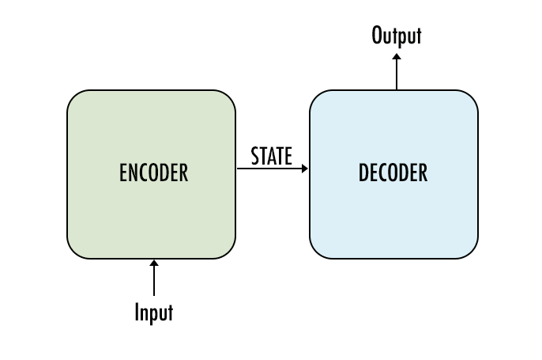
The concept

Slide 3
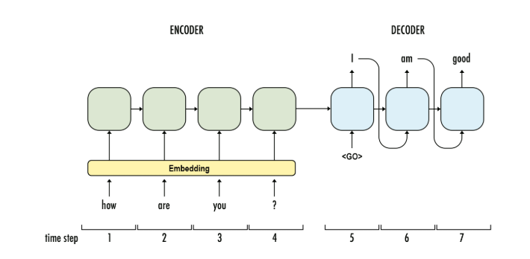
1.1a Recurrent Neural Network (RNN) Encoder-Decoder Architecture
Bạn
khỏe
không
GRU
GRU
GRU
GRU
GRU
GRU
GRU
...

Slide 4
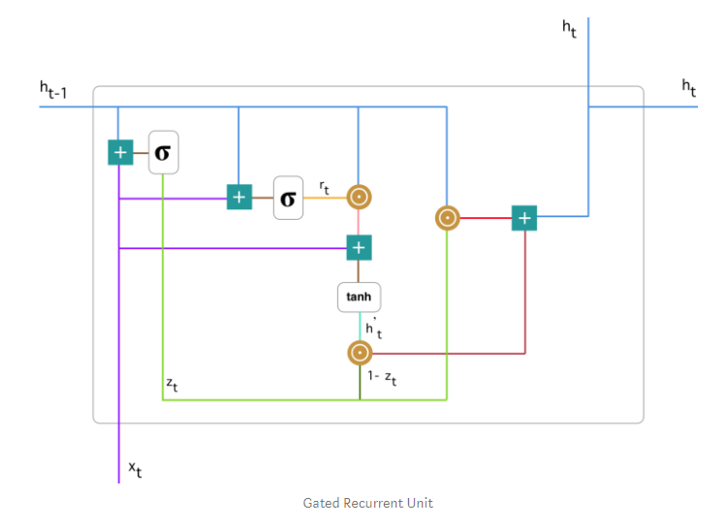

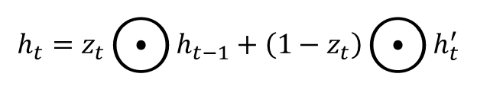


1.1b Gated Recurrent Unit (GRU)
$$z_{t}=σ\left(W_{z}^{t}x_{t}+U_{z}^{t}h_{t−1}\right)$$
$$r_{t}=σ\left(W_{r}^{t}x_{t}+U_{r}^{t}h_{t−1}\right)$$
$$h_{t}^{′}=\tanh\left(Wx_{t}+r_{t}⊙Uh_{t−1}\right)$$
$$h_{t}=z_{t}⨀{h_{t−1}}+\left(1−z_{t}\right)⨀{h_{t}^{′}}$$

Slide 5
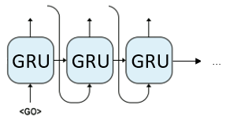
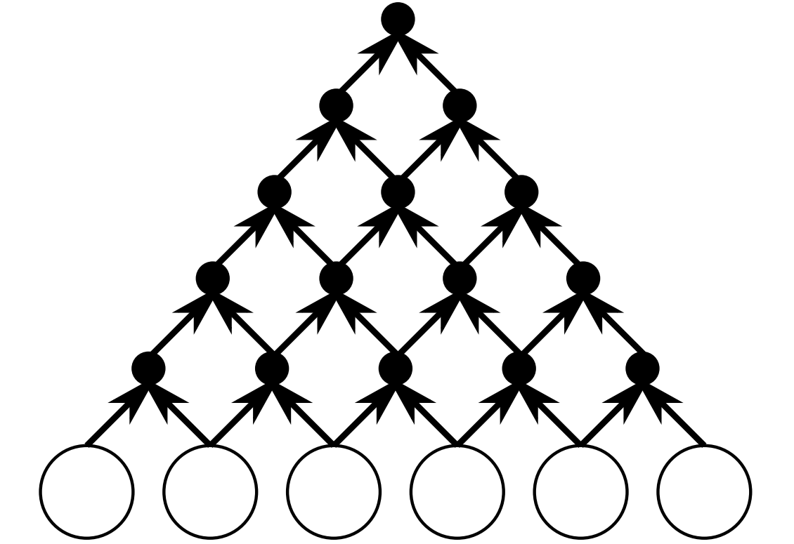



1.2a Convolutional Neural Network (CNN) Encoder- RNN Decoder Architecture
Decoder
$$y_{1}$$
$$y_{2}$$
$$y_{3}$$
Encoder

Slide 6
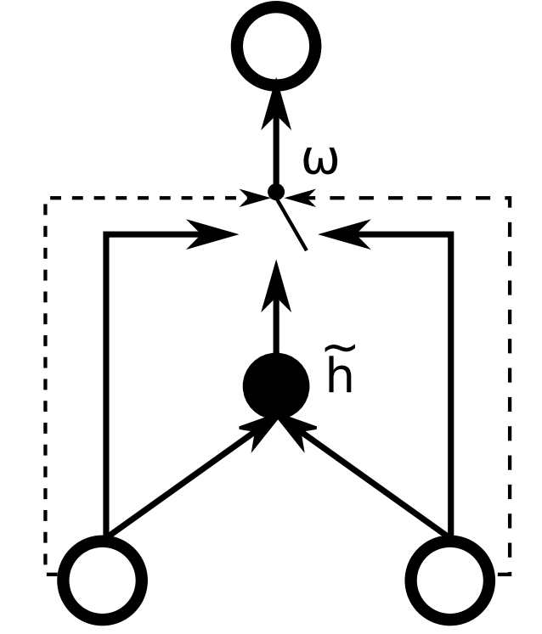



1.2b Gated Recursive Convolutional Neural Network
$$h_{t,j}$$
$$h_{j−1}^{t−1}$$
$$h_{j−1}^{t−1}$$

Slide 7
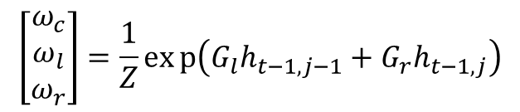



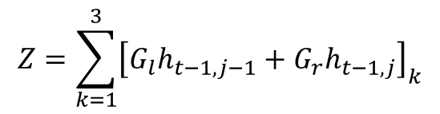
1.2b Gated Recursive Convolutional Neural Network
$$h_{t,j}$$
$${\tilde{h}}_{t,j}=f\left({W_{l}h}_{t−1,j−1}+W_{r}h_{t−1,j}\right)$$
$$h_{t,j}=ω_{c}{\tilde{h}}_{t,j}+ω_{l}h_{t−1,j−1}+ω_{r}h_{t−1,j}$$
$$\left[\begin{matrix}ω_{c} \\ ω_{l} \\ ω_{r}\end{matrix}\right]=\frac{1}{Z}exp\left(G_{l}h_{t−1,j−1}+G_{r}h_{t−1,j}\right)$$
$$Z=\sum_{k=1}^{3}{{\left[G_{l}h_{t−1,j−1}+G_{r}h_{t−1,j}\right]}_{k}}$$
$$h_{j−1}^{t−1}$$
$$h_{j}^{t−1}$$

Slide 8


1.3 Word embedding

Slide 9
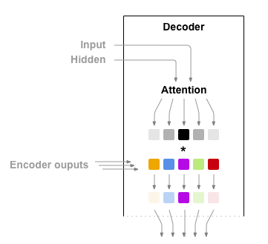
1.4 Attention

Slide 10
1.4 Attention

Slide 11
1.5 Linguistic Input Features
Car magazine
Magazine voiture
Tạp chí xe hơi
車の雑誌

Slide 12
1.5 Linguistic Input Features
Lemmas
Subword tags
Morphological features
POS tags
Dependency labels

Slide 13
1.5 Linguistic Input Features
Lemmas
Excite
Excited
Exciting
Excite
Excitement
Excitingly
Am/is/are/were/was
be

Slide 14
1.6 Greedy search
I
Get the max probability
…
yêu
…
thích
…
love
yêu
0.812
0.723
eating
apple

Slide 15
1.7 Beam search
Encoder
Decoder
…
Hidden
…
Output
Hidden
…
Hidden
Hidden
Output
Output
Hidden
Stop conditions:
Input
Output
Hidden
Meet “EOS” token and achieve the desired number of sentences
Output
Out
Hidden
Hidden
Hidden
Hidden
Output
Output
Input
Output
Hidden
Output
Reach the limit for the number of nodes allowed
Hidden
Hidden
Output
Hidden
Hidden
Output
Input
Output
…
…
…
Beam width = 3
…
…
…

