Slide 1
Neural machine translation Encoder-decoder approaches
Student: Nguyễn Duy Hàn Lâm (Id: 196005004)
Instructor: Nguyễn Chí Thiện

Slide 2
References
Cho, K., Van Merriënboer, B., Bahdanau, D., & Bengio, Y. (2014). On the properties of neural machine translation: Encoder-decoder approaches. arXiv preprint arXiv:1409.1259.
Rico Sennrich, Barry Haddow, 2016, Linguistic Input Features Improve Neural Machine Translation

Slide 3
The first problem
I go to see movies with my girlfriend.
(Flexible size)
Tôi đi xem phim với bạn gái.
(Flexible size)

Slide 4
Solution
I go to see movies with my girlfriend.
(Flexible size)
(Fixed size)
Tôi đi xem phim với bạn gái.
(Flexible size)

Slide 5
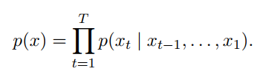
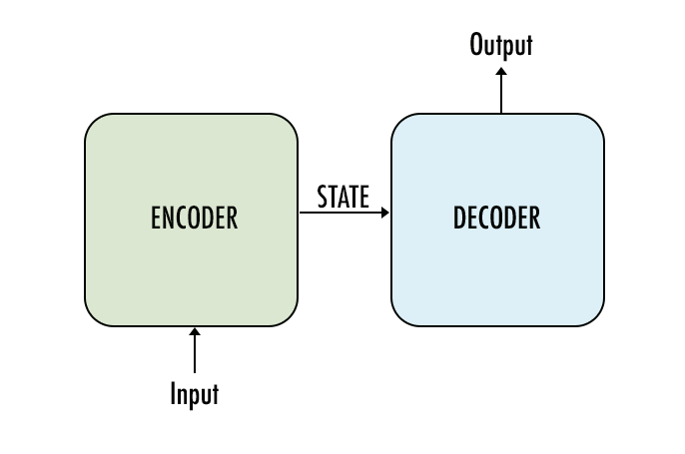
The concept

Slide 6

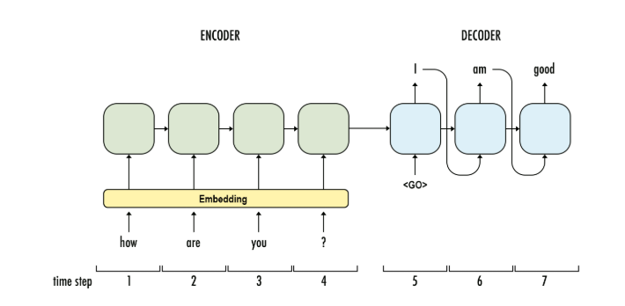
1.1a Recurrent Neural Network (RNN) Encoder-Decoder Architecture
Bạn
khỏe
không
GRU
GRU
GRU
GRU
GRU
GRU
GRU
...

Slide 7
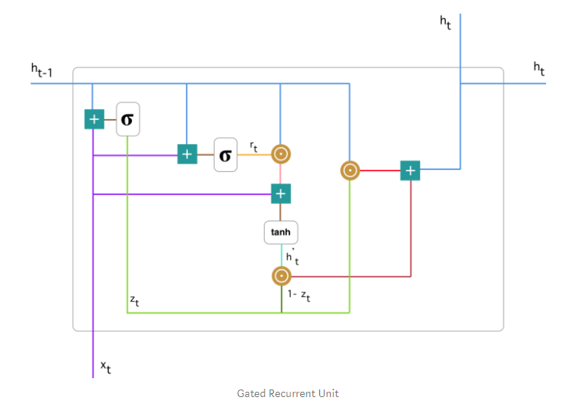




1.1b Gated Recurrent Unit (GRU)
$$z_{t}=σ\left(W_{z}^{t}x_{t}+U_{z}^{t}h_{t−1}\right)$$
$$r_{t}=σ\left(W_{r}^{t}x_{t}+U_{r}^{t}h_{t−1}\right)$$
$$h_{t}^{′}=\tanh\left(Wx_{t}+r_{t}⊙Uh_{t−1}\right)$$
$$h_{t}=z_{t}⊙h_{t−1}+\left(1−z_{t}\right)⊙h_{t}^{′}$$

Slide 8
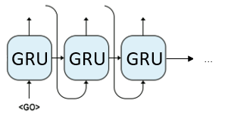
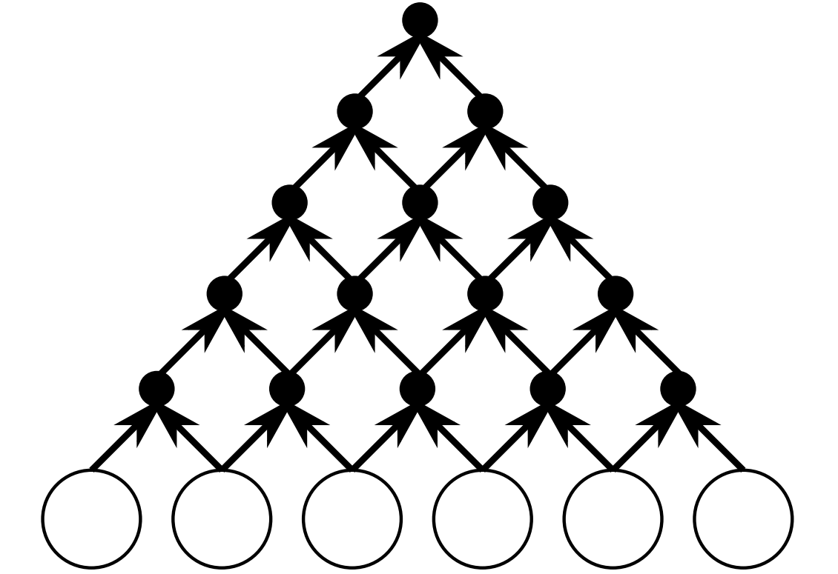



1.2a Convolutional Neural Network (CNN) Encoder- RNN Decoder Architecture
Decoder
$$y_{1}$$
$$y_{2}$$
$$y_{3}$$
Encoder

Slide 9
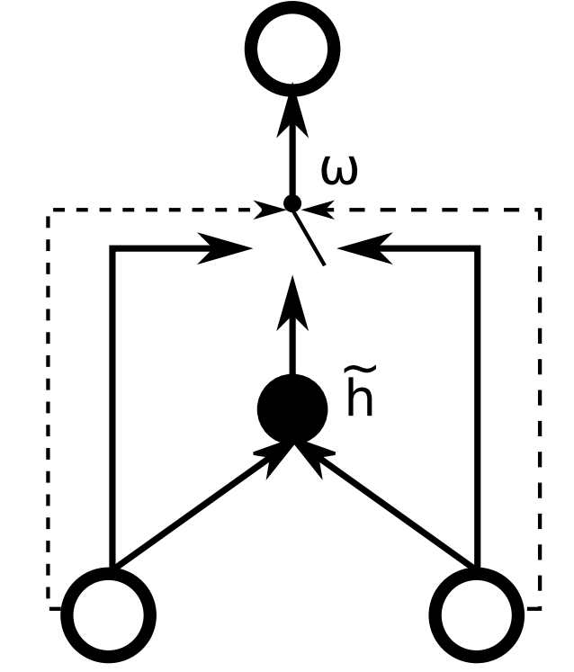




1.2b Gated Recursive Convolutional Neural Network
$$h_{t,j}$$
$$h_{j−1}^{t−1}$$
$$h_{j−1}^{t−1}$$

Slide 10
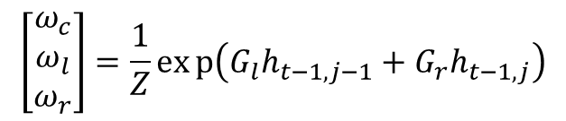



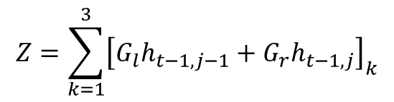
1.2b Gated Recursive Convolutional Neural Network
$${\tilde{h}}_{t−1,j}=f\left({W_{l}h}_{t−1,j−1}+W_{r}h_{t−1,j}\right)$$
$$h_{t,j}$$
$$h_{t,j}=ω_{c}{\tilde{h}}_{t−1,j}+ω_{l}h_{t−1,j−1}+ω_{r}h_{t−1,j}$$
$$\left[\begin{matrix}ω_{c} \\ ω_{l} \\ ω_{r}\end{matrix}\right]=\frac{1}{Z}exp\left(G_{l}h_{t−1,j−1}+G_{r}h_{t−1,j}\right)$$
$$Z=\sum_{k=1}^{3}{{\left[G_{l}h_{t−1,j−1}+G_{r}h_{t−1,j}\right]}_{k}}$$
$$h_{j−1}^{t−1}$$
$$h_{j}^{t−1}$$

Slide 11


1.3 Word embedding

Slide 12
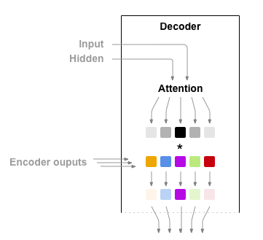
1.4 Attention

Slide 13
1.4 Attention

Slide 14
1.5 Linguistic Input Features (The second problem)
Car magazine
Magazine voiture
Tạp chí xe hơi
車の雑誌

Slide 15
1.5 Linguistic Input Features
Lemmas
Subword tags
Morphological features
POS tags
Dependency labels

Slide 16
1.5 Linguistic Input Features
Lemmas
Excite
Excited
Exciting
Excite
Excitement
Excitingly
Am/is/are/were/was
be

Slide 17
1.6 Greedy search
I
Get the max probability
…
yêu
…
thích
…
love
yêu
0.812
0.723
eating
apple

Slide 18
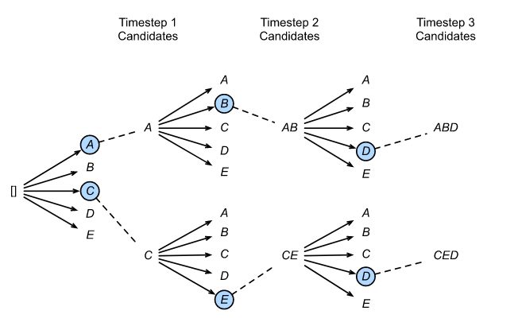
1.7 Beam search
Stop conditions:
Meet “EOS” token.
Achieve the desired number of words in the sentence.
Reach the limit for the number of nodes allowed.
Beam width = 2

