Slide 1
Neural machine translation Encoder-decoder approaches
Student: Nguyễn Duy Hàn Lâm (Id: 196005004)
Instructor: Nguyễn Chí Thiện

Slide 2
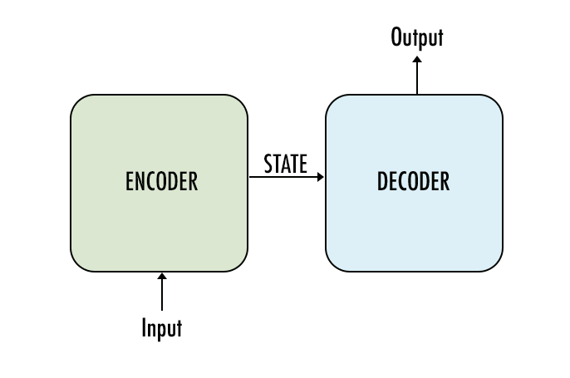
The concept

Slide 3
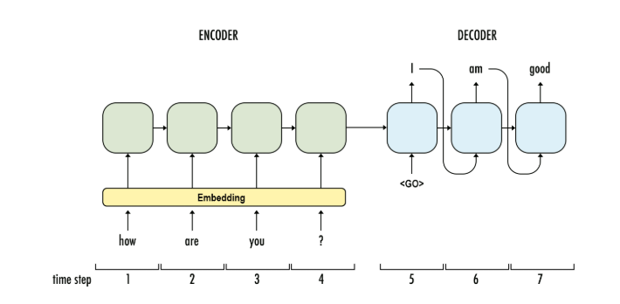
1.1a Recurrent Neural Network (RNN) Encoder-Decoder Architecture
Bạn
khỏe
không
GRU
GRU
GRU
GRU
GRU
GRU
GRU
...

Slide 4
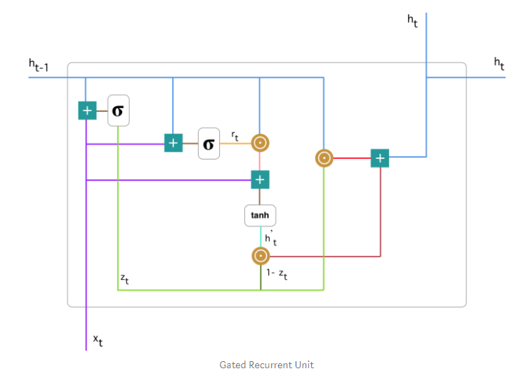

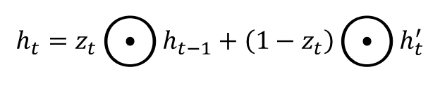


1.1b Gated Recurrent Unit (GRU)
$$z_{t}=σ\left(W_{z}^{t}x_{t}+U_{z}^{t}h_{t−1}\right)$$
$$r_{t}=σ\left(W_{r}^{t}x_{t}+U_{r}^{t}h_{t−1}\right)$$
$$h_{t}^{′}=\tanh\left(Wx_{t}+r_{t}⊙Uh_{t−1}\right)$$
$$h_{t}=z_{t}⨀{h_{t−1}}+\left(1−z_{t}\right)⨀{h_{t}^{′}}$$

Slide 5
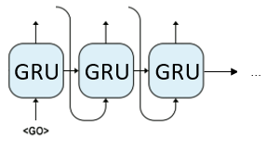
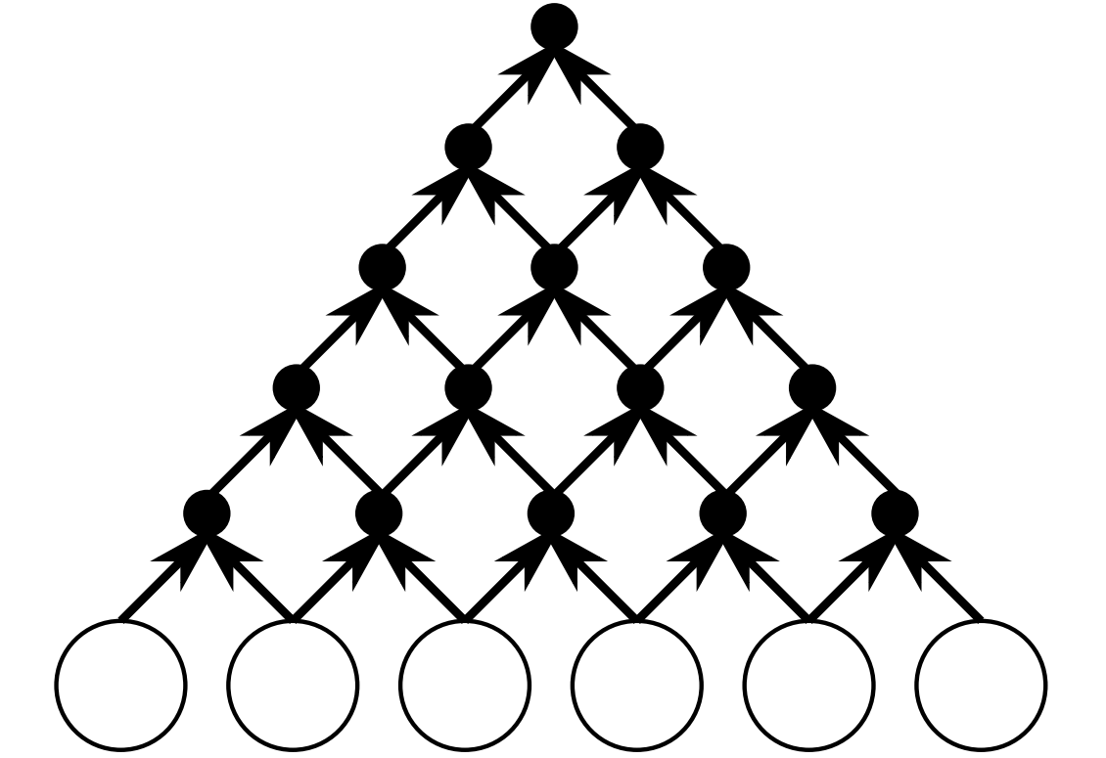



1.2a Convolutional Neural Network (CNN) Encoder- RNN Decoder Architecture
Decoder
$$y_{1}$$
$$y_{2}$$
$$y_{3}$$
Encoder

Slide 6
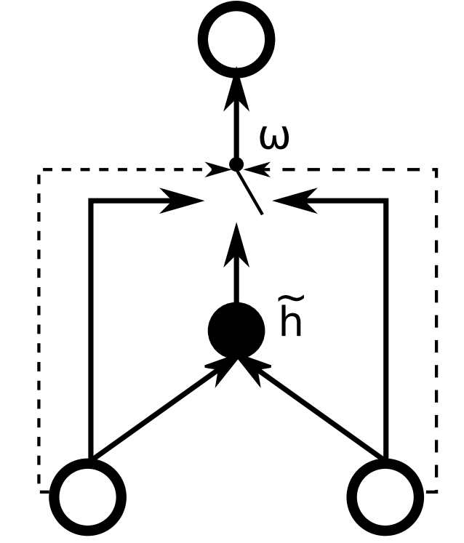



1.2b Gated Recursive Convolutional Neural Network
$$h_{t,j}$$
$$h_{j−1}^{t−1}$$
$$h_{j−1}^{t−1}$$

Slide 7
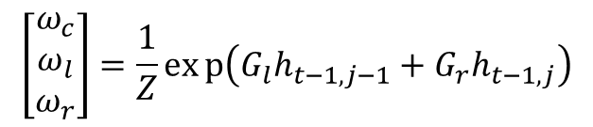



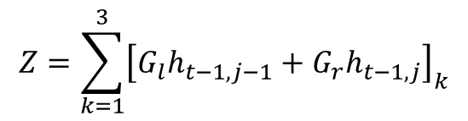
1.2b Gated Recursive Convolutional Neural Network
$$h_{t,j}$$
$${\tilde{h}}_{t,j}=f\left({W_{l}h}_{t−1,j−1}+W_{r}h_{t−1,j}\right)$$
$$h_{t,j}=ω_{c}{\tilde{h}}_{t,j}+ω_{l}h_{t−1,j−1}+ω_{r}h_{t−1,j}$$
$$\left[\begin{matrix}ω_{c} \\ ω_{l} \\ ω_{r}\end{matrix}\right]=\frac{1}{Z}exp\left(G_{l}h_{t−1,j−1}+G_{r}h_{t−1,j}\right)$$
$$Z=\sum_{k=1}^{3}{{\left[G_{l}h_{t−1,j−1}+G_{r}h_{t−1,j}\right]}_{k}}$$
$$h_{j−1}^{t−1}$$
$$h_{j}^{t−1}$$

Slide 8


1.3 Word embedding

Slide 9
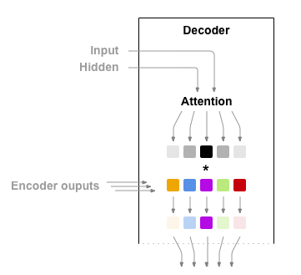
1.4 Attention

Slide 10
1.4 Attention

Slide 11
1.5 Linguistic Input Features
Car magazine
Magazine voiture
Tạp chí xe hơi
車の雑誌

Slide 12
1.5 Linguistic Input Features
Lemmas
Subword tags
Morphological features
POS tags
Dependency labels

Slide 13
1.5 Linguistic Input Features
Lemmas
Excite
Excited
Exciting
Excite
Excitement
Excitingly
Am/is/are/were/was
be

