Slide 1
Neural machine translation: Encoder-decoder approaches
Student: Nguyễn Duy Hàn Lâm (Id: 196005004)
Instructor: Nguyễn Chí Thiện

Slide 2
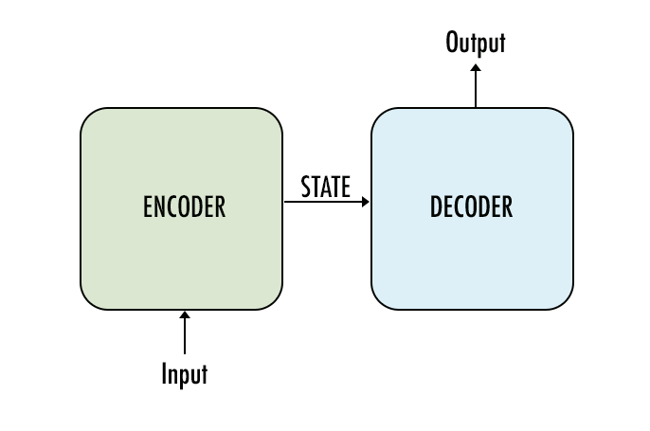
The concept

Slide 3
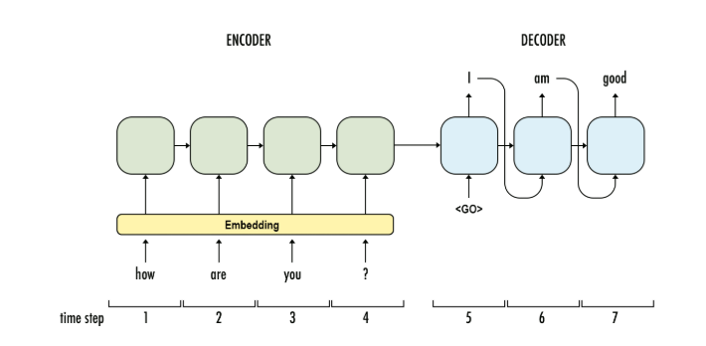
1.1 Recurrent Neural Network (RNN) Encoder-Decoder Architecture
Bạn
khỏe
không
GRU
GRU
GRU
GRU
GRU
GRU
GRU
...

Slide 4
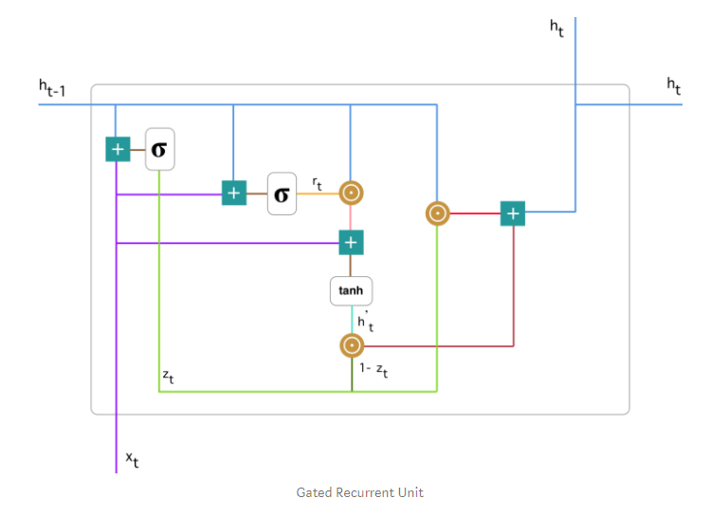

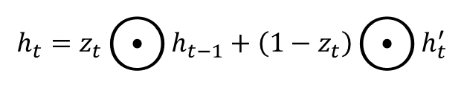


1.2 Gated Recurrent Unit (GRU)
$$z_{t}=σ\left(W_{z}^{t}x_{t}+U_{z}^{t}h_{t−1}\right)$$
$$r_{t}=σ\left(W_{r}^{t}x_{t}+U_{r}^{t}h_{t−1}\right)$$
$$h_{t}^{′}=\tanh\left(Wx_{t}+r_{t}⊙Uh_{t−1}\right)$$
$$h_{t}=z_{t}⨀{h_{t−1}}+\left(1−z_{t}\right)⨀{h_{t}^{′}}$$

Slide 5
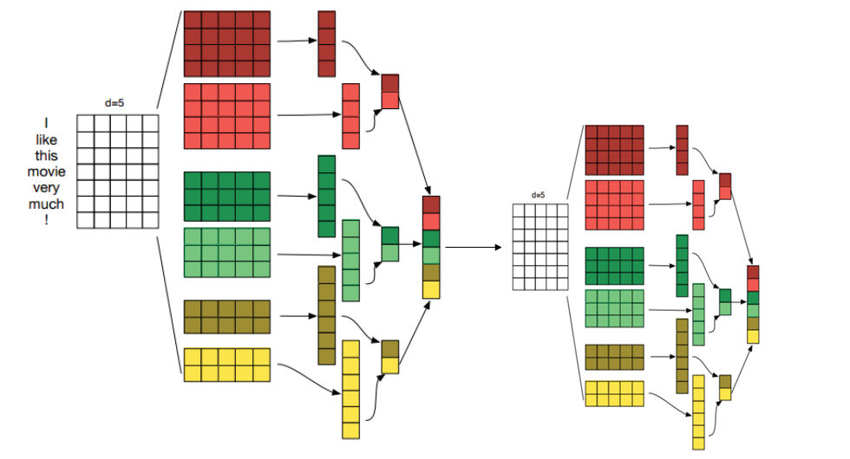
1.3 Convolutional Neural Network (CNN) Encoder-Decoder Architecture
Tôi
thích
phim
này
rất
nhiều
Encoder
Decoder

