Slide 1
Probabilistic Graphical Model
Đào Việt Duy – ID: 51603070
Nguyễn Duy Hàn Lâm – ID: 196005004

Slide 2
Content
Probabilistic Graphical Model introduction
PGMPY introduction
Application

Slide 3
Part 1 Probabilistic Graphical Model Introduction

Slide 4
Graph (G)
B
A
A
Vertical (Node)
Edge

Slide 5
Basic graph operations
D
C
C
B
B
B
?
A
A
A
Adjacent(G, A, B)
Neighbors(G, A)={B,C}
Add_vertex(G, D)
D
D
C
C
C
B
B
B
A
A
A
Remove_vertex(G, D)
Add_edge(G, C, D)
Add_edge(G, C, D)

Slide 6
Graph types
C
C
B
B
A
A
Undirected graph
Directed graph

Slide 7
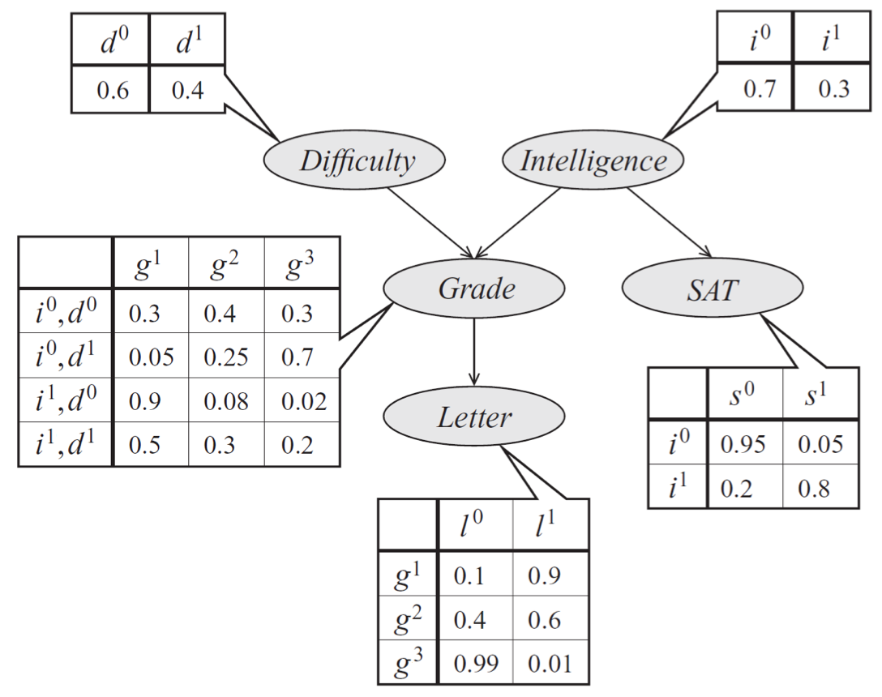
Probabilistic Graphical Model

Slide 8
Bayesian probability
$$P\left(x_{1},x_{2},…,x_{n}\right)=P\left(x_{1}\right)P\left(x_{2} | x_{1}\right)…P\left(x_{n} | x_{n−1},…,x_{2},x_{1}\right)$$

Slide 9
Bayesian network
$$P\left(d,i,g,s,l \right)=P\left(d\right)P\left(i\right)P\left(g | d,i\right)P\left(s | i\right)P\left(l | g\right)$$

Slide 10
Inference
Variable elimination
Bayesian inference

Slide 11
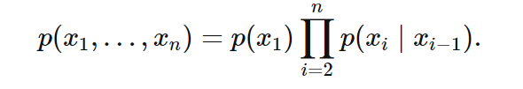
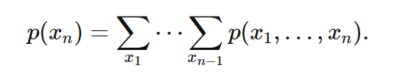
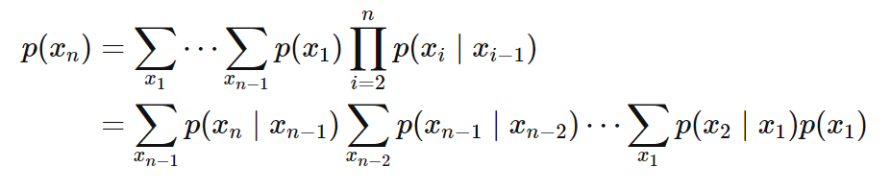
Marginal inference
$$O\left(k^{n}\right)$$

Slide 12

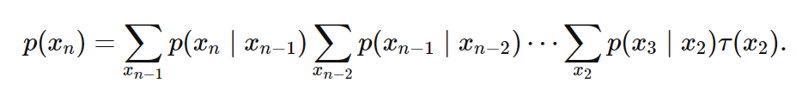
Marginal inference
$$O\left({nk}^{2}\right)$$

Slide 13

Variable elimination
$$P\left(l\right)=?$$

Slide 14



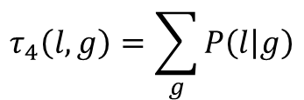
Variable elimination
Clear d:
Clear i:
Clear s:
Clear g:
$$τ_{4}\left(l,g\right)=\sum_{g}{P\left(l | g\right)}$$

Slide 15

Variable elimination
$$P\left(l\right)=τ_{4}\left(l,g\right)τ_{3}\left(g\right)τ_{2}\left(g,s\right)τ_{1}\left(g,i\right)$$

Slide 16

Bayesian inference
H: Hypothesis, E: Observed evidence.
P(H): the prior probability, probability of the hypothesis.
P(E): probability of the obsereved evidence.
P(H|E): the posterior probability, is the probability of H given E, after E is observed.
P(E|H): is the probability of observing E given H.

Slide 17
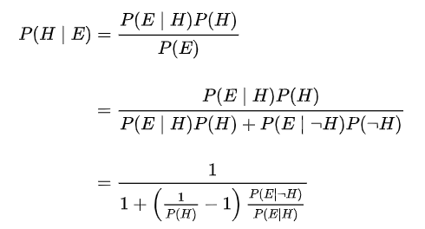
Bayesian inference

Slide 18



Bayesian inference (example)
Suppose there are two full bowls of cookies. Bowl 1 has 10 chocolate chips and 30 plain cookies, while bowl 2 has 20 of each. Fred picks a bowl at random and then picks a cookie at random. We may assume there is no reason to believe Fred treats one bowl differently from another, likewise for the cookies. The cookie turns out to be a plain one. How probable is it that Fred picked it out of bowl 1?
Hypothesis 1 (H₁): Bowl 1
Evidence (E): Cookie
Hypothesis 2 (H₂): Bowl 2

Slide 19
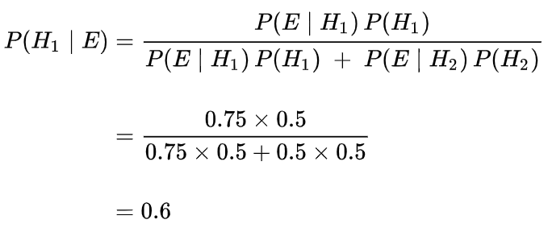
Bayesian inference (example)

Slide 20
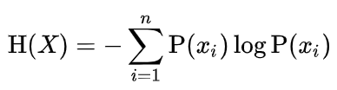
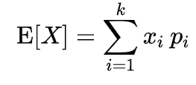
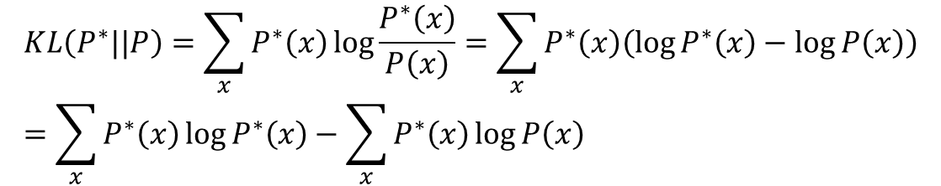
Maximum likelihood
$$KL\left(P^{∗}||P\right)=\sum_{x}{P^{∗}\left(x\right)\log{\frac{P^{∗}\left(x\right)}{P\left(x\right)}}}=\sum_{x}{P^{∗}\left(x\right)\left(\log{P^{∗}\left(x\right)}−\log{P\left(x\right)}\right)}=\sum_{x}{P^{∗}\left(x\right)\log{P^{∗}\left(x\right)}}−\sum_{x}{P^{∗}\left(x\right)\log{P\left(x\right)}}$$
Entropy:
Expected value:
$$KL\left(P^{∗}||P\right)=\sum_{x}{P^{∗}\left(x\right)\log{\frac{P^{∗}\left(x\right)}{P\left(x\right)}}}=−H\left(P^{∗}\left(x\right)\right)−E_{x\sim P^{∗}\left(x\right)}\left(\log{P\left(x\right)}\right)$$

Slide 21
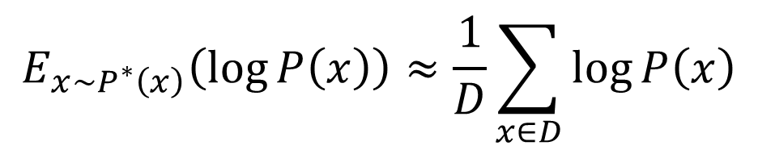
Maximum likelihood
Entropy does not depend on p.
Minimizing KL divergence is equivalent to maximizing the expected log-likelihood
$$\min_{P}{KL\left(P^{∗}||P\right)}=\max_{P}{E_{x\sim P^{∗}\left(x\right)}\left(\log{P\left(x\right)}\right)}$$
Expected value based on Monte-Carlo estimate:
$$E_{x\sim P^{∗}\left(x\right)}\left(\log{P\left(x\right)}\right)≈\frac{1}{D}\sum_{x∈D}{\log{P\left(x\right)}}$$
D: is dataset drawn independent and identically distributed (i.i.d) $P^{∗}\left(x\right)$

Slide 22
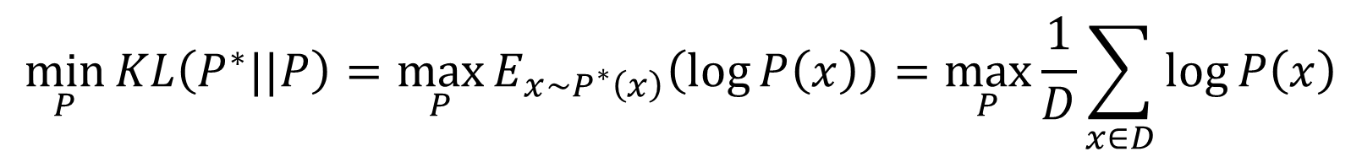
Maximum likelihood
$$\min_{P}{KL\left(P^{∗}||P\right)}=\max_{P}{E_{x\sim P^{∗}\left(x\right)}\left(\log{P\left(x\right)}\right)}=\max_{P}{\frac{1}{D}\sum_{x∈D}{\log{P\left(x\right)}}}$$

Slide 23
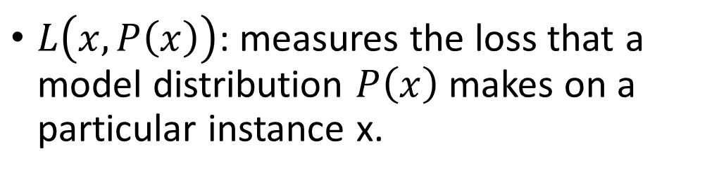
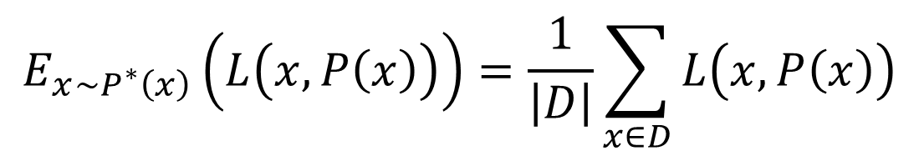
Maximum likelihood (Loss)
$$E_{x\sim P^{∗}\left(x\right)}\left(L\left(x,P\left(x\right)\right)\right)=\frac{1}{\left|D\right|}\sum_{x∈D}{L\left(x,P\left(x\right)\right)}$$
$L\left(x,P\left(x\right)\right)$: measures the loss that a model distribution $P\left(x\right)$ makes on a particular instance x.

Slide 24
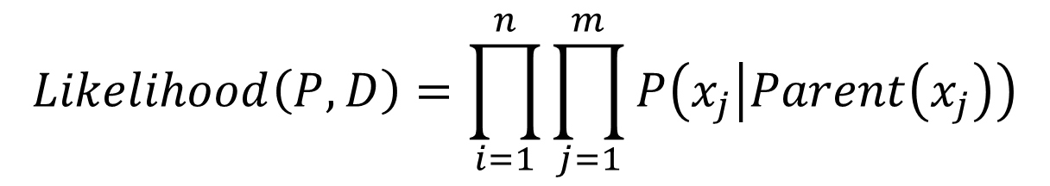
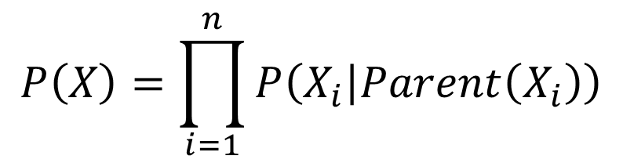

Maximum likelihood learning in Bayesian network
$$P\left(X\right)=\prod_{i=1}^{n}{P\left(X_{i} | Parent\left(X_{i}\right)\right)}$$
$$X_{i}=\left(x_{1},…,x_{m}\right)$$
$$Likelihood\left(P,D\right)=\prod_{i=1}^{n}{\prod_{j=1}^{m}{P\left(x_{j} | Parent\left(x_{j}\right)\right)}}$$

Slide 25
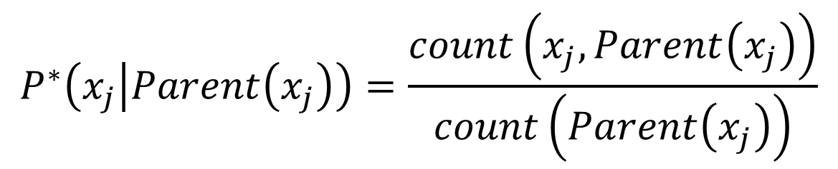
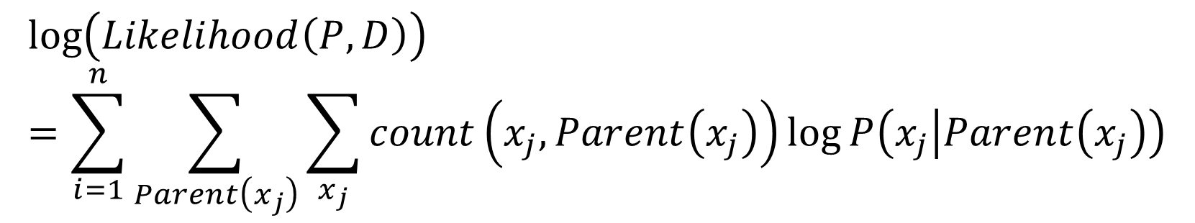
Maximum likelihood learning in Bayesian network
$$\log\left(Likelihood\left(P,D\right)\right)=\sum_{i=1}^{n}{\sum_{Parent\left(x_{j}\right)}{\sum_{x_{j}}{count\left(x_{j},Parent\left(x_{j}\right)\right)\log{P\left(x_{j} | Parent\left(x_{j}\right)\right)}}}}$$
Maximization of the (log) likelihood function decomposes into separate maximizations for the local conditional distributions.
$$P^{∗}\left(x_{j} | Parent\left(x_{j}\right)\right)=\frac{count\left(x_{j},Parent\left(x_{j}\right)\right)}{count\left(Parent\left(x_{j}\right)\right)}$$

Slide 26
Part 2 Pgmpy Introduction

Slide 27
Using process
Understand data
Apply right model
Choose learning method
Perform inference if desired
Perform testing when using structure learning methods.

Slide 28
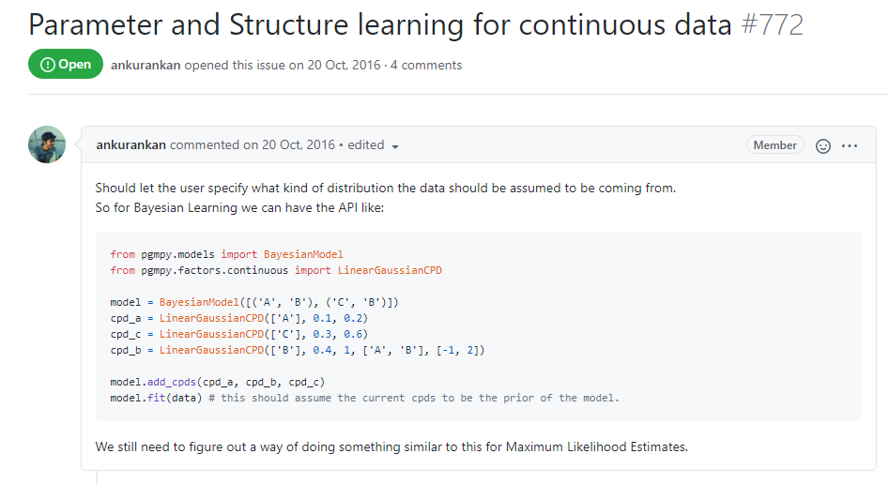

Understand data
Some notes:
Pgmpy does not support continuous data (https://github.com/pgmpy/pgmpy/issues/772)

Slide 29
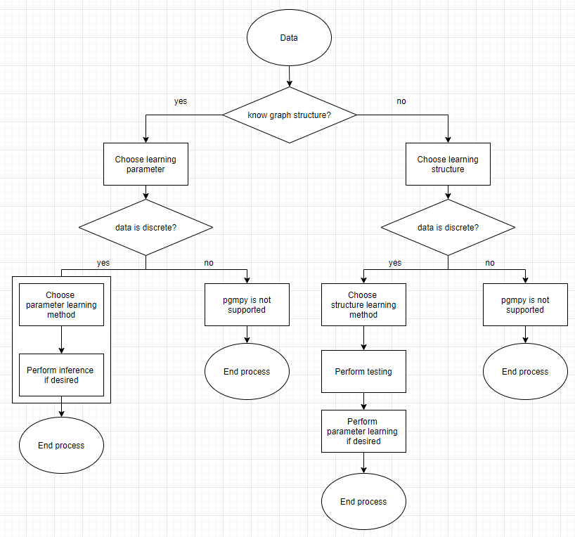

Slide 30
Part 2.1 Use pgmpy when knowing graph structure

Slide 32
Part 2.2 Use pgmpy when not knowing graph structure

Slide 34
Part 3 Application

Slide 35
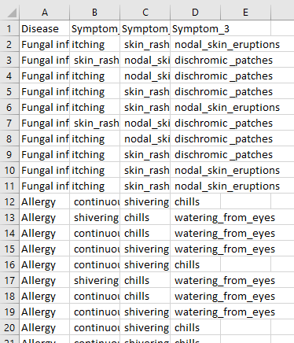
Medical diagnosis (data)
Source: https://www.kaggle.com/itachi9604/disease-symptom-description-dataset?select=dataset.csv

Slide 36
Graph
Symptom1
Symptom2
Symptom3
Disease

Slide 37

Counting result example

Slide 38

Maximum Likelihood Estimation example

Slide 39

Bayesian Parameter Estimator example

