Slide 1
Probabilistic Graphical Model
Đào Việt Duy – ID: 51603070
Nguyễn Duy Hàn Lâm – ID: 196005004

Slide 2
Content
Probabilistic Graphical Model introduction
PGMPY introduction
Application

Slide 3
Part 1.1 Graph Introduction

Slide 4
Graph (G)
B
A
A
Vertical (Node)
Edge

Slide 5
Basic graph operations
D
C
C
B
B
B
?
A
A
A
Adjacent(G, A, B)
Neighbors(G, A)={B,C}
Add_vertex(G, D)
D
D
C
C
C
B
B
B
A
A
A
Remove_vertex(G, D)
Add_edge(G, C, D)
Add_edge(G, C, D)

Slide 6
Graph types
C
C
B
B
A
A
Undirected graph
Directed graph

Slide 7
Part 1.2 Probabilistic Graphical Model Introduction

Slide 8
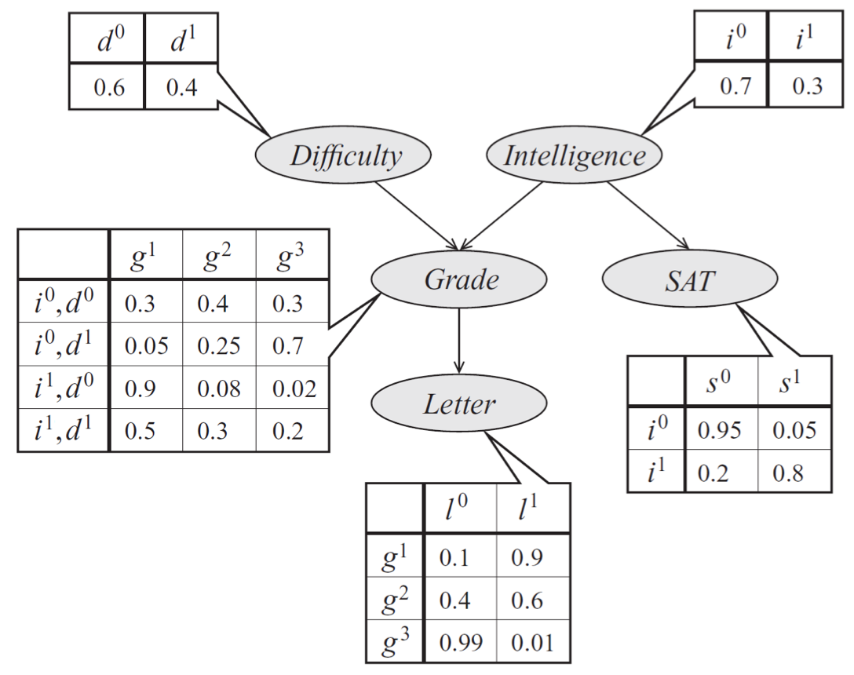
Probabilistic Graphical Model

Slide 9
Bayesian probability
$$P\left(x_{1},x_{2},…,x_{n}\right)=P\left(x_{1}\right)P\left(x_{2} | x_{1}\right)…P\left(x_{n} | x_{n−1},…,x_{2},x_{1}\right)$$

Slide 10
Bayesian network
$$P\left(d,i,g,s,l \right)=P\left(d\right)P\left(i\right)P\left(g | d,i\right)P\left(s | i\right)P\left(l | g\right)$$

Slide 11
Part 1.3 Probabilistic Graphical Model (Learning methods)

Slide 12
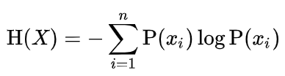
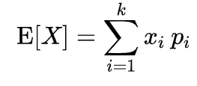
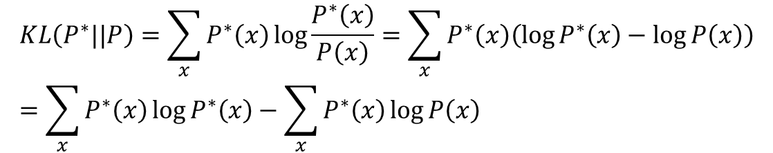
Maximum likelihood (Kullback–Leibler (KL) divergence)
$$KL\left(P^{∗}||P\right)=\sum_{x}{P^{∗}\left(x\right)\log{\frac{P^{∗}\left(x\right)}{P\left(x\right)}}}=\sum_{x}{P^{∗}\left(x\right)\left(\log{P^{∗}\left(x\right)}−\log{P\left(x\right)}\right)}=\sum_{x}{P^{∗}\left(x\right)\log{P^{∗}\left(x\right)}}−\sum_{x}{P^{∗}\left(x\right)\log{P\left(x\right)}}$$
Entropy:
Expected value:
$$KL\left(P^{∗}||P\right)=\sum_{x}{P^{∗}\left(x\right)\log{\frac{P^{∗}\left(x\right)}{P\left(x\right)}}}=−H\left(P^{∗}\left(x\right)\right)−E_{x\sim P^{∗}\left(x\right)}\left(\log{P\left(x\right)}\right)$$

Slide 13
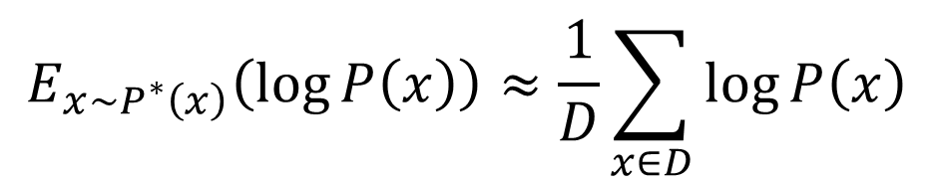
Maximum likelihood (KL divergence)
Entropy does not depend on p.
Minimizing Kullback–Leibler (KL) divergence is equivalent to maximizing the expected log-likelihood
$$\min_{P}{KL\left(P^{∗}||P\right)}=\max_{P}{E_{x\sim P^{∗}\left(x\right)}\left(\log{P\left(x\right)}\right)}$$
Expected value based on Monte-Carlo estimate:
$$E_{x\sim P^{∗}\left(x\right)}\left(\log{P\left(x\right)}\right)≈\frac{1}{D}\sum_{x∈D}{\log{P\left(x\right)}}$$
D: is dataset drawn independent and identically distributed (i.i.d) $P^{∗}\left(x\right)$

Slide 14
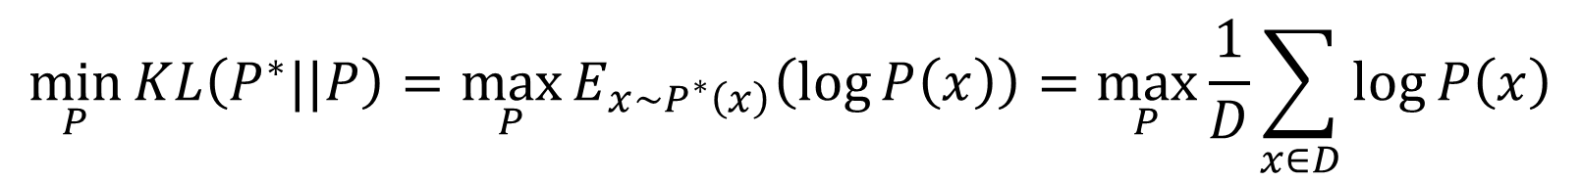
Maximum likelihood (KL divergence)
$$\min_{P}{KL\left(P^{∗}||P\right)}=\max_{P}{E_{x\sim P^{∗}\left(x\right)}\left(\log{P\left(x\right)}\right)}=\max_{P}{\frac{1}{D}\sum_{x∈D}{\log{P\left(x\right)}}}$$

Slide 15
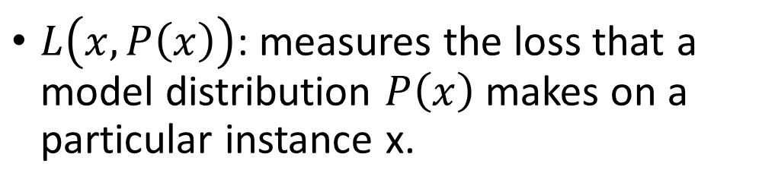
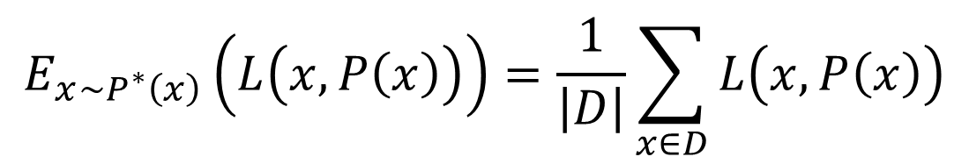
Maximum likelihood (Loss)
$$E_{x\sim P^{∗}\left(x\right)}\left(L\left(x,P\left(x\right)\right)\right)=\frac{1}{\left|D\right|}\sum_{x∈D}{L\left(x,P\left(x\right)\right)}$$
$L\left(x,P\left(x\right)\right)$: measures the loss that a model distribution $P\left(x\right)$ makes on a particular instance x.

Slide 16
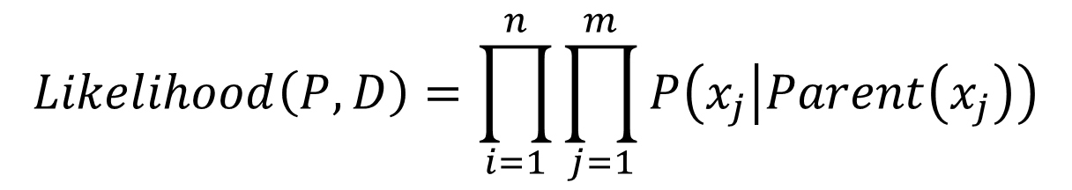
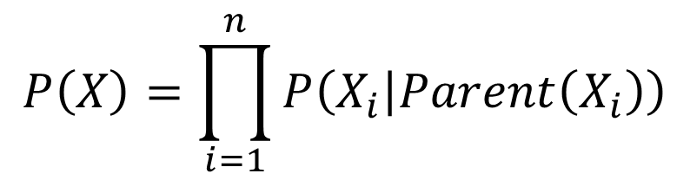

Maximum likelihood learning in Bayesian network
$$P\left(X\right)=\prod_{i=1}^{n}{P\left(X_{i} | Parent\left(X_{i}\right)\right)}$$
$$X_{i}=\left(x_{1},…,x_{m}\right)$$
$$Likelihood\left(P,D\right)=\prod_{i=1}^{n}{\prod_{j=1}^{m}{P\left(x_{j} | Parent\left(x_{j}\right)\right)}}$$

Slide 17
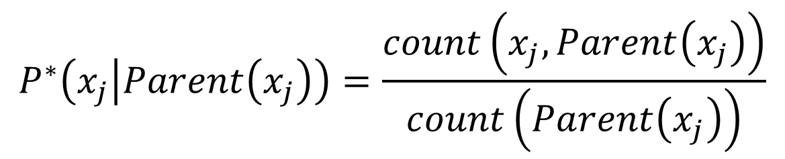
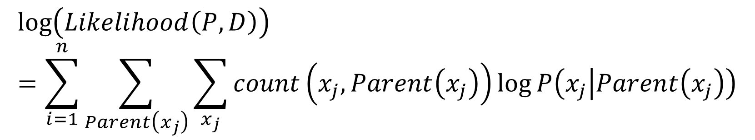
Maximum likelihood learning in Bayesian network
$$\log\left(Likelihood\left(P,D\right)\right)=\sum_{i=1}^{n}{\sum_{Parent\left(x_{j}\right)}{\sum_{x_{j}}{count\left(x_{j},Parent\left(x_{j}\right)\right)\log{P\left(x_{j} | Parent\left(x_{j}\right)\right)}}}}$$
Maximization of the (log) likelihood function decomposes into separate maximizations for the local conditional distributions.
$$P^{∗}\left(x_{j} | Parent\left(x_{j}\right)\right)=\frac{count\left(x_{j},Parent\left(x_{j}\right)\right)}{count\left(Parent\left(x_{j}\right)\right)}$$

Slide 18
Maximum likelihood (ML) problems
ML estimation does poorly when the sample size is small.
If the coin is tossed once, and came up heads, ML estimation would estimate p = 1.
Also, ML assumes uniform priors, which is often incorrect. We frequently have very specific information regarding the plausibility of various hypotheses

Slide 19
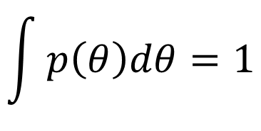
Bayesian estimator
The prior distribution p has thus far been assumed to be a true probability distribution, in that
$$\int{p\left(θ\right)dθ}=1$$

Slide 20
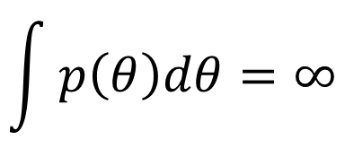
Bayesian estimator
However, occasionally this can be a restrictive requirement.
There is no distribution (covering the set, R, of all real numbers) for which every real number is equally likely.
“Distribution" seems like a natural choice, a prior distribution which does not imply a preference for any particular value of the unknown parameter.
$$\int{p\left(θ\right)dθ}=∞$$

Slide 21

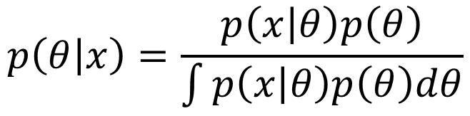
Bayesian estimator
The use of an improper prior means that the Bayes risk is undefined (since the prior is not a probability distribution and we cannot take an expectation under it).
$$p\left(θ | x\right)=\frac{p\left(x | θ\right)p\left(θ\right)}{\int{p\left(x | θ\right)p\left(θ\right)dθ}}$$
Posterior expected loss
$$h\left(a\right)=\int{L\left(θ,a\right)P\left(θ | x\right)dθ}$$
An estimator which minimizes the posterior expected loss is referred to as a generalized Bayes estimator.

Slide 22
Part 1.3 Probabilistic Graphical Model (Inferences)

Slide 23
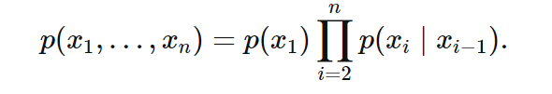
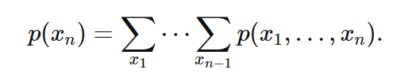
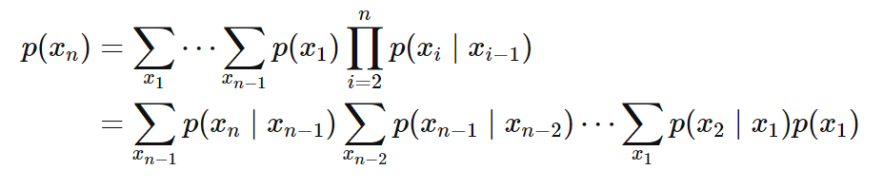
Marginal inference
$$O\left(k^{n}\right)$$

Slide 24

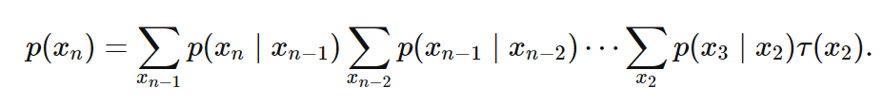
Marginal inference
$$O\left({nk}^{2}\right)$$

Slide 25

Variable elimination
$$P\left(l\right)=?$$

Slide 26



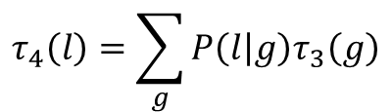
Variable elimination
Clear d:
Clear i:
Clear s:
Clear g:
$$τ_{4}\left(l\right)=\sum_{g}{P\left(l | g\right)τ_{3}\left(g\right)}$$

Slide 27


Variable elimination
$$P\left(l\right)=τ_{4}\left(l\right)$$

Slide 28

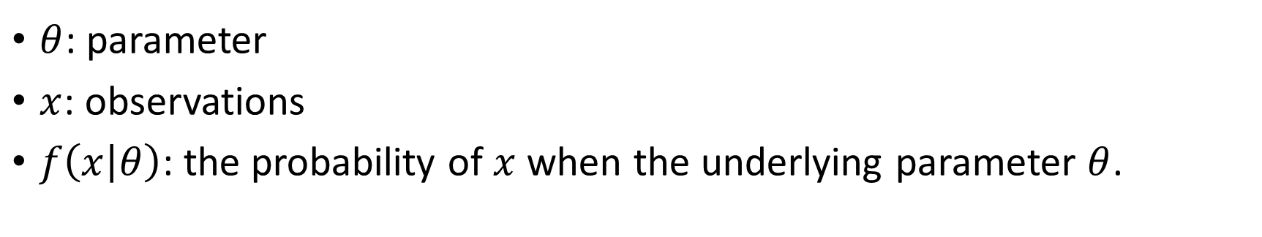
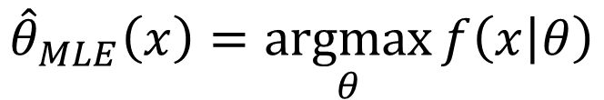
Maximum a posteriori estimation (MAP)
$$θ↦f\left(x | θ\right)$$
$θ$: parameter
$x$: observations
$f\left(x | θ\right)$: the probability of $x$ when the underlying parameter $θ$.
Assume that our estimator is MLE:
$${\hat{θ}}_{MLE}\left(x\right)=\underset{θ}{argmax}{f\left(x | θ\right)}$$

Slide 29
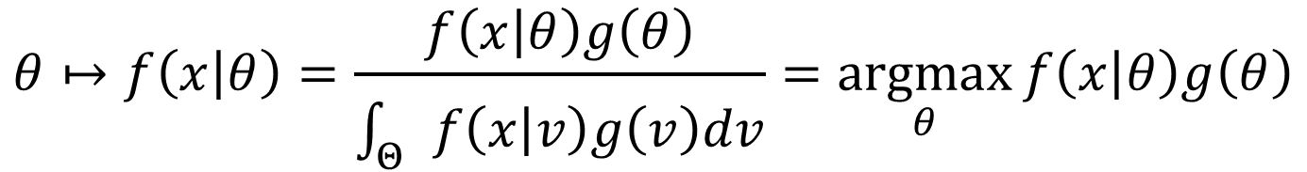
MAP
$$θ↦f\left(x | θ\right)=\frac{f\left(x | θ\right)g\left(θ\right)}{\int_{Θ}{f\left(x | v\right)g\left(v\right)dv}}=\underset{θ}{argmax}{f\left(x | θ\right)g\left(θ\right)}$$

Slide 30

Bayesian inference
H: Hypothesis, E: Observed evidence.
P(H): the prior probability, probability of the hypothesis.
P(E): probability of the obsereved evidence.
P(H|E): the posterior probability, is the probability of H given E, after E is observed.
P(E|H): is the probability of observing E given H.

Slide 31
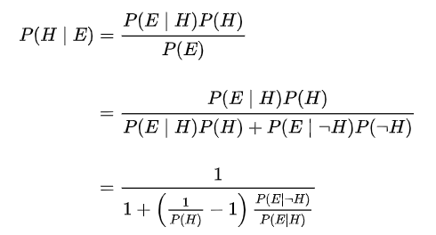
Bayesian inference

Slide 32



Bayesian inference (example)
Suppose there are two full bowls of cookies. Bowl 1 has 10 chocolate chips and 30 plain cookies, while bowl 2 has 20 of each. Fred picks a bowl at random and then picks a cookie at random. We may assume there is no reason to believe Fred treats one bowl differently from another, likewise for the cookies. The cookie turns out to be a plain one. How probable is it that Fred picked it out of bowl 1?
Hypothesis 1 (H₁): Bowl 1
Evidence (E): Cookie
Hypothesis 2 (H₂): Bowl 2

Slide 33
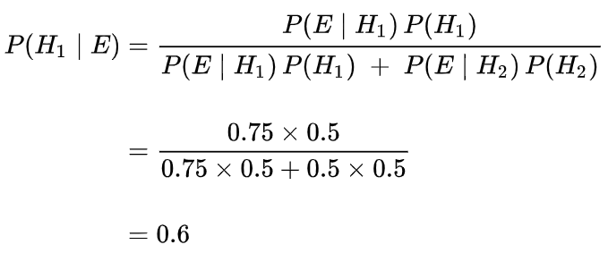
Bayesian inference (example)

Slide 34
Part 2 Pgmpy Introduction

Slide 35
Pgmpy introduction
Pgmpy is a python library for working with Probabilistic Graphical Models.
Documentation and list of algorithms supported is at our official site http://pgmpy.org/
Examples on using pgmpy: https://github.com/pgmpy/pgmpy/tree/dev/examples
Basic tutorial on Probabilistic Graphical models using pgmpy: https://github.com/pgmpy/pgmpy_notebook

Slide 36
Pgmpy installation
Install by using Anaconda:
$ conda install -c ankurankan pgmpy
Install by using “pip” command:
$ pip install pgmpy
Install from source code:
$ git clone https://github.com/pgmpy/pgmpy
$ cd pgmpy/
$ pip install -r requirements.txt
$ python setup.py install

Slide 37
Using process
Understand data
Apply right model
Choose learning method
Perform inference if desired
Perform testing when using structure learning methods.

Slide 38
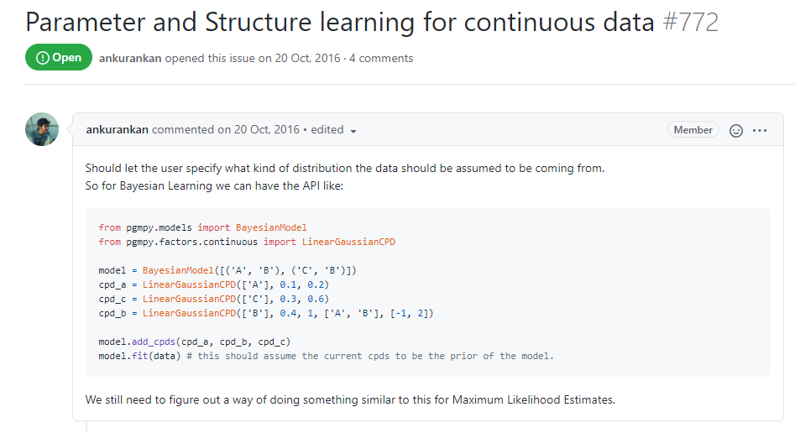

Understand data
Some notes:
Pgmpy does not support continuous data (https://github.com/pgmpy/pgmpy/issues/772)

Slide 39
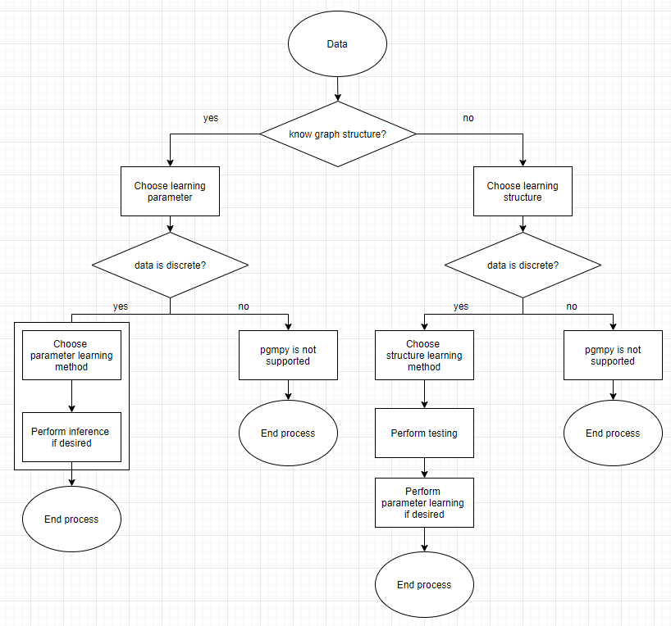

Slide 40
Part 2.1 Use pgmpy when knowing graph structure

Slide 41
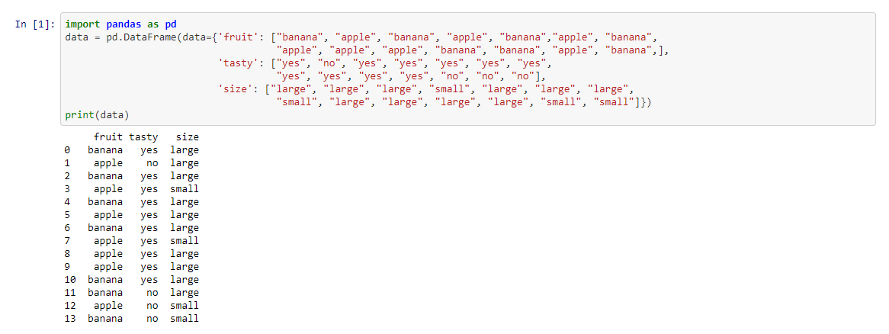
Data (Bayesian network)

Slide 42
Create a model from knowing the structure
size
fruit
tasty

Slide 43
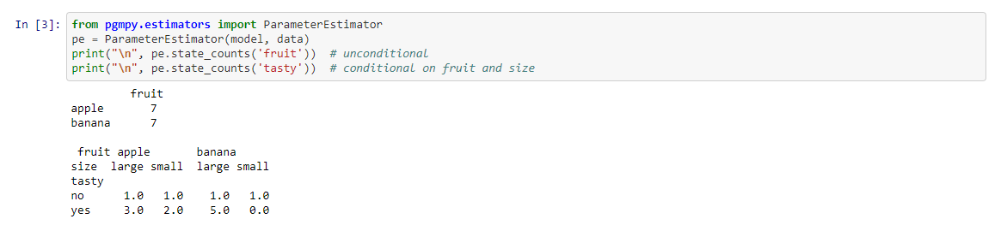
Counting

Slide 44
Part 2.2 Use pgmpy when not knowing graph structure

Slide 46
Part 3 Application

Slide 47
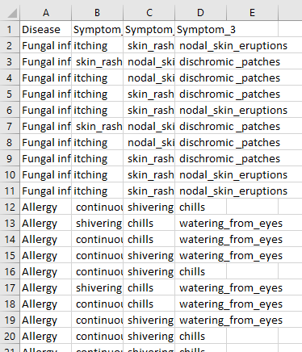
Medical diagnosis (data)
Source: https://www.kaggle.com/itachi9604/disease-symptom-description-dataset?select=dataset.csv

Slide 48
Graph
Symptom1
Symptom2
Symptom3
Disease

Slide 49
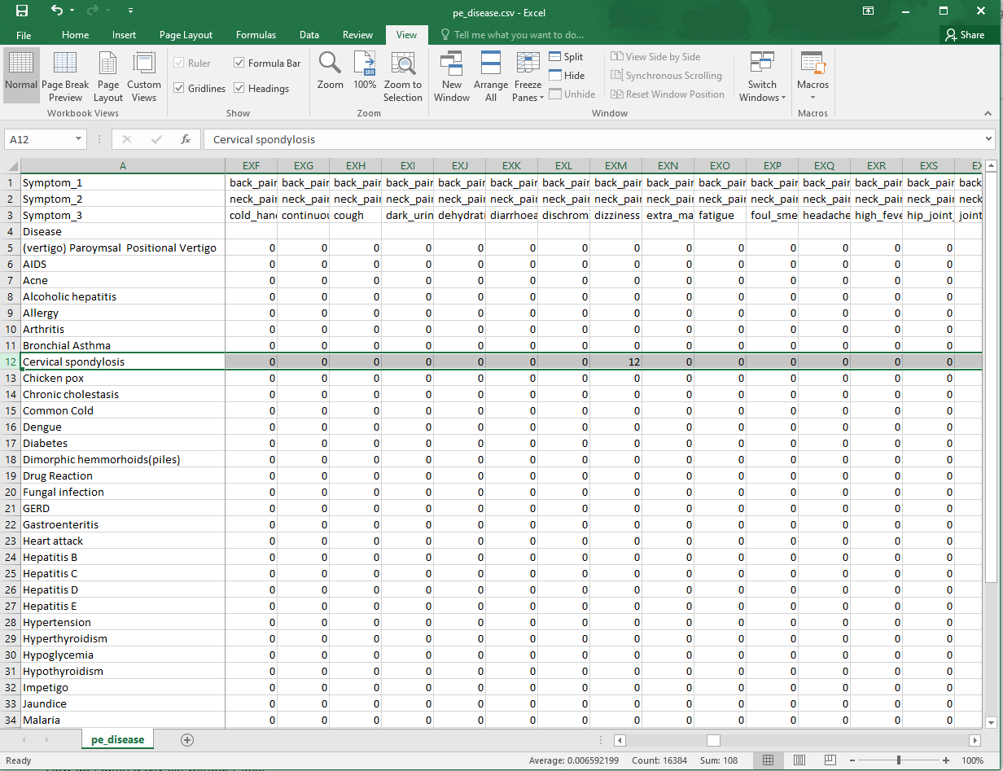
Counting result example

Slide 50
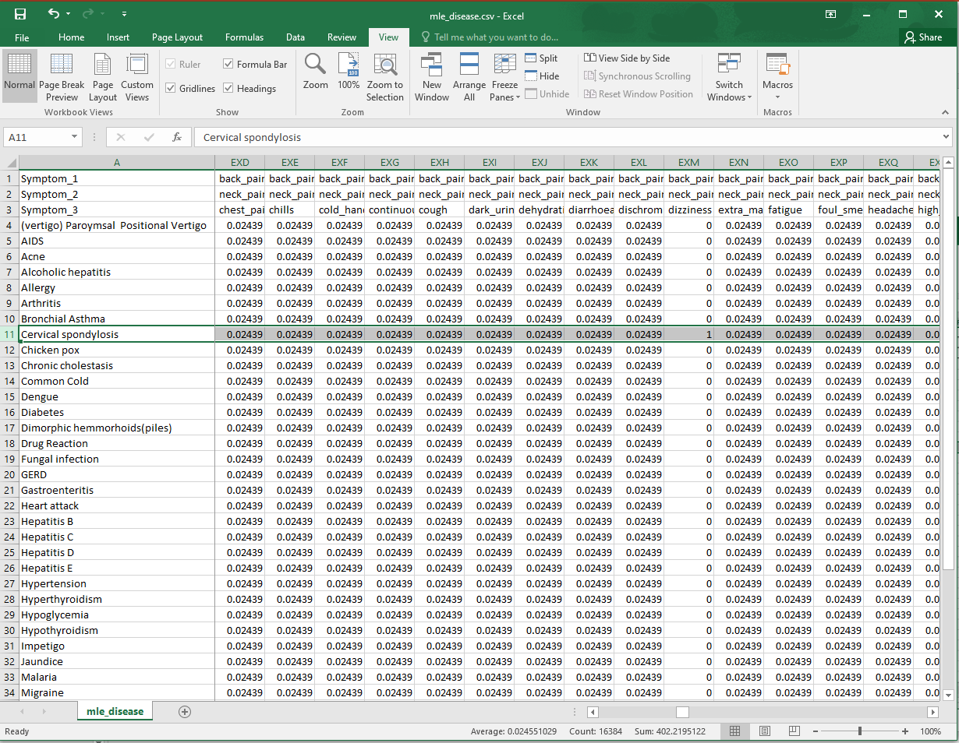
Maximum Likelihood Estimation example

Slide 51
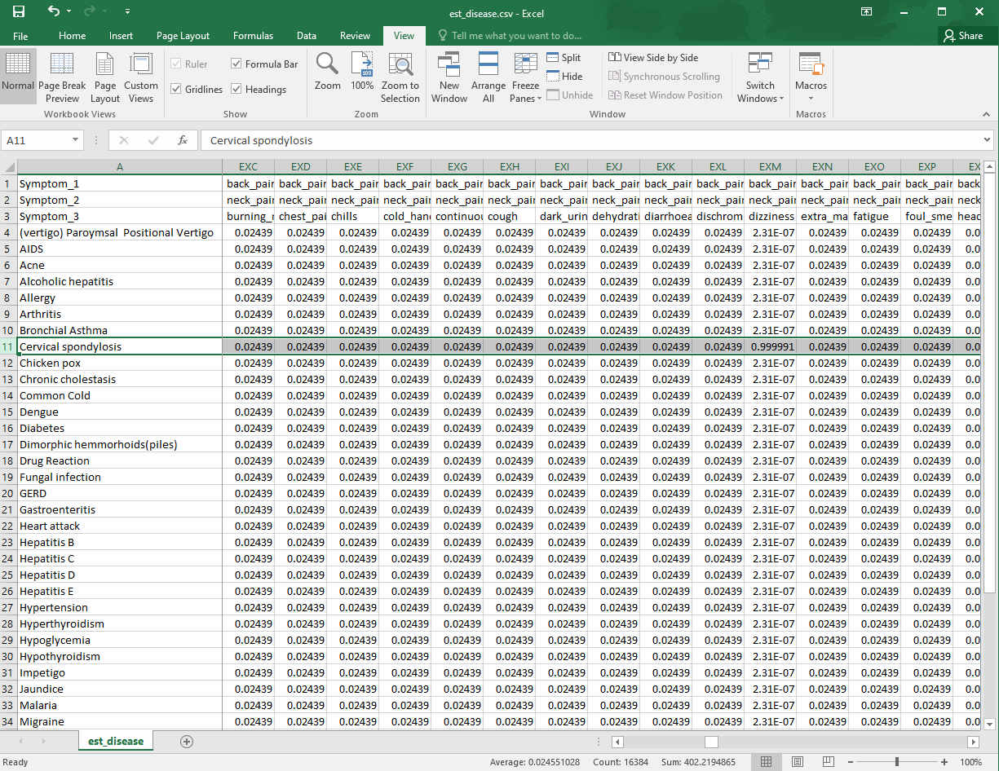
Bayesian Parameter Estimator example

