Slide 1
Probabilistic Graphical Model
Đào Việt Duy – ID: 51603070
Nguyễn Duy Hàn Lâm – ID: 196005004

Slide 2
Content
Probabilistic Graphical Model introduction
PGMPY introduction
Application

Slide 3
Part 1 Probabilistic Graphical Model Introduction

Slide 4
Graph (G)
B
A
A
Vertical (Node)
Edge

Slide 5
Basic graph operations
D
C
C
B
B
B
?
A
A
A
Adjacent(G, A, B)
Neighbors(G, A)={B,C}
Add_vertex(G, D)
D
D
C
C
C
B
B
B
A
A
A
Remove_vertex(G, D)
Add_edge(G, C, D)
Add_edge(G, C, D)

Slide 6
Graph types
C
C
B
B
A
A
Undirected graph
Directed graph

Slide 7
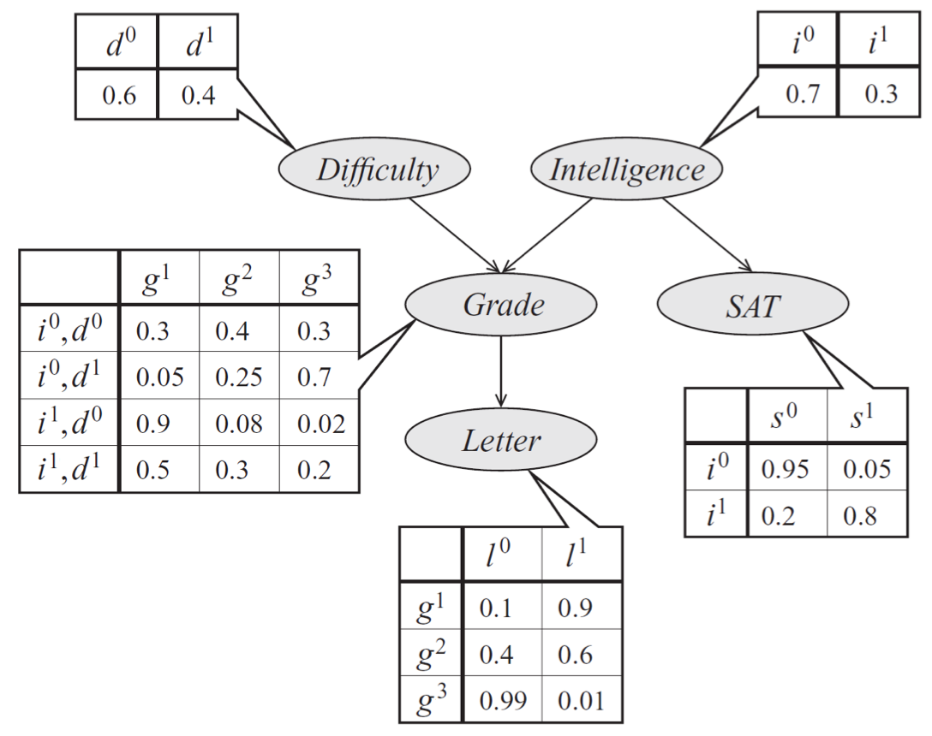
Probabilistic Graphical Model

Slide 8
Bayesian probability
$$P\left(x_{1},x_{2},…,x_{n}\right)=P\left(x_{1}\right)P\left(x_{2} | x_{1}\right)…P\left(x_{n} | x_{n−1},…,x_{2},x_{1}\right)$$

Slide 9
Bayesian network
$$P\left(d,i,g,s,l \right)=P\left(d\right)P\left(i\right)P\left(g | d,i\right)P\left(s | i\right)P\left(l | g\right)$$

Slide 10
Inference
Variable elimination
Bayesian inference

Slide 11
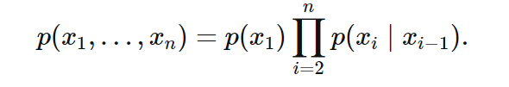
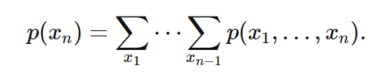
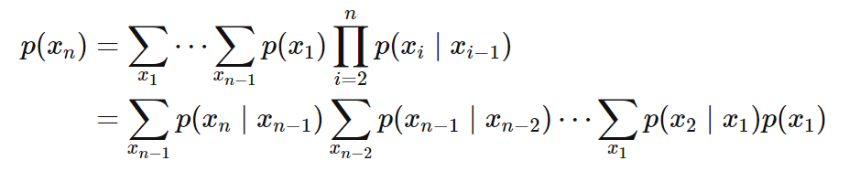
Marginal inference
$$O\left(k^{n}\right)$$

Slide 12

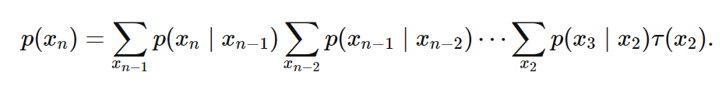
Marginal inference
$$O\left({nk}^{2}\right)$$

Slide 13

Variable elimination
$$P\left(l\right)=?$$

Slide 14



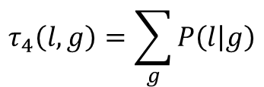
Variable elimination
Clear d:
Clear i:
Clear s:
Clear g:
$$τ_{4}\left(l,g\right)=\sum_{g}{P\left(l | g\right)}$$

Slide 15

Variable elimination
$$P\left(l\right)=τ_{4}\left(l,g\right)τ_{3}\left(g\right)τ_{2}\left(g,s\right)τ_{1}\left(g,i\right)$$

Slide 16

Bayesian inference
H: Hypothesis, E: Observed evidence.
P(H): the prior probability, probability of the hypothesis.
P(E): probability of the obsereved evidence.
P(H|E): the posterior probability, is the probability of H given E, after E is observed.
P(E|H): is the probability of observing E given H.

Slide 17
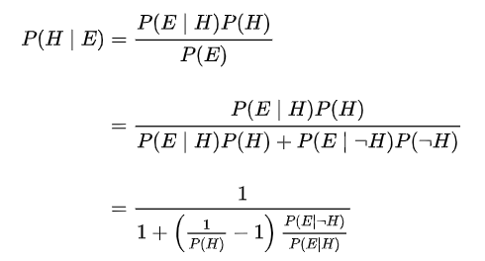
Bayesian inference

Slide 18



Bayesian inference (example)
Suppose there are two full bowls of cookies. Bowl 1 has 10 chocolate chips and 30 plain cookies, while bowl 2 has 20 of each. Fred picks a bowl at random and then picks a cookie at random. We may assume there is no reason to believe Fred treats one bowl differently from another, likewise for the cookies. The cookie turns out to be a plain one. How probable is it that Fred picked it out of bowl 1?
Hypothesis 1 (H₁): Bowl 1
Evidence (E): Cookie
Hypothesis 2 (H₂): Bowl 2

Slide 19
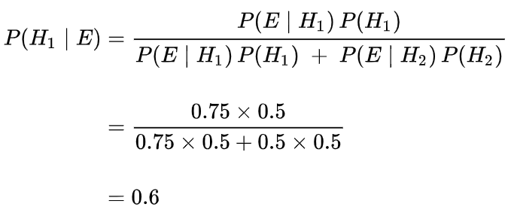
Bayesian inference (example)

Slide 20
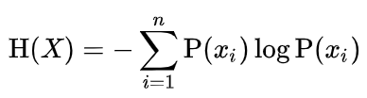
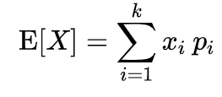
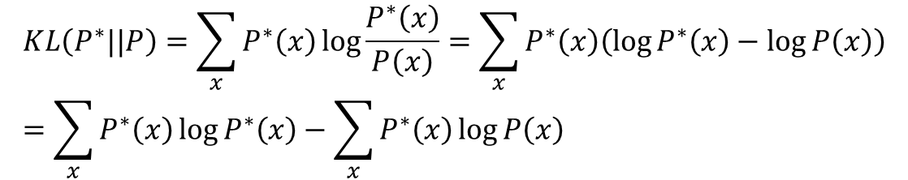
Maximum likelihood
$$KL\left(P^{∗}||P\right)=\sum_{x}{P^{∗}\left(x\right)\log{\frac{P^{∗}\left(x\right)}{P\left(x\right)}}}=\sum_{x}{P^{∗}\left(x\right)\left(\log{P^{∗}\left(x\right)}−\log{P\left(x\right)}\right)}=\sum_{x}{P^{∗}\left(x\right)\log{P^{∗}\left(x\right)}}−\sum_{x}{P^{∗}\left(x\right)\log{P\left(x\right)}}$$
Entropy:
Expected value:
$$KL\left(P^{∗}||P\right)=\sum_{x}{P^{∗}\left(x\right)\log{\frac{P^{∗}\left(x\right)}{P\left(x\right)}}}=−H\left(P^{∗}\left(x\right)\right)−E_{x\sim P^{∗}\left(x\right)}\left(\log{P\left(x\right)}\right)$$

Slide 21
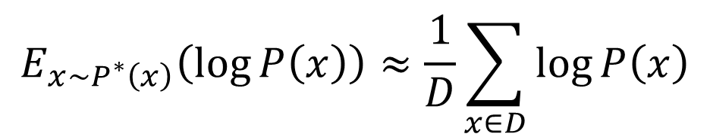
Maximum likelihood
Entropy does not depend on p.
Minimizing KL divergence is equivalent to maximizing the expected log-likelihood
$$\min_{P}{KL\left(P^{∗}||P\right)}=\max_{P}{E_{x\sim P^{∗}\left(x\right)}\left(\log{P\left(x\right)}\right)}$$
Expected value based on Monte-Carlo estimate:
$$E_{x\sim P^{∗}\left(x\right)}\left(\log{P\left(x\right)}\right)≈\frac{1}{D}\sum_{x∈D}{\log{P\left(x\right)}}$$
D: is dataset drawn independent and identically distributed (i.i.d) $P^{∗}\left(x\right)$

Slide 22
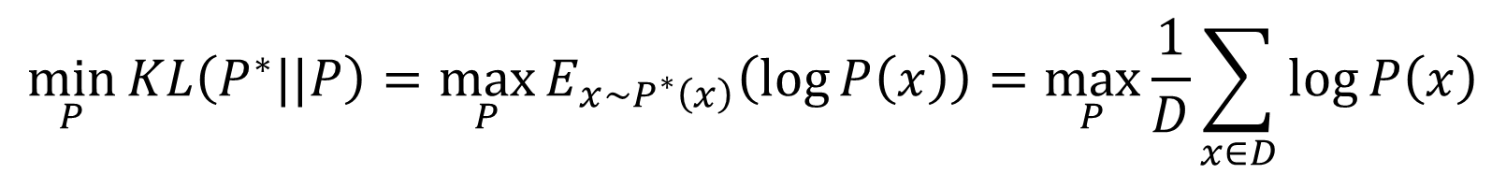
Maximum likelihood
$$\min_{P}{KL\left(P^{∗}||P\right)}=\max_{P}{E_{x\sim P^{∗}\left(x\right)}\left(\log{P\left(x\right)}\right)}=\max_{P}{\frac{1}{D}\sum_{x∈D}{\log{P\left(x\right)}}}$$

Slide 23
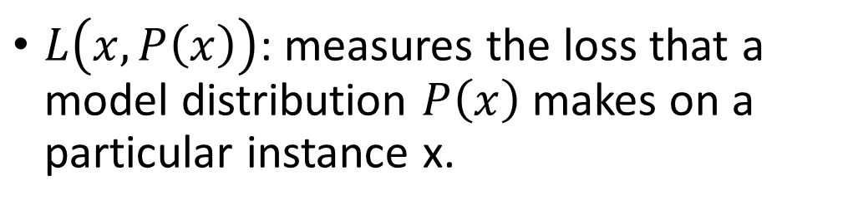
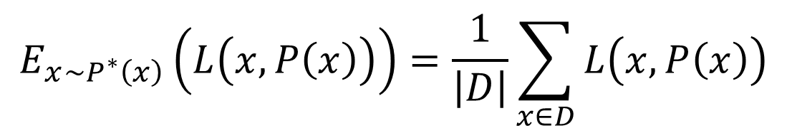
Maximum likelihood (Loss)
$$E_{x\sim P^{∗}\left(x\right)}\left(L\left(x,P\left(x\right)\right)\right)=\frac{1}{\left|D\right|}\sum_{x∈D}{L\left(x,P\left(x\right)\right)}$$
$L\left(x,P\left(x\right)\right)$: measures the loss that a model distribution $P\left(x\right)$ makes on a particular instance x.

Slide 24
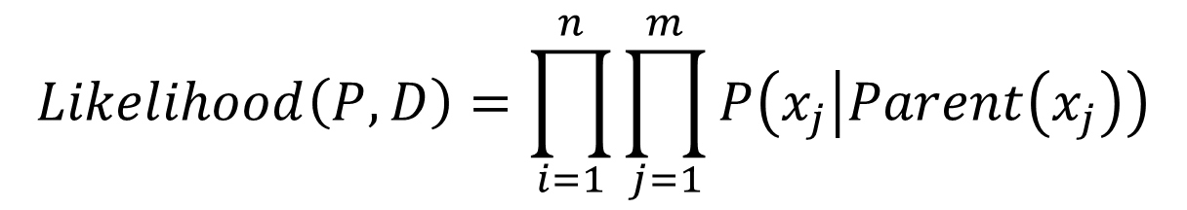
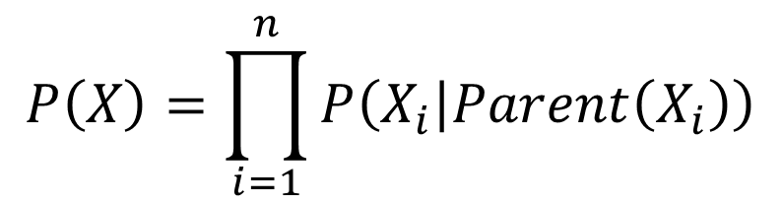

Maximum likelihood learning in Bayesian network
$$P\left(X\right)=\prod_{i=1}^{n}{P\left(X_{i} | Parent\left(X_{i}\right)\right)}$$
$$X_{i}=\left(x_{1},…,x_{m}\right)$$
$$Likelihood\left(P,D\right)=\prod_{i=1}^{n}{\prod_{j=1}^{m}{P\left(x_{j} | Parent\left(x_{j}\right)\right)}}$$

Slide 25
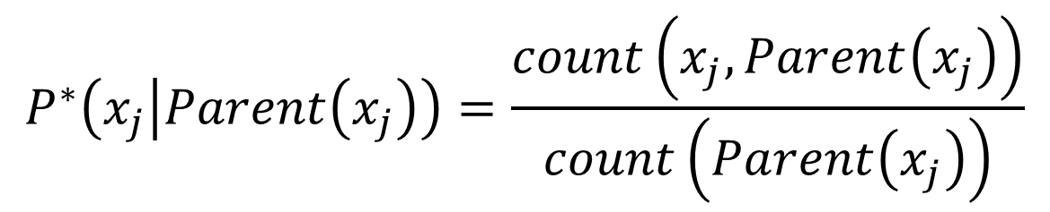
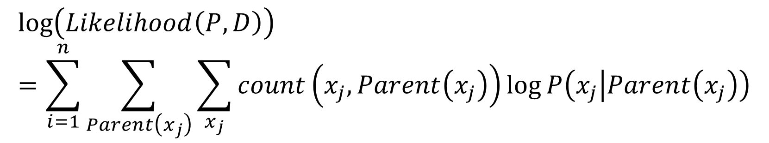
Maximum likelihood learning in Bayesian network
$$\log\left(Likelihood\left(P,D\right)\right)=\sum_{i=1}^{n}{\sum_{Parent\left(x_{j}\right)}{\sum_{x_{j}}{count\left(x_{j},Parent\left(x_{j}\right)\right)\log{P\left(x_{j} | Parent\left(x_{j}\right)\right)}}}}$$
Maximization of the (log) likelihood function decomposes into separate maximizations for the local conditional distributions.
$$P^{∗}\left(x_{j} | Parent\left(x_{j}\right)\right)=\frac{count\left(x_{j},Parent\left(x_{j}\right)\right)}{count\left(Parent\left(x_{j}\right)\right)}$$

Slide 26
Part 2 Pgmpy Introduction

Slide 27
Part 3 Application

Slide 28

Medical diagnosis (data)
Nguồn: https://www.kaggle.com/itachi9604/disease-symptom-description-dataset?select=dataset.csv

Slide 29
Graph
Symptom1
Symptom2
Symptom3
Disease

Slide 30

Counting result example

Slide 31

Maximum Likelihood Estimation example

Slide 32

Bayesian Parameter Estimator example

