Slide 1
Probabilistic Graphical Model
Đào Việt Duy – ID: 51
Nguyễn Duy Hàn Lâm – ID: 196005004

Slide 2
Content
Probabilistic Graphical Model introduction
PGMPY introduction
Application

Slide 3
Part 1 Probabilistic Graphical Model Introduction

Slide 4
Graph (G)
B
A
A
Vertical (Node)
Edge

Slide 5
Basic graph operations
D
C
C
B
B
B
?
A
A
A
Adjacent(G, A, B)
Neighbors(G, A)={B,C}
Add_vertex(G, D)
D
D
C
C
C
B
B
B
A
A
A
Remove_vertex(G, D)
Add_edge(G, C, D)
Add_edge(G, C, D)

Slide 6
Graph types
C
C
B
B
A
A
Undirected graph
Directed graph

Slide 7
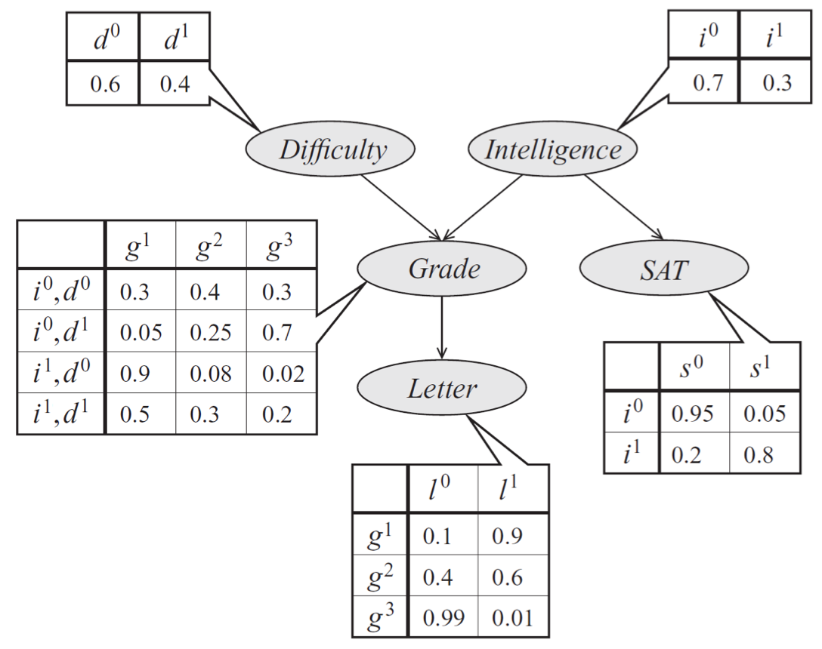
Probabilistic Graphical Model

Slide 8
Bayesian probability
$$P\left(x_{1},x_{2},…,x_{n}\right)=P\left(x_{1}\right)P\left(x_{2} | x_{1}\right)…P\left(x_{n} | x_{n−1},…,x_{2},x_{1}\right)$$

Slide 9
Bayesian network
$$P\left(d,i,g,s,l \right)=P\left(d\right)P\left(i\right)P\left(g | d,i\right)P\left(s | i\right)P\left(l | g\right)$$

Slide 10
Inference
Variable elimination

Slide 11
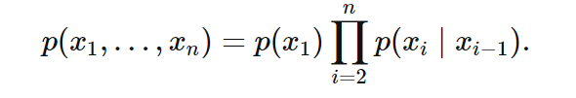
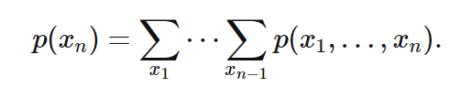
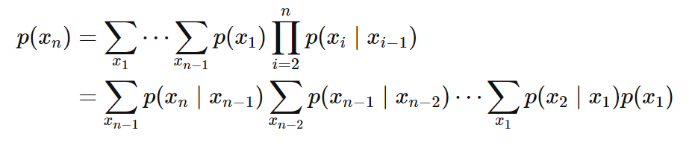
Marginal inference

Slide 12

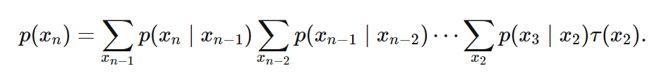
Marginal inference

Slide 13

Variable elimination
$$P\left(l\right)=?$$

Slide 14



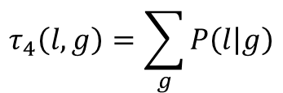
Variable elimination
Clear d:
Clear i:
Clear s:
Clear g:
$$τ_{4}\left(l,g\right)=\sum_{g}{P\left(l | g\right)}$$

Slide 15

Variable elimination
$$P\left(l\right)=τ_{4}\left(l,g\right)τ_{3}\left(g\right)τ_{2}\left(g,s\right)τ_{1}\left(g,i\right)$$

Slide 16
Part 2 Pgmpy Introduction

Slide 17
Part 3 Application

Slide 18
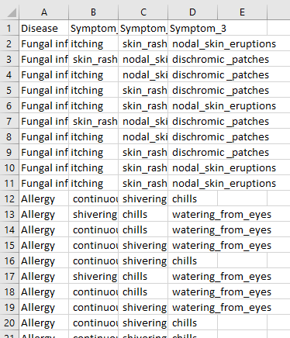
Medical diagnosis (data)
Nguồn: https://www.kaggle.com/itachi9604/disease-symptom-description-dataset?select=dataset.csv

Slide 19
Graph
Symptom1
Symptom2
Symptom3
Disease

Slide 20
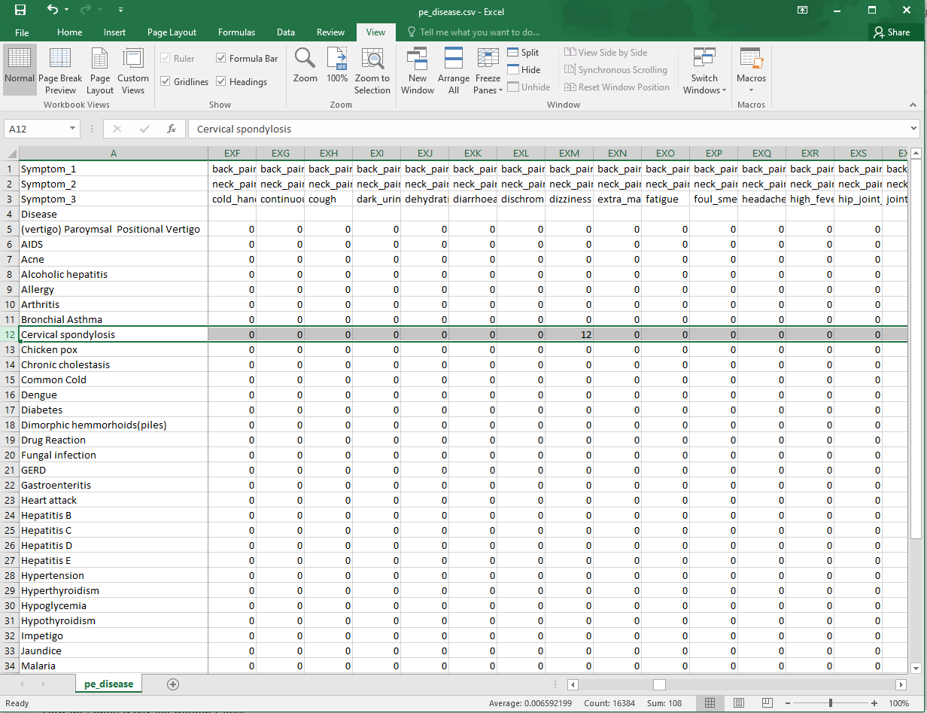
Counting result example

Slide 21
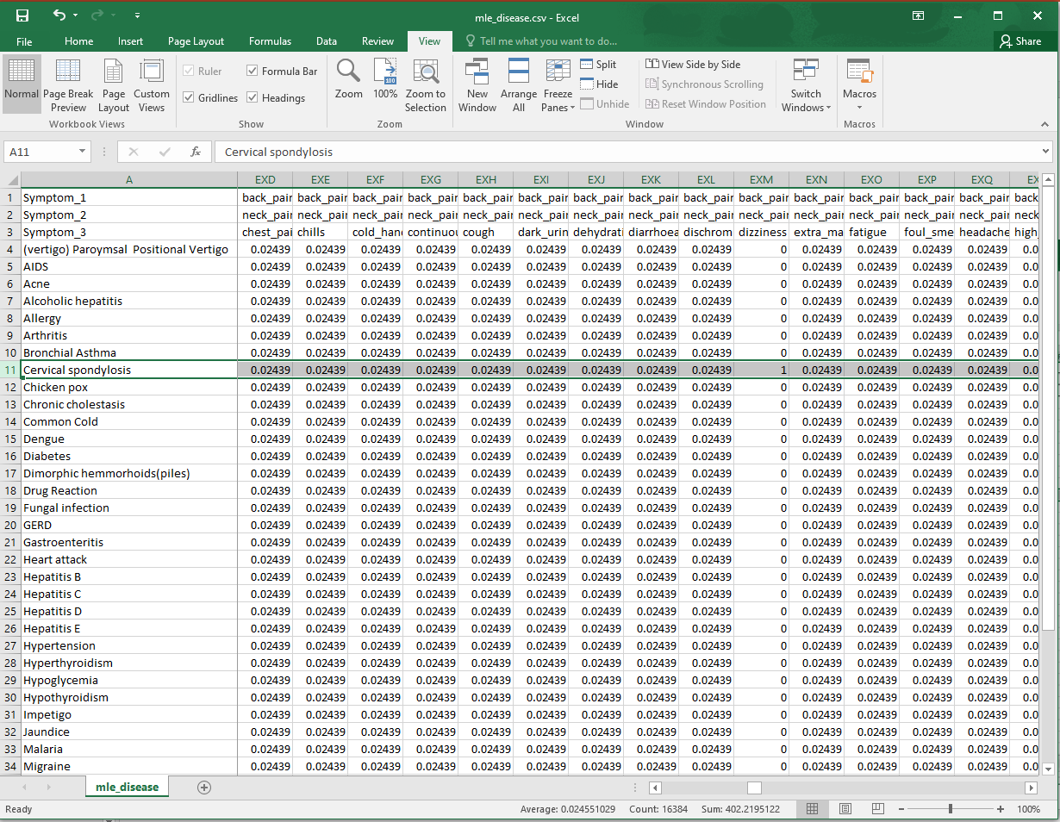
Maximum Likelihood Estimation example

Slide 22
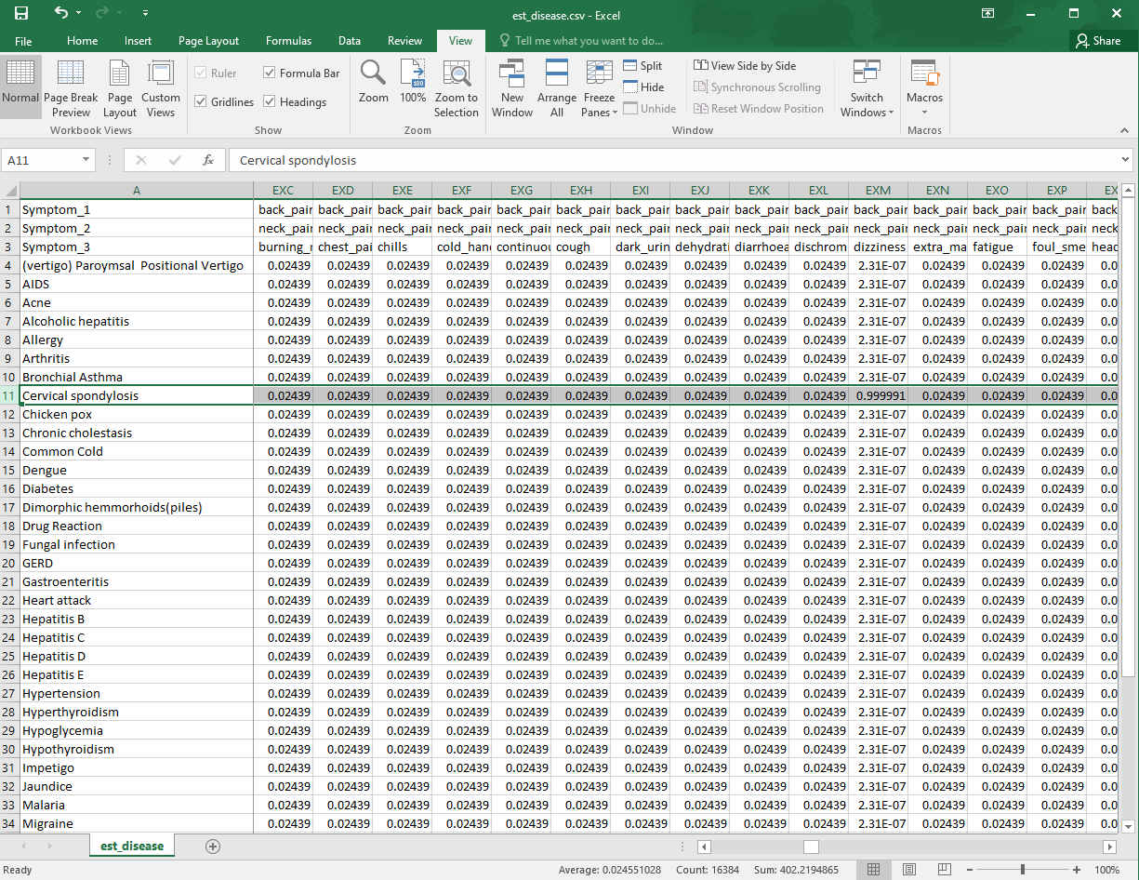
Bayesian Parameter Estimator example

