Slide 1
Recommendation System
Nguyễn Duy Hàn Lâm

Slide 2
Index
CONTENT-BASED RECOMMENDATION SYSTEM
Utility matrix, Item profile
Cách thực hiện, cách hiệu chỉnh
NEIGHBORHOOD-BASED COLLABORATIVE FILTERING
Ý tưởng
Cách thực hiện
MATRIX FACTORIZATION COLLABORATIVE FILTERING
Ý tưởng
Cách thức thực hiện

Slide 3
1.
CONTENT-BASED RECOMMENDATION SYSTEM
Feedforward

Slide 4
Utility Matrix
 | A | B | C | D | E | F
Batman | 5 | 5 | 0 | 0 | 1 | ?
Spyderman | 5 | ? | ? | 0 | ? | ?
Superman | ? | 4 | 1 | ? | ? | 1
My neighbor tororo | 1 | 1 | 4 | 4 | 4 | ?
Doraemon | 1 | 0 | 5 | ? | ? | ?
Item (i)
User (u)

Slide 5
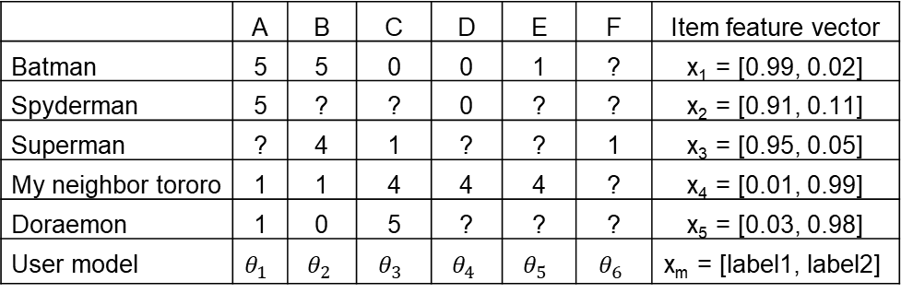

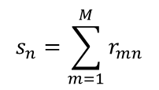
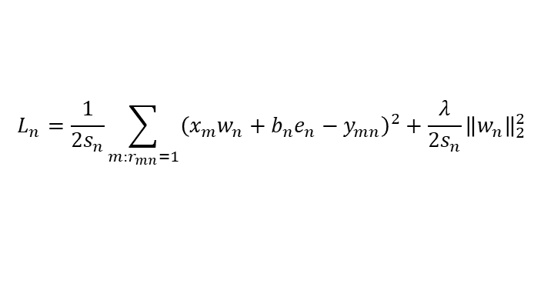
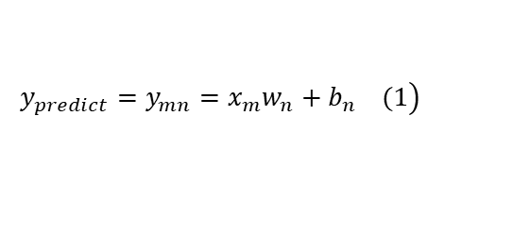
Item Profile
 | A | B | C | D | E | F | Item feature vector
Batman | 5 | 5 | 0 | 0 | 1 | ? | x₁ = [0.99, 0.02]
Spyderman | 5 | ? | ? | 0 | ? | ? | x₂ = [0.91, 0.11]
Superman | ? | 4 | 1 | ? | ? | 1 | x₃ = [0.95, 0.05]
My neighbor tororo | 1 | 1 | 4 | 4 | 4 | ? | x₄ = [0.01, 0.99]
Doraemon | 1 | 0 | 5 | ? | ? | ? | x₅ = [0.03, 0.98]
User model | $$θ_{1}$$ | $$θ_{2}$$ | $$θ_{3}$$ | $$θ_{4}$$ | $$θ_{5}$$ | $$θ_{6}$$ | x_{m} = [label1, label2]
m
n
$$\left.{y_{predict}=y}_{mn}=x_{m}w_{n}+b_{n} (1\right)$$
$$L_{n}=\frac{1}{2s_{n}}\sum_{m:r_{mn}=1}{{\left(x_{m}w_{n}+b_{n}e_{n}−y_{mn}\right)}^{2}}+\frac{λ}{2s_{n}}{\left\|w_{n}\right\|}_{2}^{2}$$
$$s_{n}=\sum_{m=1}^{M}{r_{mn}}$$
$e_{n}$ là vector chứa các giá trị 1 tương ứng với các item mà user m đã đánh giá

Slide 6
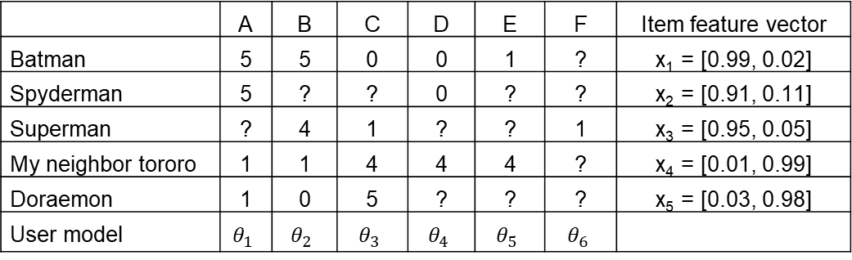



Predict
 | A | B | C | D | E | F | Item feature vector
Batman | 5 | 5 | 0 | 0 | 1 | ? | x₁ = [0.99, 0.02]
Spyderman | 5 | ? | ? | 0 | ? | ? | x₂ = [0.91, 0.11]
Superman | ? | 4 | 1 | ? | ? | 1 | x₃ = [0.95, 0.05]
My neighbor tororo | 1 | 1 | 4 | 4 | 4 | ? | x₄ = [0.01, 0.99]
Doraemon | 1 | 0 | 5 | ? | ? | ? | x₅ = [0.03, 0.98]
User model | $$θ_{1}$$ | $$θ_{2}$$ | $$θ_{3}$$ | $$θ_{4}$$ | $$θ_{5}$$ | $$θ_{6}$$
$${y_{predict}=y}_{mn}=x_{m}w_{n}+b_{n}$$
User E thích xem phim có thể loại label1 hơn label2:
$$w_{5}=\left[\begin{matrix}5∗0.13 & 5∗0.87\end{matrix}\right]$$
Vector phân loại của phim spyderman:
$$x_{5}=\left[\begin{matrix}0.91 & 0.11\end{matrix}\right]$$
Phần bù đại số:
$$b_{5}=0.22$$
$${y_{predict}=y}_{mn}={\left[\begin{matrix}0.91 & 0.11\end{matrix}\right]}^{T}\left[\begin{matrix}5∗0.13 & 5∗0.87\end{matrix}\right]+0.22=1.29$$

Slide 7
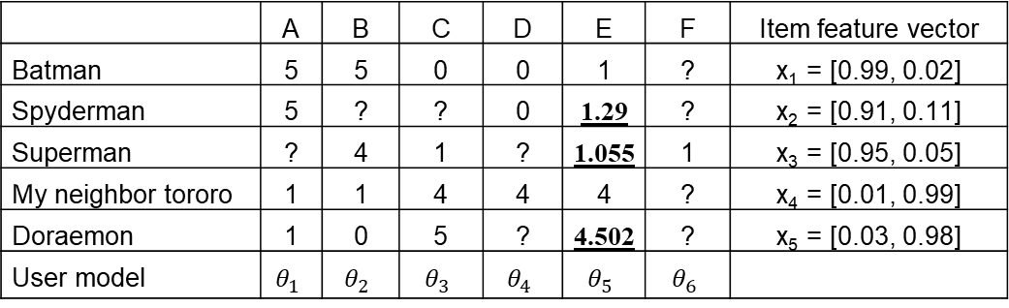

Predict
 | A | B | C | D | E | F | Item feature vector
Batman | 5 | 5 | 0 | 0 | 1 | ? | x₁ = [0.99, 0.02]
Spyderman | 5 | ? | ? | 0 | 1.29 | ? | x₂ = [0.91, 0.11]
Superman | ? | 4 | 1 | ? | 1.055 | 1 | x₃ = [0.95, 0.05]
My neighbor tororo | 1 | 1 | 4 | 4 | 4 | ? | x₄ = [0.01, 0.99]
Doraemon | 1 | 0 | 5 | ? | 4.502 | ? | x₅ = [0.03, 0.98]
User model | $$θ_{1}$$ | $$θ_{2}$$ | $$θ_{3}$$ | $$θ_{4}$$ | $$θ_{5}$$ | $$θ_{6}$$
$${y_{predict}=y}_{mn}=x_{m}w_{n}+b_{n}$$
Giả định ban đầu của ta về User E:
$$w_{5}=\left[\begin{matrix}5∗0.13 & 5∗0.87\end{matrix}\right]$$
Phần bù đại số:
$$b_{5}=0.22$$

Slide 8


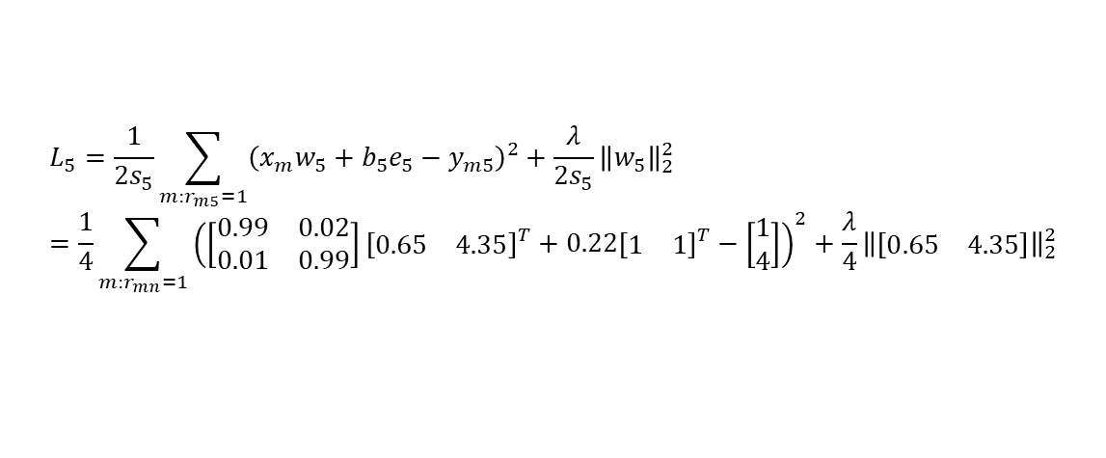
Loss function
 | A | B | C | D | E | F | Item feature vector
Batman | 5 | 5 | 0 | 0 | 1 | ? | x₁ = [0.99, 0.02]
Spyderman | 5 | ? | ? | 0 | 1.29 | ? | x₂ = [0.91, 0.11]
Superman | ? | 4 | 1 | ? | 1.055 | 1 | x₃ = [0.95, 0.05]
My neighbor tororo | 1 | 1 | 4 | 4 | 4 | ? | x₄ = [0.01, 0.99]
Doraemon | 1 | 0 | 5 | ? | 4.502 | ? | x₅ = [0.03, 0.98]
User model | $$θ_{1}$$ | $$θ_{2}$$ | $$θ_{3}$$ | $$θ_{4}$$ | $$θ_{5}$$ | $$θ_{6}$$
$$w_{5}=\left[\begin{matrix}5∗0.13 & 5∗0.87\end{matrix}\right]=\left[\begin{matrix}0.65 & 4.35\end{matrix}\right]$$
$$b_{5}=0.22$$
$$e_{n}={\left[\begin{matrix}1 & 1\end{matrix}\right]}^{T}$$
$$s_{5}=2$$
$$L_{5}=\frac{1}{2s_{5}}\sum_{m:r_{m5}=1}{{\left(x_{m}w_{5}+b_{5}e_{5}−y_{m5}\right)}^{2}}+\frac{λ}{2s_{5}}{\left\|w_{5}\right\|}_{2}^{2}=\frac{1}{4}\sum_{m:r_{mn}=1}{{\left(\left[\begin{matrix}0.99 & 0.02 \\ 0.01 & 0.99\end{matrix}\right]{\left[\begin{matrix}0.65 & 4.35\end{matrix}\right]}^{T}+0.22{\left[\begin{matrix}1 & 1\end{matrix}\right]}^{T}−\left[\begin{matrix}1 \\ 4\end{matrix}\right]\right)}^{2}}+\frac{λ}{4}{\left\|\left[\begin{matrix}0.65 & 4.35\end{matrix}\right]\right\|}_{2}^{2}$$

Slide 9
1.
CONTENT-BASED RECOMMENDATION SYSTEM
Backpropagation

Slide 10
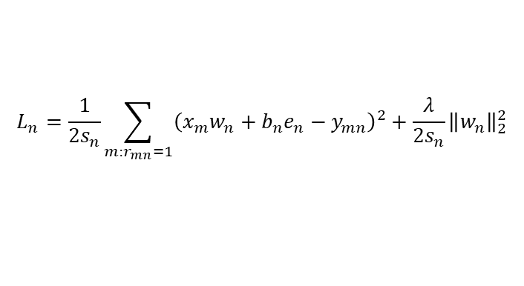


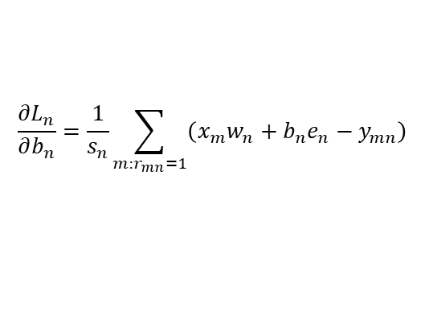
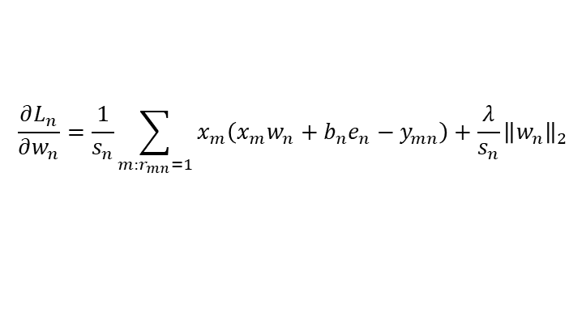
Gradient descent
$$L_{n}=\frac{1}{2s_{n}}\sum_{m:r_{mn}=1}{{\left(x_{m}w_{n}+b_{n}e_{n}−y_{mn}\right)}^{2}}+\frac{λ}{2s_{n}}{\left\|w_{n}\right\|}_{2}^{2}$$
$$\frac{∂L_{n}}{∂w_{n}}=\frac{1}{s_{n}}\sum_{m:r_{mn}=1}{x_{m}\left(x_{m}w_{n}+b_{n}e_{n}−y_{mn}\right)}+\frac{λ}{s_{n}}{\left\|w_{n}\right\|}_{2}$$
$$\frac{∂L_{n}}{∂b_{n}}=\frac{1}{s_{n}}\sum_{m:r_{mn}=1}{\left(x_{m}w_{n}+b_{n}e_{n}−y_{mn}\right)}$$
$$w_{n}^{new}=w_{n}^{old}−learning_rate∙\frac{∂L_{n}}{∂w_{n}}$$
$$b_{n}^{new}=b_{n}^{old}−learning_rate∙\frac{∂L_{n}}{∂b_{n}}$$

Slide 11
2.
NEIGHBORHOOD-BASED RECOMMENDATION SYSTEM
Ý tưởng

Slide 12
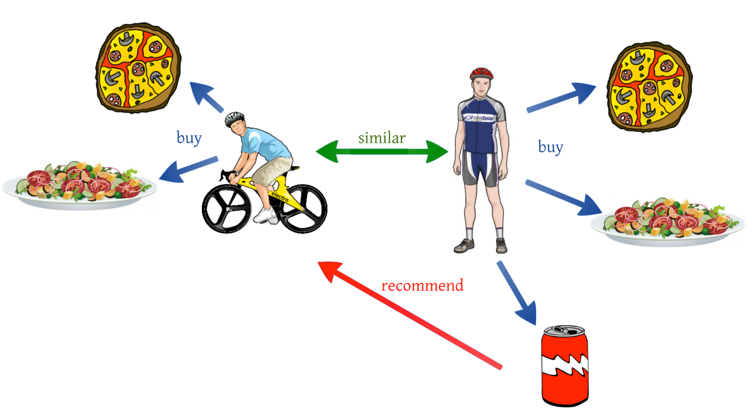

Slide 13
2.
NEIGHBORHOOD-BASED RECOMMENDATION SYSTEM
Cách thực hiện

Slide 14
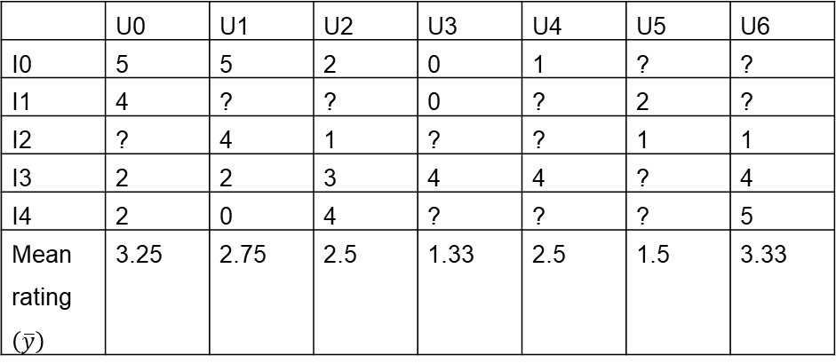

Utility Matrix
 | U0 | U1 | U2 | U3 | U4 | U5 | U6
I0 | 5 | 5 | 2 | 0 | 1 | ? | ?
I1 | 4 | ? | ? | 0 | ? | 2 | ?
I2 | ? | 4 | 1 | ? | ? | 1 | 1
I3 | 2 | 2 | 3 | 4 | 4 | ? | 4
I4 | 2 | 0 | 4 | ? | ? | ? | 5
Mean rating $\left(\overline{y}\right)$ | 3.25 | 2.75 | 2.5 | 1.33 | 2.5 | 1.5 | 3.33
Chuyển “?” thành 0
$$y_{mn}=y_{mn}−{\overline{y}}_{n}$$

Slide 15
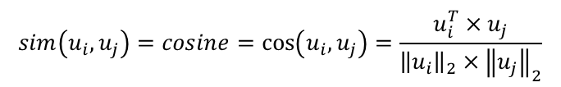
Utility Matrix
 | U0 | U1 | U2 | U3 | U4 | U5 | U6
I0 | 1.75 | 2.25 | -0.5 | -1.33 | -1.5 | 0 | 0
I1 | 0.75 | 0 | 0 | -1.33 | 0 | 0.5 | 0
I2 | 0 | 1.25 | -1.5 | 0 | 0 | -0.5 | -2.33
I3 | -1.25 | -0.75 | 0.5 | 2.67 | 1.5 | 0 | 0.67
I4 | -1.25 | -2.75 | 1.5 | 0 | 0 | 0 | 1.67
$$sim\left(u_{i},u_{j}\right)=cosine=\cos\left(u_{i},u_{j}\right)=\frac{u_{i}^{T}×u_{j}}{{\left\|u_{i}\right\|}_{2}×{\left\|u_{j}\right\|}_{2}}$$

Slide 16
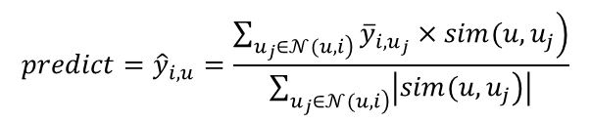
Collaborative table (user)
 | U0 | U1 | U2 | U3 | U4 | U5 | U6
U0 | 1 | 0.83 | -0.58 | -0.79 | -0.82 | 0.2 | -0.38
U1 | 0.83 | 1 | -0.87 | -0.40 | -0.55 | -0.23 | -0.71
U2 | -0.58 | -0.87 | 1 | 0.27 | 0.32 | 0.47 | 0.96
U3 | -0.79 | -0.40 | 0.27 | 1 | 0.87 | -0.29 | 0.18
U4 | -0.82 | -0.55 | 0.32 | 0.87 | 1 | 0 | 0.16
U5 | 0.2 | -0.23 | 0.47 | -0.29 | 0 | 1 | 0.56
U6 | -0.38 | -0.71 | 0.96 | 0.18 | 0.16 | 0.56 | 1
$$predict={\hat{y}}_{i,u}=\frac{\sum_{\left.u_{j}∈𝒩(u,i\right)}{\left.{\overline{y}}_{i,u_{j}}×sim(u,u_{j}\right)}}{\sum_{\left.u_{j}∈𝒩(u,i\right)}{\left|\left.sim(u,u_{j}\right)\right|}}$$

Slide 17
Predict
 | U0 | U1 | U2 | U3 | U4 | U5 | U6
I0 | 1.75 | 2.25 | -0.5 | -1.33 | -1.5 | 0.18 | -0.63
I1 | 0.75 | 0.48 | -0.17 | -1.33 | -1.33 | 0.5 | 0.05
I2 | 0.91 | 1.25 | -1.5 | -1.84 | -1.78 | -0.5 | -2.33
I3 | -1.25 | -0.75 | 0.5 | 2.67 | 1.5 | 0.59 | 0.67
I4 | -1.25 | -2.75 | 1.5 | 1.57 | 1.56 | 1.59 | 1.67
$$predict={\hat{y}}_{i,u}=\frac{\sum_{\left.u_{j}∈𝒩(u,i\right)}{\left.{\overline{y}}_{i,u_{j}}×sim(u,u_{j}\right)}}{\sum_{\left.u_{j}∈𝒩(u,i\right)}{\left|\left.sim(u,u_{j}\right)\right|}}$$

Slide 18
Utility Matrix
 | U0 | U1 | U2 | U3 | U4 | U5 | U6 | Mean
I0 | 5 | 5 | 2 | 0 | 1 | ? | ? | 2.6
I1 | 4 | ? | ? | 0 | ? | 2 | ? | 2
I2 | ? | 4 | 1 | ? | ? | 1 | 1 | 1.75
I3 | 2 | 2 | 3 | 4 | 4 | ? | 4 | 3.17
I4 | 2 | 0 | 4 | ? | ? | ? | 5 | 2.75

Slide 19
Collaborative table (item)
 | I0 | I1 | I2 | I3 | I4
I0 | 1 | 0.77 | 0.49 | -0.89 | -0.52
I1 | 0.77 | 1 | 0 | -0.64 | -0.14
I2 | -0.49 | 0 | 1 | -0.55 | -0.88
I3 | -0.89 | -0.64 | -0.55 | 1 | 0.68
I4 | -0.52 | -0.14 | -0.88 | 0.68 | 1

Slide 20
Predict
 | U0 | U1 | U2 | U3 | U4 | U5 | U6
I0 | 2.4 | 2.4 | -0.6 | -2.6 | -1.6 | -0.29 | -1.52
I1 | 2 | 2.4 | -0.6 | -2 | -1.25 | 0 | -2.25
I2 | 2.4 | 2.25 | -0.75 | -2.6 | -1.2 | -0.75 | -0.75
I3 | -1.17 | -1.17 | -0.17 | 0.83 | 0.83 | 0.34 | 0.83
I4 | -0.75 | -2.75 | 1.25 | 1.03 | 1.16 | 0.65 | 2.25

Slide 21
3.
MATRIX FACTORIZATION COLLABORATIVE FILTERING
Ý tưởng, cách thực hiện

Slide 22
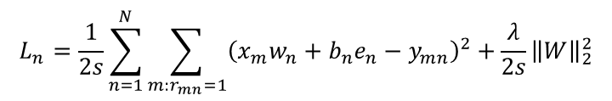

 | A | B | C | D | E | F | Item feature vector
Batman | 5 | 5 | 0 | 0 | 1 | ? | x₁ = [0.99, 0.02]
Spyderman | 5 | ? | ? | 0 | ? | ? | x₂ = [0.91, 0.11]
Superman | ? | 4 | 1 | ? | ? | 1 | x₃ = [0.95, 0.05]
My neighbor tororo | 1 | 1 | 4 | 4 | 4 | ? | x₄ = [0.01, 0.99]
Doraemon | 1 | 0 | 5 | ? | ? | ? | x₅ = [0.03, 0.98]
$$Y=\left[\begin{matrix}x_{1} \\ ⋮ \\ x_{m}\end{matrix}\right]\left[\begin{matrix}w_{1} & ⋯ & w_{n}\end{matrix}\right]=\left[\begin{matrix}x_{1}w_{1} & ⋯ & x_{1}w_{n} \\ ⋮ & ⋱ & ⋮ \\ x_{m}w_{1} & ⋯ & x_{m}w_{n}\end{matrix}\right]$$
$$L_{n}=\frac{1}{2s}\sum_{n=1}^{N}{\sum_{m:r_{mn}=1}{{\left(x_{m}w_{n}+b_{n}e_{n}−y_{mn}\right)}^{2}}}+\frac{λ}{2s}{\left\|W\right\|}_{2}^{2}$$

Slide 23
3.
MATRIX FACTORIZATION COLLABORATIVE FILTERING
Backpropagation

Slide 24
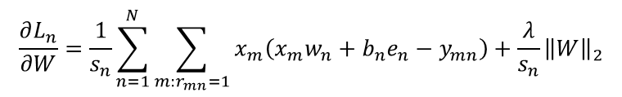
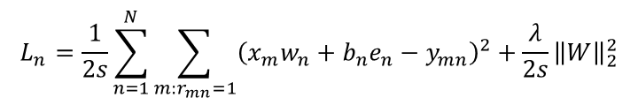


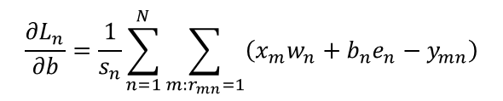
$$L_{n}=\frac{1}{2s}\sum_{n=1}^{N}{\sum_{m:r_{mn}=1}{{\left(x_{m}w_{n}+b_{n}e_{n}−y_{mn}\right)}^{2}}}+\frac{λ}{2s}{\left\|W\right\|}_{2}^{2}$$
$$\frac{∂L_{n}}{∂W}=\frac{1}{s_{n}}\sum_{n=1}^{N}{\sum_{m:r_{mn}=1}{x_{m}\left(x_{m}w_{n}+b_{n}e_{n}−y_{mn}\right)}}+\frac{λ}{s_{n}}{\left\|W\right\|}_{2}$$
$$\frac{∂L_{n}}{∂b}=\frac{1}{s_{n}}\sum_{n=1}^{N}{\sum_{m:r_{mn}=1}{\left(x_{m}w_{n}+b_{n}e_{n}−y_{mn}\right)}}$$
$$W^{new}=W^{old}−learning_rate∙\frac{∂L_{n}}{∂W}$$
$$b^{new}=b^{old}−learning_rate∙\frac{∂L_{n}}{∂b}$$

