Slide 2
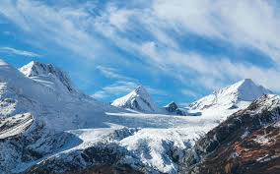
Vacation Options
Họ tên học viên:……………………………

Slide 3

Cruise
One price includes transportation, accommodation, and meals
Visit many locations without having to unpack and repack
High quality food and personal service
Not good if you suffer from seasickness

Slide 4
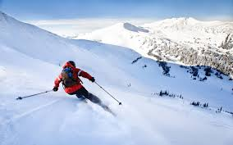
Ski Trip
Enjoy snow-capped mountain peaks and scenic views
Comfortable lodgings directly on the ski slopes
Good way to get exercise
Good weather is not guaranteed

Slide 5
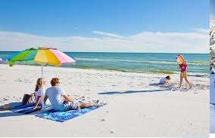
Beach Trip
Play in the ocean
Build sand castles
Participate in water sports including sailing, snorkeling, and SCUBA diving
Good weather is not guaranteed

