Slide 1





Five Fingers High School
English Collocations
With Teacher Hailey

Slide 2




Concepts and Definitions
Collocation means a natural combination of words; it refers to the way English words are closely associated with each other. For example, do and homework go together, as do make and mistakes; tall goes with man/woman and high with mountain.

Slide 3

why should we learn collocations?
Learning collocations will help you to increase your range of English vocabulary. For example, you’ll find it easier to avoid words like very or nice or beautiful or get by choosing a word that fits the context better and has a more precise meaning. This is particularly useful if you are taking an exam in English and want to make a good impression on the listeners.

Slide 4


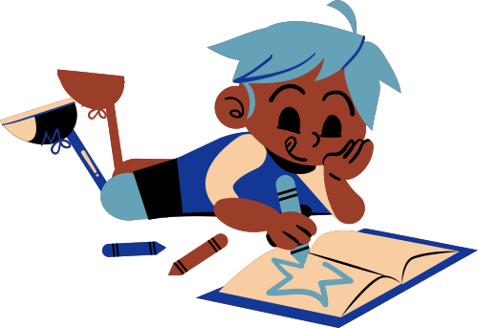
hamburgers
baseball
LIKE
playing soccer

Slide 5

a party
fun
HAVE
a breakfast

Slide 6
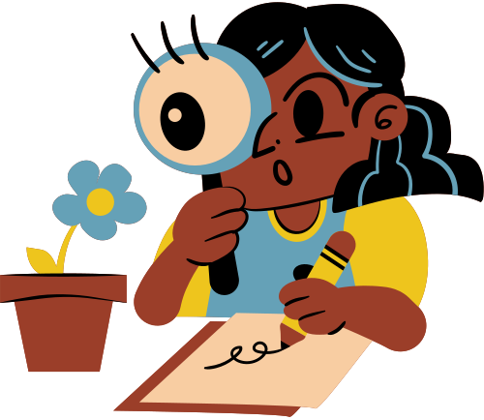
off shoes
serious
TAKE
something down

Slide 7

homework
exercise
DO
your hair

Slide 8
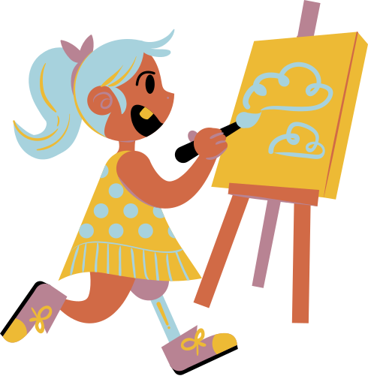
a choice
an excuse
MAKE
friends

Slide 9

fishing
to school
GO
swimming

Slide 10

a grade
a degree
GET
married

Slide 11
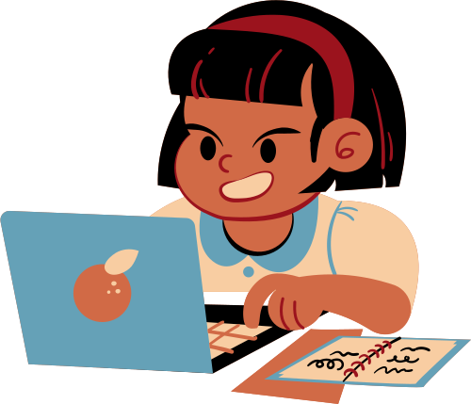
in sick
out names
CALL
in a favor

