Slide 1
MEMBERS
Nguyễn Hoài Bảo - 19520405
Đỗ Vũ Gia Cần - 19521271
Nguyễn Võ Thiên Ân - 19521186
Nguyễn Thành Phúc - 19522040

Slide 2
BATCH DATA PIPELINE FOR VISUALIZING AND FORECASTING AIR POLLUTION
Big Data Final Project

Slide 3
INTRODUCE
I

Slide 4






What we use

Slide 5
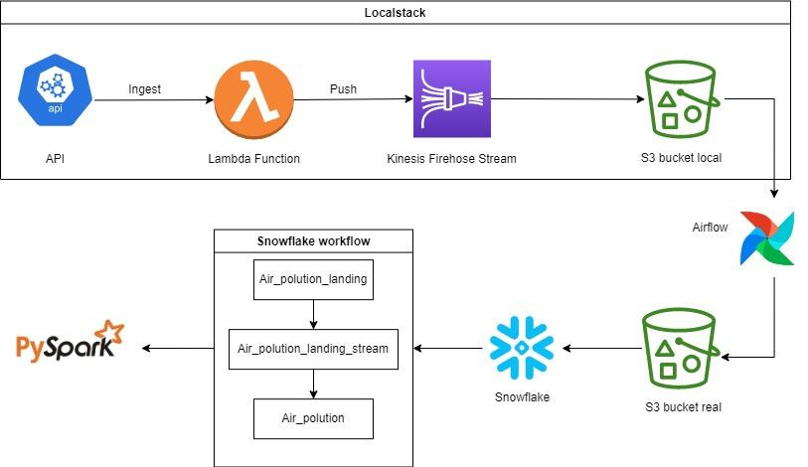
Workflow

Slide 6



Ingest data from API and push to Kinesis Firehose
1

Slide 7
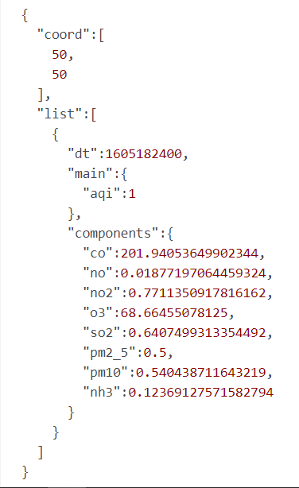

Ingest data from API and push to Kinesis Firehose
From date: 25/11/2020
Json format.

Slide 8
Ingest data from API and push to Kinesis Firehose
Data
Flatten
Push_to_firehose
Bytes format
Crawl data with request
Data_to_firehose
Firehose.put_record
Stream_name
Get_data_from_openweathermap_api
Trigger with aws_cloudwatch: 1hour

Slide 9

Data from Firehose to S3 - Localstack
2

Slide 10
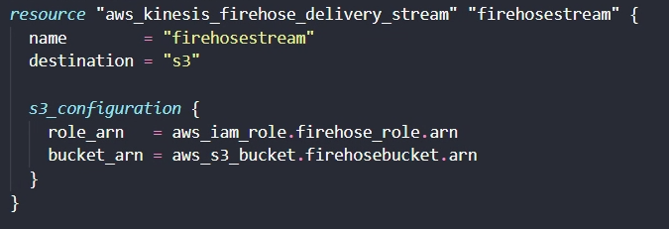

Slide 11

Airflow
3
Upload data from the S3 Localstack to the real S3

Slide 12
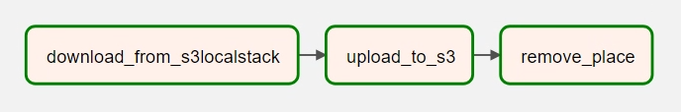
Airflow
‘Schedule_interval’: 30m
Get key list - download to local in json format.
Delete-object by bucket and key.
From source_place in local, upload file to real S3 bucket
Remove in local

Slide 13

Get data from S3 and import to SnowFlake
4

Slide 14
Get data from s3 to SnowFlake
Create external stage
s3://snowflakehanhbao/json/
Point to folder in a specified bucket in S3
Create tables
Air_polution_landing
Air_polution
Snowpipe
Update the SQS of pipe in S3 bucket Create Event notifications

Slide 15
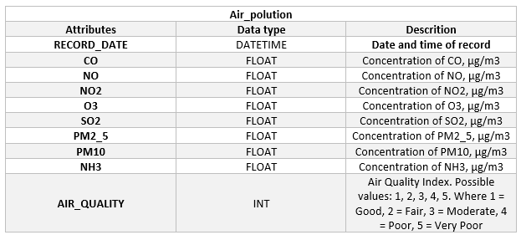

Slide 16
2. Snowflake workflow
1. Snowpipe check
2. Data from S3 bucket to Air_polution_landing
3. Stream on
Air_polution_landing
4. Stream_to_main_table
5. Truncate_table
6. Src_file_remove

Slide 17

Snowflake to Pyspark Dataframe
5

Slide 18
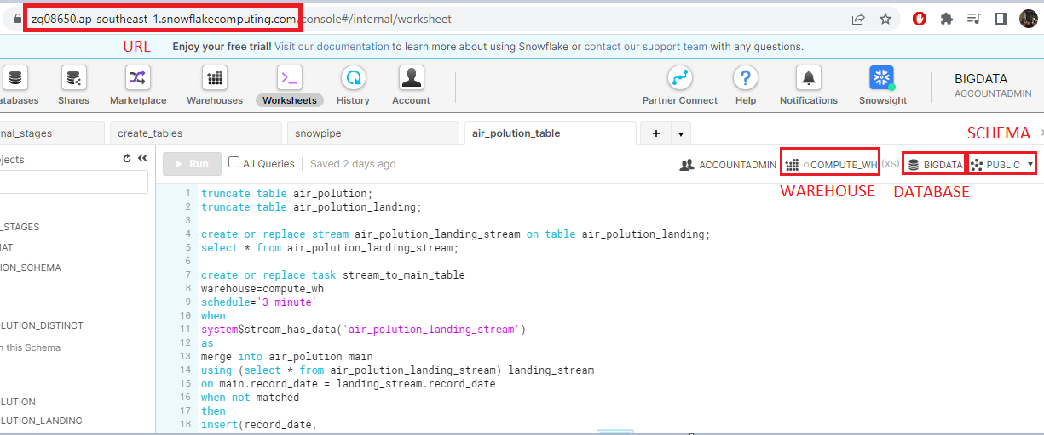
Snowflake to Pyspark Dataframe

Slide 19
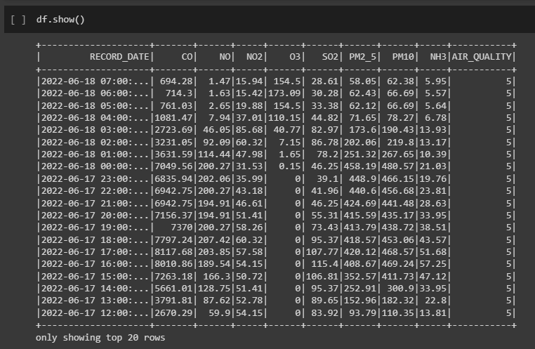
Snowflake to Pyspark Dataframe

Slide 20
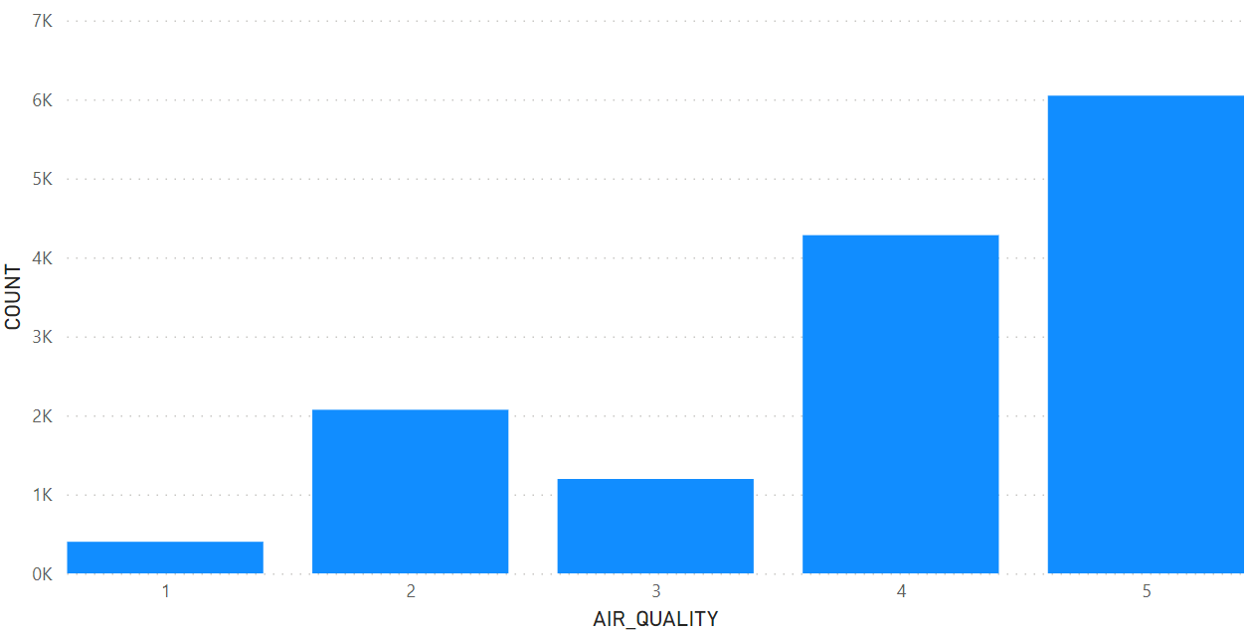
Visualize
Distribution of labels on the dataset

Slide 21
MODEL
ARIMA
II
LSTM

Slide 22
1
Autoregressive Integrated Moving Average (ARIMA)

Slide 23
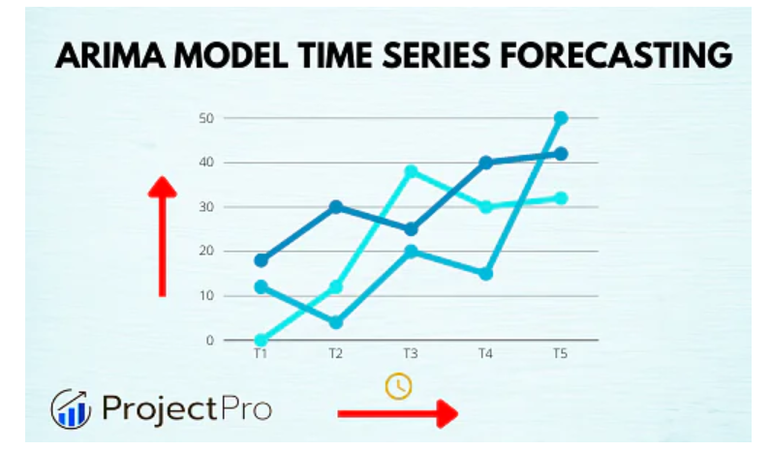
ARIMA is a statistical analysis model that used “time series data” to either better understand the dataset or to predict future trends.

Slide 24
Three components construct an ARIMA model:
Autogression (AR)
Integrated (I)
Moving Average (MA)

Slide 25
2
Long Short-Term Memory (LSTM)

Slide 26
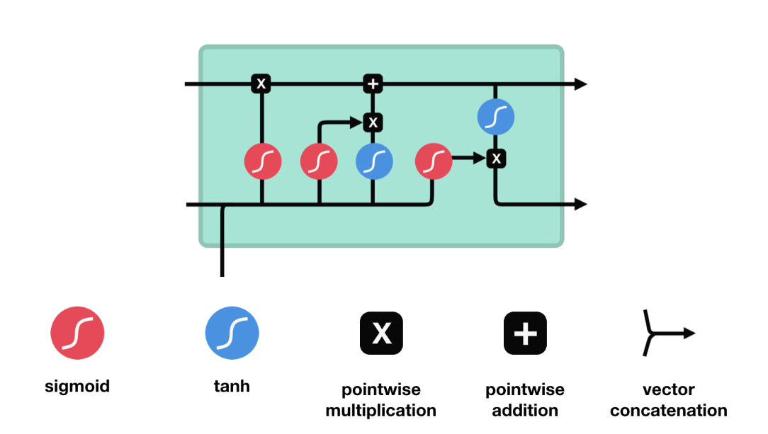
It is special kind of recurrent neural network that is capable of learning long-term dependencies in data and is becoming more and more popular nowadays.

Slide 27
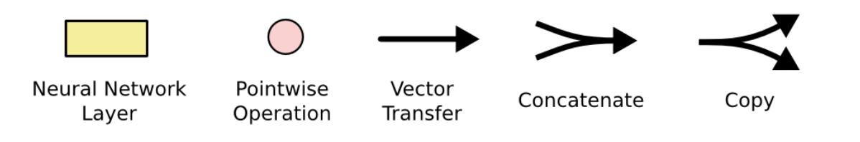
Some Notation

Slide 28
RESULT
III

Slide 29
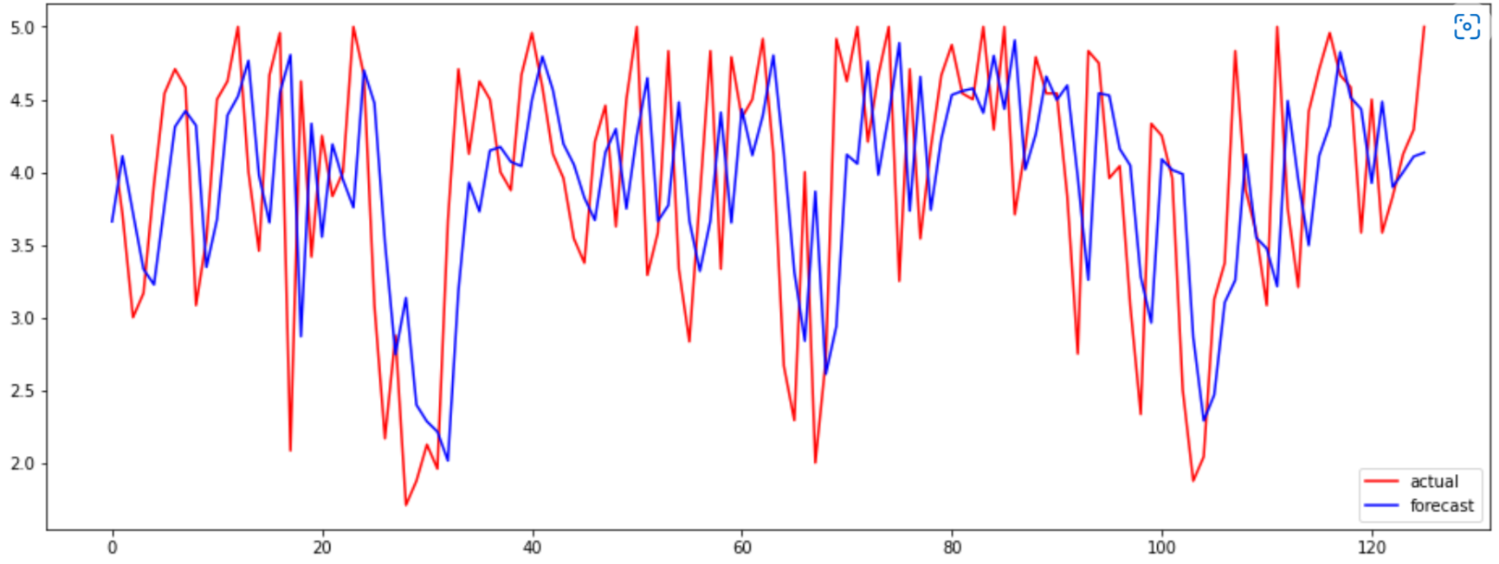
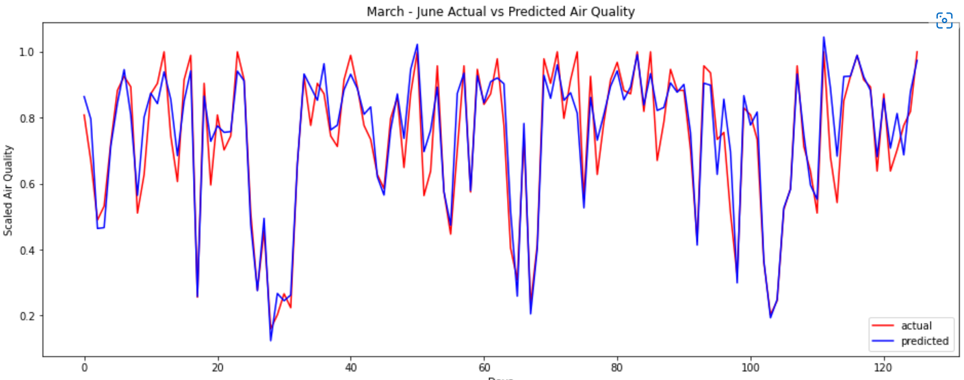
Result
Actual and predict Air Quality
ARIMA model
LSTM model
Notes:
Lam ro:
Du lieu train gom cac cot nao, lay trong bao nhieu thang/ngay
Dau vao cua mo hinh da train xong gom thong tin nao, khoang du lieu lich su gan neu co
Them bien neu co the (cuoi tuan, thoi tiet)
- So sanh:
- Do chinh xac khi du doan cac moc tuong lai khac nhau (du bao tuong lai 1 ngay, 3 ngay, 1 tuan, 2 tuan)
- Do chinh xac khi thay doi do dai dau vao (lich su gan 1 tuan, 2 tuan, 1 thang)

Slide 30
VISUALIZE
IV
USING POWER BI

Slide 31
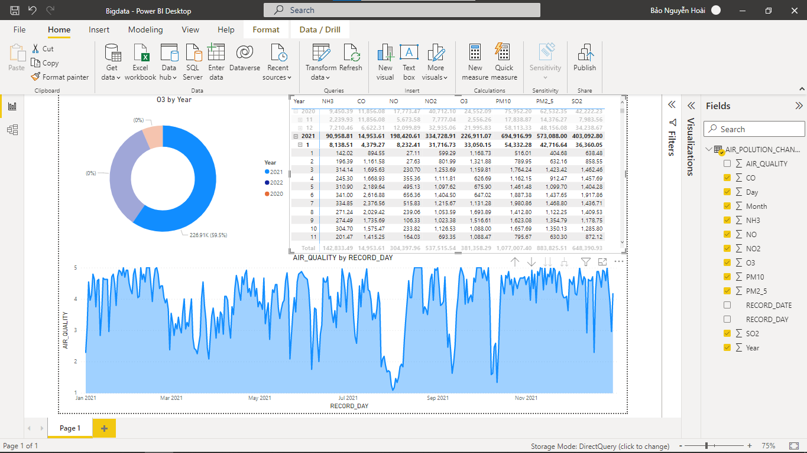
Visualize

Slide 32
Conclusion
IV

Slide 33
Conclusion
Presented a pipe-line collecting real-time data and visualise it
2 deep learning models applied achieves high performance
Future:
Experiment on other models

Slide 34
THANK YOU!

