Slide 1
Up to JAVA 11 – Features
Notes:
https://www.oracle.com/java/technologies/javase/jdk-11-relnote.html

Slide 2
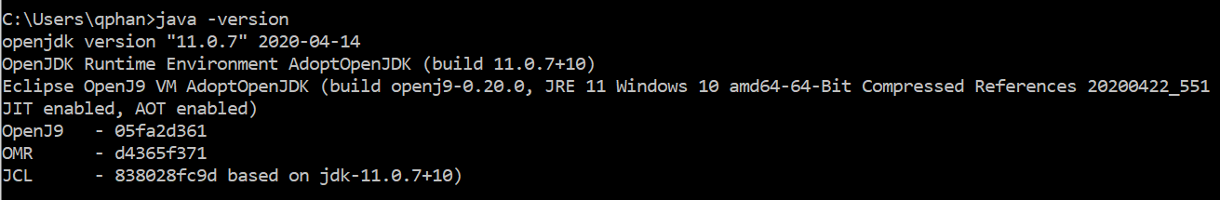
Setup
Command
Setup
JDK: 11
JVM:
+ Hotspot: standard
+ OpenJ9: better, but less stable
OpenJ9 is a JVM implementation from the default Oracle Hotspot JVM
Notes:
Download: https://adoptopenjdk.net/

Slide 3
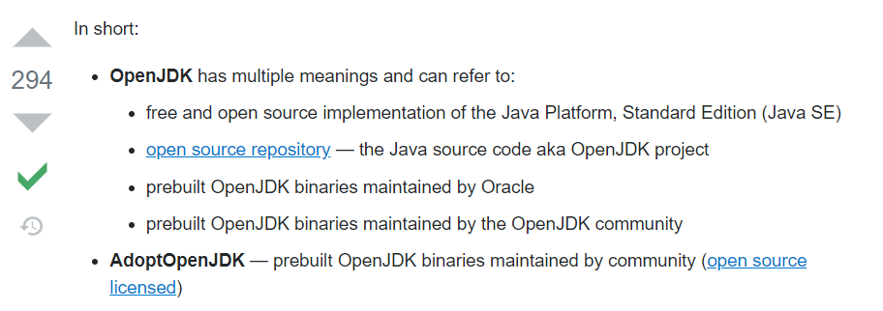
Setup
OpenJDK, AdoptOpenJDK, Oracle JDK
Notes:
Reference:
https://stackoverflow.com/questions/52431764/difference-between-openjdk-and-adoptium-adoptopenjdk

Slide 4
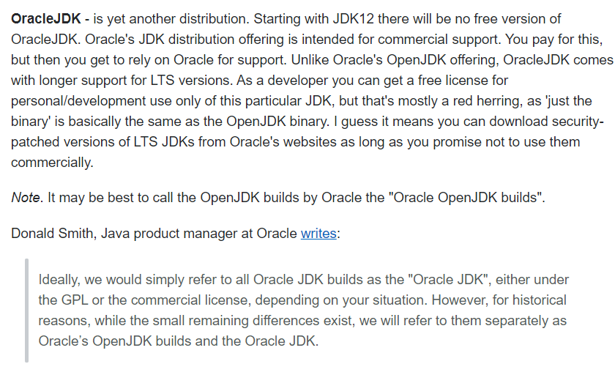
Setup
Oracle JDK, OpenJDK, AdoptOpenJDK
Notes:
Reference:
https://stackoverflow.com/questions/52431764/difference-between-openjdk-and-adoptium-adoptopenjdk ***
https://www.oracle.com/java/technologies/javase-downloads.html
GNU: General public license
https://openjdk.java.net/legal/gplv2+ce.html?xd_co_f=2bd4f1bae425f035fa21577511753180

Slide 5
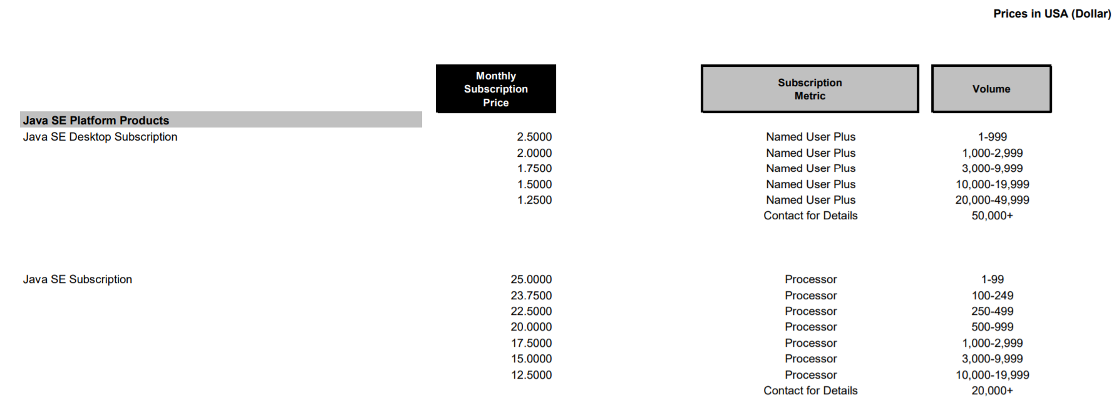
Setup
Price list for Oracle JDK
Notes:
Reference:
https://stackoverflow.com/questions/52431764/difference-between-openjdk-and-adoptium-adoptopenjdk
https://www.oracle.com/java/technologies/javase-downloads.html
https://www.techrepublic.com/article/can-you-still-use-the-java-programming-language-for-free-what-you-need-to-know/#:~:text=No%2C%20not%20unless%20you%20want,under%20a%20paid%2Dfor%20license.
http://www.oracle.com/us/corporate/pricing/price-lists/java-se-subscription-pricelist-5028356.pdf
GNU: General public license
https://openjdk.java.net/legal/gplv2+ce.html?xd_co_f=2bd4f1bae425f035fa21577511753180

Slide 6
JAVA09 - Features
1. New JIT compiler - GraalVM (build on JAVA, combine C1 and C2 with JAVA code)
source => bytecode: C1 => client compiler (JAVA)
bytecode => machine code: C2 => server compiler (runtime - C++) JIT
https://chrisseaton.com/truffleruby/jokerconf17/
https://www.baeldung.com/graal-java-jit-compiler
Notes:
JAVA09: https://www.pluralsight.com/blog/software-development/java-9-new-features
: https://www.baeldung.com/graal-java-jit-compiler (C1 vs C2)
1. module jar
+ config in module info.java
+ extext projects with many modules
+ bakeoff: core, portlets
. bo-core is dependency on bo-porlets
.
module bo-porlets{
exports com.mgmtp.lidl.bakeoff.portlets;
requires bo-core;
}
2. JShell command
Help: https://www.javatpoint.com/java-shell-tool#:~:text=To%20start%20Jshell%2C%20first%20we,welcome%20message%20to%20the%20console.
3. Collection factory methods
+ Lists, Maps ...
+ Google common
4. Interface support private methods
5. HTTP/2
A new way of performing HTTP calls arrives with Java 9
Support websocket
6. New JIT compiler - GraalVM (build on JAVA, combile C1 and C2 with JAVA code)
source => bytecode: C1 => client compiler (JAVA)
bytecode => machine code: C2 => server compiler (runtime - C++)
https://www.baeldung.com/graal-java-jit-compiler

Slide 7
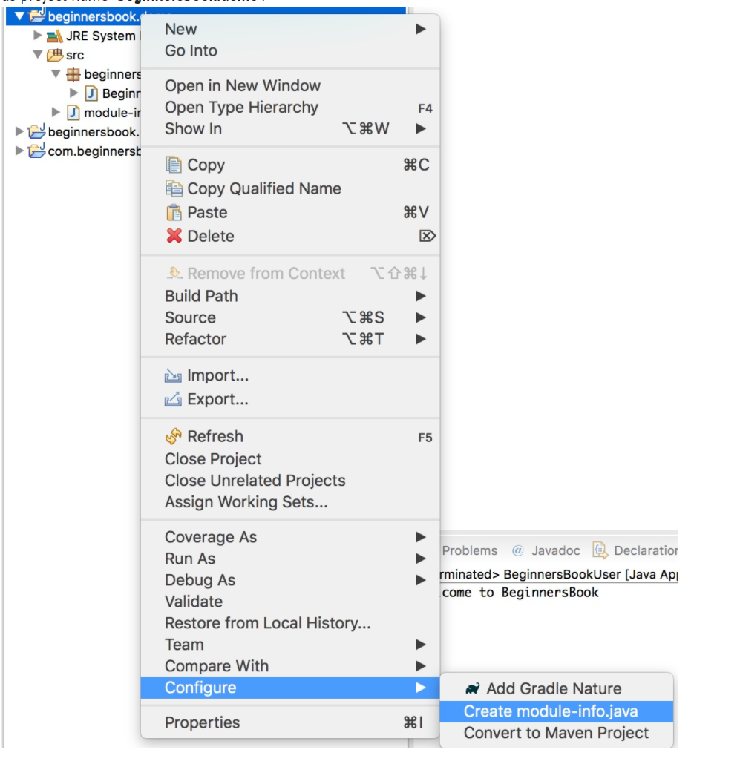
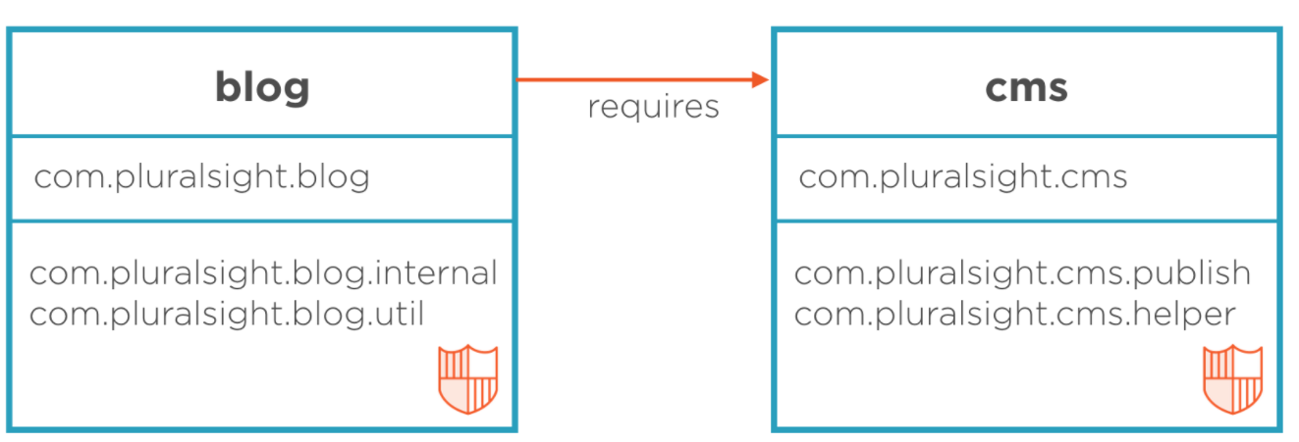
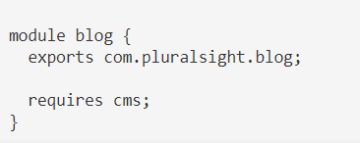
JAVA09 - Features
2. The Java Platform module system
Configure in module info.java
bakeoff: core, portlets
module bo-portlets {
exports com.mgmtp.lidl.bakeoff.portlets;
requires bo-core;
}
Notes:
JAVA09: https://www.pluralsight.com/blog/software-development/java-9-new-features
: https://www.baeldung.com/graal-java-jit-compiler (C1 vs C2)
1. module jar
+ config in module info.java
+ extext projects with many modules
+ bakeoff: core, portlets
. bo-core is dependency on bo-porlets
.
module bo-porlets{
exports com.mgmtp.lidl.bakeoff.portlets;
requires bo-core;
}
2. JShell command
Help: https://www.javatpoint.com/java-shell-tool#:~:text=To%20start%20Jshell%2C%20first%20we,welcome%20message%20to%20the%20console.
3. Collection factory methods
+ Lists, Maps ...
+ Google common
4. Interface support private methods
5. HTTP/2
A new way of performing HTTP calls arrives with Java 9
Support websocket
6. New JIT compiler - GraalVM (build on JAVA, combile C1 and C2 with JAVA code)
source => bytecode: C1 => client compiler (JAVA)
bytecode => machine code: C2 => server compiler (runtime - C++)
https://www.baeldung.com/graal-java-jit-compiler

Slide 8
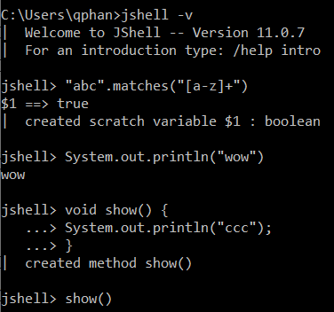
JAVA09 - Features
3. JShell command
Command: jshell -v
Notes:
JAVA09: https://www.pluralsight.com/blog/software-development/java-9-new-features
: https://www.baeldung.com/graal-java-jit-compiler (C1 vs C2)
1. module jar
+ config in module info.java
+ extext projects with many modules
+ bakeoff: core, portlets
. bo-core is dependency on bo-porlets
.
module bo-porlets{
exports com.mgmtp.lidl.bakeoff.portlets;
requires bo-core;
}
2. JShell command
Help: https://www.javatpoint.com/java-shell-tool#:~:text=To%20start%20Jshell%2C%20first%20we,welcome%20message%20to%20the%20console.
3. Collection factory methods
+ Lists, Maps ...
+ Google common
4. Interface support private methods
5. HTTP/2
A new way of performing HTTP calls arrives with Java 9
Support websocket
6. New JIT compiler - GraalVM (build on JAVA, combile C1 and C2 with JAVA code)
source => bytecode: C1 => client compiler (JAVA)
bytecode => machine code: C2 => server compiler (runtime - C++)
https://www.baeldung.com/graal-java-jit-compiler

Slide 9
JAVA09 - Features
4. Collection factory methods
+ Lists, Maps
+ From google common
5. Interface support private method
6. HTTP/2
A new way of performing HTTP calls arrives with Java 9
Support websocket
Notes:
JAVA09: https://www.pluralsight.com/blog/software-development/java-9-new-features
: https://www.baeldung.com/graal-java-jit-compiler (C1 vs C2)
1. module jar
+ config in module info.java
+ extext projects with many modules
+ bakeoff: core, portlets
. bo-core is dependency on bo-porlets
.
module bo-porlets{
exports com.mgmtp.lidl.bakeoff.portlets;
requires bo-core;
}
2. JShell command
Help: https://www.javatpoint.com/java-shell-tool#:~:text=To%20start%20Jshell%2C%20first%20we,welcome%20message%20to%20the%20console.
3. Collection factory methods
+ Lists, Maps ...
+ Google common
4. Interface support private methods
5. HTTP/2
A new way of performing HTTP calls arrives with Java 9
Support websocket
6. New JIT compiler - GraalVM (build on JAVA, combile C1 and C2 with JAVA code)
source => bytecode: C1 => client compiler (JAVA)
bytecode => machine code: C2 => server compiler (runtime - C++)
https://www.baeldung.com/graal-java-jit-compiler

Slide 10

JAVA10 - Features
1. Local-Variable Type Inference "var"
+ Use for Local-Variable
+ Still statically typed language, not dynamically typed language
https://www.journaldev.com/19871/java-10-local-variable-type-inference
https://openjdk.java.net/projects/amber/LVTIFAQ.html#:~:text=var%20can%20be%20used%20in,static%20type%20of%20the%20variable.
Notes:
JAVA10: https://www.journaldev.com/20395/java-10-features
1. Local-Variable Type Inference "var"
+ Use for Local-Variable
+ Still statically typed language, not dynamically typed language
+ https://www.journaldev.com/19871/java-10-local-variable-type-inference
+ https://openjdk.java.net/projects/amber/LVTIFAQ.html#:~:text=var%20can%20be%20used%20in,static%20type%20of%20the%20variable.
2. API Changes
Java 10 has added and removed (Yes It’s not a Typo) API’s.
Java 9 introduced enhanced deprecation where certain API’s were marked to be removed in future releases.
+ General: Get from google common

Slide 11
JAVA10 - Features
2. API Changes
Java 10 has added and removed (Yes It’s not a Typo) API’s.
Java 9 introduced enhanced deprecation where certain API’s were marked to be removed in future releases.
+ From google common
Notes:
JAVA10: https://www.journaldev.com/20395/java-10-features
1. Local-Variable Type Inference "var"
+ Use for Local-Variable
+ Still statically typed language, not dynamically typed language
+ https://www.journaldev.com/19871/java-10-local-variable-type-inference
+ https://openjdk.java.net/projects/amber/LVTIFAQ.html#:~:text=var%20can%20be%20used%20in,static%20type%20of%20the%20variable.
2. API Changes
Java 10 has added and removed (Yes It’s not a Typo) API’s.
Java 9 introduced enhanced deprecation where certain API’s were marked to be removed in future releases.
+ General: Get from google common

Slide 12
JAVA11 - Features
1. Running Java File with single command
javac filename.java
java filename
javac filename
+ From google common
Notes:
JAVA11: https://www.journaldev.com/24601/java-11-features#1-why-is-java-11-important
: http://cr.openjdk.java.net/~iris/se/11/latestSpec/java-se-11-jls-draft-diffs.pdf?xd_co_f=2bd4f1bae425f035fa21577511753180
1. Running Java File with single command
javac filename.java
java filename
javac filename
2. Strings API
.isBlank
.lines => "JD\nJD\nJD".lines().collect(Collectors.toList())
.strip(), stripLeading(), stripTrailing()
. repeat(int)
3. Local-Variable Syntax for Lambda Parameters
(@Nullable var s1, var s2) -> s1 + s2
removed in java 10
added in java 11

Slide 13
JAVA11 - Features
2. Strings API
.isBlank
.lines => "JD\nJD\nJD".lines().collect(Collectors.toList())
.strip(), stripLeading(), stripTrailing()
.repeat(int)
3. Local-Variable Syntax for Lambda Parameters
removed in java 10
added in java 11
(@Nullable var s1, var s2) -> s1 + s2
Notes:
JAVA11: https://www.journaldev.com/24601/java-11-features#1-why-is-java-11-important
: http://cr.openjdk.java.net/~iris/se/11/latestSpec/java-se-11-jls-draft-diffs.pdf?xd_co_f=2bd4f1bae425f035fa21577511753180
1. Running Java File with single command
javac filename.java
java filename
javac filename
2. Strings API
.isBlank
.lines => "JD\nJD\nJD".lines().collect(Collectors.toList())
.strip(), stripLeading(), stripTrailing()
. repeat(int)
3. Local-Variable Syntax for Lambda Parameters
(@Nullable var s1, var s2) -> s1 + s2
removed in java 10
added in java 11

