Slide 1

LGE Internal Use Only
Overview Design Pattern
CONTENT
Intro to Design Patterns
Strategy Pattern
Observer Pattern
Decorator Pattern
Factory Pattern
LGEDV DANANG
2023.09

Slide 2
I. Intro to Design Pattern
1. Why do we need design patterns
Someone has already solved your problems.
To fix known problems, can be predicted issues
Speeds up the development process
Code readability
Easy to maintain, because many people familiar with them.

Slide 3
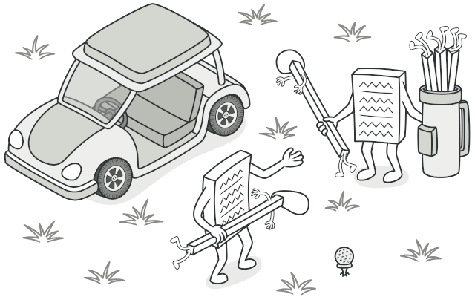
II. Strategy Pattern
1. Define
The Strategy Pattern defines a family of algorithms, encapsulates each one, and makes them interchangeable.
Strategy lets the algorithms vary independently form clients that use it.
Notes:
Người chơi golf có thể sử dụng bất kỳ chiếc gậy chơi golf nào.
Gậy chơi golf có thể được sử dụng bởi bất kỳ người chơi nào.

Slide 4
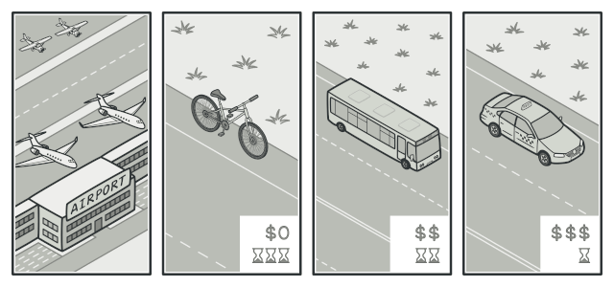
II. Strategy Pattern
2. Example: Transport strategy
Imagine that you have to get to the airport.
You can catch a bus, order a cab, or get on your bicycle.
These are your transportation strategies.
You can pick one of the strategies depending on factors such as budget or time constraints.

Slide 5
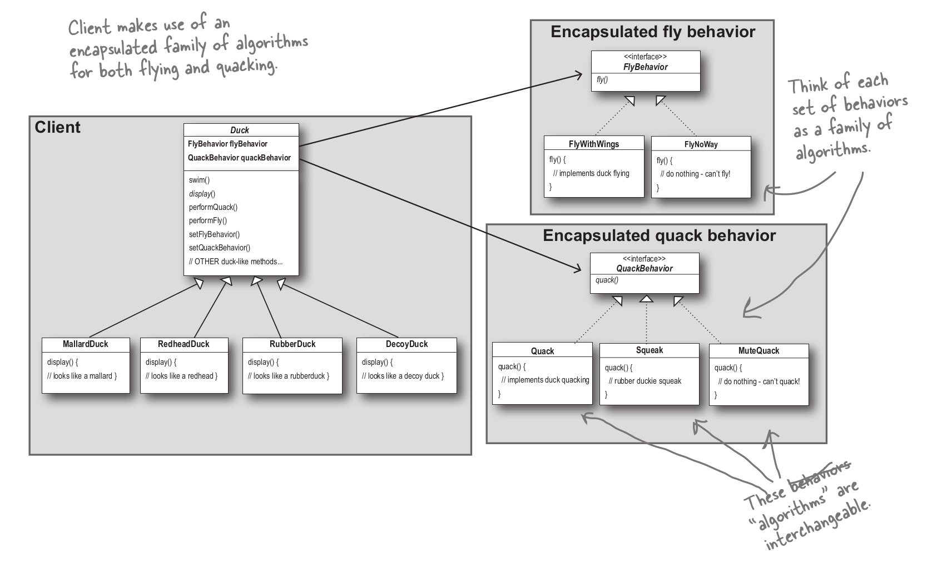
II. Strategy Pattern
3. Example: Simple SinUDuck app
Notes:
Rubber Duck cant not fly
Decoy Duck silence
Each Duck have to Behavior FlyBehavior and QuackBehavior

Slide 6
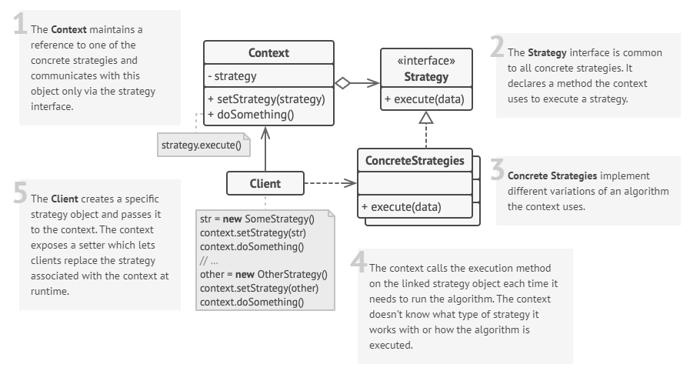
II. Strategy Pattern
4. Structure
Notes:
Rubber Duck cant not fly
Decoy Duck silence
Each Duck have to Behavior FlyBehavior and QuackBehavior

Slide 7
II. Strategy Pattern
5. Has-A vs Is-A
Has-A can be better than Is-A.
Design Principle: Favor composition over inheritance.
6. Explain source code for
Notes:
Rubber Duck cant not fly

Slide 8
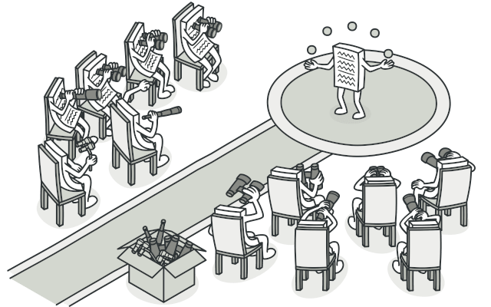
III. Observer Pattern
1. Define
The Observer Pattern defines a one-to-many dependency
Between objects so that when one object changes state,
All of its dependents are notified and updated automatically.
Notes:
Tất cả các phóng viên đang observer diễn viên(actor)

Slide 9
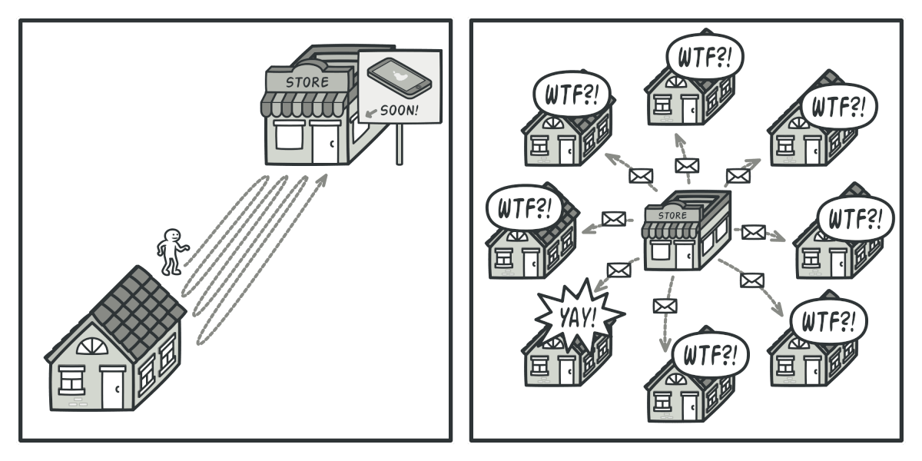
III. Observer Pattern
2.1 Example
.Imagine that you have two types of objects: a Customer and a Store. The customer is very interested in a particular brand of product (say, it’s a new model of the iPhone) which should become available in the store very soon.
Notes:
Tất cả các phóng viên đang observer diễn viên(actor)

Slide 10
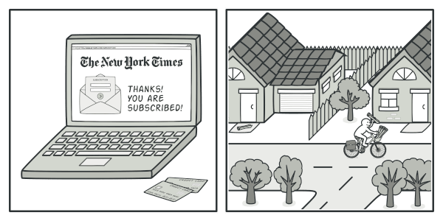
III. Observer Pattern
2.2 Real-world analog
.
Notes:
Tất cả các phóng viên đang observer diễn viên(actor)

Slide 11
III. Observer Pattern
2.2 Real-world analog
.
Notes:
Tất cả các phóng viên đang observer diễn viên(actor)

Slide 12
III. Observer Pattern
2.2 Real-world analog
.
Notes:
Tất cả các phóng viên đang observer diễn viên(actor)

Slide 13
I. Content 1
1. Article 1
Content
…..
Note:
Font : Only Arial Narrow
Language : Only English
Picture : Because of copyright issues, DO NOT attach unauthorized images

Slide 14
II. Content 2
1. Article 1
Content
…..

