Slide 1

LGE Internal Use Only
Overview Design Pattern
CONTENT
Intro to Design Patterns
Strategy Pattern
Observer Pattern
Decorator Pattern
Factory Pattern
LGEDV DANANG
2023.09

Slide 2
I. Intro to Design Pattern
1. Why do we need design patterns
Someone has already solved your problems.
To fix known problems, can be predicted issues
Speeds up the development process
Code readability
Easy to maintain, because many people familiar with them.

Slide 3

II. Strategy Pattern
1. Define
The Strategy Pattern defines a family of algorithms, encapsulates each one, and makes them interchangeable.
Strategy lets the algorithms vary independently form clients that use it.
Notes:
Người chơi golf có thể sử dụng bất kỳ chiếc gậy chơi golf nào.
Gậy chơi golf có thể được sử dụng bởi bất kỳ người chơi nào.

Slide 4
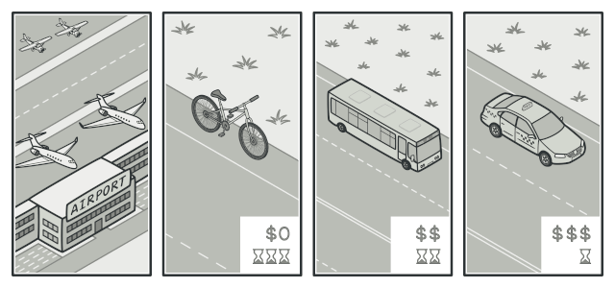
II. Strategy Pattern
2. Example: Transport strategy
Imagine that you have to get to the airport.
You can catch a bus, order a cab, or get on your bicycle.
These are your transportation strategies.
You can pick one of the strategies depending on factors such as budget or time constraints.

Slide 5
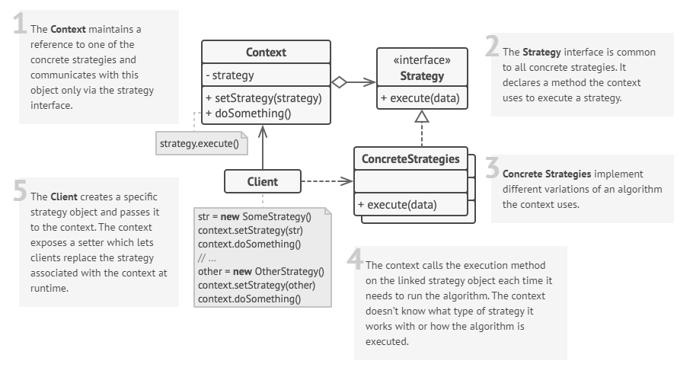
II. Strategy Pattern
3. Structure
Notes:
Rubber Duck cant not fly
Decoy Duck silence
Each Duck have to Behavior FlyBehavior and QuackBehavior

Slide 6
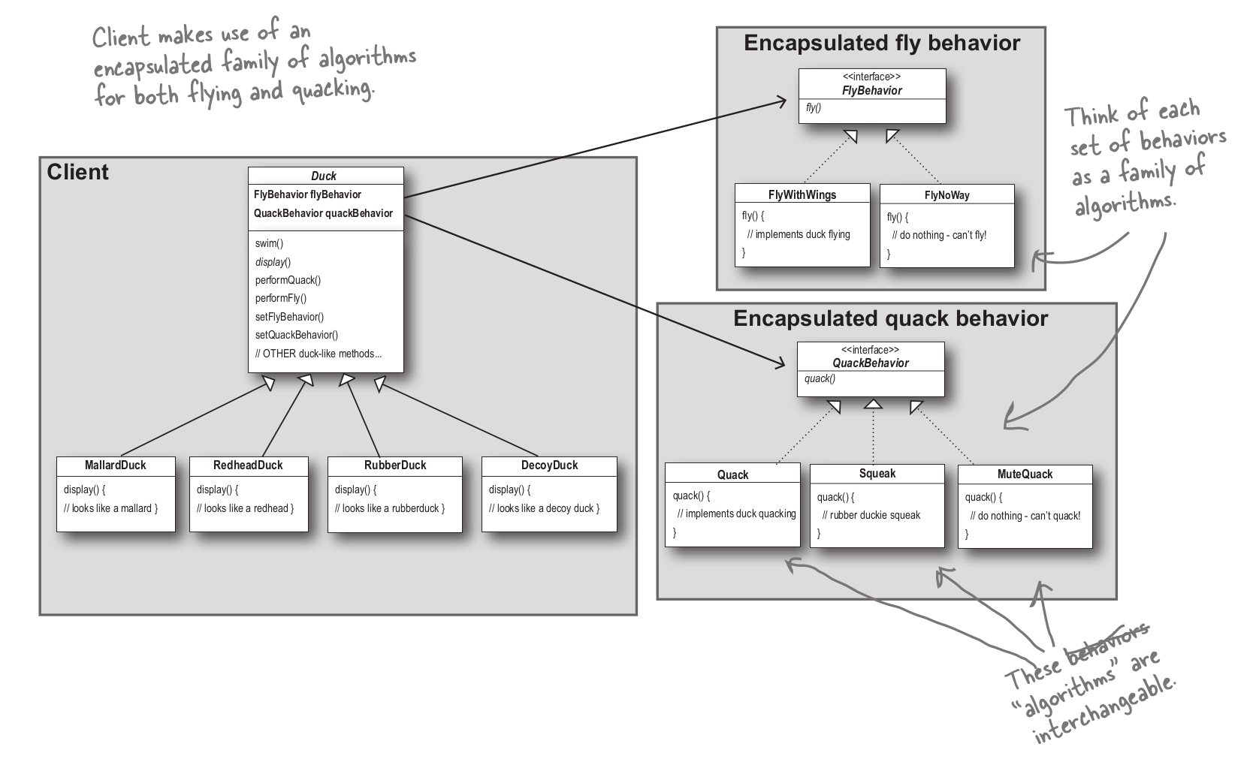
II. Strategy Pattern
4. Example: Simple SinUDuck app and demo
Notes:
Rubber Duck cant not fly
Decoy Duck silence
Each Duck have to Behavior FlyBehavior and QuackBehavior

Slide 7
II. Strategy Pattern
6. Applicability
Use the Strategy pattern when you want to use different variants of an algorithm within an object and be able to switch from one algorithm to another during runtime.
Use the Strategy when you have a lot of similar classes that only differ in the way they execute some behavior.
Use the pattern to isolate the business logic of a class from the implementation details of algorithms that may not be as important in the context of that logic.
Use the pattern when your class has a massive conditional statement that switches between different variants of the same algorithm.
Notes:
The Strategy pattern lets you indirectly alter the object’s behavior at runtime by associating it with different sub-objects which can perform specific sub-tasks in different ways.
The Strategy pattern lets you extract the varying behavior into a separate class hierarchy and combine the original classes into one, thereby reducing duplicate code.
The Strategy pattern lets you isolate the code, internal data, and dependencies of various algorithms from the rest of the code. Various clients get a simple interface to execute the algorithms and switch them at runtime.
The Strategy pattern lets you do away with such a conditional by extracting all algorithms into separate classes, all of which implement the same interface.
The original object delegates execution to one of these objects, instead of implementing all variants of the algorithm.

Slide 8
II. Strategy Pattern
7. Props and Cons
Props
You can swap algorithms used inside an object at runtime.
You can isolate the implementation details of an algorithm from the code that uses it.
You can replace inheritance with composition.
Open/Closed Principle. You can introduce new strategies without having to change the context. Cons:
If you only have a couple of algorithms and they rarely change
=> no real reason to overcomplicate the program
Clients must be aware of the differences between strategies to be able to select a proper one.
Notes:
The Strategy pattern lets you indirectly alter the object’s behavior at runtime by associating it with different sub-objects which can perform specific sub-tasks in different ways.
The Strategy pattern lets you extract the varying behavior into a separate class hierarchy and combine the original classes into one, thereby reducing duplicate code.
The Strategy pattern lets you isolate the code, internal data, and dependencies of various algorithms from the rest of the code. Various clients get a simple interface to execute the algorithms and switch them at runtime.
The Strategy pattern lets you do away with such a conditional by extracting all algorithms into separate classes, all of which implement the same interface.
The original object delegates execution to one of these objects, instead of implementing all variants of the algorithm.

Slide 9
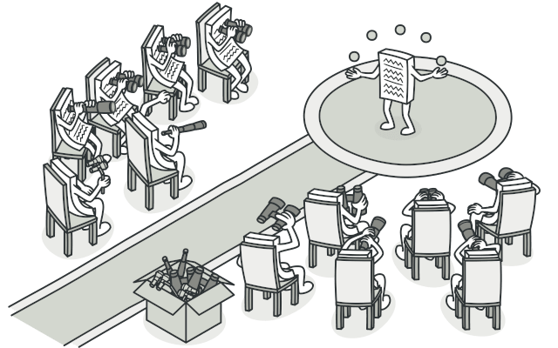
III. Observer Pattern
1. Define
The Observer Pattern defines a one-to-many dependency
Between objects so that when one object changes state,
All of its dependents are notified and updated automatically.
Notes:
Tất cả các phóng viên đang observer diễn viên(actor)

Slide 10
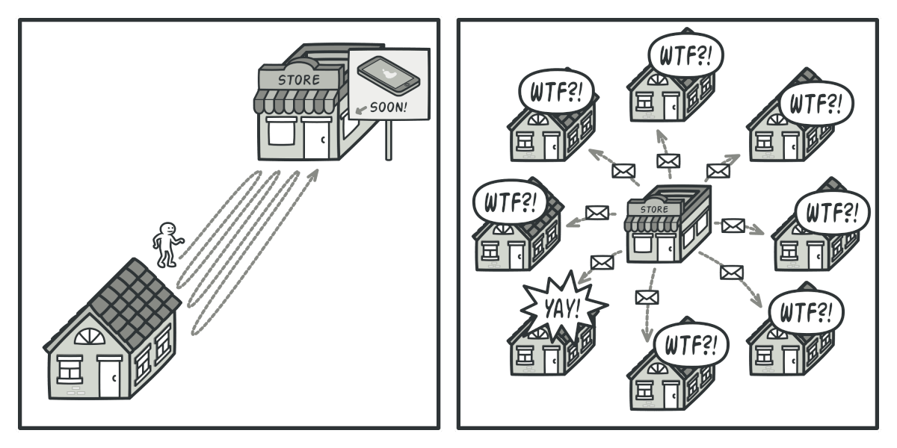
III. Observer Pattern
2 Example
Imagine that you have two types of objects: a Customer and a Store. The customer is very interested in a particular brand of product (say, it’s a new model of the iPhone) which should become available in the store very soon.
Notes:
Tất cả các phóng viên đang observer diễn viên(actor)

Slide 11

III. Observer Pattern
3. Real-world analog
Notes:
Tất cả các phóng viên đang observer diễn viên(actor)

Slide 12
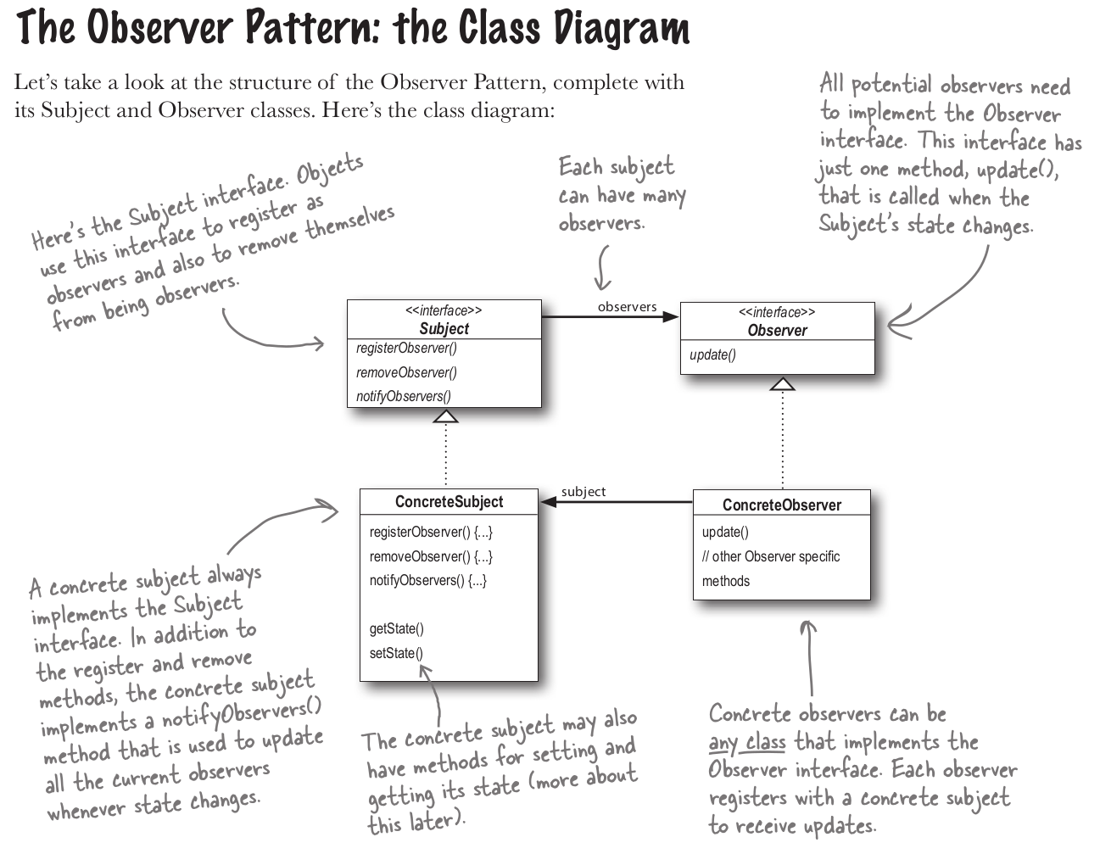
III. Observer Pattern
4. Structure
Notes:
Tất cả các phóng viên đang observer diễn viên(actor)

Slide 13
III. Observer Pattern
5. Some examples of Observer Pattern
Coding demo:
Simple
Simple Observable
Swing
Weather
Weather Observable
Notes:
Tất cả các phóng viên đang observer diễn viên(actor)

Slide 14
III. Observer Pattern
6. Applicability
Use the Observer pattern when changes to the state of one object may require changing other objects, and the actual set of objects is unknown beforehand or changes dynamically.
Use the pattern when some objects in your app must observe others, but only for a limited time or in specific cases.
Notes:
You can often experience this problem when working with classes of the graphical user interface.
For example, you created custom button classes, and you want to let the clients hook some custom code to your buttons so that it fires whenever a user presses a button.
The Observer pattern lets any object that implements the subscriber interface subscribe for event notifications in publisher objects. You can add the subscription mechanism to your buttons, letting the clients hook up their custom code via custom subscriber classes.
The subscription list is dynamic, so subscribers can join or leave the list whenever they need to.

Slide 15
III. Observer Pattern
7. Props and Cons
Props
Open/Closed Principle. You can introduce new subscriber classes without having to change the publisher’s code.
You can establish relations between objects at runtime.. Cons:
Subscribers are notified in random order.
Notes:
Tất cả các phóng viên đang observer diễn viên(actor)

Slide 16
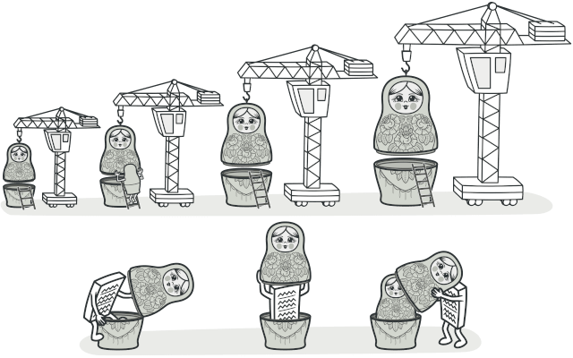
IV. Decorator Pattern
1. Define
The Observer Pattern attaches additional responsibilities to an object dynamically. Decorators provide a flexible alternative to subclassing for extending functionality.
Notes:
Tất cả các phóng viên đang observer diễn viên(actor)

Slide 17
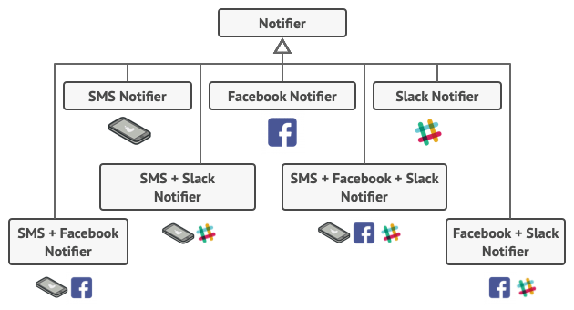
IV. Decorator Pattern
2. Example
Imagine that you’re working on a notification library which lets other programs notify their users about important events.
Notes:
You tried to address that problem by creating special subclasses which combined several notification methods within one class.
However, it quickly became apparent that this approach would bloat the code immensely, not only the library code but the client code as well. You have to find some other way to structure notifications classes so that their number won’t accidentally break some Guinness record.

Slide 18
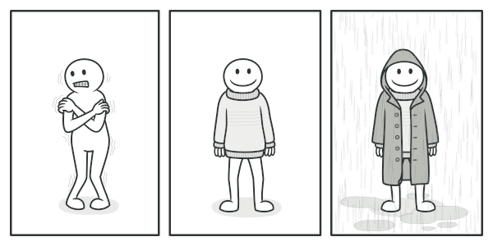
IV. Decorator Pattern
3. Real-world analog
You get a combined effect from wearing multiple pieces of clothing.

Slide 19
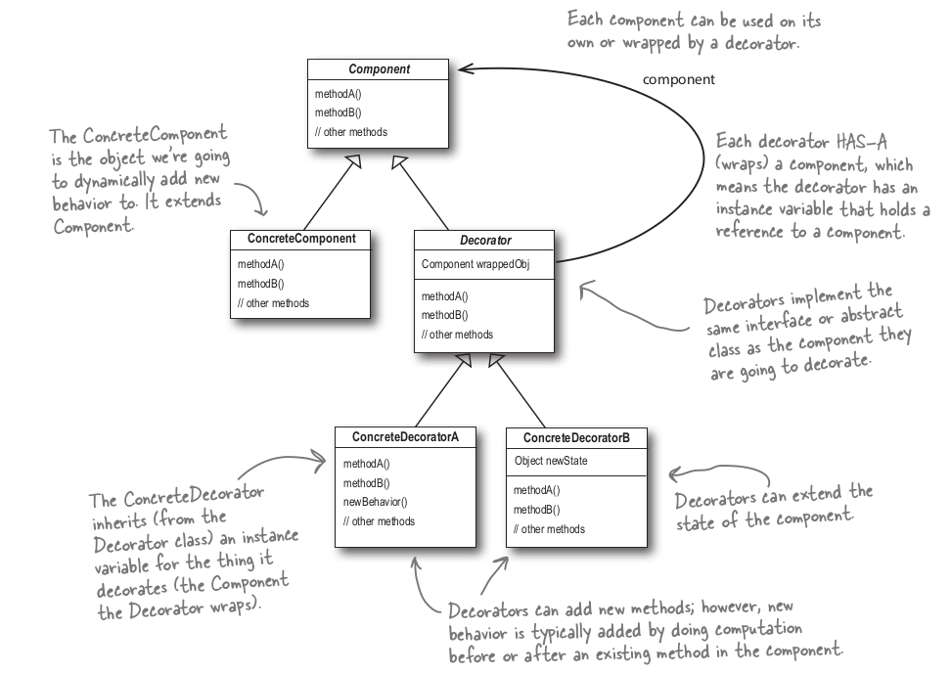
IV. Decorator Pattern
4. Structure
Notes:
You tried to address that problem by creating special subclasses which combined several notification methods within one class.
However, it quickly became apparent that this approach would bloat the code immensely, not only the library code but the client code as well. You have to find some other way to structure notifications classes so that their number won’t accidentally break some Guinness record.

Slide 20
IV. Decorator Pattern
5. Some examples of Decorator Pattern
Coding demo:
IO
Pizza
StarBuzz
StarBuzz With Sizes
Notes:
Tất cả các phóng viên đang observer diễn viên(actor)

Slide 21
IV. Decorator Pattern
6. Applicability
Use the Decorator pattern when you need to be able to assign extra behaviors to objects at runtime without breaking the code that uses these objects.
Use the pattern when it’s awkward or not possible to extend an object’s behavior using inheritance.
Notes:
The Decorator lets you structure your business logic into layers, create a decorator for each layer and compose objects with various combinations of this logic at runtime.
The client code can treat all these objects in the same way, since they all follow a common interface.
Many programming languages have the final keyword that can be used to prevent further extension of a class. For a final class, the only way to reuse the existing behavior would be to wrap the class with your own wrapper, using the Decorator pattern.

Slide 22
IV. Decorator Pattern
3. Real-world analog
You get a combined effect from wearing multiple pieces of clothing.
Notes:
You tried to address that problem by creating special subclasses which combined several notification methods within one class.
However, it quickly became apparent that this approach would bloat the code immensely, not only the library code but the client code as well. You have to find some other way to structure notifications classes so that their number won’t accidentally break some Guinness record.

Slide 23
I. Content 1
1. Article 1
Content
…..
Note:
Font : Only Arial Narrow
Language : Only English
Picture : Because of copyright issues, DO NOT attach unauthorized images

Slide 24
II. Content 2
1. Article 1
Content
…..

