Slide 1

LGE Internal Use Only
Overview Design Patterns
CONTENT
Intro to Design Patterns
Singleton Pattern
Strategy Pattern
Observer Pattern
Decorator Pattern
LGEDV DANANG
2023.09

Slide 2
I. Intro to Design Pattern
1. Why do we need design patterns
Someone has already solved your problems.
To fix known problems, can be predicted issues
Speeds up the development process
Code readability
Easy to maintain, because many people familiar with them.
2. The catalog of design patterns
The Catalog of Design Patterns
Notes:
Creational patterns These patterns provide various object creation mechanisms, which increase flexibility and reuse of existing code.
Cung cấp nhiều cơ chế tạo đối tượng, tăng tính linh hoạt và tái sử dụng code
Behavioral patterns
These patterns are concerned with algorithms and the assignment of responsibilities between objects. Kết nối với tập algorithms và phân công trách nhiệm giữa các đối tượng
Structural patterns
These patterns explain how to assemble objects and classes into larger structures while keeping these structures flexible and efficient. giải thích cách tập hợp các đối tượng và lớp thành các cấu trúc lớn hơn trong khi vẫn giữ cho các cấu trúc này linh hoạt và hiệu quả.

Slide 3
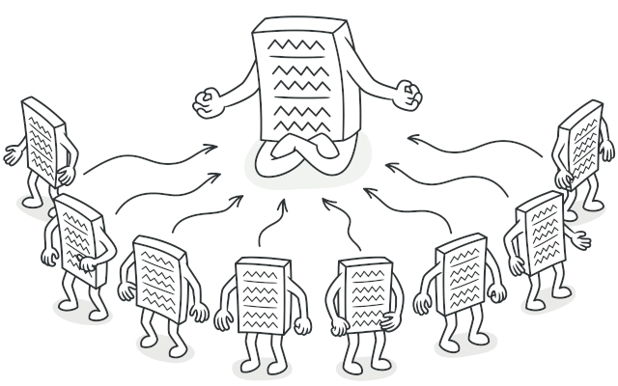
II. Singleton
1. Define
Singleton Pattern ensures a class has only one instance,
And provide global point of access to it.
Notes:
Singleton pattern thuộc loại: Creational patterns These patterns provide various object creation mechanisms, which increase flexibility and reuse of existing code.
Cung cấp nhiều cơ chế tạo đối tượng, tăng tính linh hoạt và tái sử dụng code

Slide 4
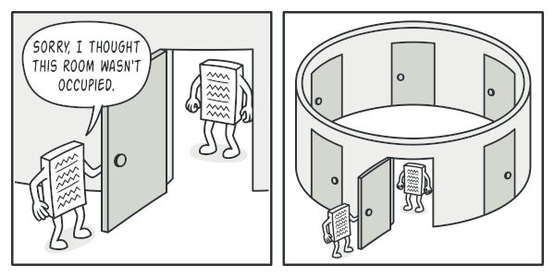
II. Singleton
2. Example
The most common reason for this is to control access to some shared resource—for example, a database or a file.

Slide 5
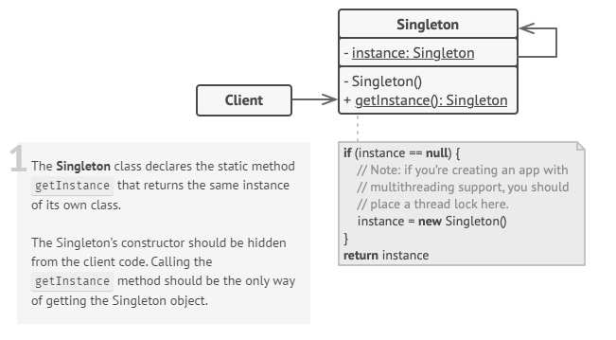
II. Singleton
3. Structure
Notes:
And provide global point of access to it. Singleton Pattern ensures a class has only one instance,

Slide 6
II. Singleton
4. Some examples for Singleton Pattern
Coding demo:
Static
Classic
Thread Safe
Double-Check Locking
Enum
Notes:
Static: init at run App, not efficient
Classis: Not Thread Safe
Double-Check Locking: Thread-safe, Refection issue Pops: - the field needs to be volatile to prevent cache incoherence issues. - Thread safe and efficient, we need to create the object in the first place and only in that case we would acquire the lock Cons: - since it requires the volatile keyword to work properly, it’s not compatible with Java 1.4 and lower versions - it’s quite verbose and it makes the code difficult to read
Enum: concise, easy to implement, resolved refection issue

Slide 7
II. Singleton
5. Applicability
Use the Singleton pattern when a class in your program should have just a single instance available to all clients;
for example, a single database object shared by different parts of the program.
Use the Singleton pattern when you need stricter control over global variables.
Notes:
Example to use singleton:
Resource Access
State Management
Logging mechanism
Configuration Management

Slide 8
II. Singleton
6. Props and Cons
Props
You can be sure that a class has only a single instance.
You gain a global access point to that instance.
The singleton object is initialized only when it’s requested for the first time. Cons:
Violates the Single Responsibility Principle. The pattern solves two problems at the time.
The Singleton pattern can mask bad design, for instance, when the components of the program know too much about each other. Global access may risk

Slide 9
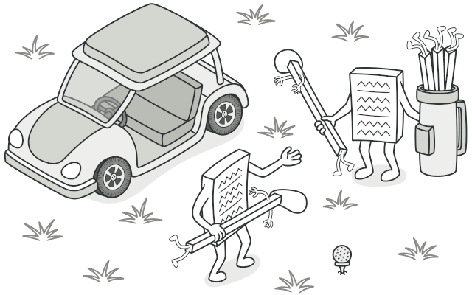
III. Strategy Pattern
1. Define
The Strategy Pattern defines a family of algorithms, encapsulates each one, and makes them interchangeable.
Strategy lets the algorithms vary independently form clients that use it.
Notes:
Strategy Pattern: Behavioral patterns
These patterns are concerned with algorithms and the assignment of responsibilities between objects. Kết nối với tập algorithms và phân công trách nhiệm giữa các đối tượng Người chơi golf thì có thể sử dụng bất kỳ chiếc gậy nào. Gậy chơi golf thì có thể được sử dụng bởi bất kỳ ai

Slide 10
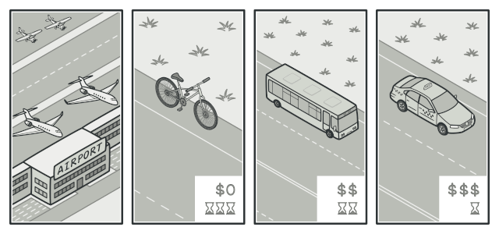
III. Strategy Pattern
2. Example: Transport strategy
Imagine that you have to get to the airport.
You can catch a bus, order a cab, or get on your bicycle.
These are your transportation strategies.
You can pick one of the strategies depending on factors such as budget or time constraints.
Notes:
Mong muốn: - Đi đến sân bay
- Điều kiện phù hợp: thời gian, chi phí

Slide 11
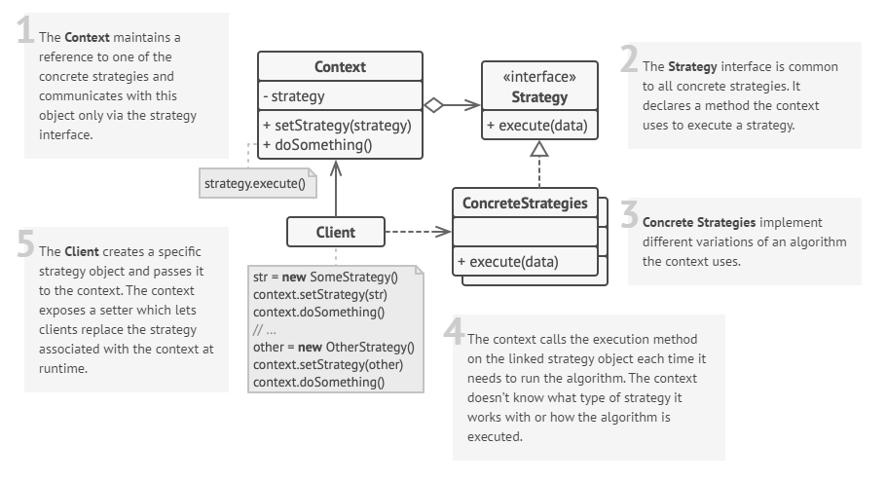
III. Strategy Pattern
3. Structure
Notes:
Rubber Duck cant not fly
Decoy Duck silence
Each Duck have to Behavior FlyBehavior and QuackBehavior

Slide 12
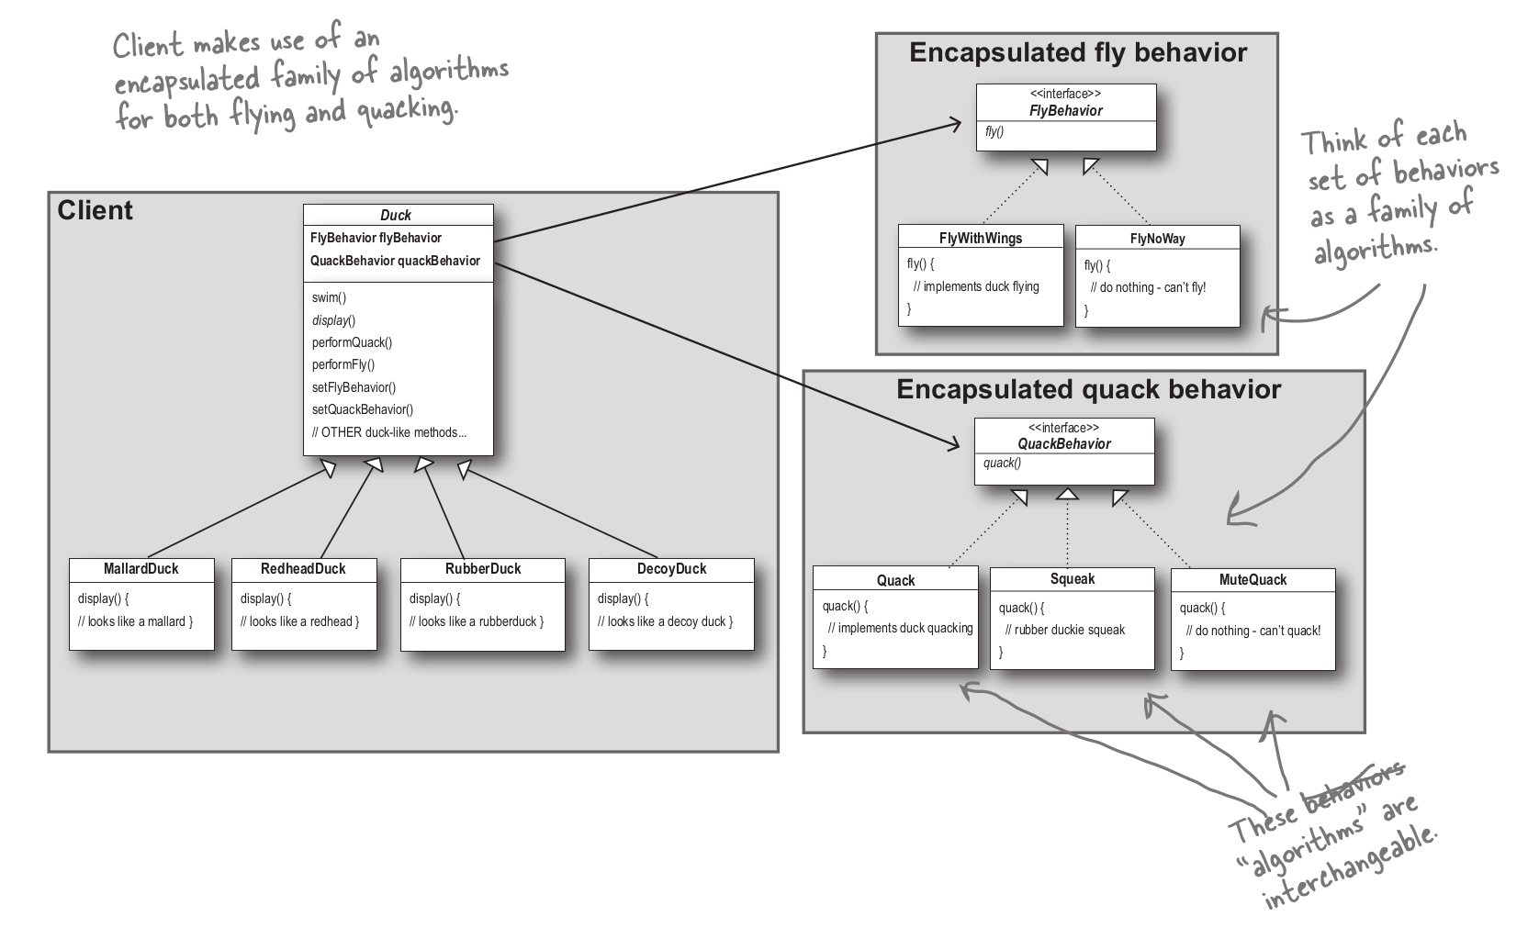
III. Strategy Pattern
4. Example: Simple SinUDuck app and demo
Notes:
Rubber Duck cant not fly
Decoy Duck silence
Each Duck have to Behavior FlyBehavior and QuackBehavior:
Thay đổi cách bay FlyWithWings cho toàn bộ con vịt

Slide 13
III. Strategy Pattern
5. Applicability
Use the Strategy pattern when you want to use different variants of an algorithm within an object and be able to switch from one algorithm to another during runtime.
Use the Strategy when you have a lot of similar classes that only differ in the way they execute some behavior.
Use the pattern to isolate the business logic of a class from the implementation details of algorithms that may not be as important in the context of that logic.
Use the pattern when your class has a massive conditional statement that switches between different variants of the same algorithm.
Notes:
Thay đổi cách implement trong runtime
Có nhiều class tương tự nhau, nhưng cách thự thi khác nhau
Logic trong algorithms có thể không quan trọng với logic chung.
The Strategy pattern lets you do away with such a conditional by extracting all algorithms into separate classes, all of which implement the same interface.
The original object delegates execution to one of these objects, instead of implementing all variants of the algorithm.

Slide 14
III. Strategy Pattern
6. Props and Cons
Props
You can swap algorithms used inside an object at runtime.
You can isolate the implementation details of an algorithm from the code that uses it.
You can replace inheritance with composition.
Open/Closed Principle. You can introduce new strategies without having to change the context. Cons:
If you only have a couple of algorithms and they rarely change
=> no real reason to overcomplicate the program
Clients must be aware of the differences between strategies to be able to select a proper one.
Notes:
The Strategy pattern lets you indirectly alter the object’s behavior at runtime by associating it with different sub-objects which can perform specific sub-tasks in different ways.
The Strategy pattern lets you extract the varying behavior into a separate class hierarchy and combine the original classes into one, thereby reducing duplicate code.
The Strategy pattern lets you isolate the code, internal data, and dependencies of various algorithms from the rest of the code. Various clients get a simple interface to execute the algorithms and switch them at runtime.
The Strategy pattern lets you do away with such a conditional by extracting all algorithms into separate classes, all of which implement the same interface.
The original object delegates execution to one of these objects, instead of implementing all variants of the algorithm.

Slide 15
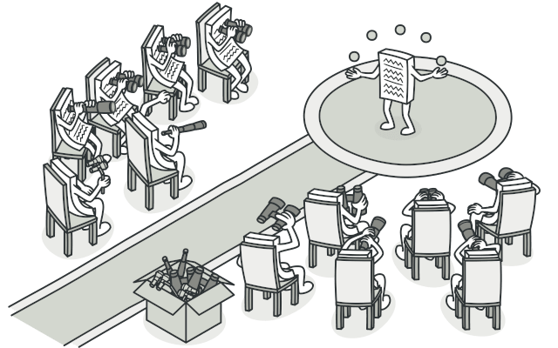
IV. Observer Pattern
1. Define
The Observer Pattern defines a one-to-many dependency
Between objects so that when one object changes state,
All of its dependents are notified and updated automatically.
Notes:
Observer Pattern: Behavioral patterns
These patterns are concerned with algorithms and the assignment of responsibilities between objects. Kết nối với tập algorithms và phân công trách nhiệm giữa các đối tượng

Slide 16
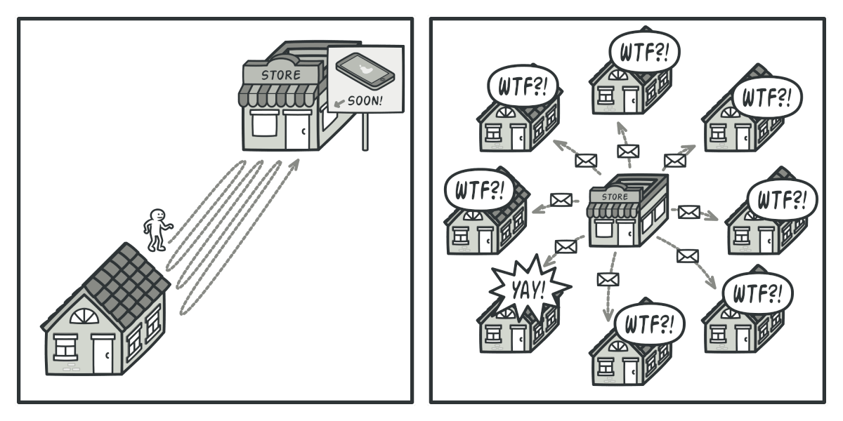
IV. Observer Pattern
2 Example
Imagine that you have two types of objects: a Customer and a Store. The customer is very interested in a particular brand of product (say, it’s a new model of the iPhone) which should become available in the store very soon.
Notes:
Ví dụ Tèo Iphone 15 ra mắt
Người dân(ifan) đi kiểm tra hang mới đã về tại của hàng
Của hàng gửi tất cả thông báo đến toàn bộ nhà dân

Slide 17

IV. Observer Pattern
3. Real-world analog
Notes:
Email, subcribe youtube
Giao báo hàng ngày

Slide 18
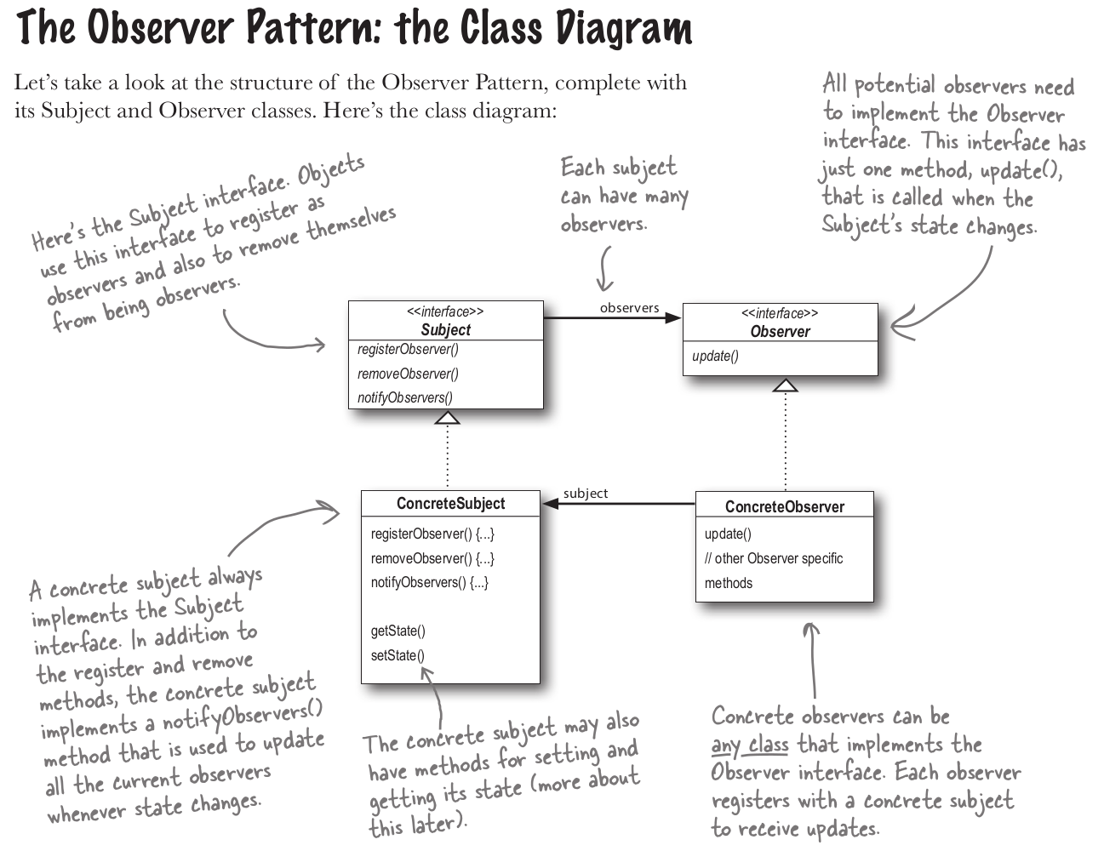
IV. Observer Pattern
4. Structure
Notes:
Subject: interface
Observer: to observe the Subject
ConcreteObserver
ConcreteSubject

Slide 19
IV. Observer Pattern
5. Some examples of Observer Pattern
Coding demo:
Simple
Simple Observable
Swing
Weather
Weather Observable

Slide 20
IV. Observer Pattern
6. Applicability
Use the Observer pattern when changes to the state of one object may require changing other objects, and the actual set of objects is unknown beforehand or changes dynamically.
Use the pattern when some objects in your app must observe others, but only for a limited time or in specific cases.
Notes:
You can often experience this problem when working with classes of the graphical user interface.
For example, you created custom button classes, and you want to let the clients hook some custom code to your buttons so that it fires whenever a user presses a button.
The Observer pattern lets any object that implements the subscriber interface subscribe for event notifications in publisher objects. You can add the subscription mechanism to your buttons, letting the clients hook up their custom code via custom subscriber classes.
The subscription list is dynamic, so subscribers can join or leave the list whenever they need to.

Slide 21
IV. Observer Pattern
7. Props and Cons
Props
Open/Closed Principle. You can introduce new subscriber classes without having to change the publisher’s code.
You can establish relations between objects at runtime.. Cons:
Subscribers are notified in random order.

Slide 22
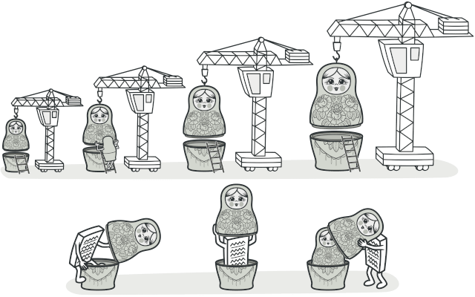
V. Decorator Pattern
1. Define
The Observer Pattern attaches additional responsibilities to an object dynamically. Decorators provide a flexible alternative to subclassing for extending functionality.
Notes:
Decorator Pattern: Structural patterns
These patterns explain how to assemble objects and classes into larger structures while keeping these structures flexible and efficient. giải thích cách tập hợp các đối tượng và lớp thành các cấu trúc lớn hơn trong khi vẫn giữ cho các cấu trúc này linh hoạt và hiệu quả.

Slide 23
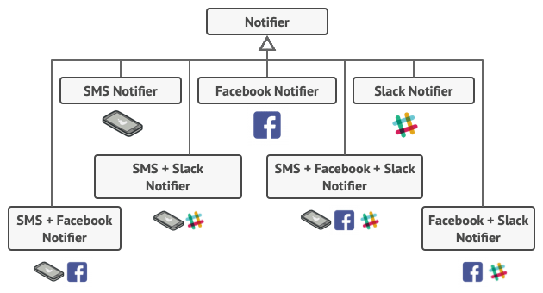
V. Decorator Pattern
2. Example
Imagine that you’re working on a notification library which lets other programs notify their users about important events.
Notes:
You tried to address that problem by creating special subclasses which combined several notification methods within one class.
Sử dụng kế thừa để tạo class con
However, it quickly became apparent that this approach would bloat the code immensely, not only the library code but the client code as well.
Quá nhiều loại class con được You have to find some other way to structure notifications classes so that their number won’t accidentally break some Guinness record.

Slide 24
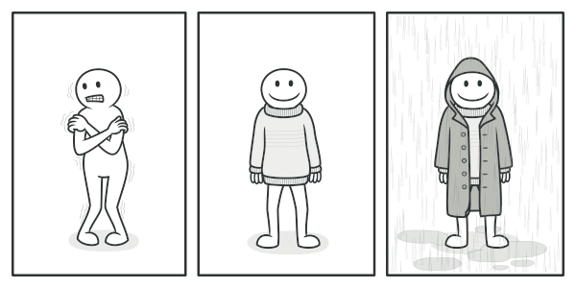
V. Decorator Pattern
3. Real-world analog
You get a combined effect from wearing multiple pieces of clothing.

Slide 25
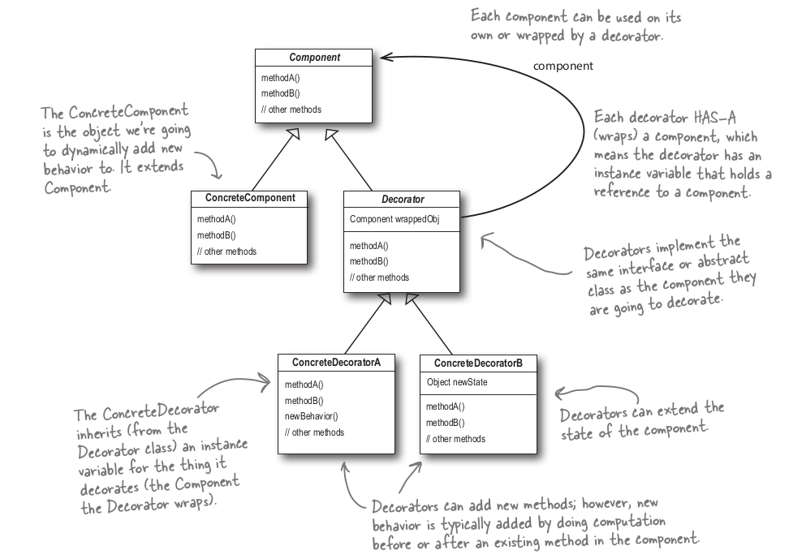
V. Decorator Pattern
4. Structure

Slide 26
V. Decorator Pattern
5. Some examples for Decorator Pattern
Coding demo:
IO
Pizza
StarBuzz
StarBuzz With Sizes
Notes:
Tất cả các phóng viên đang observer diễn viên(actor)

Slide 27
V. Decorator Pattern
6. Applicability
Use the Decorator pattern when you need to be able to assign extra behaviors to objects at runtime without breaking the code that uses these objects.
Use the pattern when it’s awkward or not possible to extend an object’s behavior using inheritance.
Notes:
The Decorator lets you structure your business logic into layers, create a decorator for each layer and compose objects with various combinations of this logic at runtime.
The client code can treat all these objects in the same way, since they all follow a common interface.
Many programming languages have the final keyword that can be used to prevent further extension of a class. For a final class, the only way to reuse the existing behavior would be to wrap the class with your own wrapper, using the Decorator pattern.

Slide 28
V. Decorator Pattern
7. Props and Cons
Props
You can extend an object’s behavior without making a new subclass.
You can add or remove responsibilities from an object at runtime.
You can combine several behaviors by wrapping an object into multiple decorators.
Single Responsibility Principle. You can divide a monolithic class that implements many possible variants of behavior into several smaller classes. Cons:
It’s hard to remove a specific wrapper from the wrappers stack.
It’s hard to implement a decorator in such a way that its behavior doesn’t depend on the order in the decorators stack.
The initial configuration code of layers might look pretty ugly.

Slide 29
Q & A

Slide 30
Thank you

Slide 31
References
https://refactoring.guru/design-patterns
https://github.com/bethrobson/Head-First-Design-Patterns
https://www.oreilly.com/library/view/head-first-design/9781492077992/
https://youtube.com/playlist?list=PLoaAbmGPgTSOrVuxwbnDJ14U9J6CXJXUk&si=s7LdqybbKAmQoPE4

