Slide 1
JIRA FOR SOFTWARE DEVELOPMENT
Notes:
Hi every one,
Today I'm very happy to be here for the presentation.
My team will present about Jira for software development

Slide 2
TABLE OF CONTENTS
01
INTRODUCTION
02
KEY FEATURES
03
BENIFITS
04
CONCLUSION
Notes:
The contents in the presentation include Introduction, Keyfeature of Jira, Benfit and conclution
I will talk about the two fist chaperters and then Mr. Vien will let you know about the two last chapters
=> Now, we go to the introcduction

Slide 3
01
INTRODUCTION

Slide 4
JIRA
Jira is project management
and issue tracking tools
Developed by Atlassian
Notes:
Jira is a widely used project management and issue tracking tool developed by Atlassian.
It's designed to help teams of all sizes plan, track, and manage their work efficiently.
Originally, it was mainly used for software development projects,
but it has since been adapted for a wide range of uses, including business projects, marketing campaigns, and even personal task management.

Slide 5

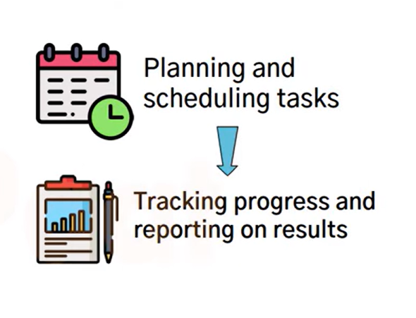

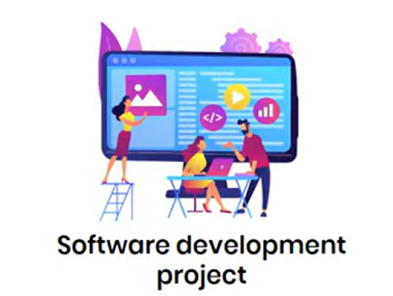


Notes:
It is design to track and manage their work efficiently
From planning and scheduling tasks
To tracking progress and reporting on results
Originally, it was mainly used for software development projects,
But now, it has been adapted for a wide range of uses,
including business projects, marketing campaigns, and even personal task management.
Jira is powerful tool, it helps you stay organized and on track
Next, we will talk about key features.

Slide 6
02
KEY FEATURES

Slide 7

Jira
Features
Issue tracking
Agile Support
Customizable workflows
Reporting and Dashboards
Integration Capabilities
Notes:
Jira have five key features:
- Issue tracking
- Reporting and dashboards
- Agile suport
- Integration Capabilities
- Customizeable workfolow
Then start with Issue tracking:

Slide 8
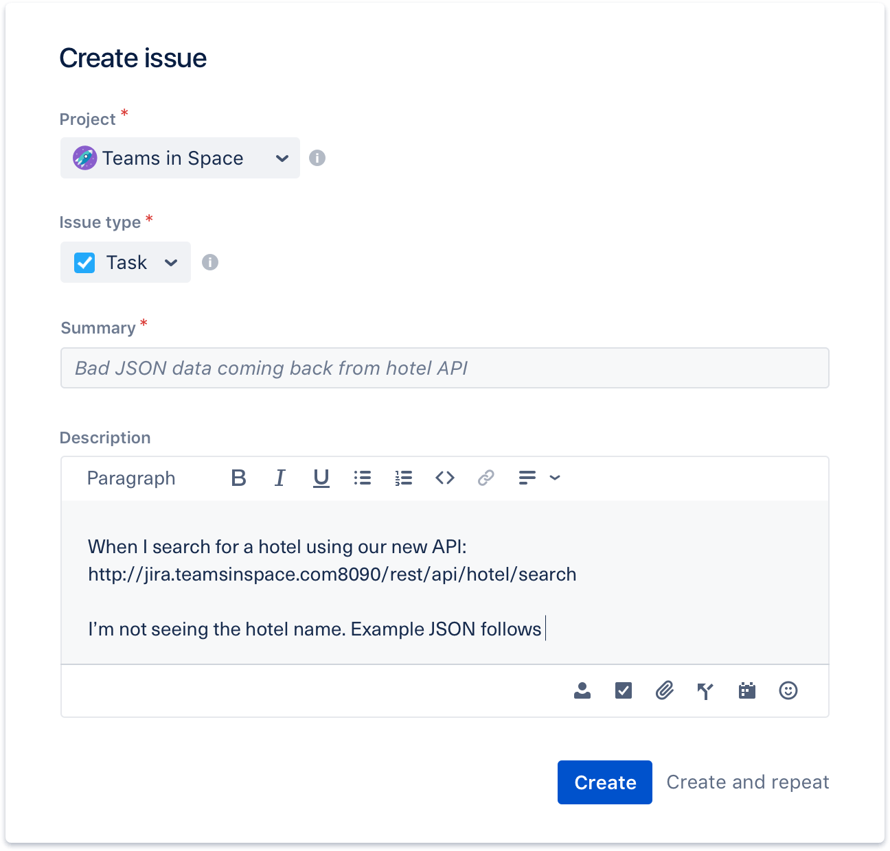
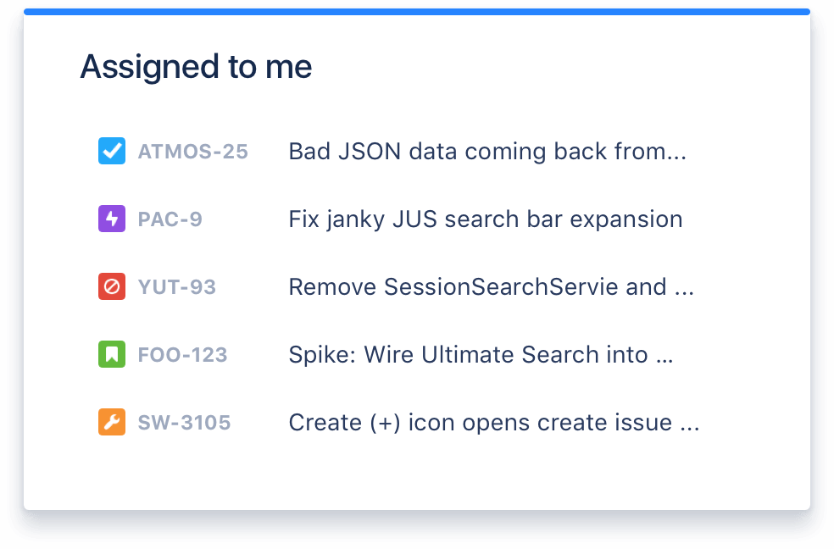
ISSUE TRACKING
Notes:
Then start with Issue tracking:
Issue tracking in Jira refers to the process of creating, managing, and monitoring tasks, bugs, user stories,
and other work items related to a software development project
We can easy check current status (it has various states like Todo, In Progress, Testing or Done)
It allow us to upload,download files and comment on the issues.
Another point, Jira user interface is very friendly Continue with Reporting

Slide 9
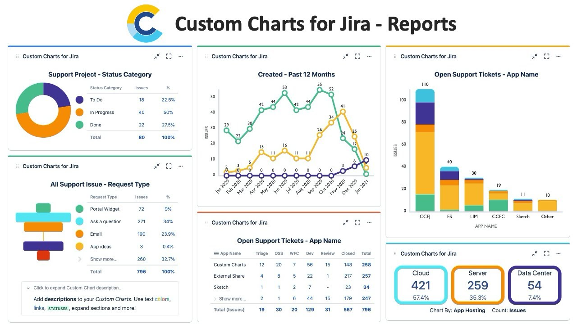
REPORTING
Notes:
Reporting in Jira provides a visual representation of project data,
allowing teams to track progress, identify trends, and make data-driven decisions.
Jira has various chart like: Bowndown, Burnup, Sprint, Epic report
To generating report we can use:
Dashboard: Aggregate/ˈæɡrɪɡət/ multiple reports for a comprehensive view.
Filtering: Focus on specific criteria/kraɪˈtɪəriə/ for relevant information.
Exporting: Share reports as a file like: PDF, CSV, excel formats.

Slide 10
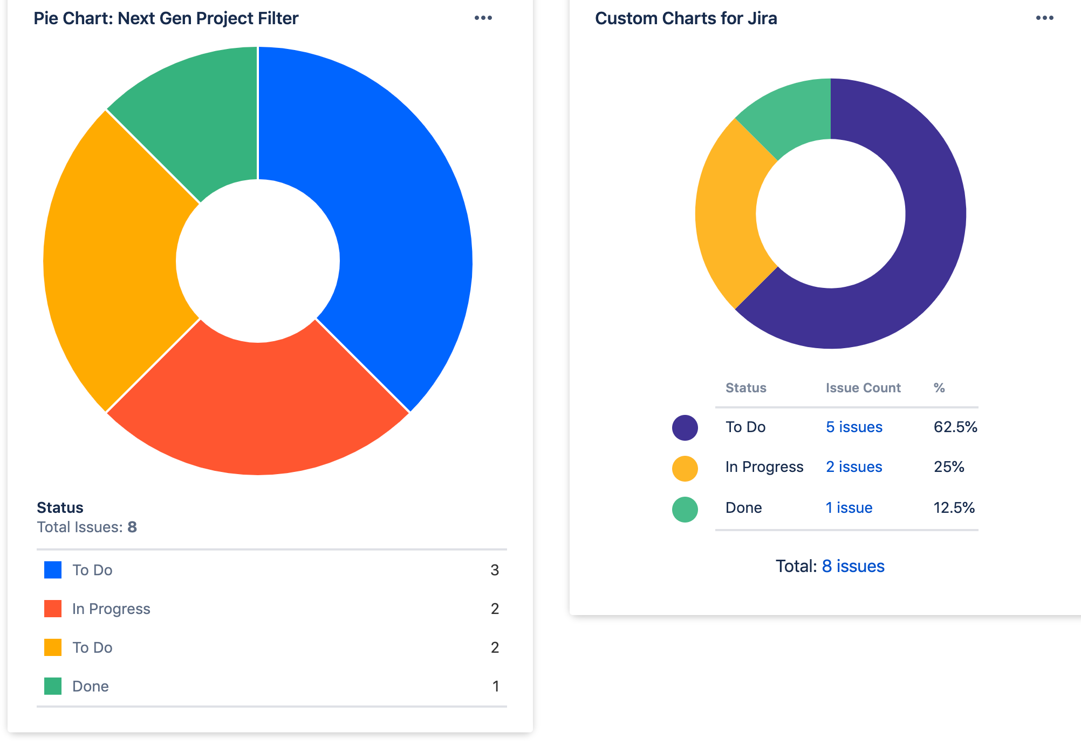
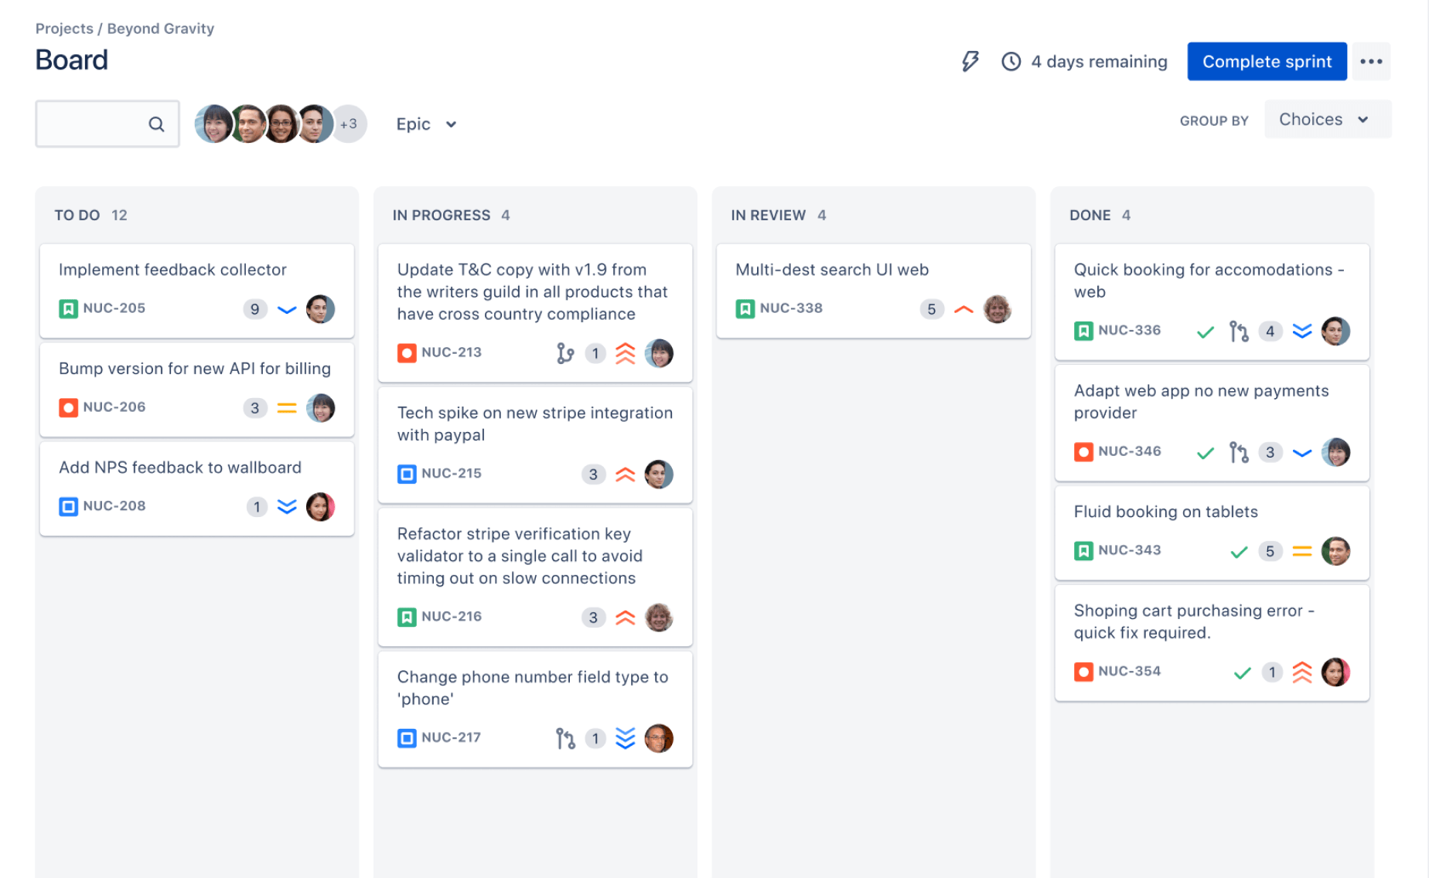
DASHBOARD
Notes:
Dashboards in Jira serve as customizable, centralized displays of relevant project information and reports, // //providing teams with a comprehensive view of project status. Components: A dashboard can consist of various components, including charts, and filters, allowing teams to aggregate/ˈæɡrɪɡət/ and visualize data from different sources.
User-Specific: Each team member can create and customize their own dashboards, for specific roles, responsibilities, and preferences/ˈprefrəns/.

Slide 11
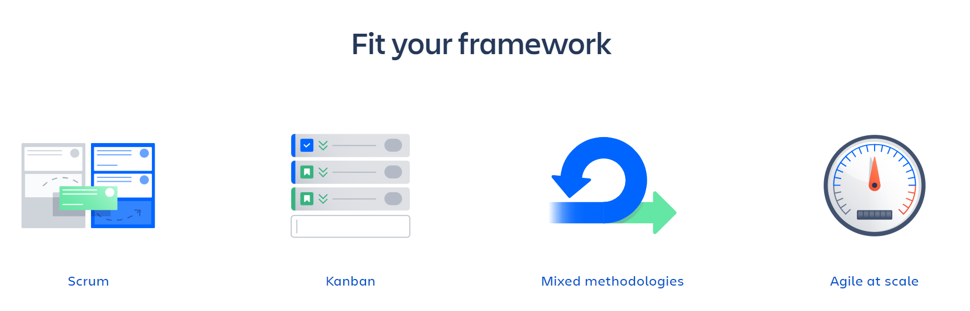
ALIGE SUPPORT
Notes:
Agile methodologies/meθəˈdɒlədʒi/, such as Scrum and Kanban, prioritize individuals and interactions,
working solutions, customer collaboration, and responding to change over following a strict plan.
Jira supports mothodologies very well, it has everything you need.
Nex step I'd like to invite Mr. Vien for next sections

Slide 12
03
BENEFITS

Slide 13

EFFICIENT COLLABORATION
Notes:
Real-Time Updates: Jira allows team members to update and track progress in real-time. This means everyone is on the same page, reducing miscommunication and ensuring that everyone has access to the latest information.
Assigning and Tracking Tasks: With Jira, tasks can be easily assigned to team members. This ensures clear ownership and accountability, leading to smoother workflows.
Commenting and Mentions: The platform provides a space for team members to comment on tasks, ask questions, or provide updates. Using mentions (@), you can notify specific team members, ensuring they see important messages.
Activity Feeds: Jira offers activity feeds that show recent updates and changes. This helps team members stay informed about what others are working on, fostering a collaborative environment.
Permission Controls: Jira allows you to set permissions, ensuring that team members have access to the information and tasks relevant to their roles. This helps maintain focus and prevents information overload.
Integration with Communication Tools: Jira seamlessly integrates with popular communication tools like Slack, Microsoft Teams, and more. This means that updates in Jira can automatically be shared in your team's preferred communication platform.
Version Control and History: Jira keeps a detailed history of changes, making it easy to track progress over time. This is invaluable for identifying trends, analyzing performance, and improving processes.

Slide 14
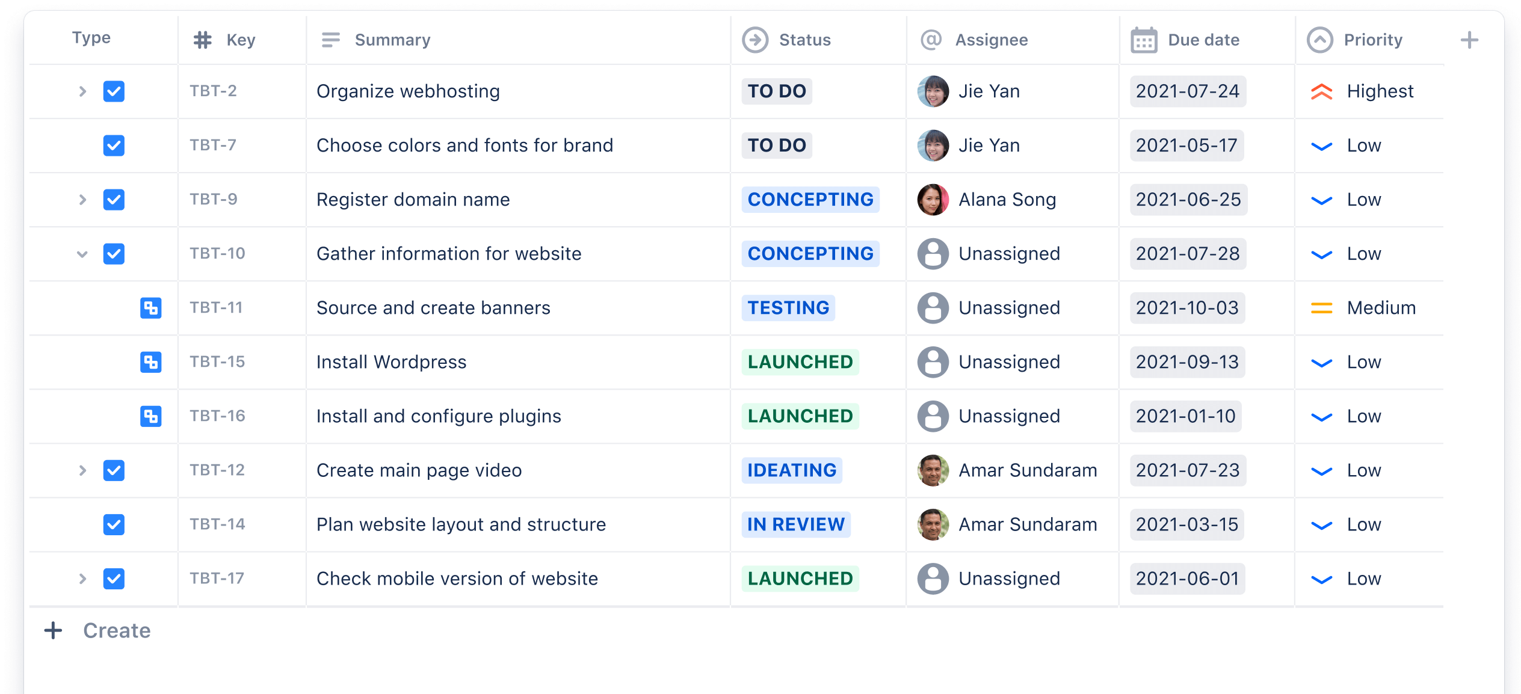
VISIBILITY AND TRANSPARENCY
Notes:
Clear Progress Tracking: Jira provides a visual representation of project progress through customizable dashboards and reports. Team members can easily see which tasks are in progress, completed, or delayed, allowing for better decision-making and resource allocation.
Customizable Dashboards: Teams can create customized dashboards that display key metrics, progress charts, and important information. This allows for a quick overview of project status without the need to dig through multiple reports.
Historical Data and Trends: Jira retains historical data, enabling teams to track performance trends over time. This information is invaluable for making informed decisions, identifying areas for improvement, and setting realistic project expectations.
Task Dependencies and Relationships: Jira allows teams to establish dependencies between tasks, making it clear which tasks are reliant on others. This visibility ensures that teams are aware of critical paths and can prioritize work accordingly.
Client Trust and Communication: Providing clients with visibility into the development process through Jira builds trust and fosters open communication. Clients appreciate being kept in the loop, leading to stronger relationships and successful outcomes.

Slide 15
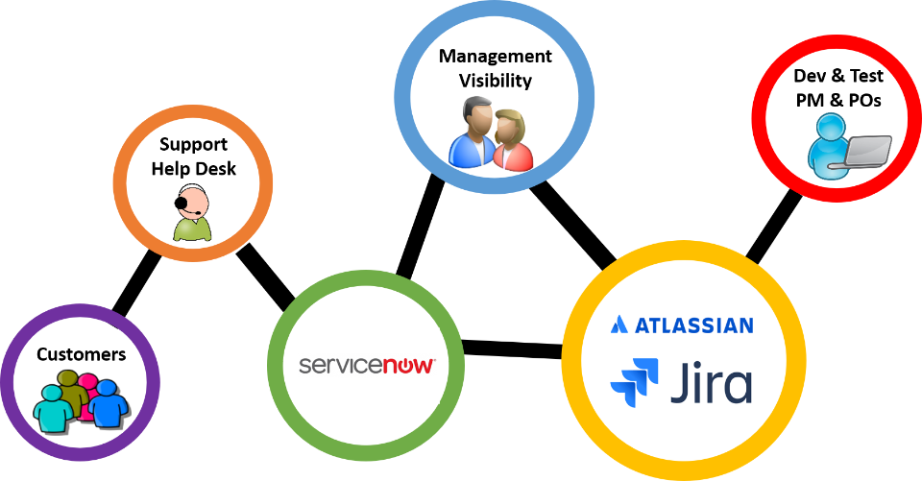
• Customization for Diverse Teams
Notes:
Flexible Workflows: Jira allows teams to design and adapt workflows to match their specific processes. Whether following Agile, Scrum, Kanban, or a unique methodology, Jira can be tailored to accommodate diverse workflows.
Permission Schemes: Jira provides robust permission controls, allowing administrators to finely tune who can access, view, edit, or transition tasks. This is essential for maintaining data security and confidentiality within diverse teams
Role-Based Access: Teams can assign specific roles to members, granting them tailored access and responsibilities based on their role in the project. This ensures that each team member has the right level of authority and visibility.
Customizable Boards: Teams can create custom boards to visualize their work, tailoring them to match their preferred workflow. This includes setting up swimlanes, filters, and columns to accommodate different team preferences.
Scalability for Large Teams: Jira is designed to scale with the needs of growing organizations. It can handle large teams and complex projects, providing customization options that accommodate the size and complexity of diverse teams.
Feedback Loops: Teams can implement custom feedback loops within Jira to gather input from stakeholders, clients, or end-users. This customization ensures that feedback channels align with the specific needs and preferences of each team.

Slide 16
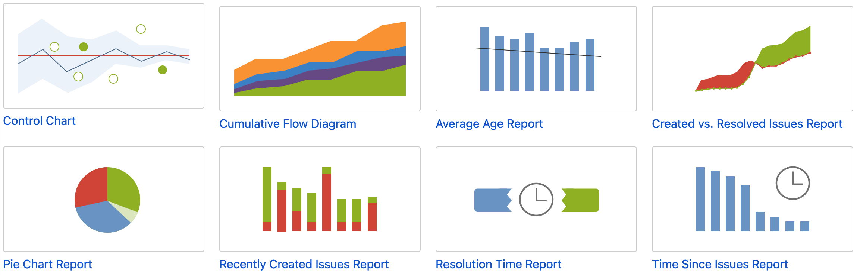
POWERFUL REPORTING
Notes:
Real-Time Updates: Jira allows team members to update and track progress in real-time. This means everyone is on the same page, reducing miscommunication and ensuring that everyone has access to the latest information.
Assigning and Tracking Tasks: With Jira, tasks can be easily assigned to team members. This ensures clear ownership and accountability, leading to smoother workflows.
Commenting and Mentions: The platform provides a space for team members to comment on tasks, ask questions, or provide updates. Using mentions (@), you can notify specific team members, ensuring they see important messages.
Activity Feeds: Jira offers activity feeds that show recent updates and changes. This helps team members stay informed about what others are working on, fostering a collaborative environment.
Permission Controls: Jira allows you to set permissions, ensuring that team members have access to the information and tasks relevant to their roles. This helps maintain focus and prevents information overload.
Integration with Communication Tools: Jira seamlessly integrates with popular communication tools like Slack, Microsoft Teams, and more. This means that updates in Jira can automatically be shared in your team's preferred communication platform.
Version Control and History: Jira keeps a detailed history of changes, making it easy to track progress over time. This is invaluable for identifying trends, analyzing performance, and improving processes.

Slide 17
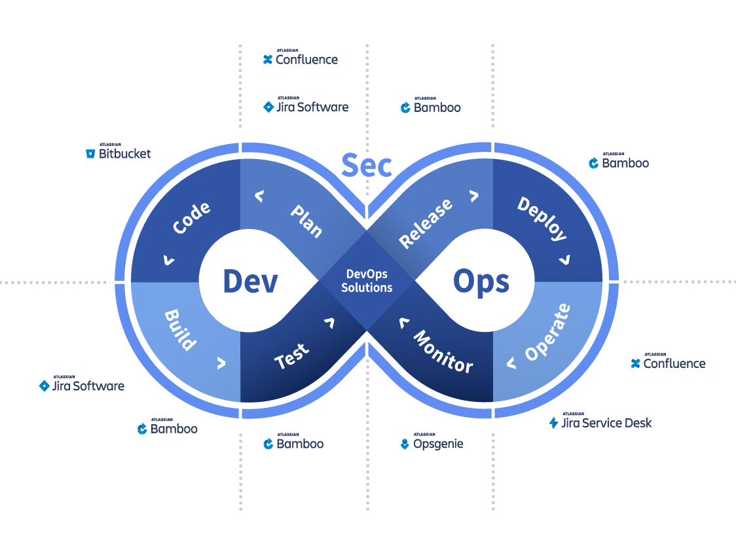
SEAMLESS INTEGRATION
Notes:
JIRA Ecosystem Version Control Systems (VCS): Jira seamlessly integrates with popular version control systems like Git, SVN, Mercurial, and more. This allows for direct linkage between code repositories and specific tasks or issues in Jira. Developers can easily view code changes associated with a task, promoting traceability and accountability.
Continuous Integration and Deployment (CI/CD): Jira can integrate with CI/CD tools like Jenkins, CircleCI, and Bamboo. This ensures that code changes are automatically tested, integrated, and deployed, streamlining the development and release process.
Development Tools and IDEs: Jira integrates with a wide range of development tools and Integrated Development Environments (IDEs) such as JIRA Development Panel for Visual Studio Code, IntelliJ IDEA, and more. This provides developers with direct access to Jira functionalities within their preferred development environment. Testing and QA Tools: Jira can be integrated with testing and quality assurance tools like Selenium, JUnit, TestRail, and others. This allows for seamless coordination between development and testing teams, ensuring that testing efforts align with development progress. Project Management Tools: Jira integrates with other project management tools like Trello, Asana, and Microsoft Project. This facilitates cross-team collaboration and enables project managers to coordinate tasks and resources across different platforms. Communication Platforms: Jira can be connected to communication tools like Slack, Microsoft Teams, and HipChat. This ensures that updates and notifications from Jira are relayed directly to team communication channels, keeping everyone informed in real-time. Customer Support and Service Desk Software: Jira Service Desk seamlessly integrates with customer support platforms like Zendesk, Freshdesk, and ServiceNow. This allows support teams to escalate technical issues directly to development teams, creating a smooth process for issue resolution.

Slide 18
04
CONCLUSION

Slide 19
CATALYST FOR SOFTWARE DEVELOPMENT
Streamlined Workflows
Enhanced Collaboration
Optimized Resource Allocation
Data-Driven Decision Making
Increased Accountability and Transparency
Notes:
JIRA Ecosystem Version Control Systems (VCS): Jira seamlessly integrates with popular version control systems like Git, SVN, Mercurial, and more. This allows for direct linkage between code repositories and specific tasks or issues in Jira. Developers can easily view code changes associated with a task, promoting traceability and accountability.
Continuous Integration and Deployment (CI/CD): Jira can integrate with CI/CD tools like Jenkins, CircleCI, and Bamboo. This ensures that code changes are automatically tested, integrated, and deployed, streamlining the development and release process.
Development Tools and IDEs: Jira integrates with a wide range of development tools and Integrated Development Environments (IDEs) such as JIRA Development Panel for Visual Studio Code, IntelliJ IDEA, and more. This provides developers with direct access to Jira functionalities within their preferred development environment. Testing and QA Tools: Jira can be integrated with testing and quality assurance tools like Selenium, JUnit, TestRail, and others. This allows for seamless coordination between development and testing teams, ensuring that testing efforts align with development progress. Project Management Tools: Jira integrates with other project management tools like Trello, Asana, and Microsoft Project. This facilitates cross-team collaboration and enables project managers to coordinate tasks and resources across different platforms. Communication Platforms: Jira can be connected to communication tools like Slack, Microsoft Teams, and HipChat. This ensures that updates and notifications from Jira are relayed directly to team communication channels, keeping everyone informed in real-time. Customer Support and Service Desk Software: Jira Service Desk seamlessly integrates with customer support platforms like Zendesk, Freshdesk, and ServiceNow. This allows support teams to escalate technical issues directly to development teams, creating a smooth process for issue resolution.

Slide 20
THANKS

