Slide 1


Distributed System
Mid-term Project: HTTP over RPC
Group Members:
1) Nguyen Hoang Vu – USTHBI7-164
2) Dang Minh Quang – USTHBI7-129
3) Vu Ngoc Quang – USTHBI6-124
4) Ha Huy Binh – USTHBI7 –
5) Nguyen Minh Duc – USTHBI7 - 053

Slide 2
What?
Remote Procedure Call (RPC)
It’s a protocol
Request a service from a program located in another computer on a network without having to understand the network's details.

Slide 3
What?
Remote Procedure Call (RPC)
It uses the Client-server model.
The requesting program is a Client and the service providing program is the server.

Slide 4
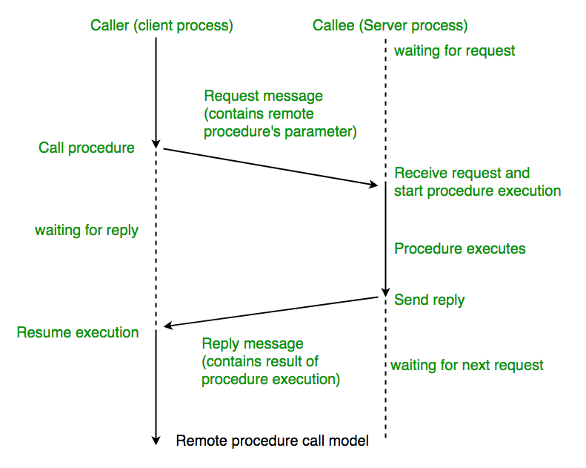
What?

Slide 5
What?
Hypertext Transfer Protocol (HTTP)
It is an application-level protocol for distributed, collaborative, hypermedia information systems.
This is the foundation for data communication for the World Wide Web.

Slide 6
What?
HTTP Request
It’s a packet of Information that one computer sends to another computer to communicate something.
In other words, HTTP Request is a packet of binary data sent by the Client to server.

Slide 7
What to do?
HTTP over RPC:
HTTP over RPC implementation allows Clients to connect to RPC server programs and execute remote procedure calls.
This can be done through a “mid-man” called HTTP Proxy.

Slide 8
What to do?
General procedure:
The Client sends request to the Proxy.
The Proxy will forward the actual request to the Server.
The Server will only see the Proxy as connection and answer to the Proxy just like to a Client.
The Proxy receives the response and forwards it back to the Client.

Slide 9
What to do?
HTTP Proxy:
It receives requests from Client.
It performs authentication, validation, and checks on those requests.

Slide 10
What to do?
HTTP Proxy:
3. If the requests are OK, HTTP Proxy forwards the requests to the RPC Server that performs the actual processing.
4. The HTTP Proxy receives the responses and forward those back to Client.

Slide 11
Why?
Why using HTTP over RPC?
Security
It provides a standardized interface to authentication services for both Clients and Servers.
The authentication services on the server host system provide RPC authentication.

Slide 12
Why?
Why using HTTP over RPC?
Security
Applications use authenticated remote procedure calls to ensure that all calls come from authorized Clients.
They can also help ensure that all server replies
come from authenticated Servers.

Slide 13
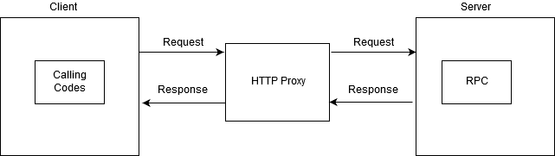
Our job?
Successfully build a server-client model as below:

Slide 14

How?

Slide 15

Thank You For Listening

