Slide 1

Blazor
new way to build client web apps
Thien Nguyen

Slide 2
Agenda
What is WebAssembly
What is Blazor
Blazor hosting models
PROS and CONS of each Blazor hosting models
Demo

Slide 3
What is WebAssembly

Slide 4
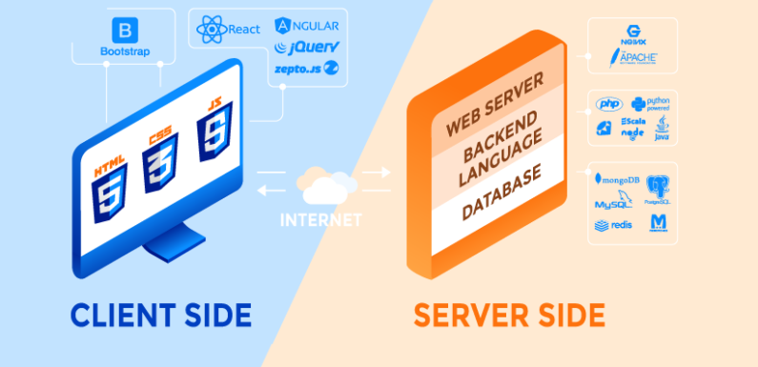
1. What is WebAssembly
Review about Server-Side and Client-Side Programming Languages

Slide 5
1. What is WebAssembly
WebAssembly (abbreviated Wasm) is a binary instruction format for a stack-based virtual machine
Wasm is designed as a portable compilation target for programming languages, enabling deployment on the web for client and server applications.
Wasm became the offical “fourth language for web” on 5th December 2019, i.e. after HTML, CSS & JavaScript
Can written by C/C++, C#, Python,…
https://webassembly.org/

Slide 6
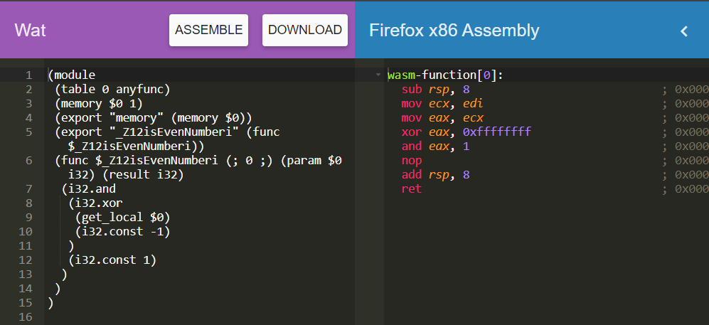
1. What is WebAssembly
WASM format
textual format .wat
binary format
.wasm

Slide 7

1. What is WebAssembly
WASM format
Me* after reading the WASM formats the first time

Slide 8
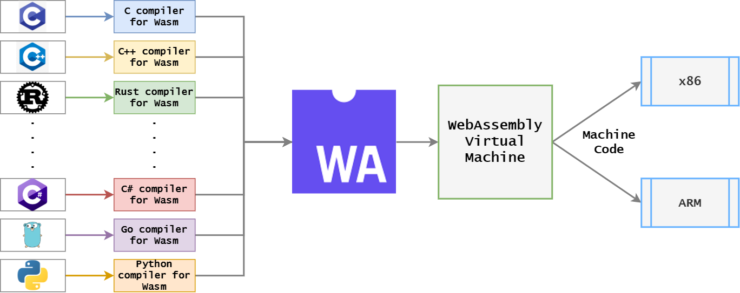
1. What is WebAssembly
WebAssembly Work

Slide 9

1. What is WebAssembly
Why would I use WebAssembly?

Slide 10
1. What is WebAssembly
Why would I use WebAssembly?
Efficient and fast
Safe
Compile a WebAssembly module from many languages: C/C++, Rust, C#, F#, Go, Kotlin, Swift,…
Can be executed on web, stand-alone

Slide 11
1. What is WebAssembly
Besides, WebAssembly not-so-great
Many features under development or not ready yet
IE and older browsers don’t support wasm
By design, code needed to be compiled before distribution. Therefore, “fix JS directly on CDN” kind of approaching doesn’t supported

Slide 12
What is Blazor

Slide 13
2. What is Blazor
Release in 2018
A client-side library that use .NET on WebAssembly
Support SPAs written in C# with Razor template
https://docs.microsoft.com/en-us/aspnet/core/blazor/?view=aspnetcore-6.0

Slide 14


2. What is Blazor
Not like Silverlight
Can run without plugin
Share libraries between client and server

Slide 15
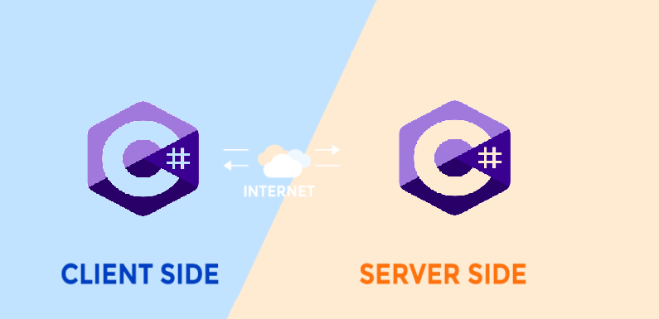
2. What is Blazor
Server-Side and Client-Side Programming Languages

Slide 16

2. What is Blazor
Milestones
2017 : Web Assembly
2017 : Blazor 1st announced
2019 : Blazor 1st preview
2019 : Blazor Server
2019 : Blazor Web Assembly
2021 : LTS for Blazor
2022 : .NET 7
16

Slide 17
Blazor hosting models

Slide 18
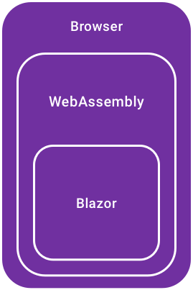
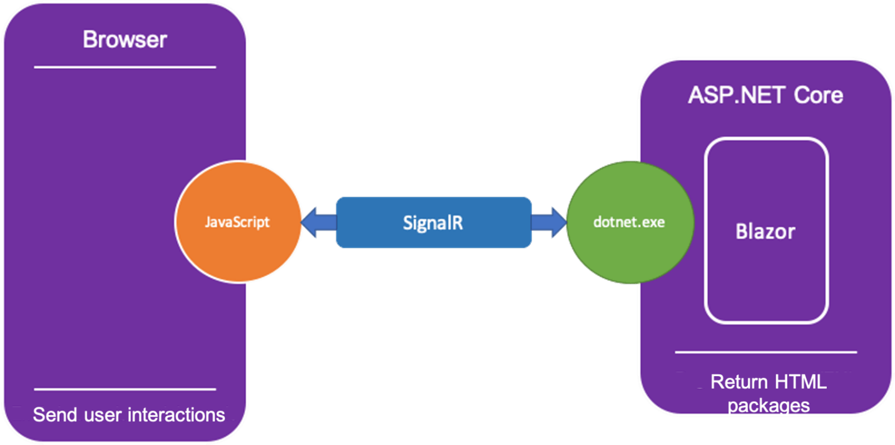
3. Blazor hosting models
Blazor WebAssembly
Client-side rendering
Incremental DOM
Blazor Server
Server-side logic
DOM updated by SignalR

Slide 19
PROS and CONS
Blazor WebAssembly and Blazor Server

Slide 20
4. PROS and CONS Blazor WebAssembly and Blazor Server
Blazor WebAssembly
PROS
.NET code for browser
Efficient and fast
NO server-side dependencies
Progressive Web App (PWA)
CONS
Need download resources before 1st running (~700 KB)
Old browser cannot be used
Need times to developing tools for developers

Slide 21
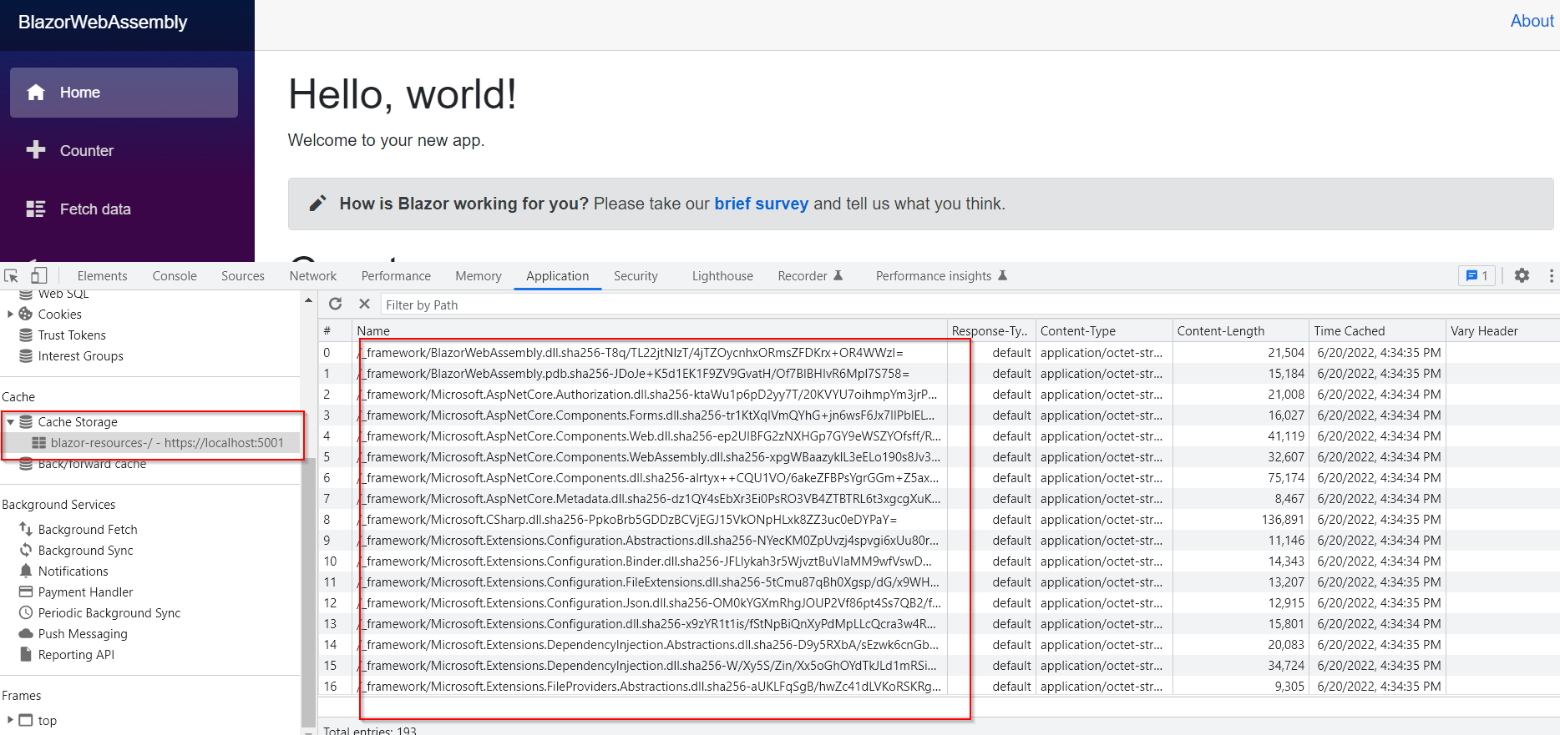
4. PROS and CONS Blazor WebAssembly and Blazor Server
Blazor WebAssembly

Slide 22
4. PROS and CONS Blazor WebAssembly and Blazor Server
Blazor Server
PROS
NO need to download before running
Server-side rendering
Load fast in 1st time
Can be used in older browser
API private
CONS
SignalR -> latency on each event
Always keeps connection
NO offline mode
High memory usage

Slide 23
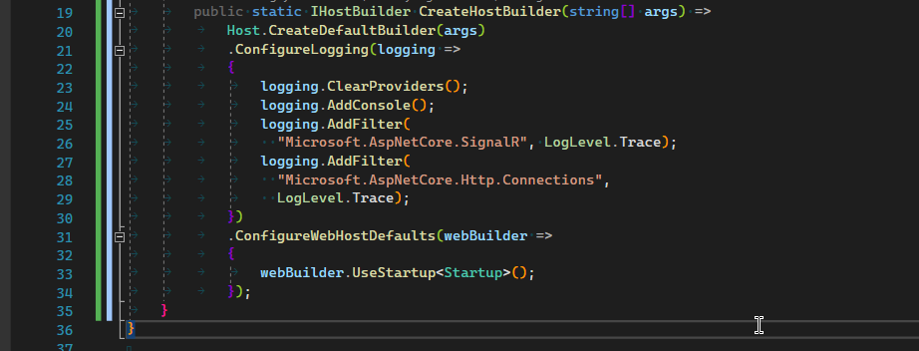
4. PROS and CONS Blazor WebAssembly and Blazor Server
Blazor Server

Slide 24
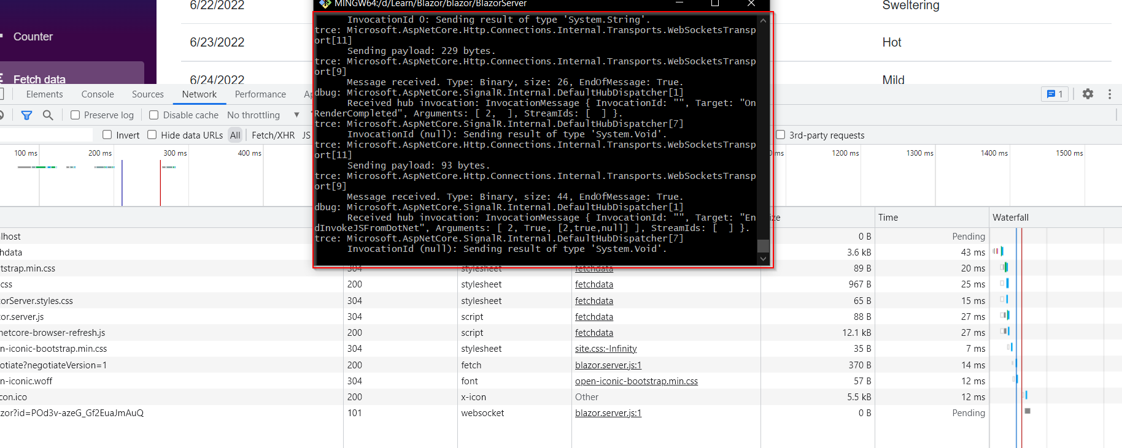
4. PROS and CONS Blazor WebAssembly and Blazor Server
Blazor Server

Slide 25

Demo

Slide 26
References
Server-Side vs Client-Side Programming Languages
https://www.techwebspace.com/server-side-vs-client-side-programming-languages/
WebAssembly
https://arghya.xyz/articles/webassembly-wasm-wasi/
https://developer.mozilla.org/en-US/docs/WebAssembly/Understanding_the_text_format
Blazor
https://docs.microsoft.com/en-us/aspnet/core/blazor/hosting-models?view=aspnetcore-5.0
Some relevant questions
ASP.NET Core hosted vs Blazor Serverside
https://stackoverflow.com/questions/58093386/whats-the-difference-between-asp-net-core-hosted-and-server-side-blazor-really
JS vs WASM
https://medium0.com/@OPTASY.com/webassembly-vs-javascript-is-wasm-faster-than-js-when-does-javascript-perform-better-db86d2ecf2cc

Slide 27

Thank you for watching

