Slide 1

Blazor
new way to build Web UI
Thien Nguyen

Slide 2
Agenda
What is WebAssembly
What is Blazor
Blazor WebAssembly and Blazor Server
PROS and CONS of Blazor WebAssembly and Blazor Server
Demo

Slide 3
What is WebAssembly

Slide 4
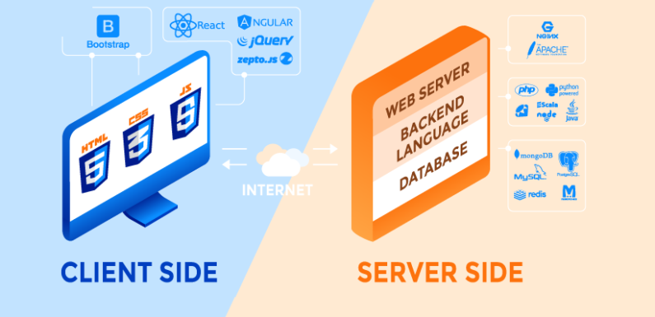
1. What is WebAssembly
Review about Server-Side and Client-Side Programming Languages

Slide 5
1. What is WebAssembly
WebAssembly (abbreviated Wasm) is a binary instruction format for a stack-based virtual machine
Wasm is designed as a portable compilation target for programming languages, enabling deployment on the web for client and server applications.
Wasm became the offical “fourth language for web” on 5th December 2019, i.e. after HTML, CSS & JavaScript
https://webassembly.org/

Slide 6
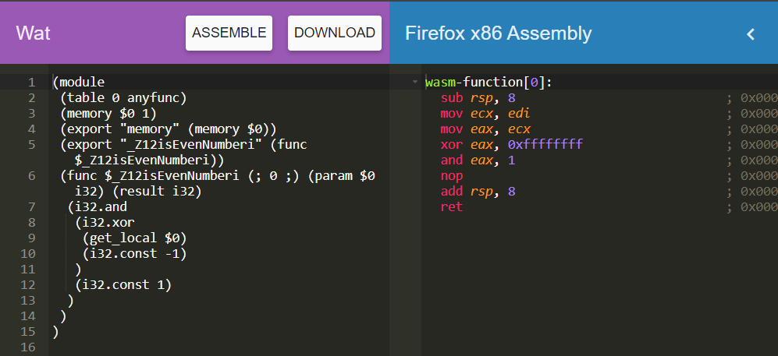
1. What is WebAssembly
WASM format
textual format .wat
binary format
.wasm

Slide 7
1. What is WebAssembly
Huh, what is that format??? How can I code that?

Slide 8
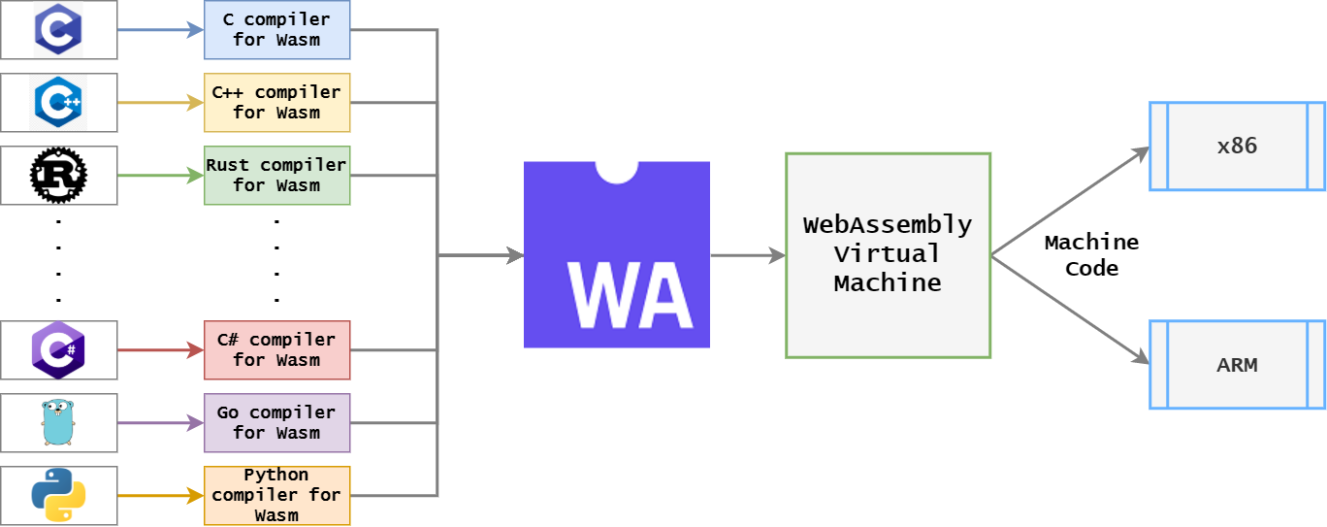
1. What is WebAssembly
WebAssembly Work
Notes:
Show some games after this slides

Slide 9
1. What is WebAssembly
Why would I use WebAssembly?
Efficient and fast
Safe
Compile a WebAssembly module from many languages: C/C++, Rust, C#, F#, Go, Kotlin, Swift,…
Can be executed on web, stand-alone
Notes:
Efficient fast : binary
Safe: memory-safe, sandboxed execution environment

Slide 10
What is Blazor

Slide 11
2. What is Blazor
Release in 2018
A client-side library that use .NET on WebAssembly
Support SPAs written in C# with Razor template
https://docs.microsoft.com/en-us/aspnet/core/blazor/?view=aspnetcore-6.0

Slide 12
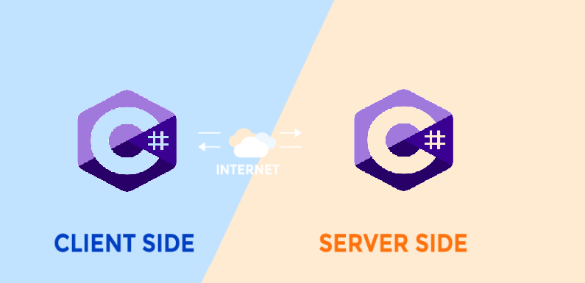
2. What is Blazor
Server-Side and Client-Side Programming Languages

Slide 13
Blazor WebAssembly and Blazor Server

Slide 14
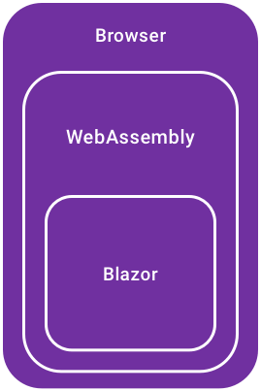
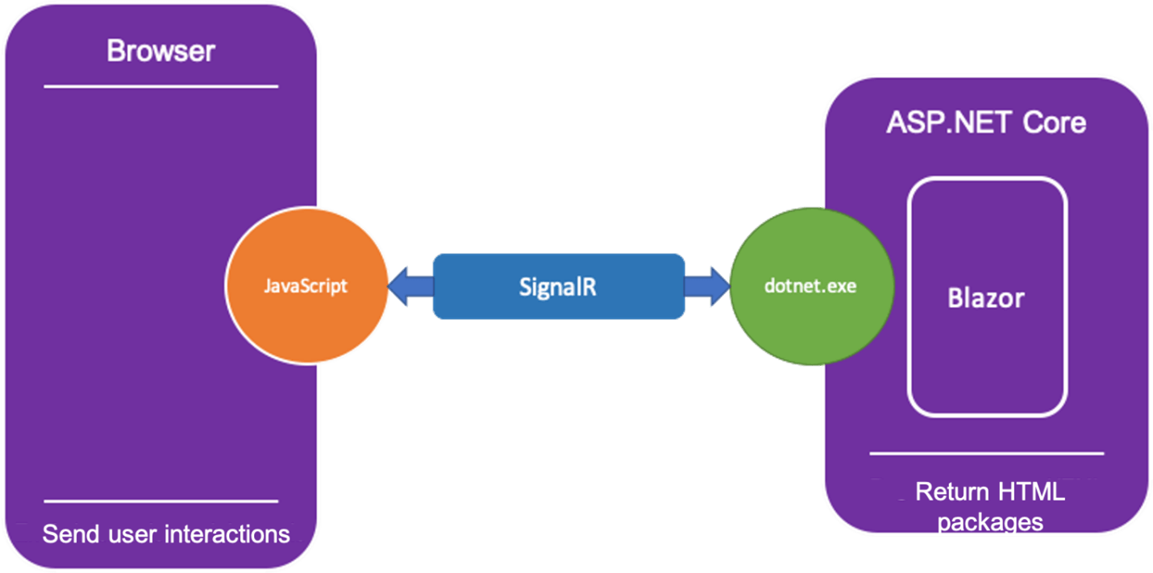
3. Blazor WebAssembly and Blazor Server
Blazor WebAssembly
Client-side rendering
Incremental DOM
Blazor Server
Server-side logic
DOM updated by SignalR

Slide 15
PROS and CONS
Blazor WebAssembly and Blazor Server

Slide 16
4. PROS and CONS Blazor WebAssembly and Blazor Server
Blazor WebAssembly
PROS
Efficient and fast
CONS
Efficient and fast

Slide 17
4. PROS and CONS Blazor WebAssembly and Blazor Server
Blazor Server
PROS
Efficient and fast
CONS
Efficient and fast

Slide 18
Demo

Slide 19
References
Server-Side vs Client-Side Programming Languages
https://www.techwebspace.com/server-side-vs-client-side-programming-languages/
WebAssembly
https://arghya.xyz/articles/webassembly-wasm-wasi/
Blazor
https://www.syncfusion.com/blogs/post/3-blazor-hosting-models.aspx

Slide 20
Thank you for watching

