Slide 1

Data Warehouses
FPT University

Slide 2
Lecture 1: Introduction to Data Warehouse and Data Warehousing

Slide 3
Overview
Escalating Need for Strategic Information
Failures of Past Decision-Support Systems
Operational Versus Decision-Support Systems
Data Warehousing—The Only Viable Solution
Data Warehouse Defined

Slide 4
Escalating Need for Strategic Information (1)
In 1960s, companies started using computer systems to support business operations:
  process orders,
  maintain inventory,
  keep the accounting books,
  service the clients,
  receive payments, and process claims.

Slide 5
Escalating Need for Strategic Information (2)
Nowadays, businesses get more complex.
The operational computer systems did provide information to run the day-to-day operations,
But what the executives needed were different kinds of information that could be readily used to make strategic decisions -> new type of getting strategic information

Slide 6
Escalating Need for Strategic Information (3)
Data warehousing is a new paradigm specifically intended to provide vital strategic information.
In the 1990s, organizations began to achieve competitive advantage by building data warehouse systems.
The next figure shows a sample of strategic areas where data warehousing is already producing results in different industries.

Slide 7
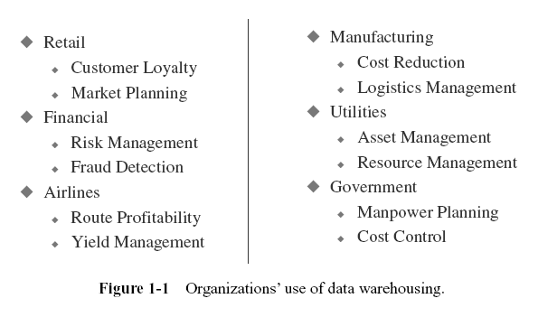

Slide 8
Strategic information (1)
Who needs strategic information in an enterprise?
  The executives and managers who are responsible for keeping the enterprise competitive.
    They need information to make proper decisions.
    They need information to formulate the business strategies, establish goals, and monitor results.
➔They need the types of information which supports to make decisions in the formulation and execution of business strategies.
So, all these types of essential information may be combined into the groups (under the broad classiﬁcation) and called as strategic information

Slide 9
Strategic information (2)
Strategic information is not for running the day-to-day operations of the business.
It is not intended to produce an invoice, make a shipment, or post a withdrawal from a bank account.
Strategic information is far more important for the continued health and survival of the corporation.
➔Critical business decisions depend on the availability of proper strategic information in an enterprise.

Slide 10
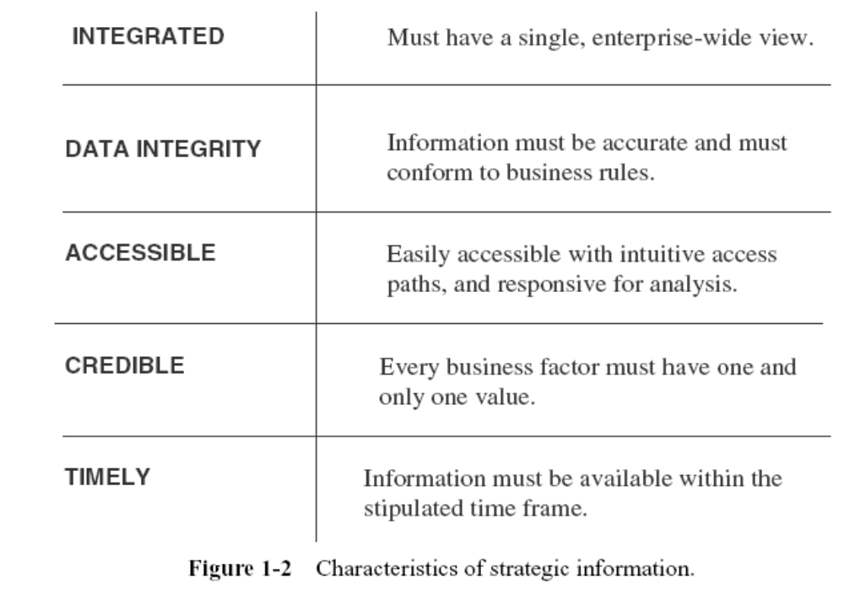
Strategic information (3)

Slide 11
Information Crisis (1)
We are faced with two unexpected facts:
  (1) organizations have lots of data;
  (2) information technology resources and systems are not effective at turning all that data into useful strategic information.
Companies have accumulated tons and tons of data about their operations.
Data is said to double every 18 months.

Slide 12
Information Crisis (2)
Most companies are faced with an information crisis not because of lack of sufficient data, but because the available data is not readily usable for strategic decision making.
These large quantities of data are very useful and good for running the business operations, but hardly amenable for use in making decisions about business strategies and objectives.

Slide 13
Information Crisis (3)
Data needed for strategic decision making :
  Must be in a format suitable for analyzing trends.
  Executives need to look at trends over time and steer their companies in the proper direction.
Operational data is event-driven , so the tons of available operational data cannot be readily used to spot trends.
In the operational systems, e.g ordering system, we do not readily have the trends of a single product over the period of a month, a quarter, or a year.

Slide 14
Information Crisis (4)
To make a strategic decision, executives and managers must be able to review data from different business viewpoints.
For example, they must be able to review sales quantities by product, salesperson, district, region, and customer groups.
➔Operational data is not directly suitable for review from different viewpoints.

Slide 15
Technology Trends
Providing strategic information requires collection of large volumes of corporate data and storing it in suitable formats.
Technology advances in data storage and reduction in storage costs

Slide 16
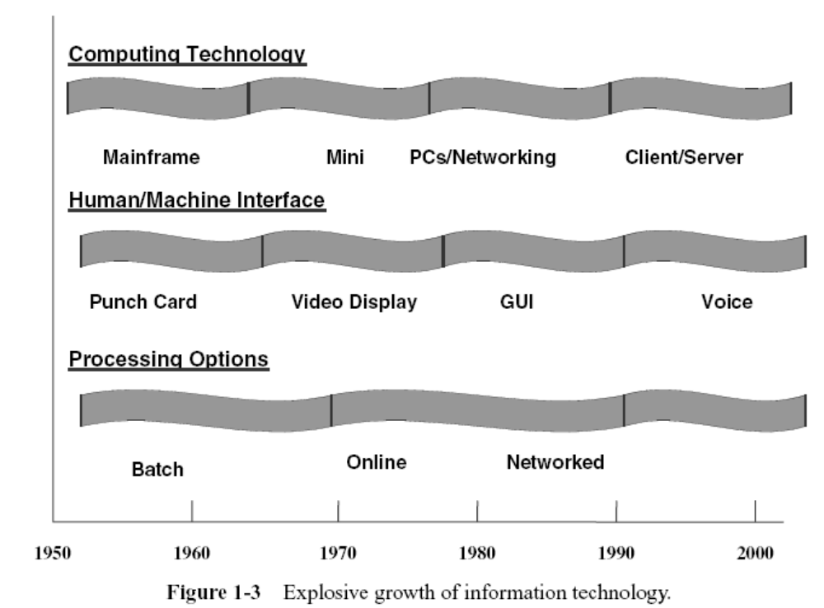
Technology Trends

Slide 17
FAILURES OF PAST DECISION-SUPPORT SYSTEMS

Slide 18
History of Decision-Support Systems
Ad Hoc Reports:
  This was the earliest stage.
  Users, especially from Marketing and Finance, would send requests to IT for special reports.
  IT would write special programs, typically one for each request, and produce the ad hoc reports.
Special Extract Programs:
  Anticipate somewhat the types of reports that would be requested from time to time.
  IT would write a suite of programs and run the programs periodically to extract data from the various applications.
  For any reports that could not be run off the extracted files, IT would write individual special programs.

Slide 19
History of Decision-Support Systems
Small Applications:
  IT would create simple applications based on the extracted files.
  The users could stipulate the parameters for each special report.
  The report printing programs would print the information based on user-specific parameters. Some advanced applications would also allow users to view information through online screens.
Information Centers:
  In the early 1970s, some major corporations created what were called information centers.
  The information center typically was a place where users could go to request ad hoc reports or view special information on screens.
  These were predetermined reports or screens. IT personnel were present at these information centers to help the users to obtain the desired information.

Slide 20
History of Decision-Support Systems
Decision-Support Systems:
  Companies began to build more sophisticated systems intended to provide strategic information.
  Again, similar to the earlier attempts, these systems were supported by extracted files.
  The systems were menu-driven and provided online information and also the ability to print special reports. Many of such DSSs were for marketing.
Executive Information Systems:
  This was an attempt to bring strategic information to the executive desktop. The main criteria were simplicity and ease of use.
  The system would display key information every day and provide ability to request simple, straightforward reports. However, only preprogrammed screens and reports were available.
  After seeing the total countrywide sales, if the executive wanted to see the analysis by region, by product, or by another dimension, it was not possible unless such breakdowns were already preprogrammed.
  This limitation caused frustration and executive information systems did not last long in many companies.

Slide 21
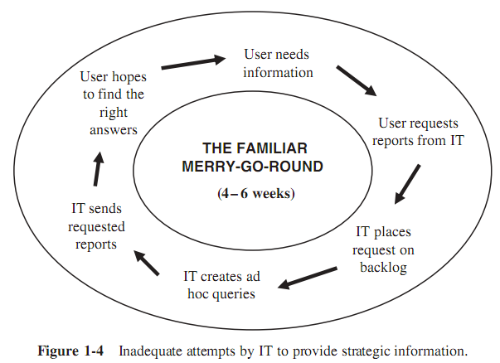
Inability to Provide Information
Every one of the past attempts at providing strategic information to decision makers was unsatisfactory.
Inadequate attempts by IT to provides trategic information:

Slide 22
Inability to Provide Information
Here are some of the factors relating to the inability to provide strategic information:
  IT receives too many ad hoc requests, resulting in a large overload. With limited resources,
  IT is unable to respond to the numerous requests in a timely fashion.
  Requests are not only too numerous, they also keep changing all the time. The users need more reports to expand and understand the earlier reports.
  The users find that they get into the spiral of asking for more and more supplementary reports, so they sometimes adapt by asking for every possible combination, which only increases the IT load even further.
  The users have to depend on IT to provide the information. They are not able to access the information themselves interactively.
  The information environment ideally suited for making strategic decision making has to be very flexible and conducive for analysis. IT has been unable to provide such an environment.

Slide 23
OPERATIONAL VERSUS DECISION-SUPPORT SYSTEMS
The operational systems such as order processing, inventory control, … and so on are not designed or intended to provide strategic information
If we need the ability to provide strategic information, we must get the information from altogether different types of systems.
Only specially designed decision support systems or informational systems can provide strategic information. Let us understand why.

Slide 24
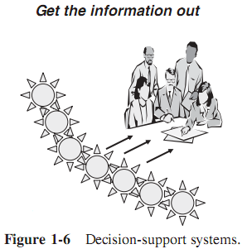
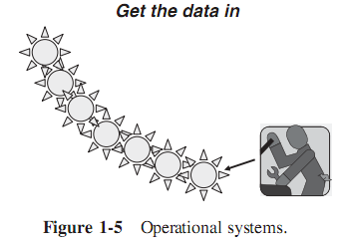
OPERATIONAL VERSUS DECISION-SUPPORT SYSTEMS

Slide 25
OPERATIONAL VERSUS DECISION-SUPPORT SYSTEMS
Making the Wheels of Business Turn: Operational systems are online transaction processing (OLTP) systems.
  OLTP are the systems that are used to run the day-to-day core business of the company.
  Operational systems make the wheels of business turn. They support the basic business processes of the company.
  These systems typically put the data into the database.
  Each transaction processes information about a single entity such as a single order, a single invoice, or a single customer.

Slide 26
OPERATIONAL VERSUS DECISION-SUPPORT SYSTEMS
Watching the Wheels of Business Turn:
  On the other hand, specially designed and built decision-support systems are not meant to run the core business processes.
  They are used to watch how the business runs, and then make strategic decisions to improve the business.
  Decision-support systems are developed to get strategic information out of the database, as opposed to OLTP systems that are designed to put the data into the database.
Decision-support systems are developed to provide strategic information. That is what we need, but the ones mentioned above

Slide 27
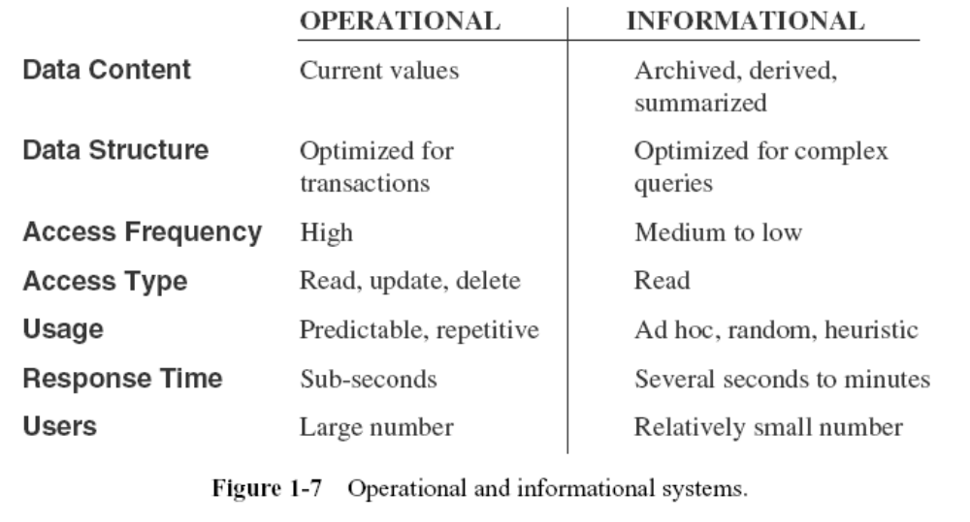
OPERATIONAL VERSUS DECISION-SUPPORT SYSTEMS

Slide 28
DATA WAREHOUSING—THE ONLY VIABLE SOLUTION
A New Type of System Environment
  Database designed for analytical tasks
  Data from multiple applications
  Easy to use and conducive to long interactive sessions by users
  Read-intensive data usage
  Direct interaction with the system by the users without IT assistance
  Content updated periodically and stable
  Content to include current and historical data
  Ability for users to run queries and get results online
  Ability for users to initiate reports

Slide 29
DATA WAREHOUSING —
THE ONLY VIABLE SOLUTION
Processing Requirements in the New Environment: Most of the processing in the new environment for strategic information will have to be analytical.
There are four levels of analytical processing requirements:
  Running of simple queries and reports against current and historical data
  Ability to perform “what if ” analysis is many different ways
  Ability to query, step back, analyze, and then continue the process to any desired length
  Spot historical trends and apply them for future results

Slide 30
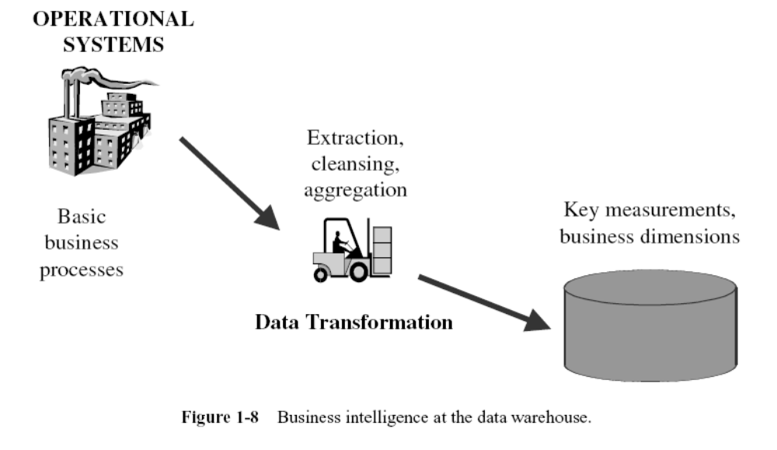
Business Intelligence at the Data Warehouse

Slide 31
DATA WAREHOUSE DEFINED
The data warehouse is an informational environment that
  Provides an integrated and total view of the enterprise
  Makes the enterprise’s current and historical information easily available for decision making
  Makes decision-support transactions possible without hindering operational systems
  Renders the organization’s information consistent
  Presents a flexible and interactive source of strategic information

Slide 32
DATA WAREHOUSE DEFINED
Data warehousing is really a simple concept:
  Take all the data you already have in the organization, clean and transform it, and then provide useful strategic information.

Slide 33
An Environment, Not a Product
An ideal environment for data analysis and decision support
Fluid, flexible, and interactive 100 percent user-driven
Very responsive and conducive to the ask–answer–ask–again pattern
Provides the ability to discover answers to complex, unpredictable questions

Slide 34
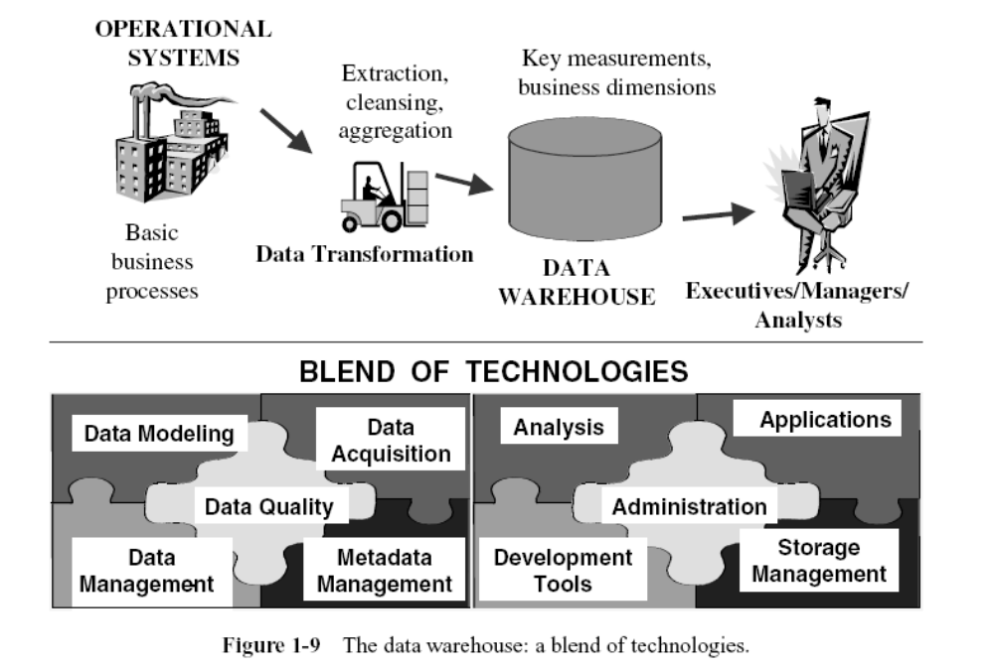
A Blend of Many Technologies

Slide 35
Practical understanding
“A data warehouse is simply a single, complete, and consistent store of data obtained from a variety of sources and made available to end users in a way they can understand and use it in a business context” – Barry Devlin, IBM Consultant

Slide 36
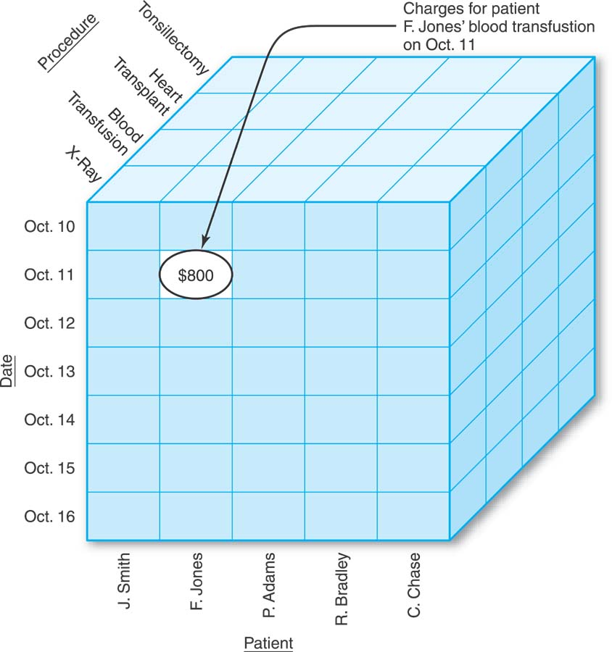
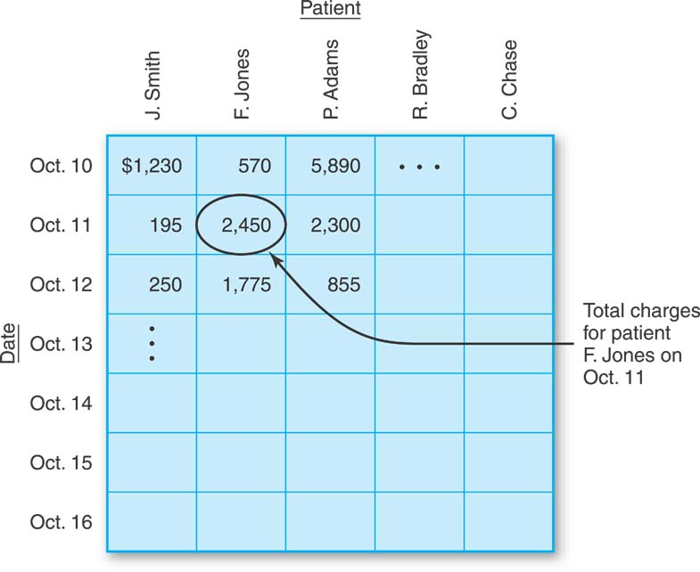
Two-dimensional data warehouse
Three-dimensional data warehouse

Slide 37
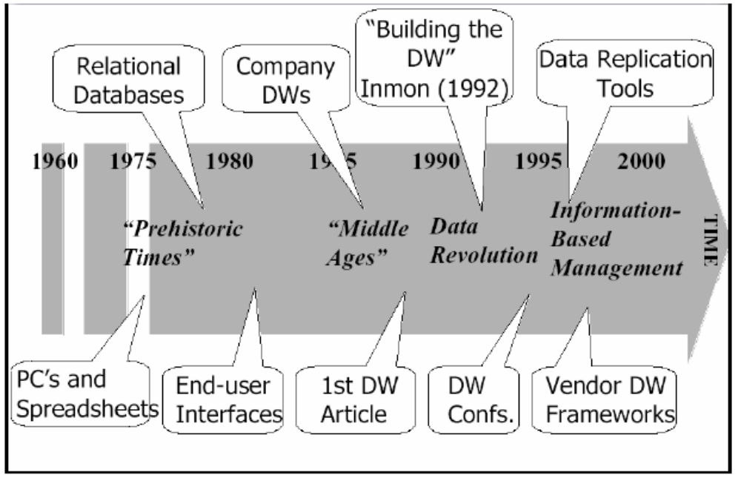
History

Slide 38
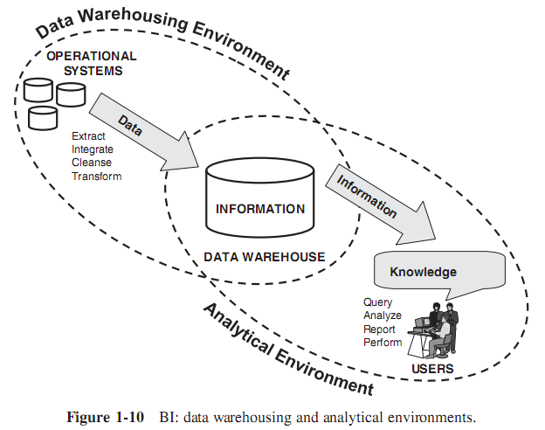
BI:Data Warehousing and Analytics

Slide 39
Question
What do we mean by strategic information? For a commercial bank, name five types of strategic objectives.

