Slide 1

Data Warehouses
FPT University
Notes:
-
-
-
-
-
-
-
-
-
-

Slide 2
Lecture 2: DATA WAREHOUSE:
THE BUILDING BLOCKS

Slide 3
Overview
DW review
Defining Features
Data Warehouses and Data Marts
Overview of the Components
Metadata in the Data Warehouse
Trends in DW

Slide 4
DW review
The data warehouse is an information delivery system.
  In this system, we integrate and transform enterprise data into information suitable for strategic decision making.
  We take all the historic data from the various operational systems, combine this internal data with any relevant data from outside sources, and pull them together.
  We resolve any conflicts in the way data resides in different systems and transform the integrated data content into a format suitable for providing information to the various classes of users.
  Finally, we implement the information delivery methods.

Slide 5
DW review
In order to set up this information delivery system, we need different components or building blocks.
  These building blocks/components are arranged together in the most optimal way to serve the intended purpose.
  Before we get into the individual components and their arrangement in the overall architecture, let us first look at some fundamental features of the data warehouse.

Slide 6
Trade-off between Query-Driven and Data Warehousing Approaches
Query-driven approach is still better for:
  Rapidly changing information/data sources;
  Accessing very large amounts of data from many sources;
  Unpredictable and dynamic requirements
Data Warehousing is more suitable when:
  Data sources on which a data warehouse is based are not frequently changing;
  Data up-to-dateness is not crucially important;
  Querying and Analysis is complex;
  Data needs to be highly summarized and aggregated;
  Fast access to integrated and derived data is vital;
  Keeping data warehouse consistent with the underlying data sources is efficient and does not compromise on expected performance.

Slide 7
Data Warehouse Features
The data in the data warehouse is:
  Separate
  Available
  Integrated
  Time stamped
  Subject oriented
  Nonvolatile
  Accessible

Slide 8
Subject-Oriented Data
The data sets for each application need to be organized around that specific application:
  Data sets are organized around individual applications to support those particular operational systems.
  These individual data sets have to provide data for the specific applications to perform the specific functions efficiently.
In striking contrast, in the data warehouse, data is stored by subjects, not by applications.
If data is stored by business subjects, what are business subjects?
  Business subjects differ from enterprise to enterprise.
  These are the subjects critical for the enterprise.
    For a manufacturing company, inventory, sales, and shipments are critical business subjects.
    For a retail store, sales at the check-out counter is a critical subject.

Slide 9
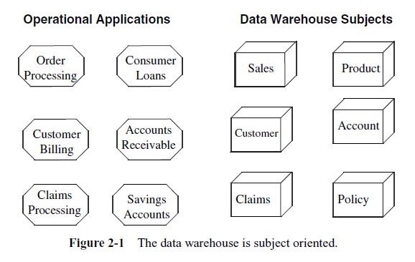
Subject-Oriented Data

Slide 10
Integrated Data
For proper decision making, we need to pull together all the relevant data from the various applications.
  The data in the data warehouse comes from several operational systems. Source data are in different databases, files, and data segments.
  These are disparate applications, so the operational platforms and operating systems could be different. The file layouts, character code representations, and field naming conventions all could be different.
In addition to data from internal operational systems, for many enterprises, data from outside sources is likely to be very important.

Slide 11
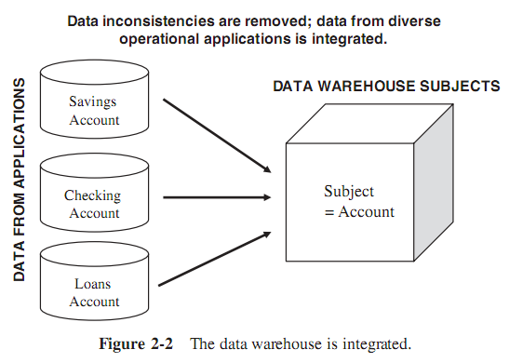
Integrated Data

Slide 12
Integrated Data
Before the data from different sources can be usefully stored in a data warehouse. These data are need to remove the inconsistencies:
  Standardize the various data elements and make sure of the meanings of data names in each data source
  And then, these data have to go through a process of transformation, consolidation, and integration.
Here are some of the items that would need standardization:
  Naming conventions
  Codes
  Data attributes
  Measurements

Slide 13
Time-Variant Data
For an operational system, the stored data contains the current values, for example:
  In an order entry system, the status of an order is the current status of the order.
  In a consumer loans application, the balance amount owed by the customer is the current amount.
  Of course, we store some past transactions in operational systems, but, essentially, operational systems reflect current information because these systems support day-to-day current operations.
On the other hand, the data in the data warehouse is meant for analysis and decision making.
  If a user is looking at the buying pattern of a specific customer, the user needs data not only about the current purchase, but on the past purchases as well.
  When an analyst in a grocery chain wants to promote two or more products together, that analyst wants sales of the selected products over a number of past quarters.

Slide 14
Time-Variant Data
So that, the data warehouse has to contain historical data, not just current values.
  Data is stored as snapshots over past and current periods.
  Every data structure in the data warehouse contains the time element. We will find historical snapshots of the operational data in the data warehouse.
  This aspect of the data warehouse is quite significant for both the design and the implementation phases.

Slide 15
Time-Variant Data
For example: in a data warehouse containing units of sale, the quantity stored in each file record or table row relates to a specific time element.
  Depending on the level of the details in the data warehouse, the sales quantity in a record may relate to a specific date, week, month, or quarter.
The time-variant nature of the data in a data warehouse
  Allows for analysis of the past
  Relates information to the present
  Enables forecasts for the future

Slide 16
Nonvolatile Data
Data extracted from the various operational systems or from outside sources, and after that, they are transformed, integrated, and stored in the data warehouse. So that:
  The data in the data warehouse is not intended to run the day-to-day business.
E.g: when we want to process the next order received from a customer:
  We do not look into the data warehouse to find the current stock status.
  The operational order entry application is meant for that purpose.
In the data warehouse, we keep the extracted stock status data as snapshots over time.
  This mean that: we do not update the data warehouse every time we process a single order.

Slide 17
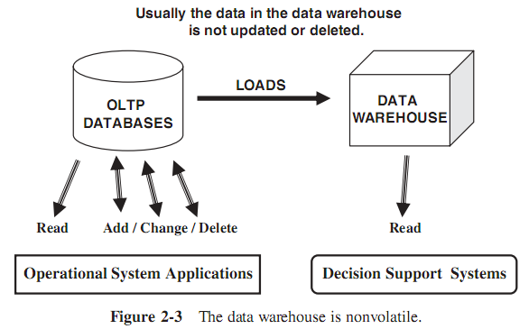
Nonvolatile Data

Slide 18
Nonvolatile Data
Data from the operational systems are moved into the data warehouse at specific intervals:
  Depending on the requirements of the business, these data movements take place twice a day, once a day, once a week, or once in two weeks.
  In fact, data movements to different data sets may take place at different frequencies.
We plan and schedule the data movements or data loads based on the requirements of business.

Slide 19
Data Granularity
When a user queries the data warehouse for analysis, they usually starts by looking at summary data. For example:
  The user may start with total sale units of a product in an entire region.
  Then, the user may want to look at the breakdown by provinces in this region. The next step may be the examination of sale units by the next level of individual stores.
  Frequently, the analysis begins at a high level and moves down to lower levels of detail.
So that, in a data warehouse, we need to keep data summarized at different levels.
  Data granularity in a data warehouse refers to the level of detail.
  The lower the level of detail, the finer the data granularity.
  Of course, if we want to keep data in the lowest level of detail, we have to store a lot of data in the data warehouse.
  We will have to decide on the granularity levels based on the data types and the expected system performance for queries

Slide 20
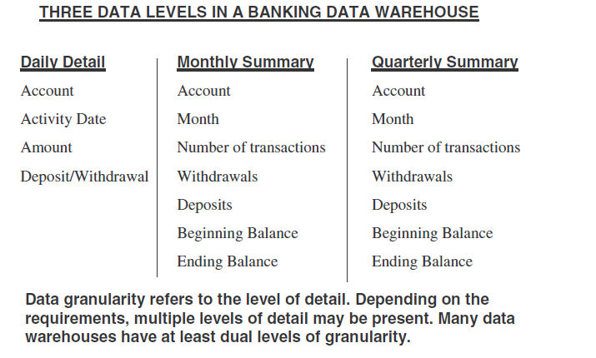
Data Granularity

Slide 21
DATA WAREHOUSES AND DATA MARTS
Before deciding to build a data warehouse, we need to ask the following basic and fundamental questions and address the relevant issues:
  Top-down or bottom-up approach?
  Enterprise-wide or departmental?
  Which first—data warehouse or data mart?
  Build pilot or go with a full-fledged implementation?
  Dependent or independent data marts?

Slide 22
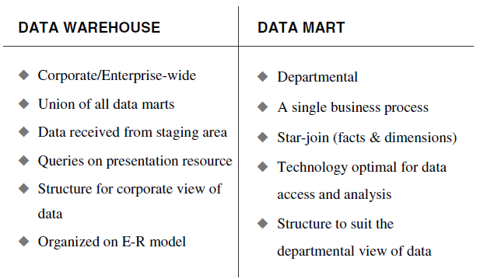
DATA WAREHOUSES AND DATA MARTS

Slide 23
Top-Down Approach
The advantages of this approach are:
  Providing an enterprise view of data
  Inherently architected - not a union of disparate data marts
  Single, central storage of data about the content
  Centralized rules and control
  May see quick results if implemented with iterations
The disadvantages are:
  Takes longer to build even with an iterative method
  High exposure/risk to failure
  Needs high level of cross-functional skills
  High outlay without proof of concept

Slide 24
Bottom-Up Approach
The advantages of this approach are:
  Faster and easier implementation of manageable pieces
  Favorable return on investment and proof of concept
  Less risk of failure
  Inherently incremental; can schedule important data marts first
  Allows project team to learn and grow
The disadvantages are:
  Each data mart has its own narrow view of data
  Permeates redundant data in every data mart
  Perpetuates inconsistent and irreconcilable data
  Proliferates unmanageable interfaces

Slide 25
A Practical Approach
In order to formulate an approach for our organization, we need to examine what exactly the organization wants:
  Is the organization looking for long-term results or fast data marts for only a few subjects for now?
  Does the organization want quick, proof-of-concept, throw-away implementations?
  Or, want to look into some other practical approach?

Slide 26
A Practical Approach
Although both the top-down and the bottom-up approaches each have their own advantages and drawbacks, a compromise approach accommodating both views appears to be practical.
The chief proponent of this practical approach is Ralph Kimball, an eminent author and data warehouse expert. The steps in this practical approach are as follows:
  1. Plan and define requirements at the overall corporate level
  2. Create a surrounding architecture for a complete warehouse
  3. Conform and standardize the data content
  4. Implement the data warehouse as a series of supermarts, one at a time

Slide 27
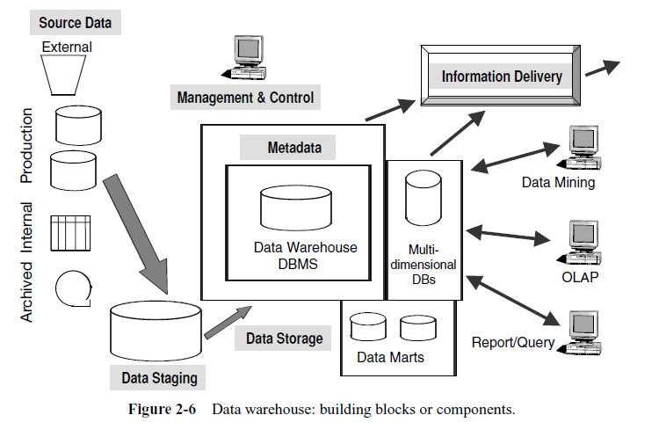
OVERVIEW OF THE COMPONENTS

Slide 28
Source Data Component
Production Data:
  This category of data comes from the various operational systems of the enterprise.
  Need to choose different segments of data from the operational systems based on the information requirements in the data warehouse.
  So that, need to standardize and transform these disparate data, and integrate into useful data for storage in the data warehouse.
Internal Data
  In every organization, users keep their “private” spreadsheets, documents, customer profiles, and sometimes even departmental databases.
  This is the internal data, parts of which could be useful in a data warehouse.
  The IT department must work with the user departments to gather the internal data.

Slide 29
Source Data Component
Archived Data/backed-up data
  In every operational system, periodically the old data is taken and stored in archived files.
  There are staged archival methods.:
    At the first stage, recent data is archived to a separate archival database that may still be online.
    At the second stage, the older data is archived to flat files on disk storage. At the next stage, the oldest data is archived to tape cartridges or microfilm and even kept off-site.
External Data
  Most executives use data from external sources. They use statistics relating to their industry produced by external agencies. They use market share data of competitors.
  For example, the data warehouse of a car rental company contains data on the current production schedules of the leading automobile manufacturers. This external data in the data warehouse helps the car rental company plan for their fleet management.

Slide 30
Data Staging Component
Three major functions need to be performed for getting the data ready into a data warehouse.
  Extract the data, transform the data, and then load the data into the data warehouse storage.
  These three major functions of extraction, transformation, and preparation for loading take place in a staging area.
  Data staging provides an area with a set of functions to clean, change, combine, convert, deduplicate, and prepare source data for storage and use in the data warehouse.
Why needing a separate place or component to perform the data preparation ?
  Remember that data in a data warehouse is subject-oriented and cuts across operational applications.
  A separate staging area, therefore, is a necessity for preparing data for the data warehouse.

Slide 31
Data Staging Component
Data Extraction:
  Is the process of retrieving data out of numerous data sources
  Have to employ the appropriate technique for each data source:
    Some source data may be in relational database systems.
    Many data sources may still be in flat files.
  Data extraction may become quite complex.
Data Transformation:
  Cleaning the data extracted from each source. May be:
    correction of misspellings
    resolution of data conflicts
    providing default values for missing data elements,
    or elimination of duplicates.
  Combining pieces of data from the different sources
  Standardize the data types and field lengths for same data elements retrieved from the various sources.

Slide 32
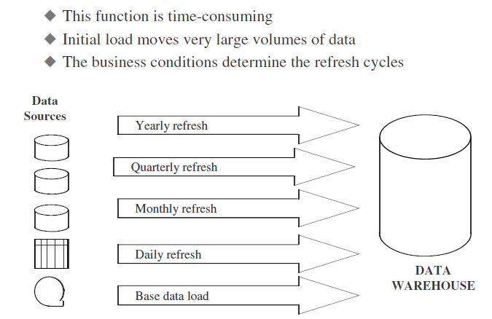
Data Staging Component
Data Loading:
  Two distinct groups of tasks form the data loading function.
  Initial loading of the data into the data warehouse storage for the first time.
  As the data warehouse starts functioning, we continue to extract the changes to the source data, transform the data revisions, and feed the incremental data revisions on an ongoing basis.

Slide 33
Data Storage Component
The data storage for the data warehouse is a separate repository.
Data repository need to keep large volumes of historical data for analysis:
  Data in the data warehouse is in structures suitable for analysis, and not for quick retrieval of individual pieces of information.
  Therefore, the data storage for the data warehouse is kept separate from the data storage for operational systems.
When the analysts use the data in the data warehouse for analysis, they need to know that the data is stable and that it represents snapshots at specified periods:
  The data storage must not be in a state of continual updating.
  For this reason, the data warehouses are “read-only” data repositories.

Slide 34
Data Storage Component
Generally, the database in your data warehouse must be open.
  Depending on your requirements, you are likely to use tools from multiple vendors.
  The data warehouse must be open to different tools. Most of the data warehouses employ relational database management systems.
Many of the data warehouses also employ multidimensional database management systems.
  Data extracted from the data warehouse storage is aggregated in many ways and the summary data is kept in the multidimensional databases (MDDBs).
  Such multidimensional database systems are usually proprietary products.

Slide 35
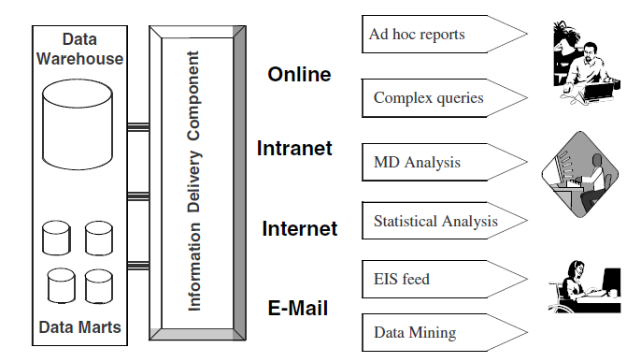
Information Delivery Component
There are many methods to delivery the information as following:

Slide 36
Metadata Component
Metadata means the data that provides information about other data
Metadata in a data warehouse is similar to the data dictionary or the data catalog in a database management system.
  The data dictionary keeps the information about the logical data structures, the information about the files, the information about the indexes, and so on.
Similarly, the metadata component is the data about the data in the data warehouse, but but much more than a data dictionary (we will discuss more later).

Slide 37
Management and Control Component
The management and control component sits on top of all the other components in data warehouse architecture. It’s functions include:
  It coordinates the services and activities within the data warehouse.
  It controls the data transformation and the data transfer into the data warehouse storage.
  It moderates the information delivery to the users.
  It works with the database management systems and enables data to be properly stored in the repositories.
  It monitors the movement of data into the staging area and from there into the data warehouse storage itself.
The management and control component interacts with the metadata component to perform the management and control functions.
  The metadata is the source of information for the management module.

Slide 38
METADATA IN THE DATA WAREHOUSE
Because of the importance of metadata in a data warehouse, we have set apart all of Chapter 9 for this topic. At this stage, we just introduction to metadata
Metadata in a data warehouse fall into three major categories:
  Operational Metadata
  Extraction and Transformation Metadata
  End-User Metadata

Slide 39
METADATA IN THE DATA WAREHOUSE
Operational Metadata:
  Data for the data warehouse comes from several operational systems These source systems contain different data structures.
  The data elements selected for the data warehouse have various field lengths and data types.
  In selecting data from the source systems for the data warehouse, we split records, combine parts of records from different source files, and deal with multiple coding schemes and field lengths.
  When we deliver information to the end-users, we must be able to tie that back to the original source data sets.
  Operational metadata contain all of this information about the operational data sources.

Slide 40
METADATA IN THE DATA WAREHOUSE
Extraction and Transformation Metadata:
  Extraction and transformation metadata contain data about the extraction of data from the source systems, namely, the extraction frequencies, extraction methods, and business rules for the data extraction.
  Also, this category of metadata contains information about all the data transformations that take place in the data staging area.
End-User Metadata:
  The end-user metadata is the navigational map of the data warehouse.
  It enables the end-users to find information from the data warehouse.
  The end-user metadata allows the end-users to use their own business terminology and look for information in those ways in which they normally think of the business.

Slide 41
METADATA IN THE DATA WAREHOUSE
Why is metadata especially important in a data warehouse?
  First, it acts as the glue that connects all parts of the data warehouse.
  Next, it provides information about the contents and structures to the developers.
  Finally, it opens the door to the end-users and makes the contents recognizable in their own terms.

Slide 42
Chapter 3:
TRENDS IN DATA WAREHOUSING

Slide 43
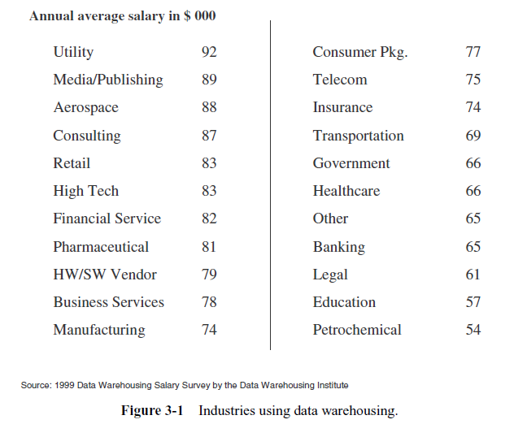
Continued Growth in Data Warehousing
Data Warehousing is Becoming Mainstream
Data Warehouse Expansion

Slide 44
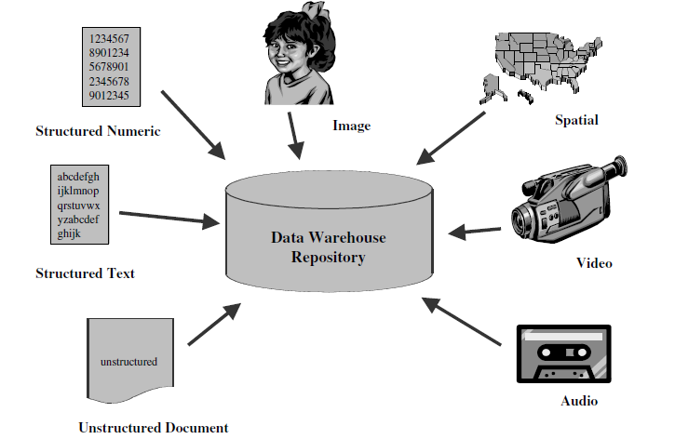
Significant Trends
Multiple Data Types

Slide 45
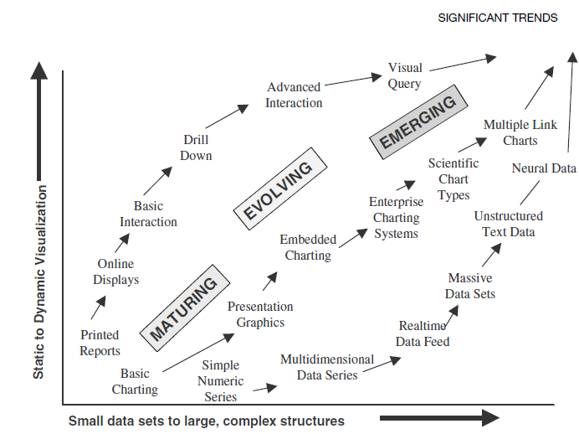
Significant Trends: Data Visualization

Slide 46
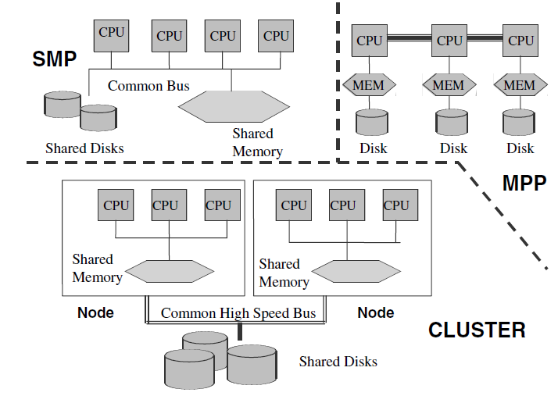
Significant Trends: Parallel Processing

Slide 47
Significant trends
Query Tools
Browser Tools
Data Fusion
Multidimensional Analysis
Agent Technology
Data Warehousing and ERP(enterprise resource planning) , KM (knowledge management), CRM (customer relationship management)

Slide 48
Emergence of Standards
Metadata
OLAP

Slide 49
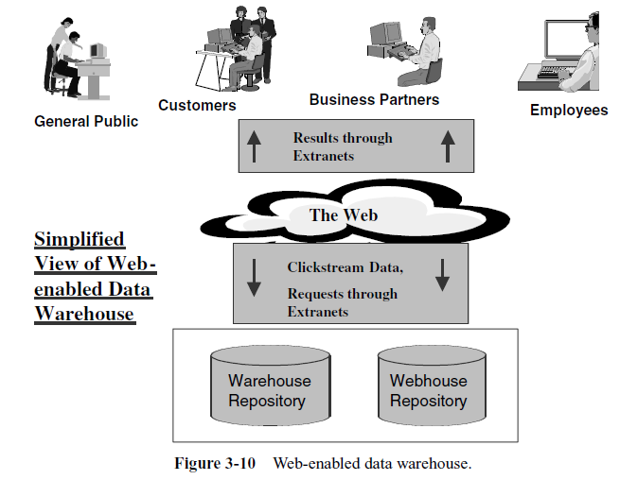
Web-Enabled Data Warehouse

