Slide 1

Data Warehouses
FPT University

Slide 2
Lecture 5: Architectural component and Infrastructure

Slide 3
Chapter 7: Architectural components

Slide 4
Outline
Data Warehouse Architecture
Architectural Framework
Technical Architecture
Infrastructure Supporting Architecture
Hardware and Operating Systems
Database Software
Collection of Tools

Slide 5
I./ UNDERSTANDING DATA WAREHOUSE ARCHITECTURE
You were introduced to the building blocks of the data warehouse. At that stage, we quickly looked at the list of components and reviewed each very briefly.
Here, we review the data warehouse architecture from different perspectives.
  You will study the architectural components in the manner in which they enable the flow of data from the sources to the end-users.
  Then you will be able to look at each area of the architecture and examine the functions, procedures, and features in that area.
  That discussion will lead you into the technical architecture in those architectural areas.

Slide 6
Architecture: Definitions
The data warehouse architecture includes a number of factors:
  Primarily, it includes the integrated data that is the centerpiece.
  Everything that is needed to prepare the data and store it.
  On the other hand, all the means for delivering information to user.
  The rules, procedures, and functions that enable the data warehouse to work and fulfill the business requirements.
What is the general purpose of the data warehouse architecture?
  The architecture provides the overall framework for developing and deploying the data warehouse;
  It is a comprehensive blueprint.
  The architecture defines the standards, measurements, general design, and support techniques.

Slide 7
Architecture in Three Major Areas
As you already know, the three major areas in the data warehouse are:
  Data acquisition
  Data storage
  Information delivery

Slide 8
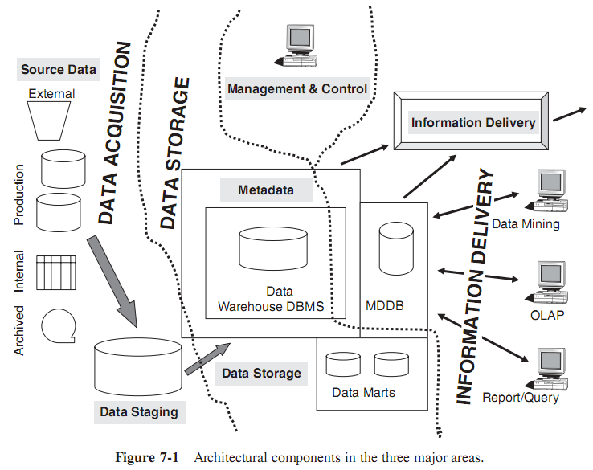
Architecture in Three Major Areas

Slide 9
II./ DISTINGUISHING CHARACTERISTICS
Data warehouse architecture is wide, complex, and expansive. It consists of distinct components.
The architecture has distinguishing characteristics worth considering in detail.
Before moving on to discuss the architectural framework itself, let us review the distinguishing characteristics of data warehouse architecture.

Slide 10
1. Different Objectives and Scope
Defining the scope for a data warehouse is also difficult.
  How do you scope an operational system?
    You consider the group of users, the range of functions, the data repository, and the output screens and reports.
For a data warehouse, what are all the factors you must consider for defining the scope?
There are several sets of factors to consider:
  First, must consider the number and extent of the data sources.
    How many legacy systems that data are extracted from?
    What are the external sources?
    Are you planning to include departmental files, spreadsheets, and private databases?
  What about including the archived data?
  Scope of the architecture may again be measured in terms of the data transformations and integration functions.
  Data granularity and data volumes are also important considerations.

Slide 11
2. Data content
The “read-only” data in the data warehouse sits in the middle as the primary component in the architecture.
Before data is brought into your data warehouse and stored as read-only data, a number of functions must be performed.
Further, the data warehouse architecture must support the storing of data grouped by business subjects, not grouped by applications as in the case of operational systems.
When we mention historical data stored in the data warehouse, we are talking about very high data volumes.
  Most companies opt to keep data going back 10 years in the data warehouse.
  Some companies want to keep even more, if the data is available. This is another reason why the data warehouse architecture must support high data volumes.

Slide 12
3. Complex Analysis and Quick Response
The data warehouse architecture must support complex analysis.
  Most of the online information retrieval during a session by a user is interactive analysis.
  User usually starts with a query at a high level, reviews the result set, initiates the next query looking at the data in a slightly different way, and so on. It is a long sesion
Therefore, the data warehouse architecture must support variations for providing analysis.
  Users must be able to drill down, roll up, slice and dice data, and play with “what-if” scenarios.
  Users must have the capability to review the result sets in different output options.
  Users are no longer content with textual result sets or results displayed in tabular formats. Every result set in tabular format must be translated into graphical charts.
The data warehouse architecture must make it easy to make strategic decisions quickly.

Slide 13
4. Flexible and Dynamic
All business requirements up front:
  Nevertheless, the missing parts of the requirements show up after your users begin to use the data warehouse. What is the implication of this ?
    You have to make sure your data warehouse architecture is flexible enough to accommodate additional requirements as and when they surface.
Additional missed requirements is need
  Business conditions themselves change.
  In fact, they keep on changing. Changing business conditions call for additional business requirements to be included in the data warehouse.
  If the data warehouse architecture is designed to be flexible and dynamic, then the data warehouse can cater to the supplemental requirements as and when they arise.

Slide 14
5. Metadata-driven
As the data moves from the source systems to the end-users as useful (it is strategic information), the metadata surrounds the entire movement.
In an operational system, there is no component that is equivalent to metadata in a data warehouse.
In your data warehouse architecture, the metadata component interleaves with and connects the other components.

Slide 15
III. ARCHITECTURAL FRAMEWORK
Earlier in a previous section, we grouped the architectural components in the three distinct areas of:
  data acquisition,
  data storage,
  and information delivery.
In each of these broad areas of the data warehouse, every architectural components serve specific purposes.

Slide 16
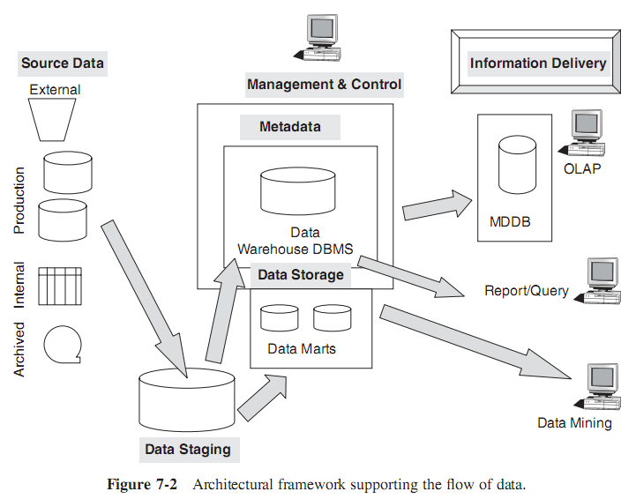
Architecture Supporting Flow of Data

Slide 17
Architecture Supporting Flow of Data
At the Data Source
  Here the internal and external data sources form the source data
  Source data governs the extraction of data for preparation and storage in the data warehouse.
  The data staging architectural component governs the transformation, cleansing, and integration of data.
In the Data Warehouse Repository
  The data storage architectural component includes the loading of data from the staging area and also storing the data in suitable formats for information delivery.
  The metadata architectural component is also a storage mechanism to contain data about the data at every point of the flow of data from beginning to end.
At the User End
  The information delivery architectural component includes dependent data marts, special multidimensional databases, and a full range of query and reporting facilities

Slide 18
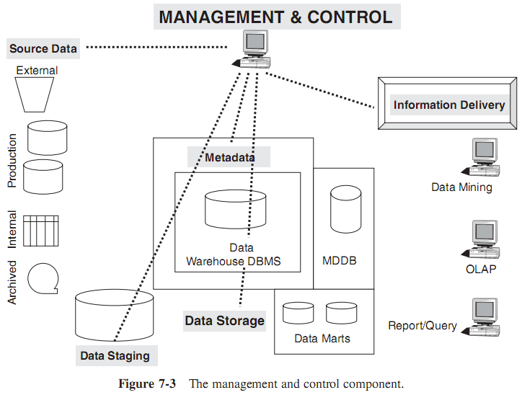
The Management and Control Module
This architectural component is an overall module managing and controlling the entire data warehouse environment.
It is working at various levels and covering all the operations.
This component has two major functions:
  first to constantly monitor all the ongoing operations,
  and next to step in and recover from problems when things go wrong.

Slide 19
IV. TECHNICAL ARCHITECTURE
The technical architecture of a data warehouse is the complete set of functions and services provided within its components.
  The technical architecture also includes the procedures and rules that are required to perform the functions and provide the services.
  The technical architecture also encompasses the data stores needed for each component to provide the services.

Slide 20
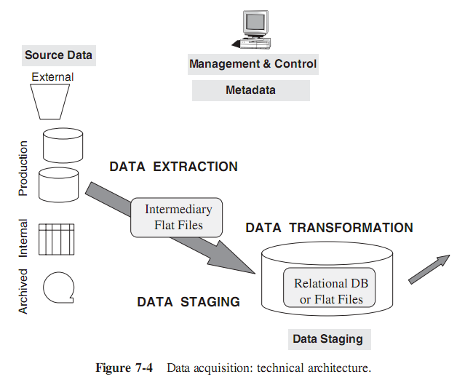
Data Acquisition
Data Extraction
Data Transformation
Data Staging

Slide 21
Data Acquisition: List of Functions and Services
Data Extraction - includes the following functions and services:
  Select data sources and determine the what types of filters to be applied to individual sources
  Generate automatic extract files from operational systems using replication and other techniques
  Create intermediary files to store selected data to be merged later
  Provide automated job control services for creating extract files.
  Transport extracted files from multiple platforms
  Reformat input from outside sources
  Reformat input from departmental data files, databases, and spreadsheets
  Generate common application code for data extraction
  Resolve inconsistencies for common data elements from multiple sources

Slide 22
Data Acquisition: List of Functions and Services
Data Transformation:
  Map input data to data for data warehouse repository
  Clean data, deduplicate, and merge/purge
  Denormalize extracted data structures as required by the dimensional model of the data warehouse
  Convert data types
  Calculate and derive attribute values
  Check for referential integrity
  Aggregate data as needed
  Resolve missing values
  Consolidate and integrate data

Slide 23
Data Acquisition: List of Functions and Services
Data Staging:
  Provide backup and recovery for staging area repositories
  Sort and merge files
  Create files as input to make changes to dimension tables
  If data staging storage is a relational database, create and populate database
  Preserve audit trail to relate each data item in the data warehouse to input source
  Resolve and create primary and foreign keys for load tables
  If staging area storage is a relational database, extract load files

Slide 24
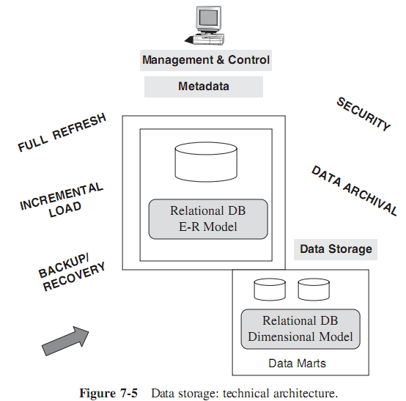
Data Storage
This covers the process of loading the data from the staging area into the data warehouse repository.
All functions for transforming and integrating the data are completed in the data staging area.

Slide 25
Data Storage: List of Functions and Services
Load data for full refreshes of data warehouse tables
Perform incremental loads at regular prescribed intervals
Support loading into multiple tables at the detailed and summarized levels
Optimize the loading process
Provide automated job control services for loading the data warehouse
Provide backup and recovery for the data warehouse database
Provide security
Monitor and fine-tune the database

Slide 26
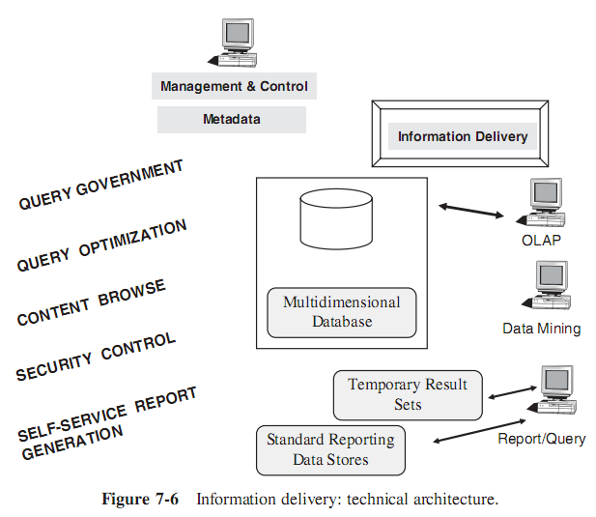
Information Delivery
This area spans a broad spectrum of many different methods of making information available to users.

Slide 27
Information Delivery: Functions and Services
Provide security to control information access
Monitor user access to improve service and for future enhancements
Allow users to browse data warehouse content
Automatically reformat queries for optimal execution
Provide self-service report generation for users, consisting of a variety of flexible options to create, schedule, and run reports
Store result sets of queries and reports for future use
Provide multiple levels of data granularity
Make provision for the users to perform complex analysis through online analytical processing (OLAP)
Enable data feeds to downstream, specialized decisions support systems such as EIS and data mining

Slide 28
Chapter 7: Infrastructure as the foundation for data warehousing

Slide 29
1. INFRASTRUCTURE SUPPORTING ARCHITECTURE
Data warehouse infrastructure includes all the foundational elements that enable the architecture to be implemented:
  Such as server hardware, operating system, network software, database software, the LAN and WAN, vendor tools for every architectural component, people, procedures, and training.
The elements of the data warehouse infrastructure may be classified into two categories:
  operational infrastructure
  and physical infrastructure.

Slide 30
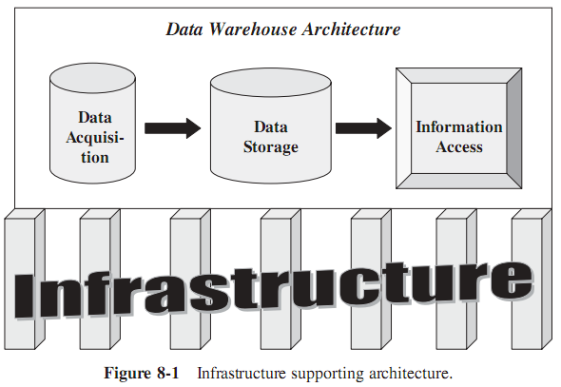
1. INFRASTRUCTURE SUPPORTING ARCHITECTURE

Slide 31
Operational Infrastructure
Operational infrastructure to support each architectural component consists of
  People
  Procedures
  Training
  Management software

Slide 32
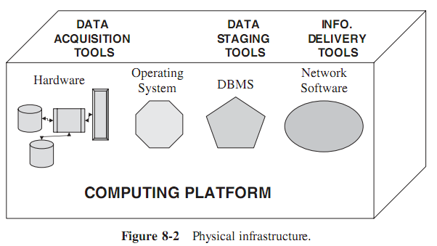
Physical Infrastructure

Slide 33
2. HARDWARE SYSTEMS and OPERATING SYSTEMS
Hardware and operating systems make up the computing environment for data warehouse. Here are some general guidelines for hardware selection:
  Scalability. When the data warehouse grows in the number of users, the number of queries, and the complexity of the queries, ensure that the selected hardware could be scaled up.
  Support. Vendor support is crucial for hardware maintenance. Make sure that the support from the hardware vendor is at the highest possible level.
  Vendor Reference. It is important to check vendor references with other sites using hardware from this vendor.
  Vendor Stability. Check on the stability and staying power of the vendor.

Slide 34
2. HARDWARE SYSTEMS and OPERATING SYSTEMS
Consider a few general criteria for the selection of the operating system:
  Salability. is first consider. Along with the hardware and database software, the OS must be able to support the increase in the number of users and applications.
  Security. When multiple client workstations access the server, the OS must be able to protect each client and associated resources.
  Reliability. The OS must be able to protect the environment from application malfunctions.
  Availability. This is a corollary to reliability. The computing environment must continue to be available after abnormal application terminations.
  Preemptive Multitasking. The OS must be able to let a higher priority task preempt or interrupt another task as and when needed
  Use multithreaded approach. The OS must be able to serve multiple requests concurrently by distributing threads to multiple processors in a multiprocessor hardware configuration.
  Memory protection. In a data warehouse environment, multiple queries will be executing concurrently. A memory protection feature in an OS prevents one task from violating the memory space of another.

Slide 35
Platform Options
Single Platform Option.
  This is the most straightforward and simplest option for implementing the data warehouse architecture.
  In this option, all functions from the backend data extraction to the front-end query processing are performed on a single computing platform.
  This was perhaps the earliest approach, when developers were implementing data warehouses on existing mainframes, minicomputers, or a single UNIX-based server.

Slide 36
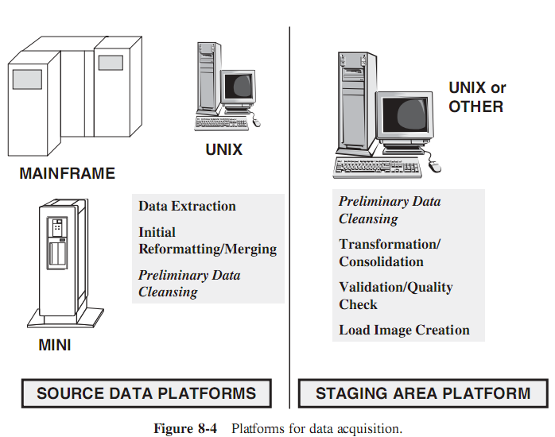
Hybrid Option

Slide 37
Data Movement Considerations.
The individual steps of data acquisition and data storage happen, data has to move across platforms.
Depending on the source platforms in your company and the choice of the platform for data staging and data storage, you have to provide for data transportation across different platforms.

Slide 38
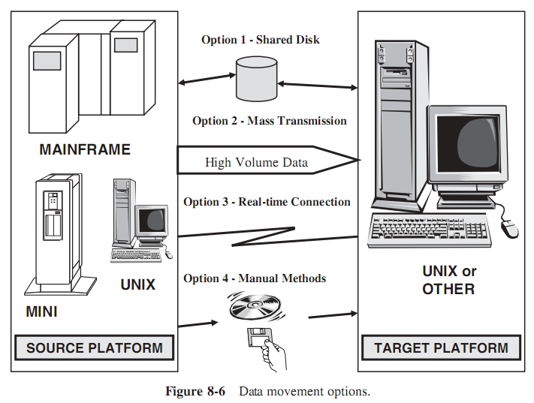
Data Movement Considerations.

Slide 39
Client Server Architecture for the Data Warehouse
Although mainframe and minicomputer platforms were utilized in the early implementations of data warehouses
Today’s warehouses are built using the client/server architecture. Most of these are multitiered, second-generation client/server architectures.

Slide 40
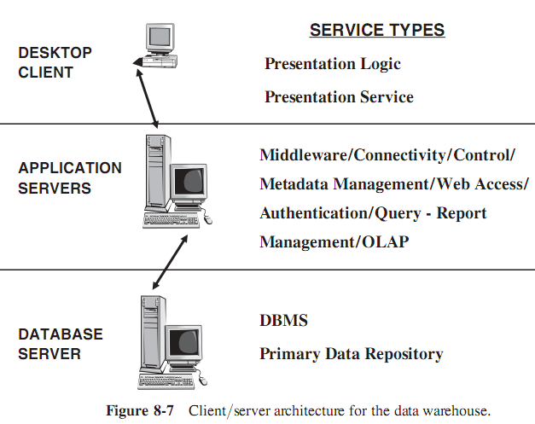
Client Server Architecture for the Data Warehouse

Slide 41
Server Hardware
Selecting the server hardware is among the most important decisions your data warehouse project team is faced with.
Probably, for most warehouses, server hardware selection can be a “bet your bottom dollar” decision.
Scalability and optimal query performance are the key phrases.
There are three option:
  SMP (Symmetric Multiprocessing)
  Clusters
  MPP (Massively Parallel Processing)

Slide 42
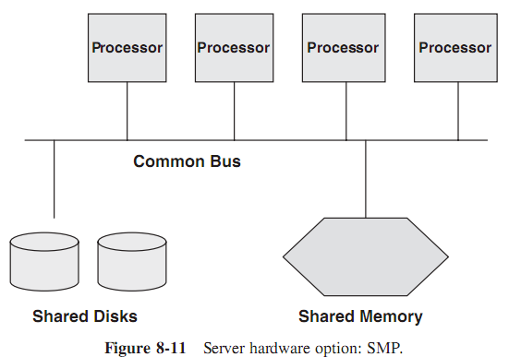
Symmetric Multiprocessing
Benefits:
  It provides high concurrency
  It balances workload very well.
  It gives scalable performance; simply add more processors to the system bus.
  Being a simple design, you can administer the server easily.
Limitations:
  Available memory may be limited.
  Performance may be limited by bandwidth for processor-to-processor communication, I/O, and bus communication.
  Availability is limited; like a single computer with many processors.

Slide 43
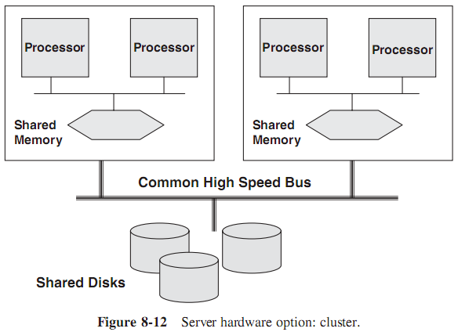
Clusters
Benefits:
  Provides high availability; all data is accessible even if one node fails.
  It preserves the concept of one database.
  This option is good for incremental growth.
Limitations:
  Bandwidth of the bus could limit the scalability of the system.
  This option comes with a high operating system overhead.
  Each node has a data cache; the architecture needs to maintain cache consistency for internode synchronization.

Slide 44
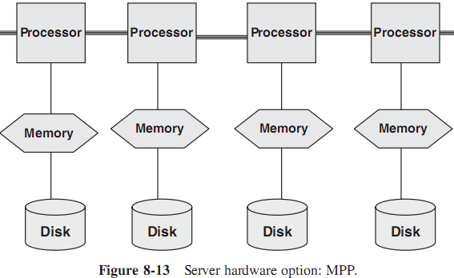
Massive Parallel Processing
Benefits:
  This architecture is highly scalable.
  The option provides fast access between nodes.
  Any failure is local to the failed node; this improves system availability.
  Generally, the cost per node is low.
Limitations:
  The architecture requires rigid data partitioning.
  Data access is restricted.
  Workload balancing is limited.
  Cache consistency must be maintained.

Slide 45
III. DATABASE SOFTWARE
Examine the features of the leading commercial RDBMSs. Consider to data warehouse features being included in the software products.
Data-warehouse related add-ons are becoming part of the database offerings.
DBMSs have also been scaled up to support very large databases.
Parallel processing options in database software are intended only for machines with multiple processors.
Most of the current database software can parallelize a large number of operations.
  These operations include the following: mass loading of data, full table scans, queries with exclusion conditions, queries with grouping, selection with distinct values, aggregation, sorting, creation of tables using subqueries, creating and rebuilding indexes, inserting rows into a table from other tables, enabling constraints, …

Slide 46
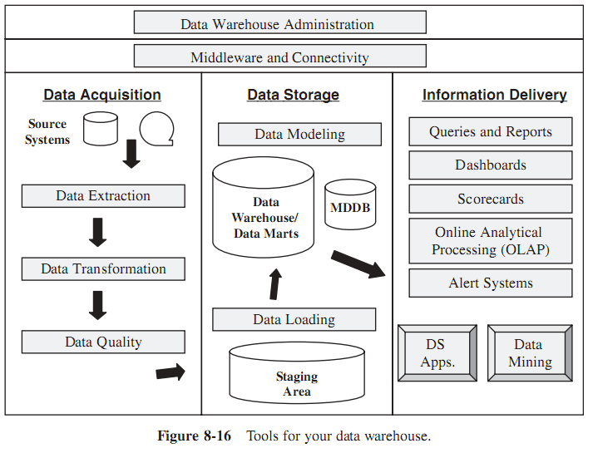
IV. COLLECTION OF TOOLS

