Slide 1

Data Warehouses
FPT University

Slide 2
Lecture 8:Data Extraction, Transformation, Loading

Slide 3
Outline
ETL Overview
Data Extraction
Data Transformation
Data Loading

Slide 4
ETL OVERVIEW
“A data warehouse is a system that extracts, cleans, conforms and delivers source data into dimensional data store and then support and implements querying and analysis for purpose of decision making”
  Source: Ralph Kimball, Jose Caserta: The data warehouse ETL Toolkit; Wiley 2004
So that, the ETL are the important processes in the data warehousing
Where and when the ETL are perform ?
  The technical architecture of the data warehouse is divided into three areas: data acquisition, data storage, and information delivery.
  Data extraction, transformation, and loading encompass the areas of data acquisition and data storage.

Slide 5
1. Most Important and Most Challenging
Each of the ETL functions fulfills a significant purpose.
When convert data from the source systems into information to store in the data warehouse, each of these functions is essential.
For changing data into information we first need to capture the data.
After we capture the data, we cannot simply dump that data into the data warehouse and call it strategic information. But we must do something else more significant
Consider an example in next slide

Slide 6
1. Most Important and Most Challenging
Example:
  The analysis user wants to compare and analyze sales by store, by product, and by month.
The sales data are available in the several sales applications in your company.And each sales transaction refers to a specific store. All these are pieces of data in the source operational systems.
For doing the analysis, the data warehouse database have to provide information about the sales
  We have to provide the sales units and dollars in a fact table, the products in a product dimension table, the stores in a store dimension table, and months in a time dimension table.

Slide 7
1. Most Important and Most Challenging (cont)
How do we do this?
  Extract the data from each of the operational systems, reconcile the variations in data representations among the source systems, and transform all the sales of all the products.
  Then load the sales data into the fact and dimension tables.
  Now, after completion of these three functions, the extracted data is sitting in the data warehouse, transformed into information, ready for analysis.

Slide 8
2. Time-Consuming and Arduous
Designing the ETL functions, testing the various processes, and deploying them consume a very high percentage of the total project effort.
It is not uncommon for a project team to spend as much as 50–70% of the project effort on ETL functions:
  Data extraction itself can be quite involved depending on the nature and complexity of the source systems.
  Activities within the data transformation include:
    reformat internal data structures,
    resequence data,
    apply various forms of conversion techniques,
    supply default values wherever values are missing,
    design the whole set of aggregates that are needed for performance improvement.
  The sheer massive size of the initial loading can populate millions of rows in the data warehouse database. Creating and managing load images for such large numbers are not easy tasks.

Slide 9
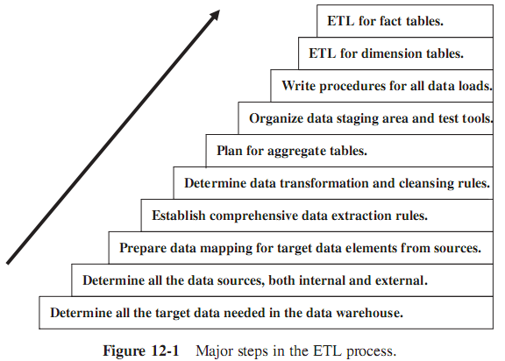
3. ETL Steps

Slide 10
I. DATA EXTRACTION
Two major factors differentiate the data extraction for a new operational system from the data extraction for a data warehouse.
  First, for a data warehouse, we have to extract data from many disparate sources.
  Next, for a data warehouse, we have to extract data on the changes for ongoing incremental loads as well as for a one-time initial full load.
For operational systems, all we need is one-time extractions and data conversions.

Slide 11
1. Source Identification
Assume that a part of the data warehouse database is designed to provide strategic information on the fulfillment of orders.
  For this purpose, we need to store historical information about the fulfilled and pending orders.
  If we ship orders through multiple delivery channels, we need to capture data about these channels.
  If our users are interested in analyzing the orders by the status of the orders as the orders go through the fulfillment process, then we need to extract data on the order statuses.
In the fact table for order fulfillment, we need attributes about the total order amount, discounts, commissions, expected delivery time, actual delivery time, ...
We also need all attributes of dimension tables
➔ First, we have to determine if we have source systems to provide these data needed.
Then, from the source systems, we have to establish the correct data source for each data element.
Further, we have to go through a verification process to ensure that the identified sources are really the right ones.

Slide 12
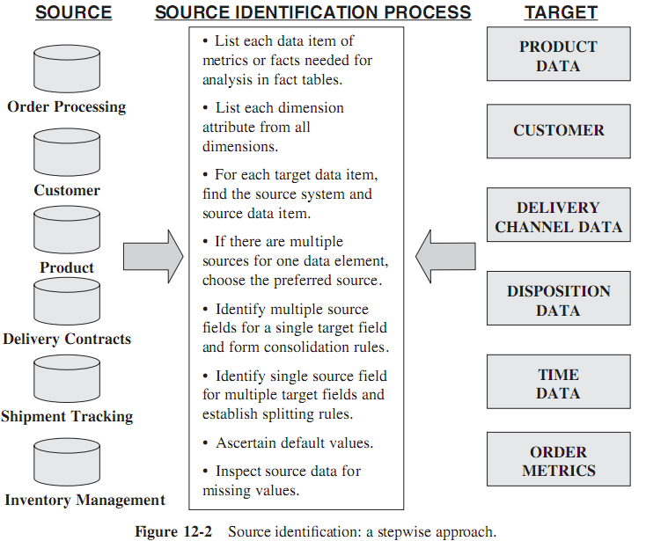
1. Source Identification

Slide 13
2. Data Extraction Techniques
Business transactions keep changing the data in the source systems.
In most cases, the value of an attribute in a source system is the value of that attribute at the current time.
But, in data warehouse, usually we need to store the history values. Question: how do you capture the history from the source systems?
➔ The answer depends on how exactly data is stored in the source systems.

Slide 14
2. Data Extraction Techniques
Data in Operational Systems - These source systems generally store data in two ways below:
Current Value
  The stored value of an attribute represents the value of the attribute at this moment of time. The values are transient or transitory.
  The value of an attribute remains constant only until a business transaction changes it. There is no telling when it will get changed.
  ➔ Data extraction for preserving the history of the changes in the data warehouse gets quite involved for this category of data. Data extraction is more dififficult
Periodic Status:
  The value of the attribute is preserved as the status every time a change occurs.
  At each of these points in time, the status value is stored with reference to the time when the new value became effective.
  ➔ Because the history of the changes is preserved in the source systems themselves. Therefore, data extraction for the purpose of keeping history in the data warehouse is relatively easier.

Slide 15
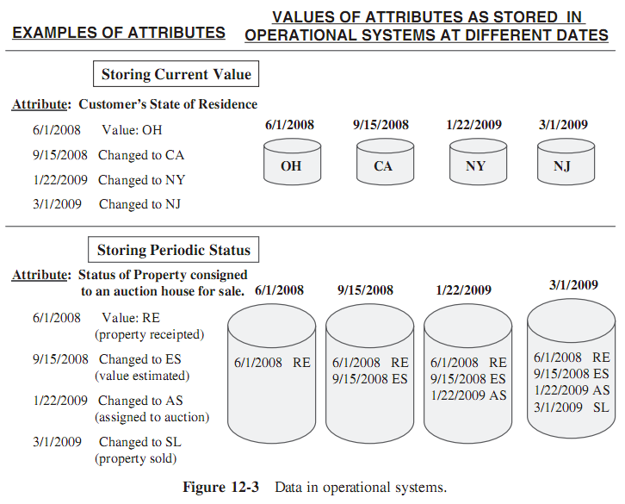
2. Data Extraction Techniques

Slide 16
2. Data Extraction Techniques
Two types of data loading for data warehouse:
  When data warehouse is deployed, the initial data as of a certain time must be moved to the data warehouse to get it started. This is the initial load.
  After the initial load, the data warehouse must be kept updated, so the history of the changes and statuses are reflected in the data warehouse. This is the incremental load
➔ The different of type data loading need different set of data

Slide 17
2. Data Extraction Techniques
There are two major types of data extractions from the source operational systems:
  “as is”(static) data :
    or static data is the capture of data at a given point in time.
    For current or transient data, this capture would include all transient data identified for extraction.
    For periodic data, this capture would include each status or event at each point in time as available in the source operational systems.
    ➔ Static data capture primarily for the initial load of the data warehouse.
  data of revisions :
    Also known as incremental data capture. Strictly, it is the revisions since the last time data was captured.
    For current or transient data, the capture of the revisions is not easy.
    For periodic status data, the incremental data capture includes the values of attributes at specific times Extract the statuses and events that have been recorded since the last data extraction.
    Incremental data capture may be immediate or deferred.

Slide 18
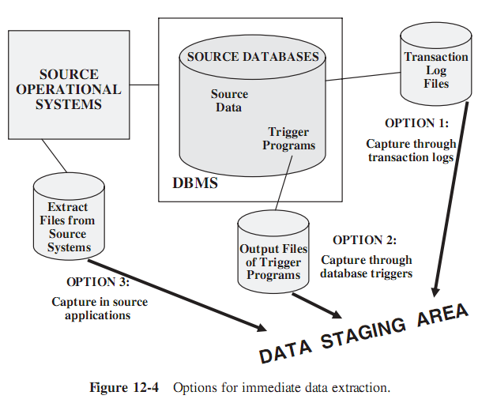
2.1.Immediate Data Extraction.
In this option, the data extraction is real-time.
It occurs as the transactions happen at the source databases and files.
Figure 12-4 shows the immediate data extraction options:
  In source applicatios
  Through database triggers
  Through transaction logs

Slide 19
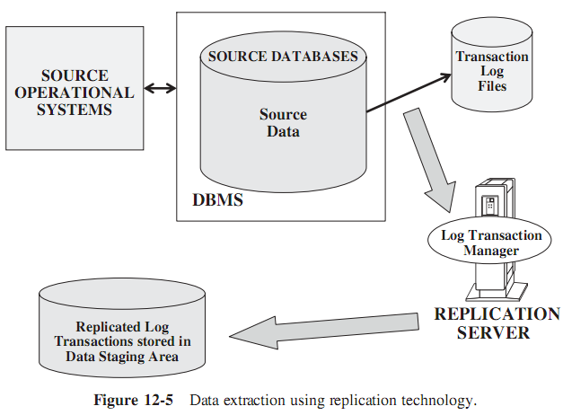
2.1.Immediate Data Extraction.
Capture through Transaction Logs. This option uses the transaction logs of the DBMSs maintained for recovery from possible failures. Only DBMS can access log file in real-time.
So, this data extraction technique need supporting from DBMS. It usually is implemented by replication mechanism.
The common steps for using replication to capture changes to source data:
  Identify the source system database table
  Identify and define target files in the staging area
  Create mapping between the source table and target files
  Define the replication mode
  Schedule the replication process

Slide 20
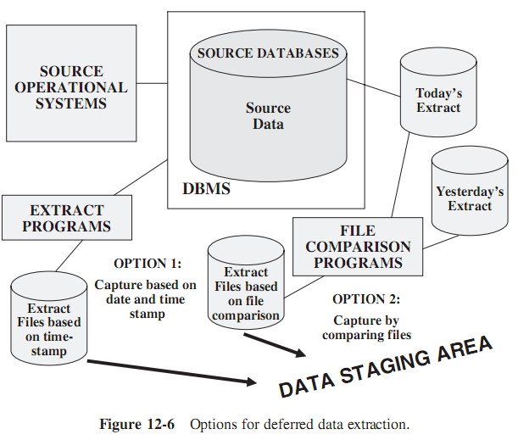
2.2 Deferred Data Extraction.
In contrast, the techniques under deferred data extraction do not capture the changes in real-time. The capture happens later.
Figure 12-6 shows the deferred data extraction options.

Slide 21
2.2 Deferred Data Extraction.
Capture Based on Date and Time Stamp.
  Every time a source record is created or updated, it may be marked with a stamp showing the date and time.
  The time stamp provides the basis for selecting records for data extraction.
  The data capture occurs at a later time, not while each source record is created or updated.
  If the data extraction program at midnight every day, each day it will extract only those with the date and time stamp later than midnight of the previous day.
This technique works well if the number of revised records is small.

Slide 22
2.2 Deferred Data Extraction.
Capture by Comparing Files:
  This technique is also called the snapshot differential technique because it compares two snapshots of the source data. Let us see how this technique works.
  Suppose we want to capture the changes to the product data.
    While performing today’s data extraction for changes to product data, we do a full file comparison between today’s copy of the product data and yesterday’s copy.
    We also compare the record keys to find the inserts and deletes. Then you capture any changes between the two copies

Slide 23
3. Evaluation of the Techniques
The following options are available for data extraction:
  Capture of static data
  Capture through transaction logs
  Capture through database triggers
  Capture in source applications
  Capture based on date and time stamp
  Capture by comparing files
Which ones are applicable in your environment?

Slide 24
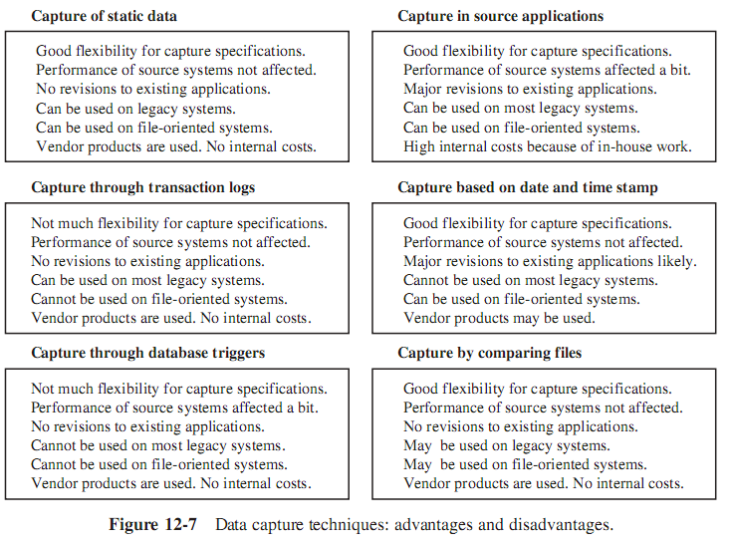
Evaluation of the Techniques

Slide 25
II.DATA TRANSFORMATION
Before moving the extracted data from the source systems into the data warehouse, we inevitably have to perform various kinds of data transformations.
We have to transform the data according to standards because they come from many dissimilar source systems.
We have to ensure that after all the data is put together, the combined data does not violate any business rules.
There are many type of data transformation, but most of data transformation functions break down into a few basic tasks:
  Selection
  Splitting/Joining
  Conversion
  Summarization
  Enrichment

Slide 26
1. Data Transformation: Basic Tasks
Selection. This takes place at the beginning of the whole process of data transformation.
  Select either whole records or parts of several records from the source systems.
  The task of selection usually forms part of the extraction function itself.
Splitting/joining. This task performs on the selected parts of source records.
  Sometimes (uncommonly), we will be splitting the selected parts even further during data transformation.
  Joining of parts selected from many source systems is more widespread in the data warehouse environment.
Conversion. It includes a large variety of rudimentary conversions of single fields for two primary reasons:
  to standardize among the extracted data from disparate source systems, and
  to make the fields usable and understandable to the users.

Slide 27
1. Data Transformation: Basic Tasks
Summarization. Sometimes we may find that it is not feasible to keep data at the lowest level of detail in the data warehouse.
  It may be that none of the users ever need data at the lowest granularity for analysis or querying.
  For example, for a grocery chain, sales data at the lowest level of detail for every transaction at the checkout may not be needed.
  Storing sales by product by store by day in the data warehouse may be quite adequate.
  ➔ So, in this case, the data transformation function includes summarization of daily sales by product and by store.
Enrichment. This task is the rearrangement and simplification of individual fields to make them more useful for the data warehouse environment.
  It may be use one or more fields from the same input record to create a better view of the data for the data warehouse.
  This principle is extended when one or more fields originate from multiple records, resulting in a single field for the data warehouse.

Slide 28
2. Major Transformation Types
Format Revisions. It is quite often.
  These revisions include changes to the data types and lengths of individual fields.
  For example:
    Product may be indicated by codes and names in which the fields are numeric and text data types.
    The lengths of the types may vary among the different source systems.
  It is wise to standardize and change the data type to text to provide values meaningful to the users.
Decoding of Fields. It is also a common type of data transformation.
  In multiple different data source systems, the same data items may be described by a plethora of field values.
  The classic example is the coding for gender, with one source system using 1 and 2 for male and female and another system using M and F.
  What do the codes AC, IN, RE, and SU mean in a customer file? We need to decode all such cryptic codes and change these into values that make sense to the users. Change the codes to Active, Inactive, Regular, and Suspended.

Slide 29
2. Major Transformation Types
Calculated and Derived Values. What if we want to keep profit margin along with sales and cost amounts in your data warehouse tables?
  The extracted data from the sales system contains sales amounts, sales units, and cost estimates by product.
  We will have to calculate the total cost and the profit margin before data can be stored in the data warehouse.
Splitting of Single Fields.
  Source systems may be stored names and addresses of customers and employees in large text fields.
  The first name, middle initials, and last name were stored as a large text in a single field. Similarly, some earlier systems stored city, state, and Zip Code data together in a single field.
  We need to store individual components of names and addresses in separate fields in the data warehouse for two reasons.
    First, we may improve the operating performance by indexing on individual components.
    Second, the end-users may need to perform analysis by using individual components such as city, state, and Zip Code.

Slide 30
2. Major Transformation Types
Merging of Information.
  This is not quite the opposite of splitting of single fields. This type of data transformation does not literally mean the merging of several fields to create a single field of data.
  For example, information about a product may come from different data sources.
  The product code and description may come from one data source.
  The relevant package types may be found in another data source. The cost data may be from yet another source.
  In this case, merging of information denotes the combination of the product code, description, package types, and cost into a single entity.
Character Set Conversion.
  This type of data transformation relates to the conversion of character sets to an agreed standard character set for textual data in the data warehouse.

Slide 31
2. Major Transformation Types
Conversion of Units of Measurements. Many companies today have global branches.
  We may have to convert the metrics so that the numbers may all be in one standard unit of measurement.
Date/Time Conversion. This type relates to representation of date and time in standard formats.
  The date of October 11, 2000 is written as 10/11/2000 in the U.S. format and as 11/10/2000 in the British format.
  This date may be standardized to be written as 11 OCT 2000.
Summarization. This type of transformation is the creating of summaries to be loaded in the data warehouse instead of loading the most granular level of data.
  For example, it may not be necessary to store in the data warehouse every single transaction on each credit card.
  Instead, we may want to summarize the daily transactions for each credit card and store the summary data instead of storing the most granular data by individual transactions.

Slide 32
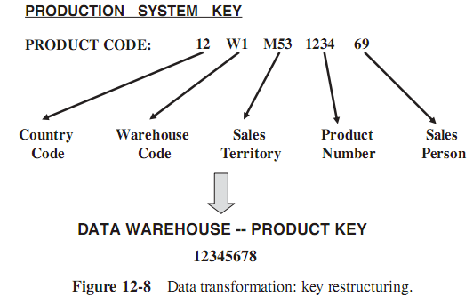
2. Major Transformation Types
Key Restructuring.
  We will have to come up with keys for the fact and dimension tables based on the keys in the extracted records.
  Please see Figure 12-8. In the example shown in the figure, the product code in this organization is structured to have inherent meaning.
  If we use this product code as the primary key, there would be problems.
  When the product is moved to another warehouse, the warehouse part of the product key will have to be changed.
  Transform such keys into generic keys generated by the system itself. This is called key restructuring.

Slide 33
2. Major Transformation Types
Deduplication. In many companies, the customer files have several records for the same customer.
  In the data warehouse, we want to keep a single record for one customer and link all the duplicates in the source systems to this single record.
  This process is called deduplication of the customer file.

Slide 34
3. Data Integration and Consolidation
Entity Identification Problem
  For example: when we have three different legacy applications developed at different times in the past, we are likely to have three different customer files in those systems.
  Most of the customers will be common to all three files.
  These unique identification numbers for the same customer may not be the same across the three systems.
  But in the data warehouse we need to keep a single record for each customer.
  We must be able to get the activities of the single customer from the various source systems and then match up with the single record to be loaded to the data warehouse.
  This is a common but very difficult problem in many enterprises where applications have evolved over time from the distant past.

Slide 35
3. Data Integration and Consolidation
Multiple Sources Problem
  This problem results from a single data element having more than one source.
  For example, suppose unit cost of products is available from two systems:
    In the standard costing application, cost values are calculated and updated at specific intervals.
    And the order processing system also carries the unit costs for all products.
  ➔ From which system should we get the cost for storing in the data warehouse?
    A straightforward solution is to assign a higher priority to one of the two sources and pick up the product unit cost from that source.
    Or we may have to select from either of the files based on the last update date.
    Or, in some other instances, we determination of the appropriate source depends on other related fields.

Slide 36
4. Transformation for Dimension Attributes
We reviewed the types of changes to these attributes. Also, we suggested ways to handle the three types of slowly changing dimensions.
  Type 1 changes are corrections of errors. These changes are applied to the data warehouse without any need to preserve history.
  Type 2 changes preserve the history in the data warehouse.
  Type 3 changes are tentative changes where the users need the ability to analyze the metrics (in both ways—with the changes and without the changes)
In order to apply the changes correctly, we need to transform the incoming changes and prepare the changes to the data for loading into the data warehouse.
See next slide

Slide 37
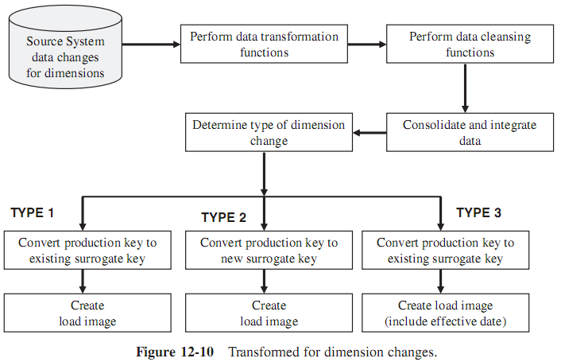
4. Transformation for Dimension Attributes

Slide 38
5. How to Implement Transformation
Using Transformation Tools
  In recent years, transformation tools have greatly increased in functionality and flexibility.
  Although the desired goal for using transformation tools is to eliminate manual methods altogether, in practice this is not completely possible.
  Even if we get the most sophisticated and comprehensive set of transformation tools, be prepared to use in-house programs here and there.
  ➔Use of automated tools certainly improves efficiency and accuracy.

Slide 39
5. How to Implement Transformation
Using Manual Techniques
  Manually coded programs and scripts (in-house) be performed every data transformation.
  Although the initial cost may be reasonable, ongoing maintenance may escalate the cost. The manual method is more likely to be prone to errors.
  A major disadvantage relates to metadata.
  Automated tools record their own metadata, but in-house programs have to be designed differently if we need to store and use metadata.
  Even if the in-house programs record the data transformation metadata initially, every time changes occur to transformation rules, the metadata has to be maintained.
  This puts an additional burden on the maintenance of the manually coded transformation programs.

Slide 40
III. DATA LOADING
Generally, after the transformation functions are ended as soon as the load images are created.
Next, we create the load images to correspond to the target files to be loaded in the data warehouse database.
The whole process of moving data into the data warehouse repository is referred to in several ways:
  Initial Load — populating all the data warehouse tables for the very first time
  Incremental Load — applying ongoing changes as necessary in a periodic manner
  Full Refresh — completely erasing the contents of one or more tables and reloading with fresh data (initial load is a refresh of all the tables)

Slide 41
III. DATA LOADING
If the data staging area and the data warehouse database are on the same server, that will save we the effort of moving the load images to the data warehouse server.
But they are in different servers, consider the options carefully and select the ones best suited for your environment:
  The Web,
  FTP,
  and database link
We have to consider the necessary bandwidth needed and also the impact of the transmissions on the network.
Moreover, think of data compression and have contingency plans.

Slide 42
III. DATA LOADING
If the data staging area and the data warehouse database are on the same server, that will save we the effort of moving the load images to the data warehouse server.
But they are in different servers, consider the options carefully and select the ones best suited for your environment:
  The Web,
  FTP,
  and database link
We have to consider the necessary bandwidth needed and also the impact of the transmissions on the network.
Moreover, think of data compression and have contingency plans.

Slide 43
1. Applying Data: Techniques and Processes
There are three types of data loading: initial load, incremental load, and full refresh.
For example: loading data into product dimension table:
  initial load: extract the data for all the products from the various source systems, integrate and transform the data, and then create load images for loading the data into the product dimension table
  incremental load: collect the changes to the product data for those product records that have changed in the source systems since the previous extract
  A full refresh is similar to the initial load.
How can we apply the data to the warehouse?
Data may be applied in the following four different modes: load, append, destructive merge, and constructive merge.
Study Figure 12-11 for an understanding of the effect of applying data in each of these four modes

Slide 44
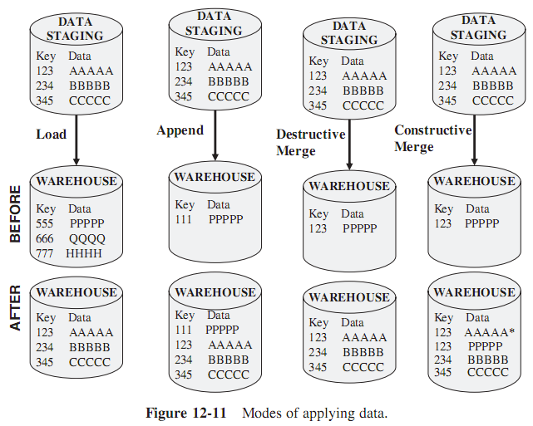
1. Applying Data: Techniques and Processes

Slide 45
1. Applying Data: Techniques and Processes
Load :
  If the target table to be loaded already exists and data exists in the table, the load process wipes out the existing data and applies the data from the incoming file.
  If the table is already empty before loading, the load process simply applies the data from the incoming file.
Append : we may think of the append as an extension of the load.
  If data already exists in the target table, the append process unconditionally adds the incoming data, preserving the existing data in the target table.
  When an incoming record is a duplicate of an already existing record, we may define how to handle an incoming duplicate.
  The incoming record may be allowed to be added as a duplicate. In the other option, the incoming duplicate record may be rejected during the append process.

Slide 46
1. Applying Data: Techniques and Processes
Destructive Merge:
  If the primary key of an incoming record matches with the key of an existing record, update the matching target record.
  If the incoming record is a new record without a match with any existing record, add the incoming record to the target table.
Constructive Merge: This mode is slightly different from the destructive merge.
  If the primary key of an incoming record matches with the key of an existing record, leave the existing record, add the incoming record, and mark the added record as superseding the old record.

Slide 47
1. Applying Data: Techniques and Processes
Now consider how these modes of applying data to the data warehouse fit into the three types of loads.
Initial Load.
  Every initial load run creates the database tables from scratch. In these cases, we will be using the load mode discussed above.
  If we need more than one run to create a single table, and the load runs for a single table must be schedule to run several days, then the approach is different.
    For the first run of the initial load of a particular table, use the load mode.
    All further runs will apply the incoming data using the append mode.
  We may rebuild or regenerate the indexes when the loads are complete.

Slide 48
1. Applying Data: Techniques and Processes
Incremental Loads.
  These are the applications of ongoing changes from the source systems. Changes to the source systems are always tied to specific times.
  Therefore, we need a method to preserve the periodic nature of the changes in the data warehouse.
  If the time stamp is also part of the primary key or if the time stamp is included in the comparison between the incoming and the existing records, then constructive merge mode may be used to preserve the periodic nature of the changes.

Slide 49
1. Applying Data: Techniques and Processes
Full Refresh. This type of application of data involves periodically rewriting the entire data warehouse.
  Sometimes, we may also do partial refreshes to rewrite only specific tables.
  Partial refreshes are rare because every dimension table is intricately tied to the fact table.
  As far as the data application modes are concerned, full refresh is similar to the initial load.
  However, in the case of full refreshes, data exists in the target tables before incoming data is applied.
  The existing data must be erased before applying the incoming data.
  Just as in the case of the initial load, the load and append modes are applicable to full refresh.

Slide 50
2. Data Refresh Versus Update
After the initial load, using two below methods to maintain the data warehouse and keep it up-to-date:
  Update—application of incremental changes in the data sources
  Refresh—complete reload at specified intervals
Technically, when refresh is used:
  Much simpler option than update.
  Involves the periodic replacement of complete data warehouse tables.
  Therefore, refresh jobs can take a long time to run. It means long down-time. The case worsens if data warehouse has large tables.
To use the update option, we have to devise the proper strategy to extract the changes from each data source. Then we have to determine the best strategy to apply the changes to the data warehouse.
Is there some kind of a guideline as to when refresh is better than update or vice versa? Figure 12-12 shows a graph comparing refresh with update.

Slide 51
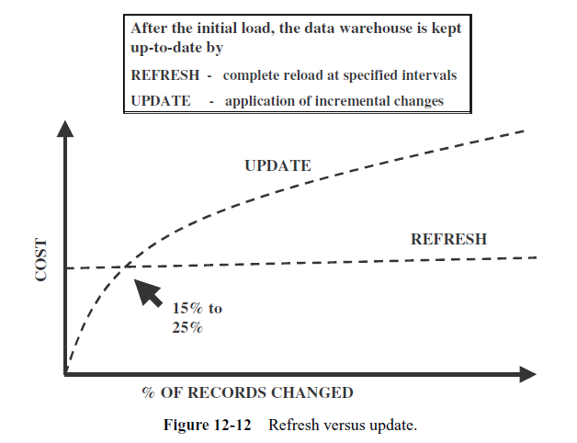
2. Data Refresh Versus Update
The cost of refresh remains constant irrespective of the number of changes in the source systems (because of always to reload completely all data).
If the number of data source changes increases:
  The time and effort for doing a full refresh remain the same
  On the other hand, the cost of update varies with the number of records to be updated
If the number of changed records falls between 15% and 25% of the total number of records, the cost of loading per record tends to be the same for a full refresh update method
If more than 25% of the source records change daily, then seriously consider full refreshes.

Slide 52
3. Procedure for Dimension Tables
In a data warehouse, dimension tables (customer, product, time, …) contain attributes that are used to analyze basic measurements such as sales and costs.
The procedure for maintaining the dimension tables includes two functions:
  first, the initial loading of the tables;
  thereafter, applying the changes on an ongoing basis.

Slide 53
3. Procedure for Dimension Tables
There are two issues that need consider
The first one is about the keys of the records in the source systems and the keys of the records in the data warehouse:
  In the data warehouse, we do not use the production system keys for the records, but we use system-generated keys
  The records in the source systems have their own keys. Therefore, before source data can be applied to the dimension tables, the production keys must be converted to the system-generated keys
  We may do the key conversion as part of the transformation functions or we may do it separately before the actual load functions.
The next issue relates to the application of the type 1, type 2, and type 3 dimension changes to the data warehouse.
Figure 12-13 shows how these different types are handled.

Slide 54
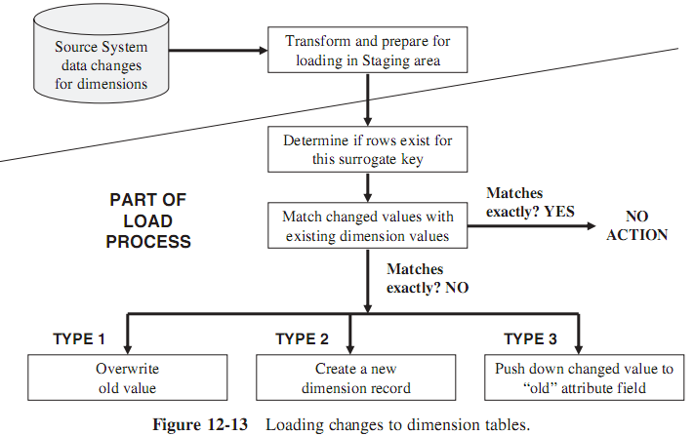
3. Procedure for Dimension Tables

Slide 55
4. Fact Tables: History and Incremental Loads
The key of the fact table is the concatenation of the keys of the dimension tables.
Therefore, for this reason, dimension records are loaded first.
Then, before loading each fact table record, we have to create the concatenated key for the fact table record from the keys of the corresponding dimension records.
Here are some tips for history loads of the fact tables:
  Identify historical data useful and interesting for the data warehouse
  Define and refine extract business rules
  Capture audit statistics to tie back to operational systems
  Perform fact table surrogate key look-up
  Improve fact table content
  Restructure the data
  Prepare the load files

Slide 56
4. Fact Tables: History and Incremental Loads
Given below are a few useful remarks about incremental loads for fact tables:
  Incremental extracts for fact tables
    Consist of new transactions
    Consist of update transactions
    Use database transaction logs for data capture
  Incremental loads for fact tables
    Load as frequently as feasible
    Use partitioned files and indexes
    Apply parallel processing techniques

