Slide 1

Data Warehouses
FPT University

Slide 2
DATA MINING
LECTURE 12

Slide 3
CHAPTER OBJECTIVES
Learn what exactly data mining is and examine its features
Compare data mining with OLAP and understand the similarities and differences
Notice the place for data mining in a data warehouse environment
Carefully go through major data mining techniques and understand how each works
Study a few data mining applications in different industries and perceive the application of the technology to your environment
Notes:
-
-
-
-
-
-
-
-
-
-
-
-
-
-
-
-
-
-
-
-
-

Slide 4
Introduction
Most of you know that the data mining has something to do with discovering knowledge
There are perhaps as many variations in the definition of data mining as there are vendors and proponents
Notes:
-
-
-
-
-
-
-
-
-
-
-
-
-
-
-
-
-
-
-
-
-

Slide 5
Introduction
data mining being put to use in more and more businesses
  an organization generates more information in a week than most people can read in a lifetime. It is humanly impossible to study, decipher, and interpret all that data to find useful information.
  A data warehouse pools all the data after proper transformation and cleansing in towel organized data structures. Nevertheless, the sheer volume of data makes it impossible for anyone to use analysis and query tools to discern useful patterns.
  many data mining tools suitable for a wide range of applications have appeared in the market. We are seeing the maturity of the tools and products.
  Data mining needs substantial computing power. Parallel hardware, databases, and other powerful components are becoming very affordable.
  organizations are placing enormous emphasis on building sound customer relationships, and for good reasons. Organizations are interested in determining which of their customers will prove to be of long-term value to them.
  Finally, competitive considerations weigh heavily on your company to get into data mining.
Notes:
-
-
-
-
-
-
-
-
-
-
-
-
-
-
-
-
-
-
-
-
-

Slide 6
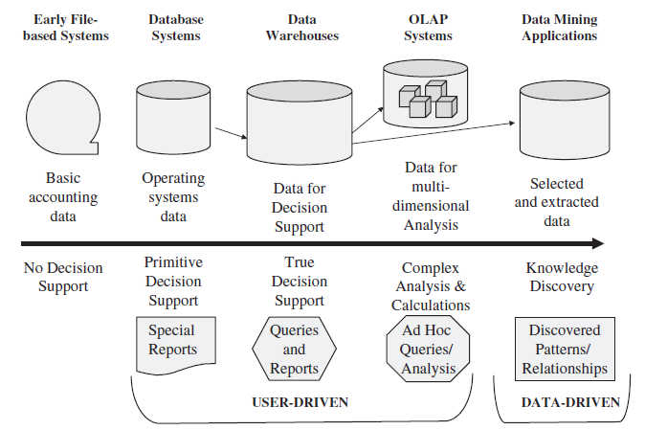
WHAT IS DATA MINING?
Like all decision support systems, data mining delivers information
the progression of decision support showed by following Figure
Notes:
-
-
-
-
-
-
-
-
-
-
-
-
-
-
-
-
-
-
-
-
-

Slide 7
Data Mining Defined
imagine a very wide and very deep repository densely packed with some important material. You use a set of sophisticated drilling tools to dig and unravel the contents. You do not know what exactly you hope to get from your effort. (Figure)
Now, as a change of scenery, replace the very wide and very deep repository with your data warehouse. Replace the material in the repository with the massive data content in your data warehouse and replace the drilling tools by data mining tools.
Data mining is synonymous with knowledge discovery—discovering some aspect of knowledge you never even suspected existed.
If you do not know that some pattern or relationship even exists, how do you direct the data mining tool to find it?
Notes:
-
-
-
-
-
-
-
-
-
-
-
-
-
-
-
-
-
-
-
-
-

Slide 8
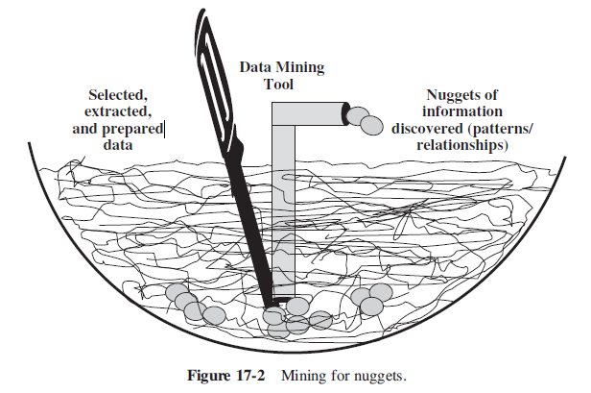
Notes:
-
-
-
-
-
-
-
-
-
-
-
-
-
-
-
-
-
-
-
-
-

Slide 9
Data Mining..(contd)
So, what is data mining? It is a knowledge discovery process. Data mining helps you understand the substance of the data in a special unsuspected way. It unearths patterns and trends in the raw data you never knew existed.
“Data mining,” writes Joseph P. Bigus in his book, Data Mining with Neural Networks (1996, p. 9), “is the efficient discovery of valuable, non-obvious information from a large collection of data.”
Data mining centers around the automatic discovery of new facts and relationships in data.
Notes:
-
-
-
-
-
-
-
-
-
-
-
-
-
-
-
-
-
-
-
-
-

Slide 10
The Knowledge Discovery Process
Relationships
  Take the example of your going to the nearby supermarket on the way home to pick up bread, milk, and a few other “things.” What other things? You are not sure. While you fetch the milk container, you happen to see a pack of assorted cheeses close by. You pause to look at the next five customers behind you. You notice that three of those customers also reach for the cheese.
  As you get your bread, a bag of barbecue-flavored potato chips catches your eye. Why not get that bag of potato chips? Now the customer behind you also wants bread and chips
  Coincidence?
Notes:
-
-
-
-
-
-
-
-
-
-
-
-
-
-
-
-
-
-
-
-
-

Slide 11
The Knowledge …(contd)
  Data mining discovers relationships of this type. The relationships may be between two or more different objects along with the time dimension. Sometimes, the relationships may be between the attributes of the same object. Whatever they may be, discovery of relationships is a key result of data mining
Notes:
-
-
-
-
-
-
-
-
-
-
-
-
-
-
-
-
-
-
-
-
-

Slide 12
The Knowledge …(contd)
Patterns
  Pattern discovery is another outcome of data mining operations. Consider a credit card company trying to discover the pattern of usage that usually warrants increase in the credit limit or a card upgrade. They would like to know which of their customers must be lured with a card upgrade and when. The data mining tools mine the usage patterns of thousands of card-holders and discover the potential pattern of usage that will produce results in a marketing campaign.
Notes:
-
-
-
-
-
-
-
-
-
-
-
-
-
-
-
-
-
-
-
-
-

Slide 13
The Knowledge …(contd)
Before you engage in data mining, you must determine clearly what you want the tool to accomplish.
Let us walk through the major phases and steps.
Figure 17-3 indicating four major phases, then read the following brief descriptions of the detailed steps.
Notes:
-
-
-
-
-
-
-
-
-
-
-
-
-
-
-
-
-
-
-
-
-

Slide 14
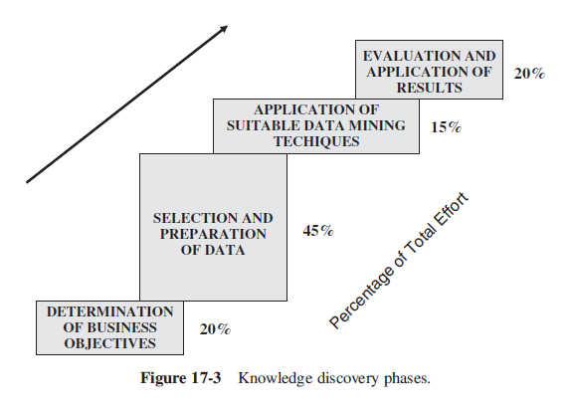
Notes:
-
-
-
-
-
-
-
-
-
-
-
-
-
-
-
-
-
-
-
-
-

Slide 15
The Knowledge …(contd)
Step 1: Define Business Objectives. First of all, determine whether you really need a data mining solution. State your objectives
Step 2: Prepare Data. This step consists of data selection, preprocessing of data, and data transformation. Select the data to be extracted from the data warehouse. Use the business objectives to determine what data has to be selected
Step 3: Perform Data Mining - the crucial step - The knowledge discovery engine applies the selected algorithm to the prepared data. The output from this step is a set of relationships or pattern.
Notes:
-
-
-
-
-
-
-
-
-
-
-
-
-
-
-
-
-
-
-
-
-

Slide 16
The Knowledge …(contd)
Step 4: Evaluate Results. You are actually seeking interesting patterns or relationships. These help you in the understanding of your customers, products, profits, and markets.
Step 5: Present Discoveries. Presentation of knowledge discoveries may be in the form of visual navigation, charts, graphs, or free-form texts.
Step 6: Incorporate Use of Discoveries. The goal of any data mining operation is to understand the business, discern new patterns and possibilities, and also turn this understanding into actions. This step involves using the results to create actionable items in the business.
Notes:
-
-
-
-
-
-
-
-
-
-
-
-
-
-
-
-
-
-
-
-
-

Slide 17
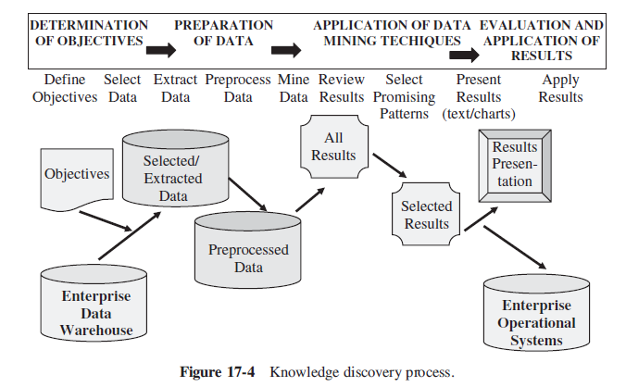
Notes:
-
-
-
-
-
-
-
-
-
-
-
-
-
-
-
-
-
-
-
-
-

Slide 18
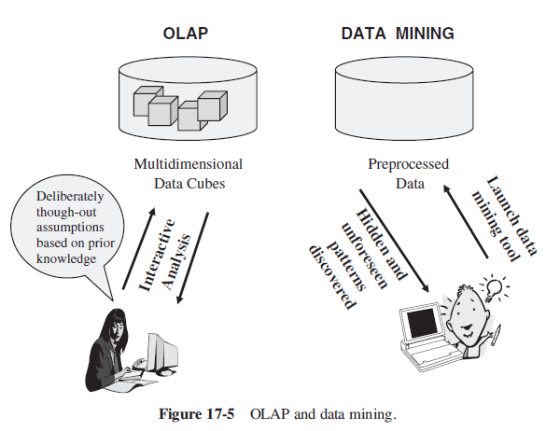
OLAP Versus Data Mining
Notes:
-
-
-
-
-
-
-
-
-
-
-
-
-
-
-
-
-
-
-
-
-

Slide 19
OLAP Versus … (contd)
OLAP: Report on the past | Data Mining: Predict the future
Who are our top 100 best customers for the last three years? Which customers defaulted on their mortgages last two years? What were the sales by territory last quarter compared to the targets? Which salespersons sold more than their quota during last four quarters? Last year, which stores exceeded the total prior year sales? Last year, which were the top five promotions that performed well? Which customers switched to other phone companies last year? | Which 100 customers offer the best profit potential? Which customers are likely to be bad credit risks? What are the anticipated sales by territory and region for next year? Which salespersons are expected to exceed their quotas next year? For the next two years, which stores are likely to have best performance? What is the expected returns for next year’s promotions? Which customers are likely to switch to the competition next year?
Notes:
-
-
-
-
-
-
-
-
-
-
-
-
-
-
-
-
-
-
-
-
-

Slide 20
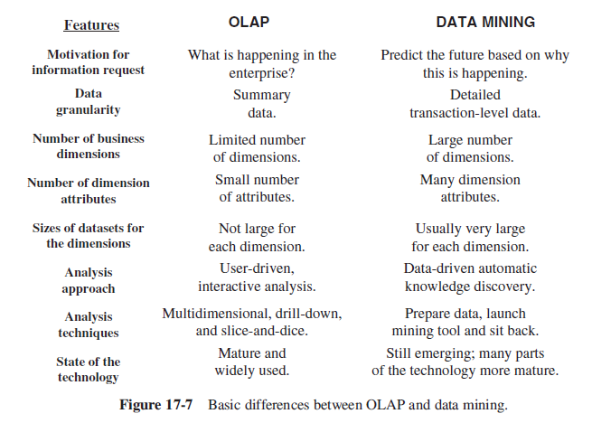
OLAP Versus … (contd)
Notes:
-
-
-
-
-
-
-
-
-
-
-
-
-
-
-
-
-
-
-
-
-

Slide 21
Some Aspects of Data Mining
Association Rules A common and powerful method employed in data mining is to discover rules about how variables associate among themselves. For example: an association rule may be of the form (bread, milk) ⇒cheese
Outlier Analysis Have you received a phone call from your credit card company about a charge of 55 Euros on your credit card account from a bookstore in Munich, Germany? Why did they call you to verify this transaction? They called you because this transaction deviates so much from your normal transactions as to arouse suspicion that it might have been charged by someone else to your account. Flying to Munich to purchase books is not your normal practice. Therefore, that charge for 55 Euros is an outlier in the charge transactions in your account
Notes:
-
-
-
-
-
-
-
-
-
-
-
-
-
-
-
-
-
-
-
-
-

Slide 22
Some Aspects …(contd)
Predictive Analytics
  This encompasses a variety of methods in data mining that analyze current and historical data to make predictions about future events.
  predictive models make use of patterns found in historical and transactional data to identify risks and opportunities. Predictive models capture relationships among many factors to allow assessment of risk or potential associated with a particular set of conditions, guiding decision making for candidate transactions Predictive analytics are also used in insurance, telecommunications, retail, healthcare, and many other fields.
Notes:
-
-
-
-
-
-
-
-
-
-
-
-
-
-
- -
-
-
-
-
-
-
-
-
-
-
-
-
-
-
-
-
-
-
-
-
-
-
-
-
-
-

Slide 23
Data Mining and the Data Warehouse
The enterprise data warehouse, either as a centralized repository feeding dependent data marts or as a conglomerate of conformed data marts on a bus structure, forms a very useful source of data for data mining
Data mining fits well and plays a significant role in the data warehouse environment.
Notes:
-
-
-
-
-
-
-
-
-
-
-
-
-
-
-
-
-
-
-
-
-

Slide 24
Data Mining and …(contd)
Data mining algorithms need large amounts of data, more so at the detailed level. Most data warehouses contain data at the lowest level of granularity.
Data mining flourishes on integrated and cleansed data. If your ETL functions were carried out properly, your data warehouse contains such data, very suitable for data mining.
The infrastructure for data warehouses is already robust, with parallel processing technology and powerful relational database systems. Because such scalable hardware is already in place, no new investment is needed to support data mining.
Notes:
-
-
-
-
-
-
-
-
-
-
-
-
-
-
-
-
-
-
-
-
-

Slide 25
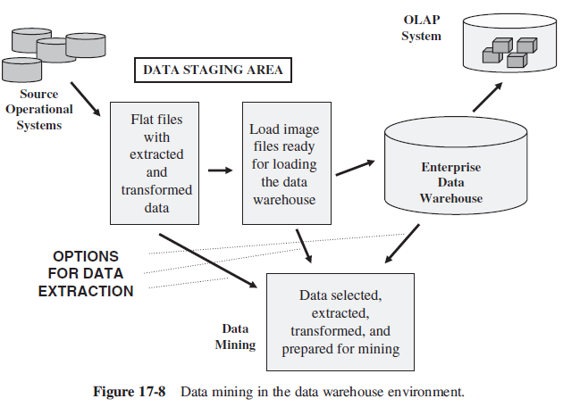
Data Mining and …(contd)
Notes:
-
-
-
-
-
-
-
-
-
-
-
-
-
-
-
-
-
-
-
-
-

Slide 26
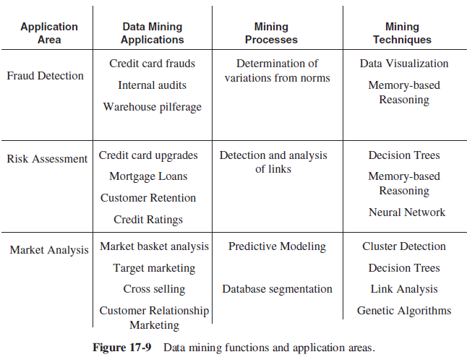
MAJOR DATA MINING TECHNIQUES
Notes:
-
-
-
-
-
-
-
-
-
-
-
-
-
-
-
-
-
-
-
-
-

Slide 27
Cluster Detection
Clustering means identifying and forming groups
For example
  You group the clothes into whites, dark-colored clothes, light-colored clothes, permanent press, and the ones to be dry-cleaned -> five distinct clusters
Clustering or cluster detection is one of the earliest data mining techniques. This technique is designated as undirected knowledge discovery or unsupervised learning.
In the cluster detection technique, you do not search preclassified data. No distinction is made between independent and dependent variables.
Notes:
-
-
-
-
-
-
-
-
-
-
-
-
-
-
-
-
-
-
-
-
-

Slide 28
Cluster ..(contd)
Notice one important aspect of clustering. When the mining algorithm produces a cluster, you must understand what that cluster means exactly. Only then you will be able to do something useful with that cluster.
But if you are dealing with 500 variables from 100,000 records, you need a special tool. How does the data mining tool perform the clustering function?
Notes:
-
-
-
-
-
-
-
-
-
-
-
-
-
-
-
-
-
-
-
-
-

Slide 29
Cluster ..(contd)
K-means clustering algorithm
Notes:
-
-
-
-
-
-
-
-
-
-
-
-
-
-
-
-
-
-
-
-
-

Slide 30
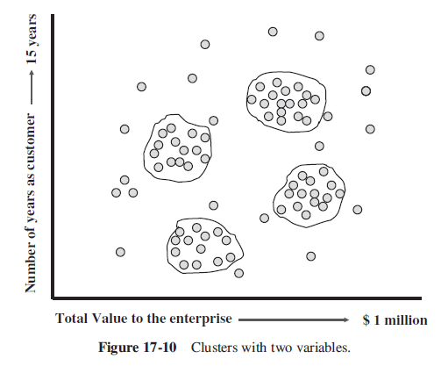
Notes:
-
-
-
-
-
-
-
-
-
-
-
-
-
-
-
-
-
-
-
-
-

Slide 31
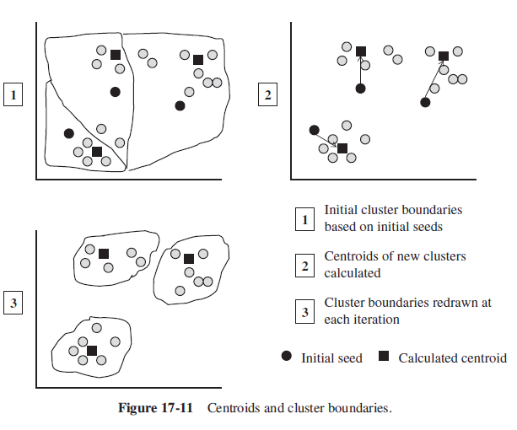
Notes:
-
-
-
-
-
-
-
-
-
-
-
-
-
-
-
-
-
-
-
-
-

Slide 32
Decision Trees
This technique applies to classification and prediction. The major attraction of decision trees is their simplicity. By following the tree, you can decipher the rules and understand why a record is classified in a certain way. Decision trees represent rules
Wherever the reasons are necessary and you must be able to trace the decision paths, decision trees are suitable.
Notes:
-
-
-
-
-
-
-
-
-
-
-
-
-
-
-
-
-
-
-
-
-

Slide 33
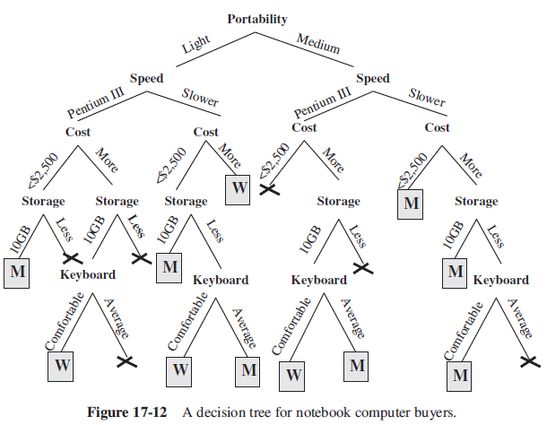
Notes:
-
-
-
-
-
-
-
-
-
-
-
-
-
-
-
-
-
-
-
-
-

Slide 34
Decision Trees… (contd)
How can you measure the effectiveness of a tree? In the example of the profiles of buyers of notebook computers, you can pass the records whose classifications are already known. Then you can calculate the percentage of correctness for the known records.
How do the decision tree algorithms build the trees?
  First, the algorithm attempts to find the test that will split the records in the best possible manner among the wanted classifications.
  At each lower level node from the root, whatever rule works best to split the subsets is applied.
  This process of finding each additional level of the tree continues.
  The tree is allowed to grow until you cannot find better ways to split the input records.
Notes:
-
-
-
-
-
-
-
-
-
-
-
-
-
-
-
-
-
-
-
-
-

Slide 35
Memory-Based Reasoning
Would you rather go to an experienced doctor or to a novice? Of course, the answer is obvious. Why? Because the experienced doctor treats you and cures you based on his or her experience
How do we use the experience to solve the current problem? First, we identify similar instances in the past; then we use the past instances and apply the information about those instances to the present. The same principles apply to the memory-based reasoning (MBR) algorithm.
MBR uses known instances of a model to predict unknown instances. This data mining technique maintains a dataset of known records.
Notes:
-
-
-
-
-
-
-
-
-
-
-
-
-
-
-
-
-
-
-
-
-

Slide 36
Memory-Based …(contd)
When a new record arrives at the data mining tool.
  first the tool calculates the “distance” between this record and the records in the training dataset. The distance function of the data mining tool does the calculation. The results determine which data records in the training dataset qualify to be considered as neighbors to the incoming data record.
  Next, the algorithm uses a combination function to combine the results of the various distance functions to obtain the final answer. The distance function and the combination function are key components of the memory-based reasoning technique.
Notes:
-
-
-
-
-
-
-
-
-
-
-
-
-
-
-
-
-
-
-
-
-

Slide 37
Memory-Based …(contd)
For solving a data mining problem using MBR, you are concerned with three critical issues:
  1. Selecting the most suitable historical records to form the training or base dataset.
  2. Establishing the best way to compose the historical record.
  3. Determining the two essential functions, namely, the distance function and the combination function.
Notes:
-
-
-
-
-
-
-
-
-
-
-
-
-
-
-
-
-
-
-
-
-

Slide 38
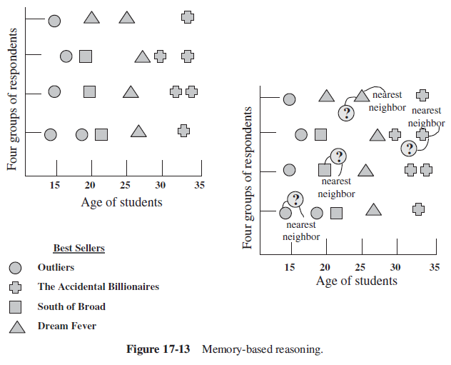
Notes:
-
-
-
-
-
-
-
-
-
-
-
-
-
-
-
-
-
-
-
-
-

Slide 39
Link Analysis
This algorithm is extremely useful for finding patterns from relationships.If you look closely at the business world, you clearly notice all types of relationships.
The link analysis technique mines relationships and discovers knowledge.
  why are skim milk and brown bread found in the same transaction about 80% of the time? Is there a strong relationship between the two products in the supermarket basket? If so, can these two products be promoted together? Are there more such combinations? How can we find such links or affinities?
Depending upon the types of knowledge discovery, link analysis techniques have three types of applications:
  associations discovery,
  sequential pattern discovery,
  similar time sequence discovery
Notes:
-
-
-
-
-
-
-
-
-
-
-
-
-
-
-
-
-
-
-
-
-

Slide 40
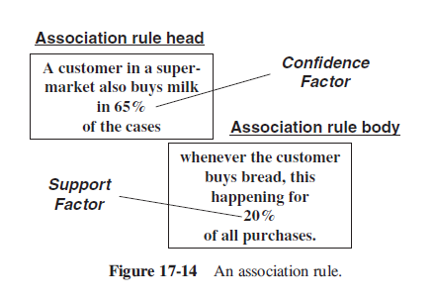
Associations Discovery
Associations are affinities between items. Associations discovery algorithms find combinations where the presence of one item suggests the presence of another
Notes:
-
-
-
-
-
-
-
-
-
-
-
-
-
-
-
-
-
-
-
-
-

Slide 41
Sequential Pattern Discovery
these algorithms discover patterns where one set of items follows another specific set. The time element plays a role in these patterns.
Typical discoveries include associations of the following types:
  Purchase of a digital camera is followed by purchase of a color printer 60% of the time.
  Purchase of a desktop is followed by purchase of a tape backup drive 65% of the time.
  Purchase of window curtains is followed by purchase of living room furniture 50% of the time.
Notes:
-
-
-
-
-
-
-
-
-
-
-
-
-
-
-
-
-
-
-
-
-

Slide 42
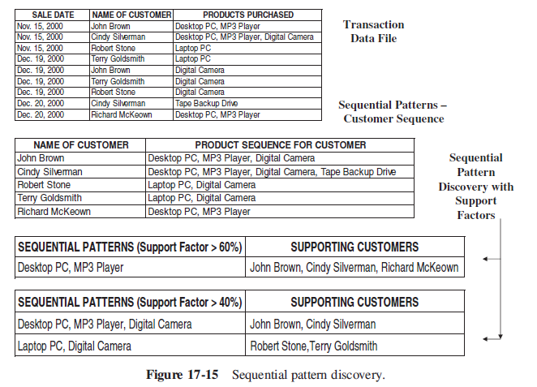
Notes:
-
-
-
-
-
-
-
-
-
-
-
-
-
-
-
-
-
-
-
-
-

Slide 43
Similar Time Sequence Discovery
This technique depends on the availability of time sequences.
In the previous technique, the results indicate sequential events over time.
This technique finds a sequence of events and then comes up with other similar sequences of events.
  For example, in retail department stores, this data mining technique comes up with a second department that has a sales stream similar to the first. Finding similar sequential price movements of stock is another application of this technique.
Notes:
-
-
-
-
-
-
-
-
-
-
-
-
-
-
-
-
-
-
-
-
-

Slide 44
Neural Networks
Neural networks mimic the human brain by learning from a training dataset and applying the learning to generalize patterns for classification and prediction.
These algorithms are effective when the data is shapeless and lacks any apparent pattern.
The basic unit of an artificial neural network is modeled after the neurons in the brain. This unit is known as a node and is one of the two main structures of the neural network model. The other structure is the link that corresponds to the connection between neurons in the brain.
Notes:
-
-
-
-
-
-
-
-
-
-
-
-
-
-
-
-
-
-
-
-
-

Slide 45
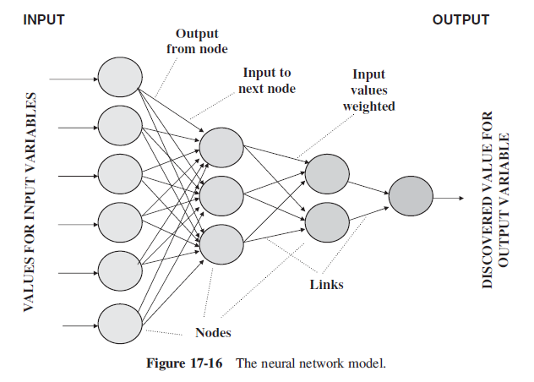
Notes:
-
-
-
-
-
-
-
-
-
-
-
-
-
-
-
-
-
-
-
-
-

Slide 46
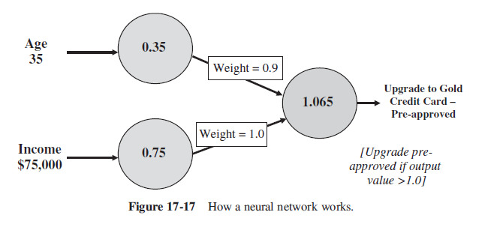
Notes:
-
-
-
-
-
-
-
-
-
-
-
-
-
-
-
-
-
-
-
-
-

Slide 47
Genetic Algorithms
In a way, genetic algorithms have something in common with neural networks. This technique also has its basis in biology.
It is said that evolution and natural selection promote the survival of the fittest. Over generations, the process propagates the genetic material in the fittest individuals from one generation to the next. Genetic algorithms apply the same principles to data mining.
Notes:
-
-
-
-
-
-
-
-
-
-
-
-
-
-
-
-
-
-
-
-
-

Slide 48
Genetic …(contd)
This is the problem to be solved:
Your company is doing a promotional mailing and wants to include free coupons in the mailing. Remember, this is a promotional mailing with the goal of increasing profits. At the same time, the promotional mailing must not produce the opposite result of lost revenue.
This is the question: What is the optimum number of coupons to be placed in each mailer to maximize profits?
Notes:
-
-
-
-
-
-
-
-
-
-
-
-
-
-
-
-
-
-
-
-
-

Slide 49
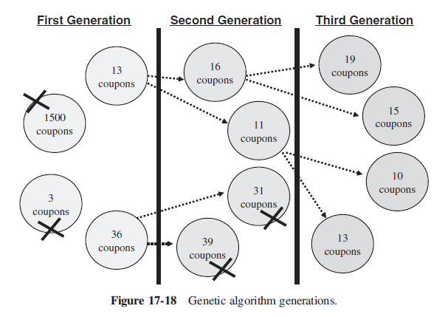
Notes:
-
-
-
-
-
-
-
-
-
-
-
-
-
-
-
-
-
-
-
-
-

Slide 50
Moving into Data Mining
You now have sufficient knowledge to look in the right direction and help your company get into data mining and reap the benefits. What are the initial steps?
As mentioned earlier, data mining techniques produce good results when large volumes of data are available.
  Almost all the algorithms need data at the lowest grain. Consider having data at the detailed level in your data warehouse.
  Another important point refers to the quality of the data
When you apply a data mining technique, it is nice to discover a few interesting patterns and relationships.
Notes:
-
-
-
-
-
-
-
-
-
-
-
-
-
-
-
-
-
-
-
-
-

Slide 51
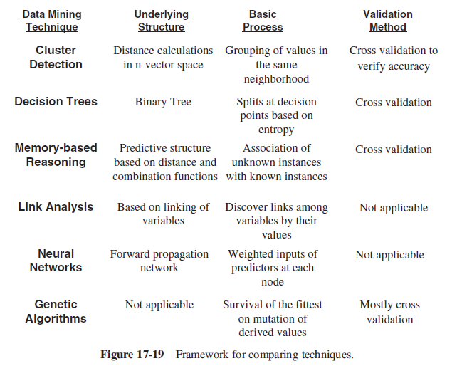
Notes:
-
-
-
-
-
-
-
-
-
-
-
-
-
-
-
-
-
-
-
-
-

Slide 52
Moving into …(contd)
The model structure refers to how the technique is perceived, not how it is actually implemented. For example, a decision tree model may actually be implemented through SQL statements.
The most available techniques supported by vendor tools in the market today include the following:
  Cluster detection
  Decision trees
  Link analysis
  Data visualization
Notes:
-
-
-
-
-
-
-
-
-
-
-
-
-
-
-
-
-
-
-
-
-

Slide 53
Moving into …(contd)
Please consider these tips carefully:
  The tool must be able to integrate well with your data warehouse environment by accepting data from the warehouse and be compatible with the overall metadata framework.
  The patterns and relationships discovered must be as accurate as possible. Discovering erratic patterns is more dangerous than not discovering any patterns at all.
  In most cases, you would need an explanation for the working of the model and know how the results were produced. The tool must be able to explain the rules and how the patterns were discovered.
Notes:
-
-
-
-
-
-
-
-
-
-
-
-
-
-
-
-
-
-
-
-
-

Slide 54
Moving into …(contd)
a list of criteria for evaluating data mining tools.
  Data Access. The data mining tool must be able to access data sources such as the data warehouse and quickly bring over the required datasets to its environment
  Data Selection. While selecting and extracting data for mining, the tool must be able to perform its operations according to a variety of criteria
  Sensitivity to Data Quality. Because of its importance, data quality is worth mentioning again. The data mining tool must be sensitive to the quality of the data it mines
  Data Visualization. Data mining techniques process substantial data volumes and produce a wide range of results.
  Extensibility. The tool architecture must be able to integrate with the data warehouse administration and other functions such as data extraction and metadata management.
Notes:
-
-
-
-
-
-
-
-
-
-
-
-
-
-
-
- -
-
-
-
-
-
-
-
-
-
-
-
-
-
-
-
-
-
-
-
-
-
-
-
-
-

Slide 55
Moving into …(contd)
  Performance. The tool must provide consistent performance irrespective of the amount of data to be mined, the specific algorithm applied, the number of variables specified, and the level of accuracy demanded.
  Scalability. Data mining needs to work with large volumes of data to discover meaningful and useful patterns and relationships
  Openness. This is a desirable feature. Openness refers to being able to integrate with the environment and other types of tools.
  Suite of Algorithms. Select a tool that provides a few different algorithms rather than one that supports only a single data mining algorithm.
Notes:
-
-
-
-
-
-
-
-
-
-
-
-
-
-
-
-
-
-
-
-
-

Slide 56
DATA MINING APPLICATIONS
Customer Segmentation. This is one of the most widespread applications. Businesses use data mining to understand their customers. Cluster detection algorithms discover clusters of customers sharing the same characteristics.
Market Basket Analysis. This is a very useful application for retail. Link analysis algorithms uncover affinities between products that are bought together. Other businesses such as upscale auction houses use these algorithms to find customers to whom they can sell higher-value items.
Risk Management. Insurance companies and mortgage businesses use data mining to uncover risks associated with potential customers.
Fraud Detection. Credit card companies use data mining to discover abnormal spending patterns of customers. Such patterns can expose fraudulent use of the cards.
Delinquency Tracking. Loan companies use the technology to track customers who are likely to default on repayments.
Demand Prediction. Retail and other businesses use data mining to match demand and supply trends to forecast demand for specific products.
Notes:
-
-
-
-
-
-
-
-
-
-
-
-
-
-
-
-
-
-
-
-
-

Slide 57
Benefits of Data Mining
In a large company manufacturing consumer goods, the shipping department regularly short-ships orders and hides the variations between the purchase orders and the freight bills. Data mining detects the criminal behavior by uncovering patterns of orders and premature inventory reductions.
A mail order company improves direct mail promotions to prospects through more targeted campaigns.
A supermarket chain improves earnings by rearranging the shelves based on discovery of affinities of products that sell together.
An airlines company increases sales to business travelers by discovering traveling patterns of frequent flyers.
Notes:
-
-
-
-
-
-
-
-
-
-
-
-
-
-
-
-
-
-
-
-
-

Slide 58
Benefits of …(contd)
A department store hikes the sales in specialty departments by anticipating sudden surges in demand.
A national health insurance provider saves large amounts of money by detecting fraudulent claims.
A major banking corporation with investment and financial services increases the leverage of direct marketing campaigns. Predictive modeling algorithms uncover clusters of customers with high lifetime values.
A manufacturer of diesel engines increases sales by forecasting sales of engines based on patterns discovered from historical data of truck registrations.
A major bank prevents loss by detecting early warning signs for attrition in its checking account business.
A catalog sales company doubles its holiday sales from the previous year by predicting which customers will use the holiday catalog.
Notes:
-
-
-
-
-
-
-
-
-
-
-
-
-
-
-
-
-
-
-
-
-

Slide 59
Applications in CRM (Customer Relationship Management)
Acquisition of a Customer
  In this first phase, you need to identify prospects and convert them into customers. A time-honored proven method for acquiring new customers has been the direct mail campaign.
Value Enhancement of a Customer
  The value of a customer to an enterprise is based on the purchases of goods and services by that customer
Retention of a Customer
  For most companies, the cost of acquiring a new customer exceeds the cost of retaining a good customer.
Notes:
-
-
-
-
-
-
-
-
-
-
-
-
-
-
-
-
-
-
-
-
-

Slide 60
Applications in the Retail Industry
The data warehouses in many retail businesses are mature and ripe. Also, through the use of scanners and cash registers, the retail industry has been able to capture detailed point-of-sale data.
The combination of the two features—huge volumes of data and low-granularity data— is ideal for data mining.
Direct marketing involves targeting campaigns and promotions to specific customer segments. Cluster detection and other predictive data mining algorithms provide customer segmentation.
Retail industry promotions necessarily require knowledge of which products to promote and in what combinations.
Notes:
-
-
-
-
-
-
-
-
-
-
-
-
-
-
-
-
-
-
-
-
-

Slide 61
Applications in…(contd)
What are the questions and concerns the industry is interested in? Here is a short list:
Customer long-term spending patterns
Customer purchasing frequency
Best types of promotions
Store plan and arrangement of promotional displays
Planning mailers with coupons
Types of customers buying special offerings
Sales trends, seasonal and regular
Manpower planning based on busy times
Most profitable segments in the customer base
Notes:
-
-
-
-
-
-
-
-
-
-
-
-
-
-
-
-
-
-
-
-
-

Slide 62
Applications in the Telecommunications Industry
Several data mining vendors and consulting companies specialize in the problems of this industry.
Customer churn is of serious concern. How many times a week do you get cold calls from telemarketing representatives in this industry? Many data mining vendors offer products to contain customer churn. The newer cellular phone market experiences the highest churn rate. Some experts estimate the total cost of acquiring a single new customer is as high as $500.
Notes:
-
-
-
-
-
-
-
-
-
-
-
-
-
-
-
-
-
-
-
-
-

Slide 63
Applications in the…(contd)
Retention of customers in the face of enticing competition
Customer behavior indicating increased line usage in the future
Discovery of profitable service packages
Customers most likely to churn
Prediction of cellular fraud
Promotion of additional products and services to existing customers
Factors that increase the customer’s propensity to use the phone
Product evaluation compared to the competition
Notes:
-
-
-
-
-
-
-
-
-
-
-
-
-
-
-
-
-
-
-
-
-

Slide 64
Applications in Biotechnology
Data Mining in the Biopharmaceutical Industry
  This industry collects huge amounts of biological data of various types. A sample of these types of data would include clinical trial results, annotated databases of disease profiles, chemical structures of combinatorial libraries of compounds, molecular pathways to sequences, structure–activity relationships, and so on.
  Influence-Based Mining. In this case, complex data in large databases are scanned for influences between specific sets of data along several dimensions.
  Affinity-Based Mining. This case is similar to influence-based mining in that data in large and complex data sets is analyzed across several dimensions
Notes:
-
-
-
-
-
-
-
-
-
-
-
-
-
-
-
-
-
-
-
-
-

Slide 65
Applications in …(contd)
Time-Delay Mining. In this case, the subject data set is not available immediately in complete form.
Trends-Based Mining. In this case, the mining technique analyzes large data sets for changes or trends over time in specific data sets.
Comparative Mining. This approach focuses on overlaying large, complex, and similar data sets for comparison.
Notes:
-
-
-
-
-
-
-
-
-
-
-
-
-
-
-
-
-
-
-
-
-

Slide 66
Data Mining in Drug Design and Production
  Data mining is becoming more and more useful for pharmaceutical companies in design and production of prescription and generic drugs.
  Synthetic Method. Generally the production is guided by a production flowchart usually consisting of many steps.
  Fermentation Method. Processes using this method produce drugs such as antibiotics in a fermentation tank.
Notes:
-
-
-
-
-
-
-
-
-
-
-
-
-
-
-
-
-
-
-
-
-

Slide 67
Data Mining in Genomics and Proteomics In today’s biotech environment, postgenomic science and its numerous studies are producing mountains of high-dimensional data.
Genomics is the branch of genetics that studies organisms in terms of their genomes. Proteomics, on the other hand, is the branch of genetics that studies the full set of proteins encoded by a genome.
Notes:
-
-
-
-
-
-
-
-
-
-
-
-
-
-
-
-
-
-
-
-
-

Slide 68
Applications in Banking and Finance
This is another industry where you will find heavy usage of data mining. Banking has been reshaped by regulations in the past few years.
Data mining applications at banks are quite varied. Fraud detection, risk assessment of potential customers, trend analysis, and direct marketing are the primary data mining applications at banks.
In the financial area, requirements for forecasting dominate. Forecasting of stock prices and commodity prices with a high level of approximation can mean large profits.
Notes:
-
-
-
-
-
-
-
-
-
-
-
-
-
-
-
-
-
-
-
-
-

