Slide 1

Data Warehouses
FPT University
Hanoi 2010

Slide 2
Lecture 13: The Physical Design Process

Slide 3
Outline
- Physical Design Steps
- Physical Design Considerations
- Physical Storage
-Indexing the Data Warehouse
-Performance Enhancement Techniques

Slide 4
Introduction
We have considered the logical model for the data warehouse in sufficient detail.
You have mastered the dimensional modeling technique that helps you design the logical model.
We will use the logical model of a data warehouse to develop and complete the physical model.
Physical design gets the work of the project team closer to implementation and deployment.
Every task so far has brought the project to the grand logical model.
Now, physical design moves it to the next significant phase.

Slide 5
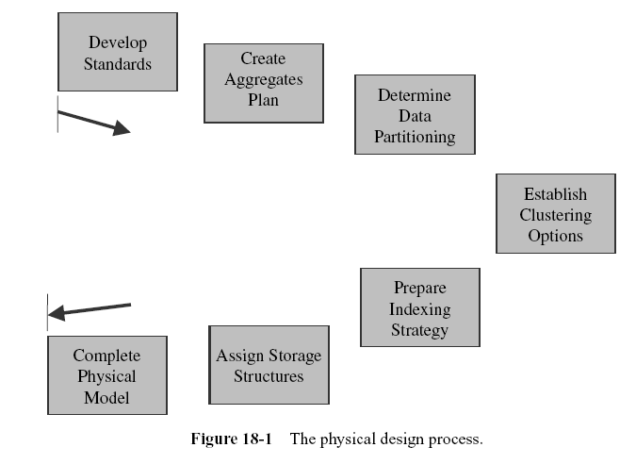
PHYSICAL DESIGN STEPS

Slide 6
1. Develop Standards
Many companies invest a lot of time and money to prescribe standards for information systems.
The standards range from how to name the fields in the database to how to conduct interviews with the user departments for requirements definition.

Slide 7
1. Develop Standards
In the data warehouse environment, the scope of the standards expands to include additional areas. Standards ensure consistency across the various areas.
If you have the same way of indicating names of the database objects, then you are leaving less room for ambiguity.
Let us say the standards in your company require the name of an object to be a concatenation of multiple words separated by dashes and that the first word in the group indicates the business subject.
With these standards, as soon as someone reads an object name, that person can know the business subject.

Slide 8
2. Create Aggregates Plan
Let us say that in your environment more than 80% of the queries ask for summary information.
  If your data warehouse stores data only at the lowest level of granularity, every such query has to read through all the detailed records and sum them up.
Consider a query looking for total sales for the year, by product, for all the stores.
  If you have detailed records keeping sales by individual calendar dates, by product, and by store, then this query needs to read a large number of detailed records.
So what is the best method to improve performance in cases like this?
  If you have higher levels of summary tables of products by store, the query could run faster.
But how many such summary tables must you create? What is the limit?

Slide 9
2. Create Aggregates Plan
Look at each dimension table and examine the hierarchical levels.
Which of these levels are more important for aggregation?
Clearly assess the tradeoff.
What you need is a comprehensive plan for aggregation.
The plan must spell out the exact types of aggregates you must build for each level of summarization.
It is possible that many of the aggregates will be present in the OLAP system.
If OLAP instances are not for universal use by all users, then the necessary aggregates must be present in the main warehouse.
The aggregate database tables must be laid out and included in the physical model.

Slide 10
3. Determine the Data Partitioning Scheme
Consider the data volumes in the warehouse. What about the number of rows in a fact table?
Let us make some rough calculations. Assume there are four dimension tables with 50 rows each on average. Even with this limited number of dimension table rows, the potential number of fact table rows exceeds six million.
Fact tables are generally very large. Large tables are not easy to manage.
During the load process, the entire table must be closed to the users.
Again, back up and recovery of large tables pose difficulties because of their sheer sizes.
Partitioning divides large database tables into manageable parts.

Slide 11
4.Establish Clustering Options
In the data warehouse, many of the data access patterns rely on sequential access of large quantities of data.
  Whenever you have this type of access and processing, you will realize much performance improvement from clustering.
  This technique involves placing and managing related units of data in the same physical block of storage.
  This arrangement causes the related units of data to be retrieved together in a single input operation.
You need to establish the proper clustering options before completing the physical model.
  Examine the tables, table by table, and find pairs that are related.
  This means that rows from the related tables are usually accessed together for processing in many cases.
  Then make plans to store the related tables close together in the same file on the medium.
  For two related tables, you may want to store the records from both files interleaved. A record from one table is followed by all the related records in the other table while storing in the same file.

Slide 12
5. Prepare an Indexing Strategy
This is a crucial step in the physical design.
  As you know, indexing is perhaps the most effective mechanism for improving performance.
  A solid indexing strategy results in enormous benefits.
  The strategy must lay down the index plan for each table, indicating the columns selected for indexing.
  The sequence of the attributes in each index also plays a critical role in performance.
  Scrutinize the attributes in each table to determine which attributes qualify for bit-mapped indexes.
Prepare a comprehensive indexing plan.
  The plan must indicate the indexes for each table.
  Further, for each table, present the sequence in which the indexes will be created.
  Describe the indexes that are expected to be built in the very first instance of the database.
  Many indexes can wait until you have monitored the data warehouse for some time.
  Spend enough time on the indexing plan.

Slide 13
6. Assign Storage Structures
Where do you want to place the data on the physical storage medium? What are the physical files? What is the plan for assigning each table to specific files? How do you want to divide each physical file into blocks of data?
Answers to questions like these go into the data storage plan.
In a data warehouse, you are not just concerned with the physical files for the data warehouse tables.
  Your storage assignment plan must include other types of storage such as the temporary data extract files, the staging area, and any storage needed for front-end applications.
  Let the plan include all the types of storage structures in the various storage areas.

Slide 14
7. Complete Physical Model
This final step reviews and confirms the completion of the prior activities and tasks.
By the time you reach this step, you have the standards for naming the database objects.
You have determined which aggregate tables are necessary and how you are going to partition the large tables.
You have completed the indexing strategy and have planned for other performance options.
You also know where to put the physical files.
All the information from the prior steps enables you to complete the physical model.
The result is the creation of the physical schema.
You can code the data definition language statements (DDL) in the chosen RDBMS and create the physical structure in the data dictionary.

Slide 15
PHYSICAL DESIGN CONSIDERATIONS
We have traced the steps for the physical design of the data warehouse.
Each step consists of specific activities that finally lead to the physical model.
When you look back at the steps, one step relates to the physical storage structure and several others deal with the performance of the data warehouse.
Physical storage and performance are significant factors.

Slide 16
1. Physical Design Objectives
When you perform the logical design of the database, your goal is to produce a conceptual model that reflects the information content of the real-world situation.
  The logical model represents the overall data components and the relationships.
  The objectives of the physical design process do not center on the structure. In physical design, you are getting closer to the operating systems, the database software, the hardware, and the platform.
  You are now more concerned about how the model is going to work than on how the model is going to look.
If you want to summarize, the major objectives of the physical design process are improving performance on the one hand, and improving the management of the stored data on the other.
  You base your physical design decisions on the usage of data.
  The frequency of access, the data volumes, the specific features supported by the chosen RDBMS, and the configuration of the storage medium influence the physical design decisions.
  You need to pay special attention to these factors and analyze each to produce an efficient physical model.

Slide 17
1.1 Improve Performance.
Monitoring performance and improving performance must happen at different levels.
At the foundational level, make sure attention is paid by appropriate staff to performance of the operating system.
At the next level lies the performance of the DBMS.
Monitoring and performance improvement at this level rests on the data warehouse administrator.
The higher levels of logical database design, application design, and query formatting also contribute to the overall performance.

Slide 18
1.2 Ensure Scalability
This is a key objective.
As we have seen, the usage of the data warehouse escalates over time with a sharper increase during the initial period.
We have discussed this supergrowth in some detail.
During the supergrowth period, it is almost impossible to keep up with the steep rise in usage.
As you have already observed, the usage increases on two counts.
The number of users increases rapidly and the complexity of the queries intensifies.
As the number of users increases, the number of concurrent users of the data warehouse also increases proportionately.
Adopt methods to address the escalation in the usage of the data warehouse on both counts.

Slide 19
1.3 Manage Storage
Why is managing storage a major objective of physical design?
Proper management of stored data will boost performance.
You can improve performance by storing related tables in the same file.
You can manage large tables more easily by storing parts of the tables at different places in storage.
You can set the space management parameters in the DBMS to optimize the use of file blocks.

Slide 20
1.4 Provide Ease of Administration
This objective covers the activities that make administration easy.
For instance, ease of administration includes methods for proper arrangement of table rows in storage so that frequent reorganization is avoided.
Another area for ease of administration is in the back up and recovery of database tables.
Review the various data warehouse administration tasks.
Make it easy for administration whenever it comes to working with storage or the DBMS.

Slide 21
1.5 Design for Flexibility
In terms of physical design, flexibility implies keeping the design open.
As changes to the data model take place, it must be easy to propagate the changes to the physical model.
Your physical design must have built-in flexibility to satisfy future requirements.

Slide 22
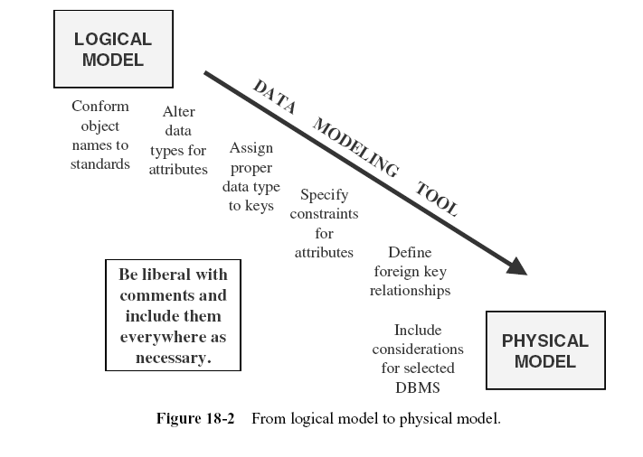
2. From Logical Model to Physical Model

Slide 23
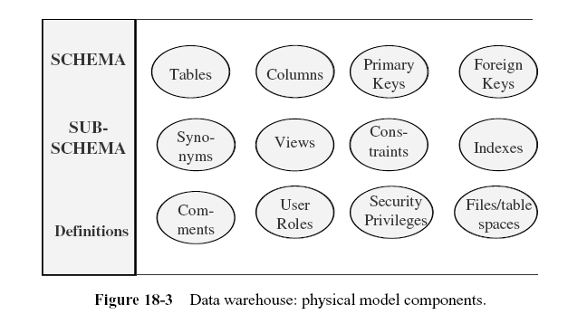
3. Physical Model Components

Slide 24
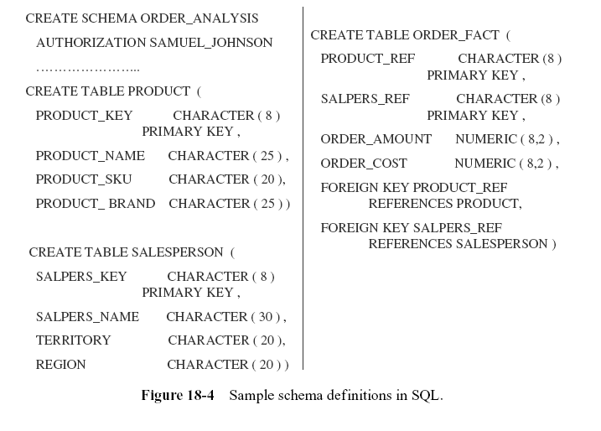

Slide 25
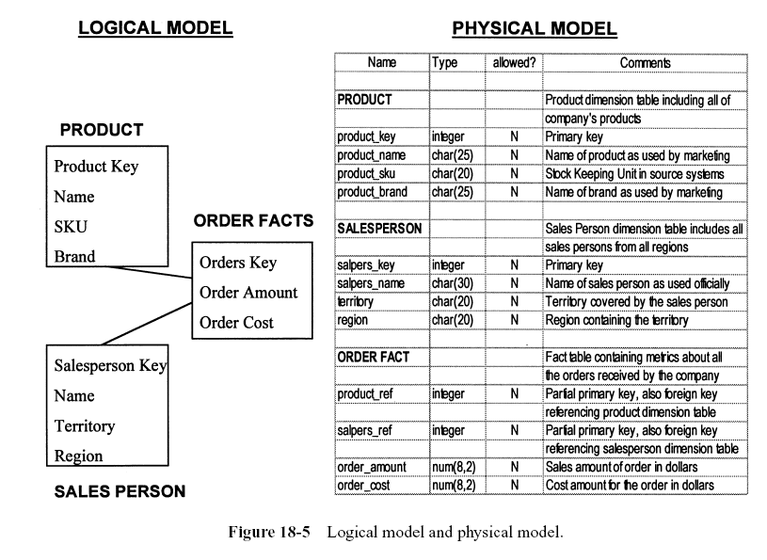

Slide 26
4. Significance of Standards
Naming of Database Objects
Naming of Files and Tables in the Staging Area.
Standards for Physical Files.

Slide 27
PHYSICAL STORAGE

Slide 28
1. Storage Area Data Structures
Take an overall look at all the data related to the data warehouse.
First, you have the data in the staging area.
Though you may look for efficiency in storage and loading, arrangement of the data in the staging area does not contribute to the performance of the data warehouse from the point of view of the users.
Looking further, the other sets of data relate to the data content of the warehouse.
These are the data and index tables in the data warehouse.
How you arrange and store these tables definitely has an impact on the performance.
Next you have the multidimensional data in the OLAP system.
In most cases, the supporting proprietary software dictates the storage and the retrieval of data in the OLAP system.

Slide 29
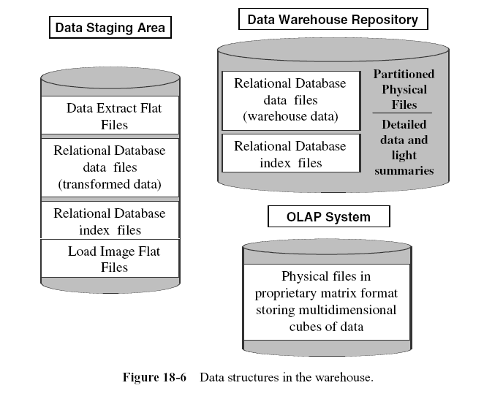

Slide 30
2. Optimizing Storage
You have reviewed the physical storage structures.
When you break each data structure down to the physical storage level, you find that the structure is stored as files in the physical storage medium.
Take the example of the customer dimension and the salesperson dimension tables.
You have basically two choices for storing the data of these two dimension tables.
Store records from each table in one physical file.
Or, if the records from these tables are retrieved together most of the time, then store records from both the tables in a single physical file.
In either case, records are stored in a file.
A collection of records in a file forms a block.
In other words, a file comprises blocks and each block contains records.

Slide 31
2. Optimizing Storage
Set the Correct Block Size.
Set the Proper Block Usage Parameters.
Manage Data Migration.
Manage Block Utilization.
Resolve Dynamic Extension.
Employ File Striping Techniques.

Slide 32
3. Using RAID Technology
Redundant array of inexpensive disks (RAID) technology has become common to the extent that almost all of today’s data warehouses make good use of this technology.
These disks are found on large servers.
The arrays enable the server to continue operation even while they are recovering from the failure of any single disk.
The underlying technique that gives the primary benefit of RAID breaks the data into parts and writes the parts to multiple disks in a striping fashion.
The technology can recover data when a disk fails and reconstruct the data. RAID is very fault-tolerant.
Here are the basic features of the technology:
  Disk mirroring—writing the same data to two disk drives connected to the same controller
  Disk duplexing—similar to mirroring, except here each drive has its own distinct controller
  Parity checking—addition of a parity bit to the data to ensure correct data transmission
  Disk striping—data spread across multiple disks by sectors or bytes
RAID is implemented at six different levels: RAID 0 through RAID 5.

Slide 33
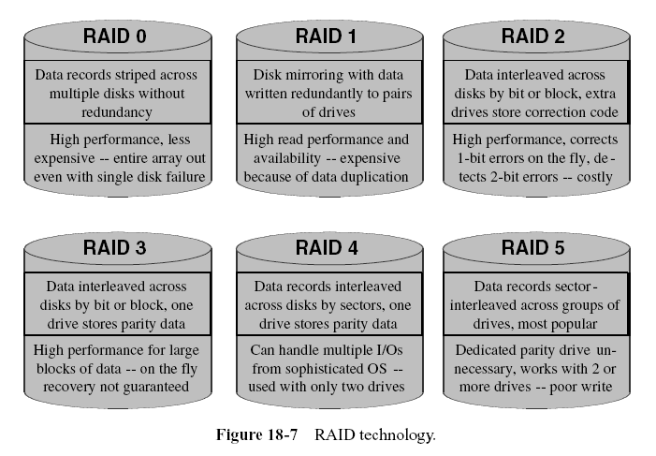

Slide 34
4. Estimating Storage Sizes
For each database table, determine
  Initial estimate of the number of rows
  Average length of the row
  Anticipated monthly increase in the number of rows
  Initial size of the table in megabytes (MB)
  Calculated table sizes in 6 months and in 12 months
For all tables, determine
  The total number of indexes
  Space needed for indexes, initially, in 6 months, and in 12 months
Estimate
  Temporary work space for sorting, merging
  Temporary files in the staging area
  Permanent files in the staging area

Slide 35
INDEXING THE DATA WAREHOUSE
In a query-centric system like the data warehouse environment, the need to process queries faster dominates.
  There is no surer way of turning your users away from the data warehouse than by unreasonably slow queries.
  For the user in an analysis session going through a rapid succession of complex queries, you have to match the pace of the query results with the speed of thought.
  Among the various methods to improve performance, indexing ranks very high.
What types of indexes must you build in your data warehouse?
  The DBMS vendors offer a variety of choices.
  The choice is no longer confined to sequential index files.
  All vendors support B-Tree indexes for efficient data retrieval.
  Another option is the bitmapped index.
  This indexing technique is very appropriate for the data warehouse environment.
  Some vendors are extending the power of indexing to specific requirements.
  These include indexes on partitioned tables and index-organized tables.

Slide 36
1. Indexing Overview
Let us consider the technique of indexing from the perspective of the data warehouse.
  The data tables are “read-only.”
  This feature implies that you almost never update the records or delete records.
  And records are not inserted into the tables after the loads.
  When you do adds, updates, or deletes, you incur additional overhead for manipulating the index files.
  But in a data warehouse this is not the case. So you can create a number of indexes for each table.
How many indexes can you create per table?
  Most of the indexing is done on the dimension tables.
  Generally, you will see a lot more indexes in a data warehouse than in an OLTP system.
  When a table grows in volume, the indexes also increase in size, requiring more storage.
  The general rule is that the maximum number of indexes varies inversely with the size of the table.
  Large numbers of indexes affect the loading process because indexes are created for new records at that time.
  You have to balance the various factors and decide on the number of indexes per table. Review the tables, one by one.

Slide 37
1.1 Indexes and Loading
When you have a large number of indexes, the loading of data into the warehouse slows down considerably.
This is because when each record is added to a data table, every corresponding index entry must be created.
The problem is more acute during initial loads.
You can address this problem by dropping the indexes before running the load jobs.
By doing so, the load jobs will not create the index entries during the load process.
After the loading process completes, you can run separate jobs to construct the index files.
Construction of the index files takes substantial time, but not as much as creating index entries during the load process.

Slide 38
1.2 Indexing for Large Tables.
Large tables with millions of rows cannot support many indexes.
When a table is too large, having more than just one index itself could cause difficulties.
If you must have many indexes for the table, consider splitting the table before defining more indexes.

Slide 39
1.3 Index-Only Reads.
As you know, in the data retrieval process the index record is first read and then the corresponding data read takes place.
The DBMS selects the best index from among the many indexes.
Let us say the DBMS uses an index based on four columns in a table and many users in your environment request data from these four columns and one more column in the table.
How does the data retrieval take place?
The DBMS uses this index record to retrieve the corresponding data record.
You need at least two input–output (I/O) operations. In this instance, the DBMS has to retrieve the data record just for one additional column.
In such cases, consider adding that extra column to the index.
The DBMS will read the index and find that all the information needed is contained in the index record itself, so it will not read the data record unnecessarily.

Slide 40
1.4 Selecting Columns for Indexing.
How do you select the columns in a table as most suitable for indexing?
Which columns will produce the best performance if indexed?
Examine the common queries and note the columns that are frequently used to constrain the queries.
Such columns are candidates for indexing.
If many queries are based on product line, then add product line to your list of potential columns for indexing.

Slide 41
1.5 A Staged Approach
Many data warehouse administrators are puzzled about how to get started with indexing.
How many indexes are needed for each table and which columns must be selected for indexing for the initial deployment of the data warehouse?
They do a preliminary review of the tables, but have no experience with real-world queries yet. This is precisely the point. Experience cannot be a guideline.
You need to wait for the users to exercise the data warehouse for some time.
A staged approach to indexing seems to be prudent. Start with indexes on just the primary and foreign keys of each table.
Keep monitoring the performance carefully. Make a special note of any queries that run for an inordinately long time.
Add indexes as more and more users come on board.

Slide 42
2. B-Tree Index
Most database management systems have the B-Tree Index technique as the default indexing method.
When you code statements using the data definition language of the database software to create an index, the system creates a B-Tree index.
RDBMSs also create B-Tree indexes automatically on primary key values.
The B-Tree index technique supercedes other techniques because of its data retrieval speed, ease of maintenance, and simplicity.

Slide 43
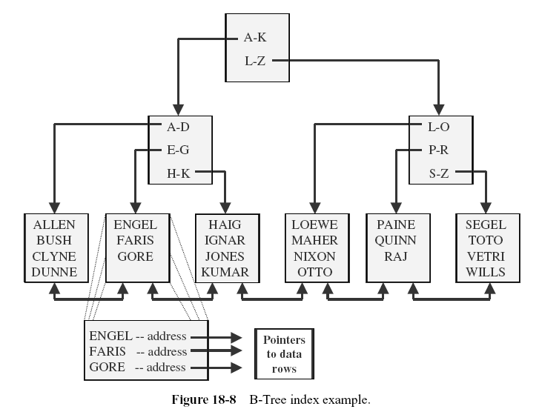

Slide 44
3. Bitmapped Index
Bitmapped indexes are ideally suitable for low-selectivity data.
A bitmap is an ordered series of bits, one for each distinct value of the indexed column.
Assume that the column for color has three distinct colors, namely, white, almond, and black.
Construct a bitmap using these three distinct values.
Each entry in the bitmap contains three bits.
Let us say the first bit refers to white, the second to almond, and the third to black.
If a product is white in color, the bitmap entry for that product consists of three bits, where the first bit is set to 1, the second bit is set to 0, and the third bit is set to 0.
If a product is almond in color, the bitmap entry for that product consists of three bits, where the first bit is set to 0, the second bit is set to 1, and the third bit is set to 0.

Slide 45
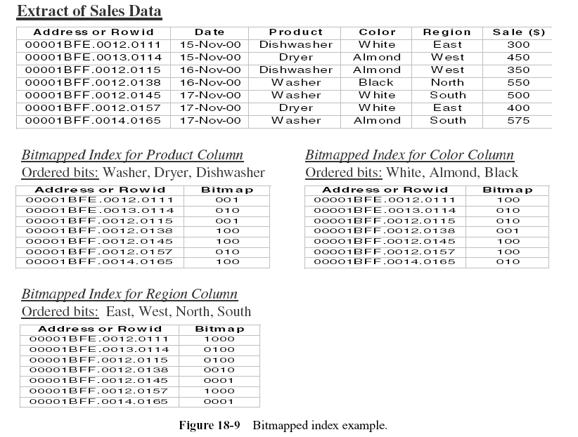

Slide 46
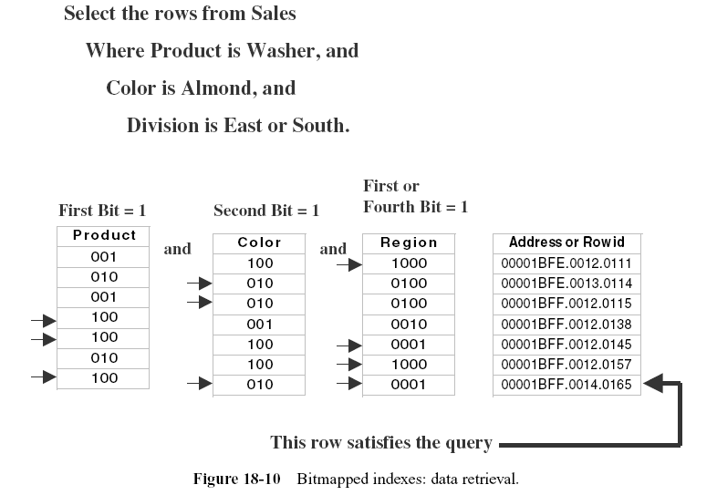

Slide 47
4. Clustered Indexes
Some RDBMSs offer a new type of indexing technique.
In the B-Tree, bitmapped, or any sequential indexing method, you have a data segment where the values of all columns are stored and an index segment where index entries are kept.
The index segment repeats the column values for the indexed columns and also holds the addresses for the entries in the data segment.
Clustered tables combine the data segment and the index segments; the two segments are one. Data is the index and index is the data.
Clustered tables improve performance considerably because in one read you get the index and the data segments.
Using the traditional indexing techniques, you need one read to get the index segment and a second read to get the data segment.
Queries run faster with clustered tables when you are looking for exact matches or searching for a range of values.
If your RDBMS supports this type of indexing, make use of this technique wherever you can in your environment.

Slide 48
5. Indexing the Fact Table
If the DBMS does not create an index on the primary key, deliberately create a Btree index on the full primary key.
Carefully design the order of individual key elements in the full concatenated key for indexing. In the high order of the concatenated key, place the keys of the dimension tables frequently referred to while querying.
Review the individual components of concatenated key. Create indexes on combinations based on query processing requirements.
If the DBMS supports intelligent combinations of indexes for access, then you may create indexes on each individual component of the concatenated key.
Do not overlook the possibilities of indexing the columns containing the metrics.
  For example, if many queries look for dollar sales within given ranges, then the column “dollar sales” is a candidate for indexing.
Bitmapped indexing does not apply to fact tables. There are hardly any low-selectivity columns.

Slide 49
6. Indexing the Dimension Tables
Create a unique B-Tree index on the single-column primary key.
Examine the columns that are commonly used to constrain the queries. These are candidates for bitmapped indexes.
Look for columns that are frequently accessed together in large dimension tables.
Determine how these columns may be arranged and used to create multicolumn indexes.
Remember that the columns that are more frequently accessed or the columns that are at the higher hierarchical levels in the dimension table are placed at the high order of the multicolumn indexes.
Individually index every column likely to be used frequently in join conditions.

Slide 50
PERFORMANCE ENHANCEMENT TECHNIQUES

Slide 51
1. Data Partitioning
Partitioning is an effective technique for storage management and improving performance. Let us summarize the benefits:
  A query needs to access only the necessary partitions. Applications can be given the choice to have partition transparency or they may explicitly request an individual partition. Queries run faster when accessing smaller amounts of data.
  An entire partition may be taken off-line for maintenance. You can separately schedule maintenance of partitions. Partitions promote concurrent maintenance operations.
  Index building is faster.
  Loading data into the data warehouse is easy and manageable.
  Data corruption affects only a single partition. Backup and recovery on a single partition reduces downtime.
  The input–output load gets balanced by mapping different partitions to the various disk drives.

Slide 52
2. Data Clustering
In the data warehouse, many queries require sequential access of huge volumes of data.
The technique of data clustering facilitates such sequential access.
Clustering fosters sequential prefetch of related data.
You achieve data clustering by physically placing related tables close to each other in storage.
When you declare a cluster of tables to the DBMS, the tables are placed in neighboring areas on disk.
How you exercise data clustering depends on the features of the DBMS.
Review the features and take advantage of data clustering.

Slide 53
3. Parallel Processing
Consider a query that accesses large quantities of data, performs summations, and then makes a selection based on multiple constraints.
It is immediately obvious that you will achieve major performance improvement if you can split the processing into components and execute the components in parallel.
The simultaneous concurrent executions will produce the result faster.
Several DBMS vendors offer parallel processing features that are transparent to the users.
Parallel processing techniques may be applied to data loading and data reorganization.
  Parallel processing techniques work in conjunction with data partitioning schemes.
  The parallel architecture of the server hardware also affects the way parallel processing options may be invoked.
  Some physical options are critical for effective parallel processing.
  You have to assess propositions like placing two partitions on the same storage device if you need to process them in parallel.
  Parallel processing and partitioning together provide great potential for improved performance.

Slide 54
4. Summary Levels
As we have discussed several times, the data warehouse needs to contain both detailed and summary data.
Select the levels of granularity for the purpose of optimizing the input–output operations.
Let us say you keep the sales data at the levels of daily detail and monthly summaries. If the users frequently request weekly sales information, then consider keeping another summary at the weekly level.
On the other hand, if you only keep weekly and monthly summaries and no daily details, every query for daily details cannot be satisfied from the data warehouse.
Choose your summary and detail levels carefully based on user requirements.
Also, rolling summary structures are especially useful in a data warehouse.
Suppose in your data warehouse you need to keep hourly data, daily data, weekly data, and monthly summaries.
Create mechanisms to roll the data into the next higher levels automatically with the passage of time.
Hourly data automatically gets summarized into the daily data, daily data into the weekly data, and so on.

Slide 55
5. Referential Integrity Checks
As you know, referential integrity constraints ensure the validity between two related tables.
The referential integrity rules in the relational model govern the values of the foreign
key in the child table and the primary key in the parent table. Every time a row is added or
deleted, the DBMS verifies that the referential integrity is preserved. This verification ensures
that parent rows are not deleted while child rows exist and that child rows are not
added without parent rows. Referential integrity verification is critical in the OLTP systems,
but it reduces performance.
Now consider the loading of data into the data warehouse. By the time the load images
are created in the staging area, the data structures have already gone through the phases of
extraction, cleansing, and transformation. The data ready to be loaded has already been
verified for correctness as far as parent and child rows are concerned. Therefore, there is
no further need for referential integrity verification while loading the data. Turning off
referential integrity verification produces significant performance gains.

Slide 56
6. Initialization Parameters
DBMS installation signals the start of performance improvement.
At the start of the installation of the database system, you can carefully plan how to set the initialization parameters.
Many times you will realize that performance degradation is to a substantial extent the result of inappropriate parameters.
The data warehouse administrator has a special responsibility to choose the right parameters.

Slide 57
7. Data Arrays
What are data arrays?
  Suppose in a financial data mart you need to keep monthly balances of individual line accounts.
  In a normalized structure, the monthly balances for a year will be found in twelve separate table rows.
  Assume that in many queries the users request for the balances for all the months together.
  How can you improve the performance? You can create a data array or repeating group with twelve slots, each to contain the balance for one month.
Although creating arrays is a clear violation of normalization principles, this technique yields tremendous performance improvement.
  In the data warehouse, the time element is interwoven into all data.
  Frequently, users look for data in a time series.
  Another example is the request for monthly sales figures for 24 months for each salesperson.
  If you analyze the common queries, you will be surprised to see how many need data that can be readily stored in arrays.

