Slide 1

Data Warehouses
FPT University
Hanoi 2010

Slide 2
Lecture 14:
Data Warehouse Deployment and Maintenance

Slide 3
CHAPTER OBJECTIVES
Study the role of the deployment phase in the data warehouse development life cycle.
Review the major deployment activities and learn how to get them done.
Examine the need for a pilot system and classify the types of pilots.
Consider data security in the data warehouse environment.
Survey the data backup and recovery requirements.
Clearly grasp the need for ongoing maintenance and administration.
Understand the collection of statistics for monitoring the data warehouse.
Perceive how statistics are used to manage growth and continue to improve performance.
Discuss user training and support functions in detail.
Consider other management and administration issues.

Slide 4
DATA WAREHOUSE TESTING
Unit testing and system testing in a data warehousing environment consist of testing the back-end functions and the front-end provisions.
Front-End
  At the front-end where the users interact with the environment and obtain business intelligence, most of the functions are usually provided through solutions obtained from third party vendors. Therefore, the testing at the front-end is really testing of the integration of vendor tools with your data warehouse.

Slide 5
DATA WAREHOUSE …(contd)
ETL Testing
  Data extraction. Ensure that all the data marked for extraction from various source systems are completely and correctly extracted -> Data completeness
  Data transformation and cleansing. Ensure that all data transformations are correctly performed according to the business rules for conversions ->Data quality
  Data loading. Verify that all load modules are correct based on the transformed and cleansed data. Ensure that all data for dimension, fact, and summary tables are correctly placed in appropriate files.
  Audit trails. Trace the data movements and control totals throughout the steps of ETL and ensure that nothing is lost or corrupted on the way from data extraction through transformation and finally loading.
  Integration. Ensure that the entire ETL process works well with all other upstream and downstream processes.

Slide 6
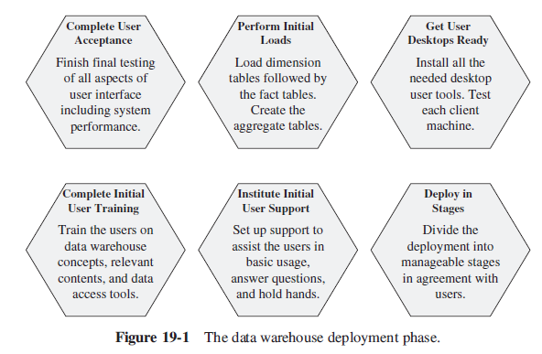
MAJOR DEPLOYMENT ACTIVITIES

Slide 7
Complete User Acceptance
Who should do the acceptance testing from the side of the users?
a few tips
  In each subject area or department, let the users select a small number of typical queries and reports, ones for which they can verify the results without too much work or difficulty, but substantial ones involving combinations of dimension table constraints.
  This is a good time to test some of the predefined queries and reports. Have each user group pick a small number of such queries and reports and test the executions.
  Have the users test the OLAP system.
  The majority of the users must be able to use the tools with comparative ease. Design acceptance tests for the user representatives to sign off on the usability of the tools.
  If your data warehouse is Web-enabled, have the users test the Web features.
  No user acceptance testing is complete without acceptance of the system performance. The project must have set the expectation of the users at an agreed level of performance.
  Remember, the acceptance test is useful if conducted in the production environment.

Slide 8
Perform Initial Loads
the major steps of the complete initial load
  Drop the indexes on the data warehouse relational tables
  each dimension table record is in a one-to-many relationship with the corresponding fact table records.
  Make sure you have proper checkpoints in place so that you can pick up from the latest checkpoint and continue.
  Load the dimension tables first
  Load the fact tables next.
  Based on your already established plan for aggregate or summary tables, create the aggregate tables based on the records in the dimension and fact tables
  You had suspended index creation during the loads; now build the indexes.
  If you had opted not to suspend the enforcement of referential integrity, all the referential violations would have recorded on the system log during the load process.

Slide 9
Get User Desktops Ready
Remote deployment of the data access tools for the client machines is a faster method
Irrespective of whether the deployment method is by remote installation or by individual visits to user areas, this is a unique opportunity to upgrade the workstations with other relevant types of software that may be lacking at the user sites.
Desktop tools cannot function without the appropriate server and middle-tier components. Plan for proper timing, installation, and testing of these other components.
Test each client machine to ensure that all components are properly installed and work well together.
Completion of the desktop readiness activity means that the users can get to their machines and start accessing the data warehouse information.

Slide 10
Complete Initial User Training
plan to train the users in the following areas:
  Basic database and data storage concepts.
  Fundamental features of a data warehouse.
  Contents of the data warehouse as applicable to each user group.
  Browsing through the warehouse contents.
  Use of data access and retrieval tools.
  Applicability of Web technology for information delivery.
  Set of predefined queries and reports.
  Types of analysis that can be performed.
  Query templates and how to use them.
  Report scheduling and delivery.
  Data load schedule and currency of the data.
  The support structure, including first line of contact.

Slide 11
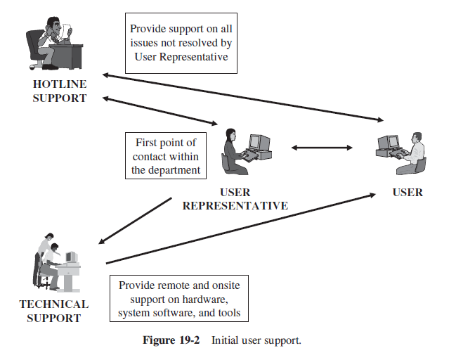
Institute Initial User Support

Slide 12
Deploy in Stages
Building and deploying a data warehouse is a major undertaking for any organization.
  This is a project that calls for many different types of skills.
  The data warehouse encompasses several different technologies.
  facing with new techniques of design.
  Dimensional modeling is a very different approach not previously used by designers in any operational systems.
  The process of data extraction, transformation, and loading is tedious and labor intensive.
  Users receive information in vastly new ways.
  The effort is big, possibly bigger than most of the previous information projects any enterprise has ever launched before.
Make the deployment happen in stages. Chalk out the stages clearly. Plan a schedule that is most effective from the point of view of the users as well as the project team.

Slide 13
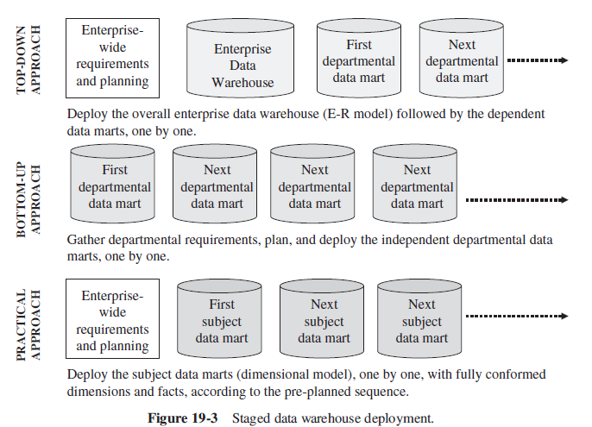

Slide 14
CONSIDERATIONS FOR A PILOT
Most companies consider deploying a pilot system before the full deployment of the entire warehouse.
This is not a matter of substituting the first full-fledged data mart as the pilot.
The pilot is separate and distinct, with specific purposes.
The pilot enables your project team to gain broad experience, gain specific experience with the new technologies, and demonstrate proof-of-concept to your users.

Slide 15
When is a Pilot Data Mart Useful?
The user community is totally new to the data warehousing concept.
The users must be shown and convinced of the ease with which they themselves can retrieve information.
The users need to gain experience with new tools and technologies.
The analysts need to perceive the strengths of the analytical features in the data warehouse.
The sponsors and upper management must observe the benefits of the data warehousing concept before getting into it further in a big way.
The IT designers and architects need to gain experience in dimensional modeling techniques and in the working of the database on this model.
The project team needs to ensure that all the ETL functions work well.
The project team wants to confirm the working together of all the new infrastructure
components such as parallel processing, replication, middleware connections, Web based technologies, and OLAP elements.

Slide 16
Types of Pilot Projects
Proof-of-Concept Pilot. The data warehouse is the viable solution for decision support. Establishing this proposition is the primary goal of the proof-of-concept pilot.
Proof-of-Technology Pilot This is perhaps the simplest and easiest to build, but as it is mainly built for IT to prove one or two technologies at a time, this type of pilot is of little interest to the users.
Comprehensive Test Pilot This is developed and deployed to verify that all the infrastructure and architectural components work together and well.

Slide 17
Types of …(contd)
User Tool Appreciation Pilot The thrust of this type of pilot is to provide the users with tools they will see and use.
Broad Business Pilot In contrast to the previous type, this type of pilot has a broader business scope.
Expandable Seed Pilot First, note the motivations for this type of pilot. You want to come up with something with business value. The scope must be manageable.

Slide 18
Choosing the Pilot
There is no industry-standard naming convention for the pilot types. One data warehouse practitioner may call a specific type an infrastructure test pilot and another an architectural planning pilot. The actual names do not matter.
Let us examine the conditions in the organization and determine if we can match them with the type of pilot that is suitable.
  If your organization is totally new to the concept of data warehousing and your senior management needs convincing and first-hand proof, adopt a proof-of-concept pilot.
  Proof-of-technology and comprehensive test pilots serve the needs of IT.

Slide 19
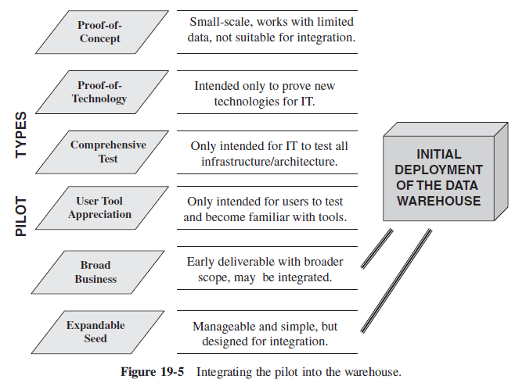
Expanding and Integrating the Pilot

Slide 20
SECURITY
In a single operational system, security provisions govern a smaller segment of the corporate data but data warehouse security extends to a very large portion of the enterprise data.
Access restrictions are difficult to set up in a data warehouse. The analyst at a data warehouse may start an analysis by getting information from one or two tables.

Slide 21
Security Policy
The project team must establish a security policy for the data warehouse.
  The scope of the information covered by the policy
  Physical security
  Security at the workstation
  Network and connections
  Database access privileges
  Security clearance for data loading
  User roles and privileges
  Security at levels of summarization
  Metadata security
  OLAP security
  Web security
  Resolution of security violations

Slide 22
Managing User Privileges
users are granted privileges for accessing the databases of OLTP systems
The access restrictions for these operations may be set at the level of entire tables or at the level of one or more columns of an individual table.

Slide 23
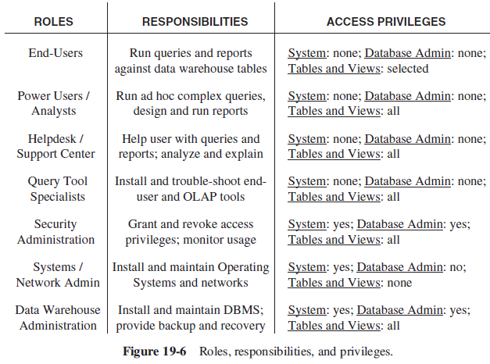

Slide 24
Password Considerations
Security protection in a data warehouse through passwords is similar to how it is done in operational systems.
Security administrators can set up acceptable patterns for passwords and also the expiry period for each password.
Follow the standards for password patterns in your company. Passwords must be cryptic and arbitrary, not easily recognizable.
The security mechanism must also record and control the number of unauthorized attempts by users to gain access with invalid passwords.

Slide 25
Security Tools
In the data warehouse environment, the security component of the database system itself is the primary security tool.
Some organizations have third-party security and management systems installed to govern the security of all systems.
Some of the end-user tools come with their own security system. Most of the OLAP tools have a security feature within the toolset.
The tool-based security, being an integral part of the toolset, cannot be suspended.

Slide 26
BACKUP AND RECOVERY

Slide 27
Why Back Up the Data Warehouse?
A datawarehouse houses huge amounts of data that has taken years to gather and accumulate.
When a data warehouse is down for any length of time, the potential losses are not as apparent as in an operational system.

Slide 28
Backup Strategy
Determine what you need to back up. Make a list of the user databases, system databases, and database logs.
The enormous size of the data warehouse stands out as a dominant factor. Let the factor of size govern all decisions in backup and recovery.
Strive for a simple administrative setup.
Be able to separate the current from the historical data and have separate procedures for each segment.
Apart from full backups, also think of doing log file backups and differential backups.
a log file backup stores the transactions from the last full backup or picks up from the previous log file backup.
A differential backup contains all the changes since the last full backup.

Slide 29
Backup Strategy
Do not overlook backing up system databases.
Choosing the medium for backing up is critical. Here, size of the data warehouse dictates the proper choice.
Commercial RDBMSs adopt a “container” concept to hold individual files. RDBMSs have special methods to back up the entire container more efficiently. Make use of such RDBMS features.
Although the backup functions of the RDBMSs serve the OLTP systems, data warehouse backups need higher speeds. Look into backup and recovery tools from third party vendors.
Plan for periodic archiving of very old data from the data warehouse. A good archival plan pays off by reducing the time for backup and restore and also contributes to improvement in query performance.

Slide 30
Setting up a Practical Schedule
As you know, backups for OLTP systems usually run at night.
If your user community is distributed in different time zones, finding a time slot becomes even more difficult.
Mission-critical OLTP systems need frequent backups
Setting up a practical backup schedule comes down to these questions. How much downtime can the users tolerate before the recovery process is completed?

Slide 31
Setting up a…(contd)
Division of the data warehouse into active and static data
Establishing different schedules for active and static data
Having more frequent periodic backups for active data in addition to less frequent backups for static data
Inclusion of differential backups and log file backups as part the backup scheme
Synchronization of the backups with the daily incremental loads
Saving of the incremental load files to be included as part of recovery if applicable

Slide 32
Recovery
Have a clear recovery plan. List the various disaster scenarios and indicate how recovery will be done in each case.
Test the recovery procedure carefully. Conduct regular recovery drills.
Considering the conditions in your organization and the established recovery procedure, estimate an average downtime to be expected for recovery.
In the case of each outage, determine how long it will take to recover. Keep the users properly and promptly informed.
Generally, your backup strategy determines how recovery will be done. If you plan to include the possibility of recovering from the daily incremental load files, keep the backups of these files handy.
If you have to go to the source systems to complete the recovery process, ensure that the sources will still be available.

Slide 33
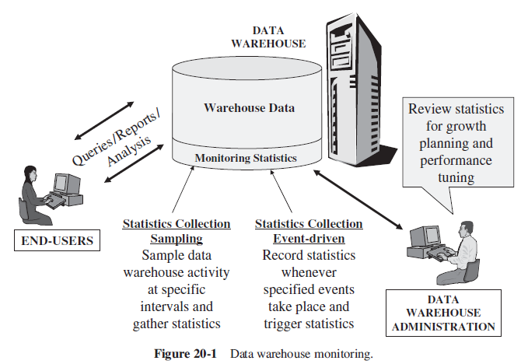
MONITORING THE DATA WAREHOUSE

Slide 34
MONITORING …
Collection of Statistics
Using Statistics for Growth Planning
Using Statistics for Fine-Tuning
Publishing Trends for Users

Slide 35
USER TRAINING AND SUPPORT
User Training Content
Preparing the Training Program
Delivering the Training Program
User Support

Slide 36
MANAGING THE DATA WAREHOUSE
Platform Upgrades
Managing Data Growth
Storage Management
ETL Management
Data Model Revisions
Information Delivery Enhancements
Ongoing Fine-Tuning

