Slide 1
Data Warehouse

Slide 2
Objectives
Demonstrate the knowledge and ability to:
Design a data warehouse or data mart to present information needed by management in a form that is usable for decision makers.
Implement a high quality data warehouse or data mart.
Effectively administer a corporate data resource in such a way that it will truly meet management’s needs.
Evaluate standards and new technologies to determine their potential impact on your information resource.

Slide 3
Course Plan
See course plan on CMS

Slide 4
Course Requirements
Following lessons in classrooms
Reading textbook and documents at home
Completing chapter assessment in time
Discussing actively in your teams and in classrooms

Slide 5
Course Objectives
Design a data warehouse or data mart to present information needed by management in a form that is usable for decision makers.
Implement a high quality data warehouse or data mart.
Effectively administer a corporate data resource in such a way that it will truly meet management’s needs.
Evaluate standards and new technologies to determine their potential impact on your information resource.

Slide 6
Grading
02 Quiz (Q) 20%
01 Labs (Lab) 10%
01 Assignment (AS) 30%
Final exam (FE) 40%
Total score =Q + AS + Lab + FE
Pass:
  Every on-going assessment component >0 and
  Final Examination score ≥ 4
  Total score ≥ 5 and
Retake only the Final Exam when not passed

Slide 7
Academic policy
Cheating, plagiarism and breach of copyright are serious
offenses under this Policy.
Cheating
  Cheating during a test or exam is construed as talking, peeking at another student’s paper or any other clandestine method of transmitting information.
Plagiarism
  Plagiarism is using the work of others without citing it; that is, holding the work of others out as your own work.
Breach of Copyright
  If you photocopy a textbook without the copyright holder's permission, you violate copyright law.

Slide 8
Q&A

Slide 9
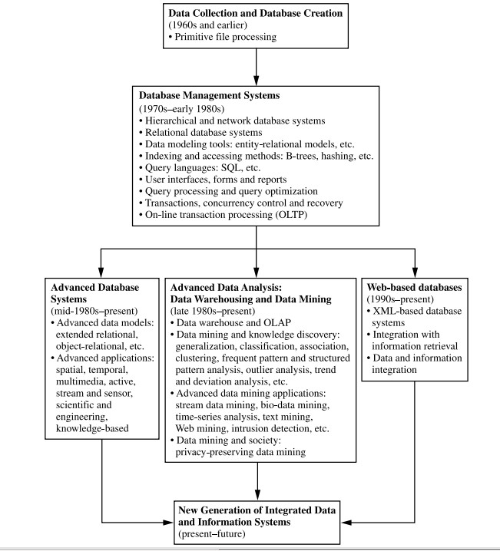

Slide 10
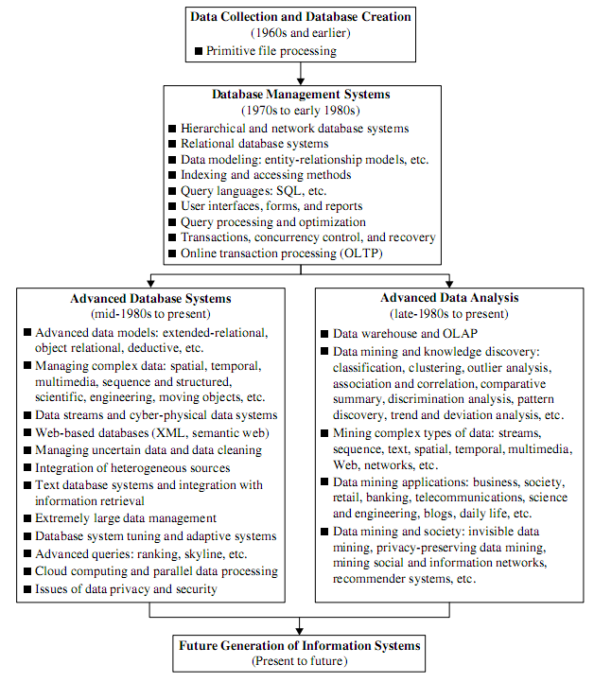

Slide 11
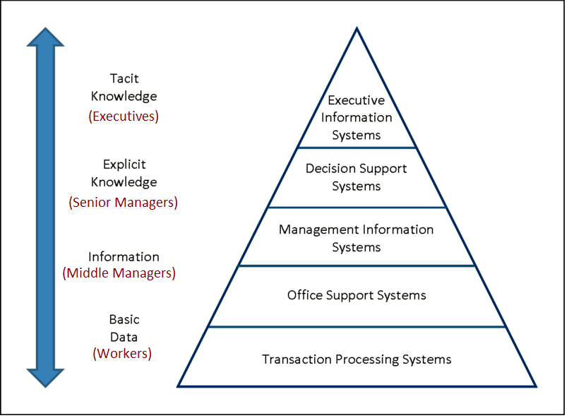

Slide 12
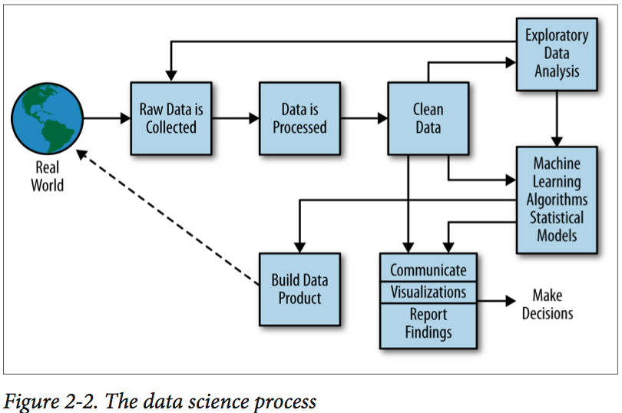

Slide 13
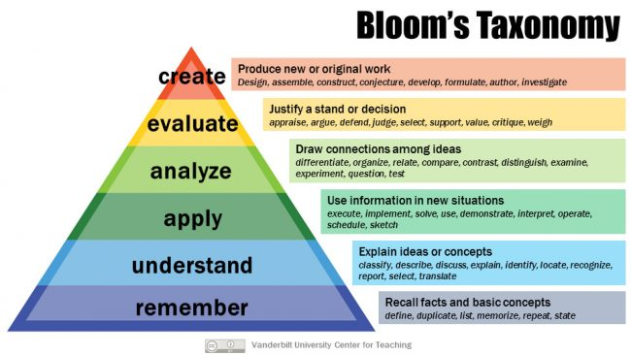

Slide 14
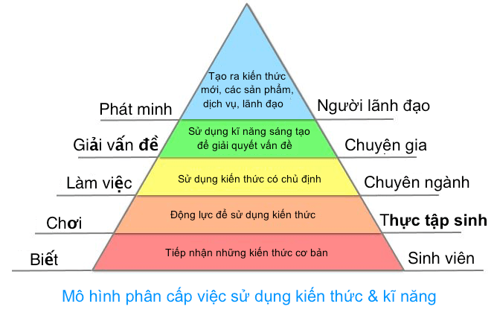

Slide 15
Nguyễn Trọng Tài
taint@fpt.edu.vn

Slide 16
Data Warehouse – DBW301 Enrollment Key
SE0567RAHSM
YourClassCode

