Slide 1

Data Warehouses
FPT University

Slide 2
Lecture 3: PLANNING AND PROJECT MANAGEMENT

Slide 3
Overview
Planning Your Data Warehouse
The Data Warehouse Project
The Project Team
Project Management Considerations

Slide 4
PLANNING YOUR DATA WAREHOUSE
Generaly, the project failure is due:
  Improper planning
  and inadequate project management
First and foremost, determine if the company really needs a data warehouse. Is it really ready for one?
We need to develop criteria for assessing the value expected from data warehouse that will develop:
  What type of data warehouse to be built, and where to keep it ?
  Where is the data going to come from ?
  Who will be using the data warehouse, how they will use it, and at what times ?
So what are issues?

Slide 5
1. Value and Expectations
First, we have to be sure that, given the culture and the current requirements of the company, a data warehouse is the most viable solution ? It realy need to build ?
After we have established the suitability of this solution, then only can we begin to enumerate the benefits and value propositions.

Slide 6
1. Value and Expectations
Will the data warehouse help the executives and managers to do better planning and make better decisions?
  Is it going to improve the bottom line?
  Is it going to increase market share? If so, by how much?
  What does the management want to accomplish through the data warehouse?
➔Make a list of realistic benefits and expectations, as the starting point of the overall planning process

Slide 7
2. Risk Assessment
Generally associate project risks with the cost of the project:
  If the project fails, how much money will go down the drain?
But the assessment of risks is more than calculating the loss from the project costs.
  What are the risks faced by the company without the benefits derivable from a data warehouse?
  What losses are likely to be incurred?
  What opportunities are likely to be missed?
Risk assessment is broad and relevant to each business.
Include this assessment as part of your planning document.

Slide 8
3. Top-down or Bottom-up
The top-down approach is to start at the enterprise-wide data warehouse, although possibly build it iteratively.
  Then data from the overall, large enterprise-wide data warehouse flows into departmental and subject data marts.
On the other hand, the bottom-up approach is to start by building individual data marts, one by one.
  The conglomerate of these data marts will make up the enterprise data warehouse.
    Make sure that the individual data marts are conformed to one another
    Have to first plan and define requirements at the overall corporate level

Slide 9
4. Build or Buy
This is a major issue for all organizations:
  No one builds a data warehouse totally from scratch by in-house programming.
  There is no need to reinvent the wheel every time: A wide and rich range of third-party tools and solutions are available.
The real question is :
  How much of the data marts should be built in-house ?
  How much of these may be composed of ready-made solutions?
  Example:
    Use in-house programs or buy a tool for loading the data warehouse storage ?
    Use in-house programs or buy the vendor tools completely for information delivery ?

Slide 10
4. Single Vendor or Best-of-Breed
There are multiple vendors and products catering to the many functions of the data warehouse. So what are the options ?
Two major options are:
  (1) use the products of a single vendor,
  (2) use products from more than one vendor, selecting appropriate tools.

Slide 11
4. Single Vendor or Best-of-Breed
(1) Choosing a single vendor solution has a few advantages:
  High level of integration among the tools
  Constant look and feel
  Seamless cooperation among components
  Centrally managed information exchange
  Overall price negotiable
(2) Advantages of the best-of-breed solution that combines products from multiple vendors:
  Could build an environment to fit with organization
  No need to compromise between database and support tools
  Select products best suited for the function

Slide 12
5. Business Requirements,
Not Technology
Data warehousing is about solving users’ need for strategic information, it is not about technology:
  Do not plan to build the data warehouse before understanding the requirements.
  Start by focusing on what information is needed and not on how to provide the information.
Do not emphasize the tools:
  Tools and products come and go.
  The basic structure and the architecture to support the user requirements are more important.
To collect user requirements, the preliminary servey can be made

Slide 13
6. Top Management Support
No major initiative in a company can succeed without the support from senior management.
This is very true in the case of the company’s data warehouse project. The project must have the full support of the top management right from day one.

Slide 14
7. Justifying Your Data Warehouse
The total investment in data warehouse for a medium-sized company could run to a few millions dollars.
Breakdown of the costs is as follows:
  Hardware: 31%
  Software, including the DBMS: 24%
  Staff and system integrators: 35%
  Aadministration: 10%.
How do you justify the total cost ?
How can you calculate the ROI (Return on investment) and ROA (Return on assets) ?

Slide 15
7. Justifying Your Data Warehouse
Some sample approaches for preparing the justification:
1. Calculate the current technology costs to produce the applications and reports supporting strategic decision making.
  Compare this with the estimated costs for the data warehouse and find the ratio between the current costs and proposed costs.
  See if this ratio is acceptable to senior management.
2. Calculate the business value of the proposed data warehouse with the estimated dollar values for profits, dividends, earnings growth, revenue growth, and market share growth.
  Review this business value expressed in dollars against the data warehouse costs and come up with the justification.

Slide 16
7. Justifying Your Data Warehouse
3. Do the full-fledged exercise.
  Identify all the components that will be affected by the proposed data warehouse and those that will affect the data warehouse.
  Start with the cost items, one by one, including
    hardware purchase or lease,
    vendor software,
    in-house software,
    installation and conversion,
    ongoing support,
    and maintenance costs.
  Then put a dollar value on each of the tangible and intangible benefits including cost reduction, revenue enhancement, and effectiveness in the business community.

Slide 17
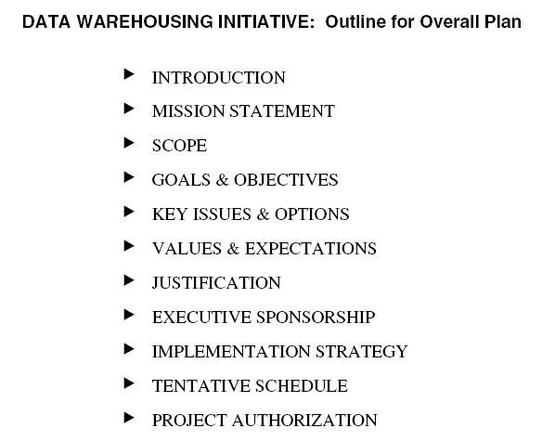
8. The Overall Plan

Slide 18
THE DATA WAREHOUSE PROJECT
Data warehouse projects are different from projects building the transaction processing systems.
The major functional pieces in a data warehouse project includes:
  acquisition component
  storage component
  information delivery component

Slide 19
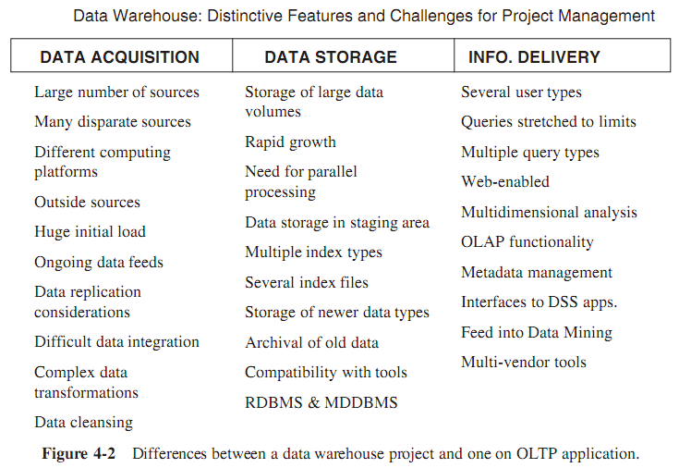
Data warehouse project is different from OLTP system project

Slide 20
The Life-Cycle Approach
The traditional system development life cycle (SDLC) begins with
  project plan,
  move into the requirements analysis phase,
  then into the design, construction,
  and testing phases,
  and finally into the implementation phase
The life cycle approach accomplishes all the major objectives in the system development process

Slide 21
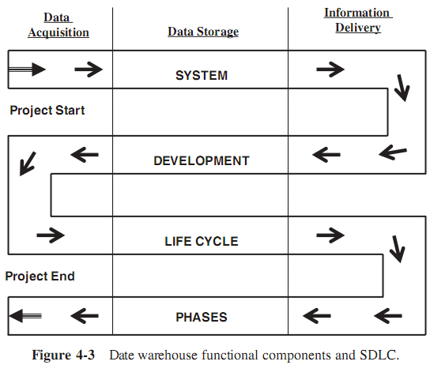
The Life-Cycle Approach
Figure 4-3 shows how to relate the functional components to SDLC

Slide 22
The Development Phases
The overall functional components of a data warehouse development process are:
  data acquisition,
  data storage,
  and information delivery
The design and construction phase for these three components may run somewhat in parallel (Figure 4-5)

Slide 23
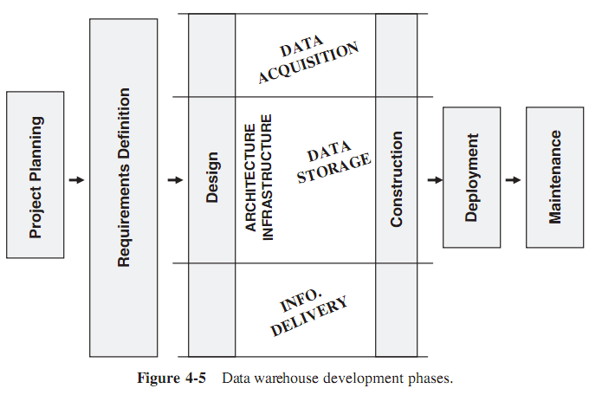
The Development Phases

Slide 24
THE PROJECT TEAM
As in any type of project, the success of a data warehouse project rides on the shoulders of the project team.
  A data warehouse project is similar to other software projects in that it is human intensive.
  It takes several trained and specially skilled persons to form the project team.
Organizing the project team has to do with matching diverse roles with the member's proper skills and levels of experience

Slide 25
Organizing the Project Team
Organizing a project team involves putting the right person in the right job
A good starting point is to list all the project challenges and specialized skills needed:
  planning,
  defining data requirements,
  defining types of queries, data modeling,
  tools selection,
  physical database design,
  source data extraction, data validation and quality control,
  setting up the metadata framework, and so on.

Slide 26
Organizing the Project Team
Next step, using the list of skills and anticipated challenges to prepare a list of team roles needed to support the development work.
After have a list of roles, assign persons to the team roles.
If the company’s human resources are meager, one person can respond many roles.
In this personnel allocation process, remember that the user representatives must also be considered as members of the project team.

Slide 27
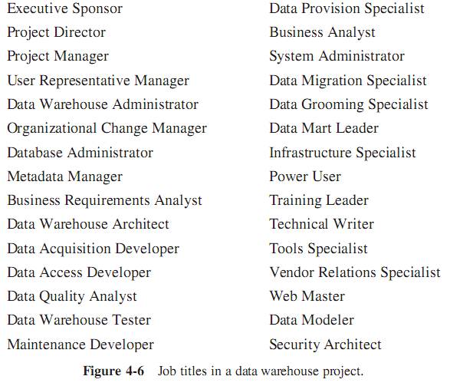
Roles and Responsibilities
Project team roles are designated to perform one or more related tasks.
In many data ware house projects, the team roles are synonymous with the job titles given to the team members.

Slide 28
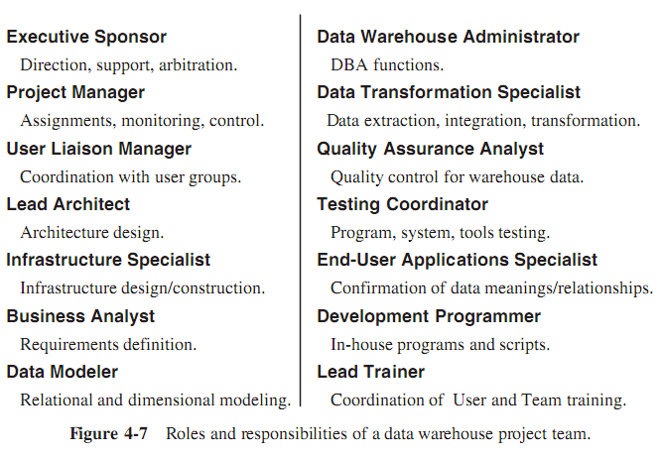
A Basic Set of Team Roles

Slide 29
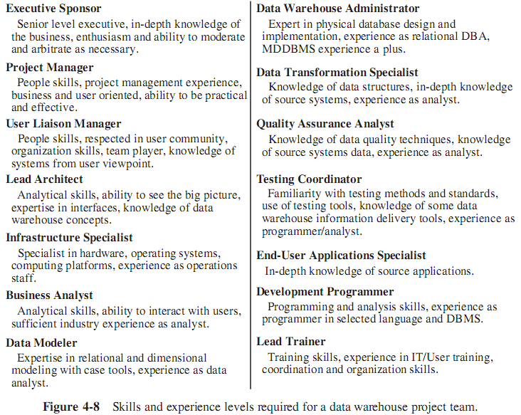
Skills and Experience Levels

Slide 30
User Participation
The warehouse project will succeed only if appropriate members of the user community are accepted as team members with specific roles.
  Make use of their expertise and knowledge of the business
  Figure 4-9 illustrates how and where in the development process users must be made to participate

Slide 31
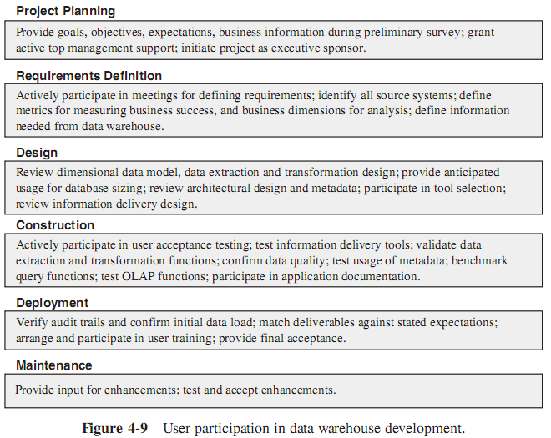
User Participation

Slide 32
PROJECT MANAGEMENT CONSIDERATIONS
Guiding Principles
Warning Signs
Success Factors, anatomyof a Successful Project
Adopt a Practical Approach

Slide 33
Guiding Principles
There are some major guiding principles that help the data warehouse project successful:
  Sponsorship – No data warehouse project succeeds without strong and committed executive sponsorship
  Project Manager – It is a serious mistake to have a project manager who is more technology-oriented than user-oriented and business-oriented.
  New Paradigm – Data warehousing is new for most companies; innovative project management methods are essential to deal with the unexpected challenges.
  Team Roles – Team roles are not to be assigned arbitrarily; the roles must reflect the needs of each individual data warehouse project.
  Data Quality – Three critical aspects of data in the data warehouse are: quality, quality , and quality.
  User Requirements – Although obvious, user requirements alone form the driving force of every task on the project schedule.

Slide 34
Guiding Principles
  Building for Growth – Number of users and number of queries increase very quickly after deployment; data warehouses not built for growth will crumble swiftly.
  Project Politics – The first data warehouse project in a company poses challenges and threats to users at different levels; trying to handle project politics is like walking the proverbial tightrope, to be trodden with extreme caution.
  Realistic Expectations – It is easy to promise the world in the first data warehouse project; setting expectations at the right and attainable levels is the best course.
  Dimensional Data Modeling – A well-designed dimensional data model is a required foundation and blueprint..
  External Data – A data warehouse does not live by internal data alone; data from relevant external sources is an absolutely necessary ingredient.
  Training – sata warehouse user tools are different and new. If the users do not know how to use the tools, they will not use the data warehouse. An unused data warehouse is a failed data warehouse.

Slide 35
Warning Signs
As the life cycle of a data warehouse project runs through the development phases, so must keep a close watch for any warning signs
  Constantly be looking for any indicators suggesting doom and failure.
  Some of the warning signs may just point to inconveniences calling for little action.
  Other warning signs indicative of wider problems that need corrective action to ensure final success.

Slide 36
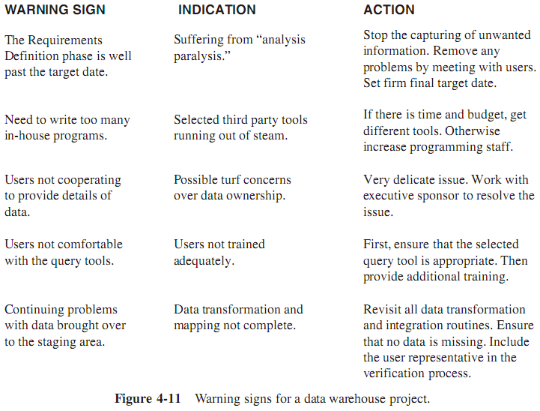
Warning Signs

Slide 37
Anatomy of a Successful Project
Key success factors for a data warehouse project includes:
  Ensure continued, long-term, committed support from the executive sponsors.
  Up front, establish well-defined, real, and agreed business value from the data warehouse project. Manage user expectations realistically.
  Get the users enthusiastically involved throughout the project.
  The data extraction, transformation, and loading (ETL) function is the most time-consuming. Do not under-estimate the time and effort for this activity.
  Remember architecture first, then technology, then tools. Select an architecture that is right for the data warehouse environment.
  The right query and information tools for the users are extremely critical. Select the most useful and easy-to-use ones, not the glamorous.
  Plan for growth and evolution. Be mindful of performance considerations.
  Assign a user-oriented project manager.
  Focus the design on queries, not transactions.
  Define proper data sources. Only load the data that is needed.

Slide 38
Adopt a Practical Approach
In the context of a data warehouse project, here are a few tips on adopting a practical approach:
  Running a project in a pragmatic way means constantly monitoring the deviations and slippage, and making in-flight corrections to stay the course. Rearrange the priorities as and when necessary.
  Let project schedules act as guides for smooth workflow and achieving results, not just to control and inhibit creativity. Please do not try to control each task to the minutest detail. You will then only have time to keep the schedules up-to-date, with less time to do the real job.
  Review project task dependencies continuously. Minimize wait times for dependent tasks.
  There really is such a thing as “too much planning.” Do not give into the temptation. Occasionally, ready–fire–aim may be a worthwhile principle for a practical approach.

Slide 39
Adopt a Practical Approach
  Similarly, “too much analysis” can produce “analysis paralysis.”
  Avoid “bleeding edge” and unproven technologies. This is very important if the project is the first data warehouse project in your company.
  Always produce early deliverables as part of the project. These deliverables will sustain the interest of the users and also serve as proof-of-concept systems.
  Architecture first, and then only the tools. Do not choose the tools and build your data warehouse around the selected tools. Build the architecture first, based on business requirements, and then pick the tools to support the architecture.

