Slide 1

Data Warehouses
FPT University

Slide 2
Lecture 4: Business requirements

Slide 3
Chapter 5:
DEFINING THE BUSINESS
REQUIREMENTS

Slide 4
Outline
Discuss how and why defining requirements is different for a data warehouse
Learn about information packages and their use in defining requirements
Review methods for gathering requirements
Understand why business requirements are the driving force
Discuss how requirements drive every development phase
Specifically learn how requirements influence data design
Note the special considerations for ETL and metadata

Slide 5
Overview
Most of the developers of data warehouses come from a background of developing operational or OLTP (online transactions processing) systems.
  OLTP systems are primarily data capture systems.
  On the other hand, data warehouse systems are information delivery systems.
  When you begin to collect requirements for your proposed data warehouse, your mindset will have to be different.
  You have to go from a data capture model to an information delivery model. This difference will have to show through all phases of the data warehouse project.
The users also have a different perspective about a data warehouse system.
  Unlike an OLTP system which is needed to run the day-to-day business, no immediate payout is seen in a decision support system.
  The users do not see a compelling need to use a decision support system whereas they cannot refrain from using an operational system, without which they cannot run their business.

Slide 6
1. DIMENSIONAL ANALYSIS
Building a data warehouse is very different from building an operational system:
  This becomes notable especially in the requirements gathering phase.
  Because of this difference, the traditional methods of collecting requirements that work well for operational systems cannot be applied to data warehouses.

Slide 7
Usage of Information Unpredictable
In providing information about the requirements for an operational system:
  The users are familiar with operational systems because they use these in their daily work, so they are able to visualize the requirements for other new operational systems
  So, the users can provide precise details of the required functions, information content, and usage patterns
In striking contrast, for a data warehousing system:
  Users are generally unable to define their requirements clearly. They cannot define precisely what information they really want from the data warehouse
  Users cannot relate a data warehouse system to anything they have used before. So, Usage of Information is Unpredictable

Slide 8
Dimensional Nature of Business Data
Even though the users cannot fully describe what they want in a data warehouse, but:
  They can provide you with very important insights into how they think about the business.
  They can tell you what measurement units are important for them.
  Each user department can let you know how they measure success in that particular department.
  The users can give you insights into how they combine the various pieces of information for strategic decision making.

Slide 9
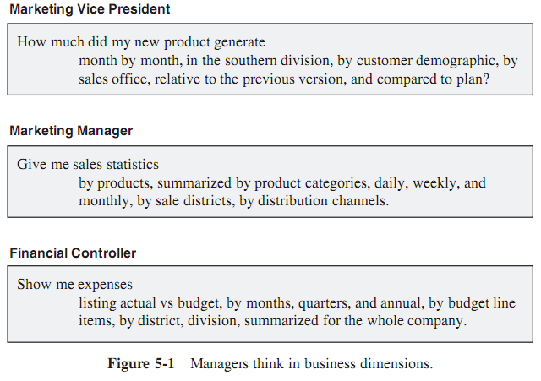
Dimensional Nature of
Business Data
Managers think of the business in terms of business dimensions. Figure 5-1 shows the kinds of questions managers are likely to ask for decision making

Slide 10
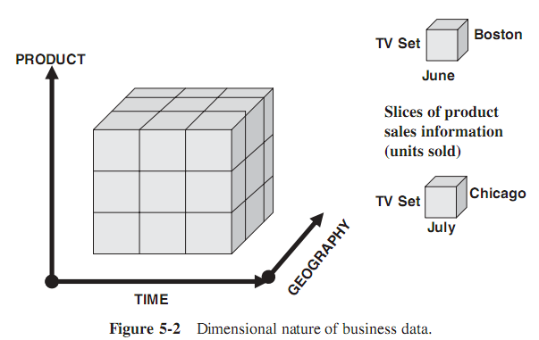
Examples of Business Dimensions
Figure shows the analysis of sales units along the three business dimensions of product, time, and geography.
These three dimensions are plotted against three axes of coordinates.
The three dimensions form a collection of cubes.
  In each of the small dimensional cubes, you will find the sales units for that particular slice of time, product, and geographical division.
  In this case, the business data of sales units is three dimensional because there are just three dimensions used in this analysis.
If there are more than three dimensions, we extend the concept to multiple dimensions and visualize multidimensional cubes, also called hypercubes.

Slide 11
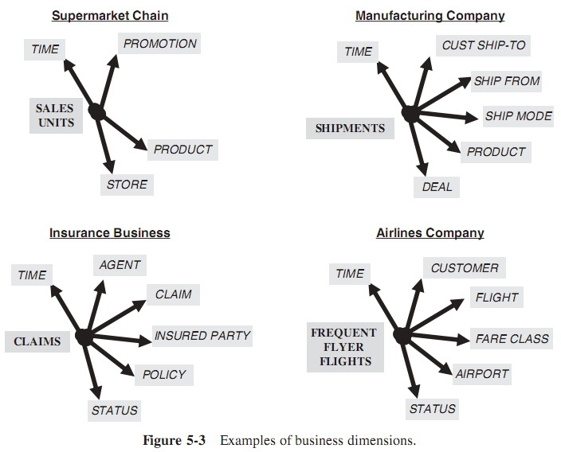
Examples of Business Dimensions

Slide 12
2. INFORMATION PACKAGES – A USEFUL CONCEPT
The information package is a novel idea for determining and recording information requirements for a data warehouse.
  This concept helps us to give a concrete form to the various insights, nebulous thoughts, and opinions expressed during the process of collecting requirements.
The information packages, put together while collecting requirements, are very useful for taking the development of the data warehouse to the next phases.

Slide 13
INFORMATION PACKAGES
Information package is a new methodology for determining requirements for a data warehouse system is based on business dimensions:
  It flows out of the need of the users to base their analysis on business dimensions.
  The new concept incorporates the basic measurements and the business dimensions.
Using the new methodology, come up with the measurements and the relevant dimensions that must be captured and kept in the data warehouse.
Come up with what is known as an information package for the specific subject.

Slide 14
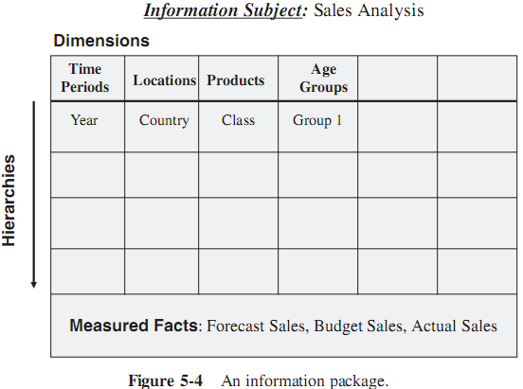
INFORMATION PACKAGES
Information packages enable:
  Define the common subject areas
  Design key business metrics
  Decide how data must be presented
  Determine how users will aggregate or roll up
  Decide the data quantity for user analysis or query
  Decide how data will be accessed
  Establish data granularity
  Estimate data warehouse size
  Determine the frequency for data refreshing
  Ascertain how information must be packaged

Slide 15
Example
In this case, we want to come up with an information package for a hotel chain.
  The subject in this case is hotel occupancy.
  We want to analyze occupancy of the rooms in the various branches of the hotel chain.
  We want to analyze the occupancy by individual hotels and by room types.
  So hotel and room type are critical business dimensions for the analysis.
  As in the other case, we also need to include the time dimension.
  In the hotel occupancy information package, the dimensions included are hotel, room type, and time.

Slide 16
Dimension Hierarchies/Categories
When a user analyzes the measurements along a business dimension:
  The user usually would like to see the numbers first in summary and then at various levels of detail.
  The user traverses the hierarchical levels of a business dimension for getting the details at various levels.
Example for auto sales analysis, the hierarchies and categories for each dimension as follows:
  Product: Model name, model year, product line, product category, exterior color, interior color, first model year
  Dealer: Dealer name, city, state, single brand flag, date first operation
  Customer demographics: Age, gender, income range, marital status, household size, vehicles owned, home value, own or rent
  Time: Date, month, quarter, year, day of week, day of month, season

Slide 17
Key Business Metrics or Facts
When using the business dimensions:
  What exactly are the users analyzing?
  What numbers are they analyzing?
The numbers the users analyze are the measurements or metrics that measure the success of their departments.
These are the facts that indicate to the users how their departments are doing in fulfilling their departmental objectives.

Slide 18
Example
Here is a list of metrics for analyzing hotel occupancy:
  Occupied rooms
  Vacant rooms
  Unavailable rooms
  Number of occupants
  Revenue

Slide 19
Summary
Now putting it all together into the information package diagrams:
  The business dimensions will be the column headings.
  In each column, we will include the hierarchies and categories for the business dimensions.
  The metrics or facts go into the bottom section of the information package.

Slide 20
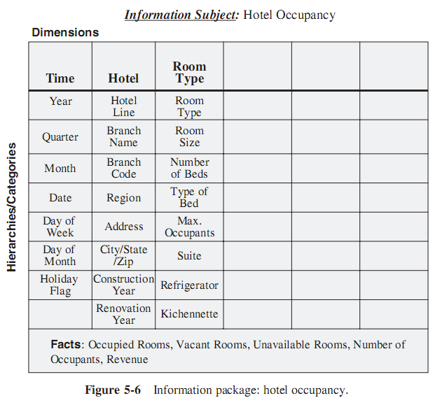
Information Package for Hotel Chain

Slide 21
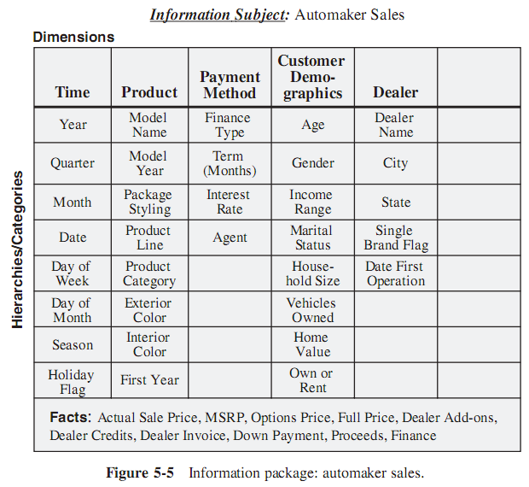
Information Package for Auto Sale

Slide 22
3. REQUIREMENTS GATHERING METHODS
Interviews
Group sessions
Questionnaires

Slide 23
Requirements Definition Document Outline
1. Introduction. State the purpose and scope of the project. Include broad project justification. Provide an executive summary of each subsequent section.
2. General requirements descriptions. Describe the source systems reviewed. Include interview summaries. Broadly state what types of information requirements are needed in the data warehouse.
3. Specific requirements. Include details of source data needed. List the data transformation and storage requirements. Describe the types of information delivery methods needed by the users.
4. Information packages. Provide as much detail as possible for each information package. Include in the form of package diagrams.
5. Other requirements. Cover miscellaneous requirements such as data extract frequencies, data loading methods, and locations to which information must be delivered.
6. User expectations. State the expectations in terms of problems and opportunities. Indicate how the users expect to use the data warehouse.
7. User participation and sign-off. List the tasks and activities in which the users are expected to participate throughout the development life cycle.
8. General implementation plan. At this stage, give a high-level plan for implementation.

Slide 24
Chapter 6:
REQUIREMENTS AS THE DRIVING FORCE FOR DATA WAREHOUSING

Slide 25
Overview
In a data warehouse, business requirements of the users form the single and most powerful driving force:
  Every task that is performed in every phase in the development of the data warehouse is determined by the requirements.
  Every decision made during the design phase (the data design, the design of the architecture, the configuration of the infrastructure, or the scheme of the information delivery methods) is totally influenced by the requirements.
  All are showed in Figure 6-1

Slide 26
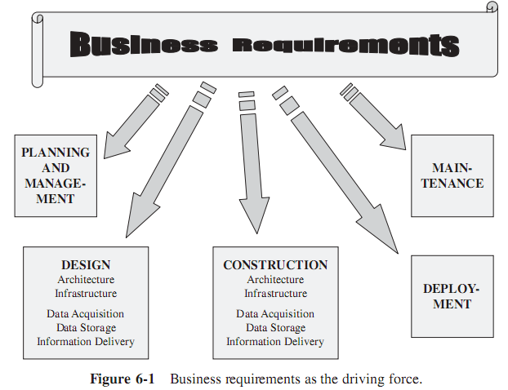
Requirements as the driving force all phases

Slide 27
1/ DATA DESIGN
In the data design phase, need to design the data model for the following data repositories:
  The staging area (the place to storage the data when the data are transformed, cleaned, and integrated from the data sources)
  The data warehouse repository itself

Slide 28
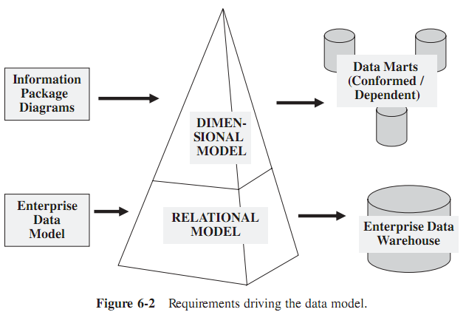
DATA DESIGN

Slide 29
Structure for Business Dimensions and Key Measurements
In the data models for the data marts, the business dimensions along which the users analyze the business metrics must be featured prominently.
Business dimensions and key measures form the backbone of the dimensional data model.
  The structure of the data model is directly related to the number of business dimensions.
  The data content of each business dimension forms part of the data model.
  In addition to the business dimensions, the group of key measurements also forms another distinct component of the data model.

Slide 30
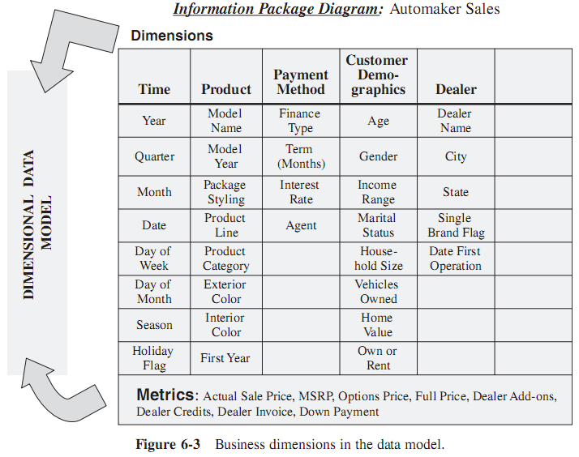
Structure for Business Dimensions and Key Measurements

Slide 31
Levels of Detail
Need to provide drill down and roll up facilities for analysis:
  Do you want to keep data at the lowest level of detail? .
  If so, when your user desires to see countrywide totals for the full year, the system must do the aggregation during analysis (while the user is waiting at the workstation)
  On the other hand, do you have to keep the details for displaying data at the lowest levels, and summaries for displaying data at higher levels of aggregation?
This discussion brings us to another specific aspect of requirements definition as it relates to the data model.
  If you need summaries in your data warehouse, then your data model must include structures to hold details as well as summary data.
  If you can afford to let the system sum up on the fly during analysis, then your data model need not have summary structures.
  Find out about the essential drill down and roll up functions, and include enough particulars about the types of summary and detail levels of data your data warehouse must hold.

Slide 32
2/ THE ARCHITECTURAL PLAN
First, recap the major architectural components of data warehouse (as discussed in Chapter 2):
  Source data
    Production data
    Internal data
    Archived data
    External data
  Data staging
    Data extraction
    Data transformation
    Data loading
  Data storage
  Information delivery
  Metadata
  Management and control

Slide 33
2/ THE ARCHITECTURAL PLAN
Planning the data warehouse architecture involves reviewing each of the components in the particular context.
Also, it involves the interfaces among the various components:
  How can the management and control module be designed to coordinate and control the functions of the different components?
  What is the information you need to do the planning?
  How will you know to size up each component and provide the appropriate infrastructure to support it?
➔ The answer is business requirements.
All the information need to plan the architecture must come from the requirements definition. (see next slide)

Slide 34
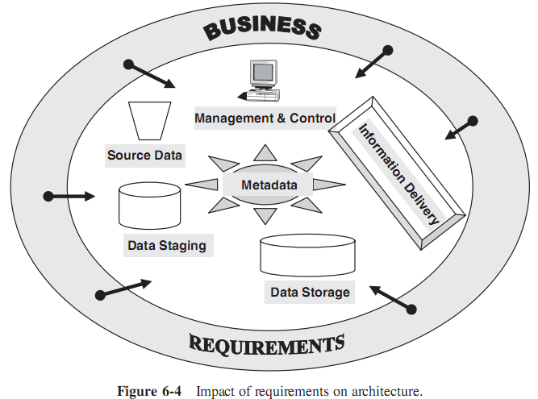
Impact of requirements on architecture.

Slide 35
Data Extraction/ Transformation/Loading
The activities that relate to ETL in a data warehouse are by far most time-consuming and human-intensive.
Special recognition of the extent and complexity of these activities in the requirements while setting up the architecture.

Slide 36
Data Extraction/ Transformation/Loading
Data Extraction: clearly identify all the internal data sources.
  Specify all the computing platforms and source files from which the data is to be extracted.
  If need to include external data sources, determine the compatibility data structures with those of the outside sources.
  Also indicate the methods for data extraction.

Slide 37
Data Extraction/ Transformation/Loading
Data Transformation. Many types of transformation functions are needed before data can be mapped and prepared for loading into the data warehouse repository.
  These functions include input selection, separation of input structures, normalization and denormalization of source structures, aggregation, conversion, resolving of missing values, and conversions of names and addresses.
  Examine each data element planned to be stored in the data warehouse against the source data elements and ascertain the mappings and transformations.

Slide 38
Data Extraction/ Transformation/Loading
Data Loading. Define the initial load.
  Determine how often each major group of data must be kept up-to-date in the data warehouse.
    How much of the updates will be nightly updates?
    Does your environment warrant more than one update cycle in a day?
    How are the changes going to be captured in the source systems?
  Define how the daily, weekly, and monthly updates will be initiated and carried out.

Slide 39
Data Quality
Bad data leads to bad decisions.
If the data quality of the data warehouse is suspect, the users will quickly lose confidence and flee the data warehouse.
So that, right in the early phase of requirements definition, identify potential sources of data pollution in the source systems.

Slide 40
Metadata
Metadata in a data warehouse is much more than details that can be carried in a data dictionary or data catalog.
Metadata acts as a glue to tie all the components together.
  When data moves from one component to another, that movement is governed by the relevant portion of metadata.
  When a user queries the data warehouse, metadata acts as the information resource to connect the query parameters with the database components.

Slide 41
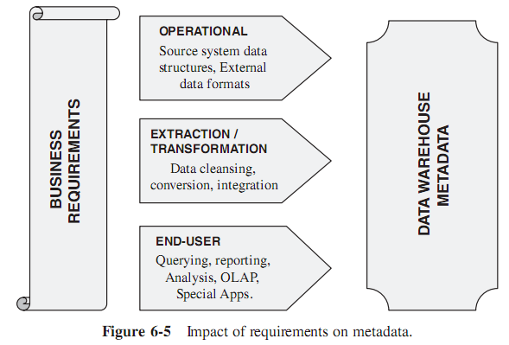
Metadata

Slide 42
3/ DATA STORAGE SPECIFICATIONS
If the top-down approach is applied for developing the data warehouse, then the storage specifications following is defined:
  The data staging area
  The overall corporate data warehouse
  Each of the dependent data marts, beginning with the first need
  Any multidimensional databases for OLAP
Alternatively, if using bottom-up approach:
  The data staging area
  Each of the conformed data marts, beginning with the first need
  Any multidimensional databases for OLAP

Slide 43
3/ DATA STORAGE SPECIFICATIONS
Typically, the overall corporate data warehouse will be based on the relational model supported by a relational database management system (RDBMS).
The data marts are usually structured on the dimensional model implemented using an RDBMS
Many vendors offer proprietary multidimensional database systems (MDDBs)
(see more:
https://en.wikipedia.org/wiki/Online_analytical_processing
http://www.tdwidirectory.com/category/infrastructure/multidimensional-databases
)

Slide 44
4/ INFORMATION DELIVERY STRATEGY
During the requirements definition phase, users tell you what information they want to retrieve from the data warehouse.
You record these requirements in the requirements definition document. You then provide all the desired features and content in the information delivery component.

Slide 45
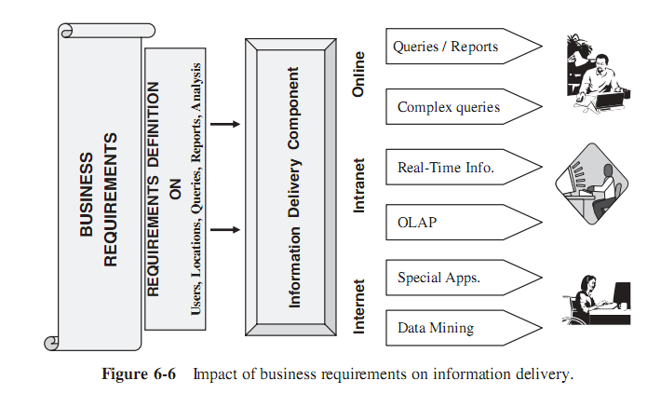
INFORMATION DELIVERY STRATEGY

