Slide 1

Data Warehouse
FPT University
Hanoi 2010

Slide 2
LECTURE 11:
DATA WAREHOUSING AND THE WEB

Slide 3
CHAPTER OBJECTIVES
Understand what Web-enabling the data warehouse means and examine the reasons for doing so
Appreciate the implications of the convergence of Web technologies and those of the data warehouse
Probe into all the facets of Web-based information delivery
Study how OLAP and the Web connect and learn the different approaches to connecting them
Examine the steps for building a Web-enabled data warehouse

Slide 4
Introduction
What is the most dominant phenomenon in computing and communication that started in the 1990s? -> the Internet with the Worldwide Web.
The impact of the Web on our lives and businesses can be matched only by a very few other developments over the past years.
The Web changes everything, as they say. Data warehousing is no exception.
What is the one major benefit of the Web revolution?
  The Web has sharply diminished the cost of delivering information
  major purpose of the data warehouse: the delivery of strategic information
-> match perfectly

Slide 5
WEB-ENABLED DATA WAREHOUSE
A Web-enabled data warehouse uses the Web for information delivery and collaboration among users.
this means an increase in the access to information in the data warehouse.
Increase in information access, in turn, means increase in the knowledge level of the enterprise. It is true that even before connecting to the Web, you could give access for information to more of your users, but with much difficulty and a proportionate increase in communication costs
The communications infrastructure is already there.

Slide 6
Why the Web?
Internet. which provides low-cost transmission of information. You may exchange information with anyone within or outside the company. Because the information is transmitted over public networks, security concerns must be addressed.
Intranet. this concept of a private network has gripped the corporate world. An intranet is a private computer network based on the data communications standards of the public Internet. The applications posting information over the intranet all reside within the firewall and, therefore, are more secure.
  have all the benefits of the popular Web technology.
  manage security better on the intranet.
Extranet. The Internet and the intranet have been followed by the extranet. An extranet is not completely open like the Internet, nor it is restricted just for internal use like an intranet. An extranet is an intranet that is open to selective access by outside parties.
  From your intranet, in addition to looking inward and downward, you could look outward to your customers, suppliers, and business partners.

Slide 7
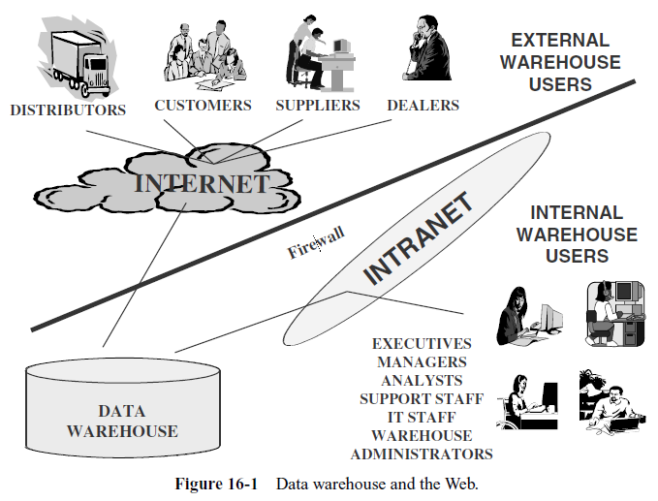

Slide 8
Why the Web?
The intranet and the extranet come with several advantages. Here are a few:
  With a universal browser, your users will have a single point of entry for information.
  Minimal training is required to access information. Users already know how to use a browser.
  Universal browsers will run on any systems.
  Web technology opens up multiple information formats to the users. They can receive text, images, charts, even video and audio.
  It is easy to keep the intranet/extranet updated so that there will be one source of information.
  Opening up your data warehouse to your business partners over the extranet fosters and strengthens the partnerships.
  Deployment and maintenance costs are low for Web-enabling your data warehouse.
  Primarily, the network costs are less. Infrastructure costs are also low.

Slide 9
Convergence of Technologies
There is no getting away from the fact that Web technology and data warehousing have converged, and the bond is only getting stronger
Remember that the Web is more significant than the data warehouse. The Web and its features will lead and the data warehouse has to follow
Consider some of the expectations promoted by the Web that are now expected to be adopted by data warehouses:
  Fast response, although some Web pages are comparatively slower
  Extremely easy and intuitive to use
  Up 24 hours a day, 7 days a week
  More up-to-date content
  Graphical, dynamic, and flexible user interfaces
  Almost personalized display
  Expectation to connect to anywhere and drill across

Slide 10
Convergence of Technologies
Over the last few years, the number of Web-enabled data warehouses has increased substantially
we must consider the three orders of effects of decreasing costs
  First-Order Effect: Simple substitution of the new technology for the old.
  Second-Order Effect: Increased demand for the functions provided by the new technology.
  Third-Order Effect: The rise of new technology-intensive structures.

Slide 11
Adapting the Data Warehouse for the Web
the following list of requisites for adapting the data warehouse to the Web.
  Information “Push” Technique.
    The data warehouse was designed and implemented using the “pull” technique (based on requests, and then provides it to the users).
    The Web can “push” information to users without their asking for it every time.
    Your data warehouse must be able to adopt the “push” technique.
  Ease of Usage.
    With the availability of click stream data, you can very quickly check the behavior of the user at the site. Among other things, click stream data reveals how easy or difficult it is for the users to browse the pages. Ease of use appears at the top of the list of requirements.
  Speedy Response.
    Some data warehouses allow jobs to run long to produce the desired results. In the Web model, speed is expected and cannot be negotiated or compromised.

Slide 12
Adapting the Data Warehouse for the Web
No Downtime.
  The Web model is designed so that the system is available all the time. Similarly, the Web-enabled data warehouse has no downtime.
Multimedia Output.
  Web pages have multiple data types—textual, numeric, graphics, sound, video, animation, audio, and maps. These types are expected to show as outputs in the information delivery system of the Web-enabled data warehouse.
Market of One.
  Web information delivery is tending to become highly personalized, with dynamically created XML pages replacing static HTML coding. Web-enabled data warehouses will have to follow suit.
Scalability.
  More access, more users, and more data—these are the results of Web-enabling the data warehouse. Therefore, scalability becomes a primary concern.

Slide 13
The Web as a Data Source
When talking about Web-enabling the data warehouse, the first, and perhaps the only thought that comes to mind is the use of Web technology as an information delivery mechanism.
Information content on the Web is so disparate and fragmented. You need to build a special search and extract system to sift through the mounds of information and pick up what is relevant for your data warehouse

Slide 14
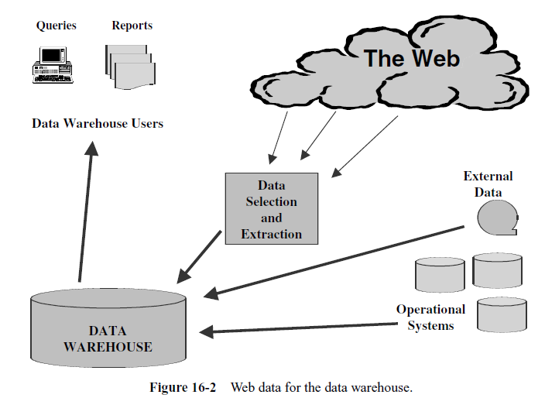

Slide 15
The Web as ..(contd)
Here are a few important uses to enrich your data warehouse:
  Add more descriptive attributes to the business dimensions.
  Include nominal or ordinal data about a dimension so that more options are available for pivoting and cross-tabulations.
  Add linkage data to a dimension so that correlation analysis with other dimensions can be performed.
  Create a new dimension table.
  Create a new fact table.

Slide 16
Clickstream Analysis
As you Web-enable your data warehouse, you find that enormous clickstream data of the visitors to your organization’s Web site becomes available
Considerations for Clickstream Data Retrieval
  Server logs usually contain multiple entries from a single page request.
  Proxy servers pose problems of confusing the identity of a session and why it ended.
  Basic clickstream data must be extracted from multiple servers.
  Retrieval of individual customer data is difficult as it gets buried in other data relating to pages served, browser types, hosts, etc.
  Identifying the separate sessions in a data stream is very involved requiring cookies or other session identification numbers.
  Clickstream data preparation is very time-consuming.

Slide 17
Clickstream Analysis (contd)
Usefulness of Clickstream Data Clickstream data may be the most important source for identifying and retaining e-commerce customers.
  Effectiveness of sales promotions
  Affinities between products that are likely to be bought together
  Customer demographics
  General buying patterns of customers
  Referring partner links
  Site statistics
  Site navigations resulting in sales
  Site navigations not producing sales
  Ability to differentiate between customer types

Slide 18
WEB-BASED INFORMATION DELIVERY

Slide 19
Expanded Usage
Users can use the browser to perform their queries easily and at any time during the day. Training costs are minimal because of the usage of the Web browser
  No headaches associated with synchronizing distributed data warehouses present in client/server environments
The Web never shuts down, information delivery in a 24/7.

Slide 20
Expanded Usage (contd)
Examine this phenomenon of extraordinary growth. Universal access generates a whole set of challenges that must be faced.
  this imposes additional strain on your Web-enabled data warehouse
    a totally open window that never shuts
    an easy and intuitive access mechanism via the ubiquitous Web browser
    -> increase in the user population
    -> the rapid acceleration of the growth

Slide 21
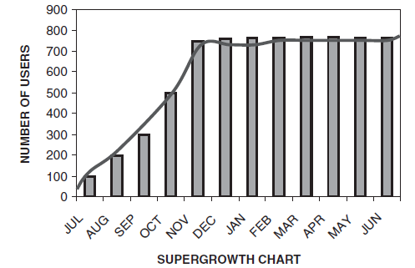
Figure 16-3 Supergrowth of a Web-enabled data warehouse

Slide 22
New Information Strategies
Understanding these expectations will assist you in developing new information delivery strategies for your Web-enabled warehouse.

Slide 23
New Information Strategies (contd)
Information Delivery Guidelines. Let us summarize the guidelines for formulating new information delivery strategies.
  Performance. Industry experts agree on a less than 10-second response time for a page to deliver the first screen of useful contents
  User Options. Users are conditioned to expect to see a number of standard options when they arrive at a Web page.

Slide 24
New Information Strategies (contd)
User Experience. Every Web designer’s fondest goal is to make each page a pleasing experience for the user. Users are eager to visit and stay on a page that is nicely formatted. If there are too many distractions and problems, users tend to shun the pages. Be judicious in the use of fonts, colors, blinking graphics, bold texts, underlines, audio clips, and video segments.
Processes. It is important that business processes be made to work smoothly and seamlessly on the Web. For the Web-enabled data warehouse, this requirement translates into streamlining Web interaction during an analysis session. Let the user be able to move from one step to the next, easily and gracefully.
User Support. In a lengthy process, a user must have the reassurance that nothing will be lost in the middle of the process. The user must know where he or she is in the process so that proceeding further will not be interrupted. During access to the Web-enabled data warehouse, let the user know the intermediary status information. For example, in running reports, provide the status of the reports to the users.

Slide 25
New Information Strategies (contd)
Resolving Problems. The user must be able to backtrack from their mistakes, make corrections, and then proceed. The user must also be able to report problems.
Information in Context. Opening the data warehouse by means of the Web provides a new slant on how information may be viewed in broader contexts. Hitherto, queriers could find answers to straight questions of “how much” and “how often.” Answers to such questions were found within narrow limits of the company’s framework. With the opening of business intelligence through the Web, the circle widens to include the entire supply chain and some competitive concerns. Information may now be obtained within the larger strategic framework.
Personalized Information. It is almost impossible to provide predefined queries that will satisfy the requirements of everyone in the value chain, so strive to provide ad hoc capabilities for asking any type of question related to any type of data in the warehouse.
Self-service Access. As the Web opens up the data warehouse to more users, both inside and outside the enterprise, tools must provide autonomous access to information. Users must be able to navigate and drill out to information sources. It must be practically an environment with self-service access where users may serve themselves.

Slide 26
New Information Strategies (contd)
HTML Files. In the Web-enabled data warehouse environment, the standard HTML document or file, also known as the Web page, is the principal means for communication.
  You can generate an HTML file one time or on a regular basis using triggers
  Database management systems offer publish-and-subscribe functions in their database engine. A subscription enables HTML pages to be created from scratch or refreshed whenever a trigger fires in the specified data source.

Slide 27
New Information Strategies (contd)
Reporting As a Strategic Tool. Next let us turn to reporting as a method of Webbased information delivery. On the Web, you are able to publish or distribute files via email.
  Report management can cover both types of reports. Routine reports and exception reports may be scheduled for distribution
  Several report management techniques are possible: parameter-driven reports, customizable reports, exception reports, predefined reports, and so on. One technique can provide for OLAP drill-down

Slide 28
Browser Technology for the Data Warehouse
Web technology and browser technology are almost synonymous. Browsers are the common client software in a Web-enabled data warehouse environment
four technologies are commonly used to build Web-enabled user interfaces.
  HTML, Java, ADO, and plug-ins

Slide 29
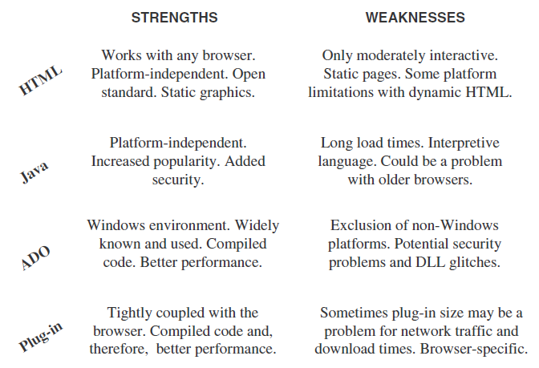
Figure 16-4 Web interface technologies

Slide 30
Security Issues
Without a doubt, when you open up your Web-enabled data warehouse to users throughout the enterprise via an intranet and to business partners outside via an extranet, you tend to maximize the value
->You may have to impose security restrictions at different levels
network level, you may look into solutions that support data encryption and restricted transfer mechanisms.
Carefully institute a security system at the application level
the Information Terrorist? This disloyal or undependable employee who has authorization to access secured information is a great threat to the security of the warehouse -> you need to address this aspect of security

Slide 31
OLAP AND THE WEB

Slide 32
Enterprise OLAP
The early warehouses started as small-scale decision support systems for a selected handful of interested analysts - Early mainframe decision support systems
The next generation of decision support systems replaced complex mainframe computing with easy-to-use GUIs and point-and-click interfaces - running on client/server architecture
The Web has put a dramatically different slant on information delivery. Web-enabled data warehouses can open their doors to a large group of users both within and outside the enterprise, and OLAP services be extended to more than a select group of analysts

Slide 33
Web-OLAP Approaches
Browser Plug-ins. you use plug-ins or browser extensions.
Precreated HTML Documents. you provide precreated HTML documents along with the navigation tools to find these.
OLAP in the Server. The best approach is to use the server to do all online analytical processing and present the results on a true thin-client information interface.

Slide 34
OLAP Engine Design
Dependence on the RDBMS. The OLAP engine relies completely on the RDBMS to perform multidimensional processing, generating complex, multipass SQL to access summary data. Joins, aggregations, and calculations are all done within the database, posing serious problems for Web-enabled systems.
Dependence on the Engine. Here the engine generates SQL to access summary data and performs all processing on a middle tier. You will observe two problem areas in this approach.
Intelligent OLAP Engine. The engine has the intelligence to determine the type of request and where it will be performed optimally. Because of its intelligence, the engine is able to distribute the joins, aggregations, and calculations between the engine component and the RDBMS

Slide 35
BUILDING A WEB-ENABLED DATA WAREHOUSE
a list of the principal features of the data Web house
  It is a fully distributed system. Many independent nodes make up the whole.
    As Dr. Kimball would say, there is no center to the data Webhouse.
  It is a Web-enabled system; it is beyond a client/server system. The distribution of tasks and the arrangement of the components are radically different.

Slide 36
BUILDING A ..(contd)
The Web browser is the key to information delivery. The system delivers the results of requests for information through remote browsers.
Because of its openness, security is a serious concern. The Web supports all data types including textual, numeric, graphical, photographic, audio, video, and more. It therefore follows that the data Webhouse supports many forms of data.
The system provides results to information requests within reasonable response times.
User interface design is of paramount importance for ease of use and for effective publication on the Web. Unlike the interfaces in other configurations, the Web has a definite method to measure the effectiveness of the user interface. The analysis of the clickstream data tells you how good the interface is.
By nature, the data Webhouse necessitates a nicely distributed architecture comprising small-scale data marts.
Because the arrangement of the components is based on a “bus” architecture of linked data marts, it is important to have fully conformed dimensions and completely conformed or standardized facts.
The Web never sleeps. Your data Webhouse is expected to be up all the time.
Finally, remember that the data Webhouse is meant to be open to all groups of users, both inside and outside the enterprise—employees, customers, suppliers, and other business partners.

Slide 37
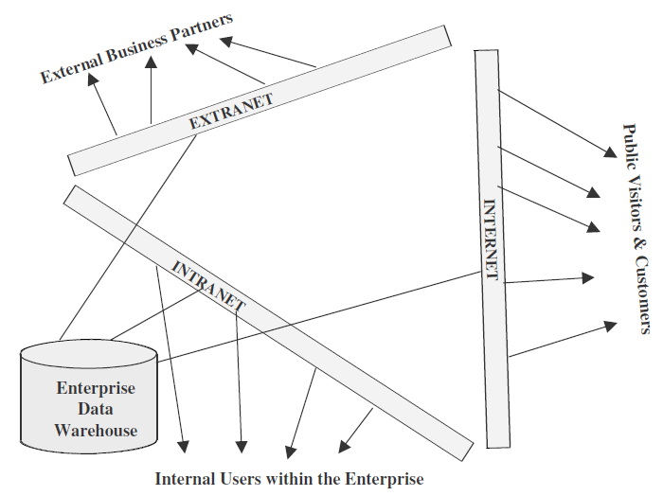
Figure 16-5 A broad overview of the data Webhouse

Slide 38
Implementation Considerations
In order to achieve basic architectural coherence among the distributed units, fully adopt dimensional modeling as the basic modeling technique.
Use the data warehouse bus architecture. This architecture, with its fully conformed dimensions and completely standardized facts, is conducive to the flow of correct information.
In a distributed environment, who conforms the dimensions and facts? This need not be physical centralization; logical centralization will work. This centralization gives the semblance of a center to the data Webhouse.

Slide 39
Implementation ..(contd)
Still the question remains: who actually conforms the dimensions and facts? The answer depends on what will work for your environment. If feasible, assign the task of conforming the dimensions and facts to the local groups of participants.
Well, how do all units become aware of the complete set of definitions for all dimensions and facts? You can have the definitions published on the Web; they then become the standards for conformed dimensions and facts
How do you physically implement the conformed dimension tables and the conformed fact tables? Dimension tables are often physically duplicated.
One last consideration, now that we understand the data Webhouse as a distributed set of dimensions and facts based on possibly dissimilar database technologies. How can you make such a distributed collection work as a cohesive whole?

Slide 40
Putting the Pieces Together
The data Webhouse configuration is beyond client/server computing. The usual two-tier or three-tier technology is inadequate. As the number of users rise sharply, new servers must be added without any difficulty. Therefore, consider a distributed component architecture.
With the user nodes spread out, you must strive for minimum administration on the client side. True thin-client technology like Java is likely to provide a zero administration client setup.
The client technology is expected to be a combination of thin clients and full clients.
Ensure complete metadata integration.
Select the right database to support the distributed environment. As you are likely to use Java, a RDBMS with the Java engine in the database would prove useful.
In many Web applications, the HTTP server becomes a point of congestion as all data from a session is fed to the browser through this server. You will find scalability to be difficult unless you implement a CORBA model.

Slide 41
Putting …(contd)
Ensure that you pay enough attention to administration and maintenance. This should include identification of the dimensions, hierarchies within dimensions, facts, and summaries. Summary management could be difficult.
TheWeb interface consists of a browser, search engine, groupware, push technologies, home pages, hypertext links, and downloaded Java and ActiveX applets.
Tools supporting HTML can be universally deployed. However, for complex analysis, HTML is cumbersome. Use HTML as much as possible and reserve Java or plug-ins for complex ad hoc analysis.

Slide 42
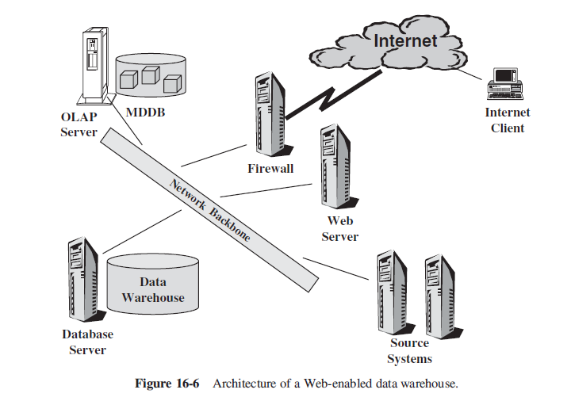
Web Processing Model

Slide 43
