Slide 1

Data Warehouses
FPT University
Notes:
-
-
-
-
-
-
-
-
-
-
-
-
-
-
-
-
-
-
-

Slide 2
Lecture 6: The Metadata

Slide 3
Outline
Find out why metadata is so important
Understand who needs metadata and what types they need
Review metadata types by the three functional areas
Discuss business metadata and technical metadata in detail
Examine all the requirements metadata must satisfy
Understand the challenges for metadata management
Study options for providing metadata

Slide 4
I. WHAT IS METADAT ?
WHY METADATA IS IMPORTANT ?
Metadata in a data warehouse contains the answers to questions about the data in the data warehouse.
There are many seemingly different definitions for metadata. Here is a sample list of definitions:
  Data about the data
  Table of contents for the data
  Catalog for the data
  Data warehouse atlas
  Data warehouse directory
  Glue that holds the data warehouse contents together
So, what exactly is metadata? Which one of these definitions comes closest to the truth?

Slide 5
I. WHY METADATA IS IMPORTANT
Consider a specific example:
  Assume your user wants to know about the table or entity called Customer in your data warehouse before running any queries on customer data.
  What is the information content about Customer in your metadata repository?
  Let us review the metadata element for the Customer entity as shown in Figure 9-1 (next slide)

Slide 6
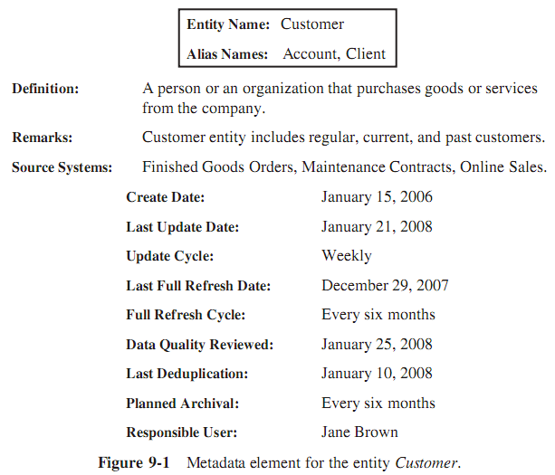
I. WHY METADATA IS IMPORTANT
Metadata describes all the pertinent aspects of the data in the data warehouse fully and precisely
Pertinent to whom? Pertinent primarily to the users and also to you as developer and part of the project team.

Slide 7
1. A Critical Need of Metadata in the Data Warehouse
For Using the Data Warehouse.
  Users retrieve information from the data warehouse. The users themselves create ad hoc queries and run these against the data warehouse.
  They format their own reports.
  Before they can create and run their queries, users need to know about the data in the data warehouse
➔ They need metadata

Slide 8
1. A Critical Need in the Data Warehouse
For Building the Data Warehouse.
  If we consider every activity and every task for building the data warehouse:
    We will come to realize that metadata is an overall compelling necessity
    And It is a very significant component in the data warehouse.
  Metadata is absolutely essential for building the data warehouse.

Slide 9
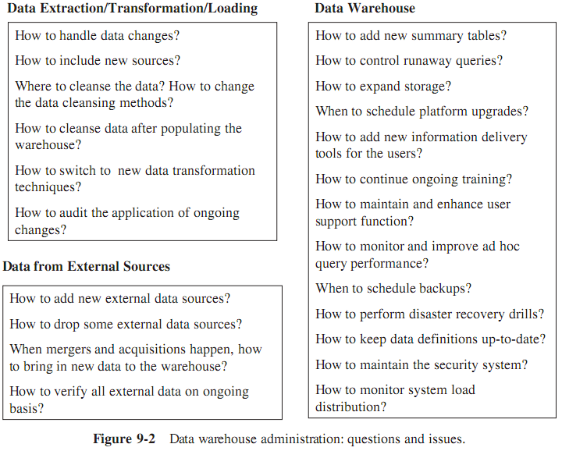
1. A Critical Need in the Data Warehouse
For Administering the Data Warehouse
  Figure 9-2 lists a series of questions relating to data warehouse administration.
  ➔ The metadata must address these issues.

Slide 10
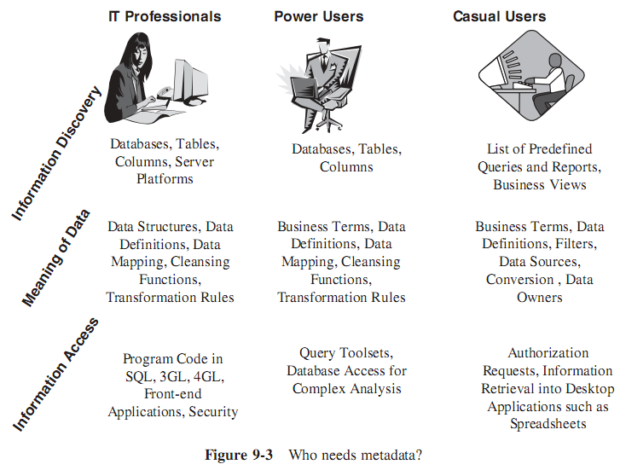
1. A Critical Need in the Data Warehouse
Who Needs Metadata ?

Slide 11
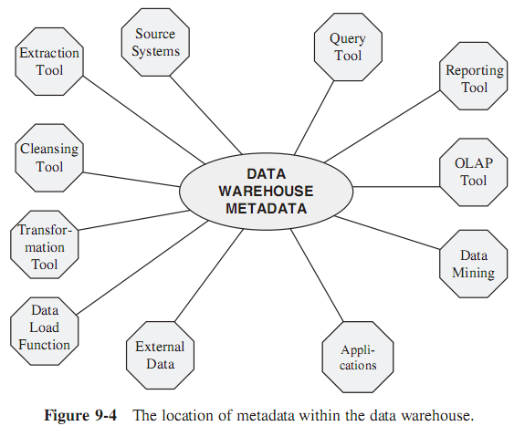
1. A Critical Need in the Data Warehouse
Metadata is Like a Nerve Center:
  The metadata assumes a key position and enables communication among various processes.
  So, It acts like a nerve center in the data warehouse
  The individual parts of the metadata are needed by two groups of people:
    end-users,
    and IT developers and administrators

Slide 12
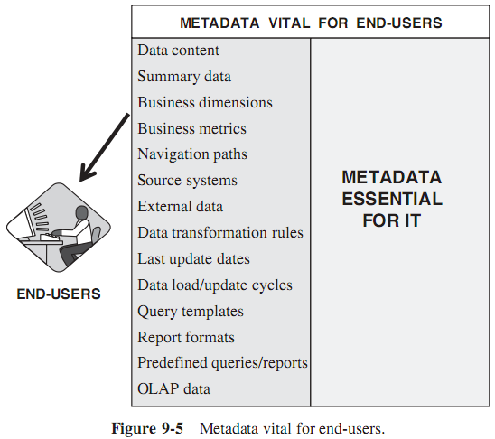
2. Why Metadata is vital for End-Users
The analysis will be more effective if the analysts are provided adequate metadata to help as a powerful roadmap of the data.
If there is sufficient and proper metadata, the analyst does not have to get assistance from IT every time he needs to run an analysis.
Easily accessible metadata is crucial for end-users.

Slide 13
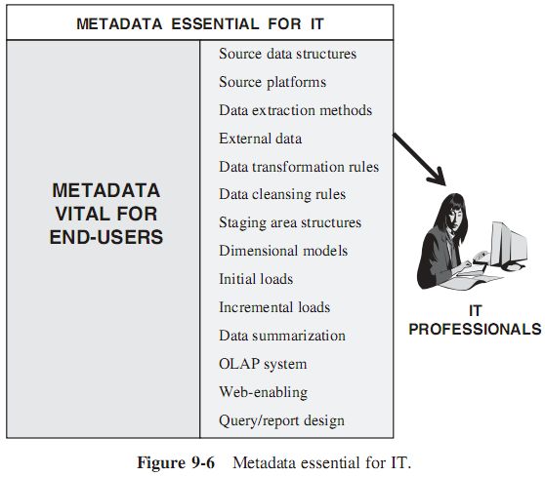
3. Why Metadata is Essential for IT
Throughout the entire data warehouse development process, metadata is essential for IT.
As the development process moves through data extraction, data transformation, data integration, data cleansing, data staging, data storage, query and report design, and design for OLAP and other front-end systems, metadata is critical for IT to perform their development activities.

Slide 14
4. Automation of Warehousing Tasks
Traditionally, metadata has been created and maintained as documentation about the data for each process.
Now metadata is assuming a new active role:
  When you, as a developer, use a tool for design and development, in that process, the tool lets you to create and record a part of the data warehouse metadata.
  When you use another tool to perform another process in the design and development, this tool uses the metadata created by the first tool.
This is how metadata assumes an active role and assists in the automation of data warehouse processes

Slide 15
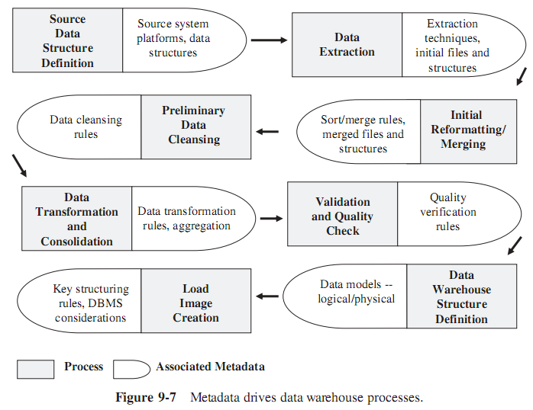
4. Automation of Warehousing Tasks

Slide 16
5. Establishing the Context of Information
Imagine this scenario: the users wants to run a query to retrieve sales data for three products during the first seven days of April in the Southern Region. This user composes the query as follows:
  Product = Widget-1 or Widget-2 or Widget-3
  Region = ‘SOUTH’
  Period = 04-01-2016 to 04-07-2016
The result comes back:
        Sale Units Amount
  Widget-1 25,355 253,550
  Widget-2 16,978 254,670
  Widget-3 7,994 271,796
In the specification for region, which territories does region “SOUTH” include? Are these the territories your user is interested in? What is the context of the data item “SOUTH” in your data warehouse? Next, does the data item 04-01-2016 denote April 1, 2016 or January 4, 2016? What is the convention used for dates in your data warehouse?
➔ Need metadata

Slide 17
II. METADATA TYPES BY FUNCTIONAL AREAS
The classification of metadata types by the functional areas in the data warehouse:
  1. Data acquisition
  2. Data storage
  3. Information delivery

Slide 18
1. Data Acquisition
In this area, the data warehouse processes relate to the following functions:
  Data extraction
  Data transformation
  Data cleansing
  Data integration
  Data staging
As the processes take place, the appropriate tools record the metadata elements relating to the processes.
The tools record the metadata elements during the development phases as well as while the data warehouse is in operation after deployment.

Slide 19
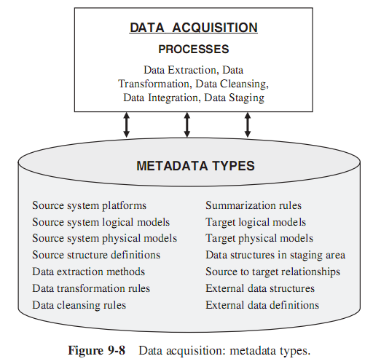
1. Data Acquisition

Slide 20
2. Data Storage
In the data storage area, the data warehouse processes relate to the following functions:
  Data loading
  Data archiving
  Data management
Metadata recorded by processes in the data storage area is used for development, administration, and by the users
The developer will be using the metadata for designing the full data refreshes and the incremental data loads.
The DBA will be using metadata for the processes of backup, recovery, and tuning the database. For purging the data warehouse and for periodic archiving of data, metadata from this area will be used for data warehouse administration

Slide 21
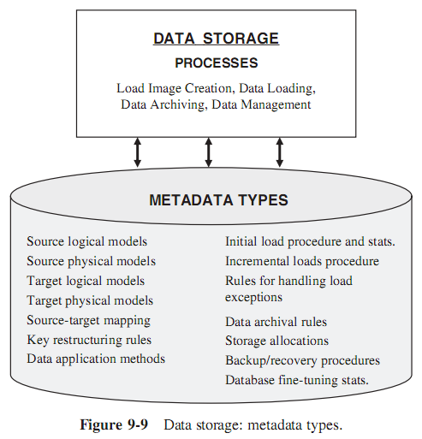
2. Data Storage

Slide 22
3. Information Delivery
In this area, the data warehouse processes relate to the following functions:
  Report generation
  Query processing
  Complex analysis
Mostly, the processes in this area are meant for end-users. End-users generally use metadata recorded in processes of the two previous areas (data acquisition, data storage)
When a user creates a query, the user
  can refer back to metadata recorded in the data acquisition and data storage areas,
  and can look up the source data configurations, data structures, and data transformations from the metadata recorded in the data acquisition area.

Slide 23
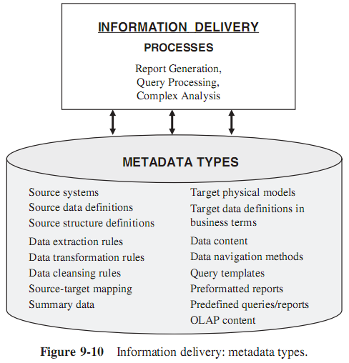
3. Information Delivery

Slide 24
III. BUSINESS METADATA
Business metadata connects the business users to the data warehouse.
Business users need to know what is available in the data warehouse from a perspective different from that of IT professionals.
  Business metadata is like a roadmap or an easy-to-use information directory showing the contents and how to get there.
  It is like a tour guide for executives and a route map for managers and business analysts.

Slide 25
1. Content Overview
Business metadata must describe the contents in plain language giving information in business terms.
  For example, the names of the data tables or individual data elements must not be cryptic but be meaningful terms that business users are familiar with.
  The data item name calc_pr_sle is not acceptable. You need to rename this as calculated-prior-month-sale.
Business metadata is much less structured than technical metadata.
A substantial portion of business metadata originates from textual documents, spreadsheets, and even business rules and policies.

Slide 26
2. Examples of Business Metadata
Business metadata focuses on providing support for the end-user.
  It must make it easy for the end-users to understand what data is available in the data ware-house and how they can use it.
  Business metadata portrays the data warehouse purely from the perspective of the end-users.
Try to better understand business metadata by looking at a list of examples:
  Connectivity procedures
  Table names and business definitions
  Attribute names and business definitions
  Data warehouse refresh schedule
  Source-to-target mappings
  Data transformation business rules
  Predefined queries
  Predefined reports
  …

Slide 27
3. Content Highlights
What types of information can the user get from business metadata?
Let us derive a list of questions business metadata can answer for the end-users:
  How can I sign onto and connect with the data warehouse?
  Which parts of the data warehouse can I access?
  Can I see all the attributes from a specific table?
  What are the definitions of the attributes I need in my query?
  Are there any queries and reports already predefined to give the results I need?
  Which source system did the data I want come from?
  What default values were used for the data items retrieved by my query?
  What types of aggregations are available for the metrics needed?
  …
➔ The answer is : using business metadata

Slide 28
4. Who Benefits?
Business metadata primarily benefits end-users. This is a general statement.
Who specifically benefits from business metadata? How does business metadata serve specific members of the end-user community? Please look over the following list:
  Managers
  Business analysts
  Power users
  Regular users
  Casual users
  Senior managers/junior executives

Slide 29
IV. TECHNICAL METADATA
Technical metadata is meant for the IT staff responsible for the development and administration of the data warehouse.
  The technical personnel need information to design each process.
  These are processes in every functional area of the data warehouse.
The technical group on the project team, must know the proposed structure and content of the data warehouse.
Different members on the project team need different kinds of information from technical metadata.
Technical metadata is like a support guide for the IT professionals to build, maintain, and administer the data warehouse.

Slide 30
1. Content Overview
IT staff require technical metadata for three distinct purposes:
  IT personnel need technical metadata for the initial development of the data warehouse. For this purpose, the metadata from the earlier process of data extraction can need.
  Technical metadata is absolutely essential for ongoing growth and maintenance of the data warehouse.
    If you are responsible for making changes to some data structures, or even for a second release of the data warehouse, where will you find the information on the contents and the various processes? You need technical metadata.
  Technical metadata is also critical for the continuous administration of the production data warehouse.
    As an administrator, you have to monitor the ongoing data extractions.
    You have to ensure that the incremental loads are completed correctly and on time.
    Your responsibility may also include database backups and archiving of old data.

Slide 31
2. Examples of Technical Metadata
Technical metadata concentrates on support for the IT staff responsible for development, maintenance, and administration.
Technical metadata is more structured than business metadata.
Technical metadata is like an internal view of the data warehouse showing the inner details in technical terms. Here is a list of examples of technical metadata:
  Data models of source systems
  Record layouts of outside sources
  Source-to-staging area mappings
  Staging area-to-data warehouse mappings
  Data extraction rules and schedules
  Data transformation rules and versioning
  Data aggregation rules
  Data cleansing rules
  …

Slide 32
3. Content Highlights
Just as in the case of business metadata, let us derive a list of questions technical metadata can answer for developers and administrators. Please review the following list:
  What databases and tables exist?
  What are the columns for each table?
  What are the keys and indexes?
  What are the physical files?
  Do the business descriptions correspond to the technical ones?
  When was the last successful update?
  What are the source systems and their data structures?
  ….

Slide 33
4. Who Benefits?
The following list indicates the specific types of personnel who will benefit from technical metadata:
  Project manager
  Data warehouse administrator
  Database administrator
  Metadata manager
  Data warehouse architect
  Data acquisition developer
  Data quality analyst
  Business analyst
  System administrator
  Infrastructure specialist
  Data modeler
  Security architect

Slide 34
V. HOW TO PROVIDE METADATA
When the data warehouse is being designed and built, metadata needs to be collected and recorded.
Metadata describes the data warehouse from various points of view (business anf techincal).
Most of the data warehouse processes are performed with the aid of software tools.
The same metadata or true copies of the relevant subsets must be available to every tool.
➔ Let us establish the basic requirements for good metadata management. What are the requirements? Next, we will consider the sources for metadata.

Slide 35
1. Metadata Requirements
Capturing and Storing Data:
  Metadata in a data warehouse environment must keep track of the revisions. As such, metadata management must provide means for capturing and storing metadata with proper versioning to indicate its time-variant feature.
Variety of Metadata Sources:
  Metadata for a data warehouse never comes from a single source. Metadata management, therefore, must be open enough to capture metadata from a large variety of sources.
Metadata Integration:
  Metadata from the data models of the source systems must be integrated with metadata from the data models of the data warehouse databases. The integration must continue further to the front-end tools used by the end-users.
Metadata Standardization:
  The same metadata in different metadata stores of different tools must be represented in the same manner

Slide 36
1. Metadata Requirements
Rippling Through of Revisions:
  Revisions will occur in metadata as data or business rules change. So that, the revisions must ripple throughout the data warehouse to the other processes
Keeping Metadata Synchronized:
  Metadata about data structures, data elements, rules, and so on must be kept synchronized at all times
Metadata Exchange:
  When the end-users are using the front-end tools for information access, they must be able to view the metadata recorded by back-end tools like the data transformation tool. There for, free and easy exchange of metadata from one tool to another must be possible.
Support for End-Users:
  Metadata management must provide simple graphical and tabular presentations to end-users, making it easy for them to browse through the metadata and understand the data in the data warehouse purely from a business perspective.

Slide 37
2. Sources of Metadata
As tools are used for the various data warehouse processes, metadata gets recorded as a by product.
For example, when a data transformation tool is used, the metadata on the source to target mappings get recorded as a byproduct of the process carried out with that tool
The sources of metadata include:
  a/ Source Systems
    Data models of operational systems (manual or with CASE tools)
    Definitions of data elements from system documentation
    Physical file layouts and field definitions
    Program specifications
    File layouts and field definitions for data from outside sources
    Other sources such as spreadsheets and manual lists

Slide 38
2. Sources of Metadata
b/ Data Extraction
  Data on source platforms and connectivity
  Layouts and definitions of selected data sources
  Definitions of fields selected for extraction
  Criteria for merging into initial extract files on each platform
  Rules for standardizing field types and lengths
  Data extraction schedules
  Extraction methods for incremental changes
  Data extraction job streams
c/ Data Transformation and Cleansing
  Specifications for mapping extracted files to data staging files
  Conversion rules for individual files
  Default values for fields with missing values
  Business rules for validity checking
  Sorting and resequencing arrangements
  Audit trail for the movement from data extraction to data staging

Slide 39
2. Sources of Metadata
d/ Data Loading
  Specifications for mapping data staging files to load images
  Rules for assigning keys for each file
  Audit trail for the movement from data staging to load images
  Schedules for full refreshes
  Schedules for incremental loads
  Data loading job streams
e/ Data Storage
  Data models for centralized data warehouse and dependent data marts
  Subject area groupings of tables
  Data models for conformed data marts
  Physical files
  Table and column definitions
  Business rules for validity checking

Slide 40
2. Sources of Metadata
f/ Information Delivery
  List of query and report tools
  List of predefined queries and reports
  Data model for special databases for OLAP
  Schedules for retrieving data for OLAP

Slide 41
3. Challenges for Metadata Management
Because the industry-wide standardization for data warehouse is far from being a reality, so that there are many challenges to be addressed while providing metadata:
  Each software tool has its own propriety metadata. If you are using several tools in your data warehouse, how can you reconcile the formats ?
  There are conflicting claims on the advantages of a centralized metadata repository as opposed to a collection of fragmented metadata stores.
  There are no easy and accepted methods of passing metadata along the processes as data moves from the source systems to the staging area and thereafter to the data warehouse storage.
  Preserving version control of metadata uniformly throughout the data warehouse is tedious and difficult.

Slide 42
4. Metadata Repository
Think of a metadata repository as a general-purpose information directory or cataloguing device to classify, store, and manage metadata.
As we have seen earlier, business metadata and technical metadata serve different purposes.
  The end-users need the business metadata;
  Data warehouse developers and administrators require the technical metadata.
Therefore, the metadata repository can be thought of as two distinct information directories, one to store business metadata and the other to store technical metadata.
This division may also be logical within a single physical repository.

Slide 43
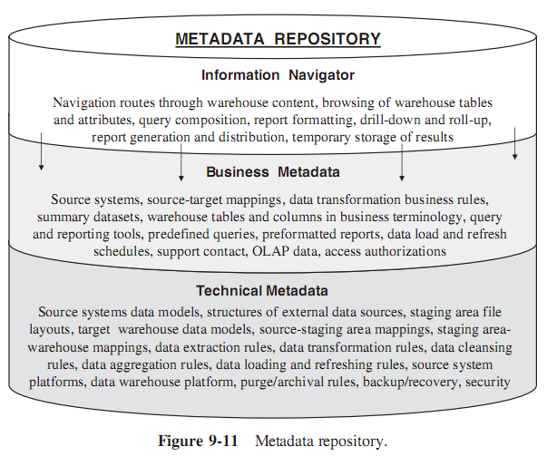
4. Metadata Repository

Slide 44
5. Metadata Integration and Standards
For a free interchange of metadata within the data warehouse between processes performed with the aid of software tools, the need for standardization is obvious.
The Meta Data Coalition and the Object Management Group have both been working on standards for metadata.
The Meta Data Coalition has accepted a standard known as the Open Information Model (OIM).
The Object Management Group has released the Common Warehouse Metamodel (CWM) as its standard.
The two bodies have declared that they are working together to fuse the standards so that there could be a single industry-wide standard.

Slide 45
6. Implementation Options
Review the following options and consider the ones most appropriate for the data warehouse environment:
  Select and use a metadata repository product with its business information directory component.
  In the opinion of some data warehouse consultants, a single centralized repository is a restrictive approach jeopardizing the autonomy of individual processes.
  Some developers have come up with their own solutions.
  Other developers create their own database to gather and store metadata and publish it on the company’s intranet.
  Some adopt clever methods of integration of information access and analysis tools.

