Slide 1

Data Warehouses
FPT University

Slide 2
Lecture 7:
Principle Of Dimensional Modeling

Slide 3
Outline
Dimensional Modeling Basics
E-R Modeling Versus Dimensional Modeling
STAR Schema

Slide 4
I. FROM REQUIREMENTS TO DATA DESIGN
The requirements definition completely drives the logical data design for the data warehouse.
Logical data design includes determination of the various data elements that are needed and combination of the data elements into structures of data.
Logical data design also includes establishing the relationships among the data structures.
The information package diagrams form (in requirements definition document) the basis for the logical data design for the data warehouse.
The data design process results in a dimensional data model.

Slide 5
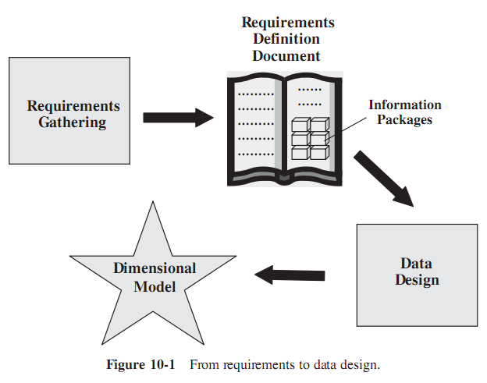
I. FROM REQUIREMENTS TO DATA DESIGN

Slide 6
1. Design Decisions
Some of the design decisions must be made before designing the dimensional data model:
  Choosing the process. Selecting the subjects from the information packages for the first set of logical structures to be designed.
  Choosing the grain. Determining the level of detail for the data in the data structures.
  Identifying and conforming the dimensions. Choosing the business dimensions (such as product, market, time, etc.) to be included in the first set of structures and making sure that each particular data element in every business dimension is conformed to one another.
  Choosing the facts. Selecting the metrics or units of measurements (such as product sale units, dollar sales, dollar revenue, etc.) to be included in the first set of structures.
  Choosing the duration of the database. Determining how far back in time you should go for historical data.

Slide 7
2. Dimensional Modeling Basics
Reviewing the information package diagram for automaker sales, we notice three types of data entities:
  (1) measurements or metrics,
  (2) business dimensions, and
  (3) attributes for each business dimension.
So when we put together the dimensional model, we need to come up with data structures to represent these three types of data entities.

Slide 8
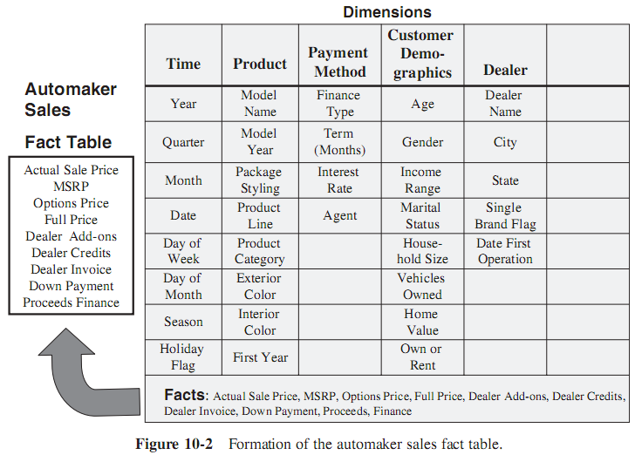
2. Dimensional Modeling Basics

Slide 9
2. Dimensional Modeling Basics
First, let us work with the measurements or metrics seen at the bottom of the information package diagram. These are the facts for analysis.
Each of these data items is a measurement or fact: i.e.
  Actual sale price is a fact about what the actual price was for the sale.
  Full price is a fact about what the full price was relating to the sale.
As we review each of these factual items, we find that we can group all of these into a single data structure. In relational database terminology, we may call the data structure a relational table.
So the metrics or facts from the information package diagram will form the fact table.
For the automaker sales analysis this fact table would be the automaker sales fact table.

Slide 10
2. Dimensional Modeling Basics
Let us now move on to the other sections of the information package diagram, taking the business dimensions one by one.
Look at the product business dimension (product column).
  The product business dimension is used when we want to analyze the facts by products.
  The list of data items relating to the product dimension are as follows:
    Model name
    Model year
    Package styling
    Product line
    Product category
    Exterior color
    Interior color
    First model year

Slide 11
2. Dimensional Modeling Basics
What can we do with all these data items in our dimensional model? All of these relate to the product in some way.
We can, therefore, group all of these data items in one data structure or one relational table.
We can call this table the product dimension table.
The data items in the above list would all be attributes in this table.

Slide 12
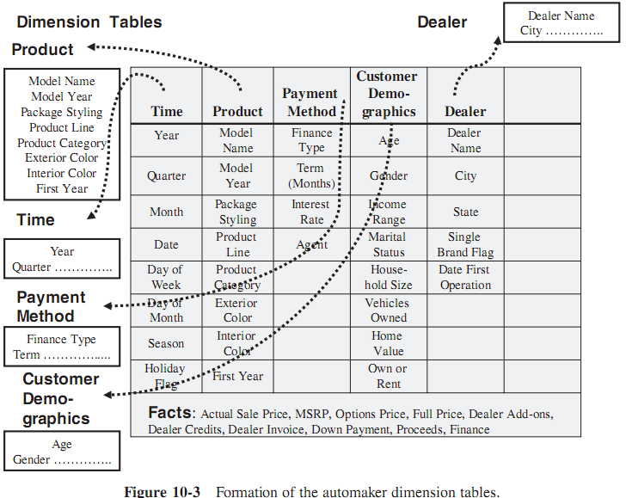
2. Dimensional Modeling Basics

Slide 13
2. Dimensional Modeling Basics
How should these tables (fact and dimension tables) be arranged in the dimensional model?
What are the relationships and how should we mark the relationships in the model?
➔ The dimensional model should primarily facilitate queries and analyses.
  What would be the types of queries and analyses?
  These would be queries and analyses where the metrics inside the fact table are analyzed across one or more dimensions using the dimension table attributes.

Slide 14
2. Dimensional Modeling Basics
Examine a typical query against the automaker sales data. How much sales proceeds did the Jeep Cherokee, Year 2000 Model, generate in January 2000 at Big Sam Auto dealership for buyers who own their homes and who took 3-year leases, financed by Daimler-Chrysler Financing?
  We are analyzing actual sale price, full price.
  We are analyzing these facts along attributes in the various dimension tables.
The attributes in the dimension tables act as constraints and filters in our queries. We also find that any or all of the attributes of each dimension table can participate in a query.
Further, each dimension table has an equal chance to be part of a query.

Slide 15
2. Dimensional Modeling Basics
➔ What the dimensional model needs to achieve and what are its purposes ?
  The model should provide the best data access.
  The whole model must be query-centric.
  It must be optimized for queries and analyses.
  The model must show that the dimension tables interact with the fact table.
  The model should allow drilling down or rolling up along dimension hierarchies.
With these requirements, we find that a dimensional model with the fact table in the middle and the dimension tables arranged around the fact table satisfies the conditions.
In this arrangement, each of the dimension tables has a direct relationship with the fact table in the middle.
Such an arrangement in the dimensional model looks like a star formation. The dimensional model is therefore called a STAR schema.

Slide 16
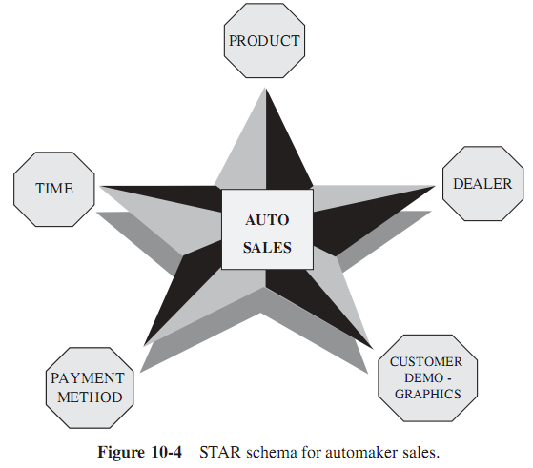
2. Dimensional Modeling Basics

Slide 17
3. E-R Modeling Versus Dimensional Modeling
We are familiar with data modeling for operational or OLTP systems. We adopt the Entity-Relationship (E-R) modeling technique to create the data models for these systems.
Figure 10-5 lists the characteristics of OLTP systems and shows why E-R modeling is suitable for OLTP systems.
We have so far discussed the basics of the dimensional model and find that this model is most suitable for modeling the data for the data warehouse.
Let us recapitulate the characteristics of the data warehouse information and review how dimensional modeling is suitable for this purpose. ➔ See next slide

Slide 18
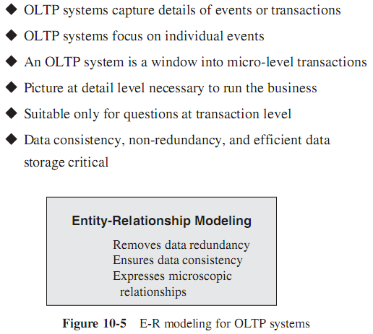
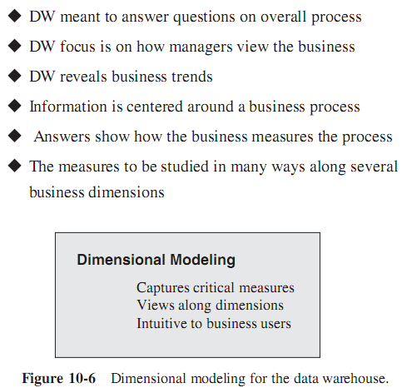

Slide 19
II. THE STAR SCHEMA
Creating the STAR schema is the fundamental data design technique for the data warehouse.
It is necessary to gain a good grasp of this technique.

Slide 20
1. Review of a Simple STAR Schema
We will take a simple STAR schema designed for order analysis.
Assume this to be the schema for a manufacturing company and that the marketing department is interested in determining how they are doing with the orders received by the company.

Slide 21
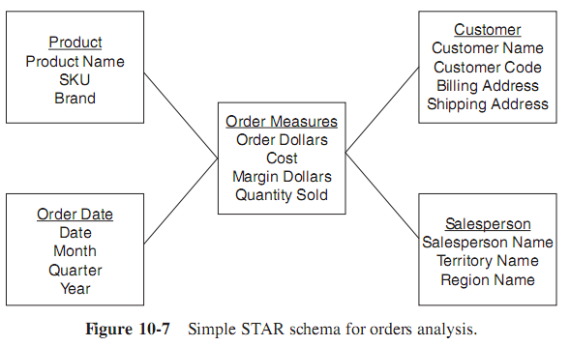
Simple STAR Schema
The STAR schema structure intuitively answers the questions of what, when, by whom, and to whom.
From the STAR schema, the users can easily visualize the answers to these questions:
  What was the product sold?
  Who was the customer?
  Which salesperson brought the order?
  When was the order placed?

Slide 22
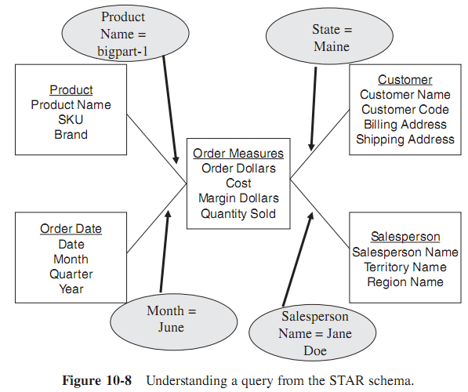
Simple STAR Schema
Simple query against the STAR schema:
  The marketing department wants the quantity sold and order dollars for product bigpart-1, relating to customers in the state of Maine, obtained by salesperson Jane Doe, during the month of June.

Slide 23
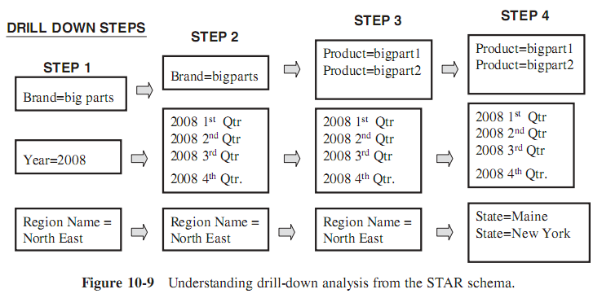
Simple STAR Schema
Show the total quantity sold of product brand big parts to customers in the northeast region for year 2008
In the next step of the analysis, the marketing department now wants to drill down to the level of quarters in 2008 for the northeast region
Next, the analysis goes down to the level of individual products in that brand.

Slide 24
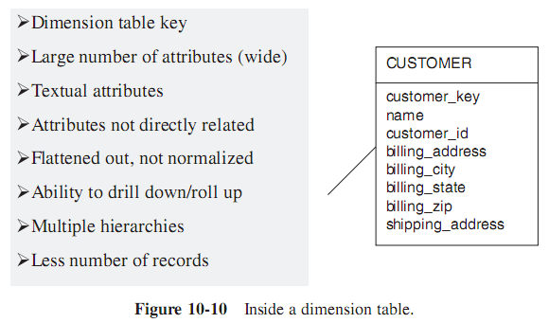
2. Inside a Dimension Table

Slide 25
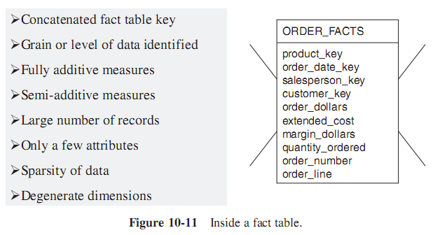
3. Inside the Fact Table

Slide 26
4. The Factless Fact Table
Apart from the concatenated primary key, a fact table contains facts or measures.
Let us say we are building a fact table to track the attendance of students:
  Student attendance, the possible dimensions are student, course, date, room, and professor.
  The attendance may be affected by any of these dimensions.
  In the fact table row, the attendance will be indicated with the number one. Every fact table row will contain the number one as attendance. If so, why bother to record the number one in every fact table row?
  ➔ There is no need to do this.
The very presence of a corresponding fact table row could indicate the attendance. This type of situation arises when the fact table represents events.
Such fact tables really do not need to contain facts.
They are “factless” fact tables. Figure 10-12 shows a typical factless fact table.

Slide 27
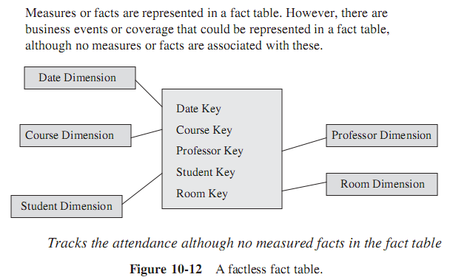
4. The Factless Fact Table

Slide 28
III. STAR SCHEMA KEYS
Primary Keys
  Each row in a dimension table is identified by a unique value of an attribute designated as the primary key of the dimension
  In a product dimension table, the primary key identifies each product uniquely.
Assume that the product code in the operational system is an 8-position code:
  Two of which positions indicate the code of the warehouse where the product is normally stored
  Two other positions denote the product category
If we use the operational system product code as the primary key for the product dimension table, what is happen ?
  Assume that the product code gets changed in the middle of a year, because the product is now stored in a different warehouse of the company
  So we have to change the product code in the data warehouse
  Then the newer data for the same product will reside in the data warehouse with different key values
  This could cause problems if we need to aggregate the data from before the change with the data from after the change to the product code

Slide 29
III. STAR SCHEMA KEYS
Surrogate Keys: What then should we use as primary keys for dimension tables?
  The answer is to use surrogate keys.
  The surrogate keys are simply system-generated sequence numbers.
  They do not have any built-in meanings.
  Of course, the surrogate keys will be mapped to the production system keys. Nevertheless, they are different.
  The general practice is to keep the operational system keys as additional attributes in the dimension tables.
Foreign Keys
  Each dimension table is in a one-to-many relationship with the central fact table. So the primary key of each dimension table must be a foreign key in the fact table

Slide 30
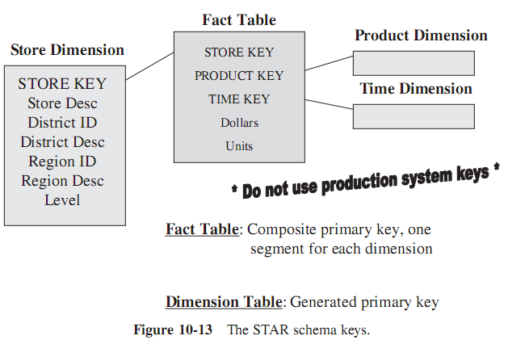
III. STAR SCHEMA KEYS

Slide 31
Primary key choice for Fact Table
There are three options:
  1. A single compound primary key whose length is the total length of the keys of the individual dimension tables. Under this option, in addition to the compound primary key, the foreign keys must also be kept in the fact table as additional attributes. This option increases the size of the fact table.
  2. Concatenated primary key that is the concatenation of all the primary keys of the dimension tables. Here you need not keep the primary keys of the dimension tables as additional attributes to serve as foreign keys. The individual parts of the primary keys themselves will serve as the foreign keys.
  3. A generated primary key independent of the keys of the dimension tables. In addition to the generated primary key, the foreign keys must also be kept in the fact table as additional attributes. This option also increases the size of the fact table.

Slide 32
IV. ADVANTAGES OF THE STAR SCHEMA
Easy for Users to Understand
Optimizes Navigation
Most Suitable for Query Processing

Slide 33
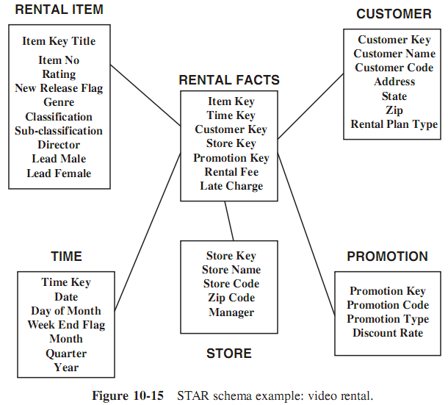
VI. STAR SCHEMA EXAMPLES

Slide 34
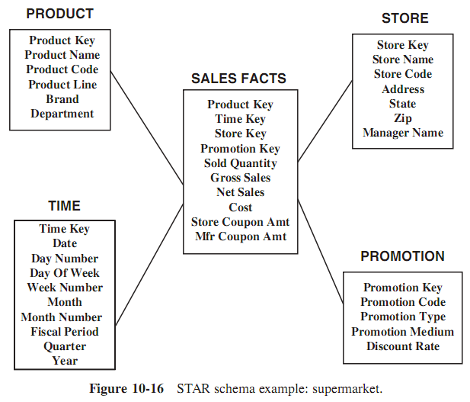
VI. STAR SCHEMA EXAMPLES

Slide 35
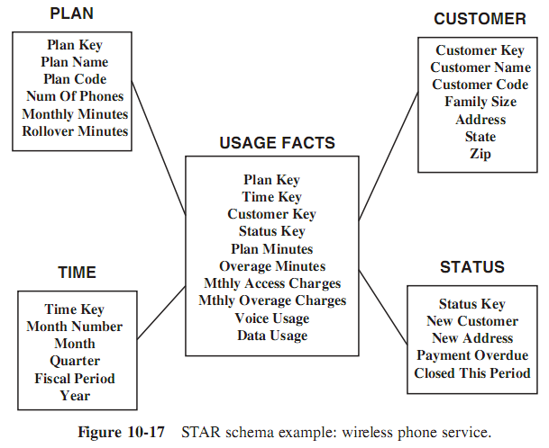
VI. STAR SCHEMA EXAMPLES

