Slide 1

Data Warehouses
FPT University

Slide 2
Lecture 7: Dimensional Modeling

Slide 3
I. UPDATES TO THE DIMENSION TABLES
Update on fact table:
  The fact table Auto Sales contains the measurements or metrics such as Actual Sale Price, Options Price, and so on
  Every day as more and more sales take place, more and more rows get added to the fact table.
  The fact table continues to grow in the number of rows over time.
  Very rarely are the rows in a fact table updated with changes. Even when there are adjustments to the prior numbers, these are also processed as additional adjustment rows and added to the fact table.
Update on dimension table
  Compared to the fact table, the dimension tables are more stable and less volatile.
  However, unlike the fact table, which changes through the increase in the number of rows, a dimension table does not change just through the increase in the number of rows, but also through changes to the attributes themselves.
  Look at the product dimension table. What about the attributes within the product dimension table? If a particular product is moved to a different product category, then the corresponding values must be changed in the product dimension table.

Slide 4
Slowly Changing Dimensions
From the consideration of the changes to the dimension tables, we can derive the following principles:
  Most dimensions are generally constant over time
  Some dimensions, though not constant over time, change slowly
  The key value of the source record does not change
  The description and other attributes change slowly over time
  In the source OLTP systems, the new values overwrite the old ones
  However, overwriting of dimension table attributes is not always the appropriate option in a data warehouse
  The ways changes are made to the dimension tables depend on the types of changes and what information must be preserved in the data warehouse

Slide 5
Type 1 Changes: Correction of Errors
Nature of Type 1 Changes : These changes usually relate to the corrections of errors in the source systems.
For example, suppose a spelling error in the customer name is corrected to read as Michael Romano from the erroneous entry of Michel Romano. Also, suppose the marital status changed from single to married.
There is no need to preserve the old values.
  In the case of Michael Romano, the old name is erroneous and needs to be discarded. When the users need to find all the orders from Michael Romano, the users will use the correct name.
But the change in the marital status is slightly different.
  This change can be handled in the same way as the change in customer name only if that change is a correction of error.
  Otherwise, you will cause problems when the users want to analyze orders by marital status.

Slide 6
Type 1 Changes: Correction of Errors
Nature of Type 1 Changes : Here are the general principles for Type 1 changes:
  Usually, the changes relate to correction of errors in source systems
  Sometimes the change in the source system has no significance
  The old value in the source system needs to be discarded
  The change in the source system need not be preserved in the data warehouse

Slide 7
Type 1 Changes: Correction of Errors
Applying Type 1 Changes to the Data Warehouse. Please look at Figure 11-2 showing the application of Type 1 changes to the customer dimension table. The method for applying Type 1 changes is:
  Overwrite the attribute value in the dimension table row with the new value
  The old value of the attribute is not preserved
  No other changes are made in the dimension table row
  The key of this dimension table or any other key values are not affected
  This type is easiest to implement

Slide 8
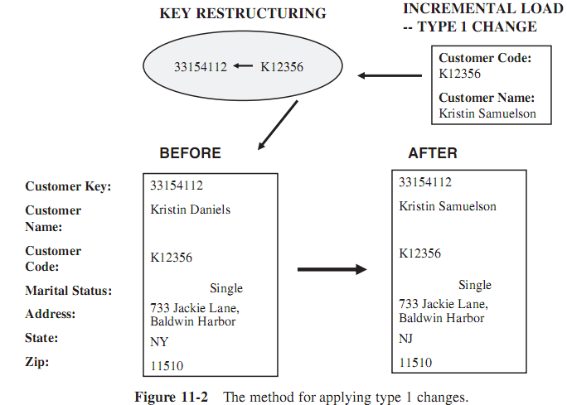
Applying Type 1 Changes to the Data Warehouse

Slide 9
Type 2 Changes: Preservation of History
Nature of Type 2 Changes.
  Go back to the change in the marital status for Kristin Samuelson from single to married.
  Assume that in your data warehouse one of the essential requirements is to track orders by marital status in addition to tracking by other attributes.
  If the change to marital status happened on October 1, 2000
    all orders from Kristin Samuelson before that date must be included under marital status: single,
    and all orders on or after October 1, 2000 should be included under marital status: married.
What exactly is needed in this case?
  In the data warehouse, we must have a way of separating the orders for the customer, so that the orders before and after that date can be added up separately.

Slide 10
Type 2 Changes: Preservation of History
Here are the general principles for this type of change:
  They usually relate to true changes in source systems
  There is a need to preserve history in the data warehouse
  This type of change partitions the history in the data warehouse
  Every change for the same attribute must be preserved

Slide 11
Type 2 Changes: Preservation of History
Applying Type 2 Changes to the Data Warehouse. Please look at Figure 11-3, showing the application of Type 2 changes to the customer dimension table.
The method for applying Type 2 changes is:
  Add a new dimension table row with the new value of the changed attribute
  An effective date field may be included in the dimension table
  There are no changes to the original row in the dimension table
  The key of the original row is not affected
  The new row is inserted with a new surrogate key

Slide 12
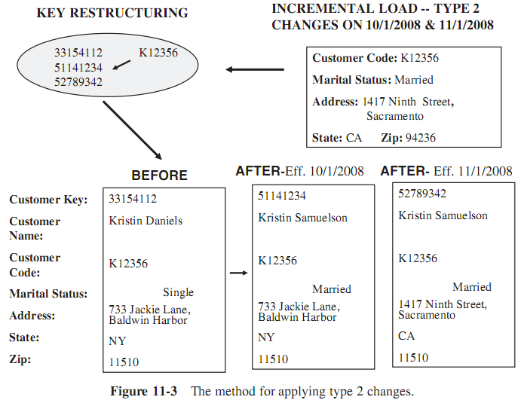
Type 2 Changes: Preservation of History

Slide 13
Type 3 Changes: Tentative Soft Revisions
Nature of Type 3 Changes. Almost all the usual changes to dimension values are either Type 1 or Type 2 changes.
  Type 1 changes are more common.
  When we apply a Type 2 change on a certain date, that date is a cut-off point. In the above case of change to marital status on October 1, 2000, that date is the cut-off date.
    Any orders from the customer prior to that date fall into the older orders group; orders on or after that date fall into the newer orders group.
    An order for this customer has to fall in one or the other group; it cannot be counted in both groups for any period of time.
What if we have the need to count the orders on or after the cut-off date in both groups during a certain period after the cut-off date?
Sometimes, though rarely, there is a need to track both the old and new values of changed attributes for a certain period, in both forward and backward directions. These types of changes are Type 3 changes.

Slide 14
Type 3 Changes: Tentative Soft Revisions
Here are the general principles for Type 3 changes:
  They usually relate to “soft” or tentative changes in the source systems
  There is a need to keep track of history with old and new values of the changed attribute
  They are used to compare performances across the transition
  They provide the ability to track forward and backward

Slide 15
Type 3 Changes: Tentative Soft Revisions
Applying Type 3 Changes to the Data Warehouse. Please look at Figure 11-4 showing the application of Type 3 changes to the SalePerson dimension table. The methods for applying Type 3 changes are:
  Add an “old” field in the dimension table for the affected attribute
  Push down the existing value of the attribute from the “current” field to the “old” field
  Keep the new value of the attribute in the “current” field
  Also, you may add a “current” effective date field for the attribute
  The key of the row is not affected, so that no new dimension row is needed
  The technique works best for one “soft” change at a time

Slide 16
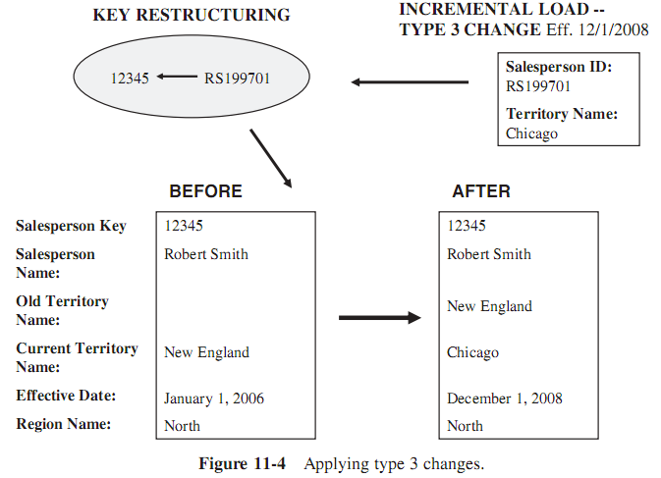
Applying Type 3 Changes to the Data Warehouse

Slide 17
II. MISCELLANEOUS DIMENSIONS
The problem:
  If the change is a type 2 change, we know that we have to create another row with the new value of the attribute.
  If the value of the attribute changes again, then we create another row with the newer value.
  What if the value changes too many times or too rapidly ?
What must you do about a not-so-slowly-changing dimension?
➔ We will complete our discussion of dimensions by considering such relevant issues.

Slide 18
Large Dimensions
We may consider a dimension large based on two factors:
  Deep : the dimension table has a very large number of rows
  Wide : the dimension table have a large number of attributes
In a data warehouse, typically the customer and product dimensions are likely to be large
  Customer
    Huge: in the range of 20 million rows
    Easily up to 150 dimension attributes
    Can have multiple hierarchies
  Product
    Sometimes as many as 100,000 product variations
    Can have more than 100 dimension attributes
    Can have multiple hierarchies

Slide 19
Large Dimensions
Because of the sheer size, many data warehouse functions involving large dimensions may be slow and inefficient
So, we need to addressthe following issues by using effective design methods, by choosing proper indexes, and by applying other optimizing techniques

Slide 20
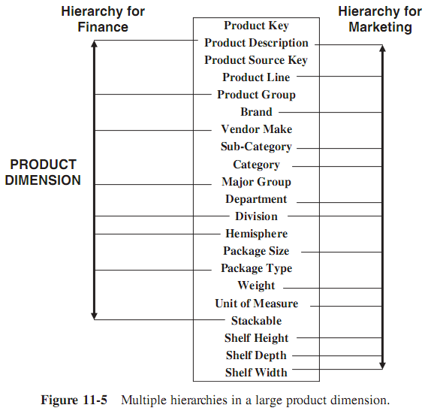
Large Dimensions
Multiple Hierarchies
  Large dimensions usually possess another distinct characteristic. They tend to have multiple hierarchies
  Take the example of the product dimension for a large retailer
    One set of attributes may form the hierarchy for the marketing department.
    Users from that department use these attributes to drill down or up
  In the same way, the finance department may need to use its own set of attributes from the same product dimension to drill down or up.
  Figure 11-5 shows multiple hierarchies within a large product dimension.

Slide 21
Rapidly Changing Dimensions
What if the dimension table is too large and is changing too rapidly?
One effective approach is to break the large dimension table into one or more simpler dimension tables.
How can you accomplish this?
  Obviously, we need to break off the rapidly changing attributes into another dimension table
  Leaving the slowly changing attributes behind in the original table
Figure 11-6 shows how a customer dimension table may be separated into two dimension tables

Slide 22
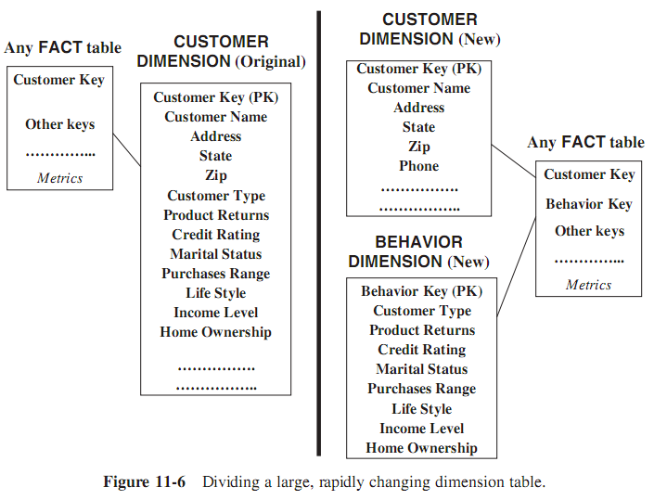
Rapidly Changing Dimensions

Slide 23
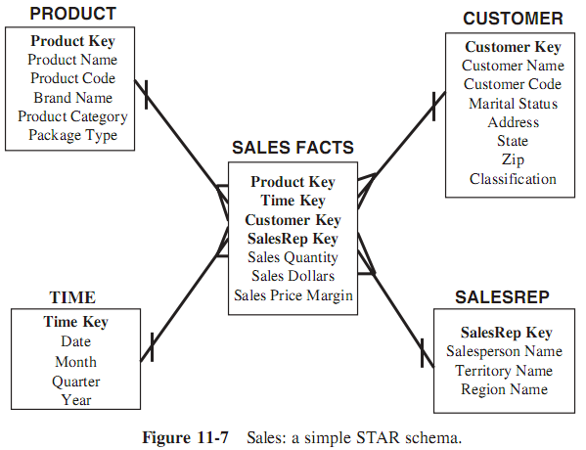
III. THE SNOWFLAKE SCHEMA
“Snowflaking” is a method of normalizing the dimension tables in a STAR schema.
When we completely normalize all the dimension tables, the resultant structure resembles a snowflake with the fact table in the middle.
Figure 11-7, which shows a simple STAR schema for sales in a manufacturing company. The model is not in the third normal form.

Slide 24
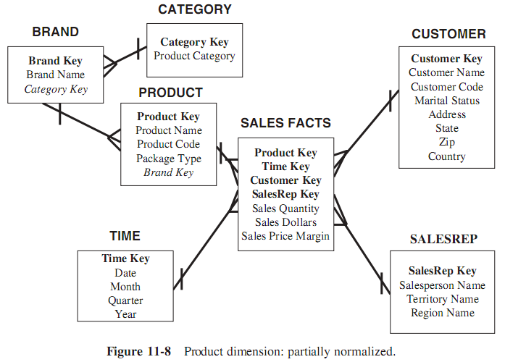
III. THE SNOWFLAKE SCHEMA
.

Slide 25
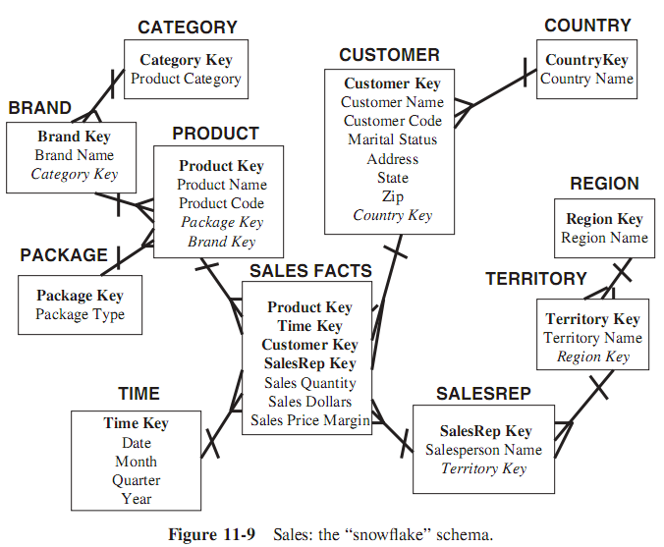
III. THE SNOWFLAKE SCHEMA
.

Slide 26
III. THE SNOWFLAKE SCHEMA
Here is a brief summary of the advantages and limitations of snowflaking:
Advantages
  Small savings in storage space
  Normalized structures are easier to update and maintain
Disadvantages
  Schema less intuitive and end-users are put off by the complexity
  Ability to browse through the contents difficult
  Degraded query performance because of additional joins
So that, snowflaking is not generally recommended in a data warehouse environment. Query performance takes the highest significance in a data warehouse and snowflaking hampers the performance.

Slide 27
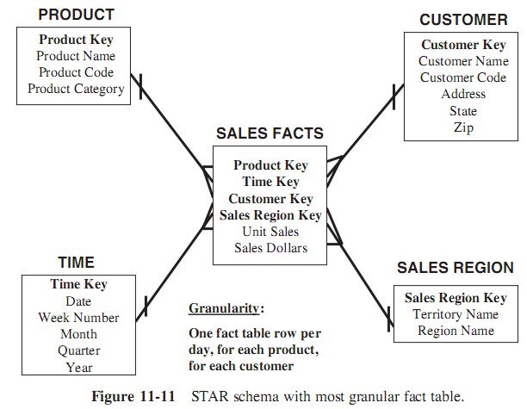
IV. AGGREGATE FACT TABLES
Aggregate values are precalculated summaries derived from the most granular fact table. These summaries form a set of separate aggregate fact tables.
We may create each aggregate fact table as a specific summarization across any number of dimensions.

Slide 28
IV. AGGREGATE FACT TABLES
Review a few typical queries against the sample STAR schema shown in Figure 11-11 before.
  Query 1: Total sales for customer number 12345678 during the first week of December 2008 for product Widget-1.
  Query 2: Total sales for all customers in the south-central territory for the first two quarters of 2009 for product category Bigtools.
Scrutinize these queries and determine how the totals will be calculated in each case.
The totals will be calculated by adding the sales dollars from the qualifying rows of the fact table:
  Query 1: All fact table rows where the customer key relates to customer number 12345678, the product key relates to product Widget-1, and the time key relates to the seven days in the first week of December 2008
  Query 2: All fact table rows where the customer key relates to all customers in the south-central territory, the product key relates to all products in the product category Bigtools, and the time key relates to about 180 days in the first two quarters of 2009. In this case, clearly a large number of fact table rows participate in the summation.
➔ Many fact table rows use participated to

Slide 29
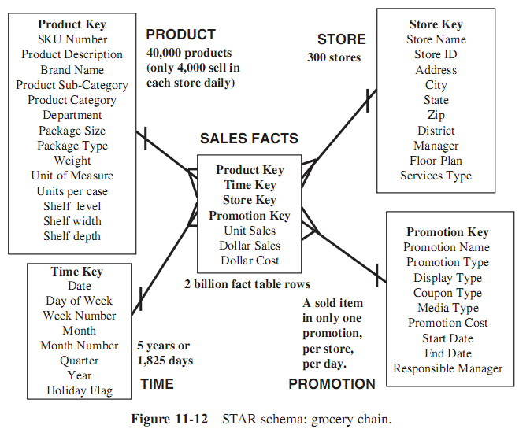
IV. AGGREGATE FACT TABLES
Fact Table Sizes: How many rows are in fact tables ? Consider an example for a large supermarket chain:
Time dimension:
  5 years x 365 days = 1825
Store dimension:
  300 stores reporting daily
Product dimension:
  40,000 products in each store (about 4000 sell in each store daily)
Promotion dimension:
  A sold item may be in only one promotion in a store on a given day
➔ Maximum number of base fact table records:
  1825 x 300 x 4000 x 1 = 2 billion

Slide 30
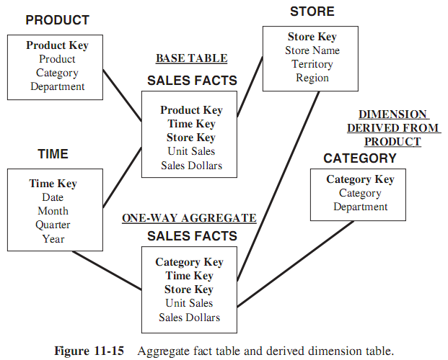
IV. AGGREGATE FACT TABLES
Aggregating Fact Tables:
  The derived aggregate fact tables are joined to one or more derived dimension tables. Figure 11-15 shows a derived aggregate fact table connected to a derived dimension table.
The maximum number of base fact table rows is calculated as follows:
  Product = 40,000 (but suppose that only 4000 selling in each store in a day)
  Store = 300
  Time = 1825
  Maximum number of base fact table rows = 2 billion
Calculate the maximum number of rows in this one-way aggregate.:
  Brand (category) = 80
  Store = 300
  Time = 1825
  Maximum number of aggregate table rows = 43,800,000

