Slide 1
Data warehouse
FPT University

Slide 2
Lecture 9
Data Quality: A key to success

Slide 3
CHAPTER OBJECTIVES
Clearly understand why data quality is critical in a data warehouse
Observe the challenges posed by corrupt data and learn the methods to deal with them
Appreciate the benefits of quality data
Review the various categories of data quality tools and examine their usage

Slide 4
OVERVIEW
Imagine a small error (such as: erroneous region codes), seemingly inconsequential, creeping into one of the operational systems.
The accuracy of the region codes may not be that important because no invoices to the customers are going to be mailed out using region codes. These region codes were entered for marketing purposes.
Next step, move the data into the data warehouse. What is the consequence of this error?
Dirty data is among the top reasons for failure of a data warehouse

Slide 5
I. WHY IS DATA QUALITY CRITICAL?
Data quality in a data warehouse is critical, more so than in an operational system. Because data in DW is used to make strategic decisions.
Some reasons why data quality is critical:
  boosts confidence in decision making,
  enables better customer service,
  increases opportunity to add better value to the services,
  reduces risk from disastrous decisions,
  reduces costs, especially of marketing campaigns,
  enhances strategic decision making,
  improves productivity by streamlining processes, and
  avoids compounding effects of data contamination.

Slide 6
1. What is Data Quality?
Consider an entity such as customer:
  Each occurrence of the customer entity refers to a single customer.
  The value of the customer name for a single occurrence of the customer entity is actually the name of that customer
Data quality implies data accuracy, but it is much more than that. Most cleansing operations concentrate on just data accuracy.
If the data is fit for the purpose for which it is intended, we can then say such data has quality.Therefore, data quality is to be related to the usage for the data item as defined by the users.
Does the data item possess fitness of purpose as defined by the users? If it does, the data item conforms to the standards of data quality

Slide 7
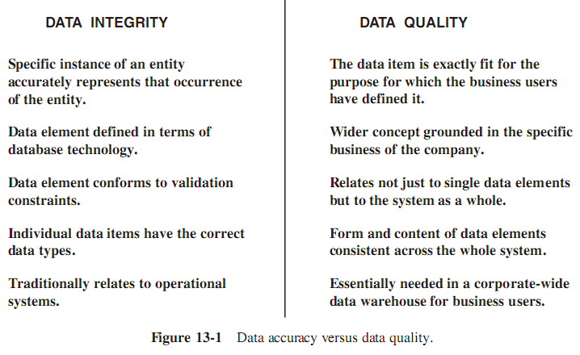
1. What is Data Quality?

Slide 8
1. What is Data Quality? (con’t)
The following list is the characteristics of high-quality data.
We study each of these data quality dimensions and use them to recognize and measure the data quality in the systems that feed the data warehouse
  Accuracy. The value stored in the system for a data element is the right value for that occurrence of the data element.
  Domain Integrity. The data value of an attribute falls in the range of allowable, defined values.
  Data Type. Value for a data attribute is actually stored as the data type defined for that attribute.
  Consistency. The form and content of a data field is the same across multiple source systems.

Slide 9
1. What is Data Quality? (con’t)
  Redundancy. The same data must not be stored in more than one place in a system (if for reasons of efficiency, a data element is intentionally stored in more than one place in a system, then the redundancy must be clearly identified and verified).
  Completeness. There are no missing values for a given attribute in the system.
  Duplication. Duplication of records in a system is completely resolved (If the product file is known to have duplicate records, then all the duplicate records for each product are identified).
  Conformance to Business Rules. The values of each data item adhere to prescribed business rules.
  Structural Definiteness. Wherever a data item can naturally be structured into individual components, the item must contain this well-defined structure.

Slide 10
1. What is Data Quality? (con’t)
  Data Anomaly. A field must be used only for the purpose for which it is defined.
  Clarity. A data element may possess all the other characteristics of quality data but if the users do not understand its meaning clearly, then the data element is of no value to the users.
  Timely. The users determine the timeliness of the data.
  Usefulness. Every data element in the data warehouse must satisfy some requirements of the collection of users.
  Adherence to Data Integrity Rules. The data stored in the relational databases of the source systems must adhere to entity integrity and referential integrity rules.

Slide 11
2. Benefits of Improved Data Quality
Analysis with Timely Information.
  Quality data produces timely information, a significant benefit for the users.
  For example: analysing promotion daily
Better Customer Service.
  The benefit of accurate and complete information for customer service cannot be overemphasized.
  For example: customer banking service (call center)
Newer Opportunities.
  Quality data in a data warehouse is a great boon for marketing and opens the doors to immense opportunities to cross-sell across product lines and departments.

Slide 12
2. Benefits of ..(con’t)
Reduced Costs and Risks
  The obvious risk is strategic decisions that could lead to disastrous consequences. Other risks include wasted time, malfunction of processes ...
  Example: quality data reduces costs is in mailings to customers, especially in marketing campaigns.
Improved Productivity
  Users get an enterprise-wide view of information from the data warehouse. This is a primary goal of the data warehouse.
  In areas where a corporate wide view of information naturally enables the streamlining of processes and operations, we will see productivity gains.

Slide 13
2. Benefits of ..(con’t)
Reliable Strategic Decision Making
  If the data in the warehouse is reliable and of high quality, then decisions based on the information will be sound.
  No data warehouse can add value to a business until the data is clean and of high quality.

Slide 14
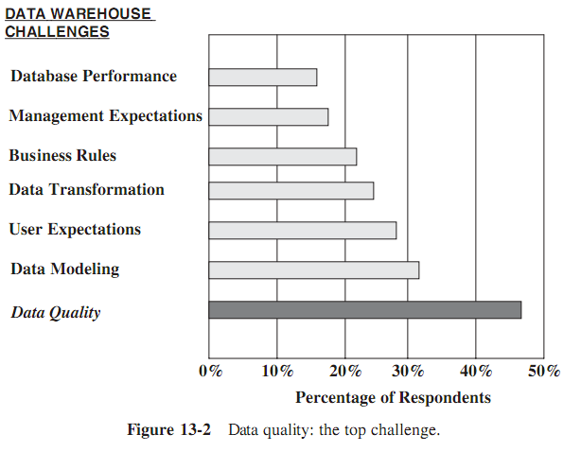
3. Types of Data Quality Problems
In a recent independent survey, businesses with data warehouses were asked the question: What is the biggest challenge in data warehouse development and usage?
Figure 13-2 shows the ranking of the answers.

Slide 15
3. Types of Data Quality Problems
The explicit types of data quality problems are listed below. These are specific types of data corruption
  Dummy values in fields: A temporary value is filled to pass the required field. Example: user can fill a temporary for Social Security number
  Absence of data values: Missing value for data field. Example: value of demographic field is omitted
  Unofficial use of fields: How many times have you asked your users to place their comments in the customer contact field because no field was provided for comments in the customer record ?
  Cryptic values: This is a prevalent problem in legacy systems, many of which were not designed with end-users in mind. For example : the customer status codes could have been started with R = Regular and N = New., …

Slide 16
3. Types of Data Quality Problems
  Contradicting values: There are related fields in the source systems in which the values must be compatible. For example, the values in the fields for state and zip code must agree
  Violation of business rules: In a payroll system, an obvious business rule is that the days worked in a year plus the vacation days, holidays, and sick days cannot exceed 365 or 366.
  Reused primary keys: reused primary-key values when overflow
  No unique identifiers: There is a different complication with identifiers. Example: a unique identifier does not represent the same product in two different systems (accounting system and sales system).
  Inconsistent values: The same field is used different value in different systems. For example: the gender field can assign True/False in one system and Male/Female in other system

Slide 17
3. Types of Data Quality Problems
  Incorrect values: Product Code: 146, Product Name: Crystal Vase, and Height: 486 inches in the same record point to some sort of data inaccuracy. The values for product name and height are not compatible. Perhaps the product code is also incorrect.
  Multipurpose fields: Same data value in a field entered by different departments may mean different things. For example: a field could start off as a storage area code to indicate the back-room storage areas in stores. Later, when the company built its own warehouse to store products, it used the same field to indicate the warehouse

Slide 18
II. DATA QUALITY CHALLENGES
Sources of Data Pollution
  System conversions. System conversions and migrations are prominent reasons for data pollution.
  Data aging. The older values (in the legacy systems) lose their meaning and significance.
  Heterogeneous system integration.
  Poor database design. Adhering to entity integrity and referential integrity rules prevents some kinds of data pollution.
  Incomplete information at data entry.
  Input errors.
  Internationalization/localization.
  Fraud.
  Lack of policies.

Slide 19
II. DATA QUALITY CHALLENGES
Validation of Names and Addresses
  For a single person, multiple records can exist among the various source systems
  Problems with entering names and addresses:
    No unique key
    Many names on one line
    One name on two lines
    Name and the address in a single line
    Personal and company names mixed
    Different addresses for the same person
    Different names and spellings for the same customer

Slide 20
III. DATA QUALITY TOOLS
Categories of Data Cleansing Tools : Generally, data cleansing tools assist the project team in two ways:
  Data error discovery tools work on the source data to identify inaccuracies and inconsistencies
  Data correction tools help fix the corrupt data. These correction tools use a series of algorithms to parse, transform, match, consolidate, and correct the data
In the following sections, we will examine the features of the two aspects of data cleansing

Slide 21
III. DATA QUALITY TOOLS
Error Discovery Features: study the following list of error discovery functions that data cleansing tools are capable of performing:
  Quickly and easily identify duplicate records.
  Identify data items whose values are outside the range of legal domain values.
  Find inconsistent data.
  Check for range of allowable values.
  Detect inconsistencies among data items from different sources.
  Reconcile problems of RDBMS referential integrity.

Slide 22
III. DATA QUALITY TOOLS
Data Correction Features: The following list describes the typical error correction functions that data cleansing tools are capable of performing:
  Normalize inconsistent data.
  Provide measurements of data quality.
  Standardize data elements to common formats.
  Validate for allowable values.

Slide 23
III. DATA QUALITY TOOLS
The DBMS for Quality Control: Later versions of RDBMS can easily prevent several types of errors creeping into the data warehouse
  Domain Integrity
  Entity Integrity Checking
  Minimize missing values
  Referential Integrity Checking
  Conformance to Business Rules

Slide 24
Self-reading more
  DATA QUALITY INITIATIVE
  MASTER DATA MANAGEMENT

Slide 25
1. Data Cleansing Decisions
Which Data to Cleanse.
  root decision
  you and your users must jointly work out the answer to this question
  The cost of cleaning up all data in the data warehouse is enormous.
Where to Cleanse.
  Data for your warehouse originates in the source operational systems, so does the data corruption.
  Cleansing the data in the staging area is comparatively easy
  if you attempt to cleanse the data in the source systems, you are taking on a complex, expensive, and difficult task

Slide 26
1. Data Cleansing …(con’t)
How to Cleanse.
  the usage of vendor tools.
How to Discover the Extent of Data Pollution.
  you have to assess the extent of data pollution before applying data cleansing techniques
  Figure 13-4
Setting Up a Data Quality Framework.
  Figure 13-5

Slide 27
2. Who Should be Responsible?
  Figure 13-6

Slide 28
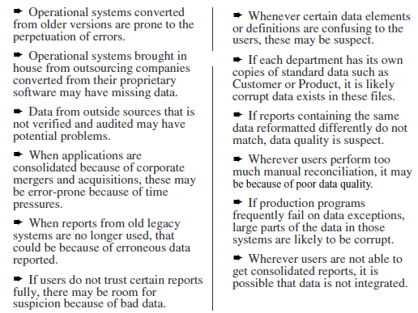
Figure 13-4 Discovering the extent of data pollution

Slide 29
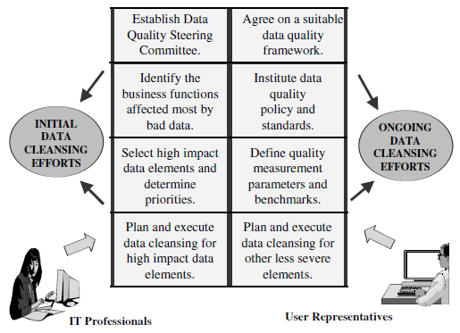
Figure 13-5 Data quality framework

Slide 30
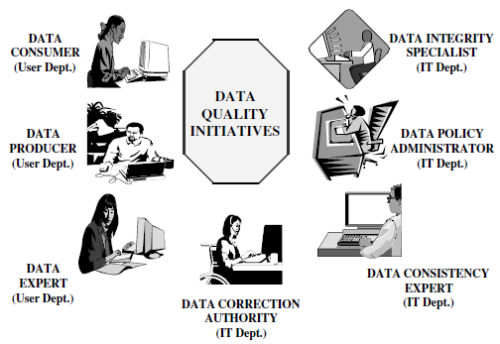
Figure 13-6 Data quality: participant and roles

Slide 31
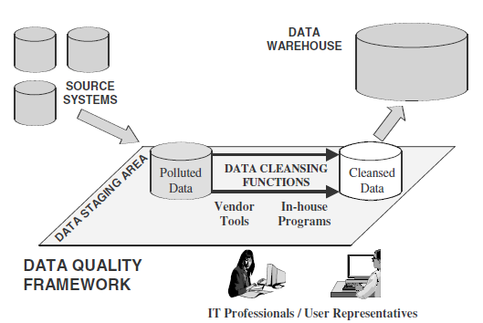

Figure 13-7 Overall data Purification
The Purification Process

Slide 32
3. Practical Tips on Data Quality
Identify high-impact pollution sources and begin your purification process with these.
Do not try to do everything with in-house programs.
Tools are good and are useful. Select proper tools.
Agree on standards and reconfirm these.
Link data quality with specific business objectives. By itself, data quality work is not attractive.
Get the senior executive sponsor of your data warehouse project to be actively involved in backing the data cleansing initiative.
Get users totally involved and keep them constantly informed of the developments.
Wherever needed, bring in outside experts for specific assignments.

Slide 33
V. MASTERDATAMANAGEMENT (MDM)
MDM is an umbrella approach to provide consistent and comprehensive core information across the organization.
MDM comprises a set of technologies, disciplines, and solutions to create and maintain consistent, accurate, and complete business data about the entities included within its ambit.

Slide 34
V. MASTERDATAMANAGEMENT (MDM)
MDM categories
MDM benefits
MDM and Data warehousing

