Slide 1

Data warehouse
FPT University

Slide 2
Lecture 10
OLAP and Data warehousing

Slide 3
OUTLINE
Demand for Online Analytical Processing
Major Features and Functions
OLAP Models
Implementation Considerations

Slide 4
I. DEMAND FOR ONLINE ANALYTICAL PROCESSING
The analysis leads to strategic decisions that are the major reasons for building data warehouses.
For performing meaningful analysis, data must be cast in a way suitable for analysis of the values of key indicators over time along business dimensions.
Data structures designed using the dimensional modeling technique support such analysis.

Slide 5
1. Need for Multidimensional Analysis
Consider daily sale analyzing:
  The analysts may want to compare actual sales against targets and against sales in prior periods.
  They examine the breakdown of sales by product, by store, by sales territory, by promotion, and so on.
➔ The daily sales are meaningful only when they are related to the dates of the sales, the products, the distribution channels, the stores, the sales territories, the promotions,… and a few more dimensions
For effective analysis, the users must have easy methods of performing complex analysis along several business dimensions.
They need an environment that presents a multi-dimensional view of data, providing the foundation for analytical processing through easy and flexible access to information.
Without a solid system for true multidimensional analysis, the data warehouse is incomplete.

Slide 6
2. Fast Access and Powerful Calculations
The query and analysis system must have consistent response times.
The users formulates each query, executes it, waits for the result set to appear on the screen:
  Both the size of the effort to formulate a query or the amount of time to receive the result sets must be consistent irrespective of the query types.
➔ An effective analytical processing environment must not only be fast and flexible, but it must also support complex and powerful calculations.

Slide 7
3. Limitations of Other Analysis Methods
The information delivery system:
  must be able to present multidimensional views of the data.
  must enable the users to use the data by analyzing it along multiple dimensions and their hierarchies in a myriad of ways.
  must be fast. It must be possible for users to perform complex calculations.
The traditional tools and methods were used to deliver information:
  The earliest method was the medium of reports.
  Then came spreadsheets with all their functionality and features.
  Next, the SQL has been the accepted interface for retrieving and manipulating data from relational databases.
➔ Clearly, all are not up to the task when it comes to complex analysis and calculations.

Slide 8
4. OLAP is the Answer
Users certainly need the ability to perform multidimensional analysis with complex calculations, but we find that the traditional tools of report writers, query products, spreadsheets, and language interfaces are distressfully inadequate.
What is the answer?
  Clearly, the tools being used in the OLTP and basic data warehouse environments do not match up to the task.
  We need different set of tools and products that are specifically meant for serious analysis. We need OLAP in the data warehouse.
What is OLAP? What are characteristics of OLAP ?
Figure 15-3 shows a simple OLAP session

Slide 9
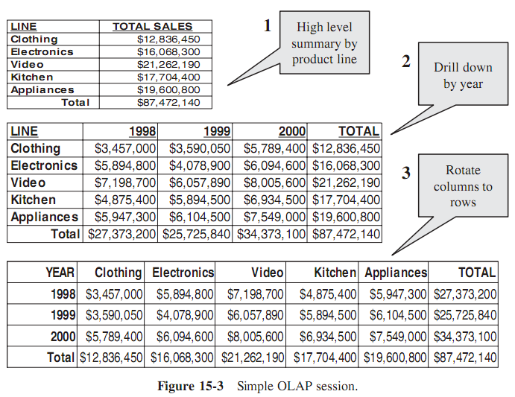

Slide 10
5. OLAP Definitions and Rules
The term OLAP or online analytical processing was introduced in a paper entitled “Providing On-Line Analytical Processing to User Analysts,” by Dr. Edgar Frank. Codd, the acknowledged “father” of the relational database model.
The paper, published in 1993, defined 12 rules or guidelines for an OLAP system. Later, in 1995, six additional rules were included.
We will discuss these rules. Before that, let us look for a short and precise definition for OLAP. Such a succinct definition comes from the OLAP council, which provides membership, sponsors research, and promotes the use of OLAP. Here is the definition:
  On-Line Analytical Processing (OLAP) is a category of software technology that enables analysts, managers and executives to gain insight into data through fast, consistent, interactive access in a wide variety of possible views of information that has been transformed from raw data to reflect the real dimensionality of the enterprise as understood by the user.

Slide 11
5. OLAP Definitions and Rules
Multidimensional Conceptual View. Provide a multidimensional data model that is intuitively analytical and easy to use.
Transparency. Make the technology, underlying data repository, computing architecture, and the diverse nature of source data totally transparent to users.
Accessibility. Provide access only to the data that is actually needed to perform the specific analysis, presenting a single, coherent, and consistent view to the users.
Consistent Reporting Performance. Ensure that the users do not experience any significant degradation in reporting performance as the number of dimensions or the size of the database increases.

Slide 12
5. OLAP Definitions and Rules
Client/Server Architecture. Conform the system to the principles of client/server architecture for optimum performance, flexibility, adaptability, and interoperability.
Generic Dimensionality. Ensure that every data dimension is equivalent in both structure and operational capabilities. Have one logical structure for all dimensions.
Dynamic Sparse Matrix Handling. Adapt the physical schema to the specific analytical model being created and loaded that optimizes sparse matrix handling
Multiuser Support. Provide support for end users to work concurrently with either the same analytical model or to create different models from the same data.In short, provide concurrent data access, data integrity, and access security.

Slide 13
5. OLAP Definitions and Rules
Unrestricted Cross-dimensional Operations. Provide ability for the system to recognize dimensional hierarchies and automatically perform roll-up and drill-down operations within a dimension or across dimensions.
Intuitive Data Manipulation. Enable consolidation path reorientation (pivoting), drill-down and roll-up, and other manipulations to be accomplished intuitively and directly via point-and-click and drag-and-drop actions on the cells of the analytical model.
Flexible Reporting. Provide capabilities to the business user to arrange columns, rows, and cells in a manner that facilitates easy manipulation, analysis, and synthesis of information.
Unlimited Dimensions and Aggregation Levels. Accommodate at least fifteen, preferably twenty, data dimensions within a common analytical model. Each of these generic dimensions must allow a practically unlimited number of user-defined aggregation levels within any given consolidation path

Slide 14
5. OLAP Definitions and Rules
In addition to these 12 basic guidelines, also take into account the following requirements, not all distinctly specified by Dr. Codd.
  Drill-through to Detail Level. Allow a smooth transition from the multidimensional, preaggregated database to the detail record level of the source data warehouse repository.
  OLAP Analysis Models. Support Dr. Codd’s four analysis models: exegetical (or descriptive), categorical (or explanatory), contemplative, and formulaic.
  Treatment of Nonnormalized Data. Prohibit calculations made within an OLAP system from affecting the external data serving as the source.
  Storing OLAP Results. Do not deploy write-capable OLAP tools on top of transactional systems.
  Missing Values. Ignore missing values, irrespective of their source.
  Incremental Database Refresh. Provide for incremental refreshes of the extracted and aggregated OLAP data.
  SQL Interface. Seamlessly integrate the OLAP system into the existing enterprise environment.

Slide 15
6. OLAP Characteristics
Let business users have a multidimensional and logical view of the data in the data warehouse,
Facilitate interactive query and complex analysis for the users,
Allow users to drill down for greater details or roll up for aggregations of metrics along a single business dimension or across multiple dimensions,
Provide ability to perform intricate calculations and comparisons, and
Present results in a number of meaningful ways, including charts and graphs.

Slide 16
II. MAJOR FEATURES AND FUNCTIONS
OLAP is an information delivery system for the data warehouse.
A data warehouse stores data and provides simpler access to to business intelligence.
An OLAP system complements the data warehouse by lifting the information delivery capabilities to new heights.

Slide 17
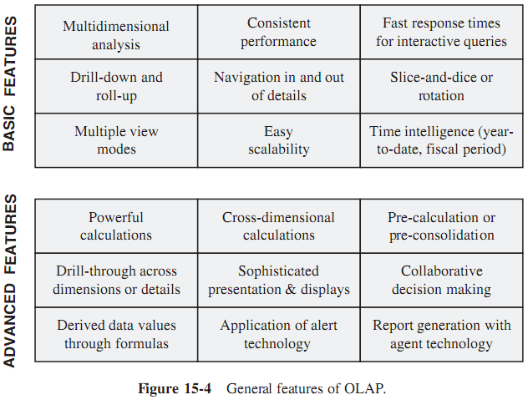
1. General Features

Slide 18
2. Dimensional Analysis
Consider a simple STAR schema with three business dimensions: product, time, and store. The fact table contains sales.
Figure 15-5 showing the schema and a three dimensional representation of the model as a cube, with products on the X-axis, time on the Y-axis, and stores on the Z-axis.
What are the values represented along each axis?
  For example, in the STAR schema, time is one of the dimensions and month is one of the attributes of the time dimension.
  Values of this attribute month are represented on the Y-axis.

Slide 19
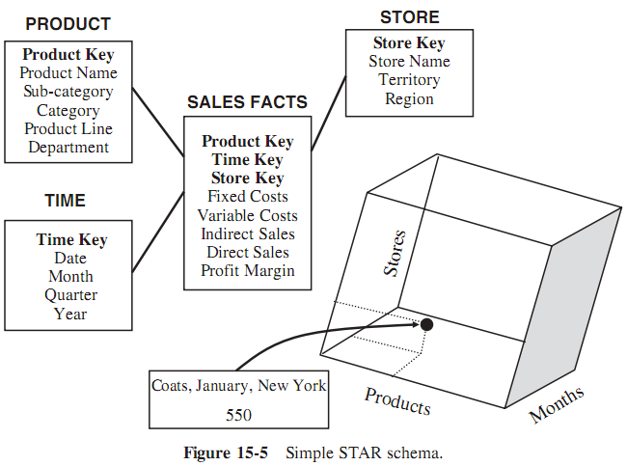
2. Dimensional Analysis

Slide 20
2. Dimensional Analysis
If we are displaying the data for sales along these three dimensions on a spreadsheet:
  The columns may display the product names,
  the rows the months,
  and pages the data along the third dimension of store names.
See Figure 15-6, which shows a screen display of a page of this three-dimensional data.

Slide 21
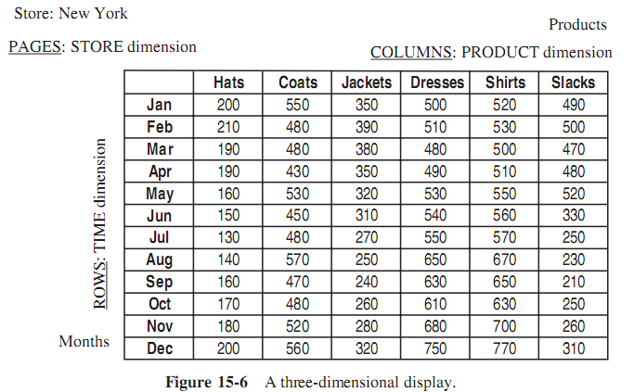
2. Dimensional Analysis

Slide 22
2. Dimensional Analysis: examples
The following is a sample of simple queries and the result sets during a multidimensional analysis:
  Query1: Display the total sales of all products for past five years in all stores.
  ➔ Display of Results:
    Rows: Year numbers 2009, 2008, 2007, 2006, 2005
    Columns: Total Sales for all products
    Page: One store per page
  Query2: Compare total sales for all stores, product by product, between years 2009 and 2008.
  ➔ Display of Results:
    Rows: Year numbers 2009, 2008; difference; percentage increase or decrease
    Columns: One column per product, showing all products
    Page: All stores

Slide 23
3. What are Hypercubes?
When we have four dimensions or more, how can we represent the data?
  We have a problem when trying to display the data on a spreadsheet as rows, columns, and pages.
So what about multidimensional analysis when there are more than three dimensions?
➔ The answer is: hypercubes. What is hypercube ?
Let us begin with the two business dimensions of product and time:
  Usually, business users wish to analyze not just sales but other metrics as well
  There are five common metrics: fixed cost, variable cost, indirect sales, direct sales, and profit margin.
  The data described here may be displayed on a spreadsheet showing metrics as columns, time as rows, and products as pages.

Slide 24
3. What are Hypercubes?
Figure 15-7 shows a sample page of the spreadsheet display:
  There are three straight lines, two of which represent the two business dimensions and the third, the metrics.
  We can independently move up or down along the straight lines. Some experts refer to this representation as a multi-dimensional domain structure (MDS)
Now the page we see in the figure is a slice passing through a single product and the divisions along the other two straight lines shown on the page as columns and rows.

Slide 25
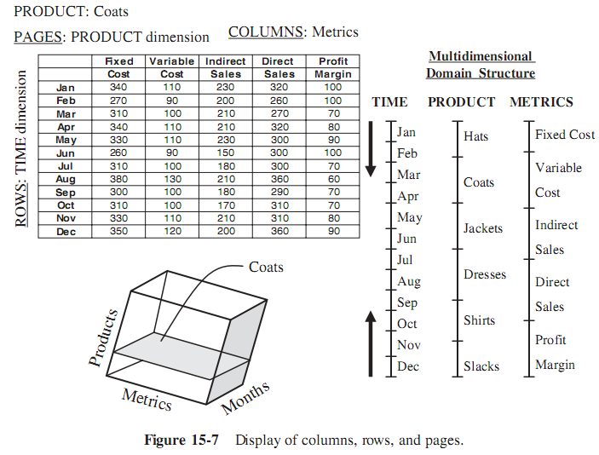
3. What are Hypercubes?

Slide 26
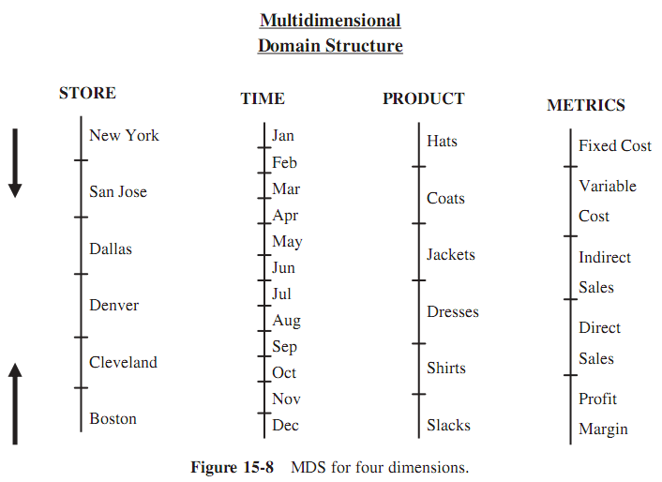
3. What are Hypercubes?

Slide 27
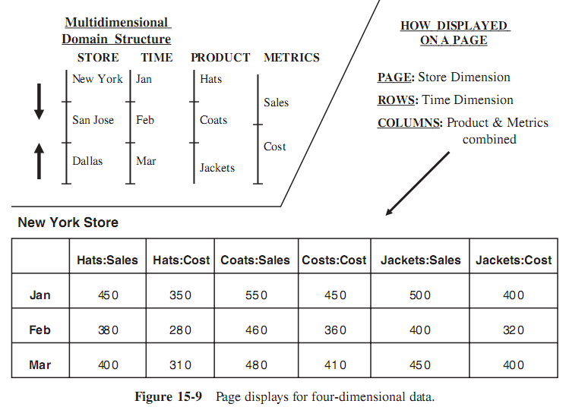
3. What are Hypercubes?

Slide 28
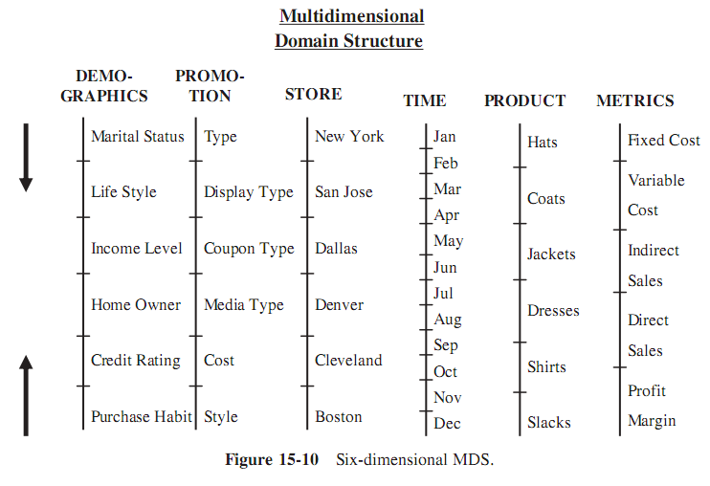
3. What are Hypercubes?

Slide 29
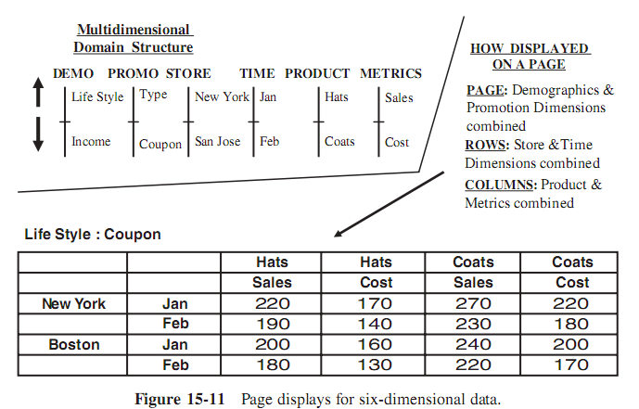
3. What are Hypercubes?

Slide 30
4. Drill-Down and Roll-Up
OLAP systems provide drill-down and roll-up capabilities.
Figure 15-12 illustrating these capabilities with reference to the product dimension hierarchies.
Note the different types of information given in the figure:
  It shows the rolling up to higher hierarchical levels of aggregation
  and the drilling down to lower levels of detail.
Also note the sales numbers shown along side. These are sales for one particular store in one particular month at these levels of aggregation.
The sale numbers you notice as you go down the hierarchy are for a single department, a single product line, a single category, and so on.

Slide 31
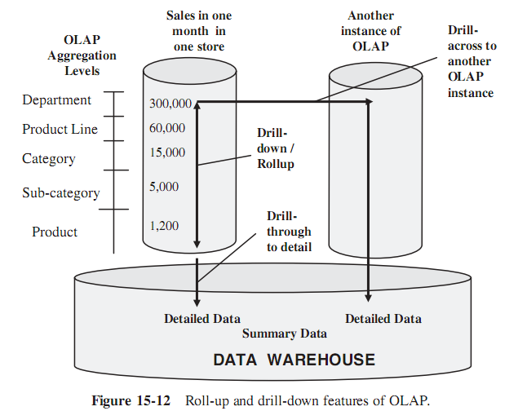
4. Drill-Down and Roll-Up

Slide 32
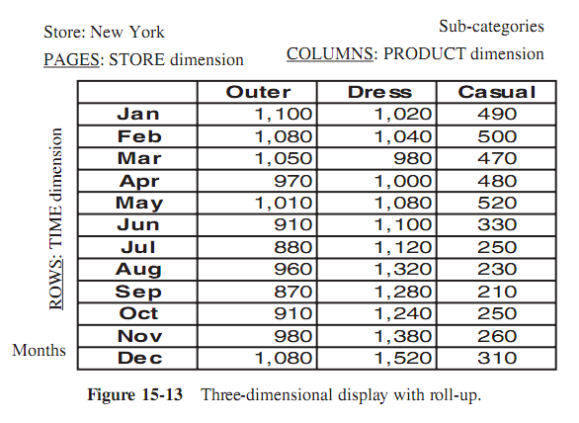
4. Drill-Down and Roll-Up

Slide 33
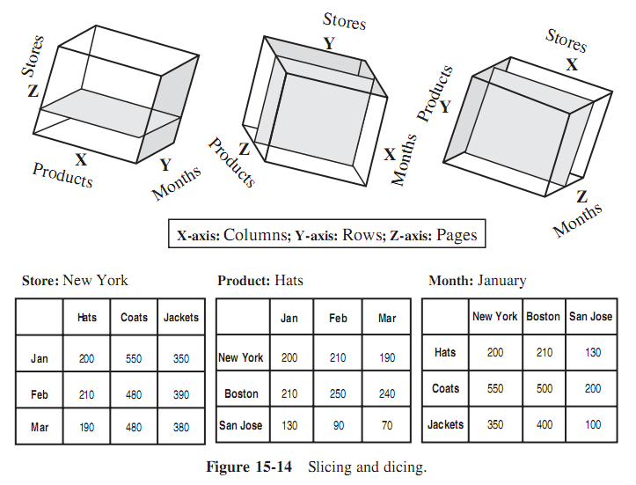
5. Slice-and-Dice or Rotation
What is the great advantage of all of this for the users?
Wth each rotation, the users can look at page displays representing different versions of the slices in the cube.
The users can view the data from many angles.

Slide 34
6. Uses and Benefits
OLAP provides the ability to perform multidimensional analysis with complex queries and complex calculations.
The benefits of OLAP systems are:
  Increased productivity of business managers, executives, and analysts
  Inherent flexibility of OLAP systems means that users may be self-sufficient in running their own analysis without IT assistance
  Benefit for IT developers because using software specifically designed for the system development results in faster delivery of applications
  Self-sufficiency of users, resulting in reduction in backlog
  More efficient operations through reducing time on query executions and in network traffic
  Ability to model real-world challenges with business metrics and dimensions

Slide 35
III. OLAP MODELS
There are many OLAP models, such as ROLAP, MOLAP and HOLAP. Basically, the storage methodology is different in each models
  ROLAP: relational online analytical processing. In this case, the OLAP system is built on top of a relational database.
  MOLAP: multidimensional online analytical processing. In this case, the OLAP system is implemented through a specialized multidimensional database.
  HOLAP: hybrid online analytical processing. This models attempts to combine the strengths and features of ROLAP and MOLAP.

Slide 36
III. OLAP MODELS
DOLAP: Refers for desktop online analytical processing. DOLAP is meant to provide portability to users of online analytical processing. In the DOLAP methodology, multidimensional datasets are created and transferred to the desktop machine.
Database OLAP: Refers to a relational databasemanagement system (RDBMS) designated to support OLAP structures and to perform OLAP calculations.
Web OLAP: Refers to online analytical processing where OLAP data is accessible from a Web browser.

Slide 37
1. Overview of Variations
MOLAP and ROLAP are the fundamental models
MOLAP model:
  Implemented by storing the data multidimensionally, that is, easily viewed in a multidimensional way.
  Here the data structure is fixed so that the logic to process multidimensional analysis can be based on well-defined methods of establishing data storage coordinates.
  Usually, multidimensional databases (MDDBs) are vendors’ proprietary systems.
ROLAP model :
  Relies on the existing relational DBMS of the data warehouse.
  OLAP features are provided against the relational database.

Slide 38
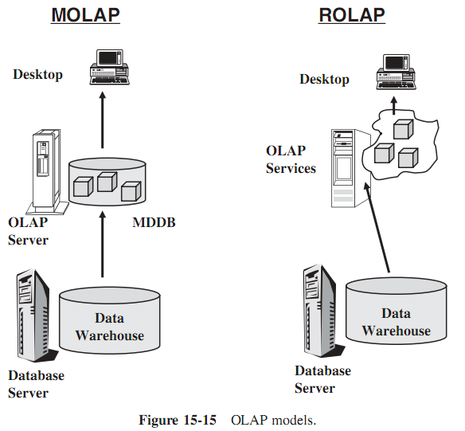
1. Overview of Variations

Slide 39
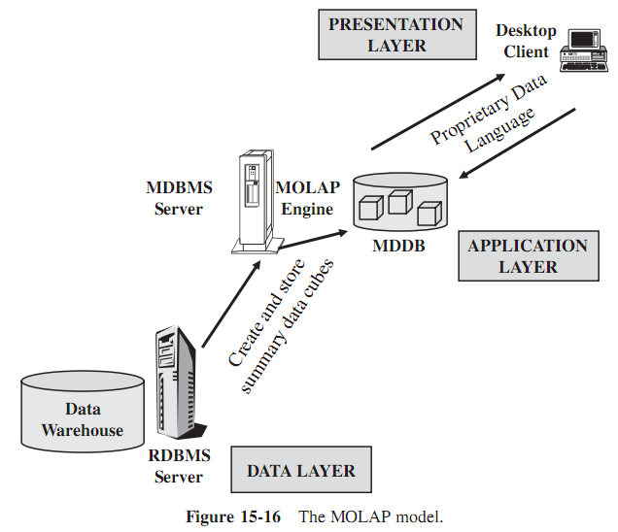
2. The MOLAP Model
Now consider the architecture for the MOLAP model. There are three layers in the multitier architecture.
Precalculated and prefabricated multidimensional data cubes are stored in multidimensional databases.
The MOLAP engine in the application layer pushes a multidimensional view of the data from the MDDBs to the users.

Slide 40
3. The ROLAP Model
In the ROLAP model, data is stored as rows and columns in relational form.
This model presents data to the users in the form of business dimensions.
In order to hide the storage structure to the user and present data multidimensionally, a semantic layer of metadata is created.
The metadata layer supports the mapping of dimensions to the relational tables.
Additional metadata supports summarizations and aggregations.
We may store the metadata in relational databases.

Slide 41
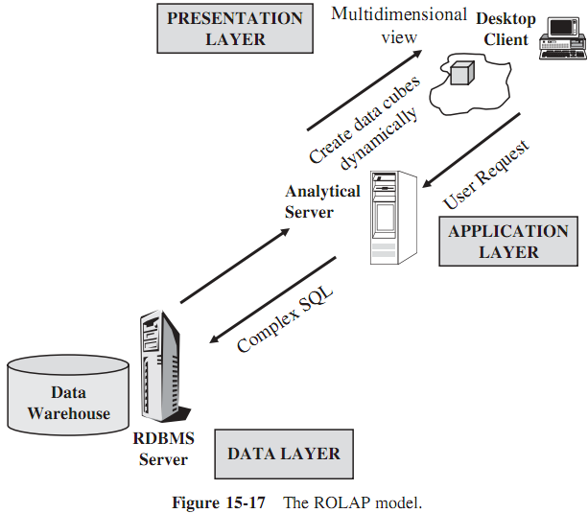
3. The ROLAP Model

Slide 42
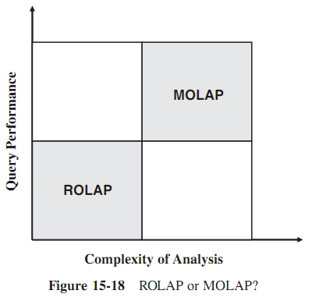
4. ROLAP VERSUS MOLAP

Slide 43
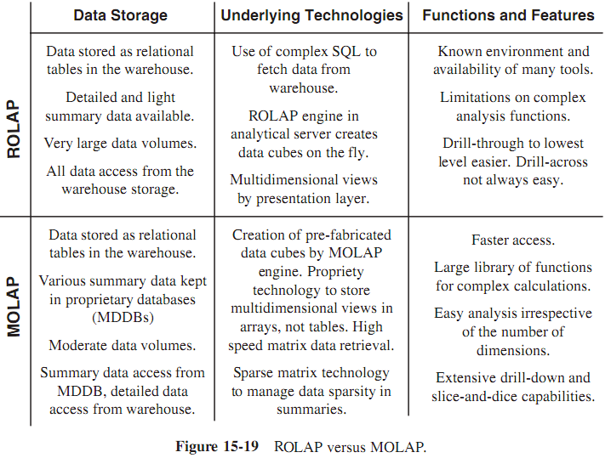
4. ROLAP VERSUS MOLAP

Slide 44
IV. OLAP IMPLEMENTATION CONSIDERATIONS
We have to take into account two key issues with regard to the MOLAP model running under MDDBMS.
The first issue relates to the lack of standardization. Each vendor tool has its own client interface.
Another issue is scalability. OLAP is generally good for handling summary data, but not good for volumes of detailed data.
On the other hand, highly normalized data in the data warehouse can give rise to processing overhead when you are performing complex analysis.
  We may reduce this by using a STAR schema multidimensional design.
  In fact, for some ROLAP tools, the multidimensional representation of data in a STAR schema arrangement is a prerequisite.

Slide 45
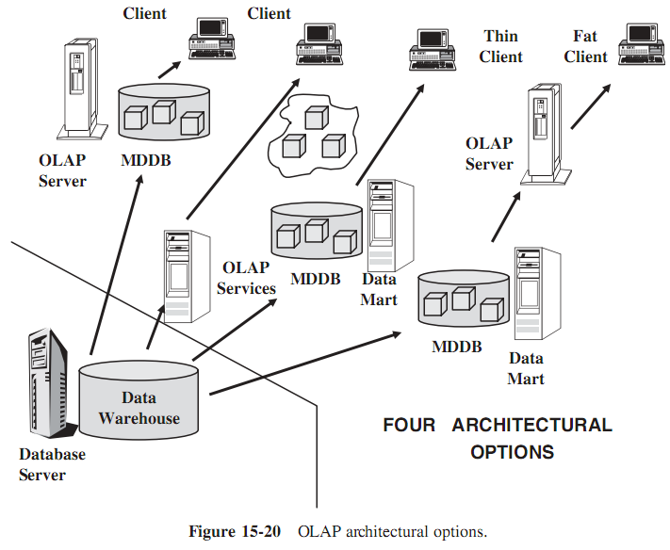
IV. OLAP IMPLEMENTATION CONSIDERATIONS

Slide 46
1. Data Design and Preparation
The data warehouse feeds data to the OLAP system.
  In the MOLAP model, separate proprietary multidimensional databases store the data fed from the data warehouse in the form of multidimensional cubes.
  On the other hand, in the ROLAP model, although no static intermediary data repository exists, data is still pushed into the OLAP system with cubes created dynamically on the fly.
Thus, the sequence of the flow of data is from the operational source systems to the data warehouse and from there to the OLAP system.

Slide 47
1. Data Design and Preparation
In order to help prepare the data for the OLAP system, let us first examine some significant characteristics of data in this system. Please review the following list:
  An OLAP system stores and uses much less data compared to a data warehouse.
  Data in the OLAP system is summarized. We will rarely find data at the lowest level of detail as in the data warehouse.
  OLAP data is more flexible for processing and analysis partly because there is much less data to work with.
  Every instance of the OLAP system in your environment is customized for the purpose that instance of the system serves.
It means, OLAP data tends to be more departmentalized, whereas data in the data warehouse serves corporate-wide needs.
An overriding principle is that OLAP data is generally customized for specific user groups

Slide 48
1. Data Design and Preparation
Example: preparing OLAP data for the marketing group of users:
  Define Subset. Select the subset of detailed data the marketing department is interested in.
  Summarize. Summarize and prepare aggregate data structures in the way the marketing department needs for summarizing. For example, summarize products along product categories as defined by marketing. Sometimes, marketing and accounting departments may categorize products in different ways.
  Denormalize. Combine relational tables in exactly the same way the marketing department needs denormalized data.
  Calculate and Derive. If some calculations and derivations of the metrics are department-specific in your company, use the ones for marketing.
  Index. Choose those attributes that are appropriate for marketing to build indexes.

Slide 49
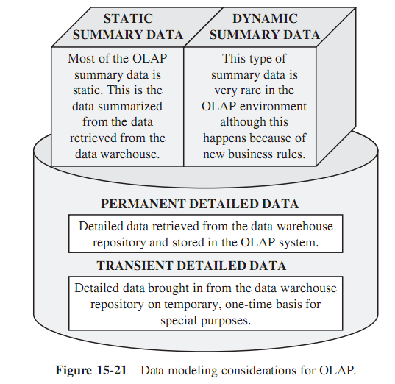
1. Data Design and Preparation
Figure 15-21 indicating the types and levels of data in OLAP systems. These types and levels must be taken into consideration while performing data modeling for the OLAP systems

Slide 50
2. Administration and Performance
Administration. The OLAP system is part of the overall data warehouse environment and, therefore, administration of the OLAP system is part of the data warehouse administration. Let us briefly indicate a few of these considerations:
  Expectations on what data will be accessed and how
  Selection of the right business dimensions
  Selection of the right filters for loading the data from the data warehouse
  Methods and techniques for moving data into the OLAP system (MOLAP model)
  Choosing the aggregation, summarization, and precalculation
  Developing application programs using the proprietary software of the OLAP vendor
  Size of the multidimensional database
  Handling of the sparse-matrix feature of multidimensional structures
  Drill down to the lowest level of detail
  Drill through to the data warehouse or to the source systems
  Drill across among OLAP system instances
  Access and security privileges
  Backup and restore facilities

Slide 51
2. Administration and Performance
Performance. First you need to recognize that the presence of an OLAP system in your data warehouse environment shifts the workload.
Some of the queries that usually must run against the data warehouse will now be redistributed to the OLAP system.
The types of queries that need OLAP are complex and filled with involved calculations.
Long and complicated analysis sessions consist of such complex queries.
Therefore, when such queries get directed to the OLAP system, the workload on the main data warehouse becomes substantially reduced.

Slide 52
3. OLAP Platforms
Usually, the data warehouse and the OLAP system start out on the same platform.
When both are small, it is cost-justifiable to keep both on the same platform. Within a year, it is usual to find rapid growth in the main data warehouse. The trend normally continues.
As this growth happens, you may want to think of moving the OLAP system to another platform to ease the congestion.

Slide 53
4. OLAP Tools and Products
Let us list a few broad guidelines:
  Let your applications and the users drive the selection of the OLAP products. Do not be carried away by flashy technology.
  Remember, your OLAP system will grow both in size and in the number of active users. Determine the scalability of the products before you choose.
  Consider how easy it is to administer the OLAP product.
  Performance and flexibility are key ingredients in the success of your OLAP system.
  As technology advances, the differences in the merits between ROLAP and MOLAP appear to be somewhat blurred. Do not worry too much about these two methods.

Slide 54
5. Implementation Steps
Let us summarize the key steps. These are the steps or activities at a very high level:
  Dimensional modeling
  Design and building of the MDDB
  Selection of the data to be moved into the OLAP system
  Data acquisition or extraction for the OLAP system
  Data loading into the OLAP server
  Computation of data aggregation and derived data
  Implementation of application on the desktop
  Provision of user training

