Slide 1
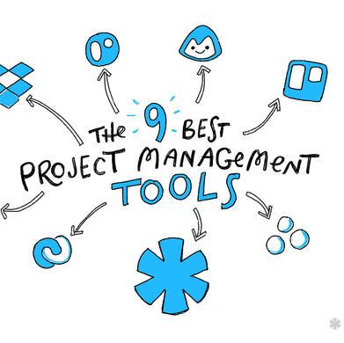

TITLE
Logo here
Subtitle
By: PhatNHSE63348
Date

Slide 2
What is it?
What can it do?
Project Management Tools
Planning
Scheduling
Resource allocation
Change management
Control cost and manage budgeting
Quality management
Documentation
Administration system
So on,…

Slide 3

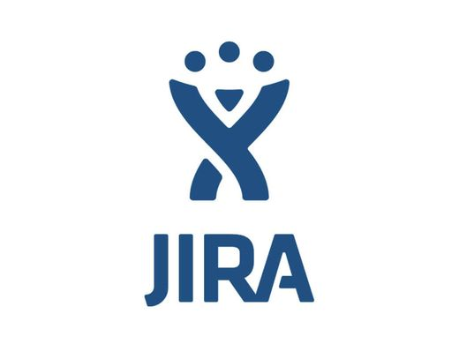


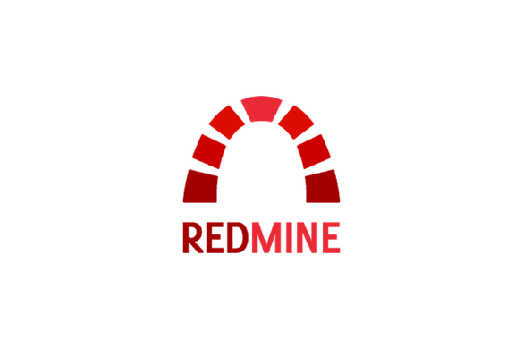
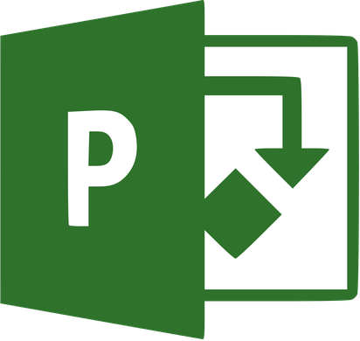
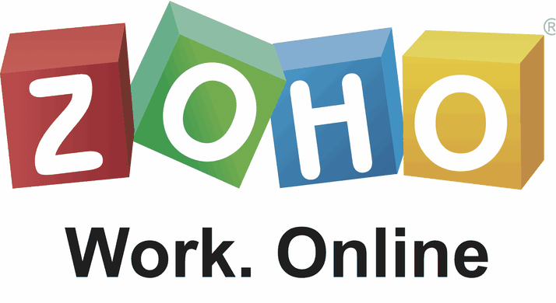
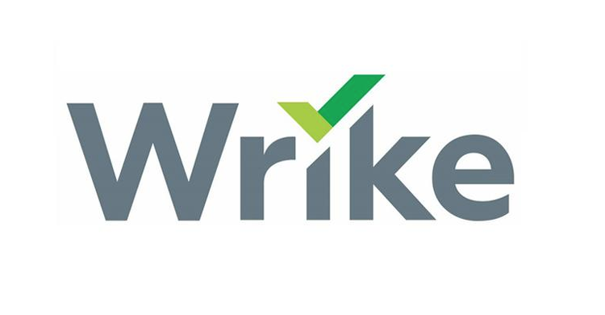
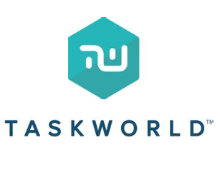

Can you name the 9 most popular project management tools?
1
2
3
4
5
6
7
8
9

Slide 4
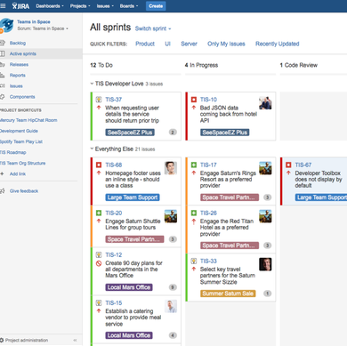
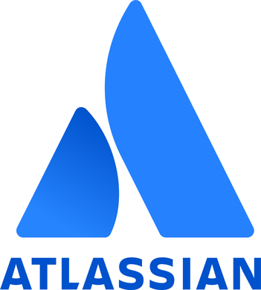
JIRA
Jira is a great tool for managing marketing projects and tasks. Jira integrates easily across multiple platforms. Also, Jira is well suited or large organizations with lots of layers and interconnected moving parts.

Slide 5
Pros & Cons
Number 1 project management, used by giant company
Hyper rich features
Ability to see task and progress
Data visualization
No testing specific functionality
Can be overwhelming with small to medium project
It’s not free

Slide 6
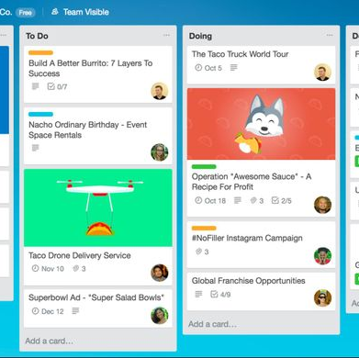
TRELLO
Infinitely flexible. Incredibly easy to use. Great mobile apps. It's free. Trello keeps track of everything, from the big picture to the minute details.

Slide 7
Pros & Cons
Many add-ons
Super flexible
The free plan include everything
Not suitable for a big project
No chart, project document management tools,…

Slide 8
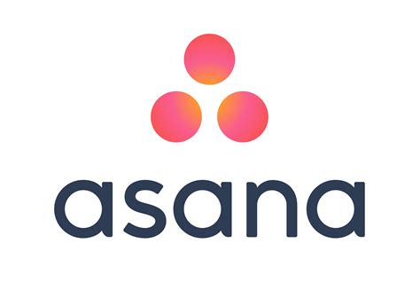
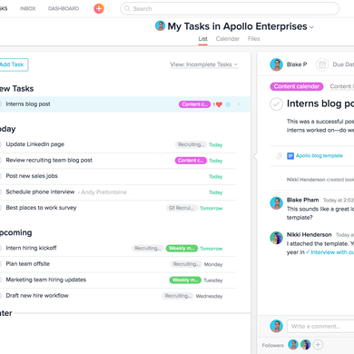
ASANA
Make more time for the work that matters most Asana is the work management platform teams use to stay focused on the goals, projects, and daily tasks that grow business.

Slide 9
Pros & Cons
Clear and intuitive interface
Top-notch communication tool
Great integration
Free for small team
A bit steeper learning curve
The hotkey sometime make people confuse

Slide 10

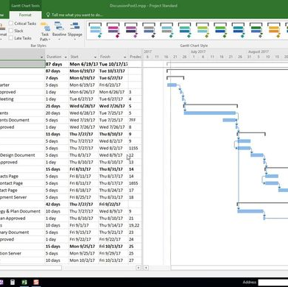
Microsoft Project
With agile in Microsoft Project, you can manage agile projects by using simple, visual task boards that support Scrum, Kanban, or custom workflows. Choose whatever methodology makes sense for your project: agile, waterfall, or hybrid.

Slide 11
Pros & Cons
Feature rich
Support multiple types of project
Can work offline
It’s expensive
Platform dependent
Must install to use

Slide 12
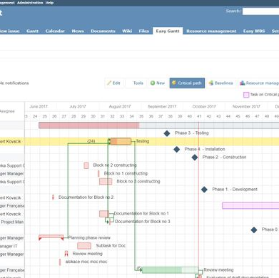
REDMINE
Redmine is a flexible project management web application. Written using the Ruby on Rails framework, it is cross-platform and cross-database.
Redmine is open source and released under the terms of the GPL.

Slide 13
Pros & Cons
Free and open source
Self hosting
Cross database
Easily customization
Multiple addons
Setting Redmine is time confusing and require tech-savy knowledge.
High server memory usage
Outdated UI – UX

Slide 14
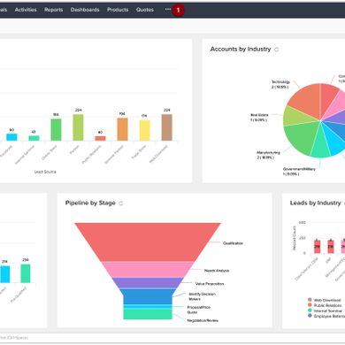

ZOHO
Unique and powerful suite of software to run your entire business, brought to you by a company with the long term vision to transform the way you work.

Slide 15
Pros & Cons
Free and open source
Self hosting
Cross database
Easily customization
Multiple addons
Setting Redmine is time confusing and require tech-savy knowledge.
High server memory usage
Outdated UI – UX

Slide 16

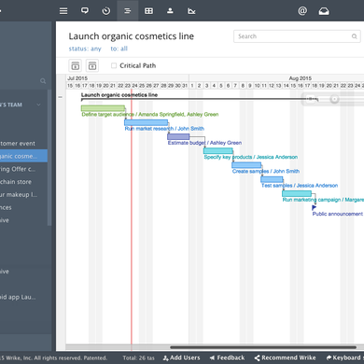
WRIKE
Wrike is an online project management software include time tracking, project planning and organization, an interactive timeline, communication and online collaboration features for teams of any size.

Slide 17
Pros & Cons
Great collaboration
Comprehensive arrangement of tasks
Free for small teams
Excellent monitoring and reporting
Less customization

Slide 18
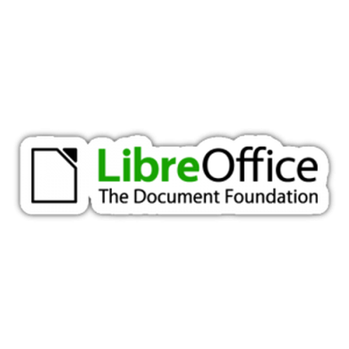
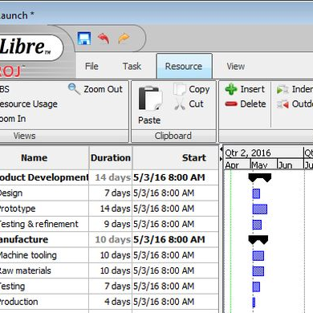
Project Libre
Projectlibre was founded to provide an open source replacement of Microsoft Project desktop. They have succeeded in that mission with over 3,000,000 desktop downloads but will soon also offer a revolutionary cloud solution, ProjectLibre Enterprise Cloud.

Slide 19
Pros & Cons
Microsoft Project 2010 compatibility
Platform independent
Earned value costing, Gantt chart, PERT graph, Resource breakdown structure, Work breakdown structure (WBS) chart
Task usage reports
Many bug fixes and correction of issues

Slide 20

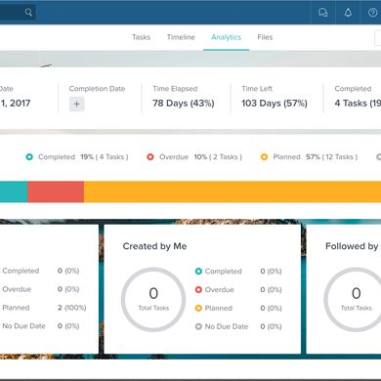
TASKWORLD
Trello is good but taskworld is better

Slide 21
Pros & Cons
Do everything Trello can do
Good customer support
98% Customer Satisfaction Rating
Not as good as Trello
The mobile applications user experience is not so smooth

Slide 22





THE END
Any information, contact me:
Nguyen Hong Phat
0903670437
phatnhse63348@fpt.edu.vn
nguyenhongphat0.github.io

