Slide 1
WrpBase
Iotprj – 2019/10/06

Slide 2
History
Revision | Author | Date | Comments
1.0 | nguyenhtm | 2019/10/06 | Initial version

Slide 3
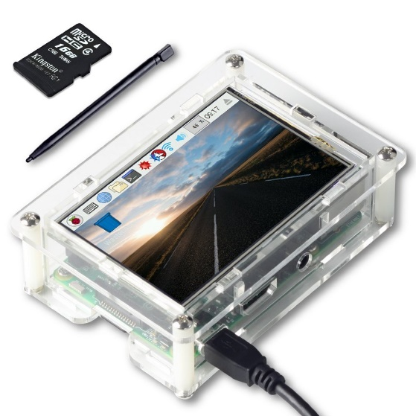
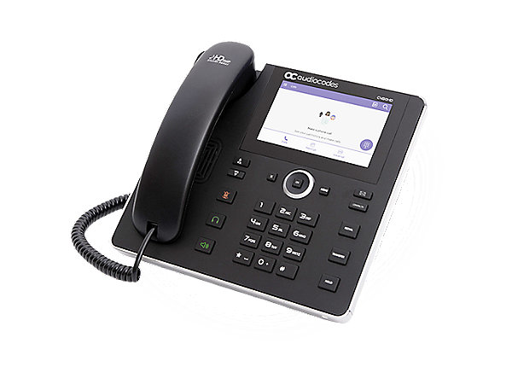
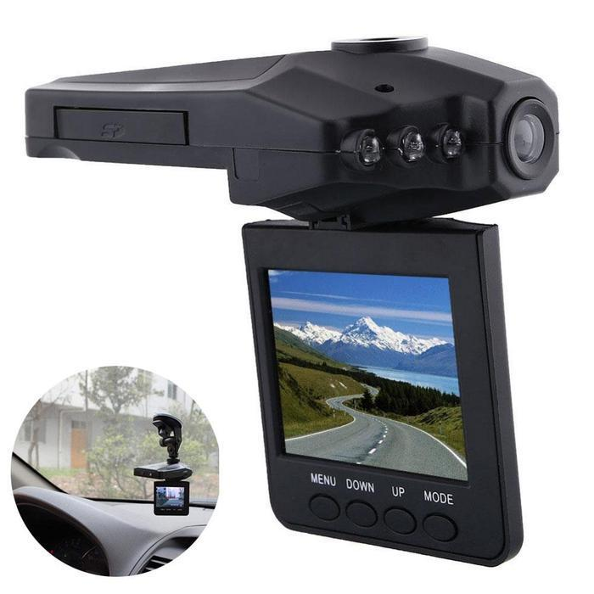
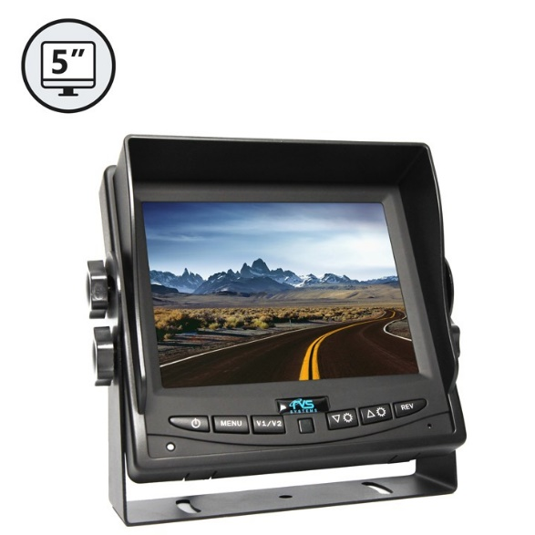
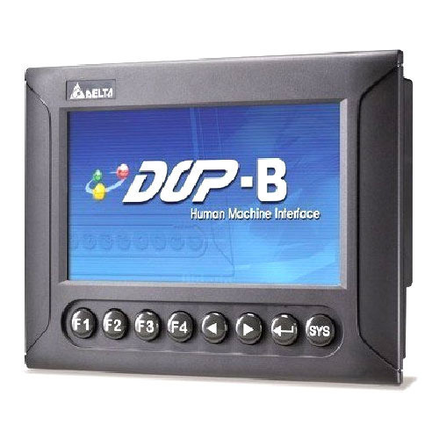
Overview
Provide a framework for developers to easily create GUI applications in IOT area with ESP32 chip

Slide 4
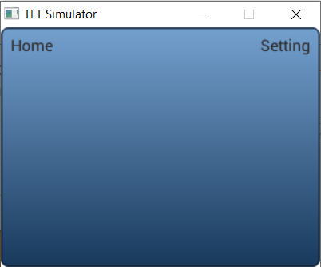
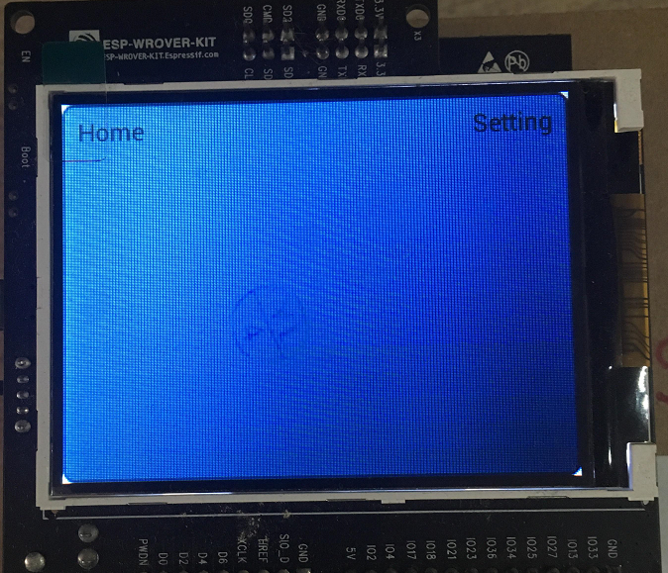
Sample App
The Sample App can run on ESP32 platform using PICO Kit and on Windows platform using SDL Simulator
Video: https://www.youtube.com/watch?v=6uVoYXjuBhI
SampleApp
wrphmi
wrpmidw
wrpgui
wrpsys
wrpdrv
lvgl
websocket
esp-idf
ILI9341
ESP32
Simulator

Slide 5
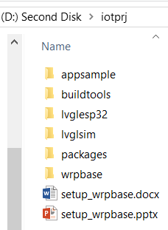
Setup
D:\iotprj\wrpbase
D:\iotprj: git clone --recursive https://github.com/nguyenhtm/espt
Folder Structures: D:\iotprj\appsample, D:\iotprj\lvglesp32, D:\iotprj\lvglsim, D:\iotprj\wrpbase
D:\iotprj\buildtools
D:\iotprj\buildtools\mingw-w64: download mingw-w64-install.exe at http://mingw-w64.org/doku.php/download
D:\iotprj\buildtools\msys32: download esp32_win32_msys2_environment_and_toolchain-20181001.zip at https://docs.espressif.com/projects/esp-idf/en/stable/get-started/windows-setup.html
D:\iotprj\buildtools\eclipse: download eclipse-cpp-2019-03-R-win32-x86_64.zip at https://www.eclipse.org/downloads/packages/file/55067
D:\iotprj\packages
D:\iotprj\packages\esp-idf: git clone --recursive https://github.com/espressif/esp-idf.git
D:\iotprj\packages\lvgl: git clone --recursive https://github.com/littlevgl/lvgl.git
D:\iotprj\packages\pc_simulator_sdl_eclipse: git clone --recursive https://github.com/littlevgl/pc_simulator_sdl_eclipse.git
D:\iotprj\packages\esp32_ili9341: git clone --recursive https://github.com/littlevgl/esp32_ili9341.git
D:\iotprj\packages\SDL2-2.0.5: download the SDL2-devel-2.0.5-mingw.tar.gz file at https://www.libsdl.org/release
D:\iotprj\packages\mongoose: git clone https://github.com/cesanta/mongoose

Slide 6
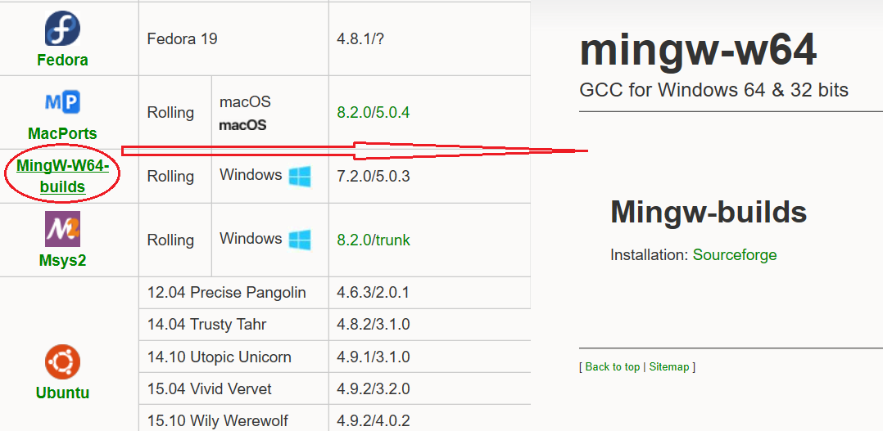
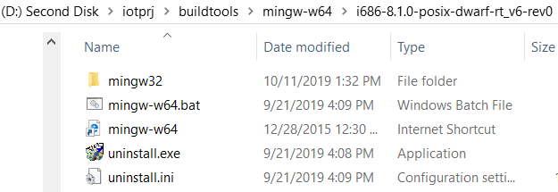
BuildTools
Mingw64
GCC for Windows 32/64 bit which is used to compile source code for simulation
Download mingw-w64-install.exe at http://mingw-w64.org/doku.php/download and install in buildtools folder
GCC install path: D:\iotprj\buildtools\mingw-w64\i686-8.1.0-posix-dwarf-rt_v6-rev0\mingw32\bin

Slide 7
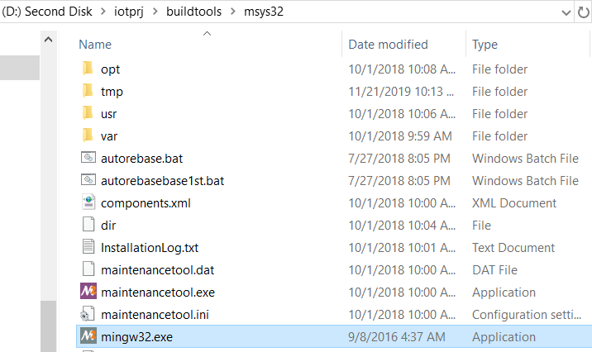
BuildTools 2
Msys32 with ESP32
GCC for ESP32 which is used to compile source code for PICO target
Download esp32_win32_msys2_environment_and_toolchain-20181001.zip at https://docs.espressif.com/projects/esp-idf/en/stable/get-started/windows-setup.html and extract at buildtools folder
GCC install path:
D:\iotprj\buildtools\msys32\opt\xtensa-esp32-elf\bin

Slide 8
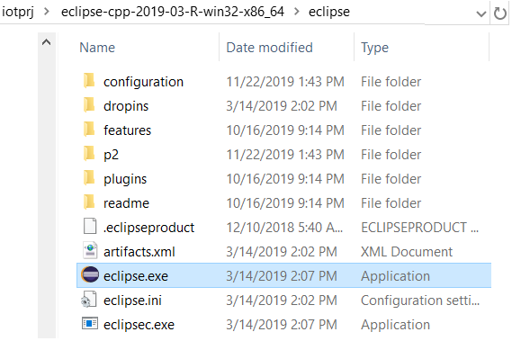
BuildTools 3
Eclipse
Editor can be editor and configured to use GCC to build the sample app on PICO target and Windows
Download eclipse-cpp-2019-03-R-win32-x86_64.zip at https://www.eclipse.org/downloads/packages/file/55067 and extract at buildtools folder
Eclipse install path:
D:\iotprj\buildtools\eclipse-cpp-2019-03-R-win32-x86_64\eclipse

Slide 9
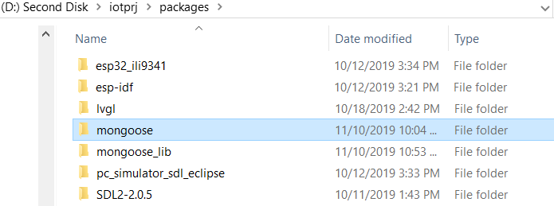
Packages
The folder used to store open sources like lvgl, mongoose or esp-idf framework. Refer to Setup slide to download
In case of mongoose, after downloading, create mongoose_lib folder and copy mongoose.c and mongoose.h files to it

Slide 10
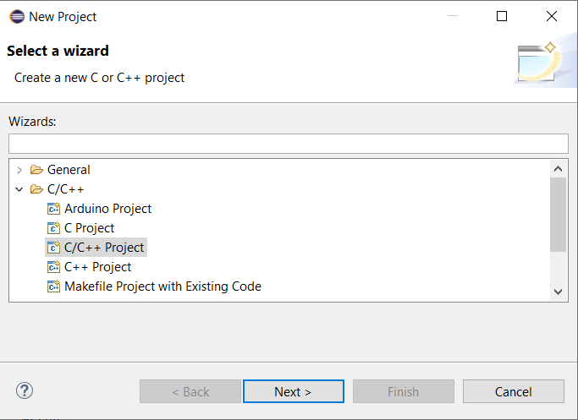
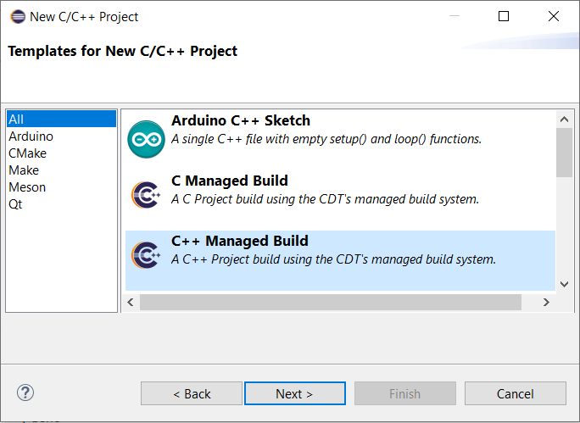
Eclipse C++ Project
Create 2 Eclispse C++ projects: one for simulation and one for ESP32
Both demo how to setup working environment and how to use open sources like lvgl, mongoose,…

Slide 11
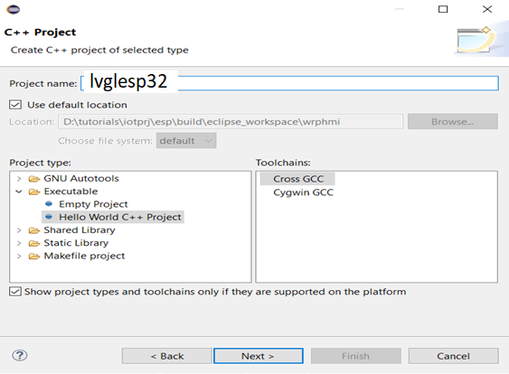
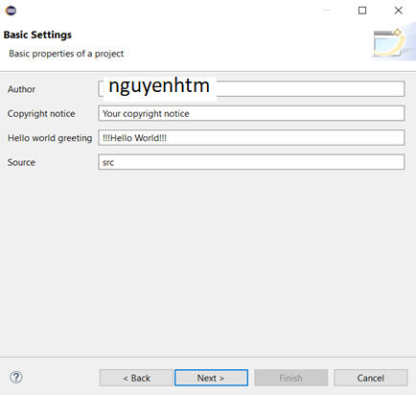
Eclipse C++ Project 2

Slide 12
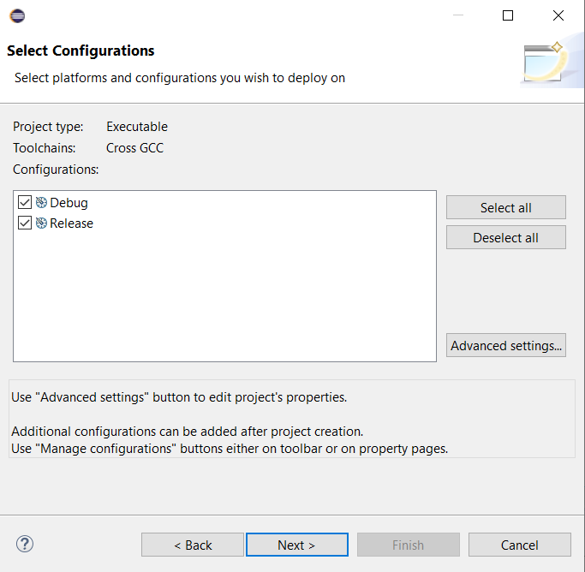
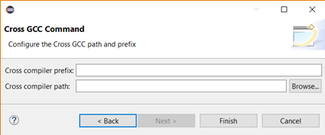
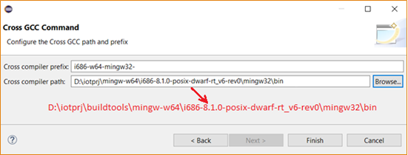
Eclipse C++ Project 3
ESP32
Empty
Simulator

Slide 13
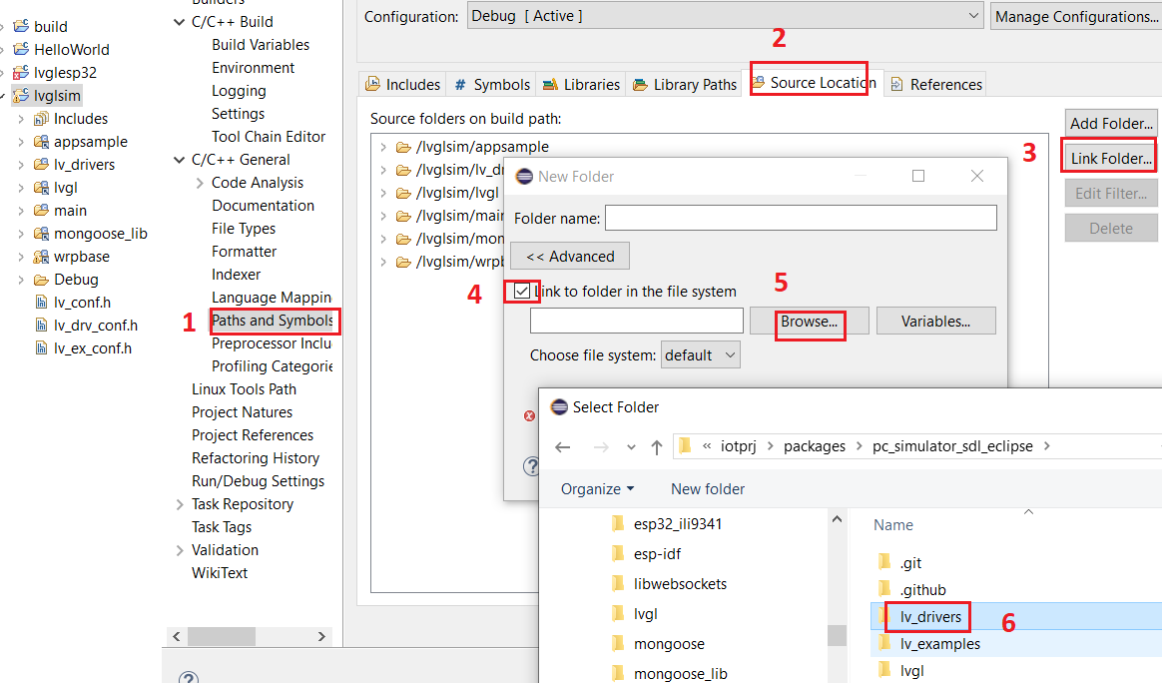
LVGL SIM Eclipse 1
Link source folders such as appsample,
Lvgl, mongoose_lib, and wrpbase

Slide 14
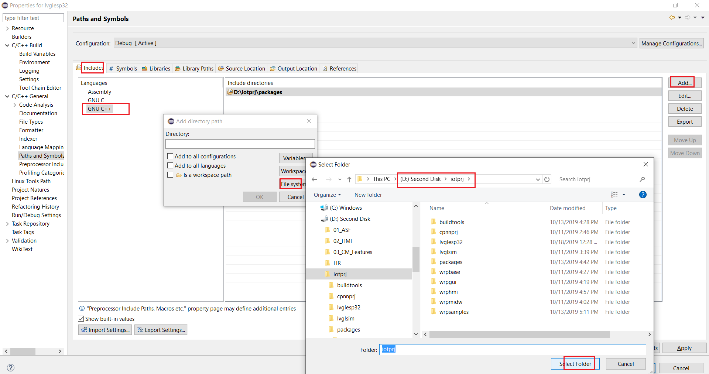
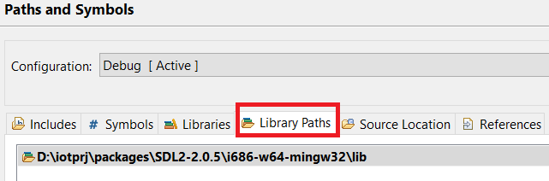
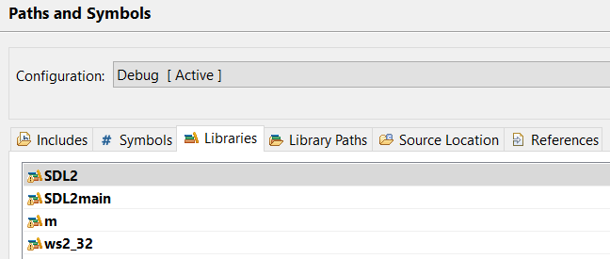
LVGL SIM Eclipse 2

Slide 15
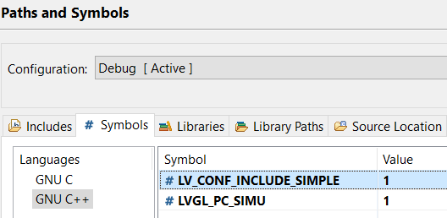
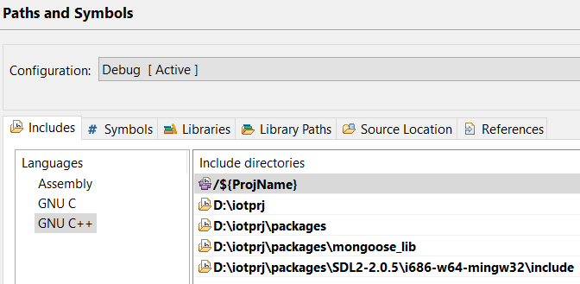
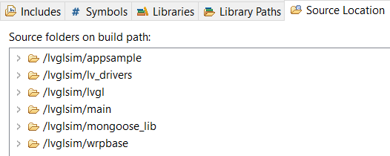
LVGL SIM Eclipse 3

Slide 16
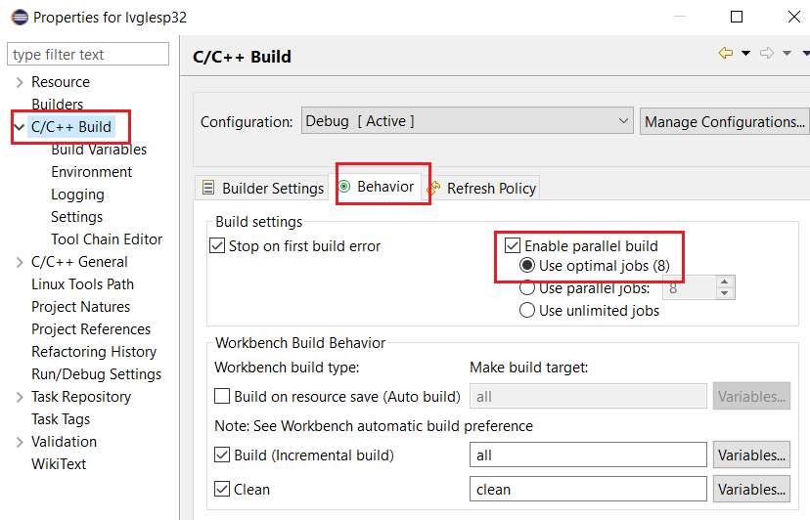
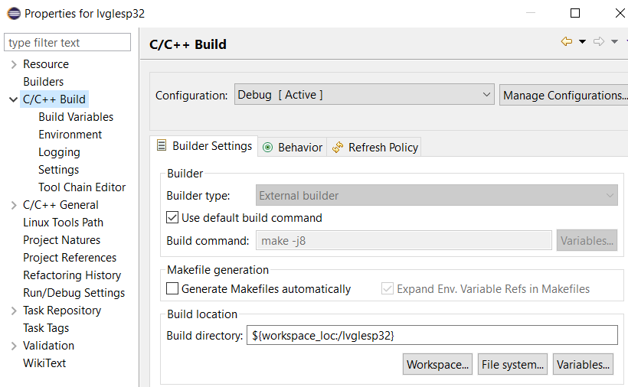
LVGL ESP32 Eclipse

Slide 17
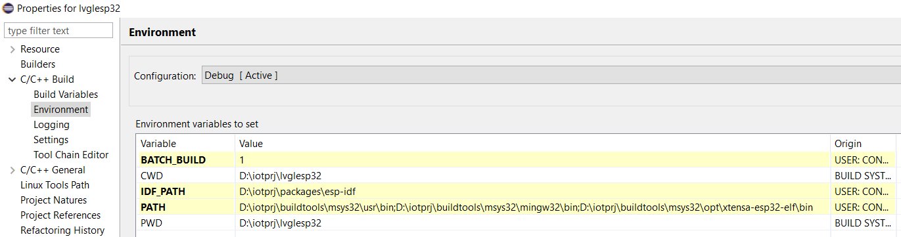
LVGL ESP32 Eclipse 1
Configure ESP-IDF framework and GCC for ESP32 compiler path as below

Slide 18
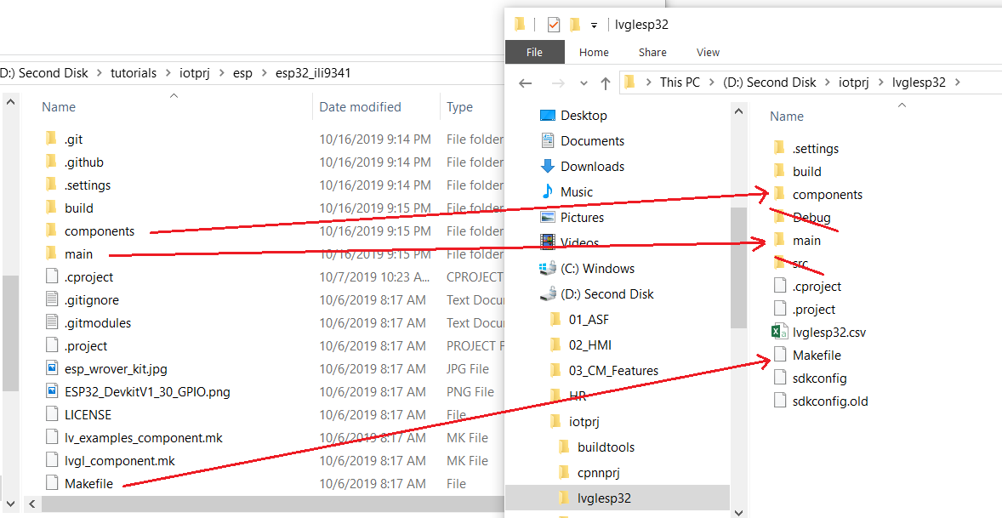
LVGL ESP32 Eclipse 2
Copy esp32_ili9341/components, main folder and Makefile to lvglesp32

Slide 19
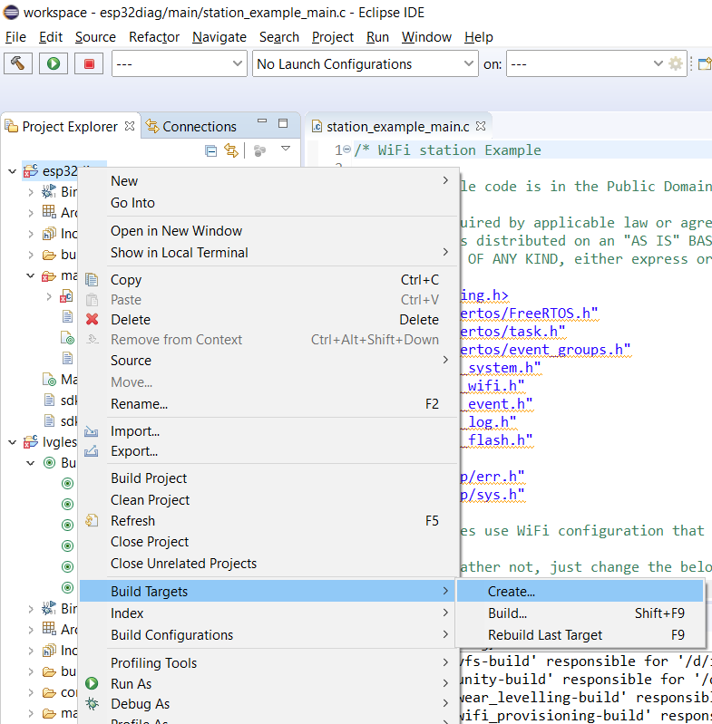
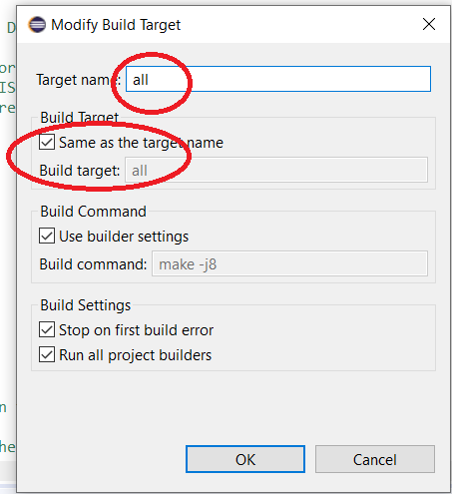
LVGL ESP32 Eclipse 3

Slide 20
LVGL ESP32 Eclipse 3
# ESP32 Diagnosis Project Name
PROJECT_NAME := esp32diag
#For C++ language flags
EXTRA_CPPFLAGS := -DLV_CONF_INCLUDE_SIMPLE -DILI9341_BCKL_ACTIVE_LVL=0
#Use LVGL library and ILI9341 driver
EXTRA_COMPONENT_DIRS := D:/iotprj/packages/lvgl D:/iotprj/packages/esp32_ili9341/components/drv
#Include headers of lvgl component and headers of ili9341 driver
COMPONENT_EXTRA_INCLUDES := D:/iotprj/packages D:/iotprj/packages/esp32_ili9341/components
#Use include macros for wrpbase
CPPFLAGS += -DLVGL_PC_SIMU=0 -DLVGL_ESP32_ILI9341=1 -DUSE_ESP_IDF=1
#Use wrpbase component
EXTRA_COMPONENT_DIRS += D:/iotprj/wrpbase/wrpdrv D:/iotprj/wrpbase/wrpsys D:/iotprj/wrpbase/wrpgui D:/iotprj/wrpbase/wrpmidw D:/iotprj/wrpbase/wrphmi D:/iotprj/wrpbase/wrpres
#esp-idf platform makefile
include $(IDF_PATH)/make/project.mk

Slide 21
Notes
Set IDF_PATH: echo 'export IDF_PATH="D:/iotprj/packages/esp-idf"' >> $HOME/.bash_profile
msys32 open will use this path
Generate partition table:
Partition table should not same name as project name otherwise same .bin is generated
Generate: python $IDF_PATH/components/partition_table/gen_esp32part.py projectname_partition_table.bin
Flash: python $IDF_PATH/tools/idf.py partition_table-flash => enter to lvglesp32\build\partition_table
D:/iotprj/buildtools/msys32/mingw32/bin/python.exe -m pip install --user -r D:/iotprj/packages/esp-idf/requirements.txt
Create components/main folders in lvglsim and copy lv_drivers, .h file into these folder => same as esp-idf app

Slide 22
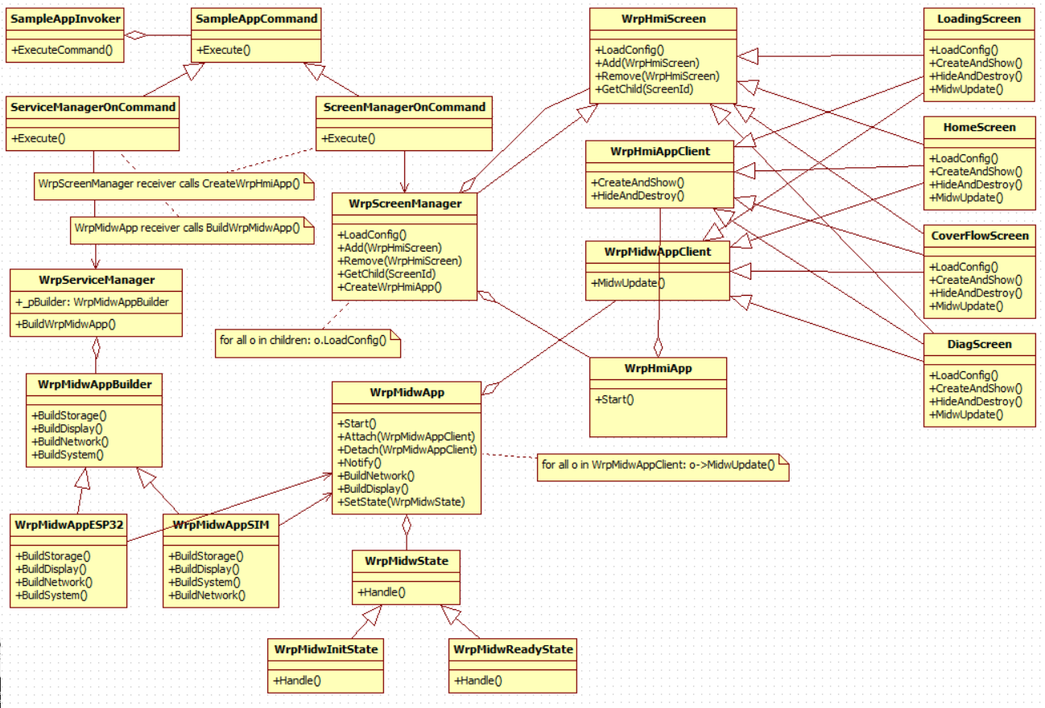

Slide 23
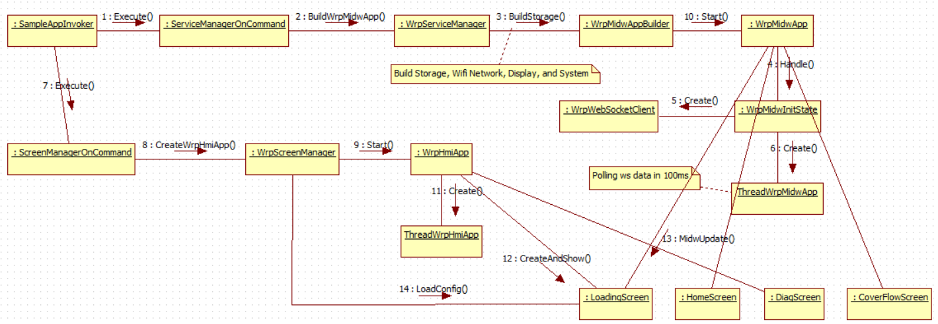

Slide 24
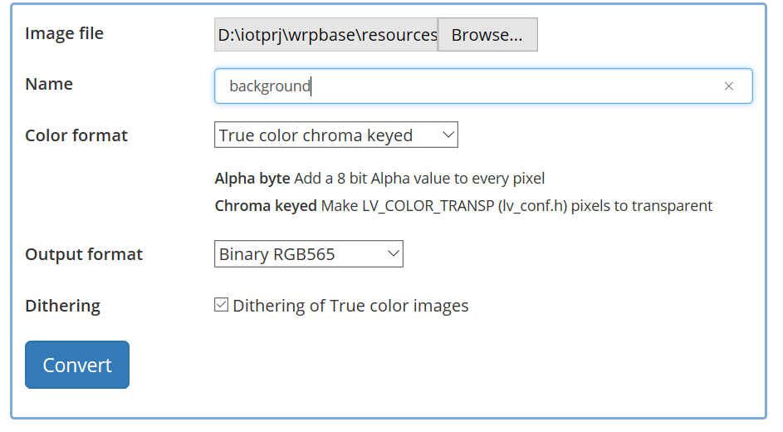
Image Converter
https://littlevgl.com/image-converter

Slide 25
References
LVGL: https://github.com/littlevgl/lvgl
ESP-IDF: https://docs.espressif.com/projects/esp-idf/en/latest/index.html
Patterns: Command, Singleton, Observer, Factory Method, Builder, State, Composite,

