Slide 1
WrpBase
Iotprj – 2020/03/21

Slide 2
History
Revision | Author | Date | Comments
1.0 | nguyenhtm | 2019/10/06 | Initial version
1.1 | nguyenhtm | 2020/03/21 | Update setup guidelines

Slide 3
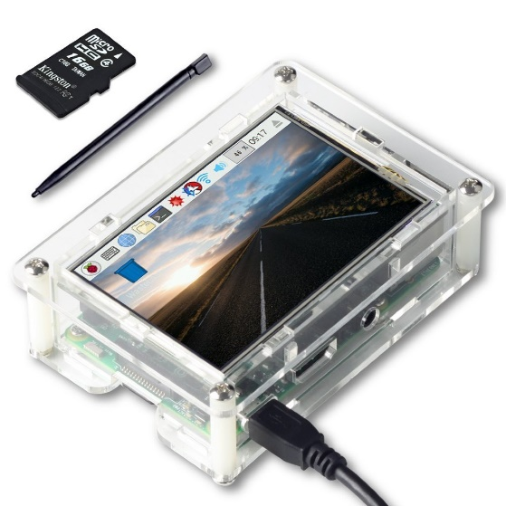
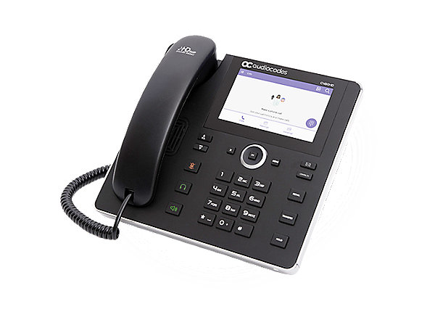
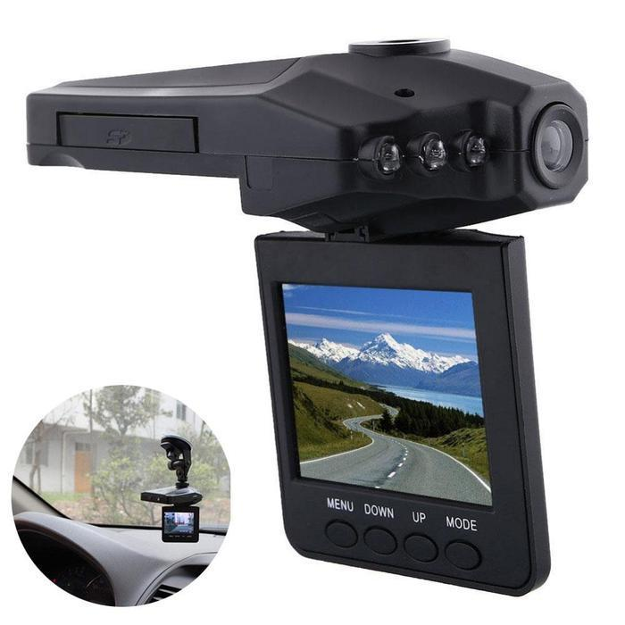
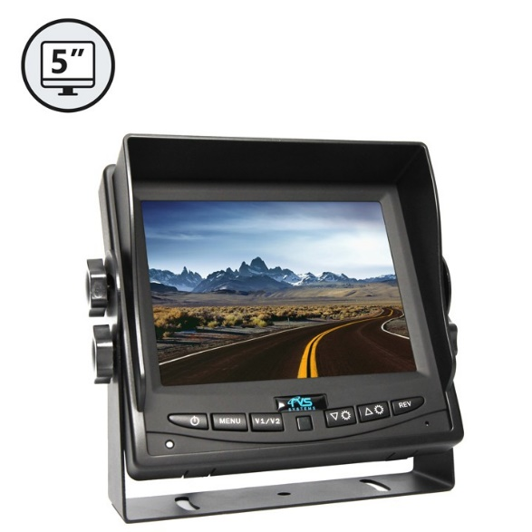
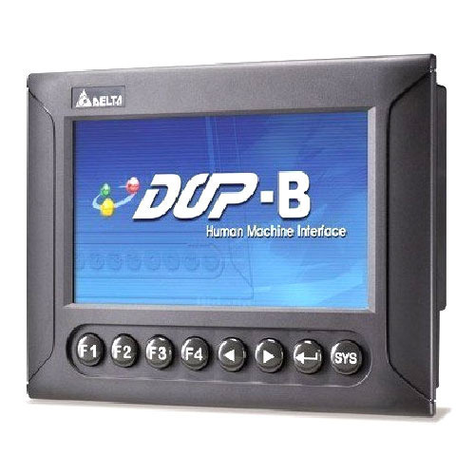
Overview
Provide a framework for developers to easily create GUI applications in IOT area with ESP32 chip

Slide 4
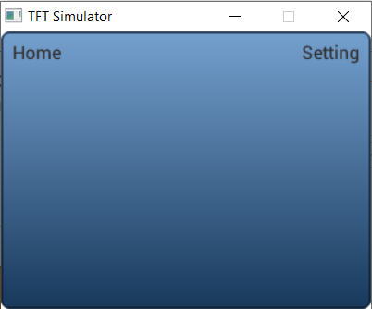
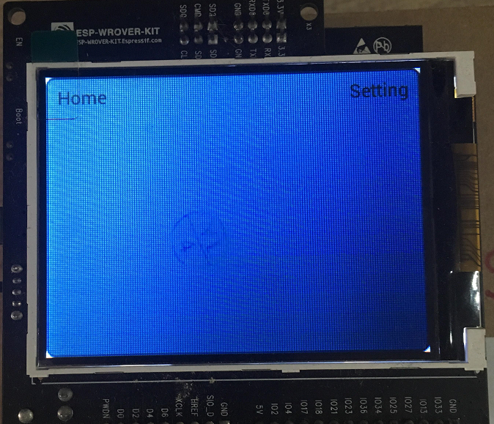
Sample App
The Sample App can run with ESP-WROVER-KIT V3 and on Windows platform using SDL Simulator
Video: https://www.youtube.com/watch?v=e4u56qCMuuE
SampleApp
wrphmi
wrpmidw
wrpgui
wrpsys
wrpdrv
lvgl
websocket
esp-idf
ILI9341
ESP32
Simulator

Slide 5
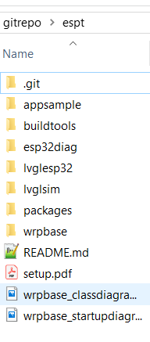
Setup
D:\iotprj\wrpbase
D:\iotprj: git clone --recursive https://github.com/nguyenhtm/espt
Folder Structures: D:\iotprj\appsample, D:\iotprj\lvglesp32, D:\iotprj\lvglsim, D:\iotprj\wrpbase
D:\iotprj\buildtools
D:\iotprj\buildtools\mingw-w64: download mingw-w64-install.exe at http://mingw-w64.org/doku.php/download
D:\iotprj\buildtools\msys32: download esp32_win32_msys2_environment_and_toolchain-20181001.zip at https://docs.espressif.com/projects/esp-idf/en/v3.3/get-started/windows-setup.html
D:\iotprj\buildtools\eclipse: download eclipse-cpp-2019-03-R-win32-x86_64.zip at https://www.eclipse.org/downloads/packages/file/55067
D:\iotprj\packages
D:\iotprj\packages\esp-idf: git clone --recursive https://github.com/espressif/esp-idf.git
D:\iotprj\packages\lvgl: git clone --recursive https://github.com/littlevgl/lvgl.git
D:\iotprj\packages\pc_simulator_sdl_eclipse: git clone --recursive https://github.com/littlevgl/pc_simulator_sdl_eclipse.git
D:\iotprj\packages\esp32_ili9341: git clone --recursive https://github.com/littlevgl/esp32_ili9341.git
D:\iotprj\packages\SDL2-2.0.5: download the SDL2-devel-2.0.5-mingw.tar.gz file at https://www.libsdl.org/release
D:\iotprj\packages\mongoose: git clone https://github.com/cesanta/mongoose
Create D:\iotprj\packages\mongoose_lib and copy 2 D:\iotprj\packages\mongoose\mongoose.c and mongoose.h files to it

Slide 6
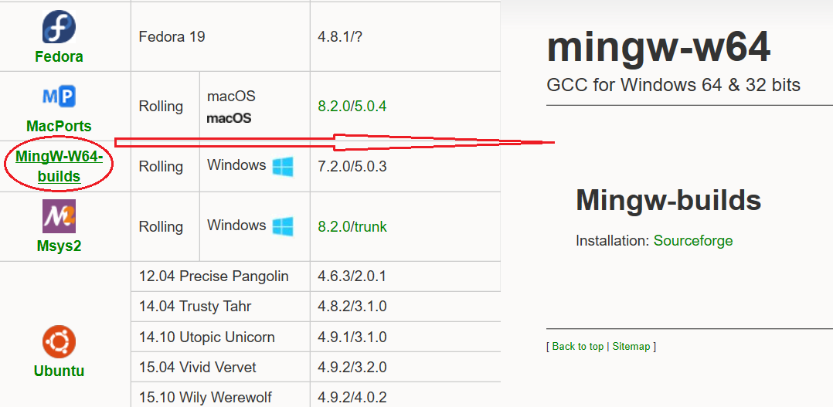
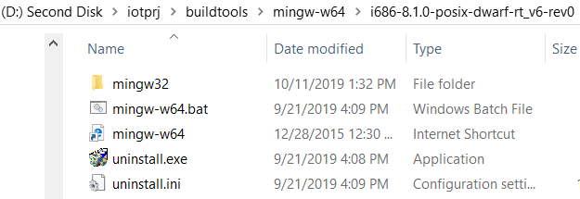
BuildTools
Mingw64
GCC for Windows 32/64 bit which is used to compile source code for simulation
Download mingw-w64-install.exe at http://mingw-w64.org/doku.php/download and install in buildtools folder
GCC install path: D:\iotprj\buildtools\mingw-w64\i686-8.1.0-posix-dwarf-rt_v6-rev0\mingw32\bin

Slide 7
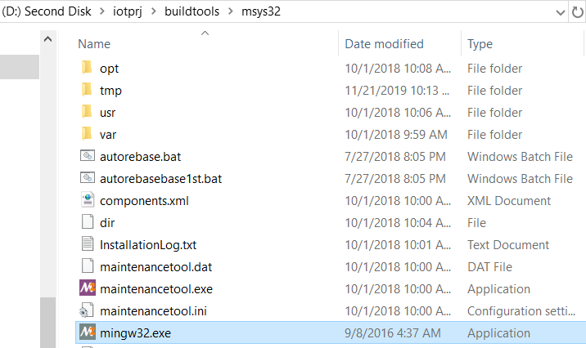
BuildTools 2
Msys32 with ESP32
GCC for ESP32 which is used to compile source code for PICO target
Download esp32_win32_msys2_environment_and_toolchain-20181001.zip at https://docs.espressif.com/projects/esp-idf/en/v3.3/get-started/windows-setup.html and extract at buildtools folder
GCC install path:
D:\iotprj\buildtools\msys32\opt\xtensa-esp32-elf\bin

Slide 8
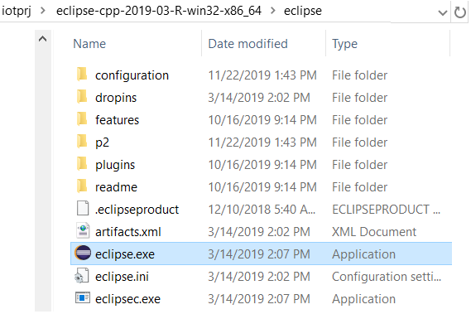
BuildTools 3
Eclipse
Editor can be editor and configured to use GCC to build the sample app on PICO target and Windows
Download eclipse-cpp-2019-03-R-win32-x86_64.zip at https://www.eclipse.org/downloads/packages/file/55067 and extract at buildtools folder
Eclipse install path:
D:\iotprj\buildtools\eclipse-cpp-2019-03-R-win32-x86_64\eclipse

Slide 9
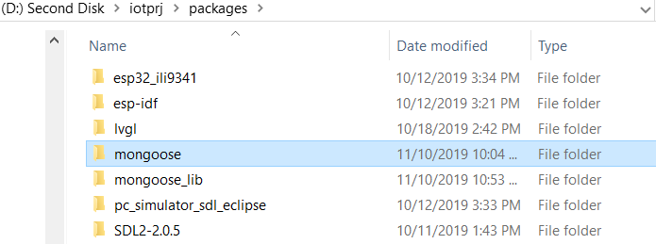
Packages
The folder used to store open sources like lvgl, mongoose or esp-idf framework. Refer to Setup slide to download
In case of mongoose, after downloading, create mongoose_lib folder and copy mongoose.c and mongoose.h files to it

Slide 10
Notes
Set IDF_PATH: echo 'export IDF_PATH="D:/iotprj/packages/esp-idf"' >> $HOME/.bash_profile
When open MSYS32 execute file, it will use this path as default.
Generate partition table:
Partition table should not same name as project name otherwise same .bin is generated
Generate: python $IDF_PATH/components/partition_table/gen_esp32part.py projectname_partition_table.bin
Flash: python $IDF_PATH/tools/idf.py partition_table-flash => enter to lvglesp32\build\partition_table
Execute the command to setup required software:
D:/iotprj/buildtools/msys32/mingw32/bin/python.exe -m pip install --user -r D:/iotprj/packages/esp-idf/requirements.txt

Slide 11
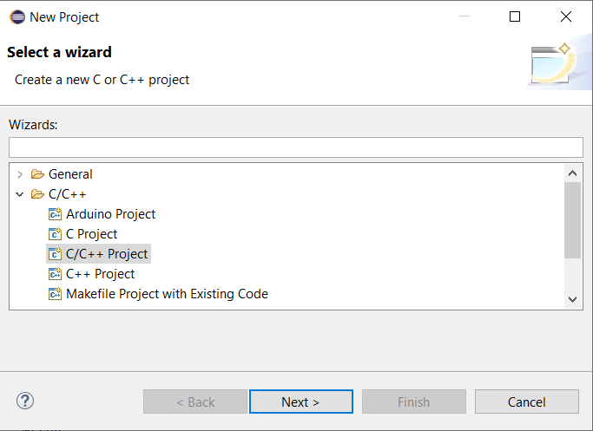
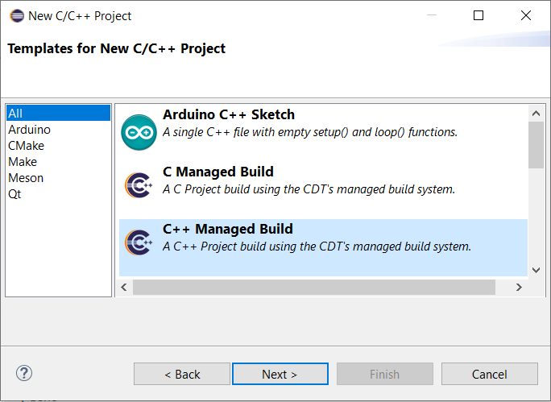
Eclipse C++ Project 1
Create 2 Eclispse C++ projects: one for simulation and one for ESP32 with LCD
Both demo how to setup working environment and how to use open sources like lvgl, mongoose,…

Slide 12
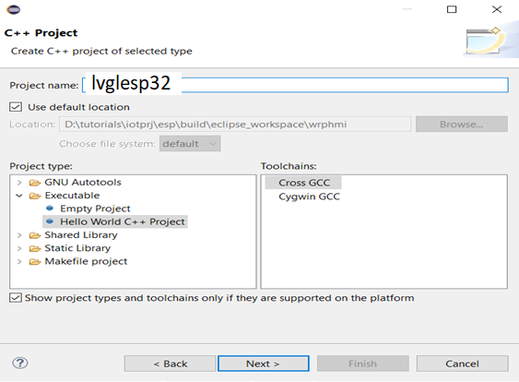
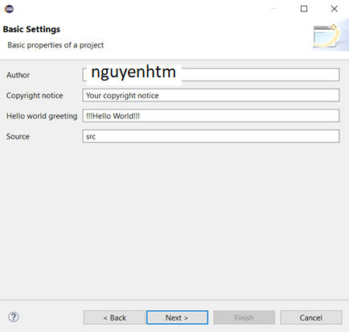
Eclipse C++ Project 2

Slide 13
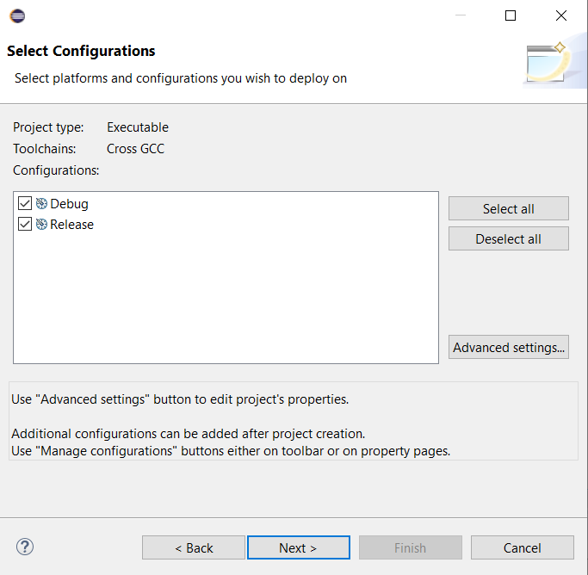
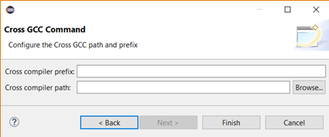
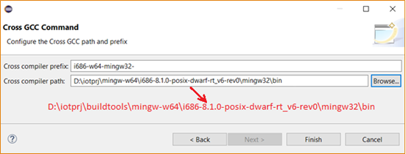
Eclipse C++ Project 3
ESP32
Empty
Simulator

Slide 14
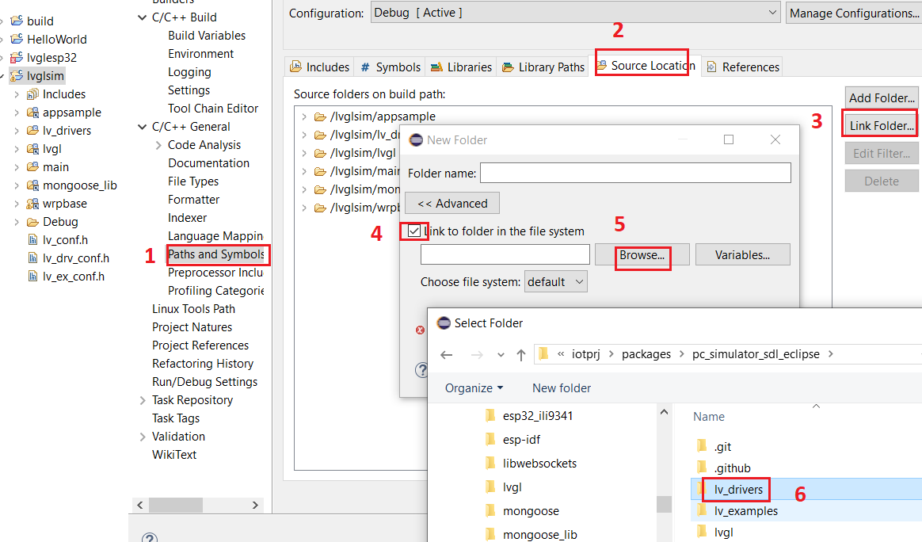
LVGL SIM Eclipse 1
Configuration of Lvgl Simu Eclipse Project:
Link source folders such as appsample,
Lvgl, mongoose_lib, and wrpbase

Slide 15
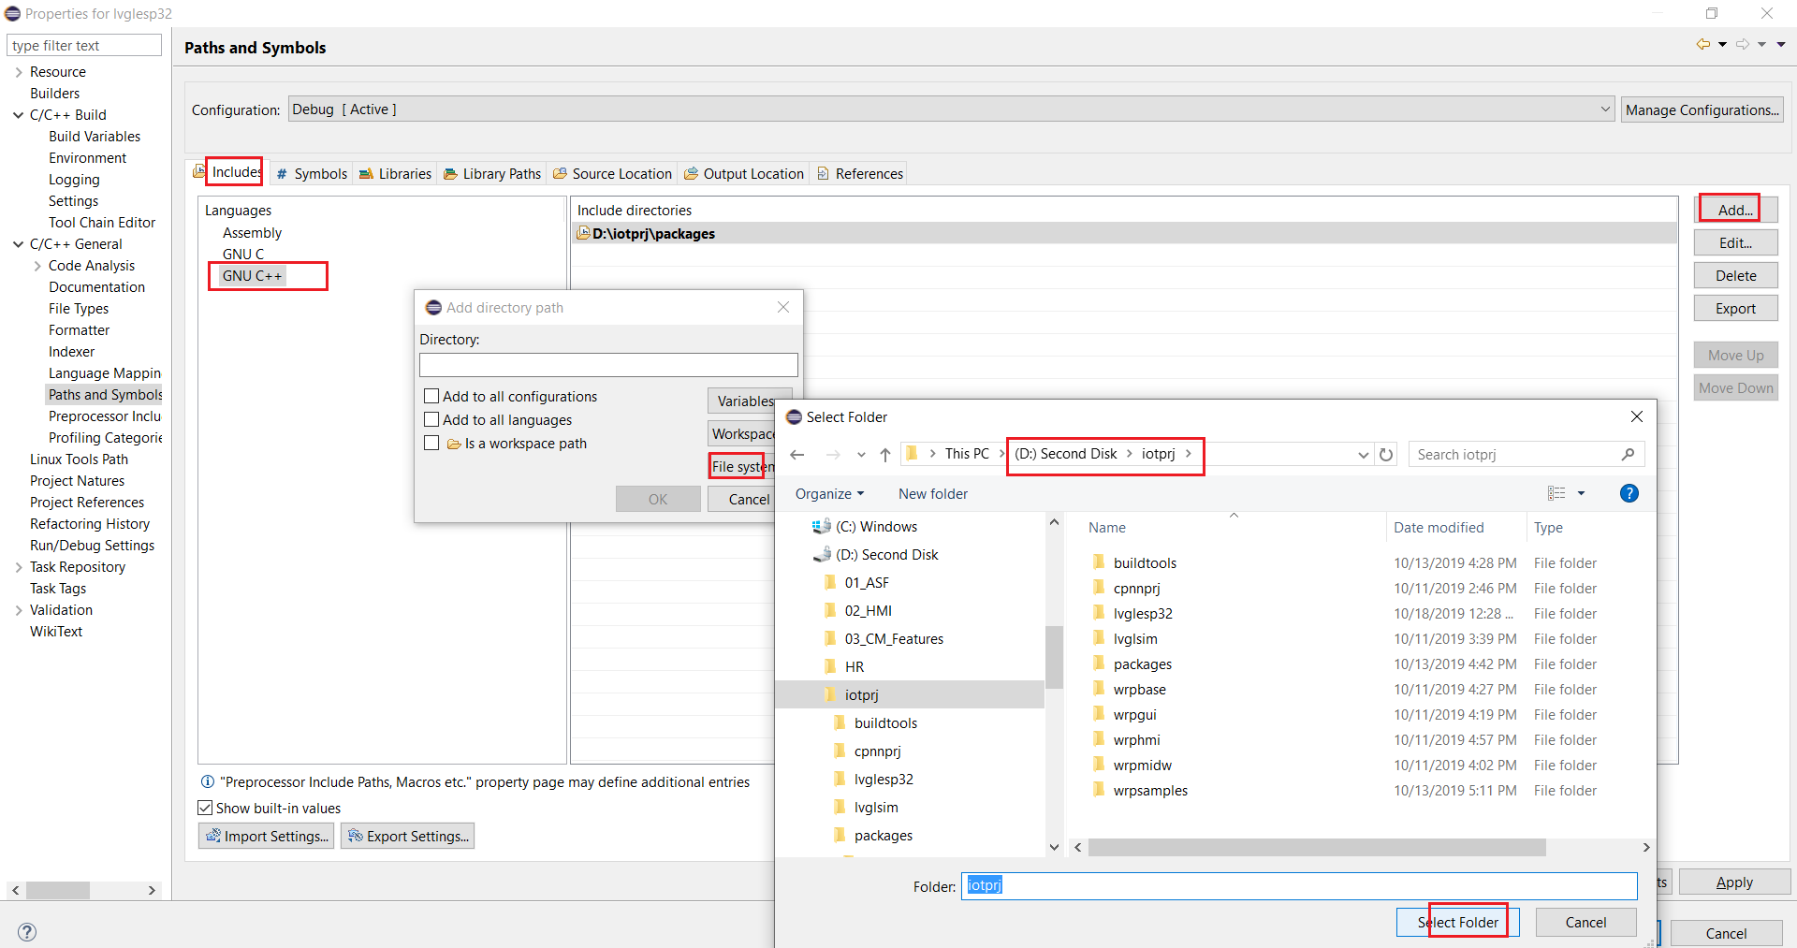
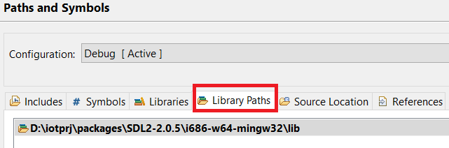
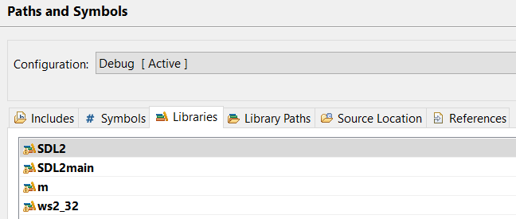
LVGL SIM Eclipse 2

Slide 16
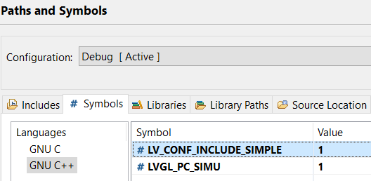
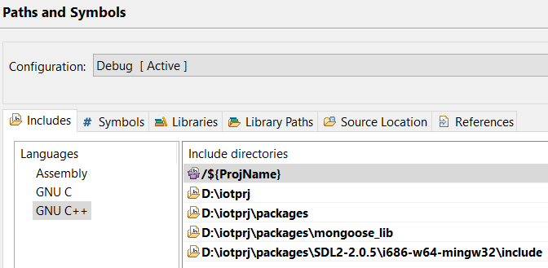
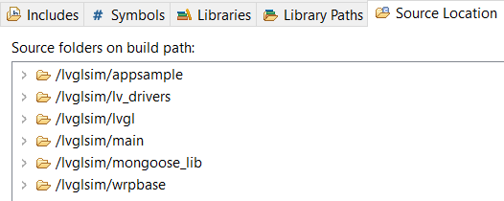
LVGL SIM Eclipse 3

Slide 17
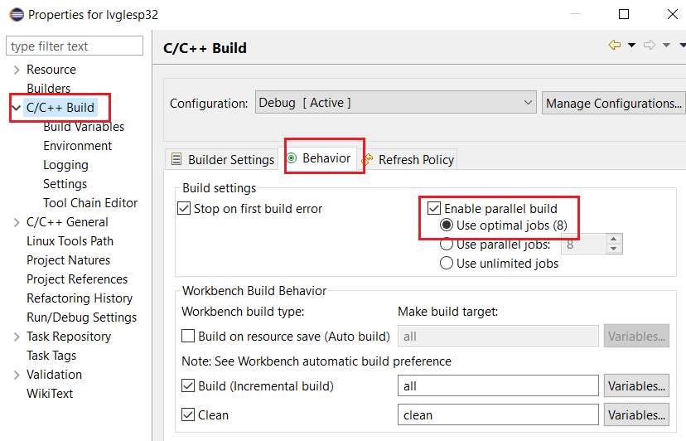
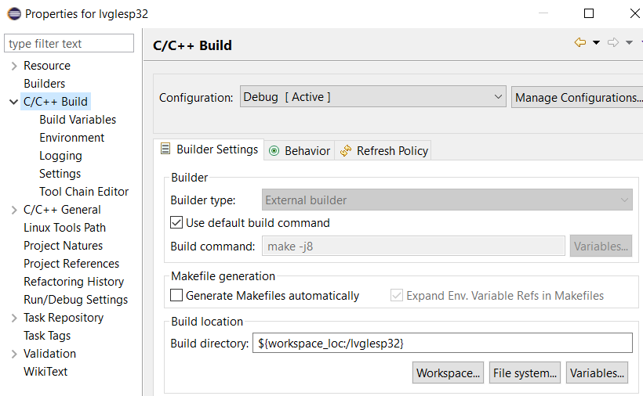
LVGL ESP32 Eclipse

Slide 18
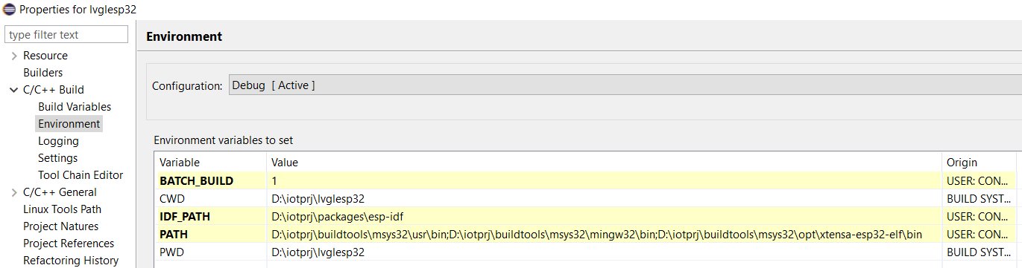
LVGL ESP32 Eclipse 1
Configure ESP-IDF framework and GCC for ESP32 compiler path as below

Slide 19
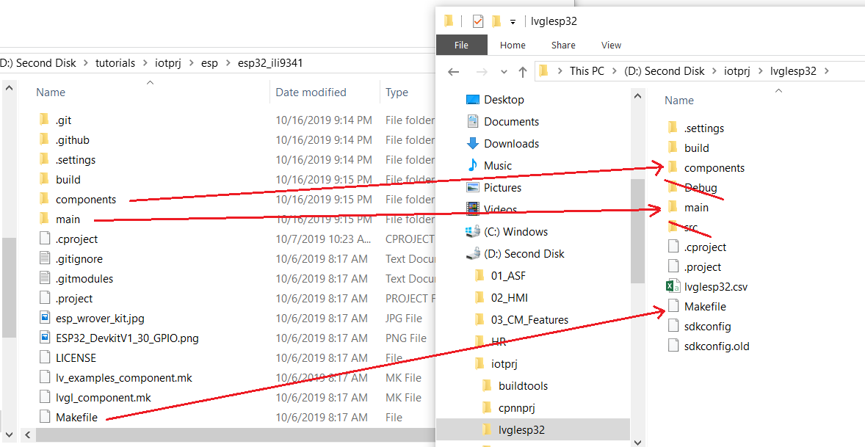
LVGL ESP32 Eclipse 2
Copy esp32_ili9341/components, main folder and Makefile to lvglesp32

Slide 20
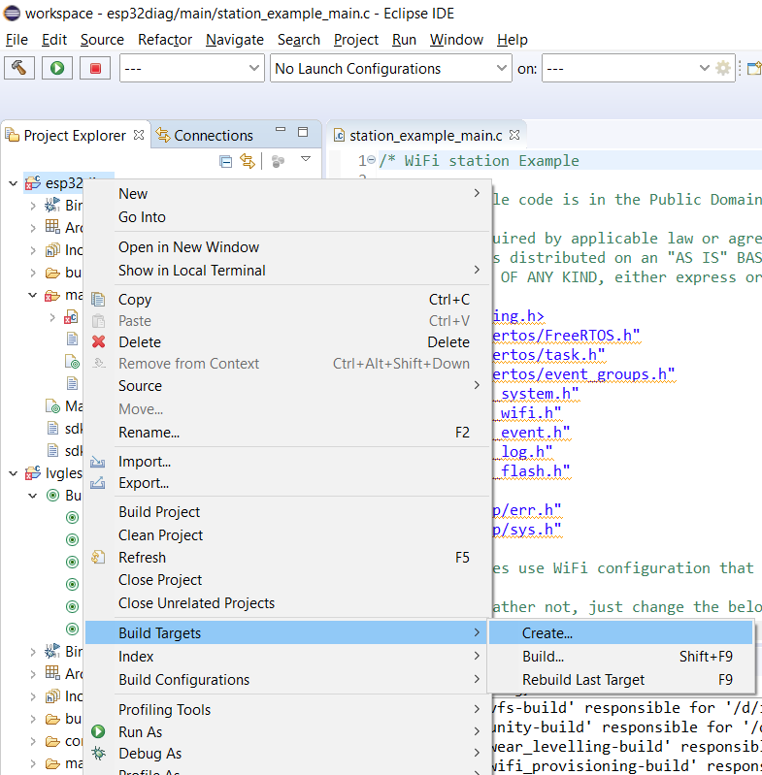
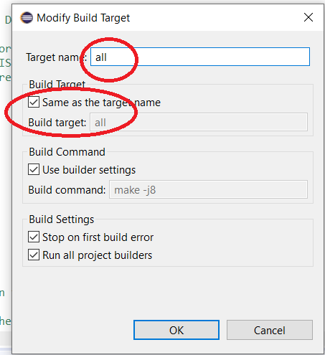
LVGL ESP32 Eclipse 3

Slide 21
LVGL ESP32 Eclipse 4
Then edit Makefile to connect to WrpBase framework as below:
# ESP32 Diagnosis Project Name
PROJECT_NAME := esp32diag
#For C++ language flags
EXTRA_CPPFLAGS := -DLV_CONF_INCLUDE_SIMPLE -DILI9341_BCKL_ACTIVE_LVL=0
#Use LVGL library and ILI9341 driver
EXTRA_COMPONENT_DIRS := D:/iotprj/packages/lvgl D:/iotprj/packages/esp32_ili9341/components/drv
#Include headers of lvgl component and headers of ili9341 driver
COMPONENT_EXTRA_INCLUDES := D:/iotprj/packages D:/iotprj/packages/esp32_ili9341/components
#Use include macros for wrpbase
CPPFLAGS += -DLVGL_PC_SIMU=0 -DLVGL_ESP32_ILI9341=1 -DUSE_ESP_IDF=1
#Use wrpbase component
EXTRA_COMPONENT_DIRS += D:/iotprj/wrpbase/wrpdrv D:/iotprj/wrpbase/wrpsys D:/iotprj/wrpbase/wrpgui D:/iotprj/wrpbase/wrpmidw D:/iotprj/wrpbase/wrphmi D:/iotprj/wrpbase/wrpres
#esp-idf platform makefile
include $(IDF_PATH)/make/project.mk

Slide 22
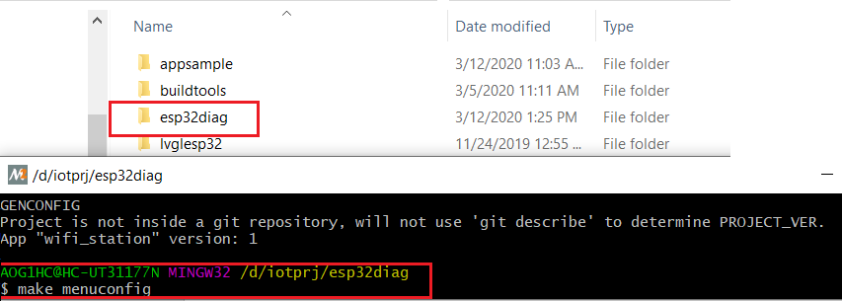
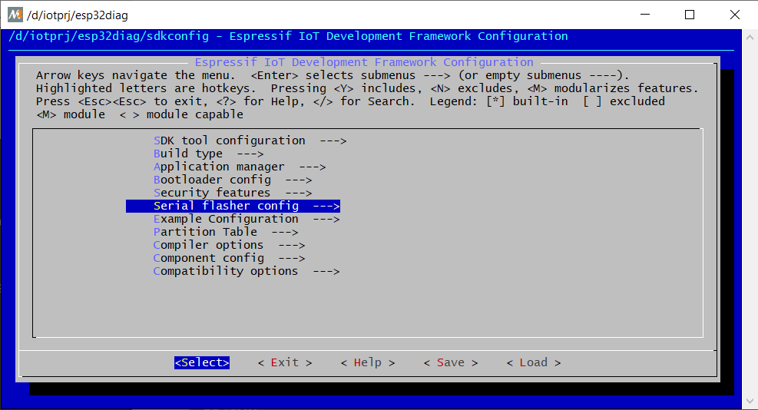
Example of New ESP32 Project 1
Example of the esp32diag project creation and WrpBase usage
Copy D:\iotprj\packages\esp-idf\examples\wifi\getting_started\station to D:\iotprj folder and rename to esp32diag
Do “make menuconfig” and then “make”
Now add it into Eclipse: create a workspace folder eg: D:\iotprj\workspace

Slide 23
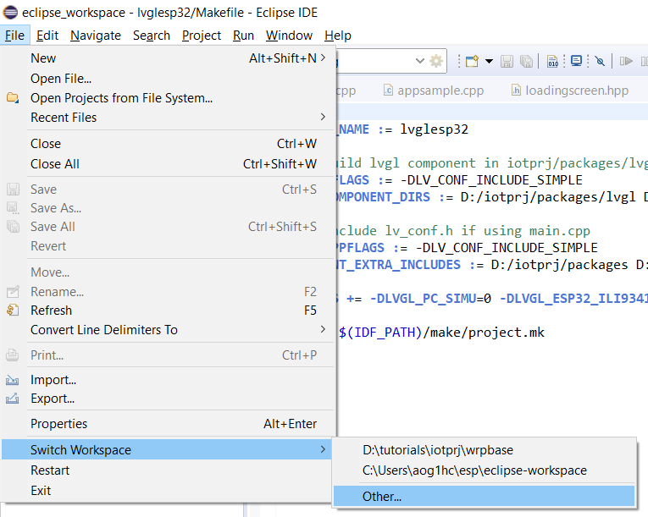
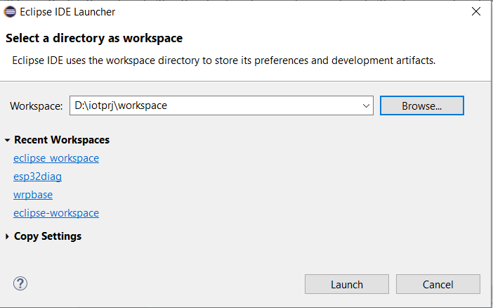
Example of New ESP32 Project 2
Open Eclipse and swith to D:\iotprj\workspace

Slide 24
Example of New ESP32 Project 3

Slide 25
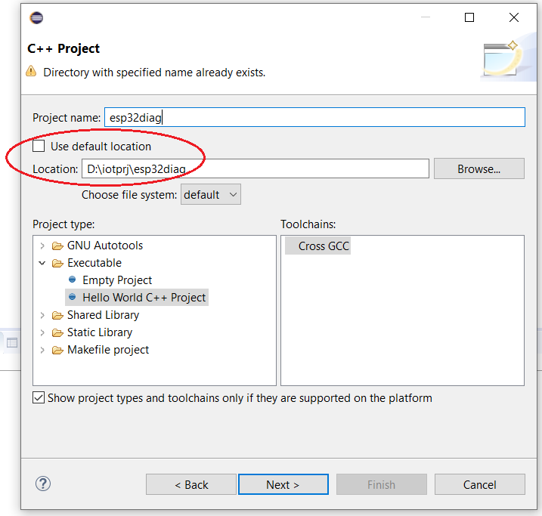
Example of New ESP32 Project 4

Slide 26
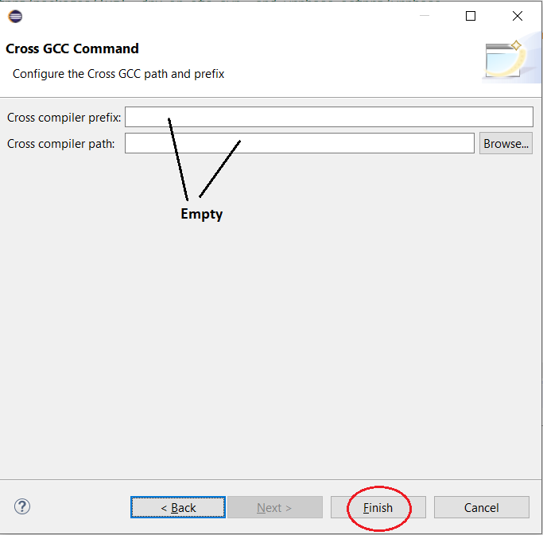
Example of New ESP32 Project 5

Slide 27
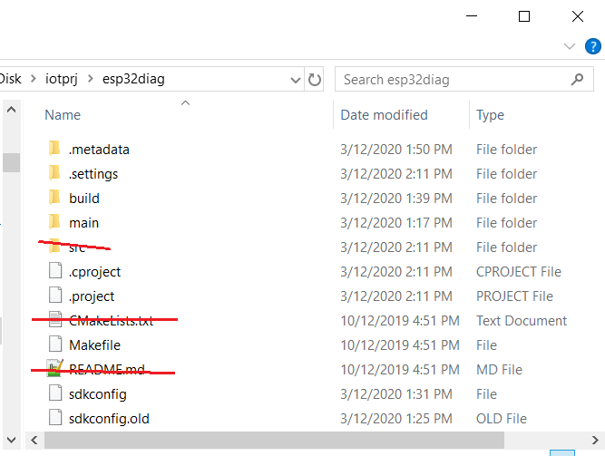
Example of New ESP32 Project 6

Slide 28
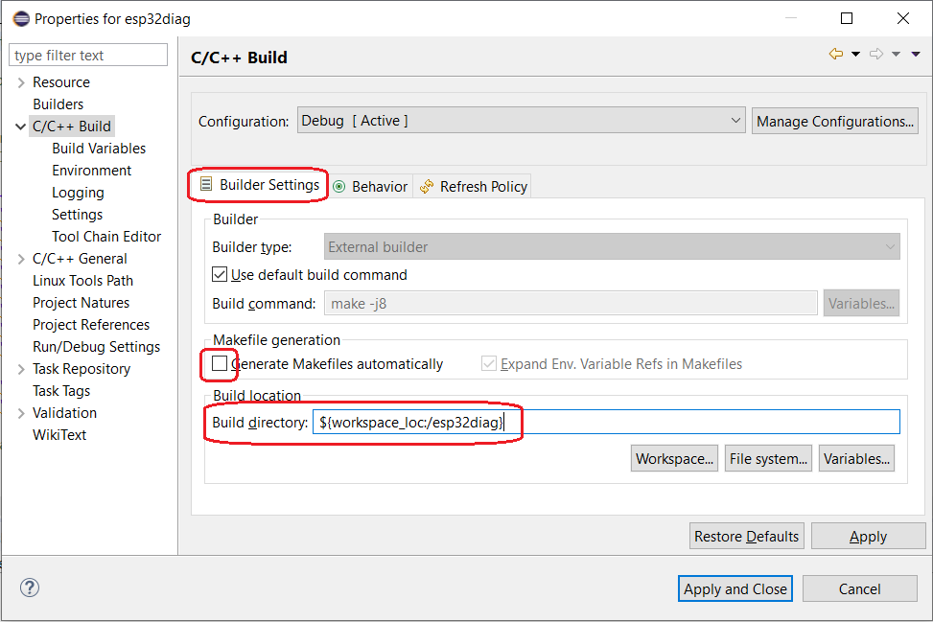
Example of New ESP32 Project 7

Slide 29
Example of New ESP32 Project 8
Create Build Target Icon

Slide 30
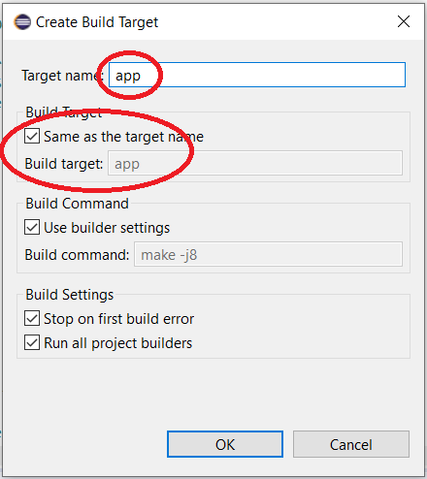
Example of New ESP32 Project 9
Similar for app-flash, clean, flash
and monitor

Slide 31
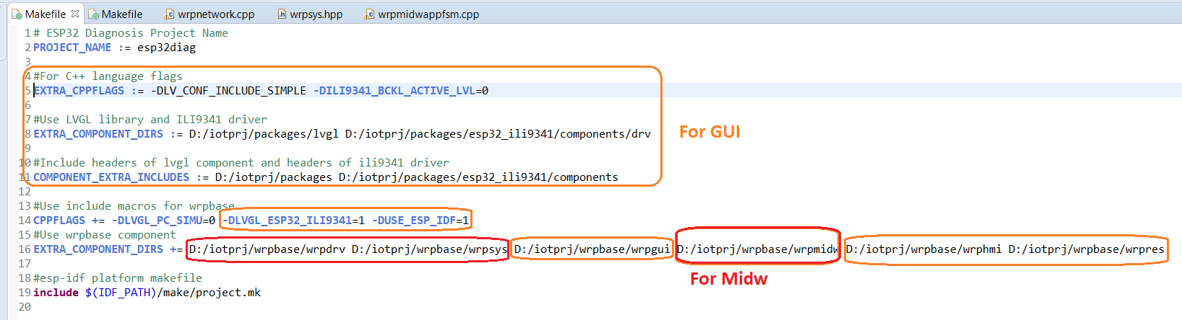
Example of New ESP32 Project 10
Edit Makefile to connect to WrpBase library

Slide 32
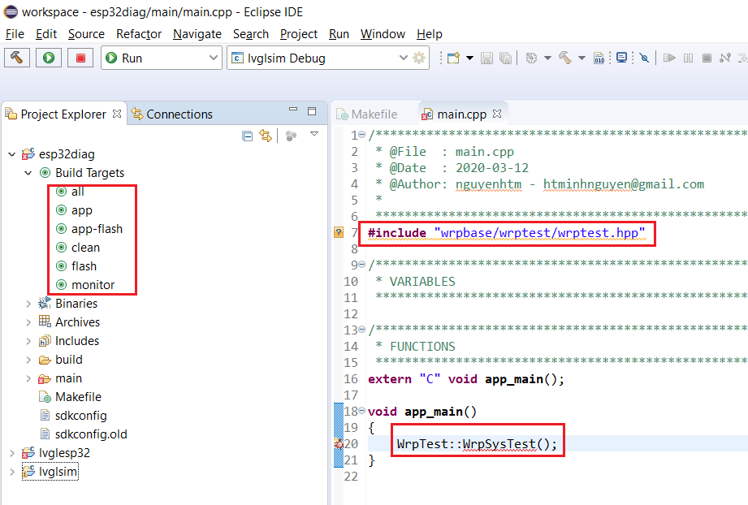
Example of New ESP32 Project 11
Edit main.cpp to execute the system test function
Click Build Targets -> app-flash to build and download into ESP32 target
DONE

Slide 33
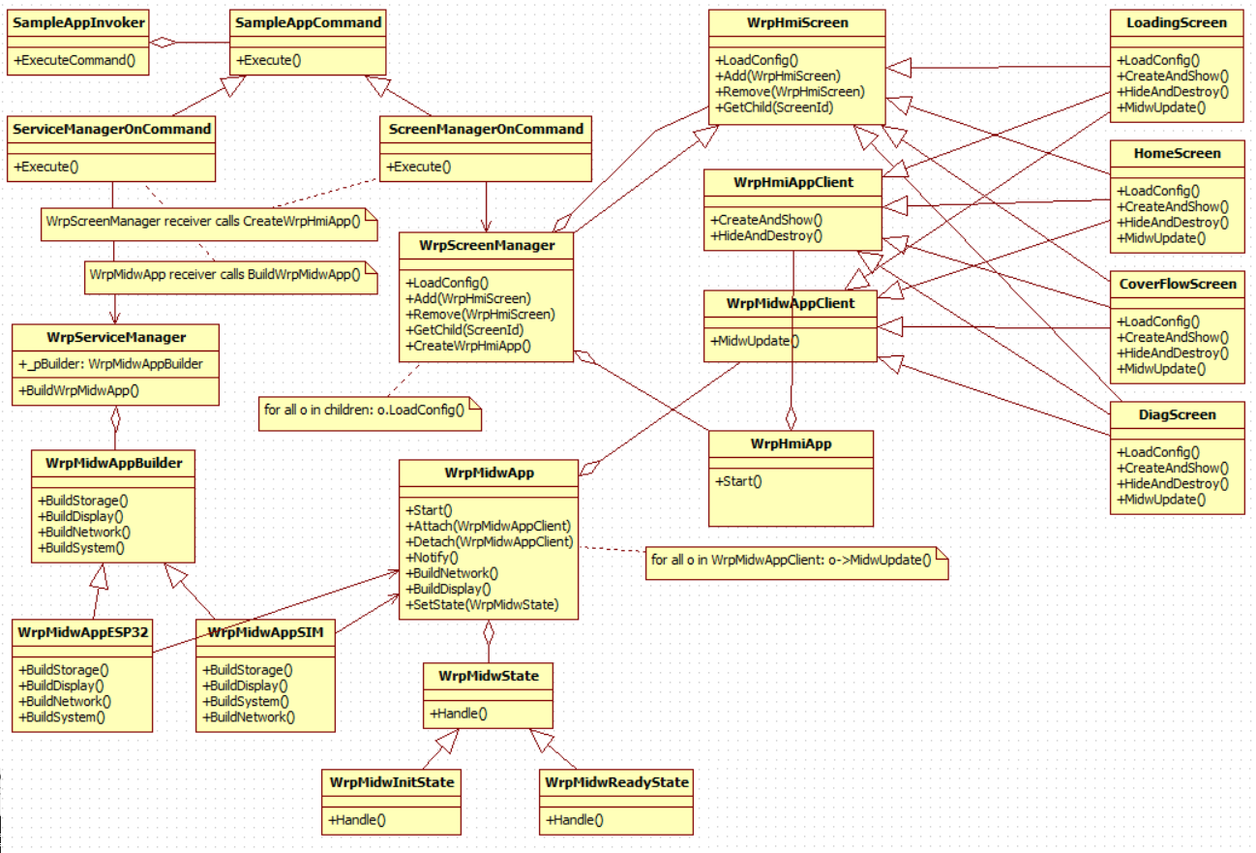
WrpBase Class Diagram

Slide 34
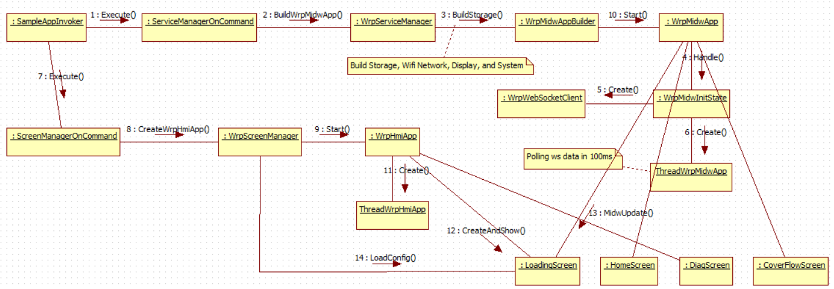
WrpBase Startup Diagram

Slide 35
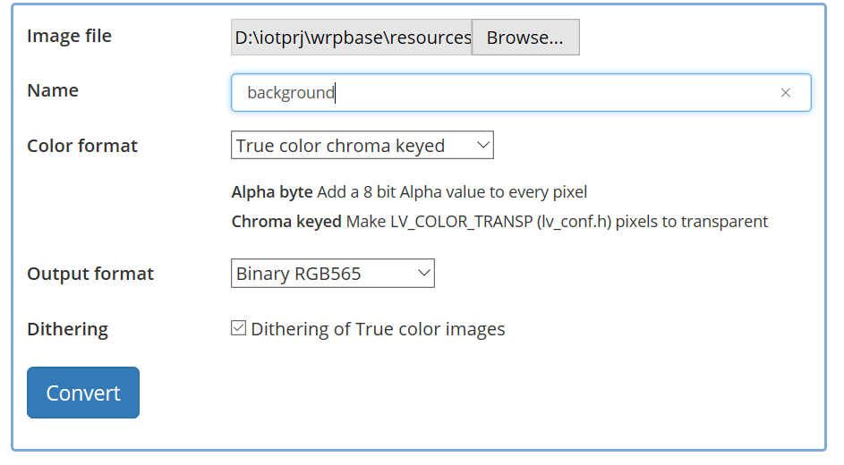
Image Converter
https://littlevgl.com/image-converter: the current configuration for image converter

Slide 36
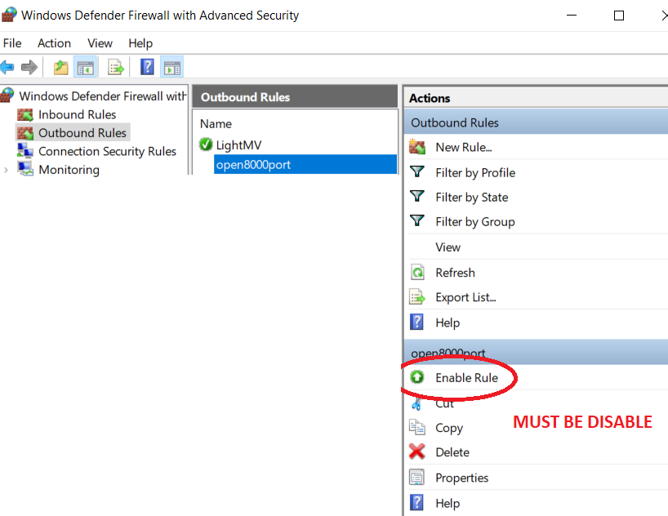
Disable Firewall

Slide 37
USB2UART Bridge
https://docs.espressif.com/projects/esp-idf/en/latest/esp32/get-started/establish-serial-connection.html

Slide 38
References
LVGL: https://github.com/littlevgl/lvgl
ESP-IDF: https://docs.espressif.com/projects/esp-idf/en/latest/index.html
Patterns: Abstract Factory, Factory Method, Builder, Composite, Singleton, Command, Observer, State, Façade,

