Slide 1
GuitarMate
Interactive Guitar Learning App with Deep Learning Pitch Detection
Nguyễn Như Duy - 22BI13123
Supervisor:
Dr. Đoàn Nhật Quang
University of Science and Technology of Hanoi Hanoi, June 2025

Slide 2
Table of Contents
1. Problem Statement & Motivation
5. Evaluation & Results
2. System Overview & Architecture
6. Conclusion & Future Work
3. Model Evaluation and Selection
4. Implementation

Slide 3

Problem Statement & Motivation
Beginner guitarists lack real-time feedback, motivation and a lesson plan.
Existing apps suffer from latency, inaccuracy, lack of interactive/guided lessons or old content.
GuitarMate was developed to provide accurate, fast feedback and engaging learning.
Solution Approach:
Interactive lessons with moving notes + hybrid pitch detection model for improved low note accuracy and admin portal can extract note automatically.

Slide 4
System Overview & Architecture
An introduction to the system's components and architecture

Slide 5


System Overview
Mobile app for learners
Admin web portal
Authentication: Firebase, secure login.
Pitch Detection: Real-time, accurate, simple.
Lessons: Step-based, visual, Instant results.
Authentication: Secure login, role-based access, Firebase
Content Management: extract notes (polyphonic, high accuracy model), edit lessons, delete, add.
User Monitoring: Analysis, traffic, lesson

Slide 6
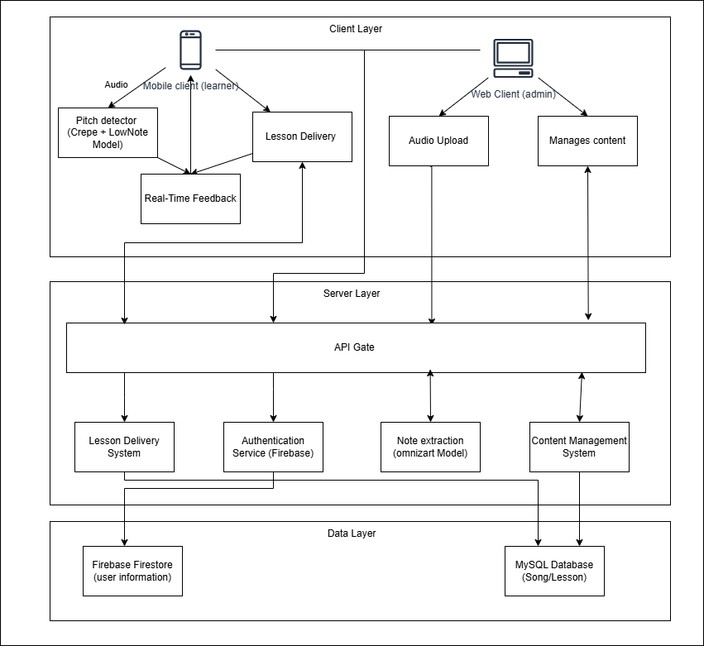

System Architecture
Client Layer
Flutter Mobile App & React Web Portal
Server Layer
Flask Backend with API Gate, Lesson Delivery, authentication, Content Management with Omnizart
Data Layer
Firebase firestore (auth/progress) & MySQL (songs/lessons)
Key Feature:
Real-time pitch detection runs entirely on device for low latency feedback.
Made with Genspark

Slide 7
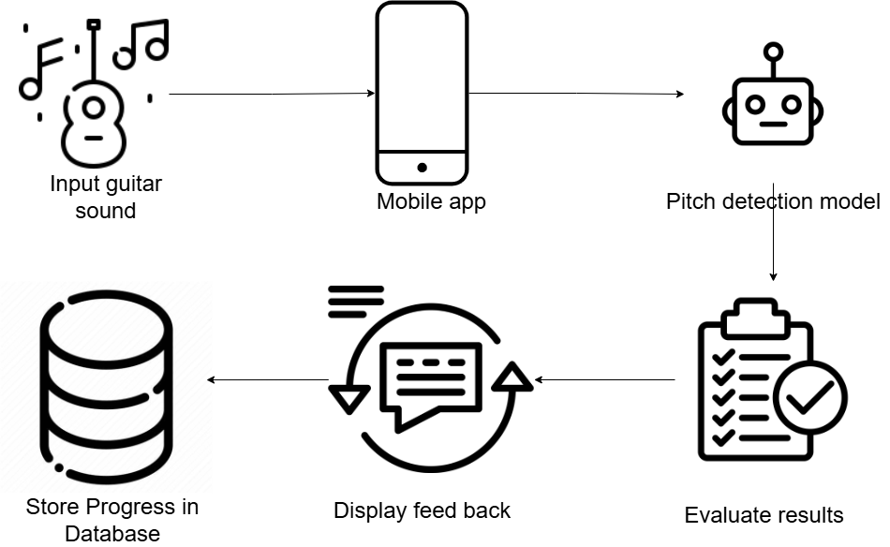
System Architecture
Made with Genspark

Slide 8
Model Evaluation and Selection
Requirement, dataset and selection

Slide 9

Model Evaluation and Selection
Model requirement
Component | Needs
Mobile app | 🔸 Fast response (≤ 100 ms) 🔸 Support for beginner guitar notes 🔸 Lightweight for mobile deployment
Admin portal | 🔸 Accurate note extraction from full recordings 🔸 Polyphonic audio handling 🔸 Offline processing is acceptable
Made with Genspark

Slide 10

Model Evaluation and Selection
Datasets for Model Evaluation
Dataset | Type | Purpose | Key details
Guitar Notes (Kaggle) | Monophonic | Mobile app | 1,452 samples (E2–A5), 44.1 kHz, focus on beginner notes
MusicNet | Polyphonic | Admin portal | 10 classical recordings, 13,589 notes, full MIDI annotations
Made with Genspark

Slide 11

Model Evaluation and Selection
Model Evaluation Summary
Model | Input size | Latency | Suitable for | Key notes
CREPE | 64 ms | 4–8 ms | Mobile app, real time, monophonic | Excellent for high notes (84%), poor for low (5.95%)
Basic Pitch | 1 – 10s | Slow | Admin portal, Short-segment transcription | Acceptable accuracy, not suitable for real-time
Omnizart | 2 – 10s | Slower | Admin portal, polyphonic transcription | Highest accuracy, Heavier, not mobile-suitable
Made with Genspark

Slide 12

Model Evaluation and Selection
Model Selection
Platform | Selected Model(s) | Reason
Mobile app | Crepe + custom CNN low note model | Real time, improve low note detection
Admin portal | Omnizart | Best f1 score, accurate full transcribe
Made with Genspark

Slide 13
Implementation of core functions
Mobile and admin web portal (don’t contain CRUD)

Slide 14


Mobile App
Real-time Pitch Detection
Accurately analyzes guitar audio in real-time to identify notes from E2 to A5, right on the device.
Interactive Lessons
Engaging lessons with moving notes, visual guidance, and progress tracking to keep beginners motivated.
Technical Achievement:
Complete on-device inference with total latency under 50ms, providing responsive feedback without servers, even for low- frequency notes.
Made with Genspark

Slide 15



Mobile App
Real-time Pitch Detection System
Onset Detection System
Detect when a note is played
Dual-Model Pitch Estimator
CREPE Model: Accurate for mid/high notes (A3–A5)
Low Note CNN Model: Specialized for low notes (E2–B2)
Audio In
Onset Detection
CREPE / Low Note Model
Note Output
System Highlights
Real-time processing
64 ms segment
Integrated with Flutter UI
via MethodChannel
Full mobile implementation
Java + Dart
Made with Genspark

Slide 16


Mobile App
Real-time Pitch Detection System
Onset detection
Detection Logic
Audio Capture
Sample Rate: 16kHz mono PCM
Frame size: 1024 sample
Duration per frame: 64ms
Normalization: x / 32768
RMS Energy
Filters out soft background noise
Signal Energy History
Adapts to changing environments
Spectral Flux
Detects frequency spikes from plucks
200ms Refractory Period
Avoids multiple triggers from one note
Made with Genspark

Slide 17
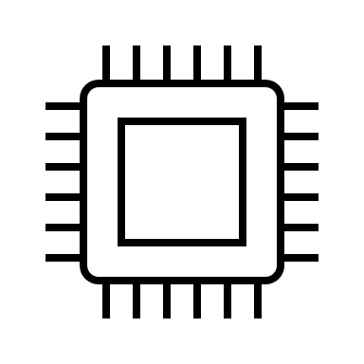

Mobile App
Real-time Pitch Detection System
Crepe Model
Preprocessing
64ms audio frames → CREPE neural network
Model output
360-bin pitch confidence
Post-Processing
Octave correction using bin filtering Harmonic checks to identify true fundamental
Made with Genspark

Slide 18


Mobile App
Real-time Pitch Detection System
Low Note Model
Dataset
Preprocessing
8,133 samples (1000+ per note)
1024-sample frames (64ms)
Notes: E2, F2, F♯2, G2, G♯2, A2, A♯2, B2
Recorded via Samsung Galaxy A54
FFT (frequency domain)
Mel filterbank (Mel spectrogram)
Input shape: 80×2 Mel spectrogram
Final shape: 80×2 Mel spectrogram
Made with Genspark

Slide 19

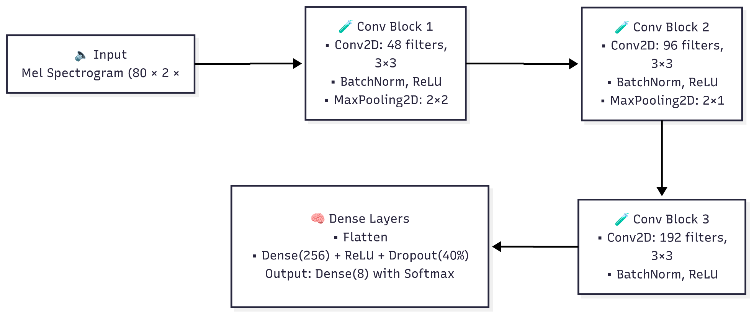

Mobile App
Real-time Pitch Detection System
Low Note Model
Architecture
)
Training Configuration
Optimizer: Adam (lr = 1.32×10⁻⁴)
Loss: Sparse Categorical Crossentropy
Made with Genspark

Slide 20
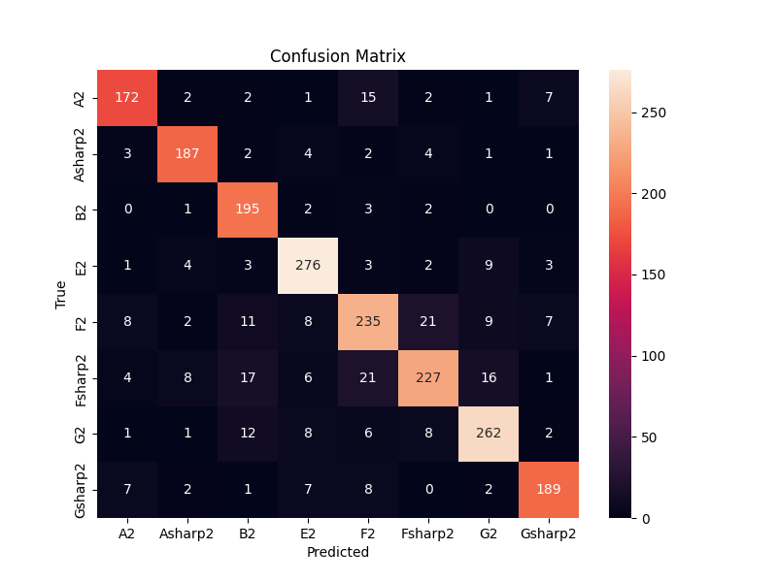

Mobile App
Real-time Pitch Detection System
Low Note Model
Results
Model Accuracy
85.99%
Confusion Matrix Insights
High Accuracy: E2 G2 F2
Made with Genspark

Slide 21




Mobile App
Interactive lesson
Time mechanism and Model switching
Data initialization:
Time definition:
Note array(Database): start & Midi
Appear time = start
Change event array: (start + 3.8) & model
Measure time = start + 4
Playback logic
3 modes: 0.5x 0.75x 1x
Change the note array: start = start * (1 / playback_speed)
Made with Genspark

Slide 22

Mobile App
Interactive lesson
Fretboard Display & Note Mapping
Note Representation:
Notes are white circles with orange fret numbers
Fret Number Calculation:
fret = pitch − open_string_pitch
Mapped using MIDI pitch + guitar tuning:
Example: MIDI 42 → String 6, Fret 2 (42−40)
String 6: 40–44 (E2)
String 5: 45–49 (A2)
String 4: 50–54 (D3)
String 3: 55–58 (G3)
String 2: 59–63 (B3)
String 1: 64–76 (E4)
2
1
3
1
Made with Genspark

Slide 23


Admin Portal
Audio upload and transcription: Admin uploads audio files processed by Omnizart to automatically extract notes with pitch and timing information.
Audio Transcription Process:
1
Upload audio file → Omnizart transcription
2
Preview & edit extracted notes in web interface
3
Approve and save to database for learner access
Made with Genspark

Slide 24
Evaluation & Results
Model evaluation and real-time performance

Slide 25
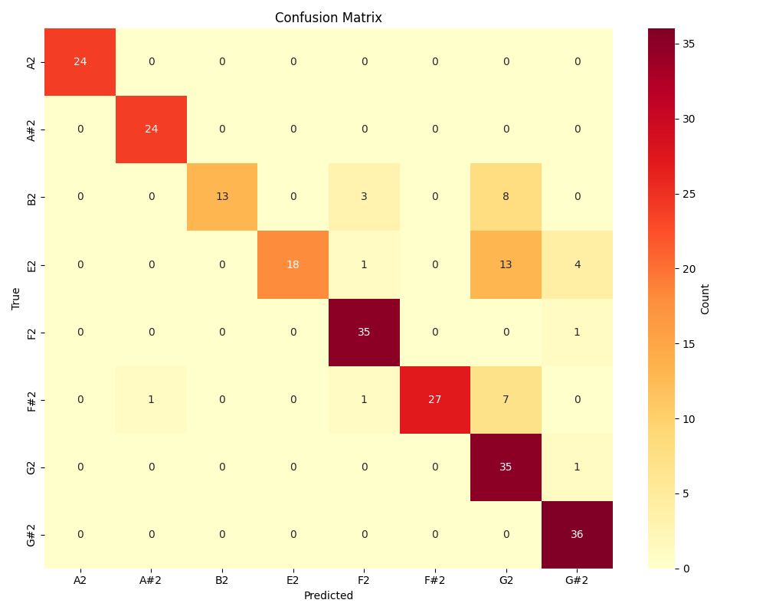

Evaluation & Results
Model evaluation
Low note model
🎯 Accuracy on Kaggle Guitar Notes Dataset (E2–B2)
Achieved 84.13% accuracy
Strong results on A2, G2, A#2, G#2
Most errors occur between adjacent low notes (e.g., E2 ↔ G#2)
Made with Genspark

Slide 26
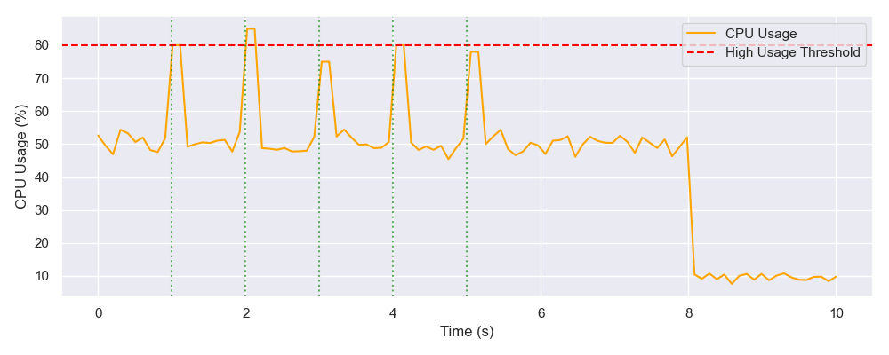
Evaluation & Results
Real-Time & System Performance
Real-Time Performance (Samsung A54)
Both model meets the real time requirement (20 - 45ms < 100ms)
Peak CPU: ~80% during inference
Idle CPU: ~10% after lesson
Optimization needed to reduce thermal load
Made with Genspark

Slide 27










Conclusion and future work
Conclusion
Future Enhancements
GuitarMate combines a real-time mobile app and admin web portal
Uses CREPE + custom low-note model for pitch detection Admins transcribe notes from audio using Omnizart
Achieves real-time feedback + editable lessons
Model accuracy and speed support live guitar learning
Chord Recognition
Detect & evaluate multiple notes (e.g., E minor chord)
Visual Feedback
Color-coded note feedback (Red = wrong, Blue = good)
Noise Robustness
Train with noisy data or add denoisers
Multi-Instrument
Expand to ukulele (UI changes) and bass (model retraining)

Slide 28
Thank you for your attention!

