Slide 1
Microservices Topic
Introducing Monolithic and Microservices
Some technical common in Microservices
Domain Driven Design (DDD)
Saga
Outbox
CQRS
Spring Cloud Microservices
Spring Cloud Config
Spring Eureka: Service Discovery and load balancing
Spring Cloud Gateway
Resilience4j: Circuit breaker, Rate limiter, Retry
Observability and monitoring

Slide 2
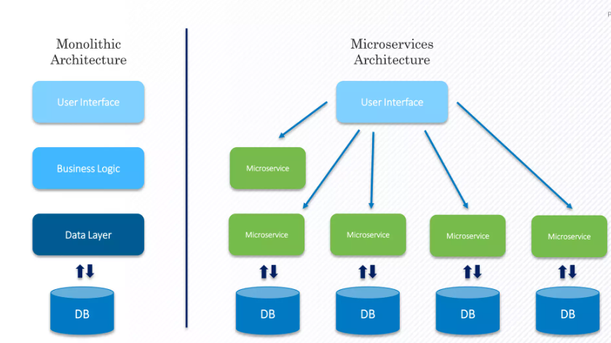
Monolithic and Microservices

Slide 3
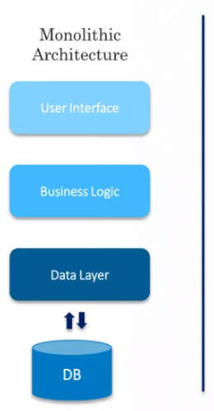
Monolithic and Microservices
Advantages
Simplicity
Development Speed
Deployment
Debugging
Ref: https://www.geeksforgeeks.org/monolithic-vs-microservices-architecture/#advantages-of-using-a-monolithic-architecture
Disadvantages
Complexity
Scalability
Technology Stack
Deployment
Fault Tolerance
Ref: https://www.geeksforgeeks.org/monolithic-vs-microservices-architecture/#disadvantages-of-using-a-monolithic-architecture

Slide 4
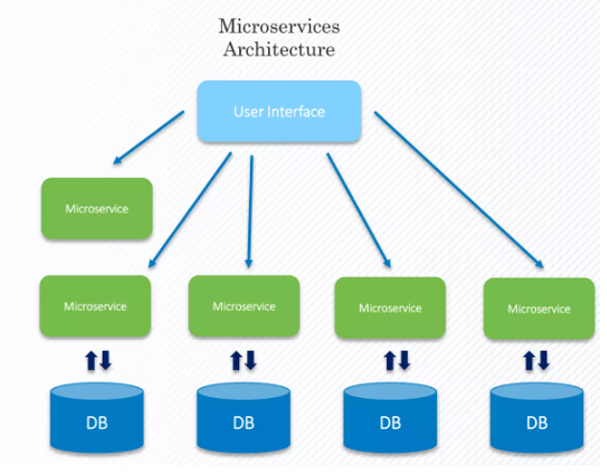
Monolithic and Microservices
Advantages
Scalability
Flexibility
Resilience
Agility
Easier Maintenance
Technology Diversity Ref: https://www.geeksforgeeks.org/monolithic-vs-microservices-architecture/#advantages-of-using-a-microservices-architecture
Disadvantages
Complexity
Increased Overhead
Deployment Complexity
Monitoring and Debugging
Cost
Testing Ref: https://www.geeksforgeeks.org/monolithic-vs-microservices-architecture/#disadvantages-of-using-a-microservices-architecture

Slide 5
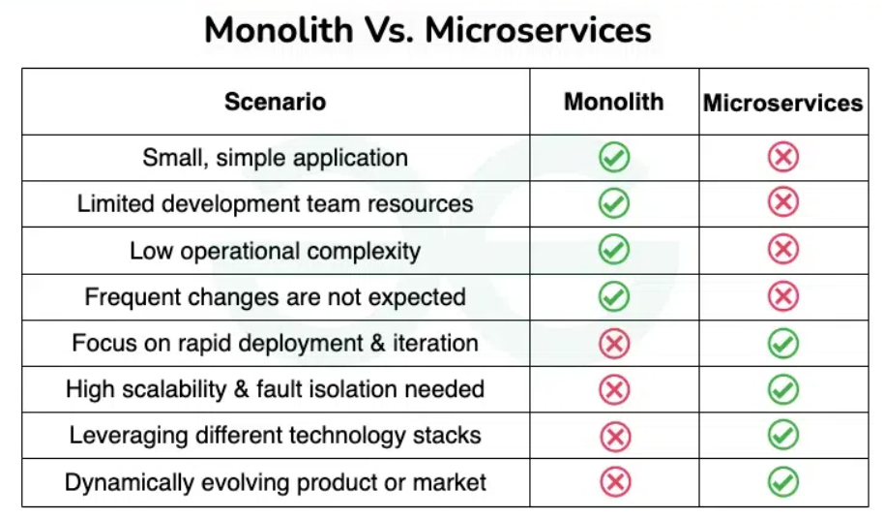

Monolithic and Microservices
When do we need to use Microservices?

Slide 6
Some technical common in Microservices
Domain Driven Design (DDD)
Saga
Outbox
CQRS

Slide 7
Some technical common in Microservices
Domain Driven Design (DDD)
Saga
Outbox
CQRS

Slide 8
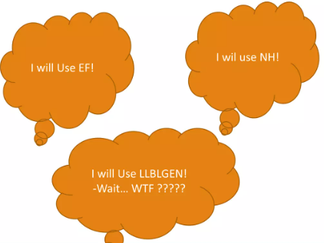
Domain Driven Design (DDD)
Problems of Enterprise Software
Maintenance, as software grows
Mixing presentation, application and domain logics
Mixing infrastructure and business code, makes hard to switch technology
Testability

Slide 9
Domain Driven Design (DDD)
What is DDD?
NOT a technology or methodology Strategic DDD: Introduces boundaries
- What is a domain? Operational of your app. eg: Online food
- Bouded Context: Boudary withi a Domain
- Ubiquitous Language: Common language used by domain experts and developers Tactical DDD: Implement
- Entities, Aggregates, Aggregate Root, Value Objects, Domain Events, Domain Services, Application services

Slide 10
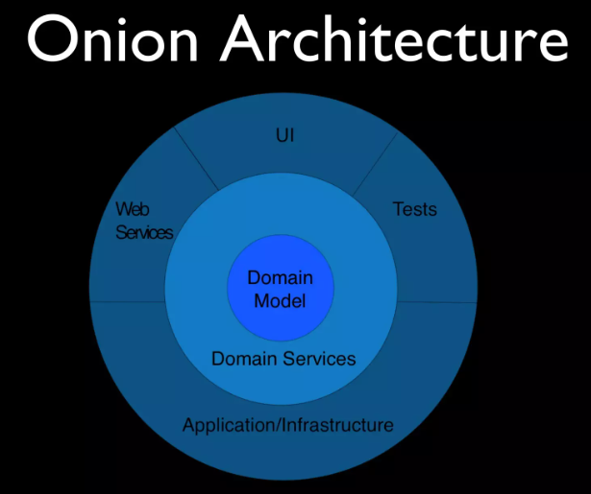
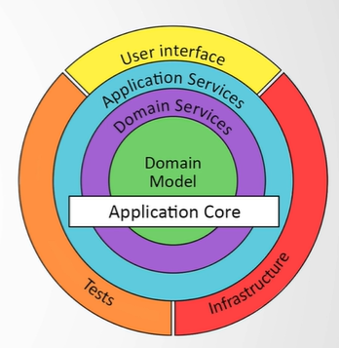
Domain Driven Design (DDD)
Architecture of DDD

Slide 11
Domain Driven Design (DDD)
Architecture of DDD
Domain Layer
- Enties, Aggregates, Aggregates Roots, Repositories, Domain Servies, Domain Events
Application Layer
- ApplicationServices, Data Transfer Objects, Authorization....
Infrastructure Layer
- Persistence, Dependency Injection, Caching, Message Broker...
Presentation Layer
- Web, MObile...

Slide 12
Domain Driven Design (DDD)
Why is DDD?
Deep understanding the Domain(subject area), object model, interactions
Distilling your daily work language as Ubiquitious Language
Arrange and cover learning challenges across people
- Bussines Analyst, Domain Expert, Developer
Leads model driven design not Database!
- Creates a langugage
- Distilled by knowledge over the time

Slide 13
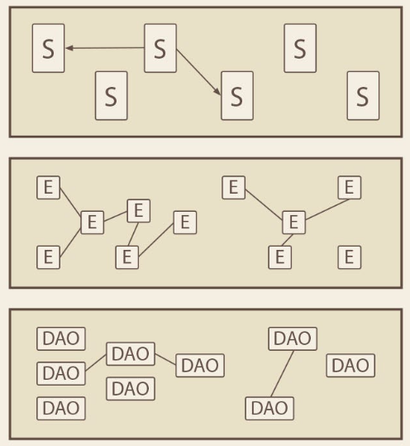
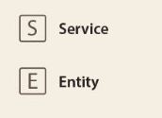
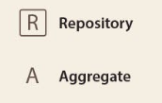
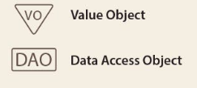
Domain Driven Design (DDD)
None DDD applied

Slide 14
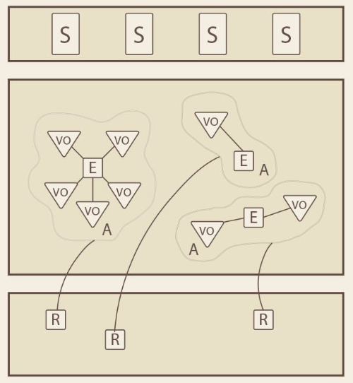
Domain Driven Design (DDD)
None DDD applied

Slide 15
Domain Driven Design (DDD)
Advantages of Domain Driven Design
- Communication
- Flexibility - Maintainability
Ref: https://codezup.com/what-is-domain-driven-design-ddd-pros-cons/

Slide 16
Domain Driven Design (DDD)
Disadvantages of DDD
- Requires Domain Expertise
- Costly
Ref: https://codezup.com/what-is-domain-driven-design-ddd-pros-cons/

Slide 17
Some technical common in Microservices
Domain Driven Design (DDD)
Saga
Outbox
CQRS

Slide 18
Saga
How to implement strong consistency?
Monolithic systems, we can use ACID Transactions with ease
Distributed systems, we need to support Distributed Transactions
- Concurrency Control/Locking Protocal (ex 2PL)
- Atomic Commit Protocol (ex 2PC, 3PC)
- Majority COnsensus protocols (ex Paxos, Raft)

Slide 19
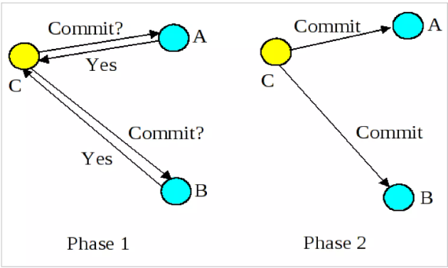
Saga
Example: Use 2PC to handle Distributed Transactions

Slide 20
Saga
2PC: Drawbacks
- Reduced throughput
- Single Point failure
- NoSql doesn't support transactions
- Little too chatty
- Most cloud platforms advertise the fact that don't implement 2PC

Slide 21
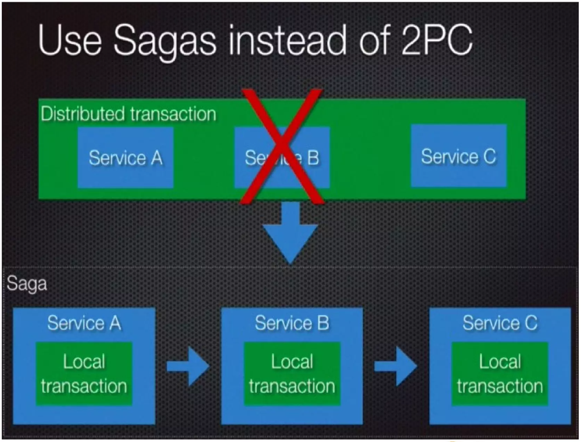
Saga
A different approach: Sagas

Slide 22
Saga
A different approach: Sagas "Unit of Work" pattern applied to Microservices
Saga: Long running local transaction broken into separate interleavable transactions
Distributed Saga: Sequence of transactions running across multiple decouped services
Transaction are ACD (No Isolation)

Slide 23
Saga
How do sagas work?
Each saga coordinates its local transactions
When DONE, triggers the next step
When FAILED/CANCELED, coodinates its local compensating transactions and triggers the prior step

Slide 24
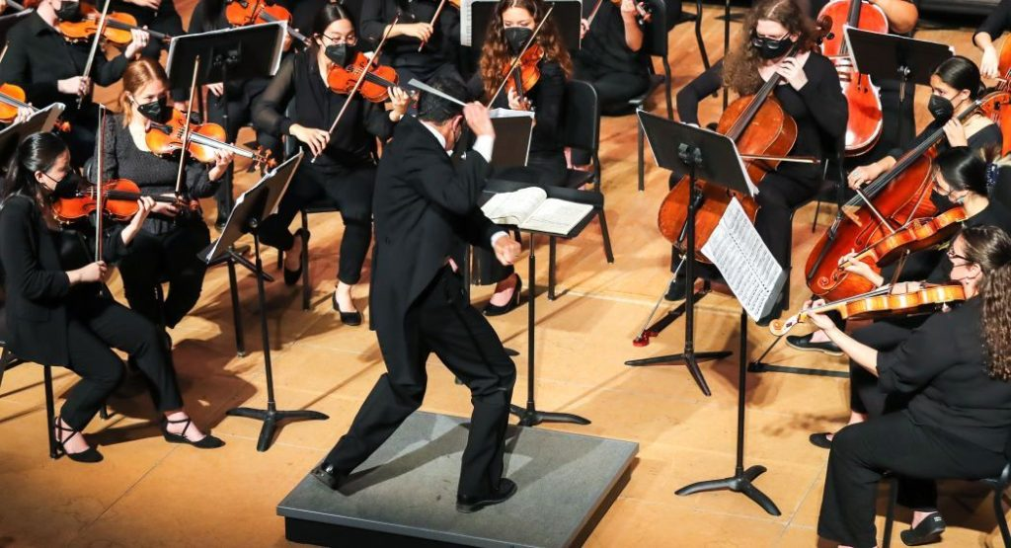
Saga
Sagas can use Orchestration or Choreography
- Choreography-based sagas: No centralized coordinator; participants triggered by domain events
- Orchestration: centralized coodinator responsible for triggering saga participants

Slide 25
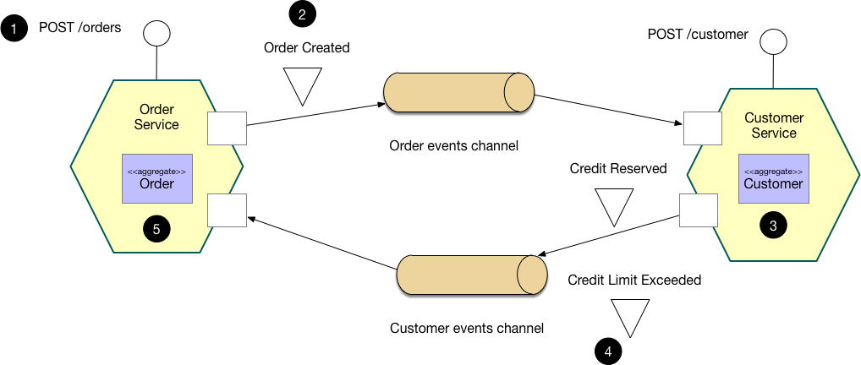
Saga
Choreography pattern

Slide 26
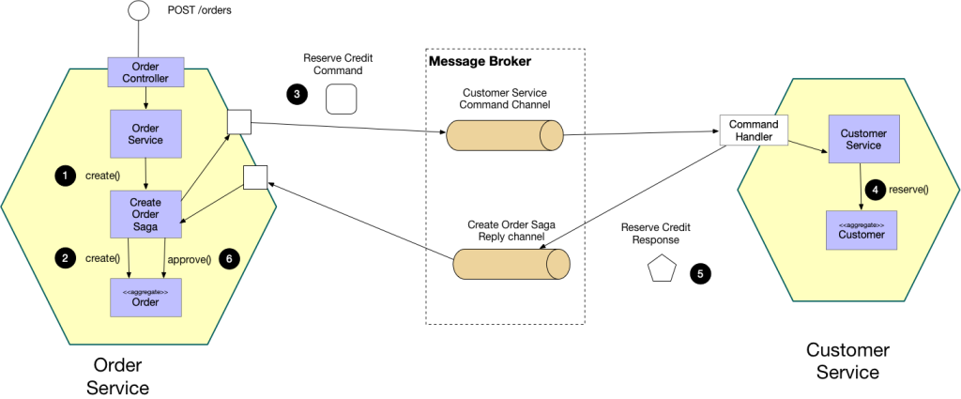
Saga
Orchestration pattern

Slide 27
Saga
Advantages of SAGA Pattern
Provides better fault tolerance
Simplifies error handling
Allows for asynchronous processing
Supports distributed transactions
Ref: https://www.geeksforgeeks.org/saga-design-pattern/

Slide 28
Saga
Disadvantage of SAGA Pattern
Increased complexity
Limited support:
Requires careful design
Increased latency
Ref: https://www.geeksforgeeks.org/saga-design-pattern/

Slide 29
Some technical common in Microservices
Some technical common in Microservices
Domain Driven Design (DDD)
Saga
Outbox
CQRS

Slide 30
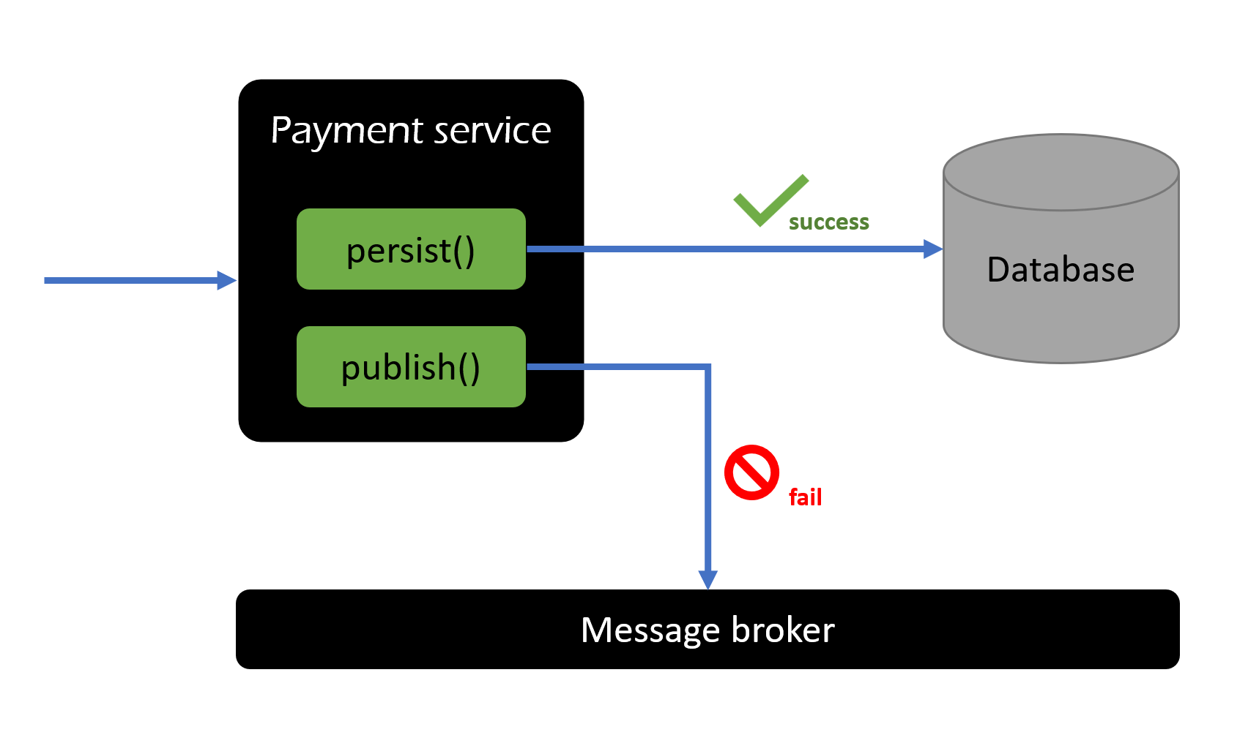
Outbox
When I apply saga patter (or other pattern), I get problem about consistency the following:

Slide 31
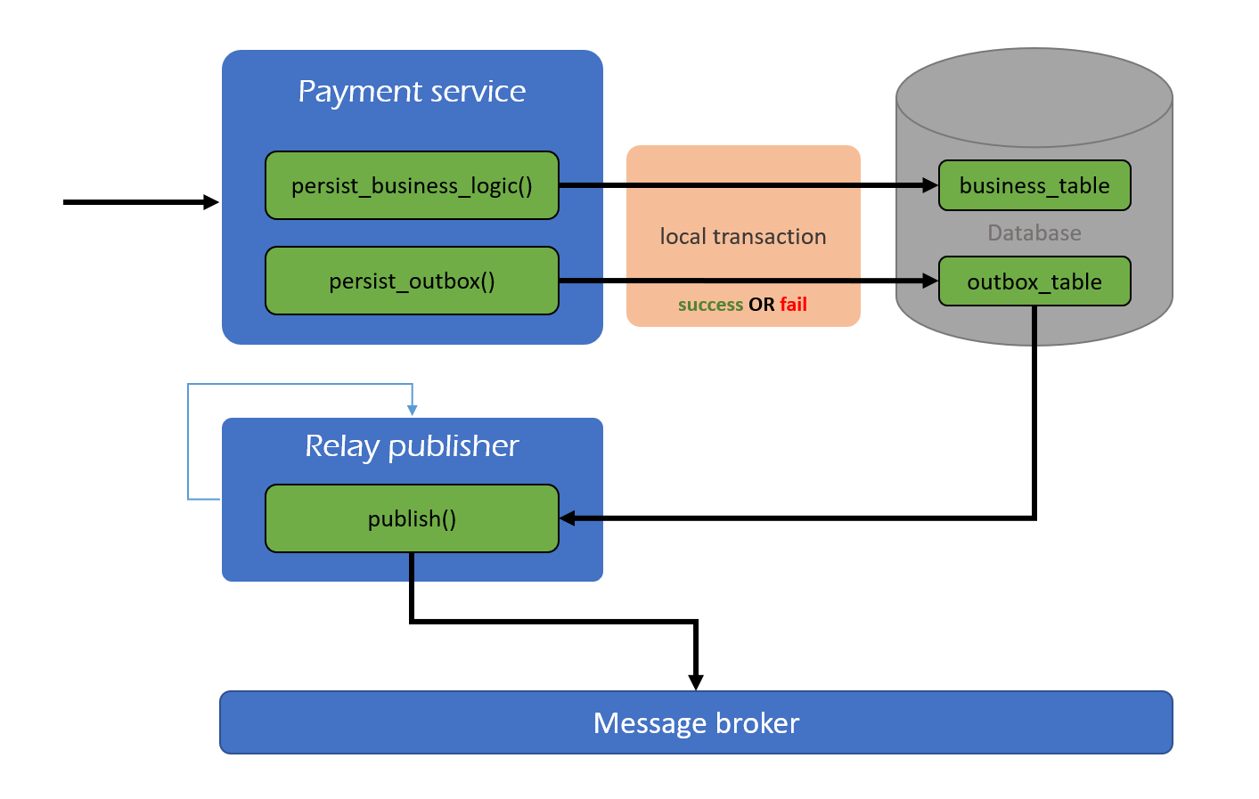
Outbox
Solution: Need make sure atomic and consistent with persist() and publish() method. We create outbox_table save to DB and use schedule to publish

Slide 32
Outbox
Outbox patter looks like a good solution to solve the consistency problem. But it still has disadvantages
Duplicate event: Need handle idempotent consumer
Near real time: Difficult real time state

Slide 33
Some technical common in Microservices
Domain Driven Design (DDD)
Saga
Outbox
CQRS

Slide 34
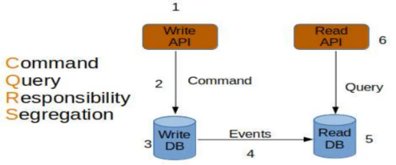
CQRS
What is CQRS Design Pattern?
CQRS stands for Common Query Responsibility Segregation

Slide 35
CQRS
When should CQRS be used?
The data reading/accessing performance has become very slow due to large number of read and write operations going on simultaneously
When read and write workloads have different requirements for latency, scaling, and consistency
The reading data queries are much more in number than the writing data queries
Business complex

Slide 36
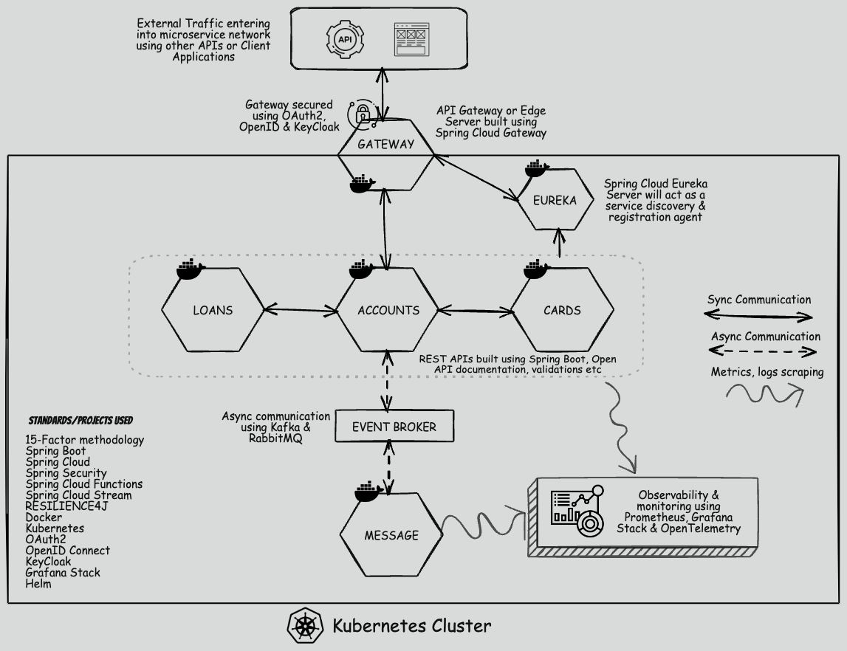

Slide 37


