Slide 1
Big data Online store analysis using pyspark

Slide 2
Transform csv file to parquet
Improved Performance: Parquet's columnar storage format allows for faster read and write operations, as it only processes the required columns, leading to better I/O performance compared to CSV.
Better Compression: Parquet files are highly compressed, reducing storage space and improving data transfer speeds. This is especially beneficial when dealing with large datasets.

Slide 3
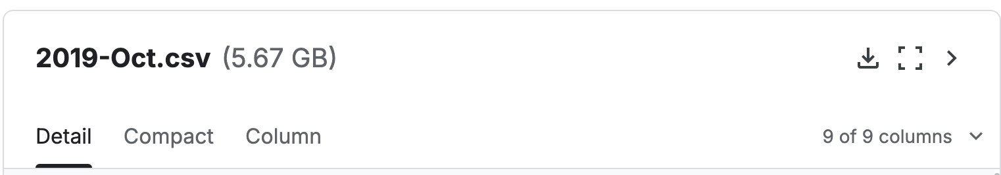
This is our file

Slide 4

After transform it into parquet
About 1.4G => efficiency for computing later on

Slide 5
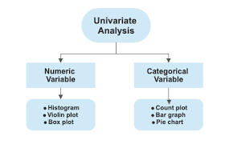
Univariate Analysis

Slide 6
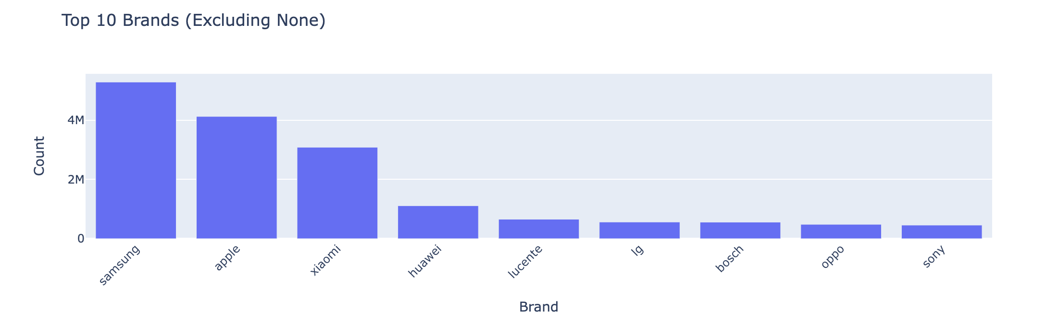
Samsung is the leading brand in this store, as shown in the image.

Slide 7
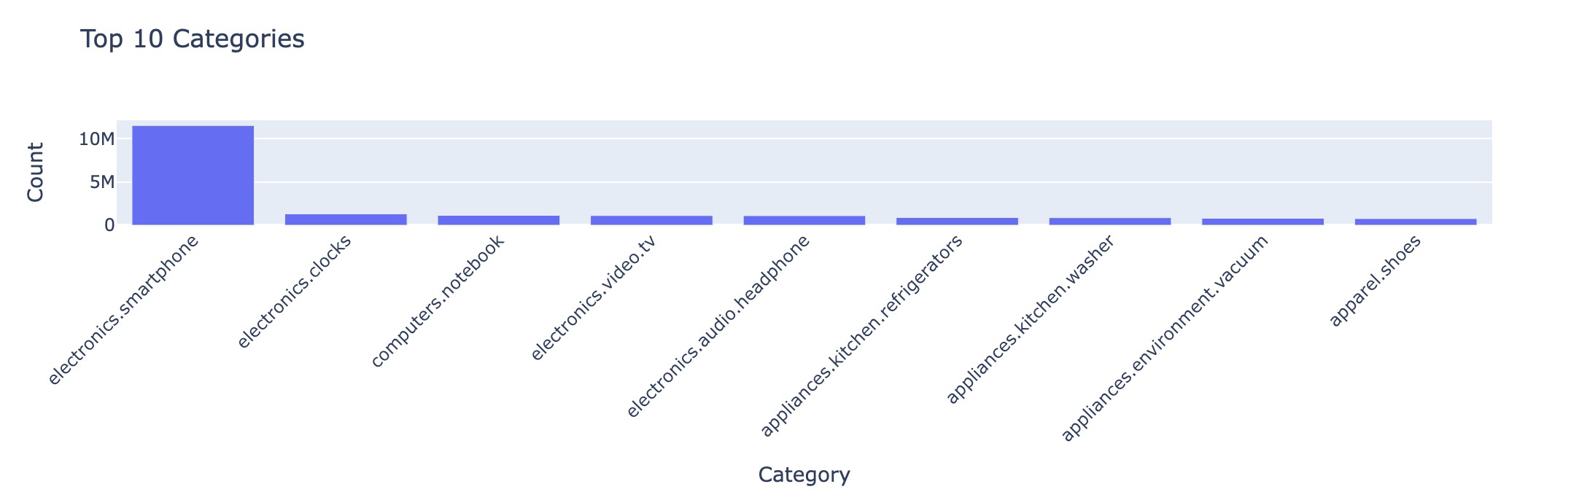
The main product sold in this store is smartphones

Slide 8
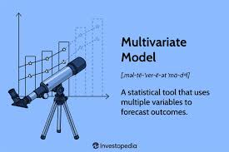
Multivariate analysis

Slide 9
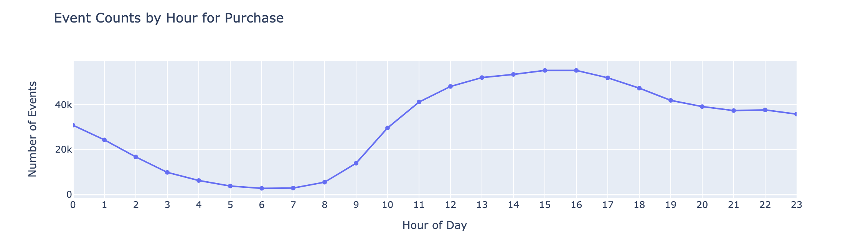
Ideal time when customer purchase a product is about 15-17

Slide 10

So we give more promotion at that time or we run ads before that time => optimize money for ads

Slide 11
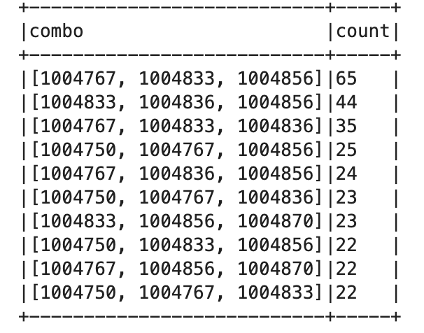
Market basket analysis

Slide 12

they input a product and then we recommend another products
Or we can give promotions for those combos

Slide 13
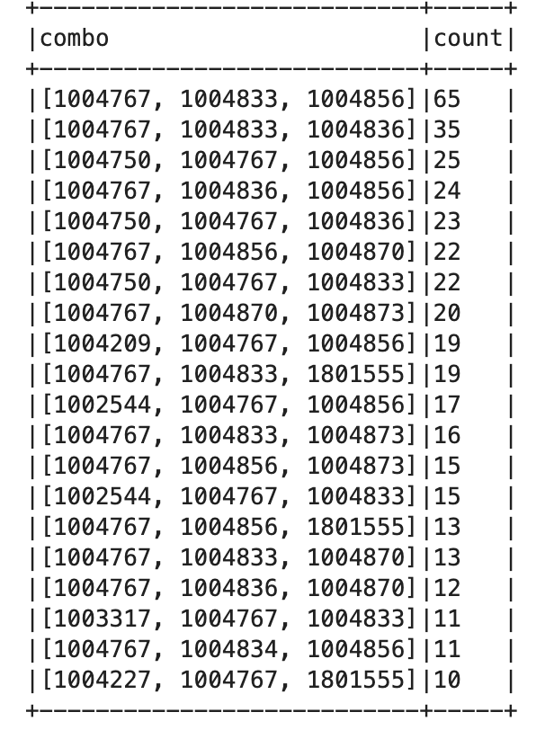
For example: Input 1004767
Then this is the result

