Slide 1
Java Bank in console
Author: Nguyen Huy Binh
Hanoi, 14/05/2023

Slide 2
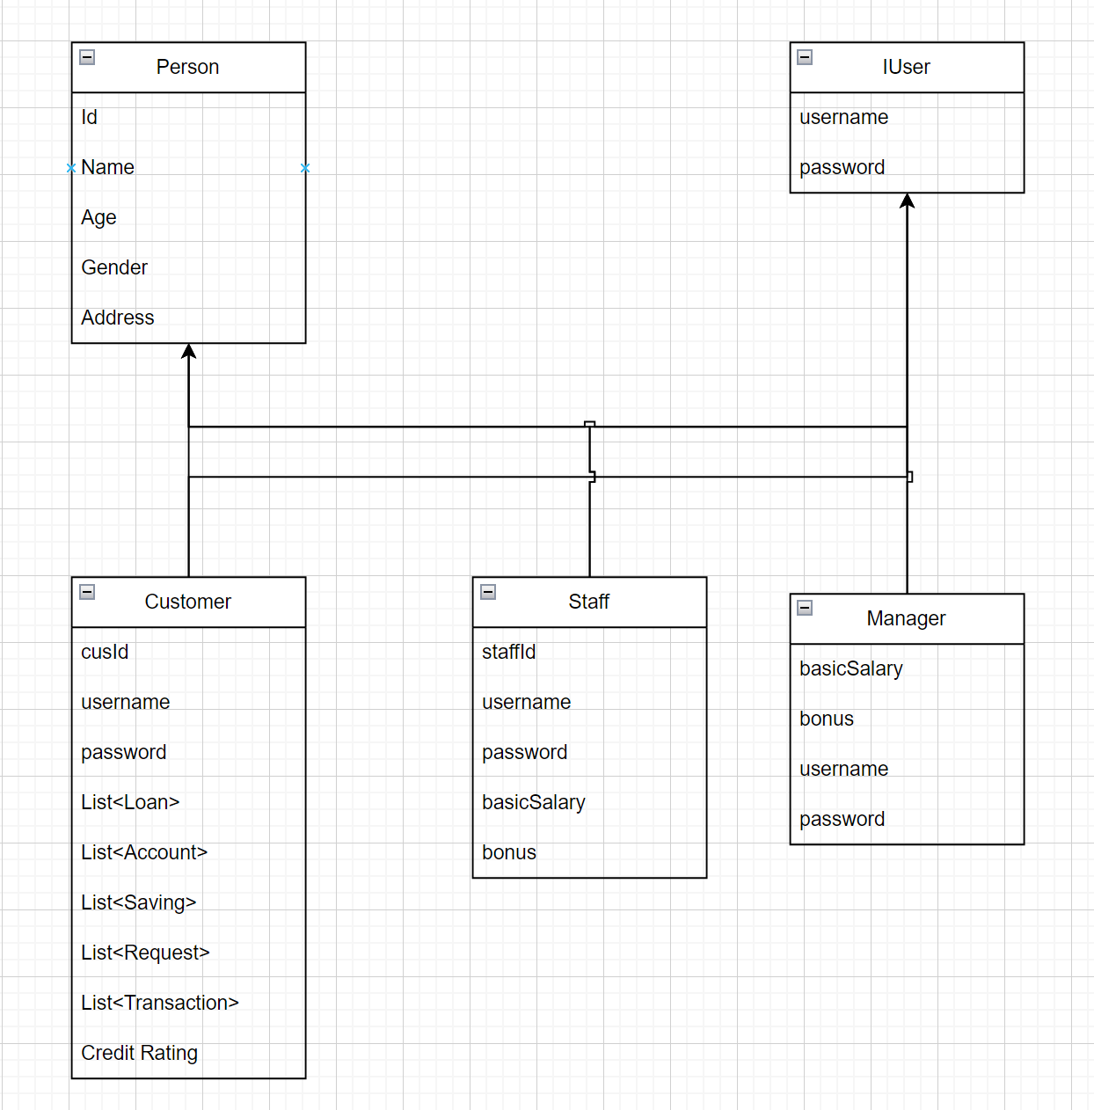
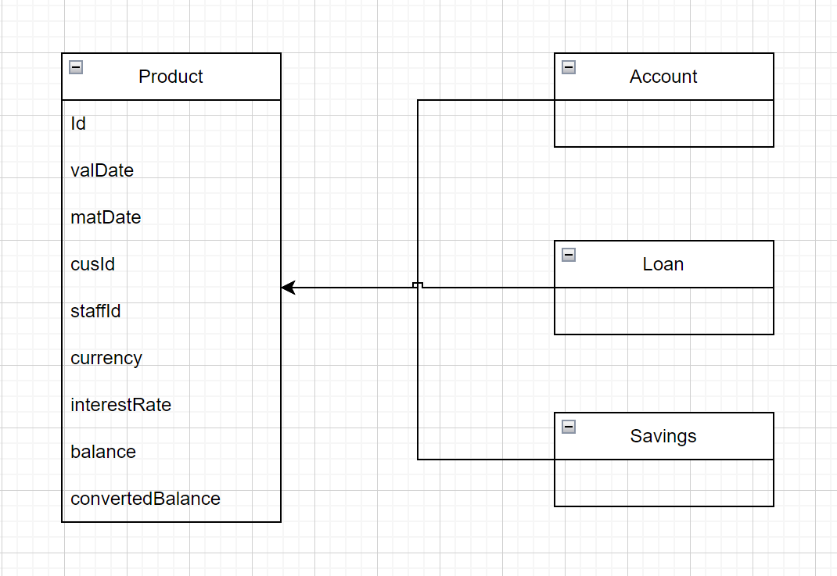
Class diagrams

Slide 3
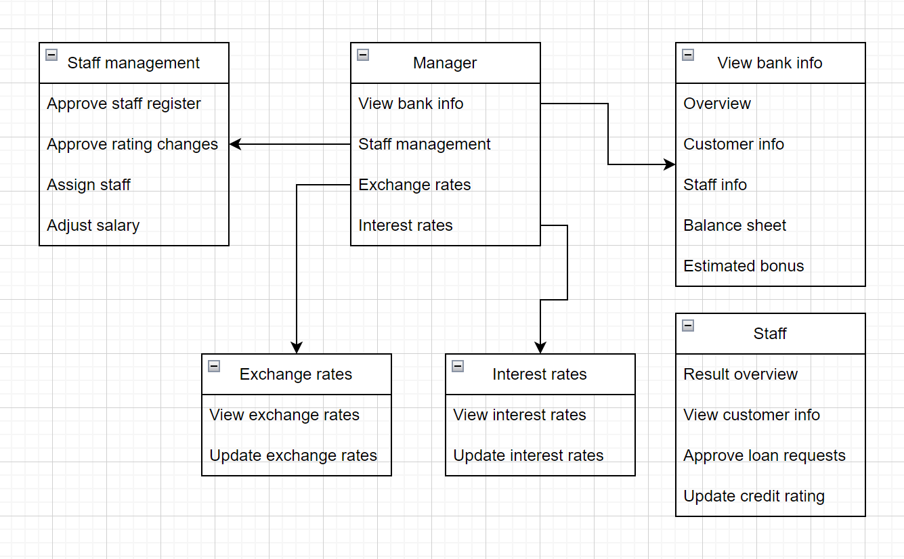
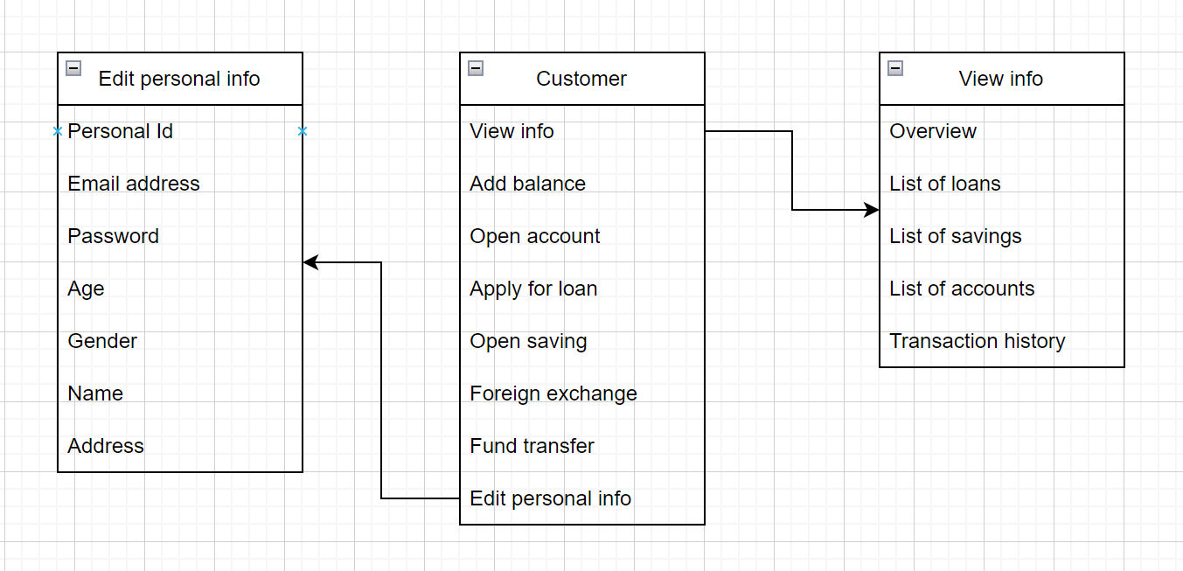
functionalities

Slide 4
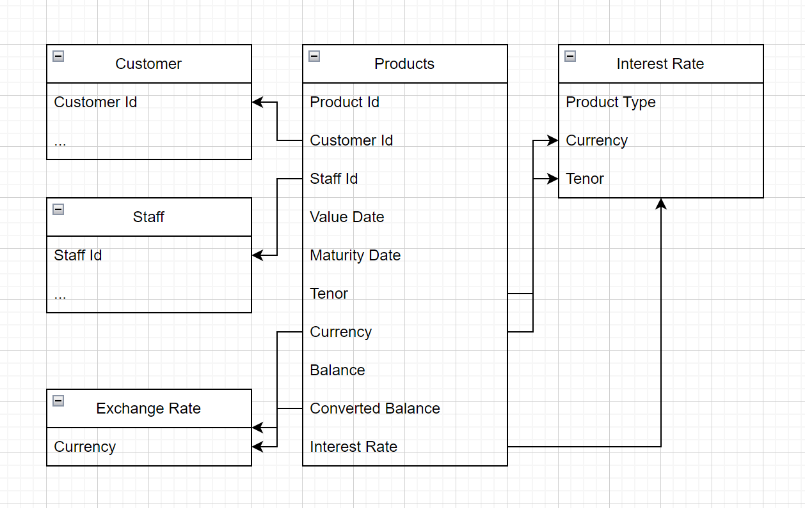
products

Slide 5
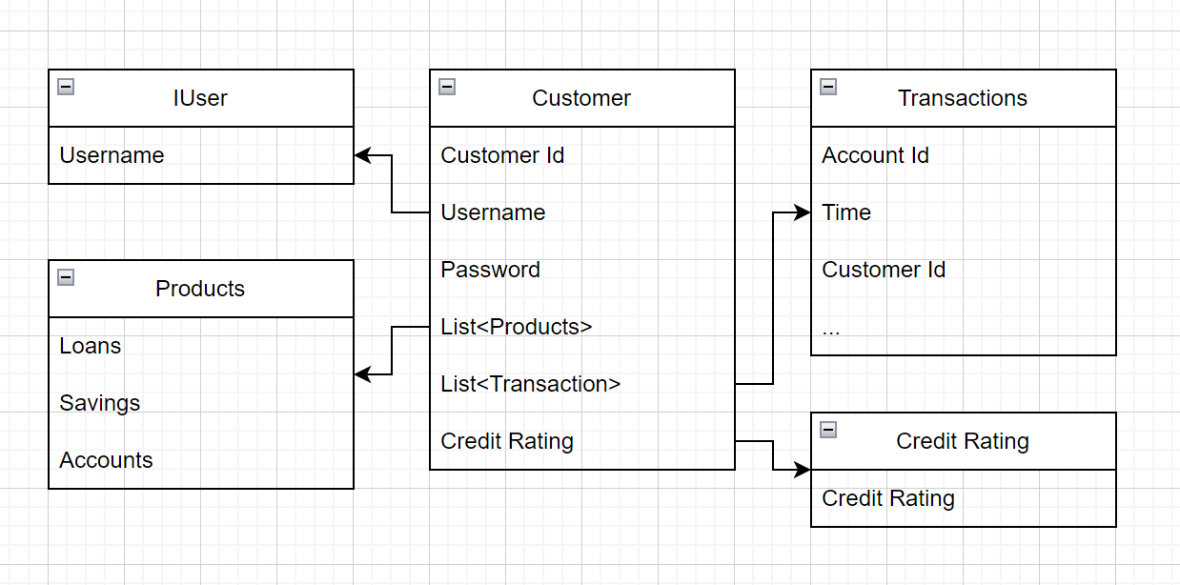
Customer

Slide 6
Balance sheet
Cashs
Outstanding deposit balance
Outstanding loan balance
Equity

Slide 7
Fund transfer
Customer
Account 1
Currency 1
Account 2
Currency 1

Slide 8
Foreign exchange
Customer
Account 1
Currency 1
Account 2
Currency 2

Slide 9
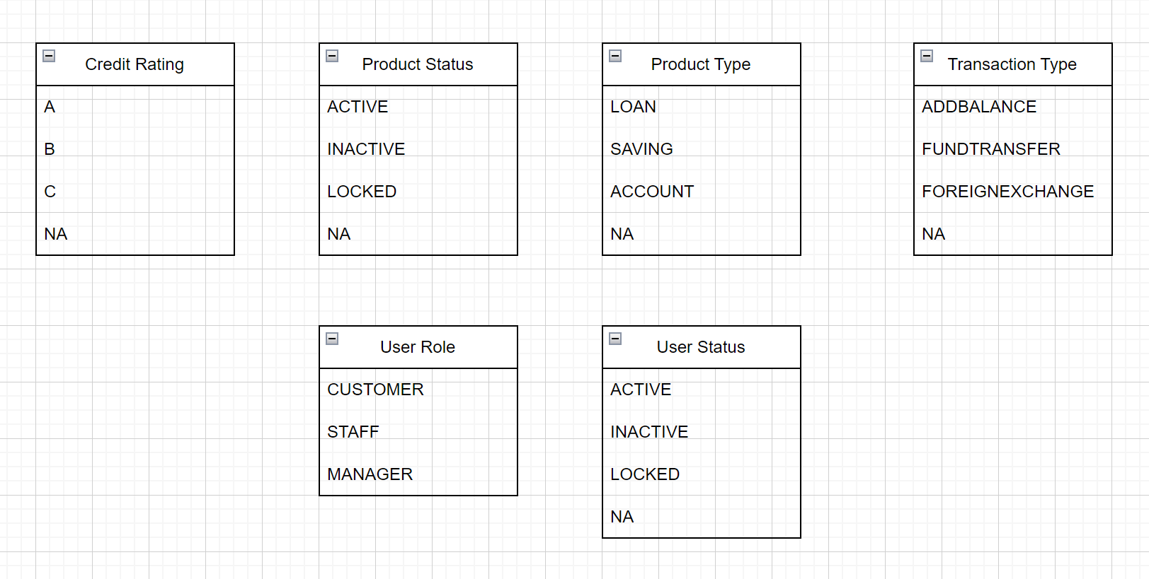
Enum

