Slide 1

CHƯƠNG V
PrimeFaces
Notes:
https://www.primefaces.org/showcase/ui/data/datatable/lazy.xhtml#

Slide 2
NỘI DUNG
Giới thiệu PrimeFaces
PrimeFaces Ajax
  PrimeFaces Ajax Event
  PrimeFaces Ajax Listener
  PrimeFaces Ajax Dropdown
Panel
  AccordionPanel
  TabView
  Wizard
Menu
  Menu
  TieredMenu
AjaxBehavior

Slide 3
NỘI DUNG
Data
  DataGrid
  PickList
  Repeat
  TreeTable
  DataTable
  Mindmap
  Schedule
  Timeline

Slide 4
PrimeFaces Introduction
It is an UI (User Interface) library for JSF (JavaServer Faces) based applications.
PrimeFaces Features:
  Rich UI Components
  Ajax Support
  Dialog Suppport
  Client Side Validation
  Mobile UI kit
  Skinning Framework (themes – giao diện )
PrimeFaces Configuration
  To configure primefaces in our JSF application, we need to download only one JAR file primefaces-{version}.jar. We can manually download it from the official site of primfaces.

Slide 5
PrimeFaces Versions
Ver | Date | Highlights
0.8.1 | 2009-02-23 | Introduced Captcha and resizable components and AJAX tab loading features were also added.
6.0 | 2016-06-07 | New components (TimeLine, InputNumber, KeyFilter, ImportEnum, ImportConstants, Knob, Repeat), new theme called Omega, new CSS grid, accessibility enhancements and many features for existing components.
6.2 | 2018-03-01 | New components (SideBar, InputGroups, AutoUpdate), new utility class for users (PrimeFaces.current() instead of RequestContext.getCurrentInstance(), security enhancements and many features for existing components.
7.0 | 2019-03-18 | New components (DataView, ToggleSwitch and LinkButton), new themes (Nova and Luna) and icons, better performance, various enhancements on accessibility and security.
8.0 | 2020-03-05 | CSP, changes for components (Scatter Chart, Timeline, DataExporter, Inverted DataScroller, DatePicker)

Slide 6


Who uses PrimeFaces?

Slide 7
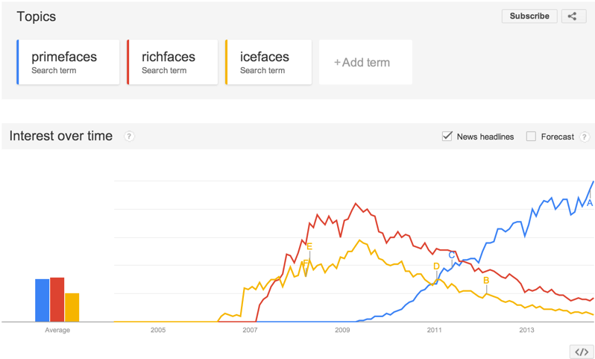
Popularity

Slide 8
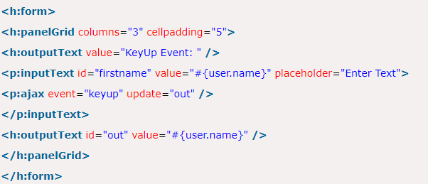
PrimeFaces Ajax
PrimeFaces Ajax Event
https://www.javatpoint.com/primefaces-ajax-event
https://www.primefaces.org/showcase/ui/ajax/event.xhtml
https://www.primefaces.org/showcase/ui/ajax/validation.xhtml?jfwid=242fa
This attribute is used to trigger event on the specified method. We can pass onclick, keyup etc events in this attribute

Slide 9
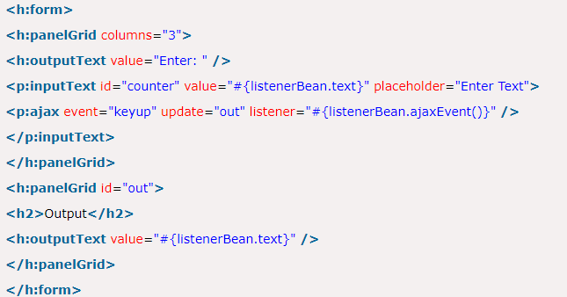
PrimeFaces Ajax
PrimeFaces Ajax Listener
https://www.javatpoint.com/primefaces-ajax-listener
This attribute is used to call Java method by using an Ajax request. It is an attribute of <a:ajax> component.

Slide 10
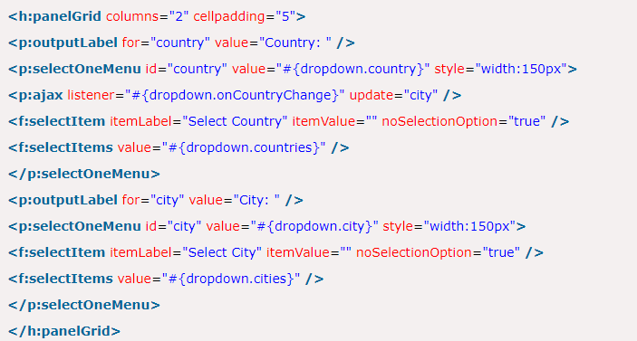
PrimeFaces Ajax
PrimeFaces Ajax Dropdown
https://www.javatpoint.com/primefaces-ajax-dropdown
PrimeFaces provides an easy way to create dynamic dropdown on the basis of filter. A new dropdown is formed by Ajax call. The <p:ajax> tag call Java method after each event is occurred.

Slide 11
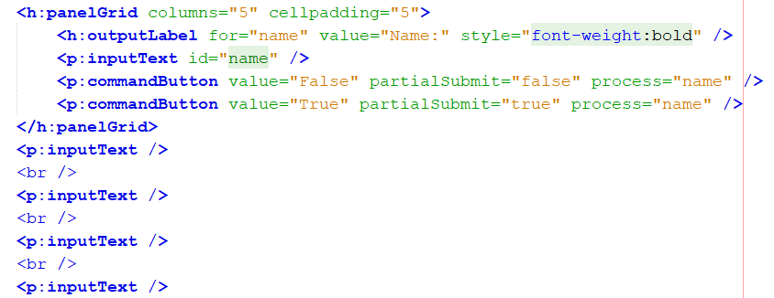
PrimeFaces Ajax
PrimeFaces Ajax PartialSubmit
PartialSubmit reduces network traffic by only adding the partially processed components to the ajax request post. For big pages with many input components, partialSubmit is extremely useful as it leads to more lightweight requests.
https://www.primefaces.org/showcase/ui/ajax/partialSubmit.xhtml
Notes:
Khi chọn PartialSubmit thì chỉ có inputText có id=name được gửi lên Server

Slide 12
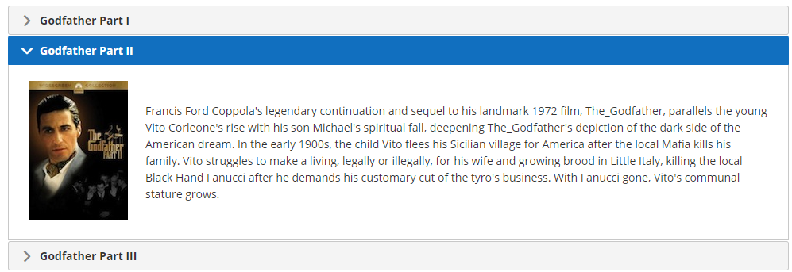
AccordionPanel
It is a container component which displays vertically stacked panels. It is used to display data in accordion format. We can switch anytime from one item to another just by clicking on that item. It is useful when user want to see single item at a time from the collection.
PrimeFaces provides <p:accordionPanel> component to create accordion in JSF application.
AccordionPanel is a container component that displays content in stacked format.

Slide 13
AccordionPanel – Attributes
Name | Default | Type | Description
multiple | false | Boolean | Controls multiple selection.
dynamic | false | Boolean | Quy định chế độ làm việc của các tab. Nếu dynamic=true thì chỉ khi tab được kích hoạt thì dữ liệu mới được tải về.
cache | true | Boolean | Sử dụng cache hay không, nếu dữ liệu đã được cache thì sẽ không load tiếp từ Server.
value | null | List | List to iterate to display dynamic number of tabs.
var | null | String | Name of iterator to use in a dynamic number of tabs.

Slide 14
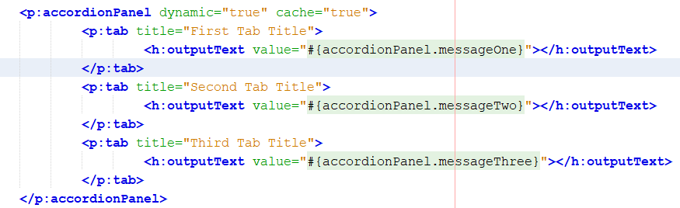
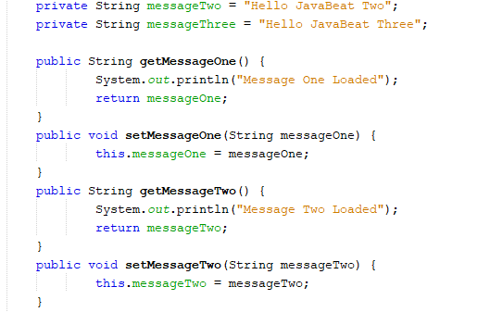
AccordionPanel - Example
package accordionPanelDynamic;
https://javabeat.net/primefaces-accordionpanel-dynamic-loading-cache/

Slide 15
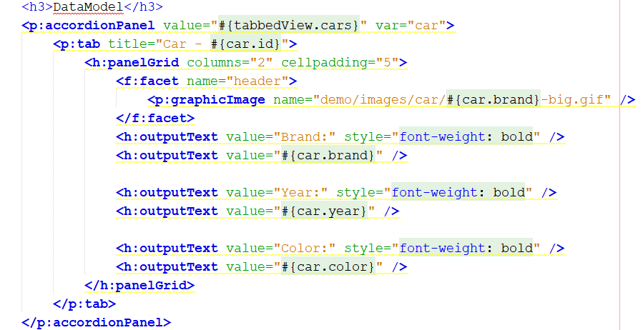
AccordionPanel - Dynamic Number of Tabs
  Trường hợp số tabs trong Panel được lấy từ CSDL, chúng ta dùng cấu trúc sau

Slide 16
AccordionPanel - Examples
package accordionPanel
https://www.primefaces.org/showcase/ui/panel/accordionPanel.xhtml

Slide 17
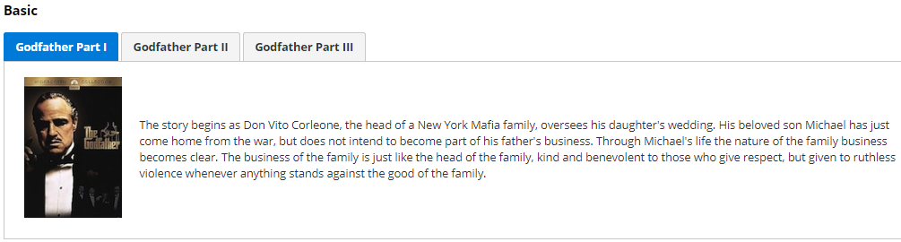
TabView
It is a container component which is used to group content in tabs at the same web page. The <p:tabView> component is used to create container. The <p:tab> is a sub component of <p:tabView> which is used to create tab individually. It is useful when we want to show more information at the same web page.
TabView is a container component to group content in tabs.
https://www.primefaces.org/showcase/ui/panel/tabView.xhtml?jfwid=5be6f

Slide 18
TabView - Attributes
Name | Default | Type | Description
cache | true | Boolean | When tab contents are lazy loaded by ajax toggleMode, caching only retrieves the tab contents once and subsequent toggles of a cached tab does not communicate with server. If caching is turned off, tab contents are reloaded from server each time tab is clicked.
var | null | String | Name of iterator to refer an item in collection.
value | null | Object | Collection model to display dynamic tabs.
dynamic | false | Boolean | Enables lazy loading of inactive tabs.

Slide 19
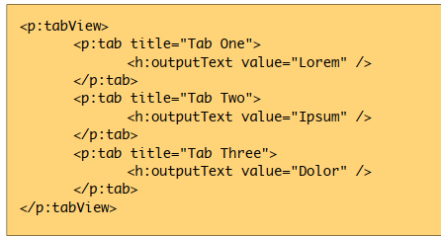
TabView - Example

Slide 20
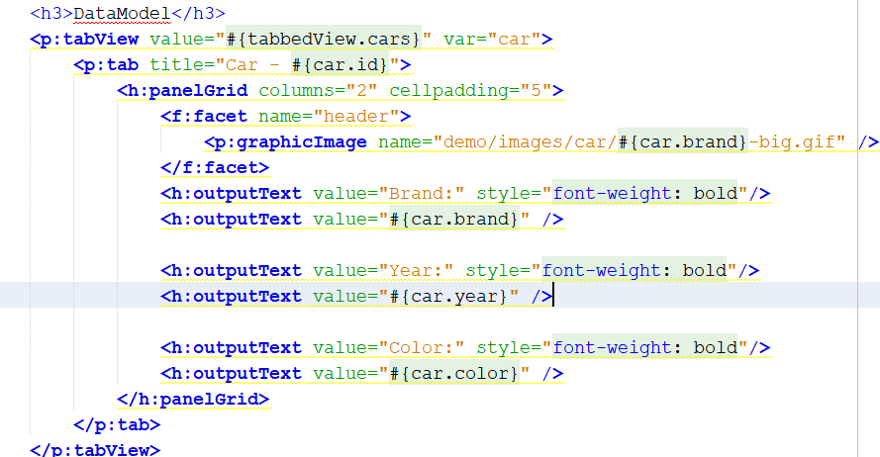
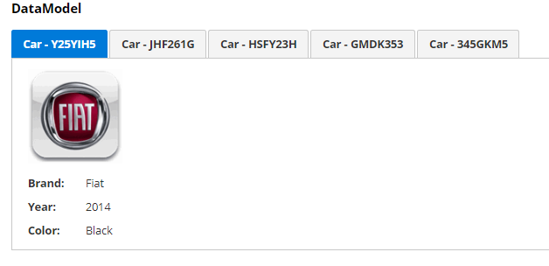
TabView - Dynamic Number of Tabs

Slide 21
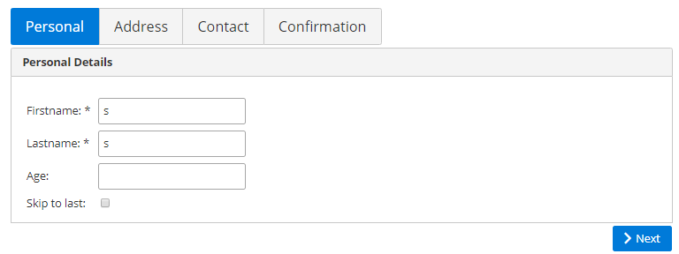
Wizard
Wizard provides an ajax enhanced UI to implement a workflow easily in a single page. Wizard consists of several child tab components where each tab represents a step in the process.
http://primefaces.org/showcase/ui/panel/wizard.xhtml?jfwid=64c8e
.

Slide 22
Wizard-Attributes
Name | Default | Type | Description
onback | null | String | Javascript event handler to be invoked when flow goes back.
onnext | null | String | Javascript event handler to be invoked when flow goes forward.
nextLabel | null | String | Label of next navigation button.
backLabel | null | String | Label of back navigation button
flowListener | null | MethodExpr | Server side listener to invoke when wizard attempts to go forward or back.

Slide 23
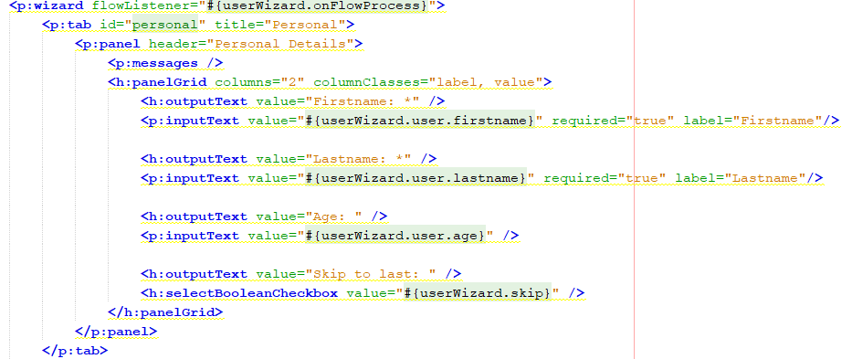
Wizard-Example

Slide 24
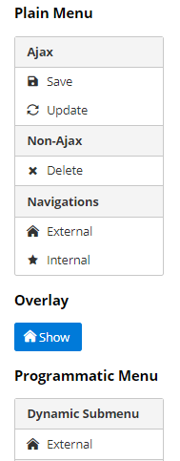
Menu
Menu is a navigation component with submenus and menuitems.
Name | Default | Type | Description
overlay | false | Boolean | Defines positioning type of menu, either static or overlay.
toggleable | false | Boolean | Defines whether clicking the header of a submenu toggles the visibility of children menuitems.
model | null | MenuModel | A menu model instance to create menu programmatically

Slide 25
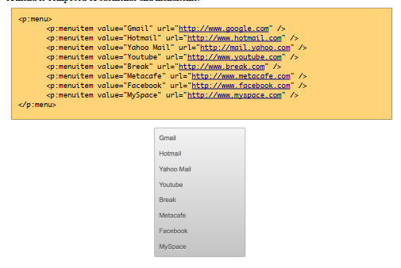
Menu-Example

Slide 26
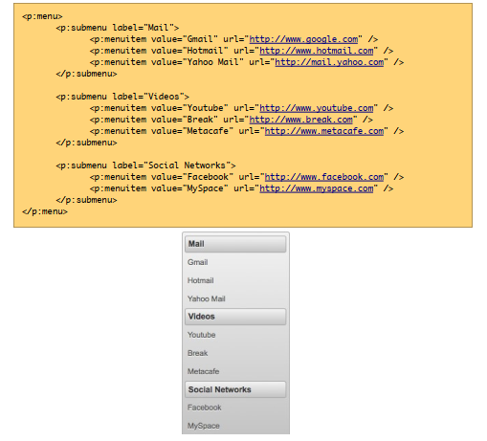
Menu-Example

Slide 27
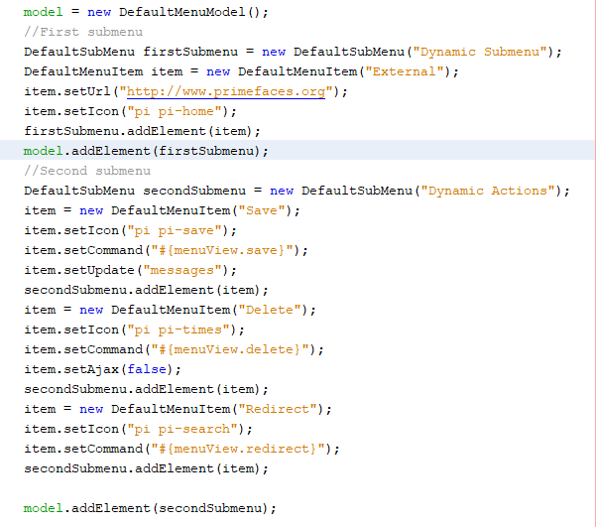
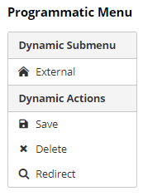
Dynamic Menus
Menus can be created programmatically as well, this is more flexible compared to the declarative approach.

Slide 28
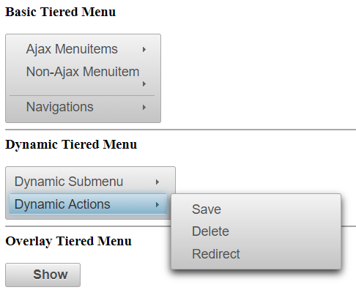
TieredMenu
TieredMenu is used to display nested submenus with overlays.

Slide 29
TieredMenu
Name | Default | Type | Description
model | null | MenuModel | MenuModel instance for programmatic menu.
autoDisplay | true | Boolean | Defines whether the first level of submenus will be displayed on mouseover or not. When set to false, click event is required to display
overlay | false | Boolean | Defines positioning, when enabled menu is displayed with absolute position relative to the trigger. Default is false, meaning static positioning

Slide 30
TieredMenu - Examples
Basic Tiered Menu
Dynamic Tiered Menu
Overlay Tiered Menu
package
menuTiered

Slide 31
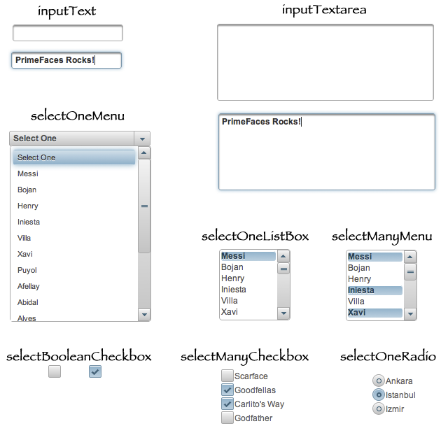
Form Components

Slide 32
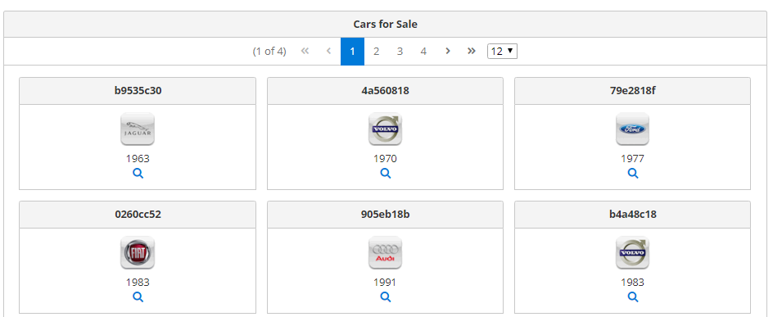
DataGrid
DataTable
DataTable

Slide 33
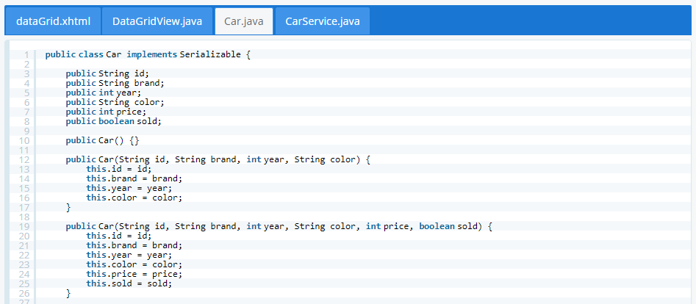
DataGrid
DataTable
DataTable

Slide 34
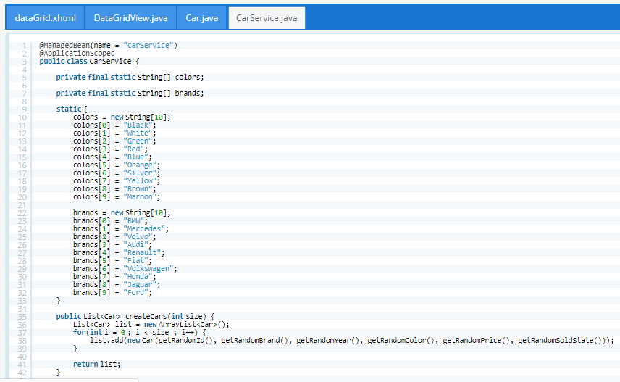
DataGrid
DataTable
DataTable

Slide 35
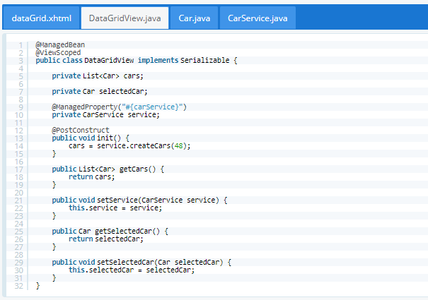
DataGrid
DataTable
DataTable

Slide 36
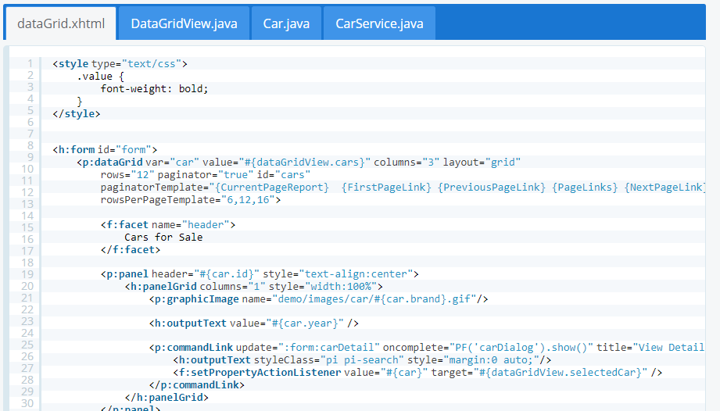
DataGrid
DataTable
DataTable

Slide 37
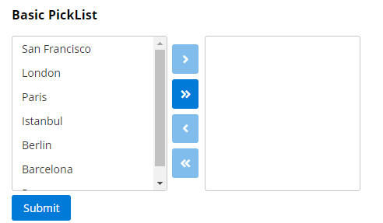
PickList

Slide 38
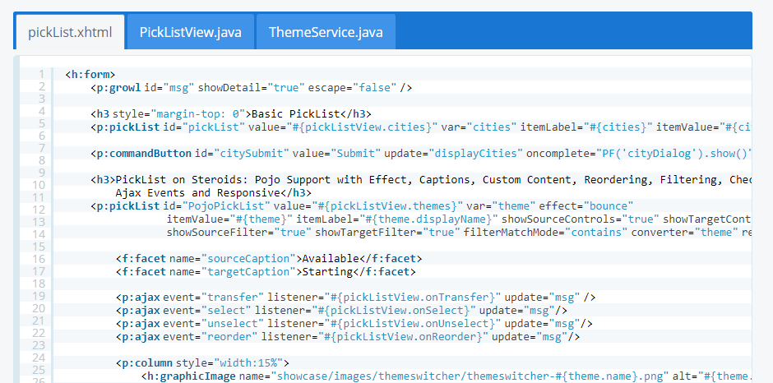
PickList

Slide 39
Repeat

Slide 40
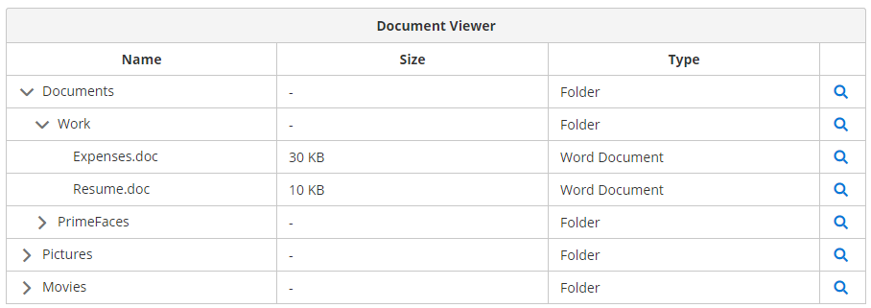
TreeTable
  DataTable

Slide 41
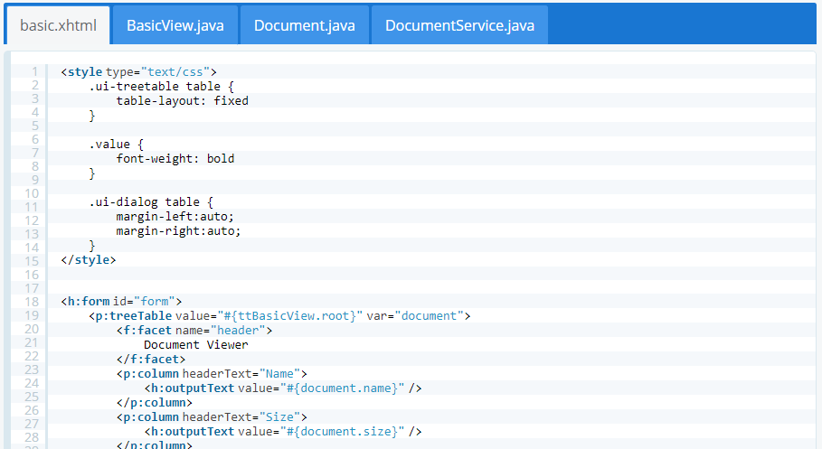
TreeTable
  DataTable

Slide 42
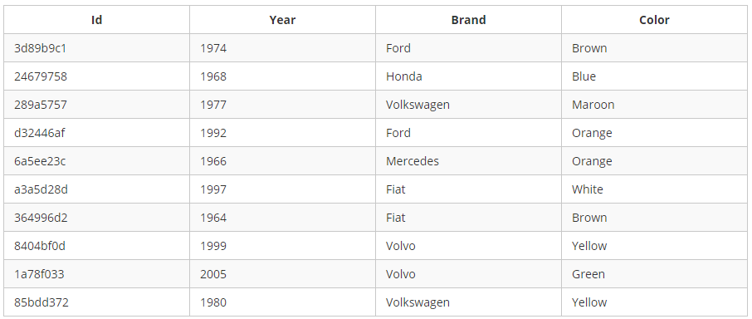
DataTable

Slide 43
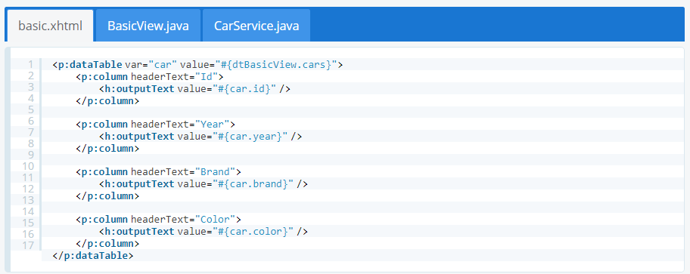
DataTable

Slide 44
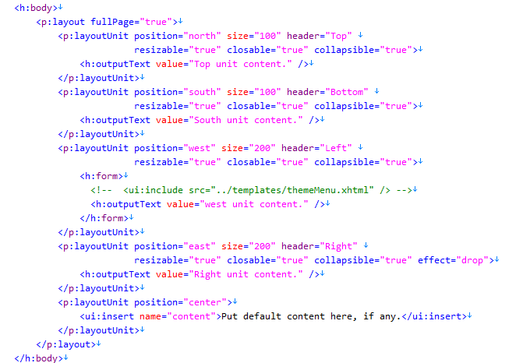
PrimeFaces - Template with <p:layout>
Package primefacesLayout
Notes:
<!DOCTYPE html>
<html lang="en"
xmlns="http://www.w3.org/1999/xhtml"
xmlns:f="http://java.sun.com/jsf/core"
xmlns:h="http://java.sun.com/jsf/html"
xmlns:ui="http://java.sun.com/jsf/facelets"
xmlns:p="http://primefaces.org/ui"
>
<h:head>
<title>Title</title>
</h:head>
<h:body>
<p:layout fullPage="true">
<p:layoutUnit position="north" size="100" header="Top"
resizable="true" closable="true" collapsible="true">
<h:outputText value="Top unit content." />
</p:layoutUnit>
<p:layoutUnit position="south" size="100" header="Bottom"
resizable="true" closable="true" collapsible="true">
<h:outputText value="South unit content." />
</p:layoutUnit>
<p:layoutUnit position="west" size="200" header="Left"
resizable="true" closable="true" collapsible="true">
<h:form>
<!-- <ui:include src="../templates/themeMenu.xhtml" /> -->
<h:outputText value="west unit content." />
</h:form>
</p:layoutUnit>
<p:layoutUnit position="east" size="200" header="Right"
resizable="true" closable="true" collapsible="true" effect="drop">
<h:outputText value="Right unit content." />
</p:layoutUnit>
<p:layoutUnit position="center">
<ui:insert name="content">Put default content here, if any.</ui:insert>
</p:layoutUnit>
</p:layout>
</h:body>
</html>

Slide 45
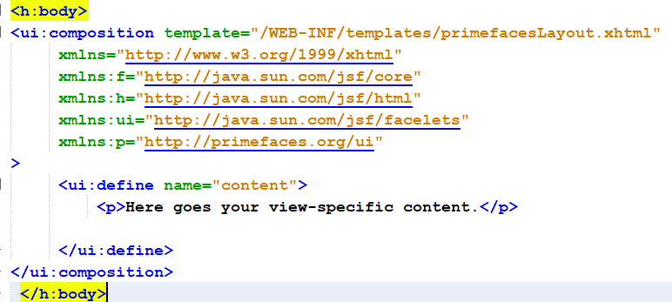
PrimeFaces - Template with <p:layout>
Using template
Notes:
<?xml version="1.0" encoding="UTF-8"?>
<!--
To change this license header, choose License Headers in Project Properties.
To change this template file, choose Tools | Templates
and open the template in the editor.
-->
<!DOCTYPE html>
<html lang="en"
xmlns="http://www.w3.org/1999/xhtml"
xmlns:f="http://java.sun.com/jsf/core"
xmlns:h="http://java.sun.com/jsf/html"
xmlns:ui="http://java.sun.com/jsf/facelets"
xmlns:p="http://primefaces.org/ui"
>
<h:head>
<title>Title</title>
</h:head>
<h:body>
<ui:composition template="/WEB-INF/templates/primefacesLayout.xhtml"
xmlns="http://www.w3.org/1999/xhtml"
xmlns:f="http://java.sun.com/jsf/core"
xmlns:h="http://java.sun.com/jsf/html"
xmlns:ui="http://java.sun.com/jsf/facelets"
xmlns:p="http://primefaces.org/ui"
>
<ui:define name="content">
<p>Here goes your view-specific content.</p>
</ui:define>
</ui:composition>
</h:body>
</html>

