Slide 1



AngularJS Testing
Eyal Vardi
http://ng-course.org eyalVardi.wordpres.com

Slide 2
Agenda
Jasmine.js
ngMock
Angular Unit Testing
End to End Tests (e2e)

Slide 3

Jasmine

Slide 4

What Is Jasmine?
Jasmine is a behavior-driven testing framework for JavaScript.
It does not rely on:
Browsers
DOM
Any JavaScript framework

Slide 5
Jasmine Structure
describe("A suite: describe your tests", function () {
var foo;
beforeEach(function () {
foo = 0;
foo += 1;
});
afterEach(function () { foo = 0; });
it("Contains spec with an expectation", function () {
expect(foo).toEqual(1);
});
it("Can have more than one expectation", function () {
expect(foo).toEqual(1);
expect(true).toEqual(true);
});
});

Slide 6
expect() Function
Takes a value, called the actual.
It is chained with a Matcher function, which takes the expected value.
it("Can contain any code", function () {
// actual == expected value
expect(value).toEqual(value);
});

Slide 7
Included Matchers
Jasmine has several built-in matchers. Here are a few:
toEqual(val)
toBe(val)
toMatch(pattern)
toBeDefined()
toBeUndefined()
toBeNull()
toBeTruthy()
toBeFalsy()
toBeContain(val)
toBeLessThen(val)
toBeGreaterThen(val)
toThrow(exp)
Every matcher's criteria can be inverted by prepending .not:
not.toEqual(val)
not.toBe(val)
not.toMatch(pattern)
…

Slide 8
Custom Matcher
beforeEach(function () {
jasmine.addMatchers({
toBeExponentiallyLessThan: function () {
return {
compare: function (actual, expected, scaleFactor) {
var result = {
pass: actual < (expected / (10 || scaleFactor))
};
//the success/failure messages
if (result.pass) {
result.message = actual +' is exponentially less than';
} else {
result.message = actual +' is not exponentially less than';
}
return result;
}
};
}
});
});
{ matcherName: fn => { compare: fn => { pass: true | false, message : string }

Slide 9
Spies
A spy can stub any function and tracks calls to it and all arguments.
A spy only exists in the describe or it block it is defined, and will be removed after each spec.
There are special matchers for interacting with spies.
The toHaveBeenCalled matcher will return true if the spy was called.
The toHaveBeenCalledWith matcher will return true if the argument list matches any of the recorded calls to the spy.

Slide 10
Spies
describe("A spy", function () {
var foo, bar = null;
beforeEach(function () {
foo = {setBar: function (value) {bar = value;}};
spyOn(foo, 'setBar');
foo.setBar(123); // The bar == null
foo.setBar(456, 'another param'); // The bar == null
});
it("tracks that the spy was called", function () {
expect(foo.setBar).toHaveBeenCalled();
});
it("tracks all the arguments of its calls", function () {
expect(foo.setBar).toHaveBeenCalledWith(123);
expect(foo.setBar).toHaveBeenCalledWith(456, 'another param');
});
it("spy stops all execution on a function", function () {
expect(bar).toBeNull();
});
});

Slide 11
Spies Tracking Properties
Every call to a spy is tracked and exposed on the calls property.
.calls.any()
.calls.count()
.calls.argsFor(index)
.calls.allArgs()
.calls.all()
.calls.mostRecent()
.calls.reset()

Slide 12
Spies Tracking Properties
describe("A spy", function () {
var foo, bar = null;
beforeEach(function () {
foo = { setBar: function (value) {bar = value;} };
spyOn(foo, 'setBar');
});
it("tracks the arguments of all calls", function () {
foo.setBar(123);
foo.setBar(456, "baz");
expect(foo.setBar.calls.allArgs()) .toEqual([[123], [456, "baz"]]);
});
it("can provide the context and arguments to all calls", function () {
foo.setBar(123);
expect( foo.setBar.calls.all() ) .toEqual([{ object: foo, args: [123] }]);
});
});

Slide 13
Spies and.* Functions
and.callThrough() // spy()=>fn()
and.returenValue(value) // spy()=>val
and.callFake(wfn) // spy()=>wfn()
and.throwError(value) // spy()=>throw(val)
and.stub()

Slide 14
Spies
describe("A spy", function () {
var foo, bar = null;
beforeEach(function () {
foo = {
setBar: function (value) {bar = value;}
};
spyOn(foo, 'setBar').and.callThrough();
});
it("can call through and then stub in the same spec", function () {
foo.setBar(123);
expect(bar).toEqual(123);
foo.setBar.and.stub();
bar = null;
foo.setBar(123);
expect(bar).toBe(null);
});
});

Slide 15
createSpyObj Function
In order to create a mock with multiple spies, use jasmine.createSpyObj and pass an array of strings. It returns an object that has a property for each string that is a spy.
describe("Multiple spies, when created manually", function () {
var tape;
beforeEach(function () {
tape = jasmine.createSpyObj('tape', ['play', 'pause']);
tape.play();
tape.pause();
});
it("tracks that the spies were called", function () {
expect(tape.play).toHaveBeenCalled();
expect(tape.pause).toHaveBeenCalled();
});
});

Slide 16
Jasmine Test Runner Page
<link href="jasmine.css" rel="stylesheet" />
<script src="jasmine.js"></script>
<script src="jasmine-html.js"></script>
<!– Angular Framework Modules -->
<script src="angular.js"></script>
<script src="angular-mocks.js"></script>
<!-- The Application Modules-->
<script src="app.js"></script>
<!-- The Specs Unit Testing -->
<script src="appSpec.js"></script>
<!-- use Jasmine to run and display test results -->
<script type="text/javascript">
var jasmineEnv = jasmine.getEnv();
jasmineEnv.addReporter( new jasmine.HtmlReporter() );
jasmineEnv.execute();
</script>

Slide 17
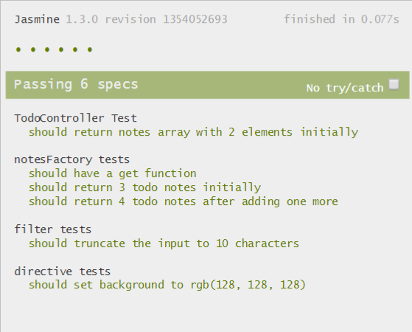
Jasmine Test Runner Page
<link href="jasmine.css" rel="stylesheet" />
<script src="jasmine.js"></script>
<script src="jasmine-html.js"></script>
<!– Angular Framework Modules -->
<script src="angular.js"></script>
<script src="angular-mocks.js"></script>
<!-- The Application Modules-->
<script src="app.js"></script>
<!-- The Specs Unit Testing -->
<script src="appSpec.js"></script>
<!-- use Jasmine to run and display test results -->
<script type="text/javascript">
var jasmineEnv = jasmine.getEnv();
jasmineEnv.addReporter( new jasmine.HtmlReporter() );
jasmineEnv.execute();
</script>

Slide 18
Angular Mock (ngMock)

Slide 19
ngMock Module
The ngMock module providers support to inject and mock Angular services into unit tests.
angular.mock.module()
angular.mock.inject()
ngMock also extends various core ng services such that they can be inspected and controlled in a synchronous manner within test code.
$httpBackend
$interval
$timeout

Slide 20
Jasmine & ngMock
describe('controllers', function () {
var $controller;
beforeEach( module('myApp.controllers') );
beforeEach( inject(function ( _$controller_ ) {
$controller = _$controller_;
}));
it('MyCtrl Spec', function () {
var myCtrl1 = $controller('MyCtrl1', { $scope: {} });
expect(myCtrl1).toBeDefined();
});
});

Slide 21
$timeout Testing
angular.module('async', [])
.factory('asyncGreeter', function ($timeout, $log) {
return {
say: function (name, timeout) {
$timeout(
function() {
$log.info("Hello," + name ); }, timeout );
}
};
});

Slide 22
$timeout Testing
describe('Async Greeter test', function () {
var asyncGreeter, $timeout, $log;
beforeEach(module('async'));
beforeEach(inject(function (_asyncGreeter_, _$timeout_, _$log_){
asyncGreeter = _asyncGreeter_;
$timeout = _$timeout_;
$log = _$log_;
}));
it('should greet the async World', function () {
asyncGreeter.say( 'World', 1000 * 100 );
$timeout.flush();
expect($log.info.logs).toContain(['Hello, World!']);
});
});

Slide 23

Jasmine.js & Angular Mock

Slide 24
Testing Logging & Debugging
$log - Gathers all logged messages in arrays (one array per logging level).
$log.logs
$log.debug.logs
$log.error.logs
dump(obj) - Method for serializing common angular objects (scope, elements, etc..) into strings, useful for debugging.
$log.warn.logs
$log.info.logs

Slide 25
$httpBackend

Slide 26
$httpBackend Mock
Fake HTTP backend implementation suitable for unit testing applications that use the $http service.
There are two ways to specify what test data should be returned as http responses :
$httpBackend.expect
$httpBackend.when

Slide 27
Expect vs. When
Request expectations provide a way to make assertions about requests made by the application and to define responses for those requests.
Backend definitions allow you to define a fake backend for your application which doesn't assert if a particular request was made or not, it just returns a trained response if a request is made.
 | Request expectations | Backend definitions
Syntax | .expect(...).respond(...) | .when(...).respond(...)
Typical usage | strict unit tests | loose unit testing
Fulfills multiple requests | NO | YES
Order of requests matters | YES | NO
Request required | YES | NO
Response required | optional (see below) | YES

Slide 28
$httpBackend Unit Testing

Slide 29
$httpBackend Mock (ngMockE2E)
We don't want to manually have to flush mocked out requests like we do during unit testing.
myAppDev = angular.module('myAppDev', ['myApp', 'ngMockE2E']);
myAppDev.run(function ($httpBackend) {
phones = [{ name: 'phone1' }, { name: 'phone2' }];
// returns the current list of phones
$httpBackend.whenGET('/phones').respond(phones);
// adds a new phone to the phones array
$httpBackend.whenPOST('/phones').respond(function(method,url,data){
var phone = angular.fromJson(data);
phones.push(phone);
return [200, phone, {}];
});
$httpBackend.whenGET(/^\/templates\//).passThrough();
//...
});

Slide 30
End to End Testing (E2E)

Slide 31
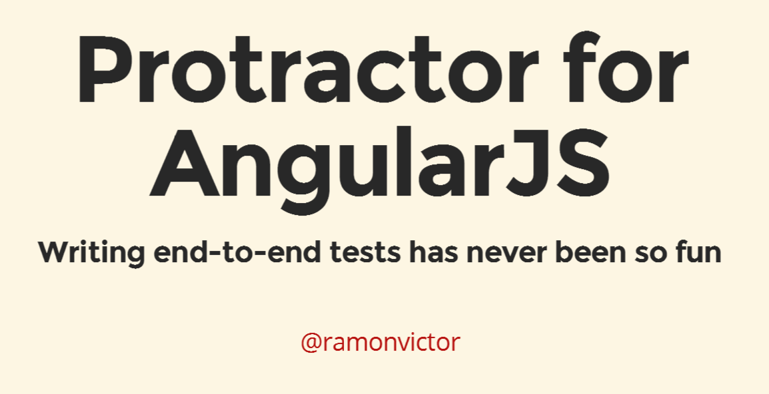
Protractor
Thanks to Ramon Victor.

Slide 32
Thanks
eyalvardi.wordpress.com
Eyal Vardi
http://ng-course.org eyalVardi.wordpres.com

