Slide 1


Fantasy football
CIS 22C
Spring 2016
Team 4

Slide 2

Team Member
Kevin Nguyen
ka u ieong
bret farley
minting ye

Slide 3


Why this topic?
Fantasy football

Slide 4

A brief introduction of the program
Fantasy football
Add new data
Delete data
Find data
List hash sequence
List sorted data
Print indented tree
Print efficiency
Team choice

Slide 5
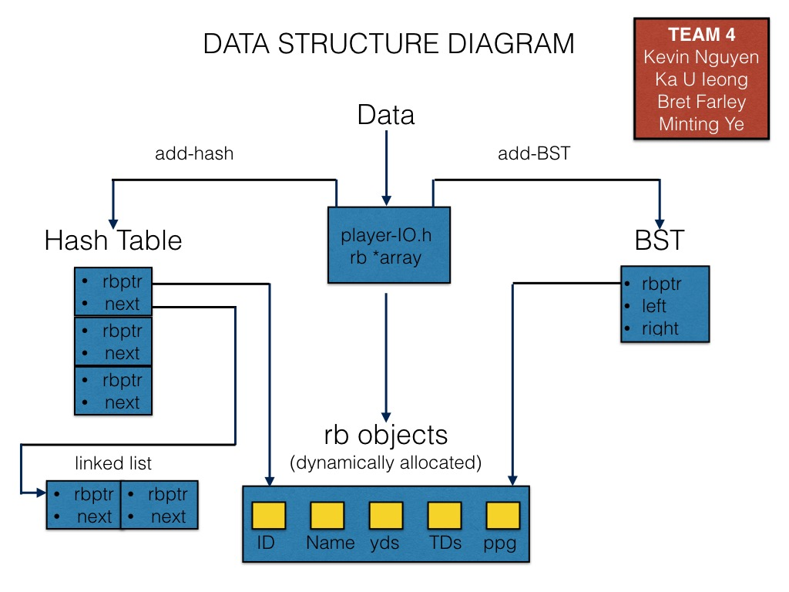
data structure diagram
Fantasy football

Slide 6
structure chart
Fantasy football

Slide 7
key design efficiencies
Fantasy football
Load Factor
Longest Linked List
Average number of nodes in lined lists

Slide 8
Hash
Fantasy football
int HashTable::hash(std::string key)
{
int index = 0;
int sum = 0;
for(unsigned i = 0; i < key.length(); i++)
sum += (int) key[i]; //summing the ASCII values for each character in the string
index = sum % TABLE_SIZE; //dividing the summed ASCII values by 35 && storing remainder as my index
return index;
}

Slide 9
Collision solution
Fantasy football
Solve collisions using lined list resolution
The lined list data is sorted

Slide 10
run the program
Fantasy football

Slide 11
q&A
Fantasy football

Slide 12
conclusion
Fantasy football

