Slide 1


Fantasy football
CIS 22C
Spring 2016
Team 4

Slide 2

Team Member
Kevin Nguyen
ka u ieong
bret farley
minting ye

Slide 3


Why this topic?
Fantasy football
In 2015, there are 56.8 million people playing fantasy sports in the USA and Canada.
The $70 Billion Fantasy Football Market
Notes:
USA14%, Canada19%)

Slide 4
Team assignments
Fantasy football
Team coordinator/Documentation: Kevin
BST/Data Record: Bret
Hashed Table/Documentation: Minting
File IO: Johnny
Testing/Presentation: All members

Slide 5

A brief introduction of the program
Fantasy football
Add new data
Delete data
Find data
List hash sequence
List sorted data
Print indented tree
Print efficiency
Team choice
Save
Exit

Slide 6
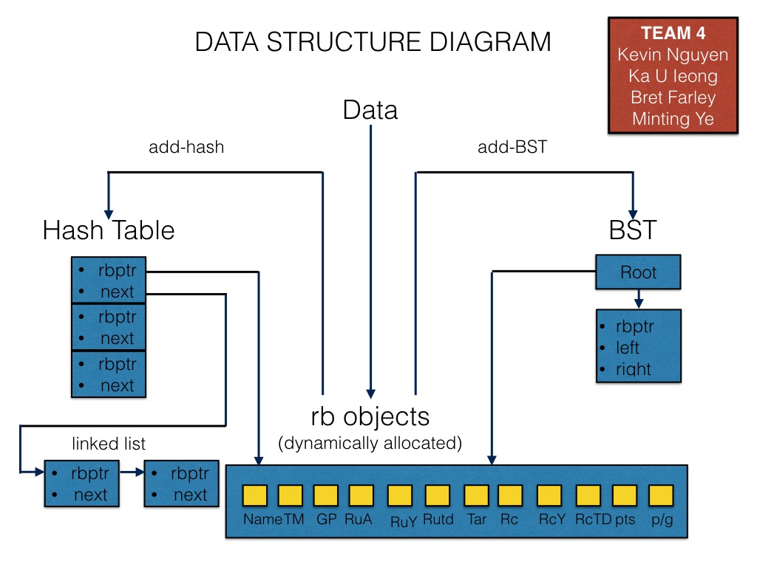
data structure diagram
Fantasy football

Slide 7
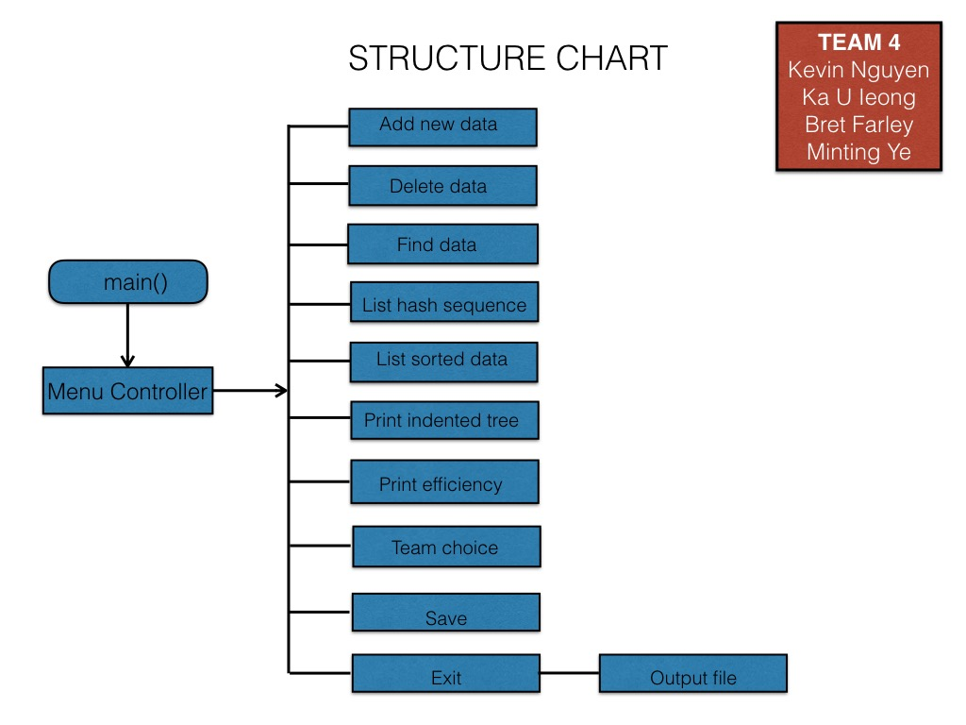
structure chart
Fantasy football

Slide 8
key design efficiencies
Fantasy football
Load Factor/ Average number of nodes in lined lists: 1.724
Longest Linked List: 5
Easy and fast to compute
Place entries evenly throughout the hash table
Notes:
AVL statistics: Average height for around 50 objects
table size is the number of chains, not the maximum number of dictionary entries.
the current number of dictionary entries n exceeds tableSize. (the load factor is the average length of each linked chain.)
downside: the storage overhead of the pointers int he lined chain. (If the data entries in the dictionary are small, the pointers add a significant overhead in storage, and you many want to consider a simpler collision-resolution scheme. On the other hand, if the entries are large, the addition of a pointer is insignificant, so separate chaining is a good choice.

Slide 9
Hash
Fantasy football
int HashTable::hash(std::string key)
{
int index = 0;
int sum = 0;
for(unsigned i = 0; i < key.length(); i++)
sum += (int) key[i]; //summing the ASCII values for each character in the string
index = sum % TABLE_SIZE; //dividing the summed ASCII values by 35 && storing remainder as my index
return index;
}

Slide 10
Collision solution
Fantasy football
Solve collisions using lined list resolution:
the most time-efficient collision-resolution scheme
The lined list data is sorted
Notes:
buckets/separate chaining: the most time-efficient collision-resolution scheme.
(each location of the hash table contains a pointer to a linked chain

Slide 11
run the program
Fantasy football

Slide 12
Fantasy football

Slide 13
q&A
Fantasy football

Slide 14
conclusion
Fantasy football

