Slide 1



Production Control System
(for DongYang VN)
Production Control Principal
AGENDA
Benefit
System Overview
Notes:
Good afternoon everyone.
My name is Khánh. I'm from IT section, and nice to meet you.
Today, I would like to explain to you about our TQM conference.
The theme is : TMA management system at Extruding section.
My safety declaration: Always drive at the right speed.

Slide 2












Quy trình sản xuất
Dán mã vạch lên xe (Có thể in lại bởi Quản Lý)
Khu vực chờ kiểm tra lại
In mã vạch
Kiểm tra lại
Điều tra lịch sử
A
Công nhân
Xác nhận
NG
Màn hình giám sát
Máy chủ
Lệnh sản xuất
OK
Khu vực bảo lưu hàng lỗi
Báo cáo
NG
A
QC/QA
In lại mã vạch (SL tồn)
Kiểm
tra
Không đủ số lượng
Người dùng
OK
Quét mã vạch để xuất kho
Thông số
Sản phẩm
A
Xử lý
tồn kho
A
Ware
house
Công nhân
Quét mã vạch
để nhập kho
Công nhân
Phiếu xuất
Notes:
The first, my customer is Extruding section.
Every year we have a large amount of TMA return.
These include a lot of GUM types and return from 4 sections (Mixing, Cutting, Extruding, Building)

Slide 3
1. Production Control Principal.
Production
Attach BC to the cart (Can reprint by Manager)
Pending Area
Printing
Re-check
Tracing history
A
Operator
Confirm
NG
Monitoring
Server
Work order
OK
NG
Area
Report
NG
A
QC/QA
Printing remain BC
Check
Not enough quantity
Users
OK
Scan BC to stock-out
Product spec
A
Calculate
A
Ware
house
Operator
Scan BC to stock-in
Operator
Purchase order
Notes:
The first, my customer is Extruding section.
Every year we have a large amount of TMA return.
These include a lot of GUM types and return from 4 sections (Mixing, Cutting, Extruding, Building)

Slide 4
2. Benefit.
Before: Manually production System
After: Utilize Production Control System
All manually.
Difficult or impossible to ensure Quality level.
Difficult to know actual production result & status.
Use a lot of paper (cost money, time, lost data …)
Strictly control Quality:
+ Ensure no missed production-step.
+ Automatic calculate inventory at Stock-out step.
Monitoring Production Status in real time.
Fast & Intuitive reporting:
+ Store production data at the server.
+ Synthesize data on server to make reports.
Saving cost:
+ No printing check-sheet.
+ No printing report.
+ Reduce manual workload
Notes:
The first, my customer is Extruding section.
Every year we have a large amount of TMA return.
These include a lot of GUM types and return from 4 sections (Mixing, Cutting, Extruding, Building)

Slide 5
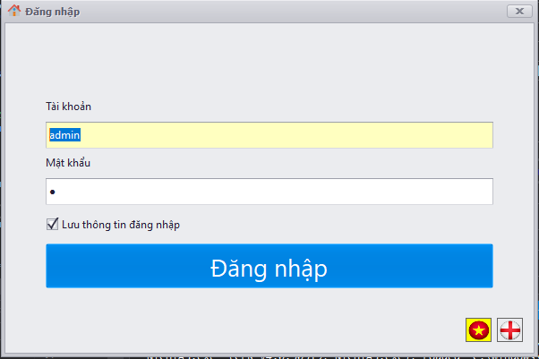
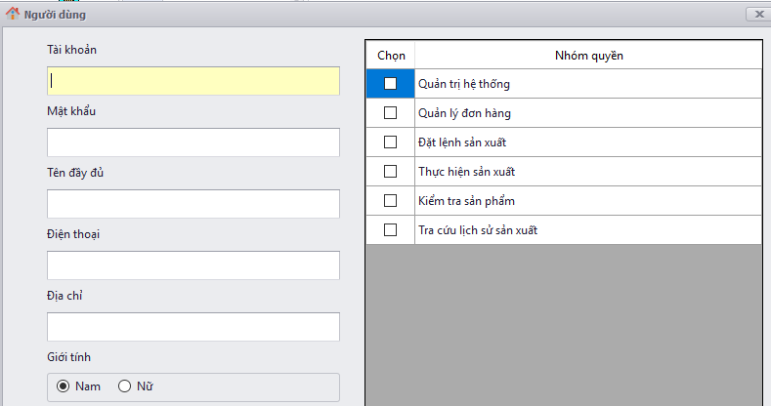
3. System Overview
User management and authorization
Permission
Control
Login to the system with your account
Notes:
The first, my customer is Extruding section.
Every year we have a large amount of TMA return.
These include a lot of GUM types and return from 4 sections (Mixing, Cutting, Extruding, Building)

Slide 6
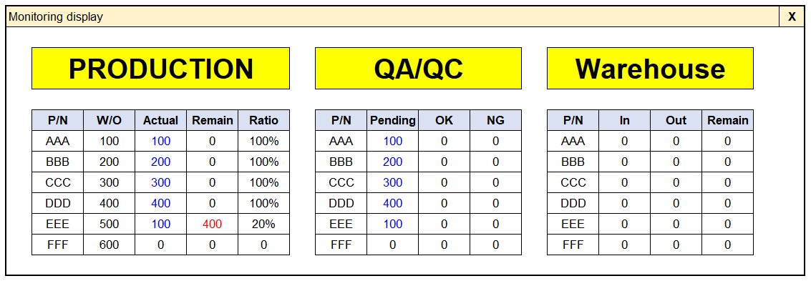
3. System Overview.
Monitoring – Step1: After operator scan to check
Automatic send result actual production to pending by QA
Notes:
The first, my customer is Extruding section.
Every year we have a large amount of TMA return.
These include a lot of GUM types and return from 4 sections (Mixing, Cutting, Extruding, Building)

Slide 7
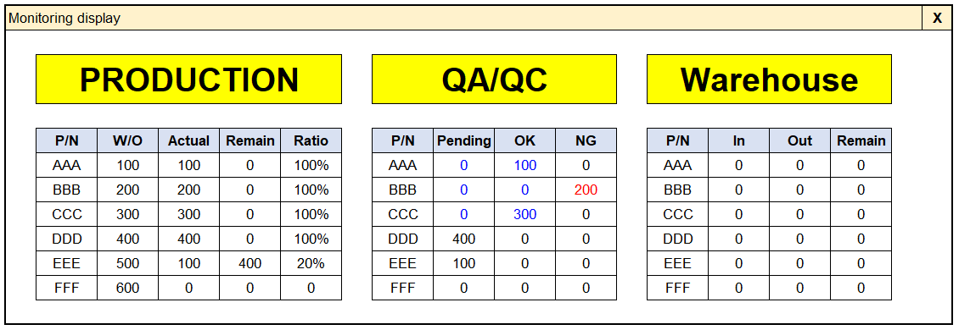
3. System Overview.
Monitoring – Step2: After QC/QA scan to check
Re-check by QA
If result still NG then QA will reject barcode
Automatic reset after check OK/NG
Notes:
The first, my customer is Extruding section.
Every year we have a large amount of TMA return.
These include a lot of GUM types and return from 4 sections (Mixing, Cutting, Extruding, Building)

Slide 8
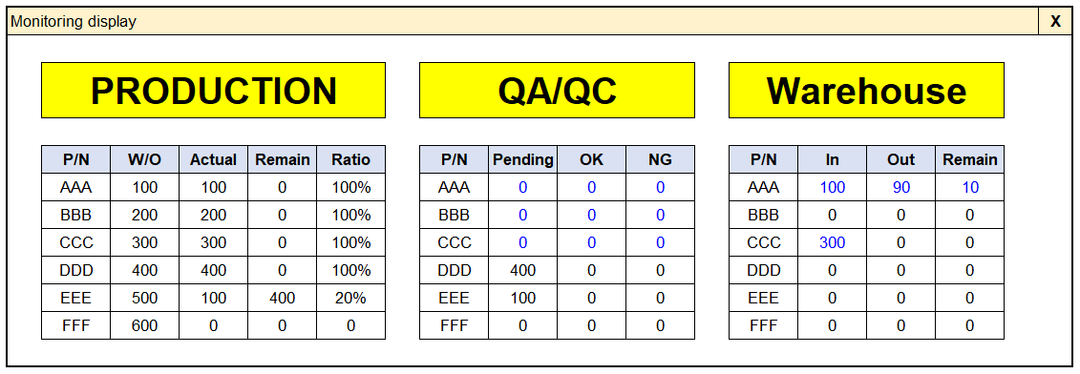
3. System Overview.
Monitoring – Step3: After scan Stock-In/Stock-Out
Automatic reset after stock-in
Calculate remain and print new BC
Notes:
The first, my customer is Extruding section.
Every year we have a large amount of TMA return.
These include a lot of GUM types and return from 4 sections (Mixing, Cutting, Extruding, Building)

Slide 9
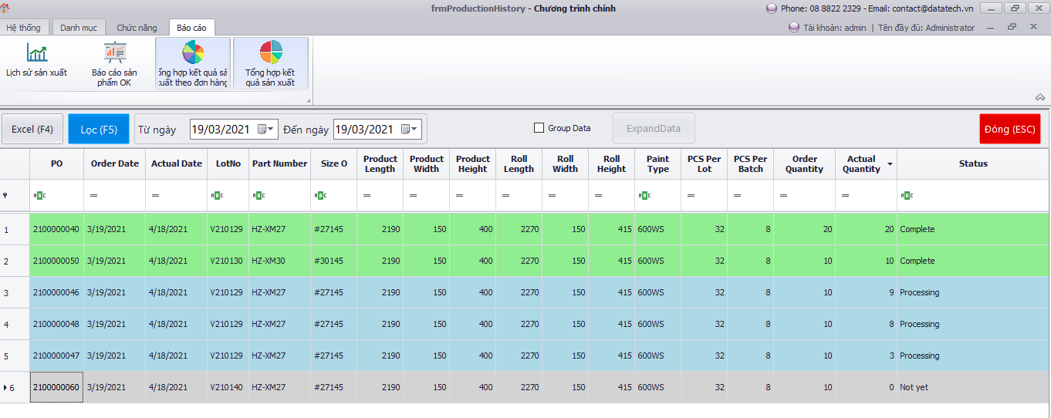
3. System Overview.
Report
Notes:
The first, my customer is Extruding section.
Every year we have a large amount of TMA return.
These include a lot of GUM types and return from 4 sections (Mixing, Cutting, Extruding, Building)

Slide 10
Thanks for watching !!!
Notes:
That's all for my report

