Slide 1



Production Control System
(for DongYang VN)
Production Control Principal
AGENDA
Benefit
System Overview
Notes:
Good afternoon everyone.
My name is Khánh. I'm from IT section, and nice to meet you.
Today, I would like to explain to you about our TQM conference.
The theme is : TMA management system at Extruding section.
My safety declaration: Always drive at the right speed.

Slide 2












1. Production Control Principal.
Production
Attach BC to the cart (Can reprint by Manager)
Pending Area
Printing
Re-check
Tracing history
A
Operator
Confirm
NG
Monitoring
Server
Work order
OK
NG
Area
Report
NG
A
QC/QA
Printing remain BC
Check
Not enough quantity
Users
OK
Scan BC to stock-out
Product spec
A
Calculate
A
Ware
house
Operator
Scan BC to stock-in
Operator
Purchase order
Notes:
The first, my customer is Extruding section.
Every year we have a large amount of TMA return.
These include a lot of GUM types and return from 4 sections (Mixing, Cutting, Extruding, Building)

Slide 3
2. Benefit.
Before: Manually production System
After: Utilize Production Control System
All manually.
Difficult or impossible to ensure Quality level.
Difficult to know actual production result & status.
Use a lot of paper (cost money, time, lost data …)
Strictly control Quality:
+ Ensure no missed production-step.
+ Automatic calculate inventory at Stock-out step.
Monitoring Production Status in real time.
Fast & Intuitive reporting:
+ Store production data at the server.
+ Synthesize data on server to make reports.
Saving cost:
+ No printing check-sheet.
+ No printing report.
+ Reduce manual workload
Notes:
The first, my customer is Extruding section.
Every year we have a large amount of TMA return.
These include a lot of GUM types and return from 4 sections (Mixing, Cutting, Extruding, Building)

Slide 4
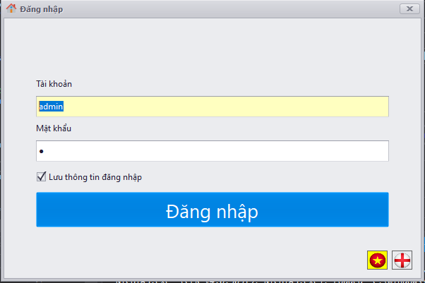
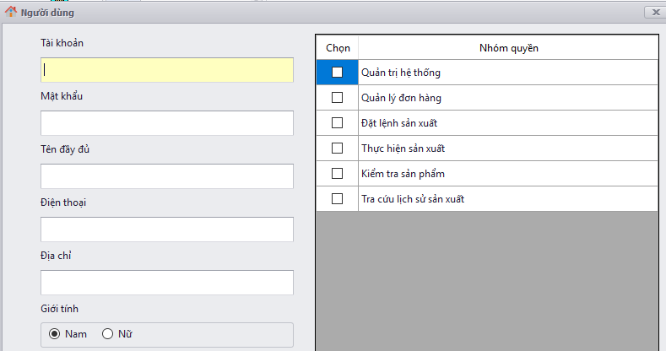
3. System Overview
User management and authorization
Permission
Control
Login to the system with your account
Notes:
The first, my customer is Extruding section.
Every year we have a large amount of TMA return.
These include a lot of GUM types and return from 4 sections (Mixing, Cutting, Extruding, Building)

Slide 5
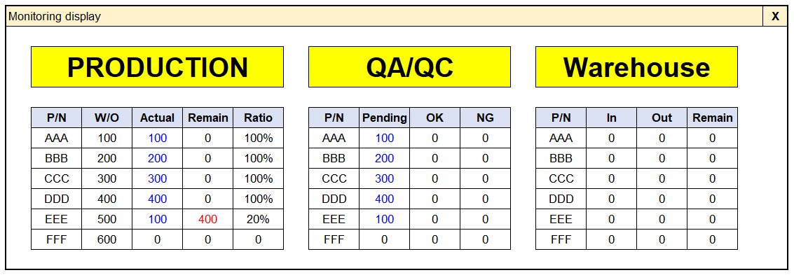
3. System Overview.
Monitoring – Step1: After operator scan to check
Automatic send result actual production to pending by QA
Notes:
The first, my customer is Extruding section.
Every year we have a large amount of TMA return.
These include a lot of GUM types and return from 4 sections (Mixing, Cutting, Extruding, Building)

Slide 6
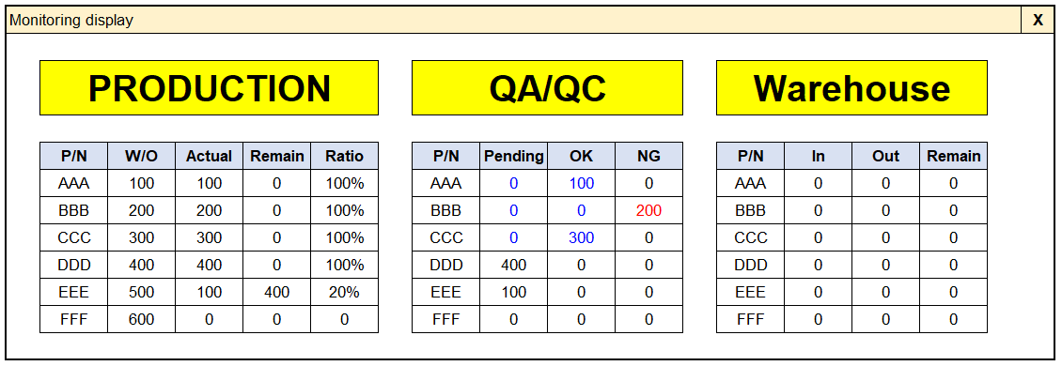
3. System Overview.
Monitoring – Step2: After QC/QA scan to check
Re-check by QA
If result still NG then QA will reject barcode
Automatic reset after check OK/NG
Notes:
The first, my customer is Extruding section.
Every year we have a large amount of TMA return.
These include a lot of GUM types and return from 4 sections (Mixing, Cutting, Extruding, Building)

Slide 7
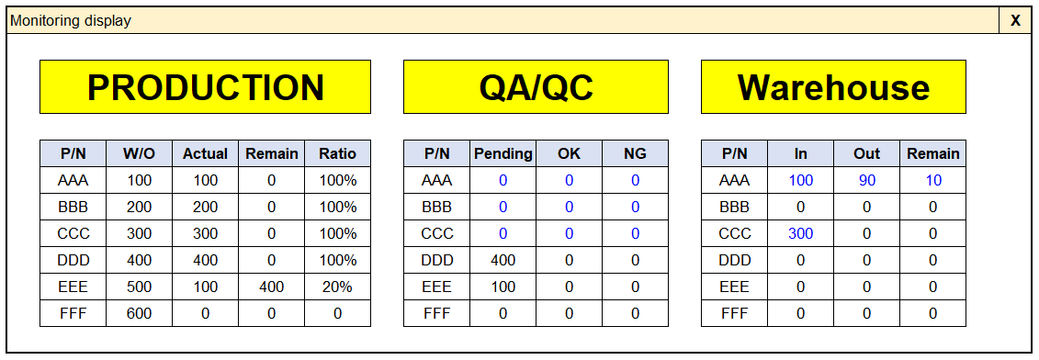
3. System Overview.
Monitoring – Step3: After scan Stock-In/Stock-Out
Automatic reset after stock-in
Calculate remain and print new BC
Notes:
The first, my customer is Extruding section.
Every year we have a large amount of TMA return.
These include a lot of GUM types and return from 4 sections (Mixing, Cutting, Extruding, Building)

Slide 8
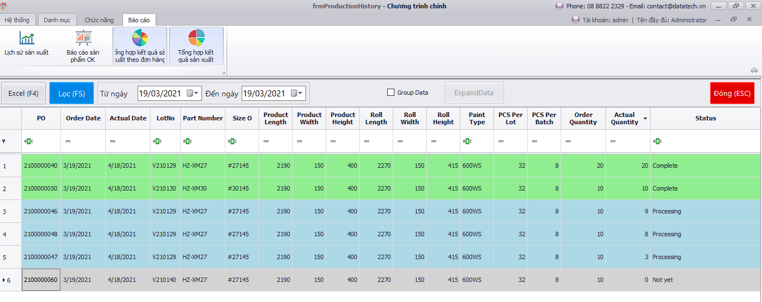
3. System Overview.
Report
Notes:
The first, my customer is Extruding section.
Every year we have a large amount of TMA return.
These include a lot of GUM types and return from 4 sections (Mixing, Cutting, Extruding, Building)

Slide 9
Thanks for watching !!!
Notes:
That's all for my report

